Slide 1
New Adhesion Force Testing for Lunar Dust Mitigation
Kate Crossett
Dr. Chris Wohl, Dr. Lopa Das
2021 Summer Student Research Symposium
All images credited to NASA unless otherwise stated

Slide 2
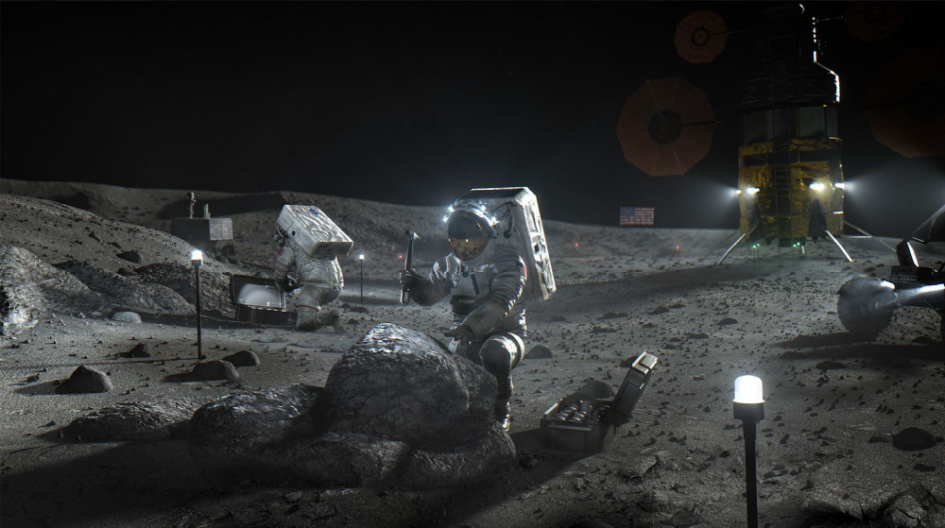
Lunar Dust Mitigation
Lunar dust is strongly adhesive
  Clogs gears
  Degrades materials
  Blocks solar panels
Two Approaches
  Active
  Passive

Slide 3
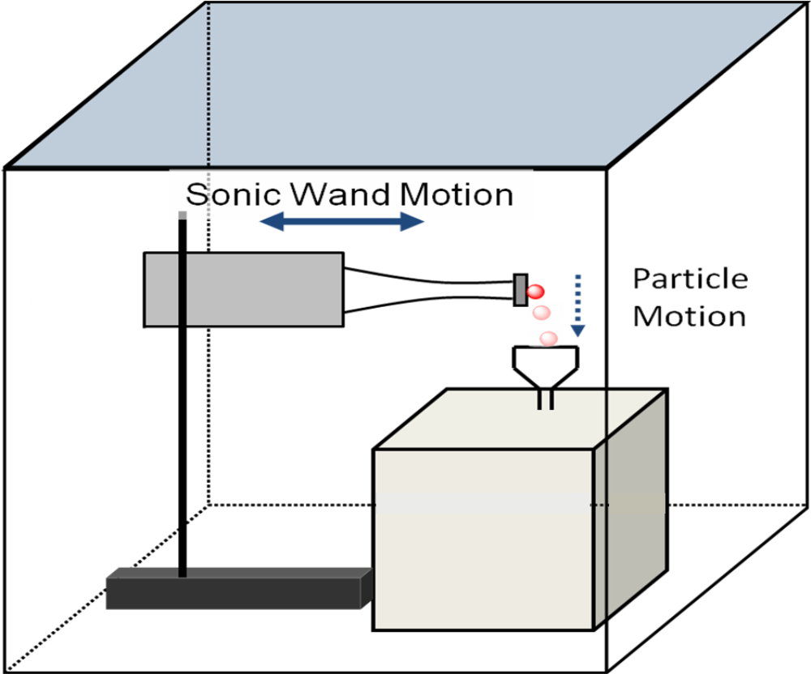
Current System: Ultrasonic Wand
Heating up
  Glue melting
Brittle samples shatter
Want larger range of forces to test
Sample size very limited

Slide 4
Objective
Design a new device to quantitatively test adhesion forces of lunar dust on various surfaces that addresses the limitations of the ultrasonic wand approach

Slide 5
Is it worth it to try and fix the current system?
No, but a new adhesive to attach the samples might work as a temporary solution
Adhesive | Max Temp | Time to Cure | Ease/Means of Removal
A | 260 C | 12 hrs | wash off with water
B | 250 C | 3 - 7 days | scrape off
C | 180 C | 24 hrs | scrape off
D | 200 C | 80 min | difficult
E | 260 C | 24 hrs | scrape off

Slide 6
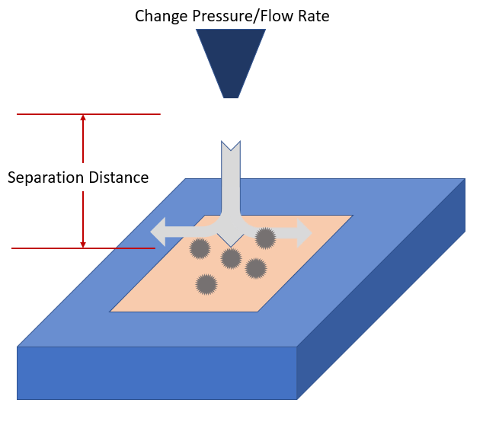
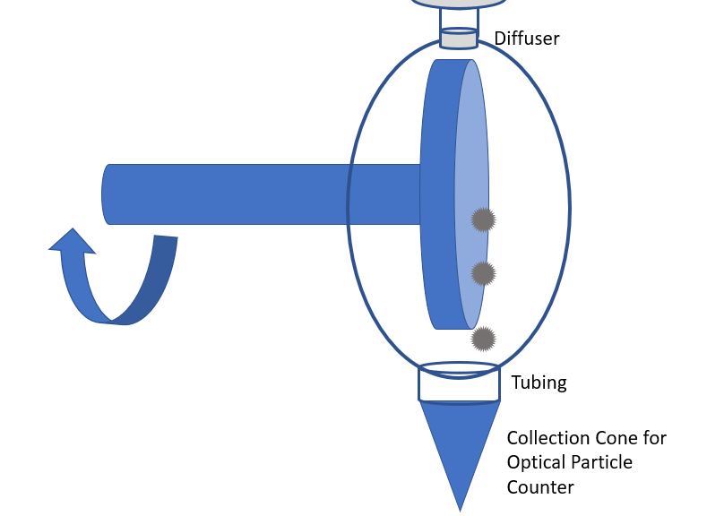
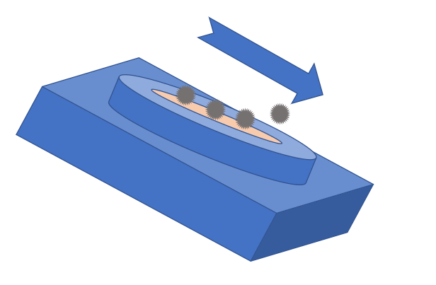
Brainstorm
Rotating Disk
Forced Air
Vibrating Table
New Piezoelectric Device
Directed Electric Field
Mechanical Agitation

Slide 7
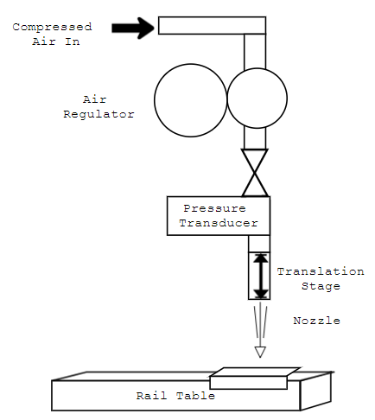
Designing Forced Air Test
Before
After
Based on experimental set up from: Phares, D. J., Smedley, G. T. & Flagan, R. C. 2000 Effect of Particle Size and Material Properties on Aerodynamic Resuspension from Surfaces J. Aerosol Sci. Vol. 31, No, 11, 1335-1353.

Slide 8
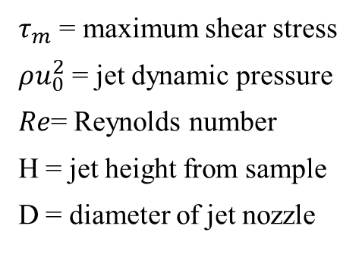
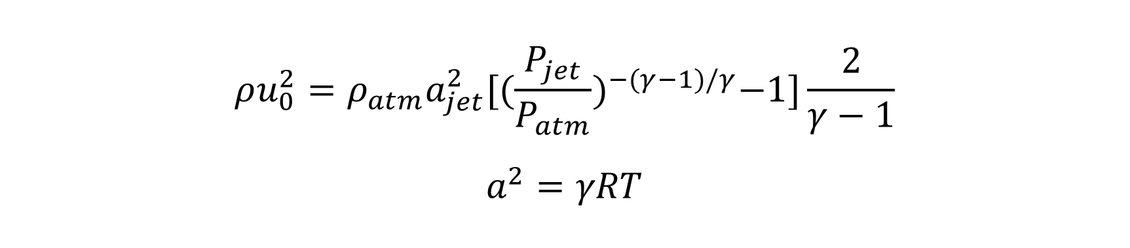
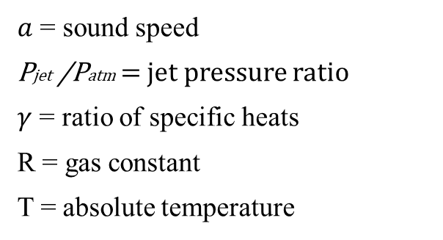
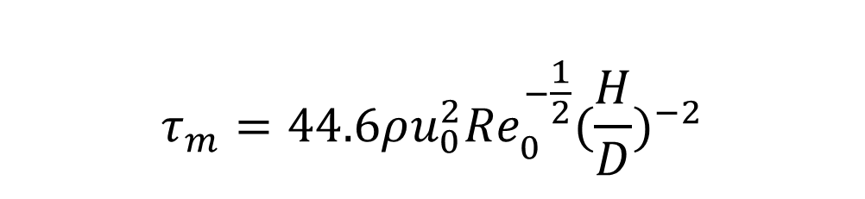
Shear Stress Equations
$$τ_{m}=44.6ρu_{0}^{2}{Re}_{0}^{−\frac{1}{2}}({\frac{H}{D})}^{−2}$$
$$ρu_{0}^{2}=ρ_{atm}a_{jet}^{2}{[(\frac{P_{jet}}{P_{atm}})}^{−(γ−1)/γ}−1]\frac{2}{γ−1}$$
$$a^{2}=γRT$$
$τ_{m}$ = maximum shear stress
$ρu_{0}^{2}$ = jet dynamic pressure
$Re$= Reynolds number
H = jet height from sample
D = diameter of jet nozzle
$a$ = sound speed
Pjet /Patm = jet pressure ratio
$γ$ = ratio of specific heats
R = gas constant
T = absolute temperature

Slide 9
Advantages and Challenges
Wider range of force can be tested
Samples less likely to break or fall off
No heating of sample
Sample size more flexible
Can’t use particle counter
Relies on camera/microscope to capture data
Need larger samples (at least 15 mm across)

Slide 10
Next Steps
Need to build this setup to test if it works
Other members of our group are designing other test setups
More research into a variety of testing ideas will give the best idea of the strengths of all the different possible approaches

Slide 11
Acknowledgements
Dr. Glen King
Dr. Keith Gordon
Jonathan Hernandez
Dr. Sang Choi
Dr. Jenna Eppink
Advanced Materials and Processing Branch
NIFS program coordinators: Jessica Gangitano, Patricia Sanchez, and Jalisa Thomas

