Slide 1

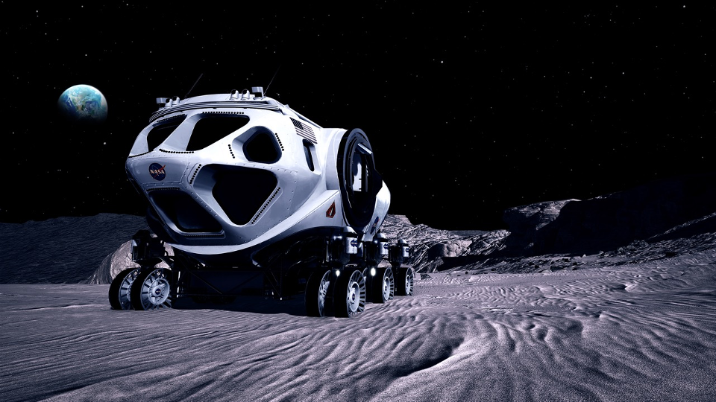
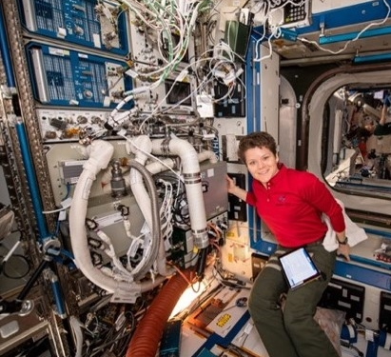
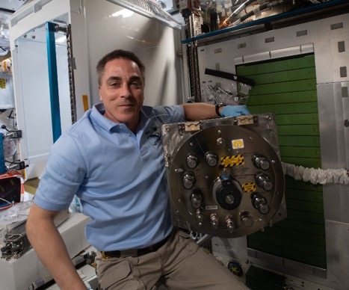
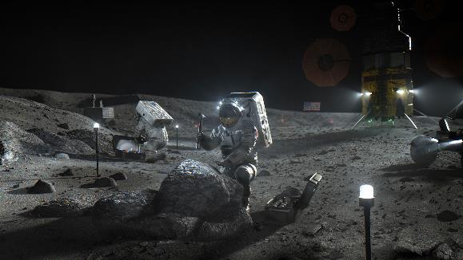
Lunar Life Support Overview
National Aeronautics and Space Administration
James Broyan – NASA ECLSS-CHP SCLT Deputy

Slide 2
Outline
ECLSS-CHP overview
  Capabilities
  Interaction of surface elements
Potential science interactions
Summary comments
Nomenclature
  ECLSS – Environmental Control and Life Support Systems
  CHP – Crew Health and Performance
  SCLT – System Capability
  Leadership Team

Slide 3
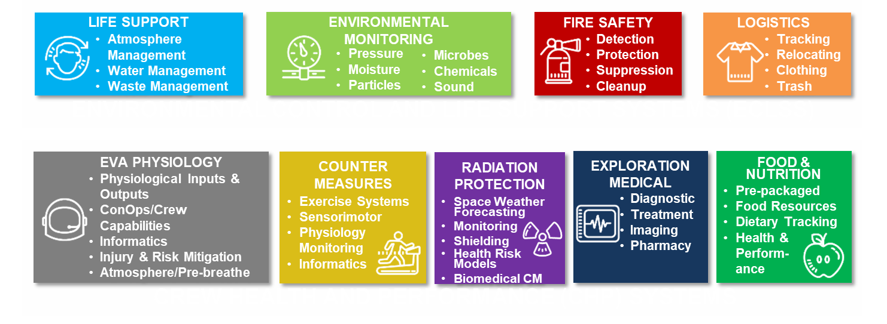
ECLSS-CHP Capabilities Overview
  Capability needs depend on key mission characteristics
  Strength of gravity (μg, lunar, Martian)
  Total length of the mission or combined missions of an element
  Uncrewed periods (dormancy) between missions

Slide 4
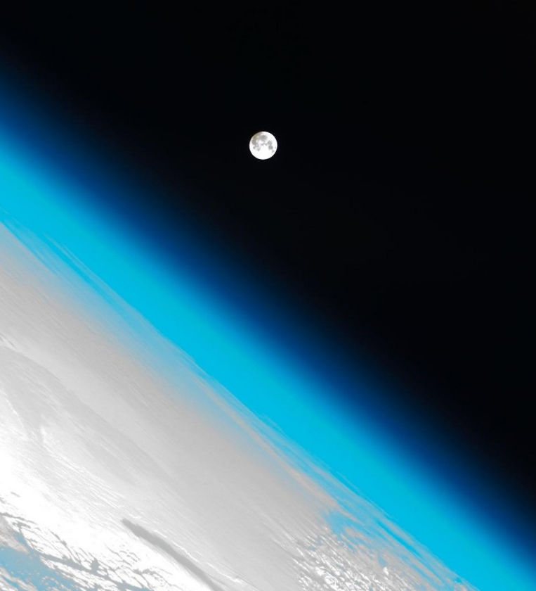
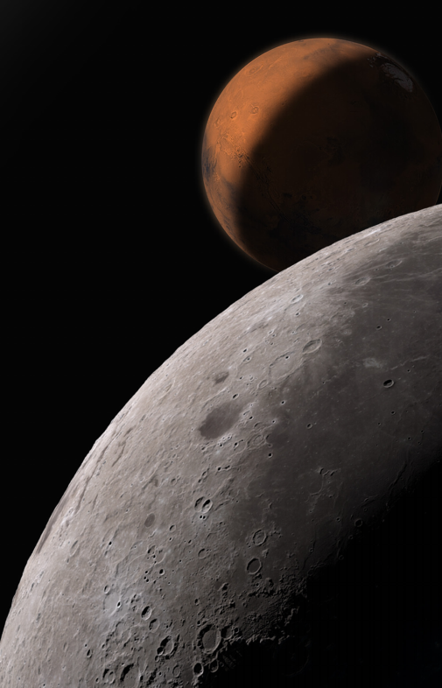
Considerations for Lunar Habitats
Technology reliability is critical - Very limited resupply frequency
  Leverage ISS and integrated ground testing to reduce uncertainty and understand operation
  Utilize partial gravity to simplify complex ug components – improve reliability
Individual surface elements may be small
Individual missions may be short
Technology decisions should combine elements and missions
  Landed mass ‘cost’ greatly shortens break even duration for closed loop ECLSS
  Not all elements need closed loop ECLSS
  Waste and products can be transferred between elements

Slide 5
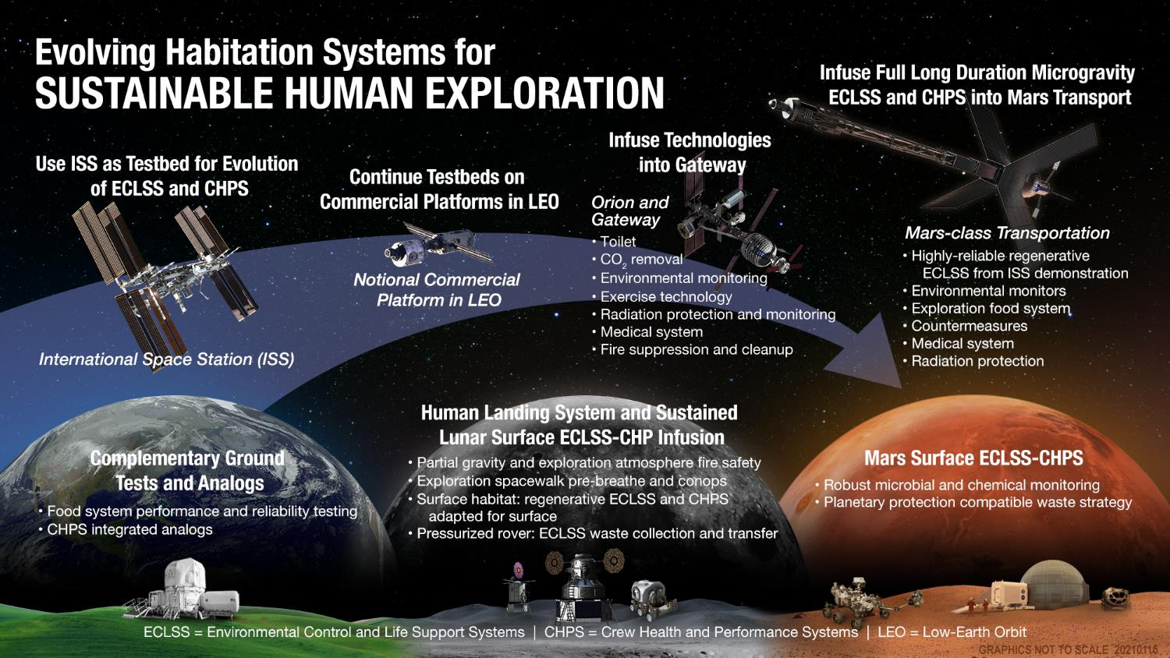

Slide 6
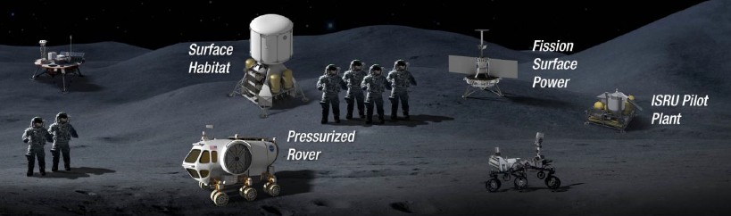

Lunar Regen ECLSS and Fluid/Gas Transfers
Consolidate regenerative ECLSS in the surface habitat
  Transfer waste from rover crew to surface habitat for processing
  Recycle urine, condensate water, and carbon dioxide
  Transfer water and oxygen to rovers and EVA
  ECLSS processes, EVA, waste disposal, and leakages contribute to releases to the lunar surface
Water
Oxygen
Wastewater
Urine
Waste
Venting

Slide 7
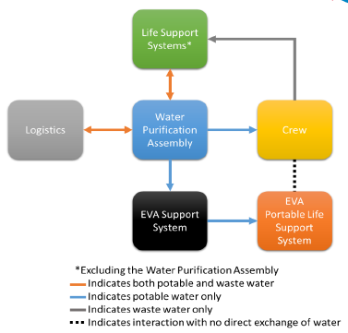
Potential Science Interactions (1/2)
Potable water biocides
  May need biocide removal prior to science use
  Early elements with only stored water may use silver or iodine
  Regen ECLSS will use iodine
Disinfection solution generation
  Could be available for science surface and equipment cleaning
  Developing in-flight hydrogen peroxide generation
Lower atmospheric pressure
  Lower pressures may impact diffusion processes thermal cooling
  10.2 or 8.2 psia likely used to facilitate frequent EVA
Reduced ECLSS during uncrewed (dormant) periods
  What science atmosphere conditions are required with no crew?
  Reduced humidity, temperature, pressure being considered
  Possibly lower air recycling and no or infrequent CO2 removal
Science / Utilization
Water transfers between capability areas

Slide 8
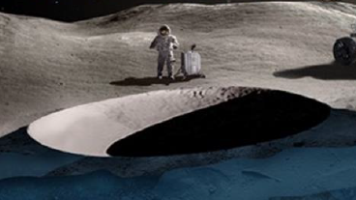
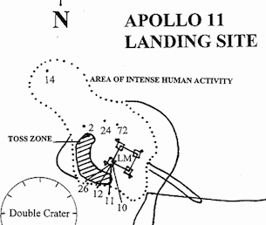
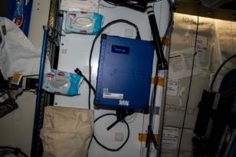
Potential Science Interactions (2/2)
Habitat/ECLSS venting and leaking
  Venting/leaking can deposit on cold lunar surfaces
  Are witness plates, additional monitoring and sample curation required?
  ECLSS process bi-products
  Air lock residual releases
  EVA suit leakage and water evaporation for thermal rejection
Habitat/Rover trash surface disposal
  Trash will release water and gases which can deposit on cold lunar surfaces
  Trash bags/containers may not be pressure sealed
ECLSS-CHP Monitoring capabilities
  Maybe possible to use ECLSS monitors for science
    Examples: Radiation sensors, trace gas analysis, water constituents, microbial, and CHP ultrasound
Habitat interior dust filtration
  Filters will keep it within CHP respiration limits
  Are lower particulate levels required for some science?
Permeant shaded region ‘cold trap’
Apollo trash disposal region
ISS Airborne particle monitor

Slide 9
Summary Comments
ECLSS will leverage ISS μg technology to ensure reliability
  Includes ECLSS restart after long uncrewed periods
ECLSS venting and surface trash disposal will locally contribute chemical/biological signatures to science
  Need to identify if there are compounds of science concern
  Need to understand if gas/fluid transfer or trash surface disposal concept of operations are of science concern
  Need to understand how habitat influences or impacts science sample curation outside and inside the habitat
Maybe possible for science to utilize ECLSS-CHP monitors
  Need to identify science utilization use cases
  Need to identify sample type, frequency, mission phase
Need to identify what ECLSS products and environments are needed for science
  Both for crewed and uncrewed periods

Slide 10

National Aeronautics and Space Administration
Questions?
10

Slide 11
National Aeronautics and Space Administration
Backup Charts
11

Slide 12
Estimates of Contaminant Release to Mars Surface from 200 kg Gas Loss*
Approximate Cabin Atmosphere Contaminant Levels Based on ISS Experience
Contaminant | Value | Units
Airborne Bacteria | 50 | CFU/m³
Airborne Fungi | 10 | CFU/m³
Methane | 6 | mg/m³
Alcohols + Acetone | 6 | mg/m³
Octafluoropropane | 9 | mg/m³
Formaldehyde | 0.03 | mg/m³
Other VOCs | 4 | mg/m³
Estimate Released (540 d)
Cabin Pressure |  | Units
8 psi | 10.2 psi
15,486 | 12,159 | CFU
3,097 | 2,432 | CFU
1,858 | 1,459 | mg
1,858 | 1,459 | mg
2,787 | 2,189 | mg
9 | 7 | mg
1,239 | 973 | mg
  Potential releases from habitat leakage represent about ¼ of the total and would be hard to mitigate. We are assuming primary leakage is from seals and bulkheads (unfiltered) rather than wall of hull.
  Potential releases due to airlock use could be mitigated by suit port
  Unplanned or contingency depresses (in the case of fire or toxic chemical release) could result in the entire cabin volume vented.
*D. Barta, M. Anderson, K. Lange, W. Vonau COSPAR, July 17, 2018
Notes:
In this table I have listed Cabin Atmosphere Contaminant Levels Based on ISS Experience, including micro-organisms and trace organic compounds.
Then estimates are given for quantities released during expected cabin leakage and air lock use during a 540 day stay on Mars.
Are these releases acceptable?
Releases due to extra vehicular activity could be decreased by filters on air lock vents or use of a suit port
But mitigating losses due to leakage will be difficult

Slide 13

Spacecraft Habitation Functions + ISRU interfaces with potential forward and backward contamination sources
KEY
Habitation Systems Outputs to ISRU
ISRU Inputs to Habitation Systems
Crew Safety
Waste Management
Water Recovery System (WRS)
Crew Systems
Temperature and Humidity Control
Environmental Monitoring
EVA
O2 Generation Assembly (OGA)
CO2 Removal and Reduction
Condensate
Temperature and Humidity Control
Trace Contaminant Control System (TCCS)
CO2 Removal
Water, Plastic, or Regolith from ISRU
Radiation Shielding
Waste Management
Filtration & Heavy VOC Removal
By-Products
Acoustic Monitor
Fire Detection & Suppression
By-Products
Discarded Solid Waste for ISRU
Recovered Water
Atmosphere Monitors
Crew Exercise
Microbial Monitors
Unreacted CO2 for ISRU
Waste Disposal
N
CO2 Reduction
Waste
Urine Recovery
Pre-Treat Urine
O2
O2/N2 Control
H₂ from ISRU
Brine
Discarded Brine Waste for ISRU
Brine & Urine Monitor
Crew
Prebreathe
Medical O2
Brine Water Recovery
N₂ from ISRU
Water Quality Monitors
Particulate Monitor
C
EVA Vehicular Activities
(EVAs)
Extra Vehicular Activities (EVAs)
High P O2
Waste Water
Crew Food Rehydration, Drinking Water and Hygiene
Water Recovery System (WRS)
Brine Water
O2 and H20 Loss
O2
Product Water
O₂ and H₂O Loss
Biocide
Condensate
ISRU Support for Food and Plant Growth
O2 Generation
Product Water
H₂0 from ISRU
O₂ from ISRU
Notes:
This is for a long duration largely closed ECLSS and its complications have potential for multiple contamination interfaces. Multiple version of this depending on what functions are assumed to be beneficial. Currently these do not consider additional functions for PP. Adding these functions would require understanding the PP requirements.

Slide 14
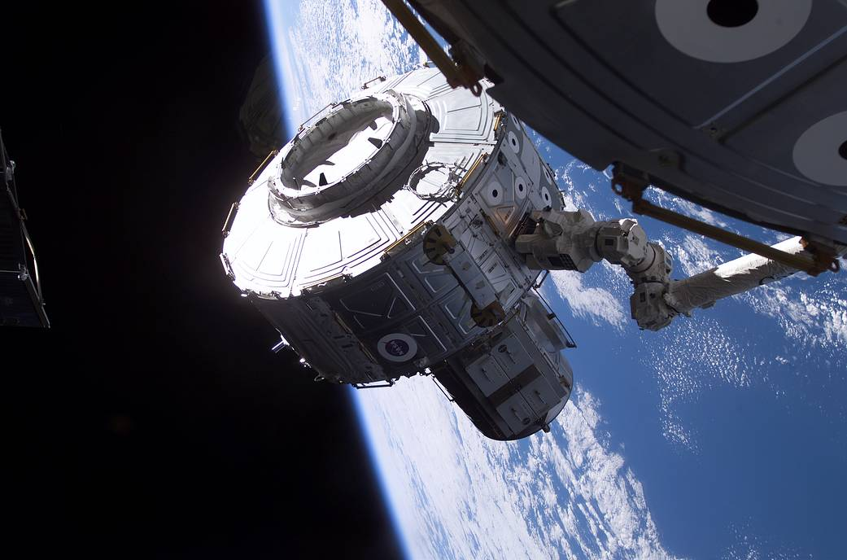
Gas Venting (1/2)
Air lock venting
  Air save pumps recover air prior to hatch opening
  Pumping down to low pressures increases pump size and time
  SOA: ISS Quest airlock pumps to ~ 5 psia before venting
  No microbial countermeasures prior to venting
Seals and vehicle joint leaking*
  Combination of elastomeric and metallic seals
  Monitoring: atmospheric pressure, major gas constituents, and resupply quantities
Airlock and leak quantity estimates
Based on NASA-SP-2009-566-ADD2 (2014) with three 6.5 hr EVAs/week would result in 0.18-0.53 kg/day loss
Habitat leakage estimated at 0.1 kg/day
Possible mitigations
  Suit-locks could reduce gas loss but not flight proven yet
ISS Quest Joint Airlock installation on STS-107
* D. Barta, M. Anderson, K. Lange, W. Vonau COSPAR, July 17, 2018
Notes:
Image Info: NASA ISS webpage
Gas venting considers both point venting and general venting. Our existing flight experience is

Slide 15

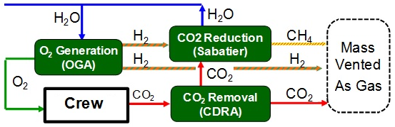
Gas Venting (2/2)
Atmospheric Revitalization
  SOA: ISS Oxygen Generation Assembly, CDRA, Sabatier ~47% recovery. Quantities*:
      Methane: 0.21 – 0 kg/CM/day
      Carbon dioxide: 0.48-1.04 kg/CM/day
      Hydrogen: 0 – 0.10 kg/CM/day
      Trace organics ~0.04 ppm
      Micro-organisms – not known but possible
  Future CO₂ reduction technology in development >75% recovery (Bosch or methane pyrolysis)
    Possible quantities depend on technology*
      ‘Solid’ carbon ~0.27 kg/CM/day
      Acetylene ~0.3 kg/CM/day
Possible mitigations
Preventing specific gases requires additional equipment and mass
Sterilizing vented gases
Witness plates and/or monitoring
ISS Air Recovery Schematic*
* D. Barta, M. Anderson, K. Lange, W. Vonau COSPAR, July 17, 2018

Slide 16
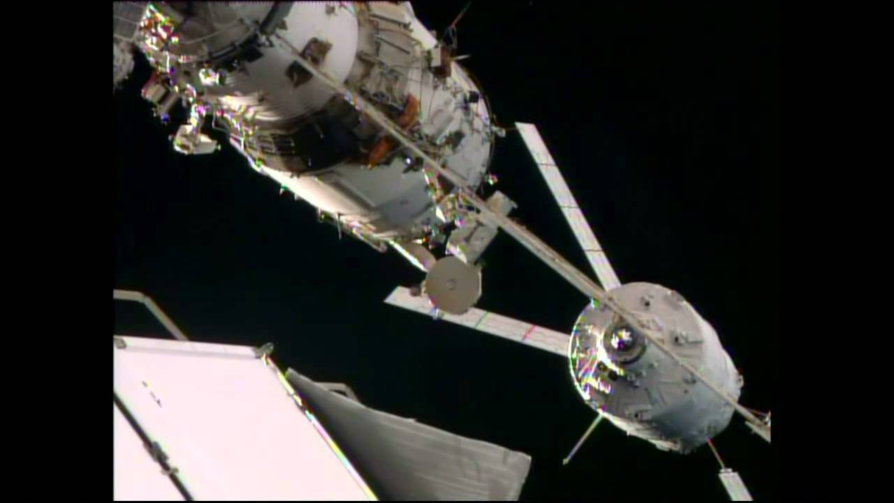
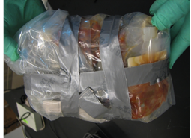

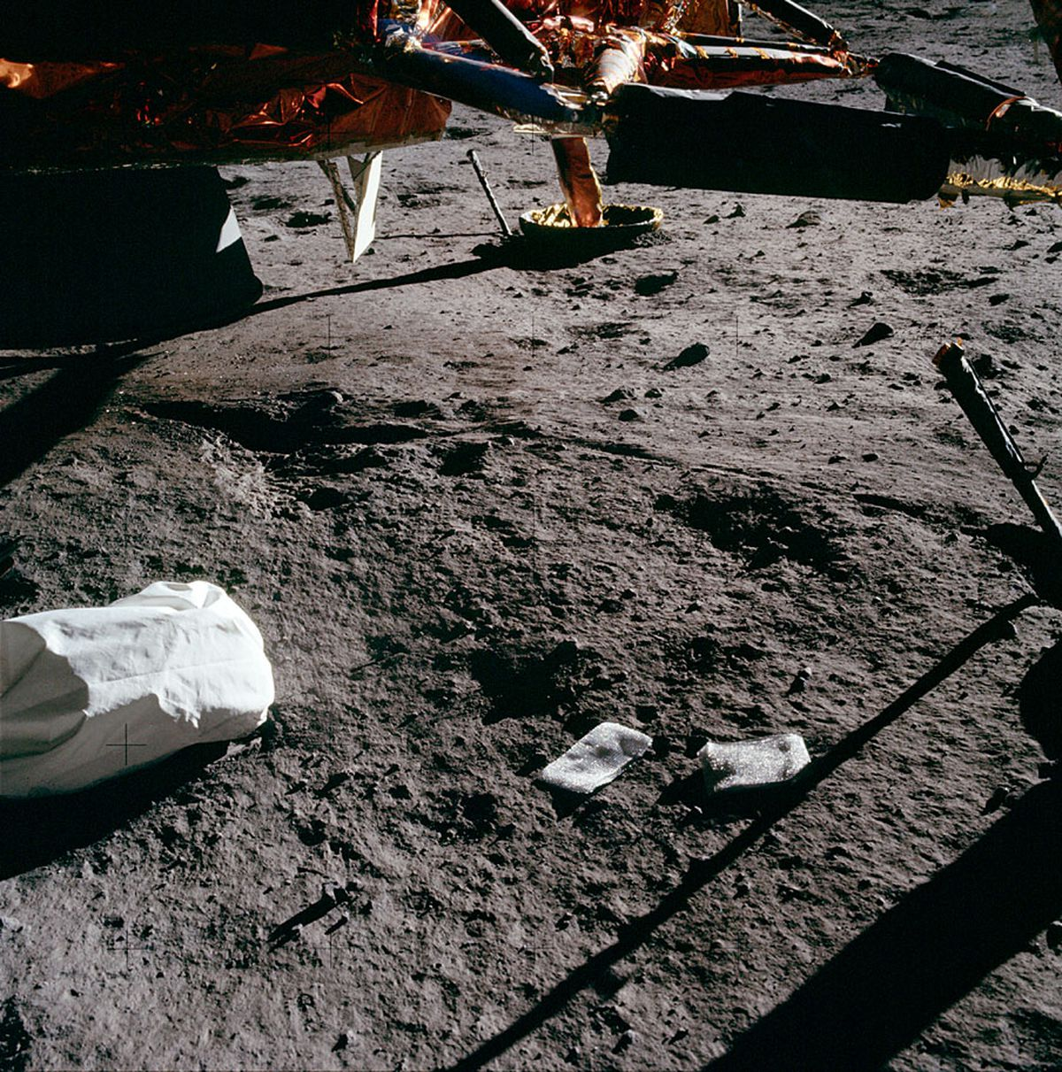
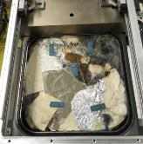
Trash Jettison
Trash collection
  Wide array of dry and wet materials**
  Temporary storage and disposal in bags (non-pressure seal)
  SOA: Unprocessed trash jettisoned in ISS visiting vehicle every ~30-120 days
  Estimated quantity*: 0.91 kg/CM/day, ~20-25% water by mass
  Wet trash is microbially active and outgas is managed by atmospheric trace contaminant control system (TCCS)
Possible mitigations
  Improved trash bags (partial microbial control)
  Trash Compactor Processing System (TCPS) ~160C
  Trash-to-gas (TtG) >600C
  Challenges
  Thermal processing releases >80 volatiles**
  Maintaining sterility after processing
ATV departing ISS (top left), Shuttle Trash ‘foot ball (top right),
Apollo jettison bag (middle),
Prototype TCPS tile (bottom)
* D. Barta, M. Anderson, K. Lange, W. Vonau COSPAR, July 17, 2018
** Young, J. et.al. ICES-2020-374; Delzeit, L., et. al., AIAA 2013-3395
Notes:
Image Info: NASA ISS webpage

Slide 17
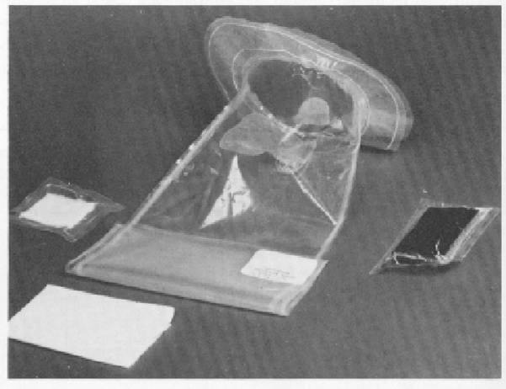
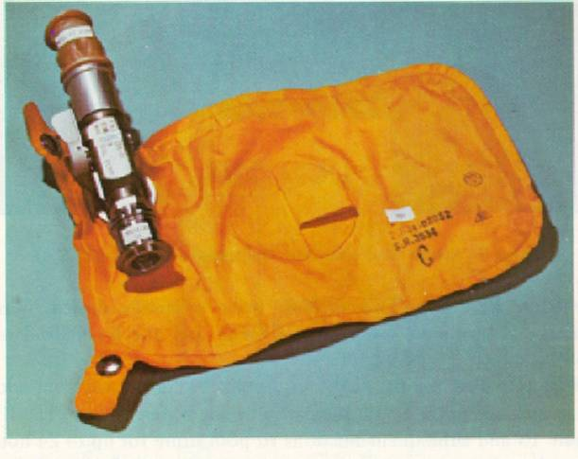
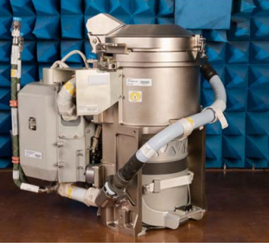
Toilet Waste
Urine – collect and chemically pretreated
  SOA:
    Short missions: vent (Apollo, Shuttle, Orion), jettison (Apollo)
    Long missions: >94% recovery with urine and brine processing
  Quantity:
    1.5 urine l/CM/day without processing, ~1-4% solids (salts and organics)
    ~0.1 l/CM/day with urine and brine processing
Fecal – collect, store, and jettison
  SOA: Storage, no treatment, no water recovery
  Quantity: 0.3 kg/CM/day + wipes
  ~75% water, ~25% organics*, microbially active
Possible mitigations
  Improved storage containers
  Fecal drying
Apollo Fecal Bag** (top),
Apollo Urine Collection Device** (middle),
Orion Toilet System*** (bottom)
* D. Barta, M. Anderson, K. Lange, W. Vonau COSPAR, July 17, 2018
** J. Broyan, ICES-2007-273
*** D. Autrey, et. al., ICES-2020-278
Notes:
Image Info: NASA ISS webpage

Slide 18

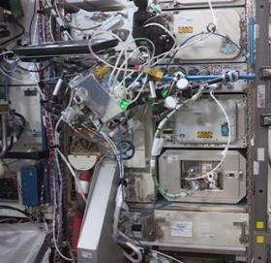
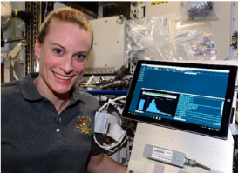
Environmental Monitoring
Current Technology/SOA
Distinct technologies for : air, water, microbial, particulate, and acoustic monitoring
Reliance on returned samples and ground analysis
Future Exploration Goals
In-mission analysis of samples, significantly reduced ground support
Improved efficiency and reliability with lower mass and volume
Technology Development and Demonstration
Spacecraft Atmosphere Monitor (SAM) – upgrade for trace gases
MinION Biomolecular Sequencer
Airborne Particulate Monitor (APM)
Advanced Total Organic Carbon Analyzer (TOCA)
Organic water monitor
Possible Forward Contamination
Improved chemical and microbial species identification, witness plates?
Possible Reverse Contamination
Ability to detect unknown contaminants
Non-DNA detection, tracer compounds, witness plates?
SAM installed on the space station
ISS MinION DNA Sequencer
Notes:
Image Info: Top: Spacecraft Atmosphere Monitor (SAM), Bottom: Min-Ion DNA Sequencer

