Slide 1
Computational Modeling of Cathode Process of Solid-State Batteries
Justyn Lewis
Dr. Vesselin Yamakov & Dr. Yi Lin
2021 Summer Student Research Symposium

Slide 2
Challenge
My project focused on modeling particle-particle interactions in a solid-state battery cathode.
The history of this challenge comes from solid-state batteries having low power and energy density. By modeling the physical processes, we can provide guidance to improve the performance of the battery, such as the power and energy density.
In the past this challenge has been addressed by trial-and-error approach via building and testing.

Slide 3

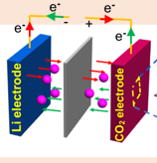
Objective
The objective of the entire project is to find a way to increase the power and energy density of solid-state batteries.
The objective of my work was to learn how to use the FEniCS Python library to solve and model multi-physics phenomena in the cathode.
My work ties into the overreaching goal of the project by allowing the team to better understand the battery processes.

Slide 4

Approach
I took notes on FEniCS software, how solid-state batteries work, and I tested Python code to ensure that FEniCS can work on the K-Cluster
I accomplished this by learning how to submit jobs to the K-Cluster, wrote python code that used the FEniCS library, tested it on the K-Cluster, and examined my results
This contributes to the research objectives by allowing my team to be able to accurately predict the energy density of a system of lithium-ion particles.

Slide 5
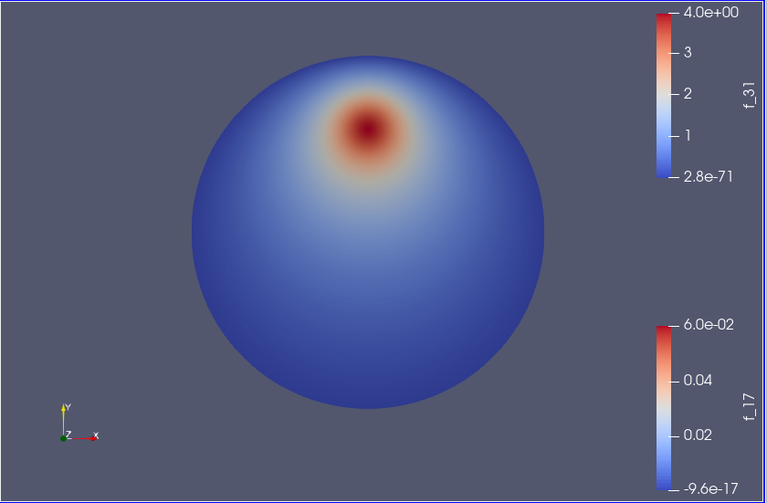
Results
FEniCS was used to model a solid electrolyte sphere in contact with another sphere at the bright point at the top.
ParaView was used to interpret the data output from FEniCS.

Slide 6
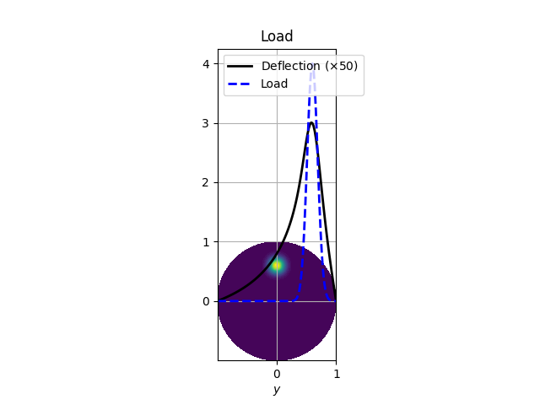
Analysis/Summary
What do your results mean?
These results show the distribution of Li-ions in a spherical solid electrolyte particle during diffusion, when the sphere particle is in contact with another sphere at the bright point at the top.
These results solve for an electric field in a metallic sphere when it has charges at one point.

Slide 7
Next Steps/Outlook/Future Work
If I had four more weeks, I would model a 1,000-particle system.
If I had four more months, I would use the results from the 1,000-particle system to build machine learning algorithms to model a 1,000,000-paticle system.
What I have done is lay the groundwork, so that future computer scientist/engineers can model larger, more realistic particle based interactions.

Slide 8
Acknowledgements
I would like to thank:
Dr. Vesselin Yamakov for working with me everyday and teaching me the basics of how to use the K-Cluster, Paraview, and more, so that I could grow from there.
Dr. Yi Lin for being an amazing leader and answering all my questions.
All the other interns on my team for being helpful and supportive.
All the NASA LaRC support staff and program coordinators.
NIFS for funding this research and creating a fund for hiring black engineering students.

