Slide 1
Enabling Sustained Presence Using Recyclables
An In-Situ, Recyclable 3D Printing Method for Lunar and Deep Space Travel
Brendan J. Koene
Christopher J. Wohl and Bryce L. Horvath
2021 Summer Student Research Symposium
*Unless otherwise indicated, all images are credited to NASA

Slide 2
In-Space Manufacturing
The Enabling Sustained Presence Using Recyclables (ESPUR) Program is focused on helping with the issue of limiting the amount of weight on a spacecraft using in-space manufacturing.
Probability of Sufficiency (POS)- the probability that enough spare parts are provided to cover all failures during a mission outside of the atmosphere.¹
The ISS has been outfitted with a 3D printer and, more recently, a device known as a “Refabricator”. The Refabricator can take old 3D printed objects and refabricate them into a new object.²
Notes:
The ESPUR program has two big goals that strongly relate. The first of these is the need to raise the Probability of Sufficiency. The second is lowering the weight taken up by spare parts on a spacecraft. In-space manufacturing is a great way that both things can be easily accomplished. There have been two ways this has been implemented on the ISS. The first is the 2014 addition of 3D printing capabilities. The second is the 2018 installation of the refabricator. The refabricator is a device that allows the user to take 3D printed objects and recycle them into feedstock for the machine. The same machine can then 3D Print new parts. There has not yet been any implementation of in-space manufacturing on lunar or deep space missions. We hope to be able to help change that.

Slide 3
ESPUR Objective
The objective of the ESPUR Project is to create a new in-space manufacturing ability using chemical reactions between particles.
I attempted to discover patterns based on how the ESPUR material connected in random arrangements. I used those same calculated arrangements to do finite element analysis (FEA) work with the material.
For a project like ESPUR, it is important to do both theoretical and experimental tests. I was able to be a big part of the theoretical testing alongside the rest of my team.
Notes:
The ESPUR project looks to be a way of manufacturing spare parts in space to lower the need of extra weight. We are attempting to solve this problem in a radically different way than the previous solutions. Rather than merely breaking down parts into pieces and reforming, ESPUR material will form a chemical bond between an epoxy and a polyurethane that is reversible based on heat. My part in this project was to determine specific properties about how these particles will interact by doing FEA work. Along with the physical testing aspect of the project, I was able to help with a big part of doing theoretical tests using the MATLAB and Abaqus softwares.

Slide 4
My Approach
I used the program MATLAB to design a system of particles to depict the reactions between polyurethanes.
I used Abaqus to determine how the ESPUR material in the setups I generated in MATLAB would respond to relevant load cases.
The work I was able to do for the project is going to help the ongoing search for how to go about choosing polyurethanes and an epoxy as well as how to go about chemically binding them for the best experimental results. It will likely gateway into the ability to do experimental testing
Notes:
Almost all my work in MATLAB was on a single program, which has a few different purposes. It can graphically represent a number of particles as spheres, it provides histograms to show likelihood of different connection types, and it can take data from a given iteration of the program and input it into Abaqus for some FEA testing, among many other things, which are on the next slides. Due to the long time it took me to receive my NASA laptop and get things downloaded, I have not yet done the FEA testing. I am really hoping that my work is going to be very useful in the future of the ESPUR project.

Slide 5
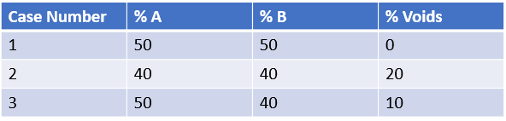
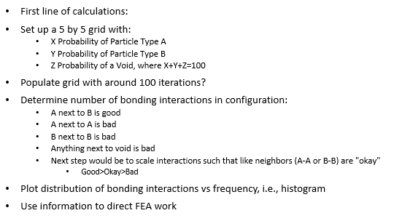
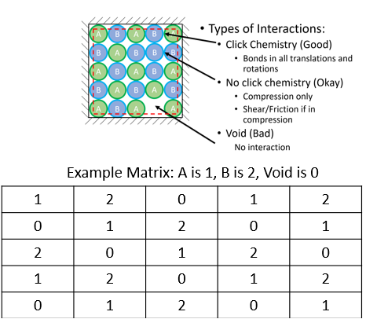
Primary Task
Notes:
I was tasked with creating a program in MatLab that would do the following things: *talk through slide*. This project eventually evolved into a code that did many more things.

Slide 6
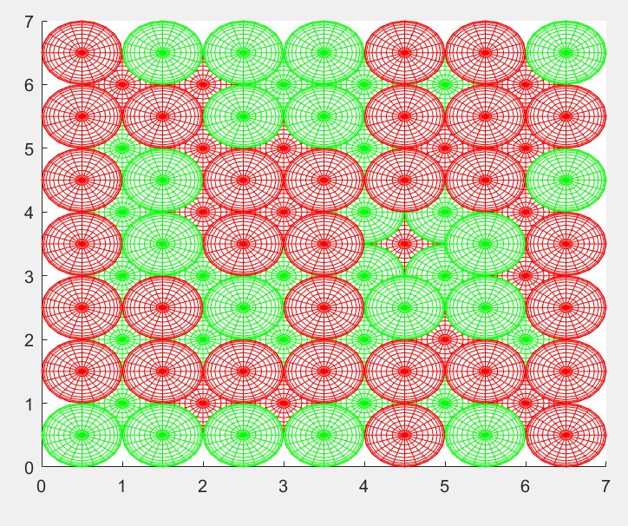
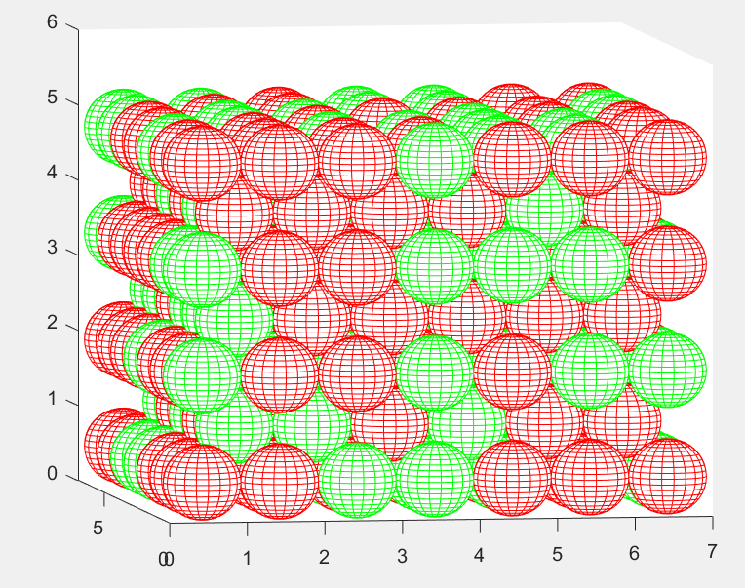
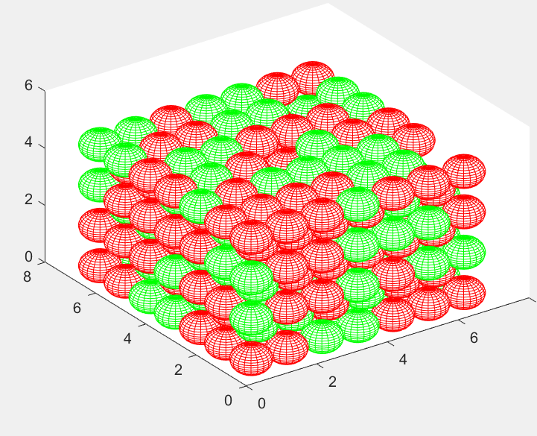
The Results
Figures 1 through 3- graphical representation of the different
Polyurethane particles connecting in different ways
Notes:
*talk through what these images mean relative to the previous slide*

Slide 7
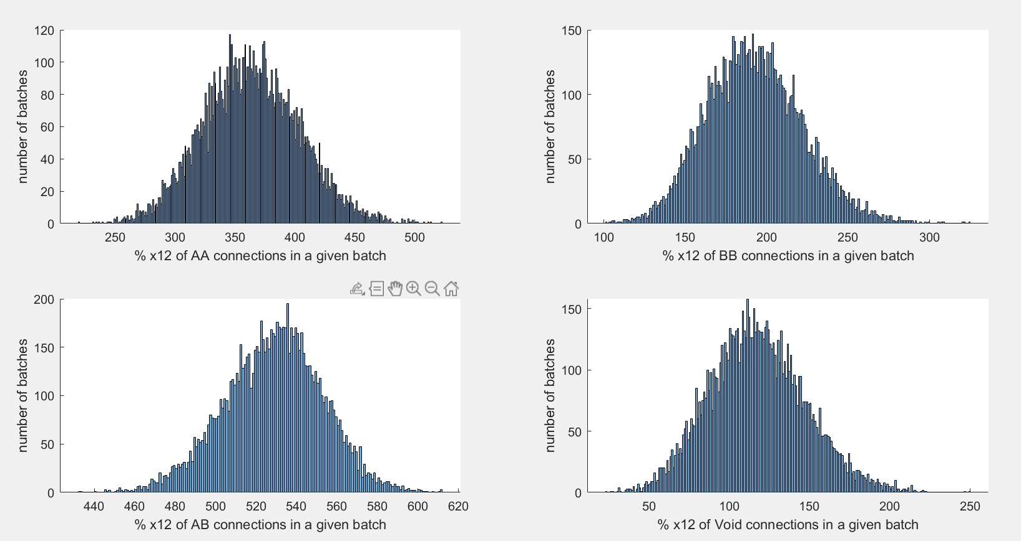
The Results
Histograms for percentage of different connection types in all iterations
Notes:
*Talk through the meaning of the slide*

Slide 8
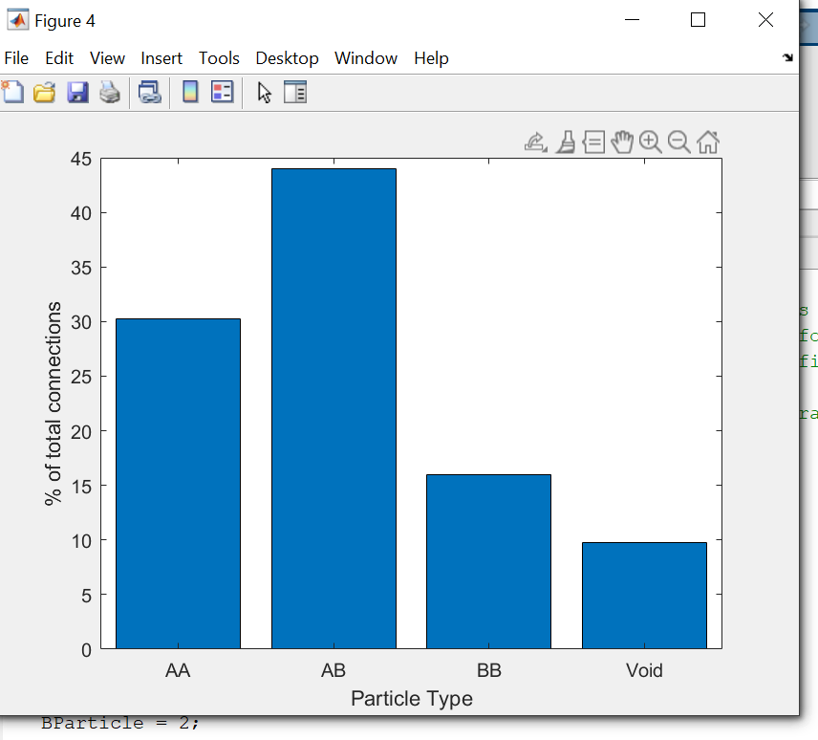
The Results
Percentage of different connection types over all iterations
Notes:
This graph is a very simple depiction of the average number of each type of connection

Slide 9
Analysis/Summary
The results were somewhat expected. They will quite possibly lead to new possibilities for testing materials soon. Based on calculated probable interactions from mixed particle formulations these results will lead the ESPUR project to begin determining polyurethanes and an epoxy to be used for the material.
Notes:
I would say that these results were expected as they lead us forward to a place of more questions and testing. Will a given material sustain Mars temperatures? Will it be impermeable enough for there to be very little void between bonds? Will the Coefficients of Thermal Expansion be close enough? All of these are questions that we can ask to begin choosing good materials to use.

Slide 10
Next Steps/Outlook/Future Work
If I had four more weeks, I would continue environmental work, FEA simulation, and CAD modeling.
If I had four more months, I would identify materials to begin the field testing and hopefully able to join on-site for some material testing.
Based on current status the work on the ESPUR project has much longer to go before being ready for space, but I think we are very close to finishing the theoretical work needed for the project.
Notes:
If I had four more weeks, I would like to expand on my work with the environmental testing side of the ESPUR work as well as doing some more FEA simulation and downloading SOLIDWORKS for 3D CAD modeling.
If I had four more months, I would probably start with doing the same type of thing as if I had four more weeks, but I’d like to see this project reaching a place in which we have identified materials to begin testing with. Once this point is reached, I’d enjoy working more on the environmental side of the project.

Slide 11
Acknowledgements
I would like to thank my mentors Chris and Bryce for the time that they’ve taken out of their days and lives to help me understand the project and my own work goals, as well as the rest of my amazing team. In addition, I’d like to thank my sponsors and coordinators at the STF program for their help in allowing me to be a part of this research project and funding my work. Finally, I’d like to thank Gabrielle Snyder for not giving up on downloading MatLab and Abaqus despite weeks of difficulty.
Notes:
I would like to thank my mentors Chris and Bryce for the time that they’ve taken out of their days and lives to help me understand the project and my own work goals, as well as the rest of my amazing team. In addition, I’d like to thank my sponsors and coordinators at the STF program for their help in allowing me to be a part of this research project and funding my work. Finally, I’d like to thank Gabrielle Snyder for not giving up on downloading MatLab and Abaqus despite weeks of difficulty.

Slide 12
References
¹ Owens, A., & De Weck, O. (2016). Systems Analysis of In-Space Manufacturing Applications for the International Space Station and the Evolvable Mars Campaign. AIAA SPACE 2016. https://doi.org/10.2514/6.2016-5394
² Rainey, K. (2017, August 28). Full Circle: NASA to Demonstrate Refabricator to Recycle, Reuse, Repeat. NASA. https://www.nasa.gov/mission_pages/centers/marshall/images/refabricator.html.
Notes:
Thank you all for listening! Any questions?

