Slide 1
Development of a Computer Tool to Analyze MISSE Images
Intern: Carlos A. Perez
Mentors: Sheila A. Thibeault, Jin Ho Kang, and Keith L. Gordon
2021 Summer Student Research Symposium
All MISSE Photographic Images Credit: NASA

Slide 2
Introduction
The Materials International Space Station Experiment (MISSE) contains individual experiments focused on the investigation of the effects that occur because of the exposure of the material to the space environment. The specimens are mounted on the exterior of the International Space Station (ISS) on the MISSE-Flight Facility (MISSE-FF) and are exposed to the extreme environmental conditions. There have been 14 MISSE missions since the establishment in 2001. This project will evaluate MISSE 9 - MISSE 13 specimens and how they change due to the space environment.

Slide 3
Objectives
Collect images and data from MISSE 9 until MISSE 14
Organize all the images based on the mission, the specimens, and the dates
Analyze each specimen to determine possible changes
Determine options to quantify the changes in the MISSE images
Create a computer program that portrays the monthly variation in a specimen

Slide 4
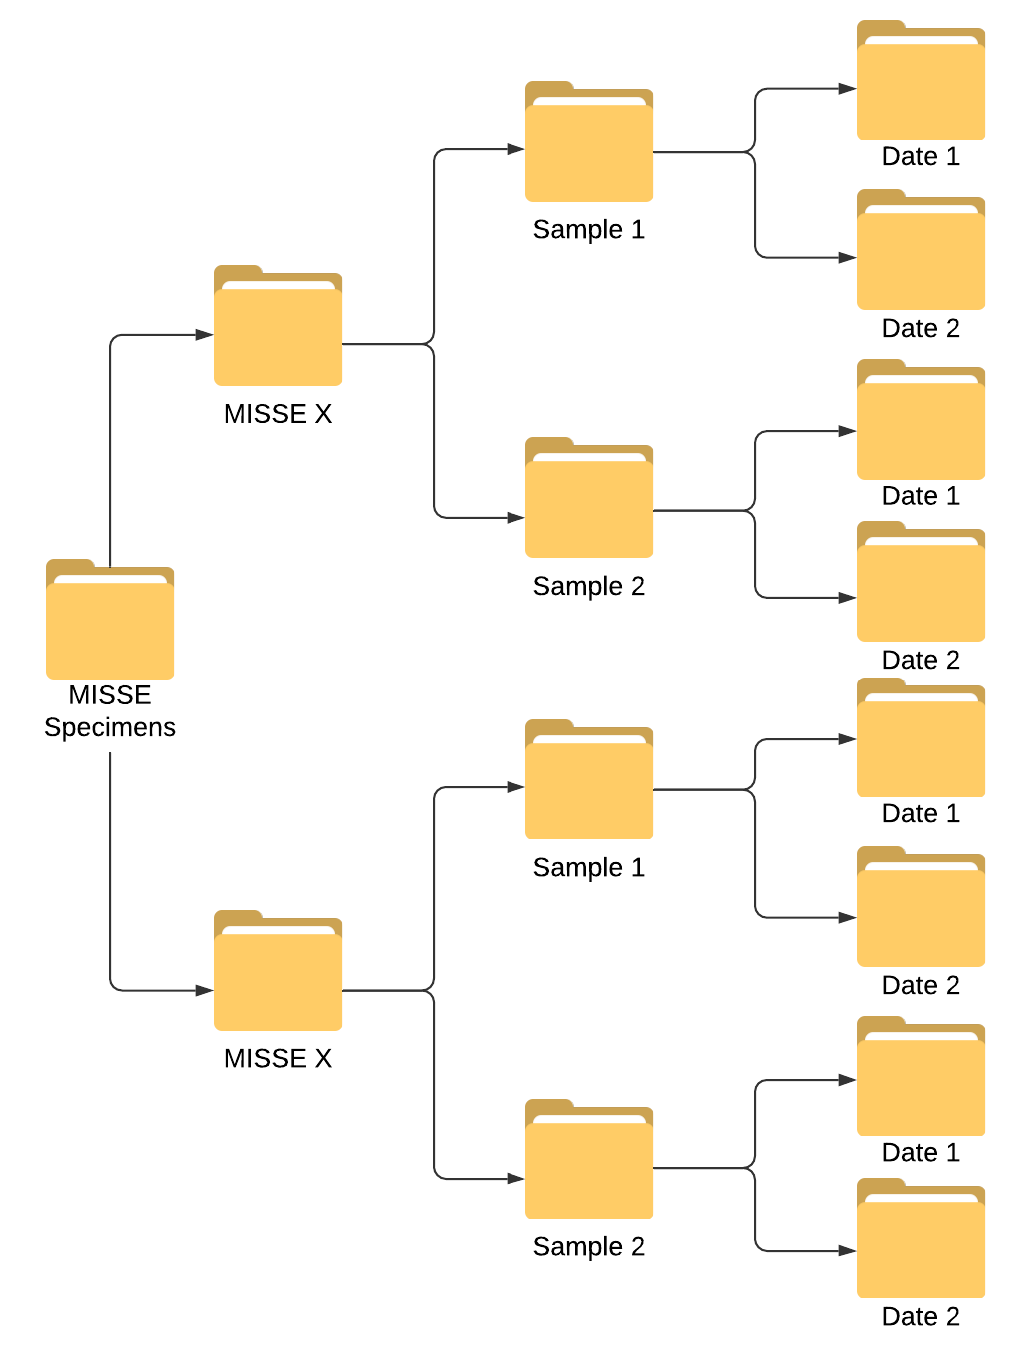
Organization and Management
In order to determine a change, each specimen was sorted according to its specific mission and date
All the MISSE photographic images were taken by high-resolution cameras on the MISSE-FF
The time of exposure for each mission was:
  M9R2: 280 days, 17 hours, 13 minutes
  M9W3: 198 days, 23 hours, 32 minutes
  M9Z3: 198 days, 4 hours, 24 minutes
  M10N3: 174 days, 0 hours, 20 minutes
  M10R1: 426 days, 0 hours, 32 minutes
  M10Z2: 250 days, 7 hours, 52 minutes
  M11Z3: 318 days, 4 hours, 55 minutes
  M11R3: 150 days, 3 hours, 25 minutes
  M11W2: 313 days, 3 hours, 4 minutes
MISSE specimen folder classification model

Slide 5
Results of the Qualitative Analysis
The analysis showed that the changes obtained were in color and texture
We currently only have a complete set of images from MISSE 9, MISSE 10, and MISSE 11
On MISSE 9 and MISSE 10, most of the specimens did not show a change
On MISSE 11, 10 out of 12 samples showed a variation of color, or color and texture

Slide 6
Results Distribution
We have complete data for MISSE 9 – MISSE 11 and partial data for MISSE 12 – MISSE 13
The distribution of the MISSE 9 – MISSE 13 specimens were as follows:
  48% of the materials did not show a change
  17% demonstrated a change in color
  6% demonstrated a change in color and texture
  29% cannot yet be determined

Slide 7
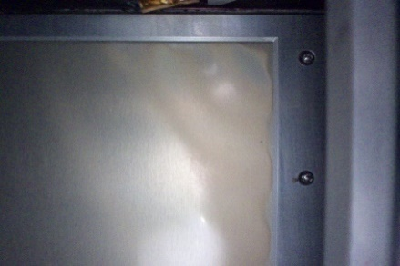
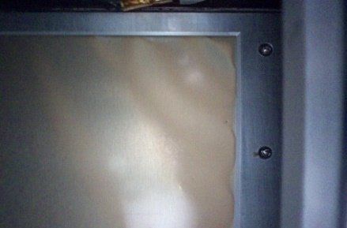
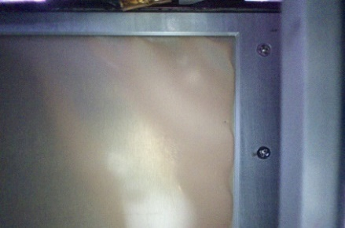
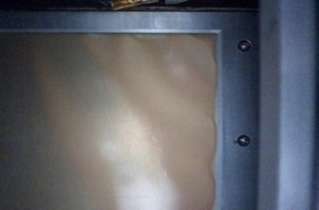


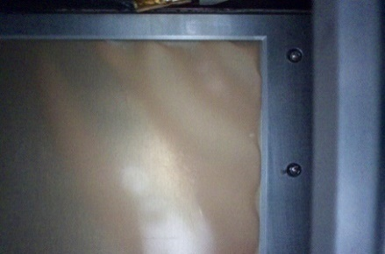
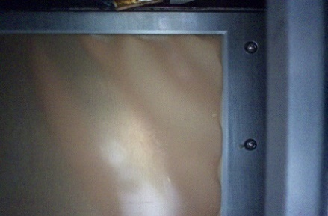
Example of Change in a Material
Space exposure images of MISSE 11, Specimen MIR1 (Polyvinyl fluoride)
June 2019
July 2019
August 2019
September 2019
October 2019
December 2019
January 2020
February 2020

Slide 8
Program Design
The programming language selected for this project was Python
To manipulate the image data, PIL(Python Imaging Library) and matplotlib libraries were installed
The objective of the program is to provide a quantitative result for the qualitative observations
To achieve the desire objective, the program needs to complete the next steps:
Open and read an image
Distribute points across the image
Detect the color in the points selected
Compare the values within all the images
Display results

Slide 9
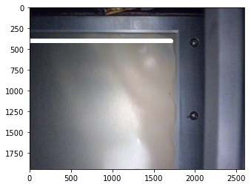
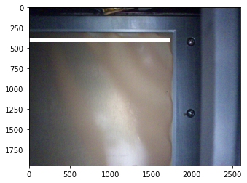
Point Selection
A total of 1700 points were drawn in each one of the images using matplotlib
July 2019
October 2019

Slide 10
Color Detection
The quantification of the colors was obtained using the RGB (Red, Green, and Blue) code, since:
  It contains 16 billion combinations of colors
  It is divided by 3 elements
  It has tools that allow an easy application to Python programming
To manage other values that can affect the results of the images, the HSV (Hue, Saturation, Value) code was also applied
RGB | HSV
Red: 34 | Hue: 110
Green: 188 | Saturation: 177
Blue: 126 | Value: 111
Example of the RGB and HSV results given a specific color

Slide 11
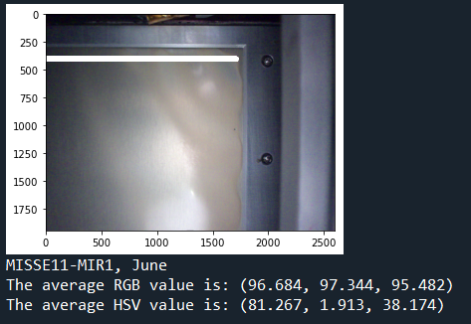
Color Output
An algorithm was applied to detect the RGB and HSV values of each one of the points selected in the images
The average for each of the parameters was calculated to obtain a final color
Output example for the image taken on June 2019

Slide 12
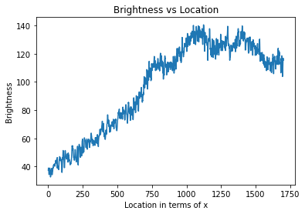
Brightness
It was observed that the brightness was different in each one of the images
To analyze the brightness in a specimen, a graph was made showing its variation as a function of location
Similarly, other graphs were created to compare the red, green, and blue components in the images
Brightness vs Location graph for June 2019

Slide 13
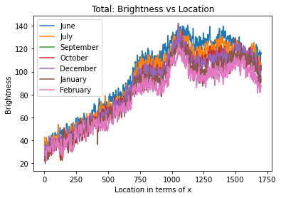
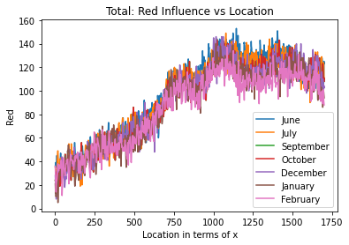
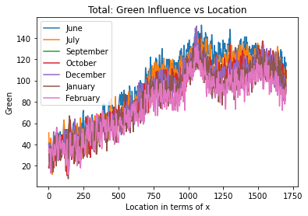
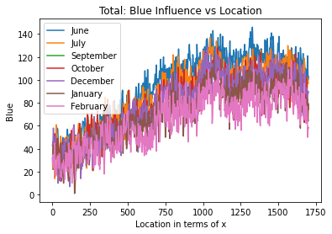
Results
To analyze the changes, the graphs showing the influence from the brightness, red, green, and blue components were combined

Slide 14


Conclusion
The final results revealed that there was a monthly decrease in the brightness and also in the RGB values
The brightness is reflected to a lesser extent each month, which affirms that the color is getting darker
By comparing the first and last images, an evident change can be observed on the average of the RGB values
MISSE 11, MIR1 (Polyvinyl fluoride)
June 2019
February 2020
June 2019
RGB values:
(96.68, 97.34, 95.48)
February 2020
RGB values:
(85.44, 77.20, 64.82)

Slide 15
Acknowledgments
I would like to express my sincere gratitude to:
Mentors
  Sheila Thibeault
  Jin Ho Kang
  Keith Gordon
  Charles Liles
Alpha Space Test and Research Alliance LLC (Alpha Space)
  Allen Hebert
  Allison Goode
  Jeffrey Buell
NIFS coordinators
  Jessica Gangitano
  Valerie Ellis
  Jalisa Thomas
  Patricia Sanchez
  Christine Dillard

