Slide 1
Graphical User Interfaces for Laser Powder Bed Fusion Additive Manufacturing
Leah Ican
Dr. Samuel Hocker
2021 Summer Student Research Symposium

Slide 2
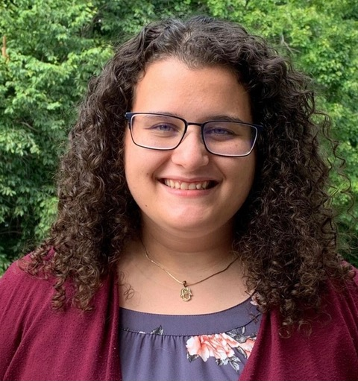
About Me
Northern Virginia Community College – Graduated Spring 2021
A.S. in Computer Science
Virginia Tech - Fall 2021
B.S. in Computer Science
Image Credit: Leah Ican

Slide 3
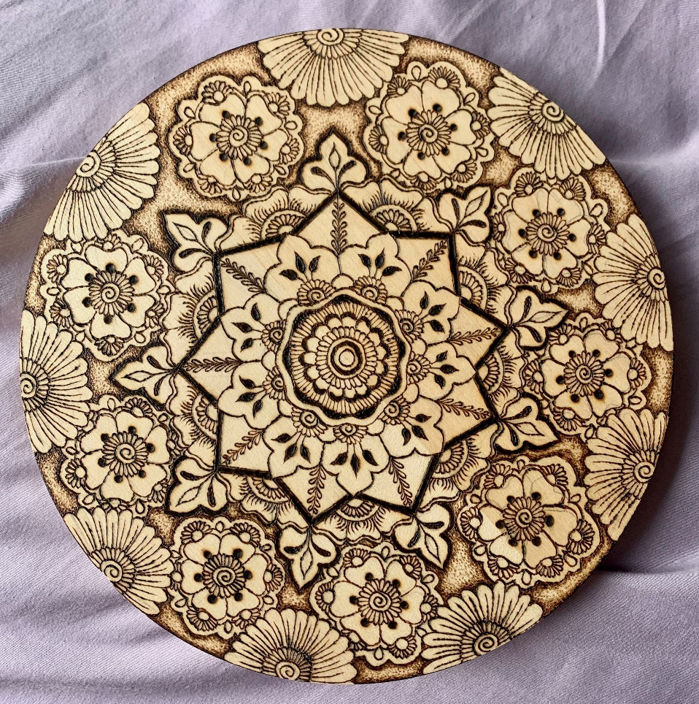
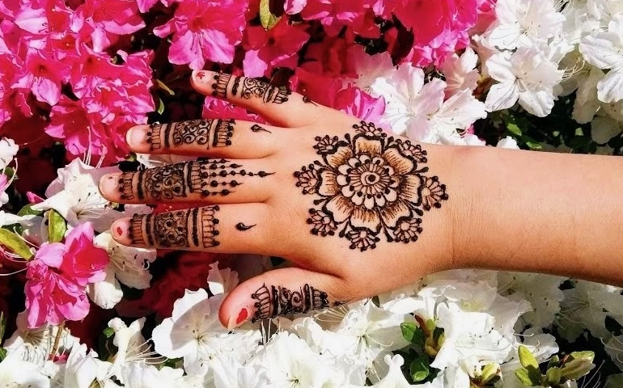
About Me
I am an entrepreneur
Enjoy Pyrography
Image Credit: Leah Ican

Slide 4
Challenge
Display data from sensors on the Laser Powder Bed Fusion (LPBF) machine for Additive Manufacturing for Aerospace
The printer has sensors that track multiple aspects of the LPBF process on novel materials
Data derived is not easy to access or visualize
Interns/researchers need to sift through multiple files of code through the command line to access the data for their research.

Slide 5
Objective
To be able to record and monitor all aspects of the LPBF process
Create Graphical User Interfaces (GUIs) that display data taken from sensors on the LPBF machine and run functions based on that data

Slide 6

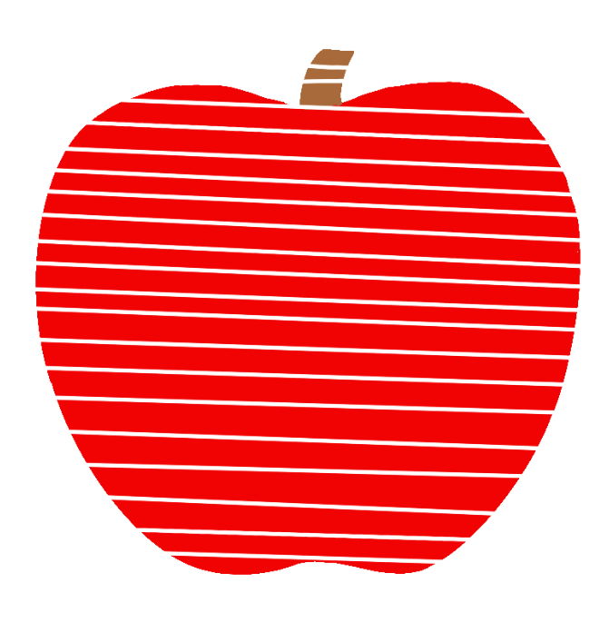
Additive Manufacturing
3D Printing
Print lighter and stronger materials
Prints 3D objects layer by layer

Slide 7
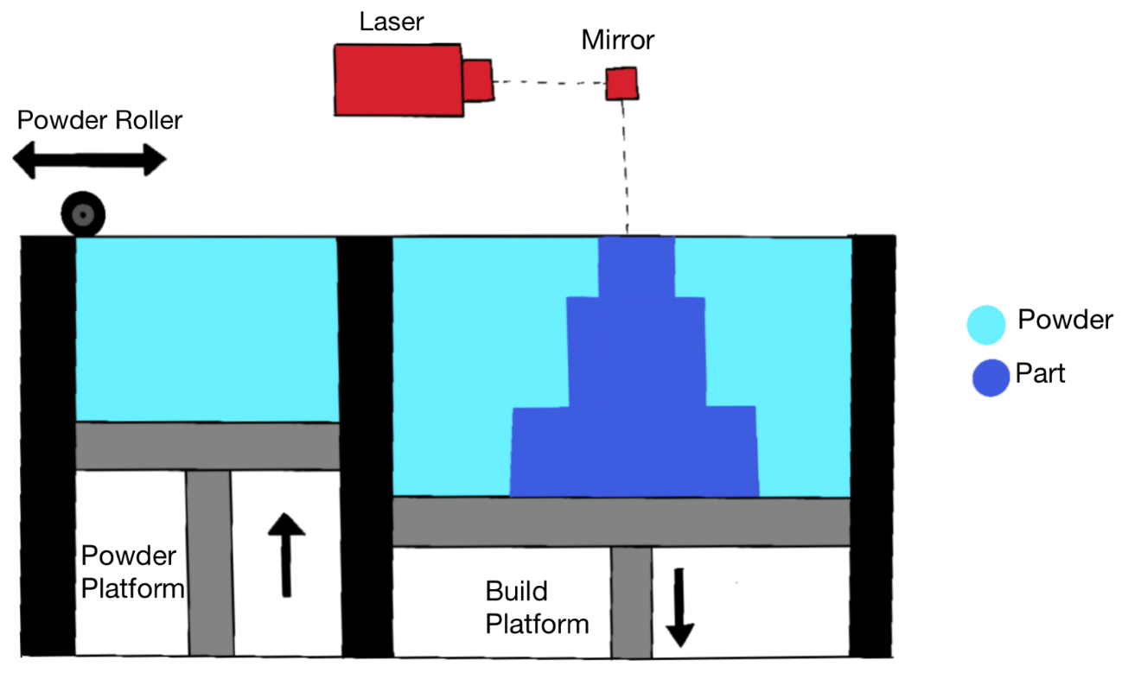
Laser Powder Bed Fusion (LPBF)
A form of additive manufacturing
Selective Laser Melting
Melts and fuses metallic powders together, layer by layer

Slide 8
Approach
I created basic GUIs

Slide 9
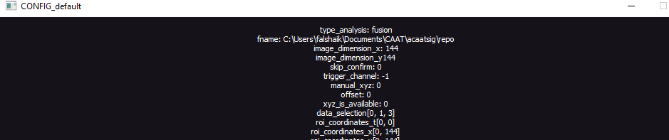
Results

Slide 10
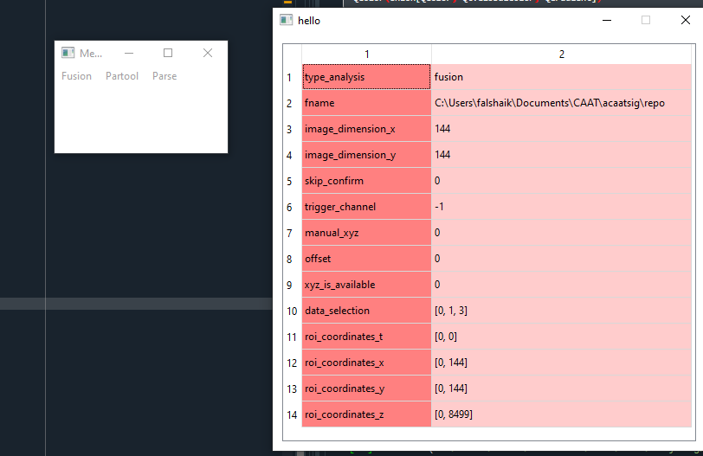
Results

Slide 11
Approach
I created basic GUIs
I integrated functions from my basic GUIs into the main GUI
I mainly used:
  Python – a multi-purpose and high-level programming language
  PyQt – a GUI module/toolkit

Slide 12
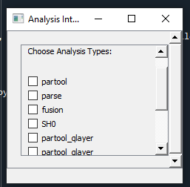
Results

Slide 13
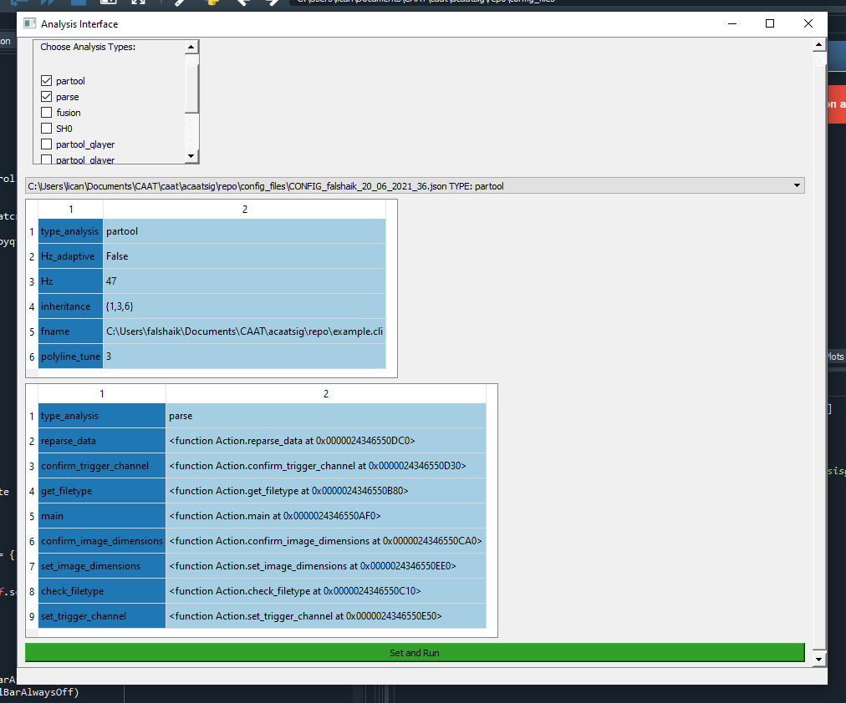
Results

Slide 14
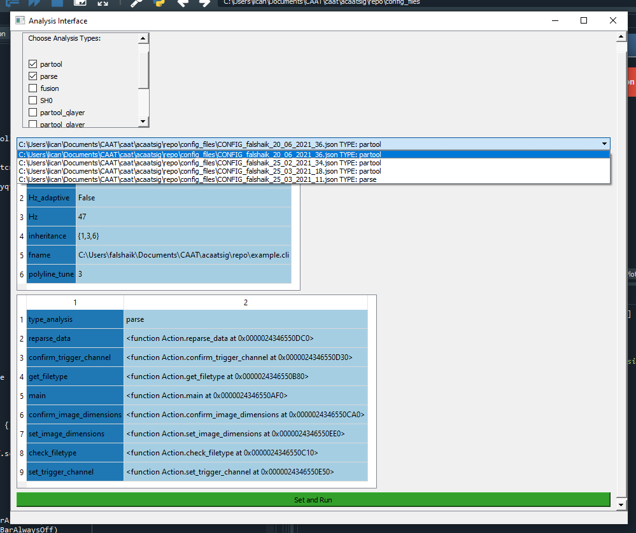
Results

Slide 15
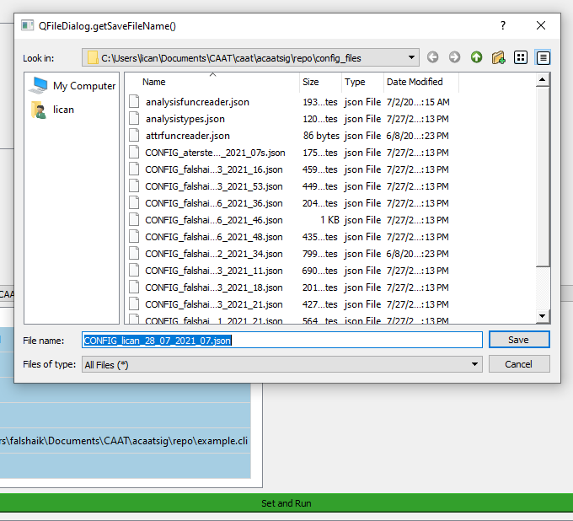
Results

Slide 16
Approach
I created basic GUIs
I integrated functions from my basic GUIs into the main GUI
I worked on a separate function called partool-qlayer
I mainly used:
  Python – a multi-purpose and high-level programming language
  PyQt – a GUI module/toolkit
  PyVista – 3D visualization/mesh analysis in Python

Slide 17
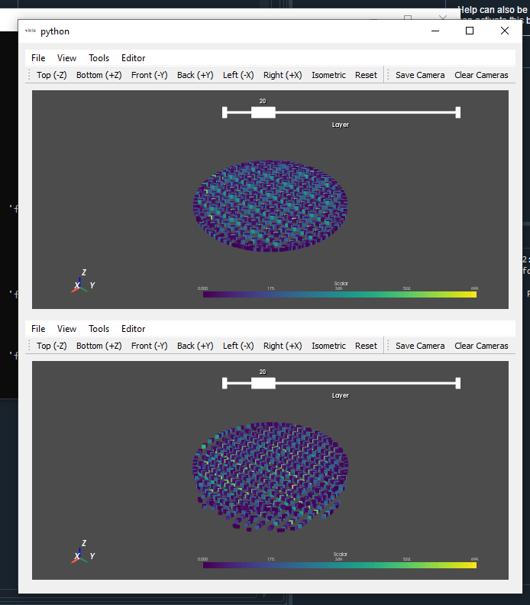
Results

Slide 18
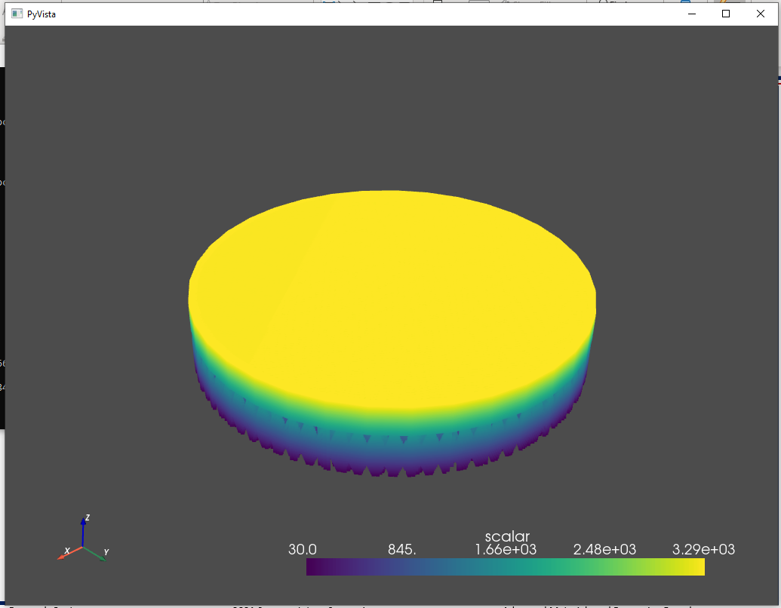
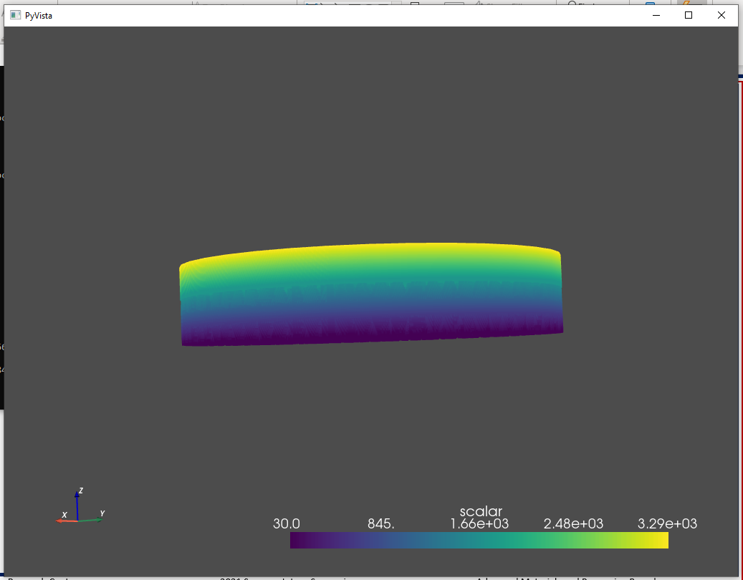
Results

Slide 19
Analysis/Summary
It will now be easier for future interns and researchers to access the data that they need to continue working with the LPBF machine
The results were what were expected along with some changes that would impact the project as a whole
    -Implementation of PyVista for 3D graphs instead of Matplotlib

Slide 20
Next Steps/Outlook/Future Work
Work on optimizing the code and ensuring there are no redundancies
Add more function capabilities
  -There are many functions, like qlayer, that still need to be implemented
I can see its ability to broaden as there is a lot of complex data derived from the LPBF machine that could be displayed or utilized
  -It can get intricate

Slide 21
Acknowledgements
Anjesa Terstena and Fatima Al-Shaikhli
Stem Takes Flight
Nicole Shaw and Debbie Murray
NASA Langley and the Advanced Materials and Processing Branch
All images credit NASA unless otherwise noted

Slide 22
Additive manufacturing is a rapidly growing field and laser powder bed fusion is a relatively new addition. During the process of laser powder bed fusion additive manufacturing, there is a large compilation of data collected from the many sensors and cameras hooked to the machine. As such, there needed to be a process devised that can compile the data and display or analyze it in a user-friendly manner. In order to do so, the goal of my internship at NASA Langley Research Center was to create Graphical User Interfaces (GUIs) that could take in user input regarding certain variables attached to the sensors and provide visual output in the form of plots and figures. The main resources utilized for the GUIs were Python, PyQt, and PyVista. The resulting GUIs contain dynamic elements that can continue to be updated as the need arises. Through the implementation of the GUIs, there is no need for researchers to learn command line functions in order to access the data. Instead, the data regarding all the variables is readily available and displayed quickly so that the research can continue to move forward.
Notes:
Thank the branch

