Slide 1




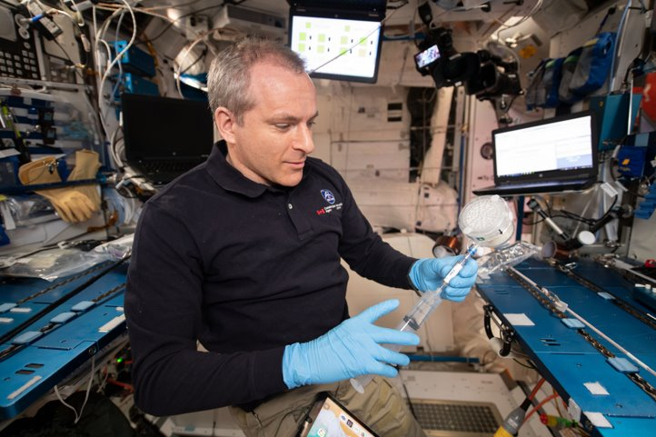
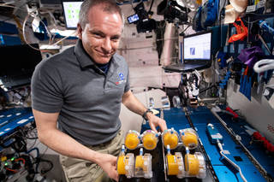
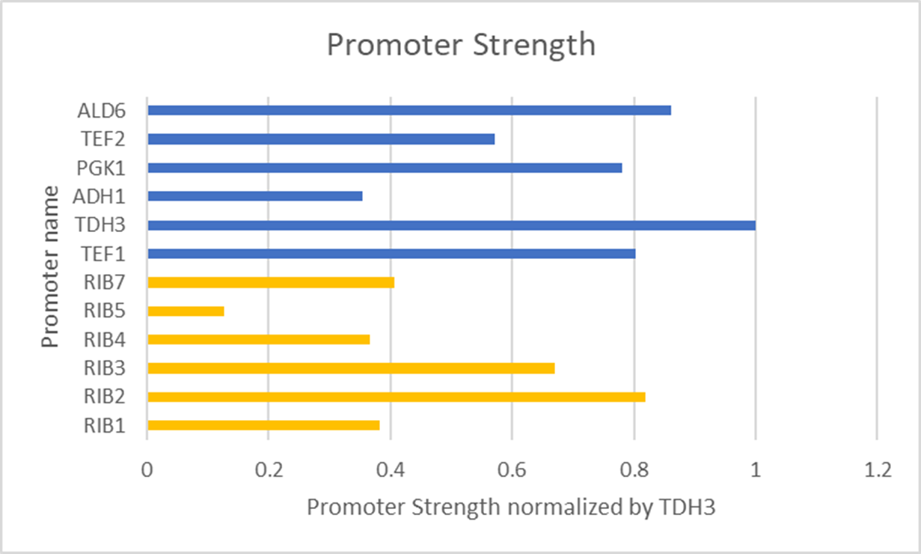
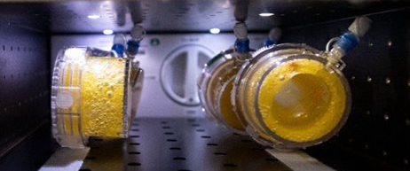




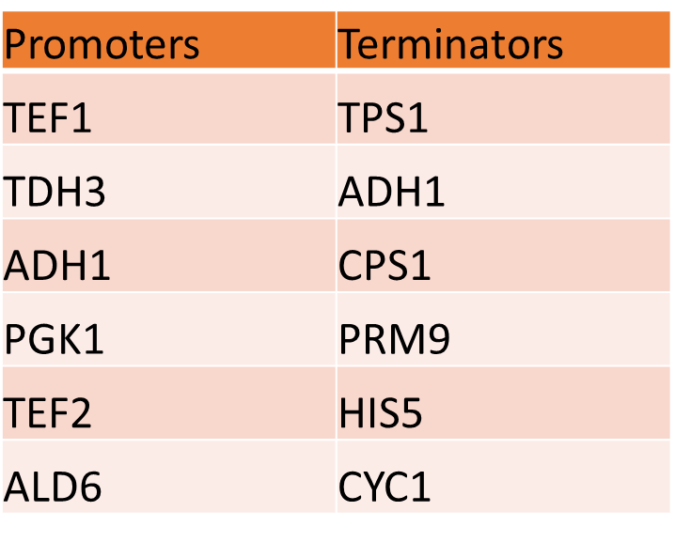

REPLACE THIS BOX WITH YOUR ORGANIZATION’S
HIGH RESOLUTION LOGO
Microbial Factories for Solar System Exploration
Amy Rees¹; John Hogan²
¹NASA Ames SLSTP; Clemson University ²NASA Ames Research Center
Abstract
As humans venture deeper into space for longer duration missions, resupply missions become far more difficult and costly. To address this, alternative methods of in situ biomanufacturing can be developed to provide a reliable source of required nutrients. BioNutrients is an ongoing project including three separate flight experiments that aims to provide on-demand nutrient production through 5-year shelf stable microbial factories for astronauts on long-duration missions. The BioNutrients-3 (BN-3) flight experiment aims to demonstrate on-orbit food safety, user-friendly production pack design, and multi-compound production capability. This current study seeks to support the multiple compound production element of BN-3 by investigating the production of multiple compounds via multiple pathways in one organism. An experiment has been designed to modify an existing strain of Saccharomyces boulardii designed by the BioNutrients team to efficiently produce β-carotene to also efficiently produce a second nutrient, riboflavin. This experiment entails the random shuffling and recombination of gene elements including promoters and terminators of various strengths to identify optimal combinations for the upregulation of the riboflavin production pathway. Implementation of this experiment would provide insight into the efficiency of the multiple pathways production method and pave the way for additional fine tuning of the riboflavin production pathway and additional nutrient production pathways in S. boulardii.
Figure 1. Astronaut performs hydration operations on ISS. (credit: NASA)
Figure 2. Astronaut with hydrated carotenoid production packs. (credit: NASA)
Figure 3. Close up of hydrated production packs with clear evidence of yeast metabolism (CO₂ bubbles) and carotenoid production (orange pigment). (credit: NASA)
Figure 5. Relative promoter strength of library promoters compared with promoters native to the riboflavin pathway
Major Goal for BN-3 Experiment
Production of Multiple Distinct Compounds per Pack
Possible Route: Multiple pathways in one organism
Conclusions and Future Implementation
Intro to BioNutrients (BN)
Going forward, this promoter and terminator library will hopefully be implemented at Ames Research Center to aid in the optimization of the riboflavin production pathway in Saccharomyces. Just this library consisting of six promoters, six terminators, and three genes will allow for over 46,000 different combinations to be screened for riboflavin production. This experiment will not only help us to determine which combination of promoters, genes, and terminators allows for the greatest upregulation of the riboflavin production pathway, but it will also provide insight into the functionality and efficiency of the multiple metabolic pathways method of multiple compound production for BioNutrients.
Astronauts need good nutrition during spaceflight
Vitamins and nutrients degrade during spaceflight
NASA moving toward long duration missions, less opportunity for resupply missions
Need new methods to manufacture vitamins and other compounds in orbit
Objective: Curate a library of promoters and terminators to identify combinations that will upregulate desired gene products without disrupting metabolism
BioNutrients aims to develop genetically engineered microbes capable of efficiently producing vitamins and other compounds in space
Methods and Materials
Riboflavin
Identify desired product
Identify host organism
Identify pathways and genes of interest
Identify promoters and terminators
Identify assembly methods
Acknowledgements
Saccharomyces boulardii
Thank you to John Hogan and the entire BioNutrients team. Special thanks to Mark Settles, Aditya Hindupur, Natalie Ball ,Michael Dougherty, and Frances Donovan for specific guidance. Additionally, thanks to NASA SLSTP 2021 management-Sigrid Reinsch, Hami Ray, and Desi Bridges; SLSTP 2021 staffers Ama Luthens and Simon Ng, and my fellow research associates. Thank you to KBR Wyle and Space Biology for their support of SLSTP.
Examples of strains and their products:
S. boulardii → Beta carotene
S. cerevisiae Y55 → Zeaxanthin
RIB1, RIB3, RIB7
Various strengths
Golden Gate Assembly
Results
BioNutrients Flight Experiments
Developed library of 6 promoters and 6 terminators, and 3 genes
Random shuffling of these elements allows for 46,656 different combinations with potential for successful pathway upregulation
SCAN HERE FOR MORE ON BIONUTRIENTS
5-year ongoing series of experiments aboard the ISS
Engineered microbes grown on edible media in user friendly production packs (Figure 1)
Astronauts hydrate production packs to trigger dried yeast cells to begin metabolizing (Figure 2)
Production packs returned to measure cell growth, product production, and to ensure food safety
Figure 4. Promoters and terminators curated for library
Additional Questions? Contact Me:
References
Amy Rees
Clemson University
arees@g.clemson.edu
Ball, N., Kagawa, H., Hindupur, A., Sims, K., Hogan, J., Levri, J. (2020). “BioNutrients-1: Development of an On-Demand Nutrient Production System for Long-Duration Missions.”
Ball, N., Kagawa, H., Hindupur, A., Hogan, J. (2017). “Development of Storage Methods for Saccharomyces Strains to be Utilized for In situ Nutrient Production in Long Duration Space Missions.”
NASA Ames Research Center, BioNutrients Project Images
Curran KA, Karim AS, Gupta A, Alper HS. Use of expression-enhancing terminators in Saccharomyces cerevisiae to increase mRNA half-life and improve gene expression control for metabolic engineering applications. Metab Eng. 2013;19:88-97. doi:10.1016/j.ymben.2013.07.001 .
Wei, Linna, et al. “Characterization of Terminators in Saccharomyces Cerevisiae and an Exploration of Factors Affecting Their Strength.” ChemBioChem, vol. 18, no. 24, 2017, pp. 2422–27. Wiley Online Library, https://doi.org/10.1002/cbic.201700516.
QPromoters: Sequence based prediction of promoter strength in Saccharomyces cerevisiae Devang Haresh Liya, Mirudula Elanchezhian, Mukulika Pahari, Nithishwer Mouroug Anand, Shivani Suresh, Nivedha Balaji, Ashwin Kumar Jainarayanan bioRxiv 2021.04.27.441621; doi: https://doi.org/10.1101/2021.04.27.441621
NEB Golden Gate. https://goldengate.neb.com/#!/. Accessed 9 Aug. 2021.

