Slide 1
ASSATEAGUE ISLAND Ecological Forecasting
Characterizing Nearshore Suspended Sediments and Landcover Change Relative to Sediment Bypassing and Catastrophic Events
M. Colin Marvin, Porter Abbey, Jay Mrazek,
Erin Weitzel, & Remi Work
Idaho – Pocatello
Notes:
Hello everyone, we are the Assateague Island Ecological Forecasting team, and our project focused on Characterizing Nearshore Suspended Sediments and Landcover Change Relative to Sediment Bypassing and Catastrophic Events. My name is [PLACEHOLDER], and my teammates were [PLACEHOLDER].

Slide 2
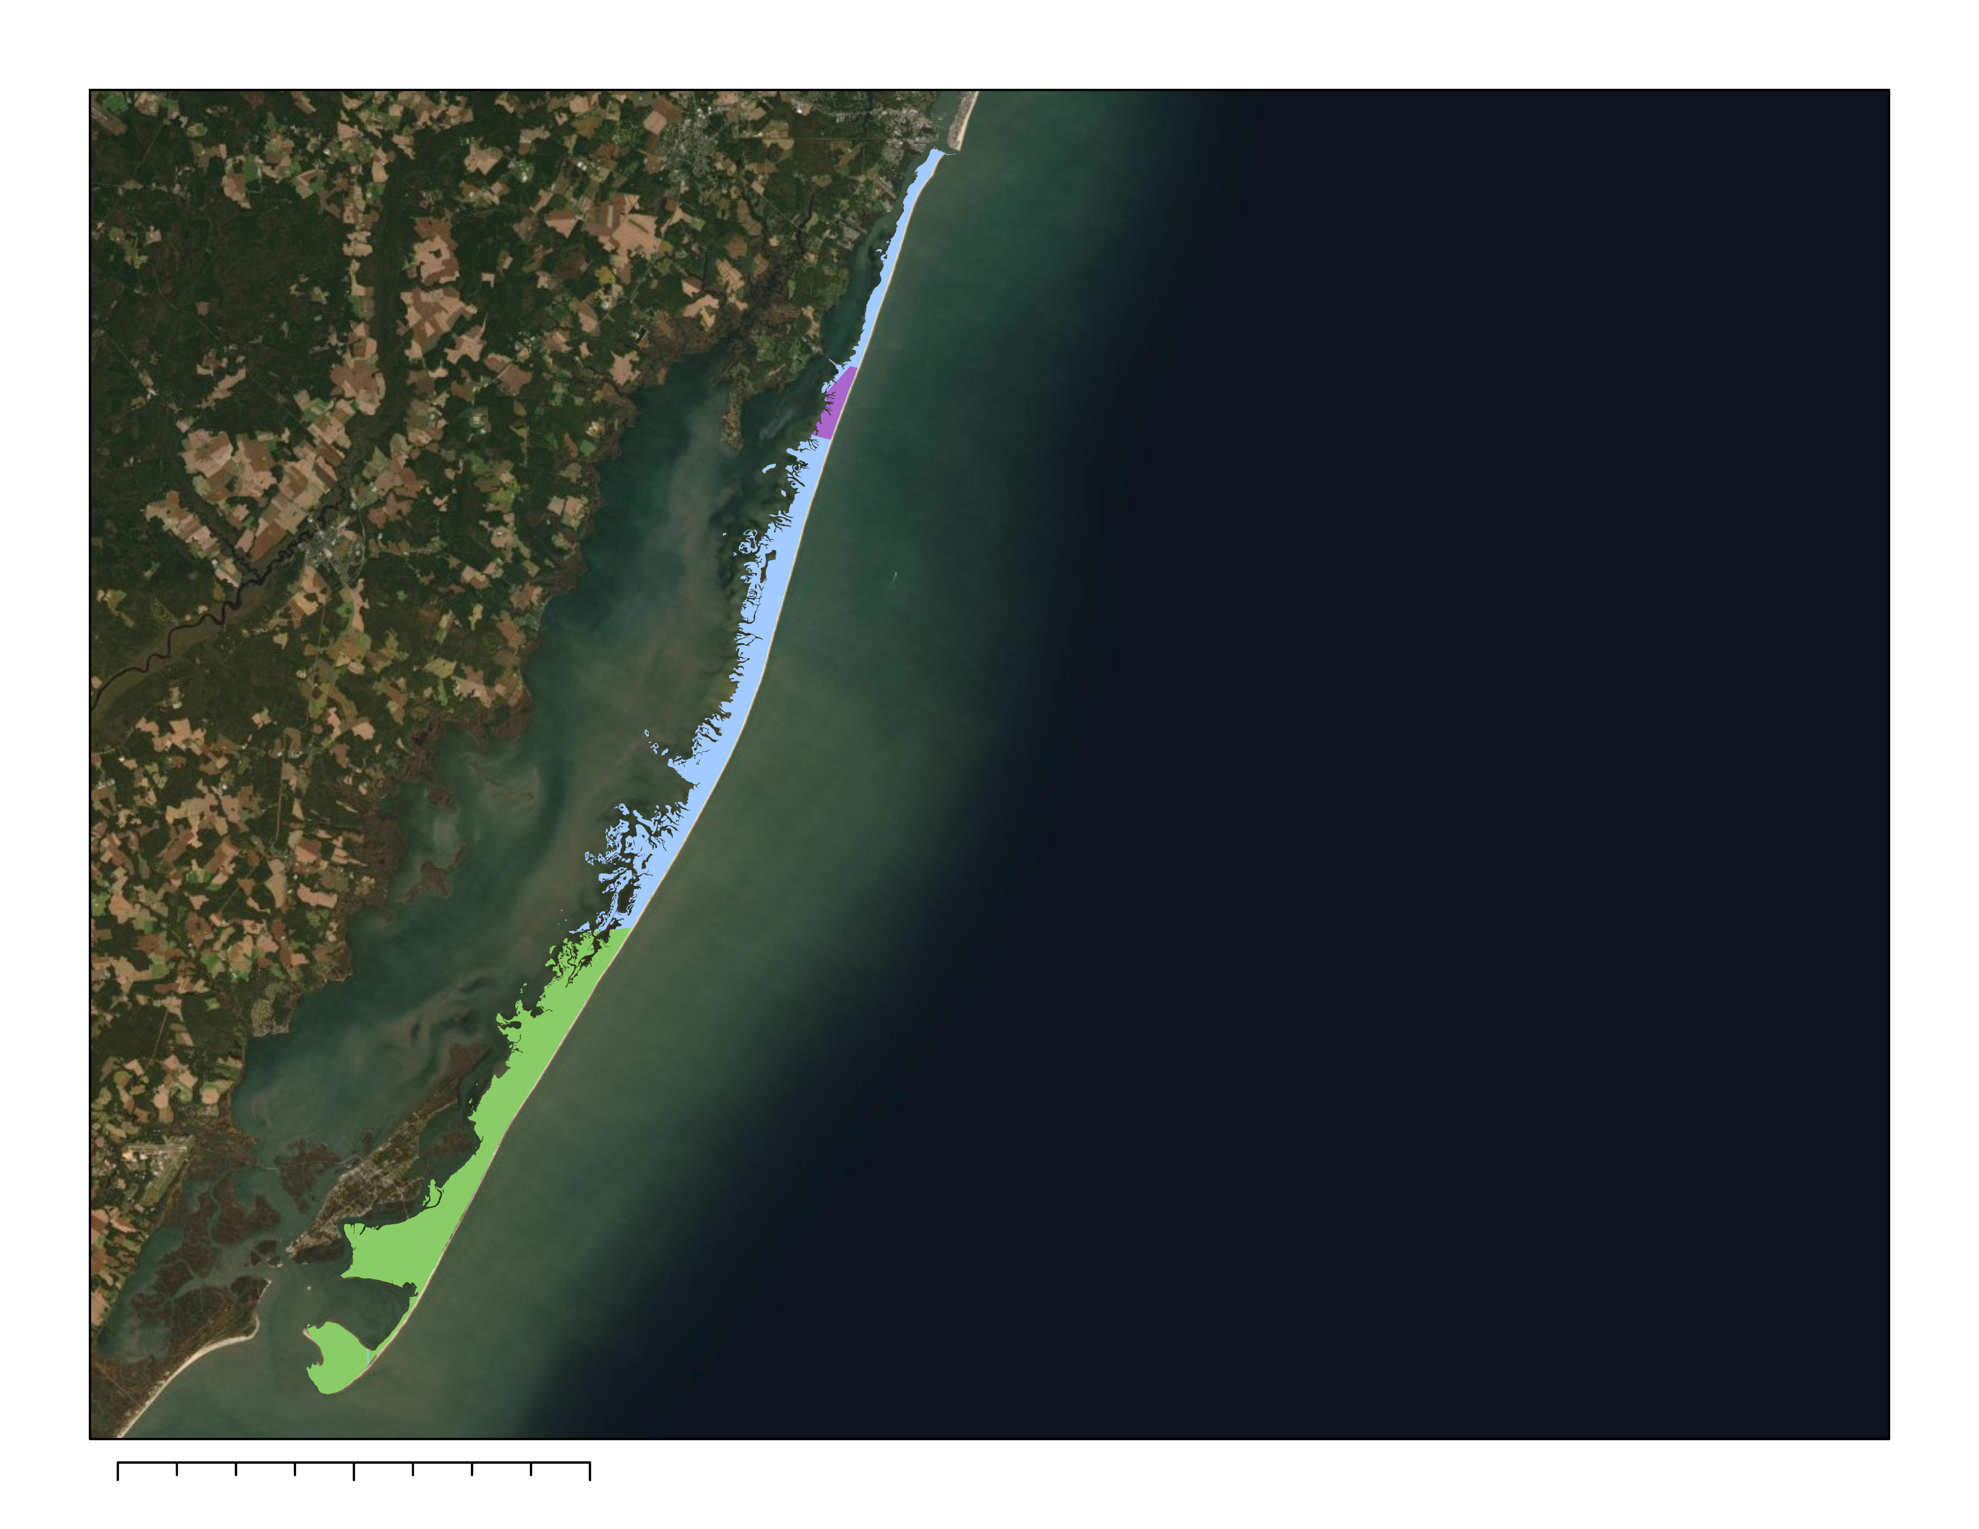
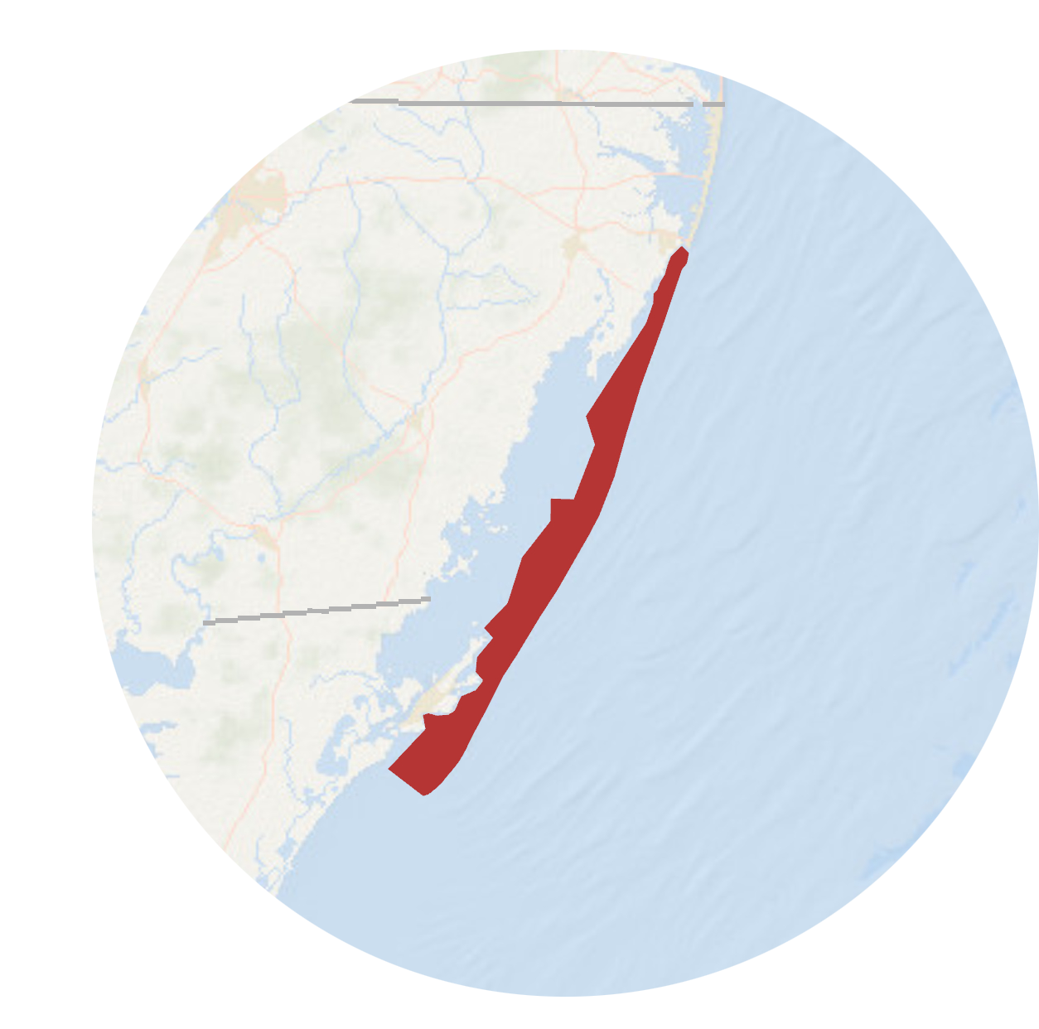

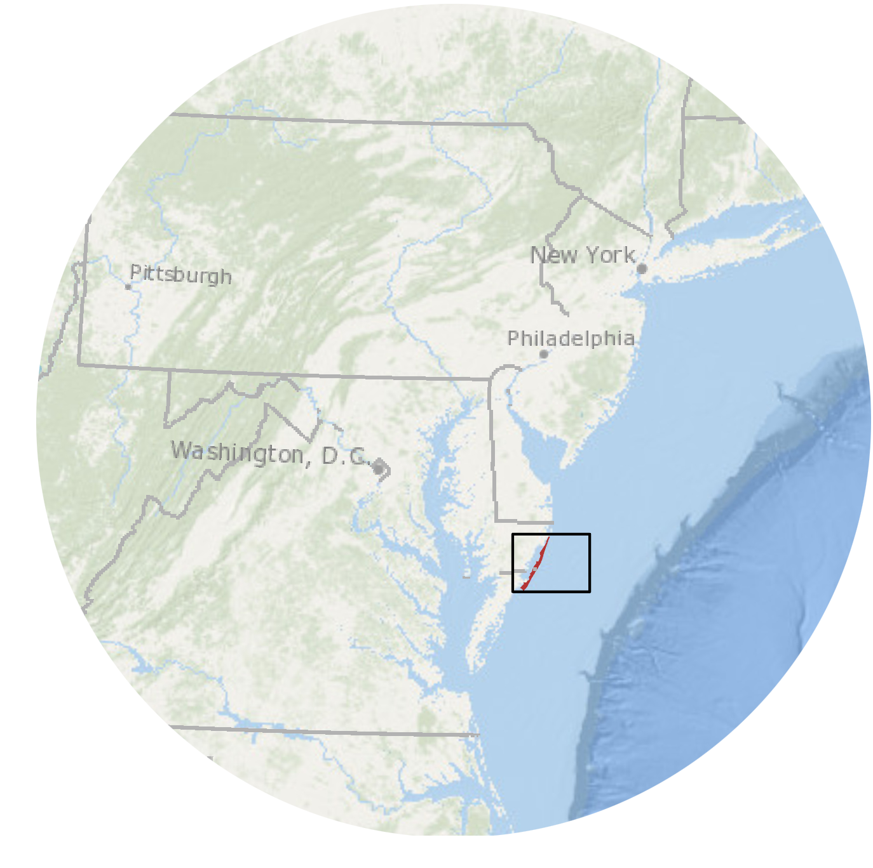

STUDY SITE
Assateague Island Jurisdictional Boundaries
Assateague Island
Assateague State Park​
Assateague Island
National Seashore​​
Chincoteague
National Wildlife Refuge​​
0 5 10 20 Kilometers
Notes:
Assateague Island is a barrier island situated off the coast of Maryland and Virginia, east of which is the Atlantic Ocean. Assateague is 60km long, and here you can see its position. Assateague Island National Seashore, shortened to ASIS, is managed by the National Park Service, and it contains most of the northern Maryland portion of the island, depicted here in blue. About 3 km of the Maryland portion, though, belongs to the Assateague Island State Park, which is shown in purple. Meanwhile, a majority of the Virginia side is the Chincoteague Wildlife Refuge, which is under the US Fish and Wildlife Service's jurisdiction, indicated in green. The island's legal boundary is depicted in red to the right in the upper inset map.
------------------------------ Basemap Information Below ------------------------------
1. Satellite imagery from Earthstar Geographics, 2021
2. Esri ocean basemap from the National Oceanic and Atmospheric Administration's Office of Coast Survey, 2021

Slide 3
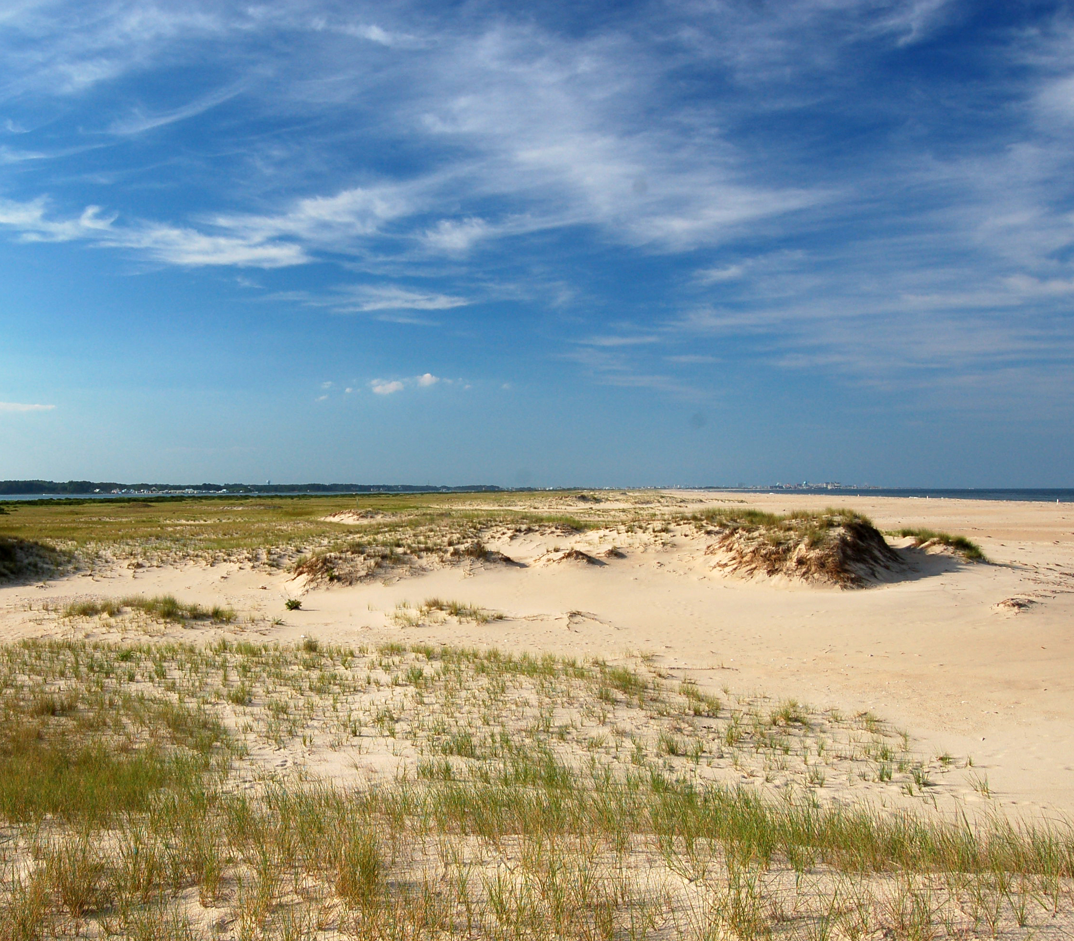
GEOMORPHOLOGY
Dynamic morphology driven by natural processes
Sediment supply
Wind
Storms and overwash
Image Credit: Alexandra Fries, 2011
Notes:
As a barrier island, Assateague's surficial morphology is incredibly dynamic, being driven by the effects of sediment supply, aeolian processes, storms, and sea level rise. It is constantly reshaped by these natural processes, and especially experiences drastic changes like overwash events from hurricanes and northeasters. These bring sediment inland and help facilitate the migration of the island's shoreline. For example, the photo here shows the consequences of overwash on an Assateague beach, where a storm brought sand onto previously vegetated dunes.
------------------------------ Image Information Below ------------------------------
https://ian.umces.edu/media-library/dune-overwash-1/ (creative commons CC BY-SA 4.0) Taken in 2011 by Alexandra Fries for the University of Maryland's Integration and Application Network.

Slide 4
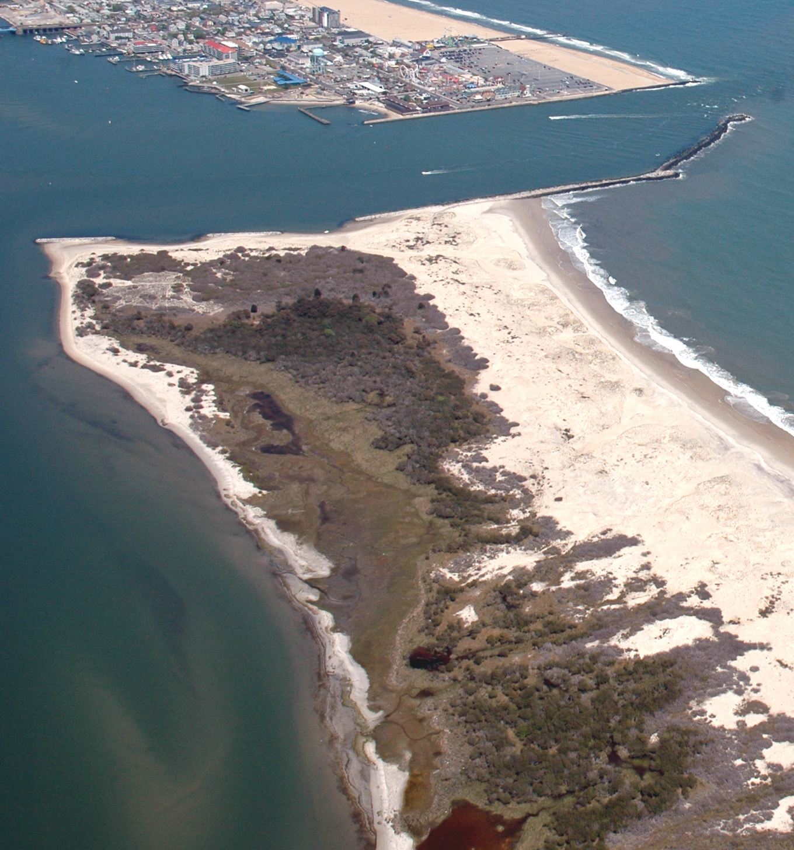
ISLAND HISTORY
1933: Ocean City inlet formation
1935: Jetty system construction
1965: Assateague Island National Seashore designation
2002: North End Restoration Project implementation, short-term beach nourishment begins
2004: Long-term operations begin
Image Credit: Jane Thomas, 2006
Notes:
In 1933, a massive hurricane swept across New England, and it breached the preexisting barrier island and formed the Ocean City inlet. This created Assateague to the south and Fenwick Island to the north. To stabilize the land, the United States Army Corps of Engineers (USACE) constructed the Ocean City inlet jetty system in 1935. Ocean City inlet and the related jetty system can be seen in the upper part of this image. Assateague Island, meanwhile, is shown just southwards. However, this jetty system disrupted the natural longshore sediment transport to Assateague Island, which trends southward from Fenwick to Assateague. Across 65 years, this sediment starvation led to the accelerated erosion of Assateague's shoreline. Then in 1965, Congress designated a portion of Assateague Island as a National Seashore. In 2002 USACE began the North End Restoration project. The operations are intended to mitigate the negative effects of the Ocean City inlet jetty system and protect Assateague’s geologic integrity by restoring the north end of the island’s natural sediment supply to pre-inlet conditions.
The sediment bypassing operations at ASIS consist of two parts, short and long term. In 2002, a short-term beach nourishment effort was performed, which deposited 1.4 million cubic meters of sediment to account for the 65 years of sediment loss. And in 2004, long-term sediment bypassing operations commenced with semi-annual dredging of sediment from the inlet's ebb tidal delta and shoal area and subsequently, deposition on the nearshore of Assateague's north end.
------------------------------ Image Information Below ------------------------------
https://ian.umces.edu/media-library/ocean-city-inlet/ (creative commons CC BY-SA 4.0) Taken by Jane Thomas in 2006, University of Maryland Application and Integration Network.

Slide 5
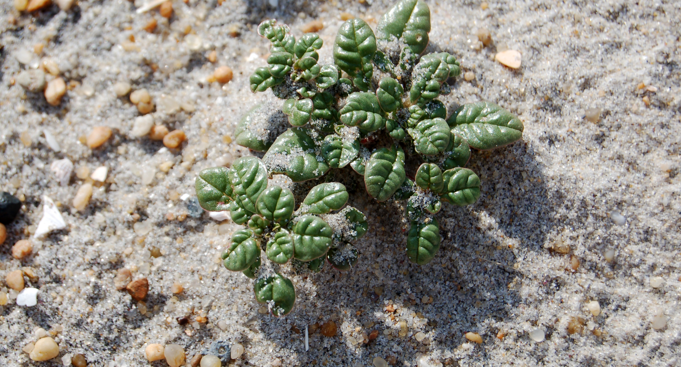
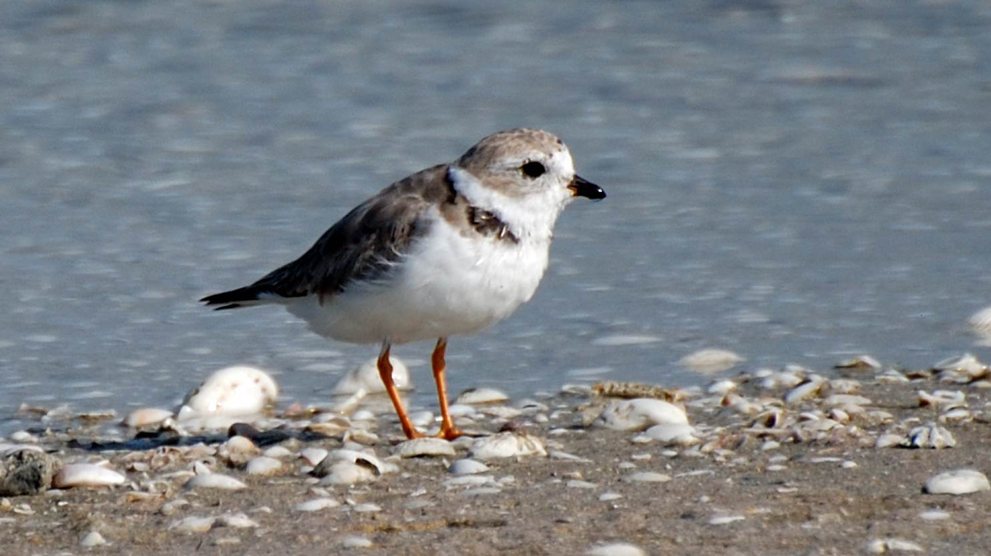
CONCERNS
Unclear effects of recent reductions in sediment deposition
Sustain Assateague's geologic integrity
Habitat protection for sensitive species
Piping plover
Seabeach amaranth
Image Credit: Alexandra Fries, 2011
Image Credit: Kevin T. Edwards, 2008
Notes:
Protecting Assateague's geologic integrity and sensitive habitats by promoting natural processes is extremely important. The island serves as a buffer to protect the mainland. ASIS also provides a home for rare, threatened, and endangered species. However, the ASIS is vulnerable to unnatural breaches and accelerated erosion of the shoreline due to the construction of the Ocean City inlet jetty system. Due to funding shortfalls, though, the amount of sand deposited has decreased. This has led the park to question if the sediment bypassing operations are continuing to have their intended benefits, which include replenishing Assateague's sediment supply and mitigating the island's shoreline erosion and unnatural migration. ASIS is concerned with the unclear effects of the reduction in semi-annual sediment depositions and with the protection of the island's geologic integrity, natural processes, and habitats that house threatened and endangered species.
Assateague Island’s unique geological features and dynamic process make it an ideal habitat for many rare or protected species of flora and fauna. Many species, like migrating shorebirds, rely on naturally disturbed areas for nesting and feeding. A particular species of concern for the park is the status of the migratory piping plover, which has been classified as endangered under the Endangered Species Act since 1986. The piping plover, shown on the right, prefers minimally vegetated dunes, such as those affected by storm overwash, to forage and nest. The seabeach amaranth prefers similar habitats and is pictured to the left.
------------------------------ Image Information Below ------------------------------
https://ian.umces.edu/media-library/amaranthus-pumilus-seabeach-amaranth-2/ (creative commons CC BY-SA 4.0) Taken by Alexandra Fries, 2011, University of Maryland Integration and Application Network.
https://ian.umces.edu/media-library/piping-plover/ (creative commons CC BY-SA 4.0) Taken by Kevin T Edwards for Kevin's Nature Photos, 2008.

Slide 6
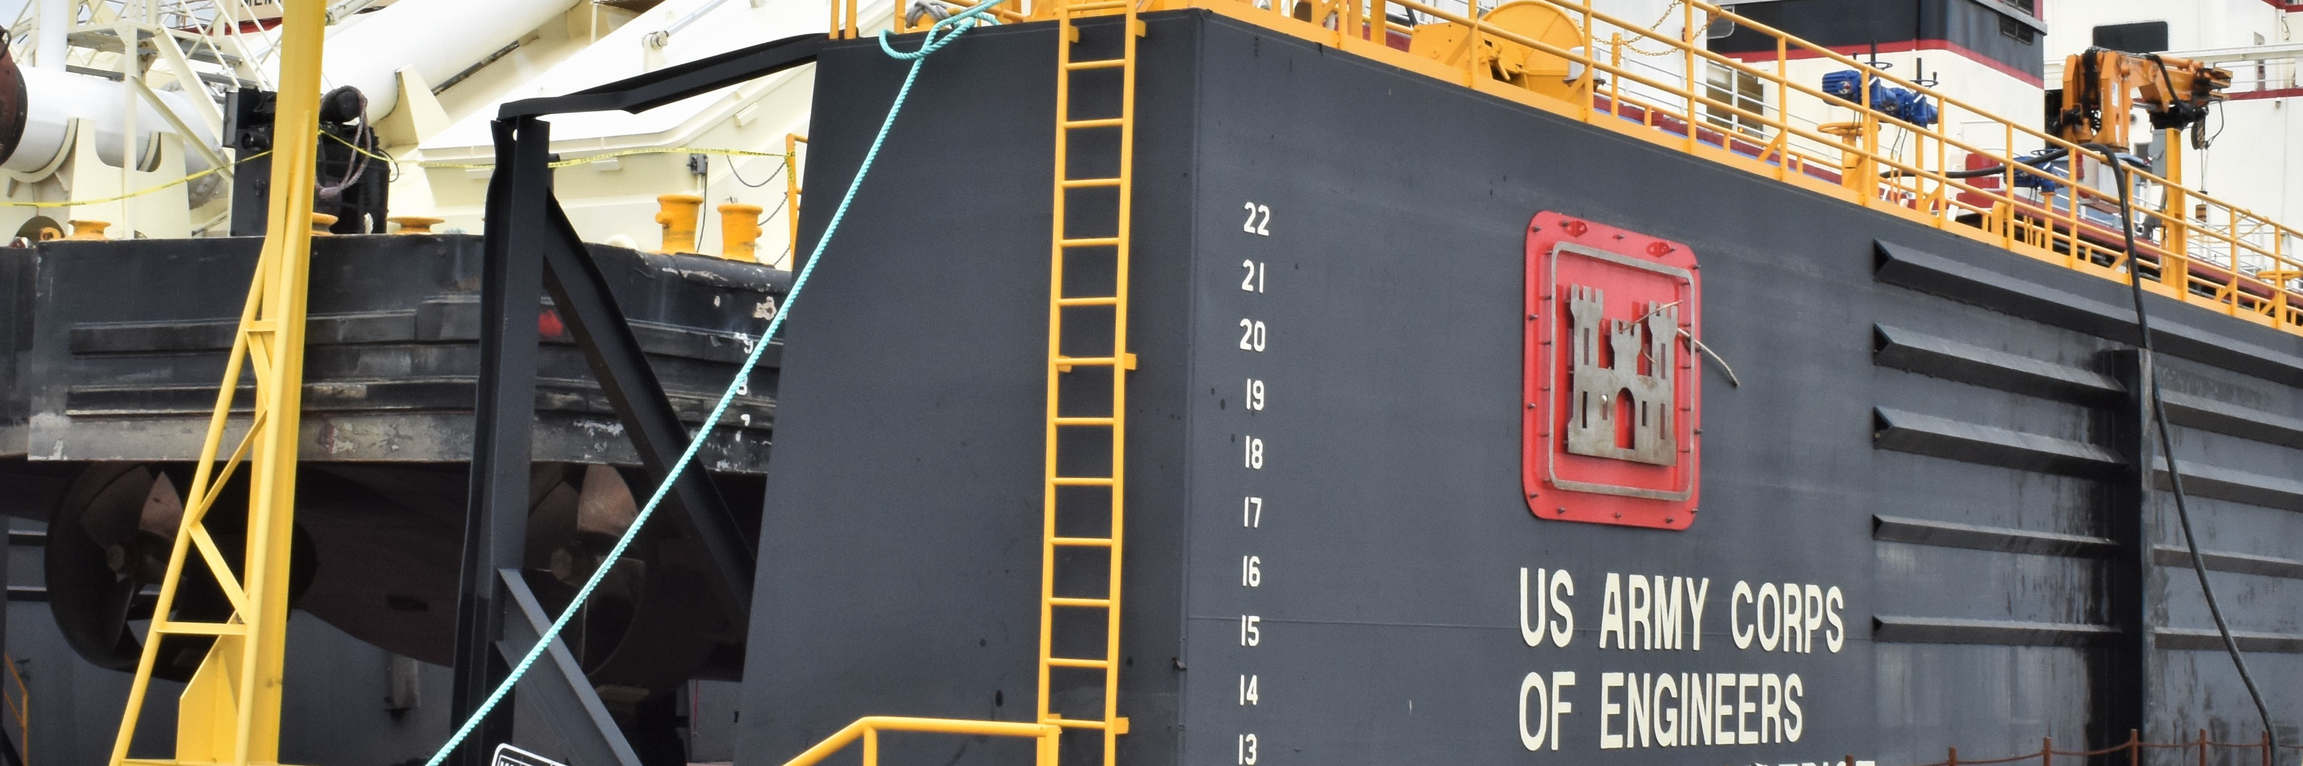


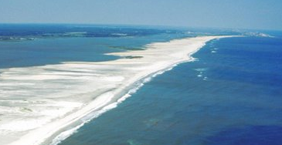
PARTNERS
United States Army Corps of Engineers
Image Credit: Jessica Haas, 2021
Assateague Island National Seashore
Ocean and Coastal Resources Branch
Natural Resource Stewardship and Science Directorate
Image Credit: Susanne Bledsoe, 1998
Notes:
The United States Army Corps of Engineers is a federal agency dedicated to providing engineering solutions for security, economy, and disaster risks. The National Park Service (NPS) is a federal agency dedicated to preserving the natural resources of National Parks; as such, they utilize natural or nature-based management strategies. Both the NPS staff at the Assateague Island National Seashore and the USACE are our main end users, and they are involved with the North End Restoration Project. Additionally, our collaborators included the Ocean and Coastal Resources Branch and the Natural Resource Stewardship and Science Directorate of the NPS.
------------------------------ Image Information Below ------------------------------
1. https://www.usace.army.mil/Media/Images/igphoto/2002627278/ (public domain). Taken by Jessica Haas of the United States Army Corps of Engineers in 2021, this photo shows an engineering yard and dredge.
2. https://www.usgs.gov/media/images/aerial-view-assateague-island (public domain) This image is an aerial view of the upper end of Assateague Island, looking north, taken in 1998 by Susanne Bledsoe of the US Army Corps of Engineers. Ocean City is visible in the upper right, to the east of the island is the Atlantic Ocean, and to the west of the island is the Delmarva Peninsula.

Slide 7


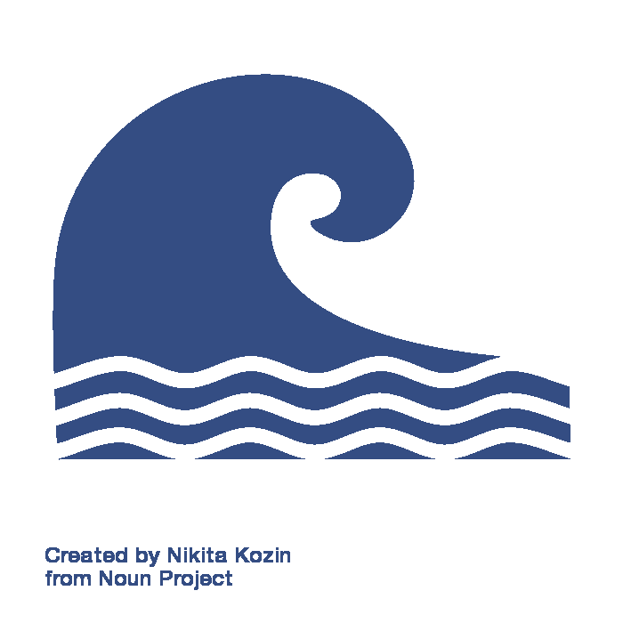

OBJECTIVES
ANALYZE
From 2004-2020
FORECAST
To 2031 and 2046
Sediment
Transport
Land Cover
Change
Land Cover
Change
Icon Credit: The Noun Project and Microsoft PowerPoint
Notes:
We had two main objectives for our research: historical time series analysis (denoted by the satellite icon) and forecasting (depicted in purple with a calendar icon). Historical analysis was split into two sections: sediment transport (shown in blue) and land cover change (in green). For sediment transport, we wanted to analyze how the sediment bypassing operations were influencing the longshore sediment transport of Assateague island. Meanwhile for land cover, we were interested in how the island's habitats were changing in response to the sediment bypassing operations. We analyzed changes in sediment transport by utilizing NASA Earth observations and to track nearshore turbidity and ocean color. We also used NASA EOs to analyze land cover. Both of these historical analyses covered the period of 2004 through 2020. Additionally, (indicated in purple) we forecast land cover on Assateague to the years 2031 and 2046 to assist in future habitat analysis for the sensitive species inhabiting ASIS.
These two objectives, historical analysis and forecasting, were both meant to help our partners better understand the impacts of sediment bypassing on ASIS and make informed management decisions regarding habitat protection on Assateague Island.
------------------------------ Icon Information Below ------------------------------
1. Satellite icon: PowerPoint (Microsoft Office 365 2021) [Satellite]
2. Wave icon: https://thenounproject.com/term/wave/981734/ (creative commons CC BY 3.0). Wave by Nikita Kozin from the Noun Project.
3. Plant icon: PowerPoint (Microsoft Office 365 2021) [Plant]
4. Calendar icon: PowerPoint (Microsoft Office 365 2021) [Calendar]
5. Pencil icon: PowerPoint (Microsoft Office 365 2021) [Pencil]

Slide 8
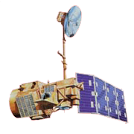
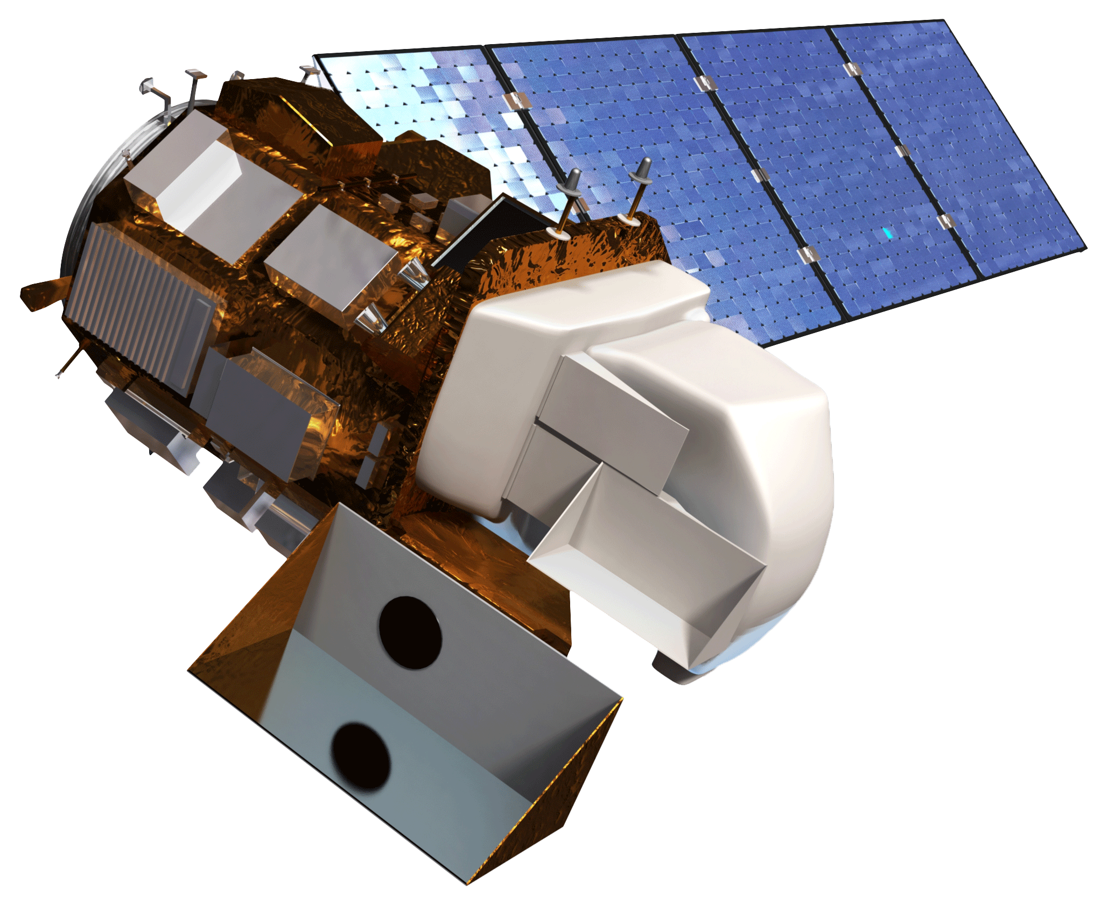
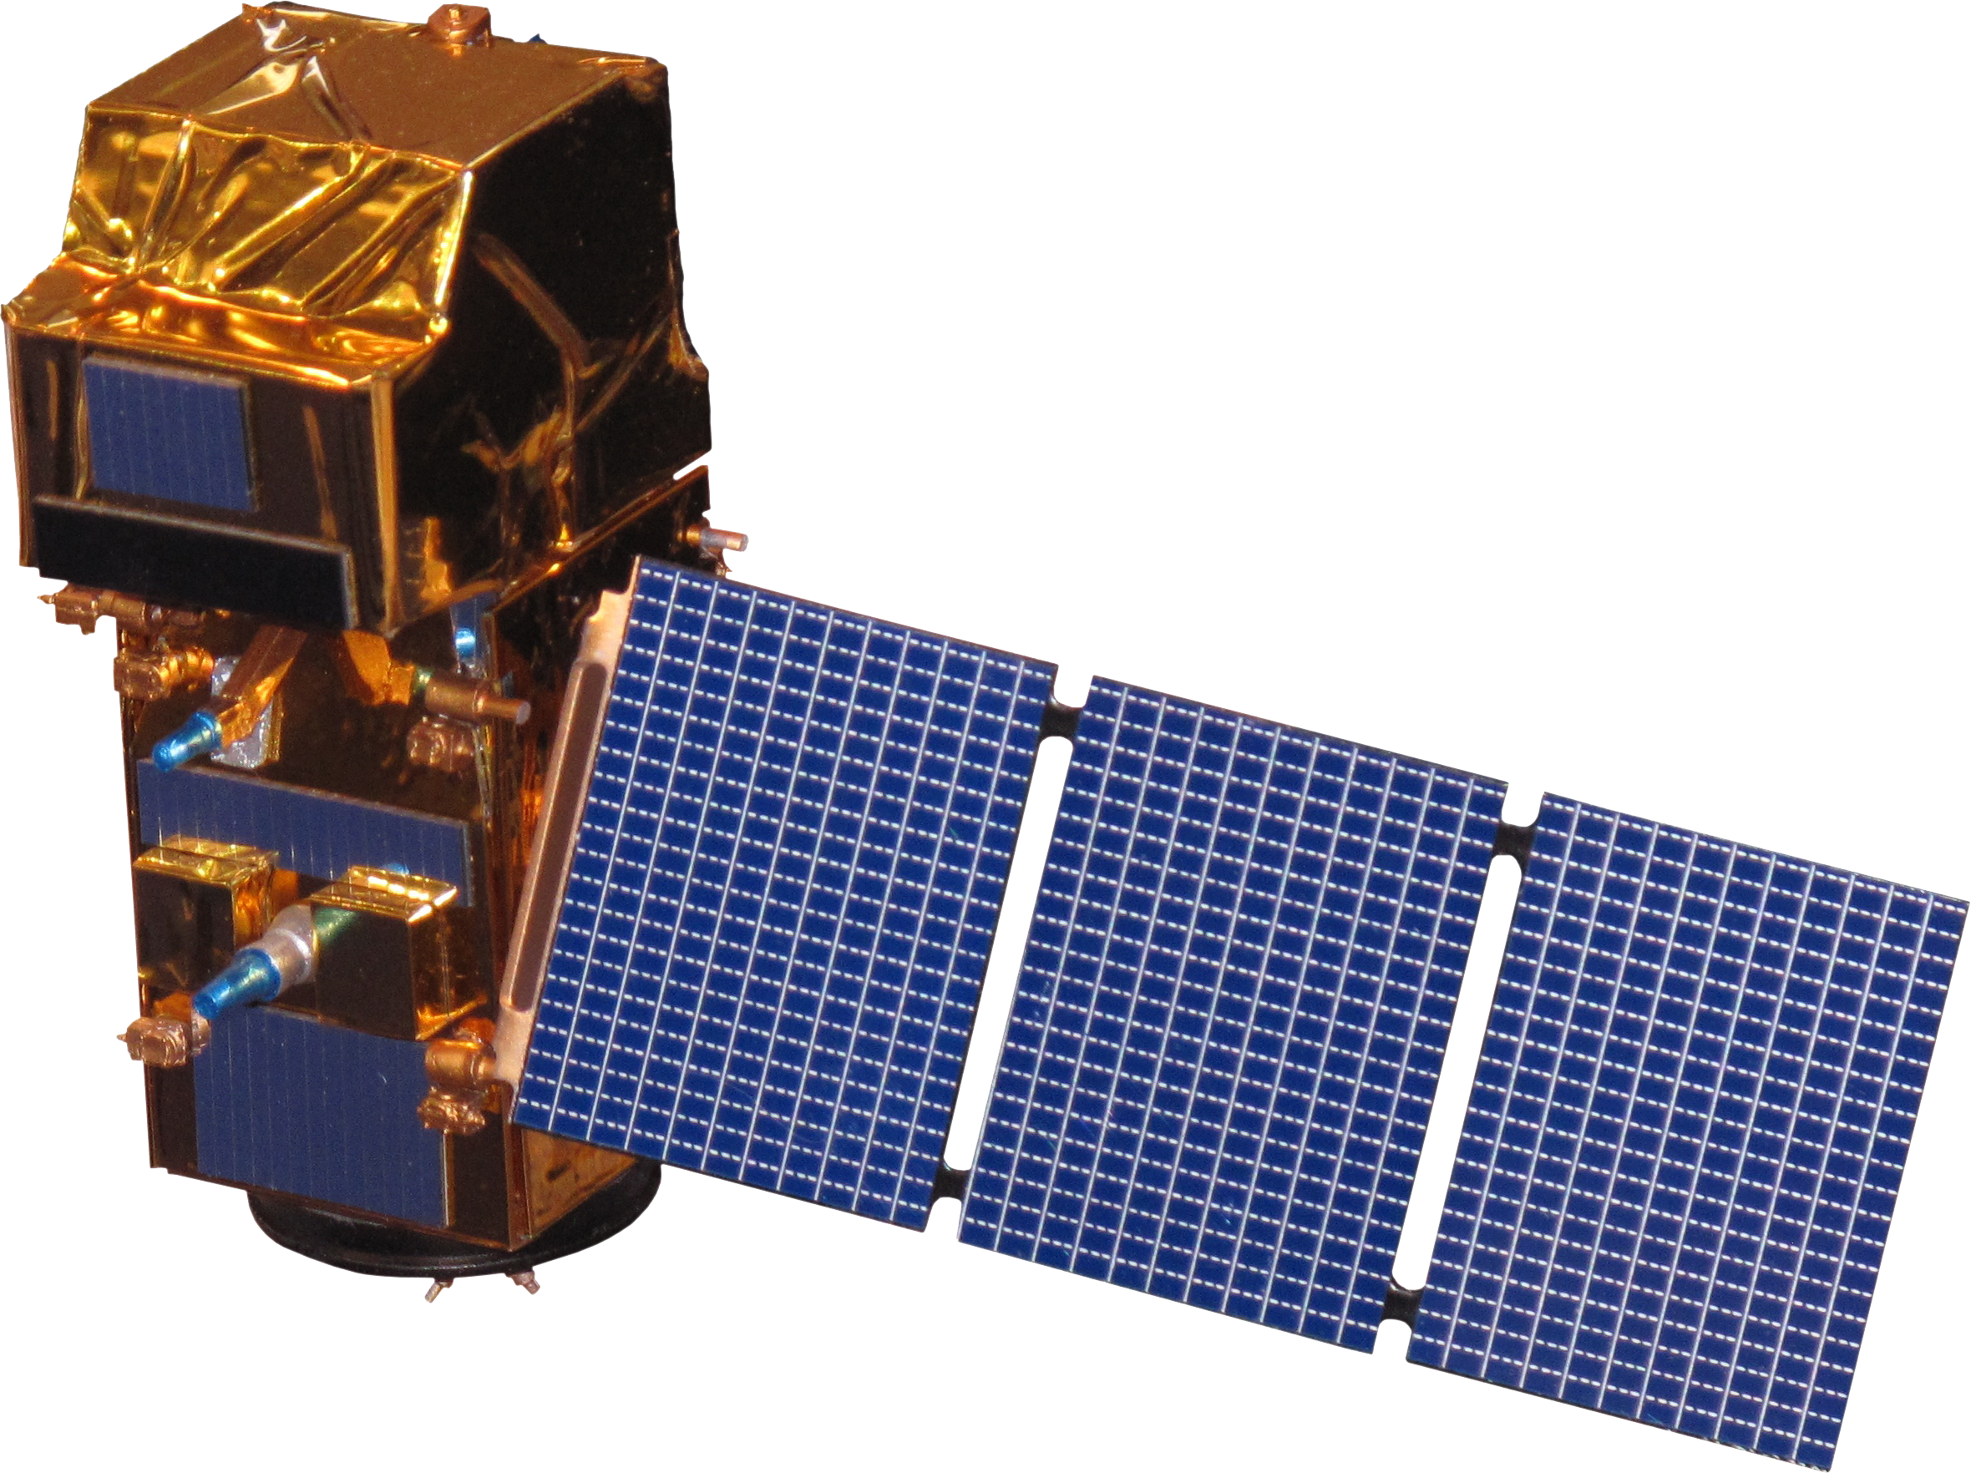
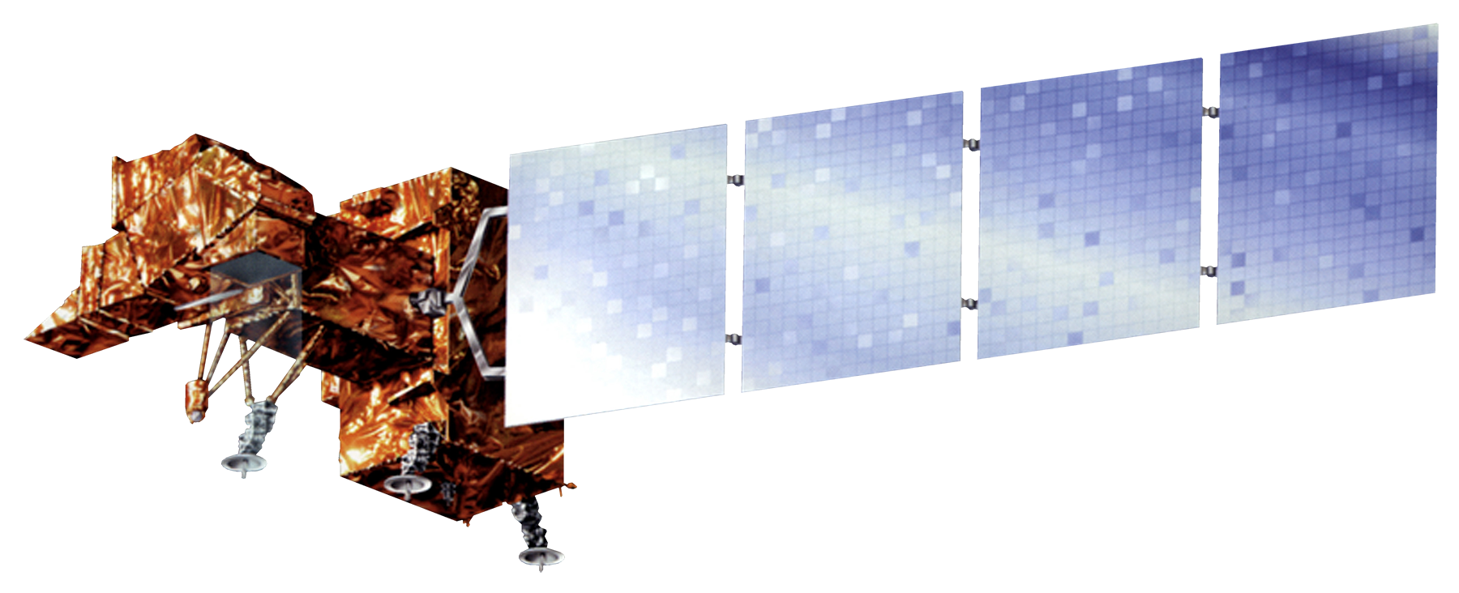
EARTH OBSERVATIONS
Satellite
Name | Landsat 5 | Landsat 7 | Landsat 8 | Sentinel-2
Sensor | Thematic Mapper (TM) | Enhanced Thematic Mapper Plus (ETM+) | Operational Land Imager (OLI) | Multi-Spectral Instrument (MSI)
Use | Remote sensing of land cover, ocean color, and turbidity
Image Credits: NASA, ESA
Notes:
To accomplish our first objective of analyzing historical sediment transport and land cover, we used data from Landsat 5 TM (Thematic Mapper), Landsat 7 ETM+, Landsat 8 OLI, and Sentinel-2 MSI (Table 1). We acquired these data through Google Earth Engine (GEE) scripts like ORCAA.
------------------------------ Image Information Below ------------------------------
Landsat Images Credit: National Aeronautics and Space Administration, accessed July 2021. https://eospso.nasa.gov/content/nasas-earth-observing-system-project-science-office (public domain)
Sentinel Image Credit: European Space Agency, accessed July 2021. https://www.esa.int/Applications/Observing_the_Earth/Copernicus/Sentinel-2/Downloads

Slide 9

METHODOLOGY
Google Earth Engine
IDRISI TerrSet
Historical
Sediment Transport
Historical Land Cover Change
Land Cover Forecasting
Time series maps of turbidity and ocean color
Time series maps of land cover classification
Models of land cover for 2031 and 2046
Icon Credit: The Noun Project and Microsoft PowerPoint
Notes:
Google Earth Engine (shown in light brown at the top) is where we accessed all the Earth observations data needed to complete both the sediment transport and landcover classification parts of our project. GEE is a cloud-based catalog of satellite data that allows us to find, clean, and export layers. For our sediment transport maps, shown in blue, we used rasters of ocean color and turbidity and compiled data over the period 2004-2020. For the historical land cover classification work, shown in green: we collected imagery, normalized difference vegetation and water indices, and obtained elevation layers. These were first used as inputs for our random forest supervised land cover classification, then plugged into IDRISI TerrSet (shown in grey), specifically for land change modelling work, which is indicated in purple, to create forecasts 10 and 25 years into the future. The pencil icons denote a final product, which includes our time series maps and land cover models. We provided a series of historical change maps for sediment transport and land cover, plus models of land cover forecast 10 and 25 years into the future. These results allowed ASIS and USACE to review the efficiency of sediment bypassing operations and their impacts on Assateague's geology and ecology. With our help, USACE was able to make better-informed decisions for future sediment bypassing operations, and ASIS was able to develop better park management strategies to protect threatened and endangered wildlife species.
------------------------------ Icon Information Below ------------------------------
1. Wave icon: https://thenounproject.com/term/wave/981734/ (creative commons CC BY 3.0). Wave by Nikita Kozin from the Noun Project.
2. Plant icon: PowerPoint (Microsoft Office 365 2021) [Plant]
3. Calendar icon: PowerPoint (Microsoft Office 365 2021) [Calendar]
4. Pencil icon: PowerPoint (Microsoft Office 365 2021) [Pencil]

Slide 10




METHODS: Sediment Transport
ORCAA
Adjust code to project needs
Process within GEE
Seasonal Outputs
ORCAA script
Additional code
Processing with GEE
Seasonal outputs
Icon Credit: The Noun Project and Microsoft PowerPoint
Notes:
All sediment transport-related data was accessed on GEE. Pre-2016 layers were strictly Landsat 7 ETM+ imagery due to temporal restrictions while post-2016 layers were both Sentinel-2 and Landsat 8.
------------------------------ Icon Information Below ------------------------------
1. Wave icon: https://thenounproject.com/term/wave/981734/ (creative commons CC BY 3.0). Wave by Nikita Kozin from the Noun Project.
2. Desktop icon: PowerPoint (Microsoft Office 365 2021) [Desktop]
3. Keyboard icon: PowerPoint (Microsoft Office 365 2021) [Keyboard]
4. Gears icon: PowerPoint (Microsoft Office 365 2021) [Gears]
5. Lightbulb icon: PowerPoint (Microsoft Office 365 2021) [Lightbulb]
6. Satellite icon: PowerPoint (Microsoft Office 365 2021) [Satellite]

Slide 11
METHODS: Sediment Transport
Ocean color rasters
Ocean color time series maps
ORCAA
Sediment bypassing case study
Turbidity rasters
Turbidity time series maps
Icon Credit: The Noun Project and Microsoft PowerPoint
Notes:
A previously developed GUI in GEE called ORCAA allowed us to easily access data to create ocean color and turbidity layers for creating time series maps. Both ocean color and turbidity were accessed on a bi-annual basis from 2004 to 2020.
------------------------------ Icon Information Below ------------------------------
1. Wave icon: https://thenounproject.com/term/wave/981734/ (creative commons CC BY 3.0). Wave by Nikita Kozin from the Noun Project.
2. Satellite icon: PowerPoint (Microsoft Office 365 2021) [Satellite]

Slide 12
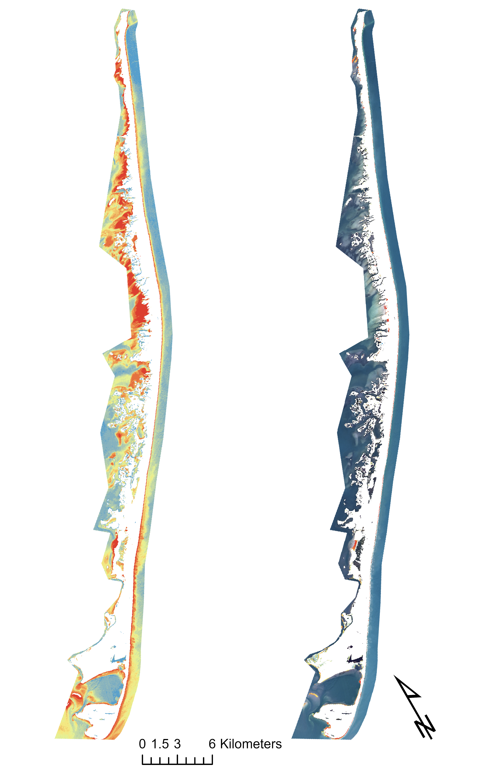

Turbidity:
RESULTS: Long-term Sediment Transport
0-10%
11-20%
21-30%
North vs South, East vs West
More recent plumes visible
Strong seasonality
Island growth in south
31-40%
41-50%
51-60%
61-70%
Turbidity
Ocean Color
71-80%
81-90%
0
3
6
km
91-100%
Icon Credit: The Noun Project and Microsoft PowerPoint
Notes:
We saw trends in turbidity on all sides of the island that also varied with season. Overall, there was generally higher turbidity on the W side of the island (bayside). In the summer months, we generally see higher turbidity on the ocean-facing N and S sides, but not in the middle. In the winter we see higher levels of turbidity in the middle of the island due to powerful winter storms. Plumes of sediment are most visible on the bay side and in newer imagery. We know longshore sediment transport is occurring due to the growth on the southern part of the island.
------------------------------ Icon Information Below ------------------------------
1. Wave icon: https://thenounproject.com/term/wave/981734/ (creative commons CC BY 3.0). Wave by Nikita Kozin from the Noun Project.

Slide 13
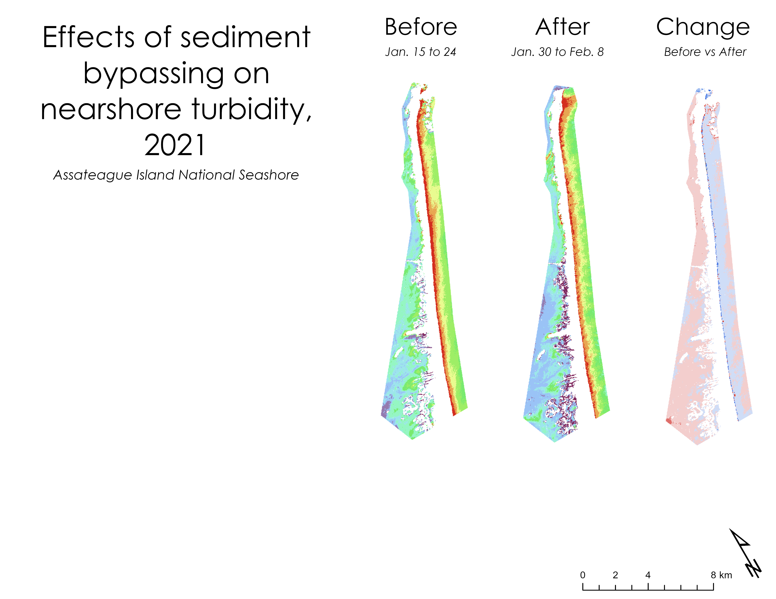

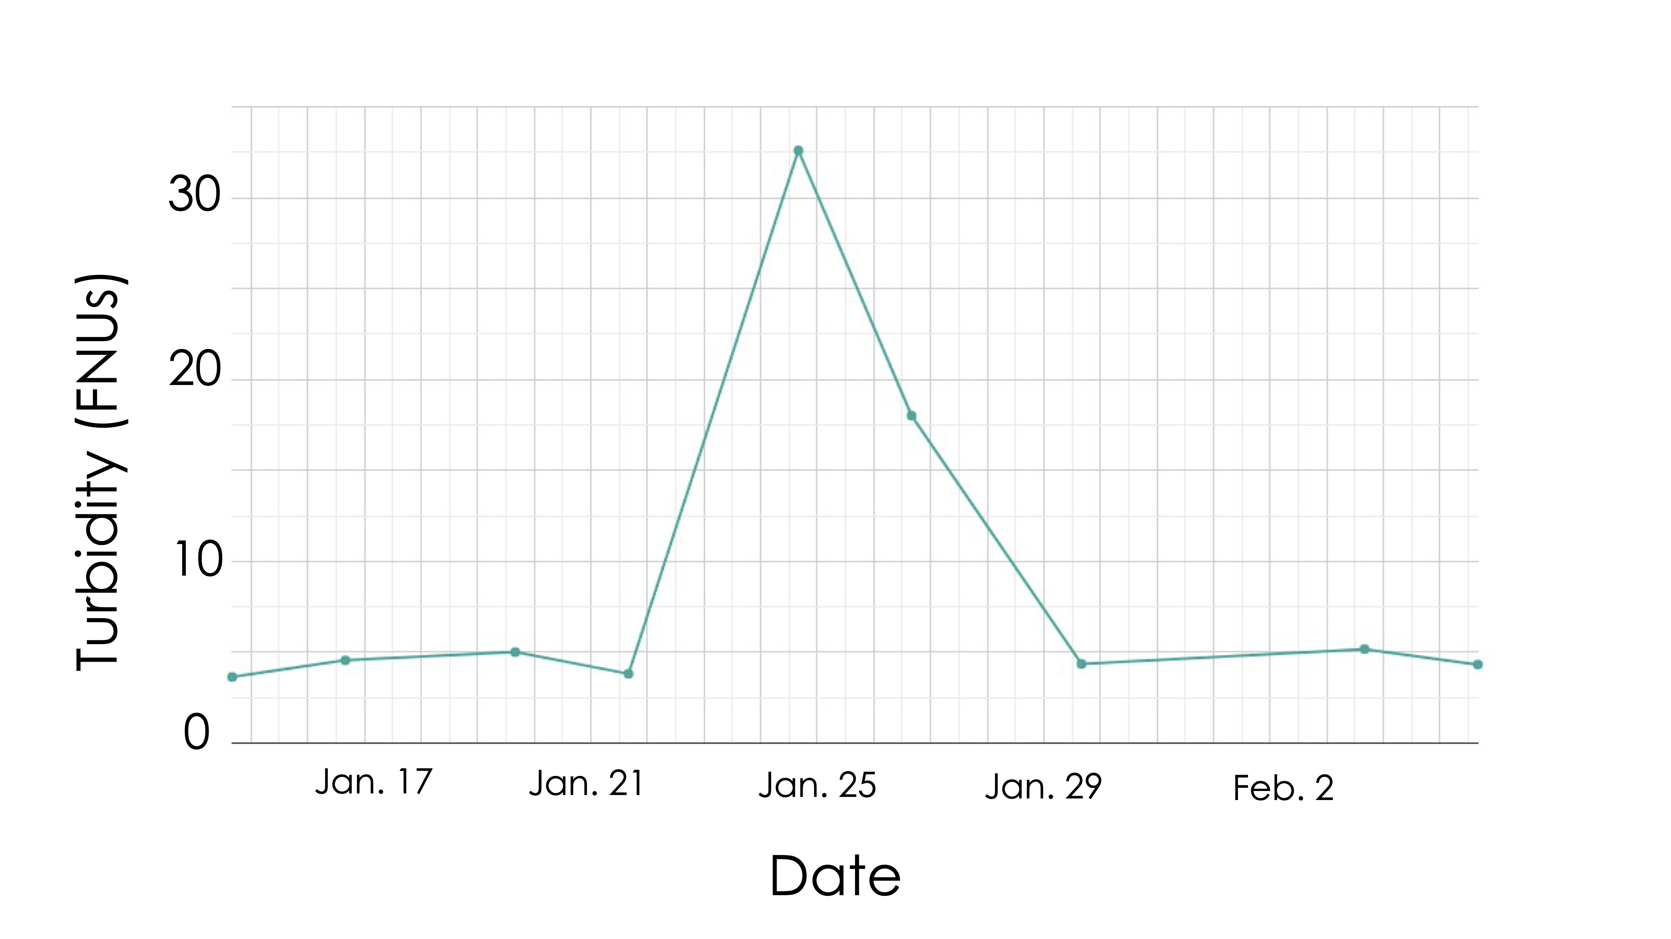

RESULTS: Sediment Bypassing Case Study
Before
After
Change
Turbidity (FNUs):
Change in FNUs:
30
0-10%
< -4
11-20%
-4 to -2
21-30%
-2 to 0
Turbidity (FNUs)
31-40%
0 to 2
15
41-50%
2 to 4
51-60%
> 4
61-70%
71-80%
0
81-90%
Jan. 17
Jan. 21
Jan. 25
Jan. 29
Feb. 2
91-100%
Date
0
4
8
km
Icon Credit: The Noun Project and Microsoft PowerPoint
Notes:
Sediment bypassing events can be clearly seen through NASA Earth observations. On the left we can see the sharp change in nearshore turbidity as compared to before and after a sediment bypassing event in January of 2021. Turbidity is measured in Formazin Nephelometric Units, or FNUs. On the far right, we can see in shaded blue the increase in turbidity as deposited sediment makes its way alongshore.
------------------------------ Icon Information Below ------------------------------
1. Wave icon: https://thenounproject.com/term/wave/981734/ (creative commons CC BY 3.0). Wave by Nikita Kozin from the Noun Project.

Slide 14
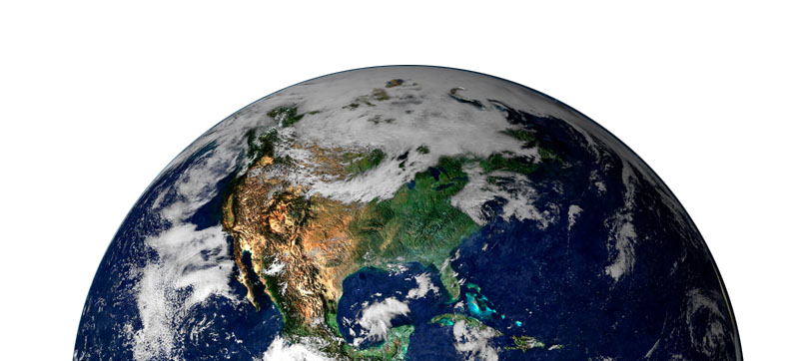
METHODS: Land Cover
Training
Data
Random Forest
Classifier
Inputs
GOOGLE EARTH ENGINE
Land Cover
Rasters
Reference
Imagery
Image Credit: NASA, Microsoft PowerPoint
Notes:
Our workflow for the historical land cover segment of this project revolved around Google Earth Engine. We used National Agriculture Imagery Program (NAIP) imagery as well as National Oceanic and Atmospheric Administration Coastal Change Analysis Program (NOAA C-CAP) to create 2016 training data for a Random Forest supervised land cover classification. As inputs for the classifier, we used Landsat 8 OLI imagery as well as 6 indices derived from Landsat: Normalized Difference Vegetation Index (NDVI), Normalized Difference Moisture Index (NDMI), Normalized Difference Wetness Index (NDWI), and Tasseled Cap Transformation indices of greenness, wetness, and brightness. We also used a 2010 LiDAR-derived elevation product from the USGS. We generated each of our inputs on a seasonal basis, creating a summer and winter time series image for each. We created classified land cover outputs for 2016 and 2018, using the 2018 one as an input for our land cover forecasting.
------------------------------ Icon Information Below ------------------------------
1. Plant icon: PowerPoint (Microsoft Office 365 2021) [Plant]
------------------------------ Image Information Below ------------------------------
Created by Reto Stöckli, Nazmi El Saleous, and Marit Jentoft-Nilsen from the NASA GSFC in 2000. https://www.flickr.com/photos/gsfc/6049973495. (creative commons CC BY 2.0). This image was edited to have a transparent background.

Slide 15
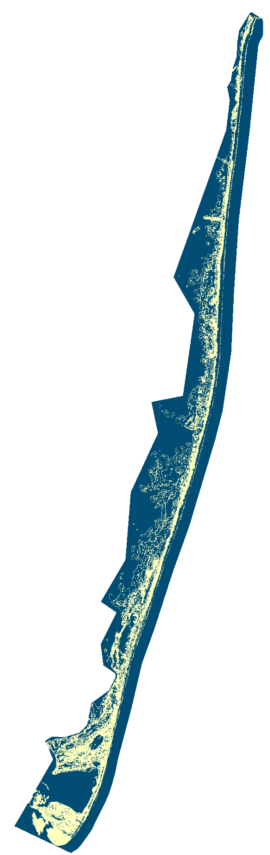
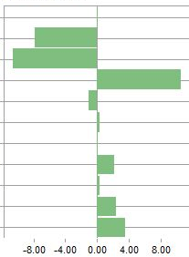
RESULTS: Land Cover Change
Net change between 2006 and 2018
Estuarine Forested Wetland
Open Water
Barren Land
Unconsolidated Shore
Estuarine Emergent/Shrub Wetland
Pal. Emergent/Shrub Wetland Aq. Bed
Palustrine Forested Wetland
Shrub
Land Cover Type:
Forest
No change
Grassland
Change
Developed
-8.00
-4.00
0.00
4.00
8.00
Square Kilometers
Icon Credit: Microsoft PowerPoint
Notes:
As for our results, the 2018 land cover classification that we generated with our Google Earth Engine script was highly accurate, with an overall accuracy of 97.87% and a Kappa Index of Agreement of 0.9677. The largest net decreases in land cover between 2006 and 2018 were in open water, with a decrease of 7.79 square kilometers, and in barren land, a decrease of 10.63 square kilometers. The largest net increase in land cover between 2006 and 2018 was in unconsolidated shore, with an increase of 10.59 square kilometers. There was minimal net change in wetland land cover categories, with the largest of the four being a net decrease of 1.00 square kilometer in estuarine emergent shrub wetland.
------------------------------ Icon Information Below ------------------------------
Plant icon: PowerPoint (Microsoft Office 365 2021) [Plant]

Slide 16




METHODS: Forecasting
Land Change Modeler
Import historical land cover
Change
analysis
maps
Change
prediction
modeling
Icon Credit: Microsoft PowerPoint
Notes:
Next, our team used the IDRISI TerrSet Land Change Modeler (LCM) to detect patterns of historical land cover change and forecast changes out to 2021, 2031, and 2046. First, we employed the Change Analysis tool to identify land cover change from 2006-2018. We then produced change analysis maps identifying the various land cover transition types. Afterwards, we created transition potentials, which expressed the likelihood that a specific land cover type would change into another. From here, we used a stochastic model known as a Markov Chain to forecast future land cover for Assateague Island.
------------------------------ Icon Information Below ------------------------------
1. Calendar icon: PowerPoint (Microsoft Office 365 2021) [Calendar]
2. Trees icon: PowerPoint (Microsoft Office 365 2021) [Trees]
3. Gears icon: PowerPoint (Microsoft Office 365 2021) [Gears]
4. Map icon: PowerPoint (Microsoft Office 365 2021) [Map]
5. Hourglass icon: PowerPoint (Microsoft Office 365 2021) [Hourglass]

Slide 17
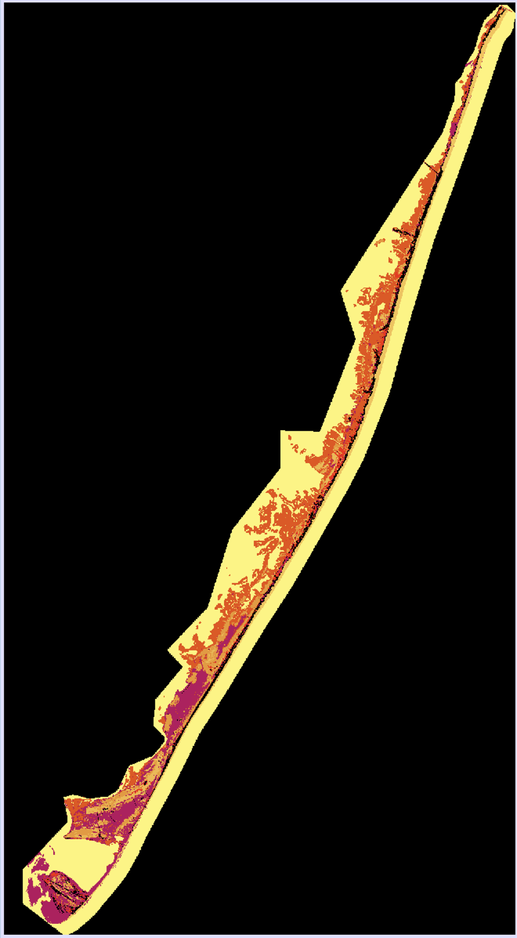

RESULTS: Land Cover Forecasting
Projected Potential for Transition:
2031
10-year forecast
2046
25-year forecast
NPS management plans
Stochastic model
Storm disturbance scenarios
0.00
0.27
0.54
Icon Credit: Microsoft PowerPoint
Notes:
We chose to forecast land cover 10 and 25 years ahead, in accordance with Assateague Island's management planning timelines. Our stochastic model accounted for the impact of storm disturbance due to four major storm events that occurred during our study period. The 2031 projected potential for transition is shown here, highlighting that the southern end near Tom's Cove is projected to change the most, while the Atlantic-side foreshore areas of the beach have the lowest potential for change.
------------------------------ Icon Information Below ------------------------------
Calendar icon: PowerPoint (Microsoft Office 365 2021) [Calendar]

Slide 18
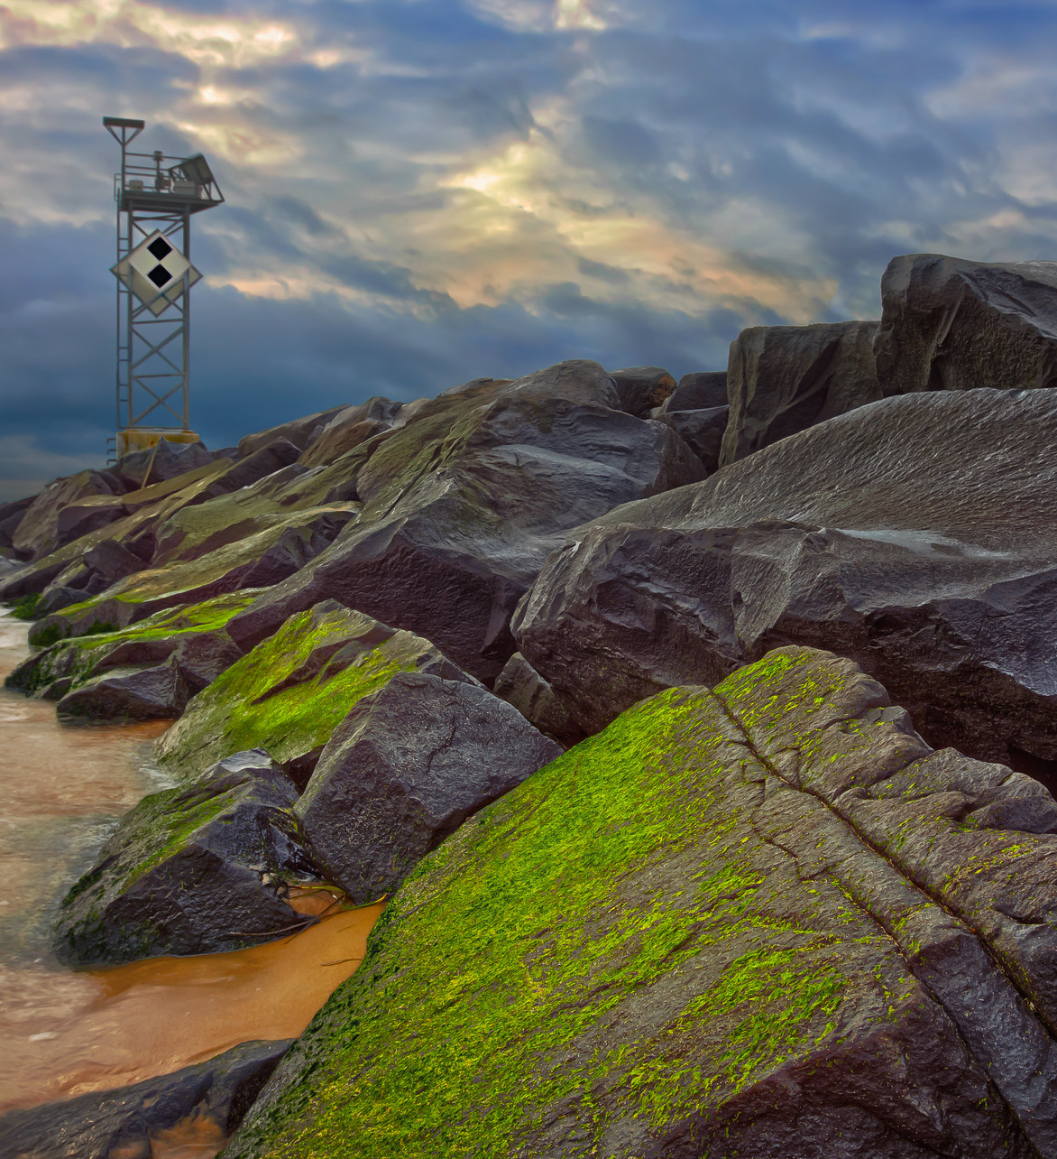
ERRORS & UNCERTANTIES
Coarse spatial resolution of turbidity
Ambiguity of turbidity due to potential presence of other suspended solids
Limited homogenous pixels for training data
Consolidated land cover classes
Change drivers not used in model
Inherent uncertainty of forecasting
Image Credit: Eric Walker, 2014
Icon Credit: The Noun Project and Microsoft PowerPoint
Notes:
Overall, our methods and results relied on several assumptions that we must keep in mind for our interpretation. For example, the spatial resolution of turbidity may be too coarse to see smaller-scale plumes of sediment. Our turbidity layers could also be showing suspended organic matter as well as sediment. Additionally, for land cover classification, there were often multiple landcover types per pixel that were not easily distinguishable from reference imagery by eye. Without ground-truthing, this introduced uncertainty into our classification. Furthermore, similar landcover classes from the NOAA CCAP 2016 data were condensed. For example, we combined multiple difference types of wetland into one 'wetland' category. This introduced error by making classes that are potentially less spectrally unique, less accurate, and oversimplified. As for our landcover change prediction model, we did not use explanatory variables to account for dynamic drivers of change. Examples of explanatory variables that would have been used include National Difference Water Index (NDWI), National Difference Vegetation Index (NDVI), and elevation. However, this was not practical with our constraints on time, as well as the implicit complications associated with modeling explanatory variables. As such, we made the decision to exclude the modeling of these variables and assume a more static, stochastic change model. For this, the only variable was the land cover policy withheld by the NPS which was held static (as it is assumed to not change). These potential errors and uncertainties in this project, though, could be used to inform future research in this project's area.
------------------------------ Image Information Below ------------------------------
Walker, Eric (2014). 15041082398_c06dcedca0_o.jpg. [Photograph]. This image is licensed under CC BY-NC 2.0. Retrieved from https://www.flickr.com/photos/premierehdr/15041082398.
------------------------------ Icon Information Below ------------------------------
1. Wave icon: https://thenounproject.com/term/wave/981734/ (creative commons CC BY 3.0). Wave by Nikita Kozin from the Noun Project.
2. Plant icon: PowerPoint (Microsoft Office 365 2021) [Plant]
3. Calendar icon: PowerPoint (Microsoft Office 365 2021) [Calendar]

Slide 19
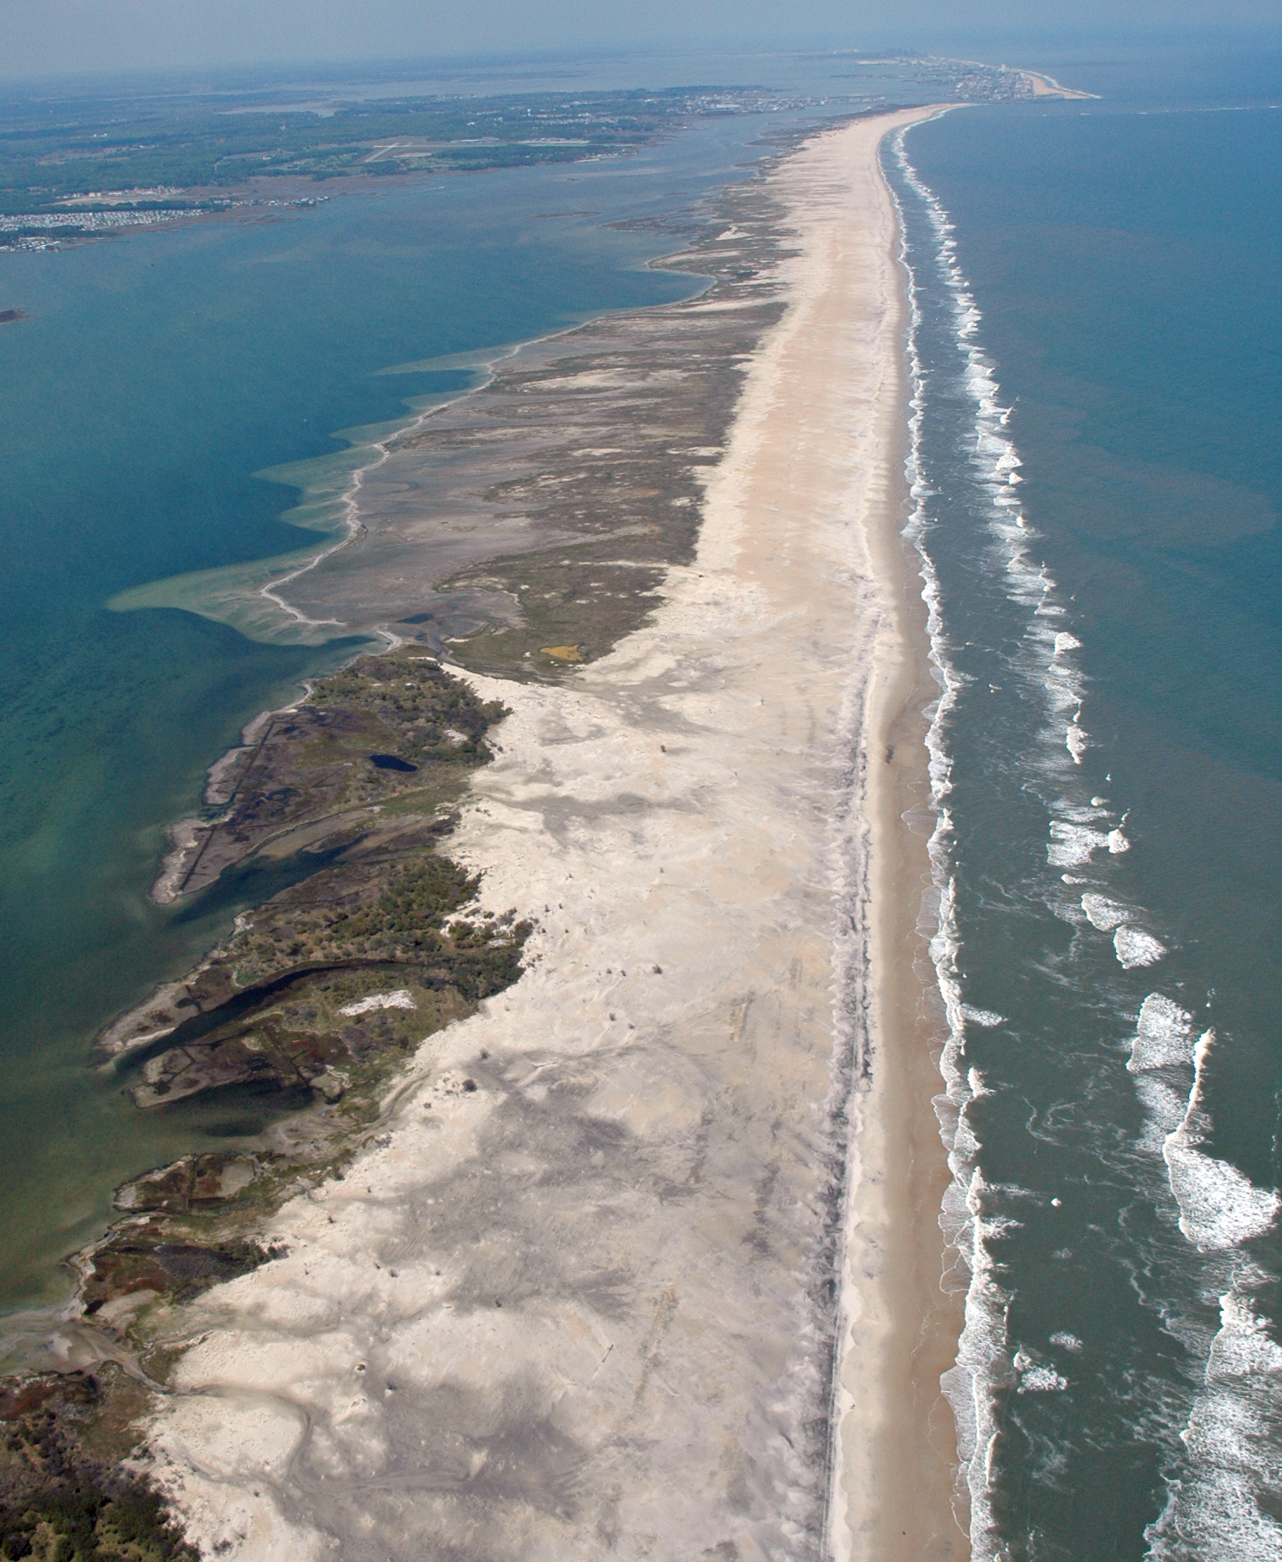
FUTURE WORK
More in-depth case studies
Larger scale land cover modeling
Habitat suitability analysis for threatened and endangered species
Image Credit: Jane Thomas, 2006
Icon Credit: The Noun Project and Microsoft PowerPoint
Notes:
To help build upon and improve upon our initial 10 week project, more work could be done in the future. We would suggest further analyzing changes in suspended sediment pre- and post-deposition to get a more informed view of where sediment is going after USACE deposits it during sediment bypassing. Case studies could focus more on specific sediment deposition events, as well as the effects of the first 2002 beach nourishment event. Different remote sensing methods could also be employed to better distinguish sediment from other factors influencing turbidity. Additionally, a volumetric change analysis could be used to quantify morphological change. Also, to improve our landcover classification, we would suggest ground truthing, forecasting at different timescales, including explanatory variables, and adding in canopy height as an input.
------------------------------ Image Information Below ------------------------------
Taken by Jane Thomas from the University of Maryland's Integration and Application Network in 2006. https://ian.umces.edu/media-library/assateague-island/ (creative commons CC BY-SA 4.0)
------------------------------ Icon Information Below ------------------------------
1. Wave icon: https://thenounproject.com/term/wave/981734/ (creative commons CC BY 3.0). Wave by Nikita Kozin from the Noun Project.
2. Plant icon: PowerPoint (Microsoft Office 365 2021) [Plant]

Slide 20
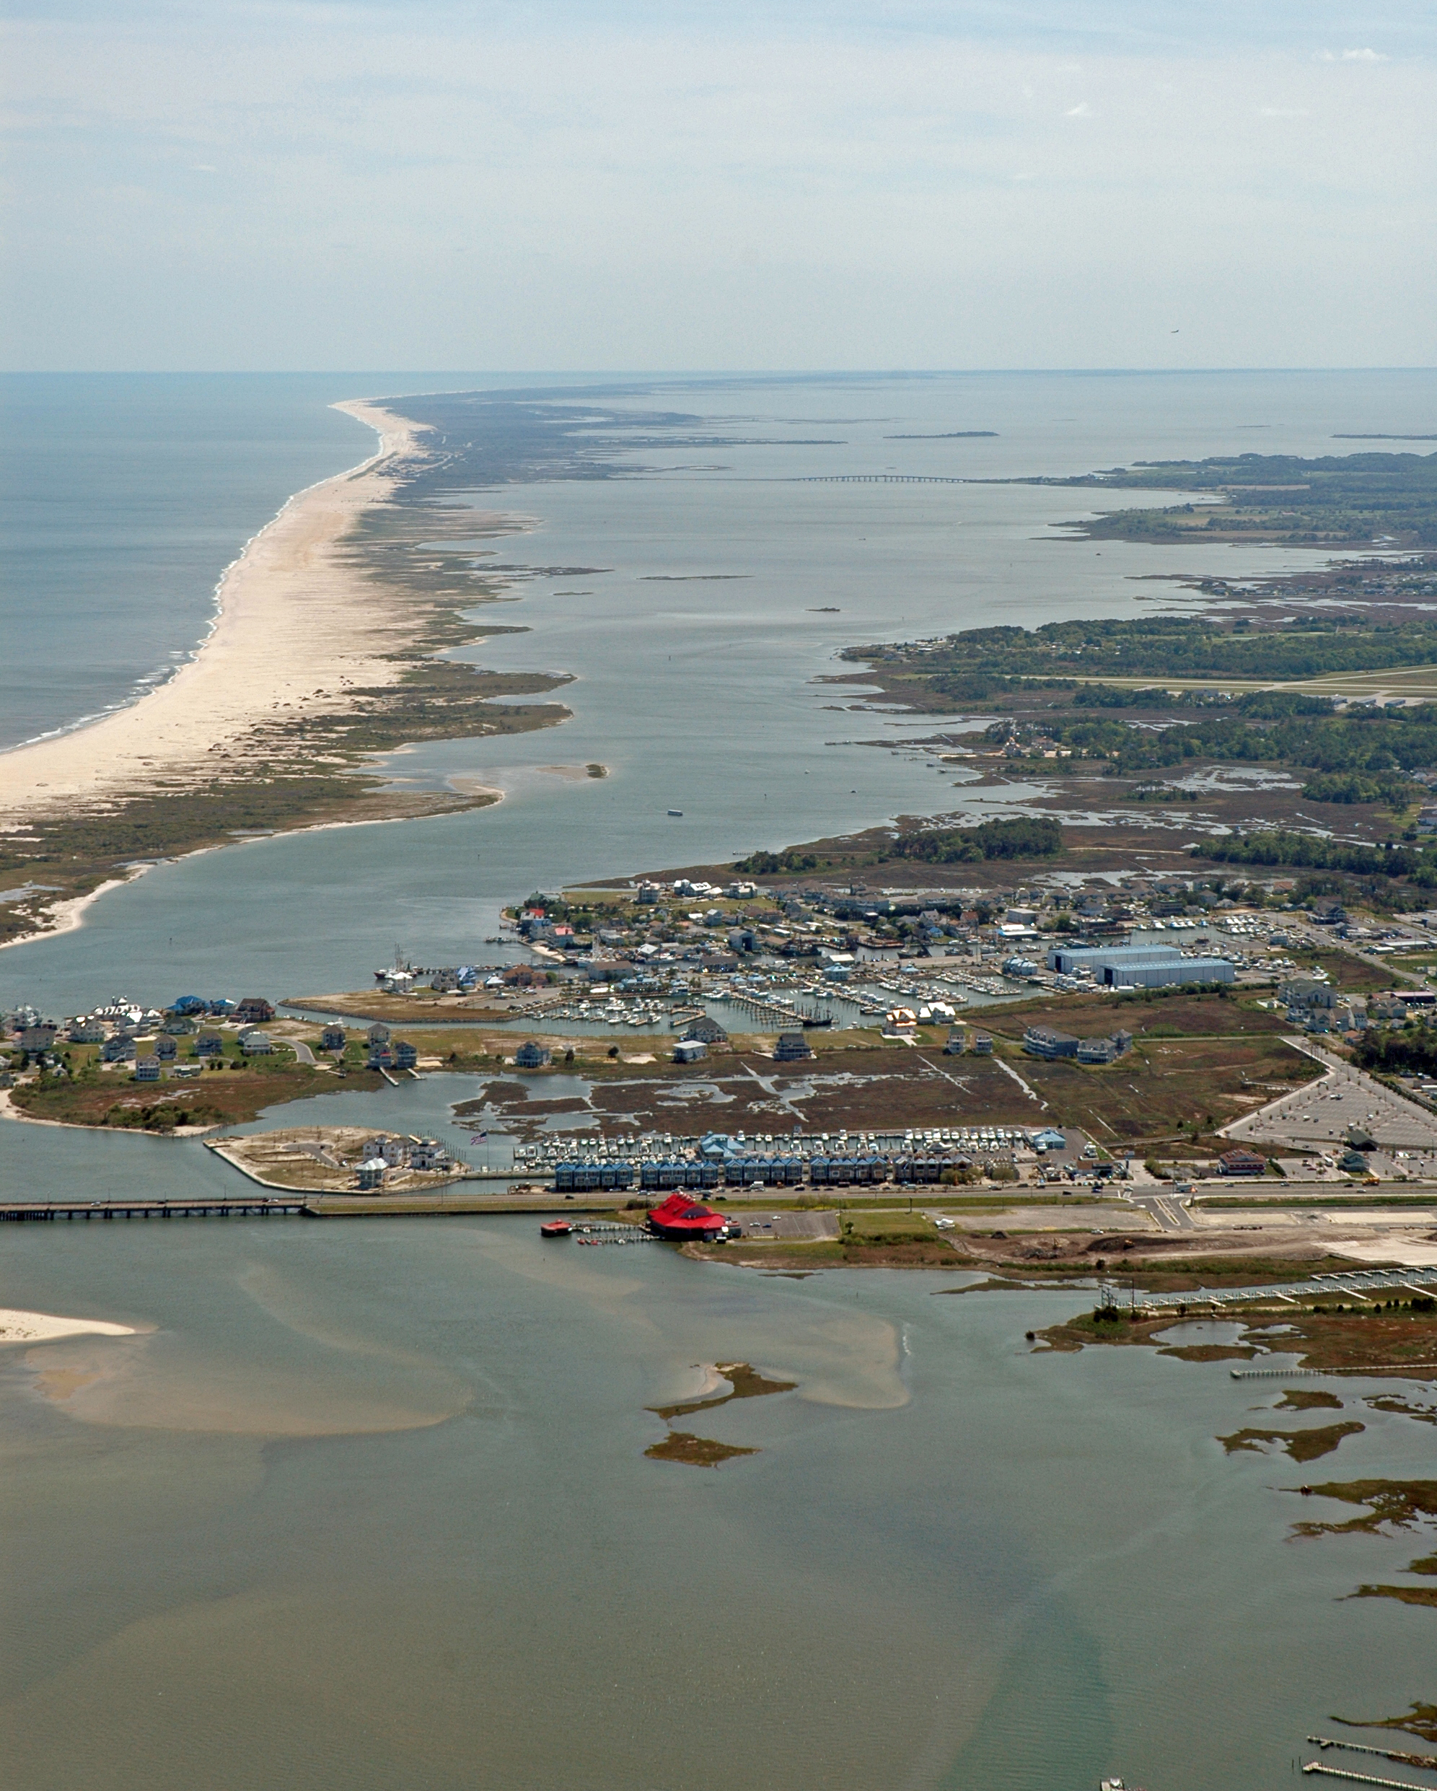
CONCLUSIONS
Turbidity layers work well for visualizing where sediment is moving, but not how much and where to
Southern end of island has grown since 2006
Shifts in habitat distribution
Exhibits how land cover and habitats might change
Image Credit: Jane Thomas, 2006
Icon Credit: The Noun Project and Microsoft PowerPoint
Notes:
Through this work we determined that satellite derived turbidity data allows us to visualize where sediment is moving but not determine how much or specific transport patterns. We found that the southern end of the island has gotten larger since 2006 and this growth could be causing a shift in habitat distribution over time. Forecasting this change can show park manager how land cover and habitat type might change in the future.
------------------------------ Image Information Below ------------------------------
https://ian.umces.edu/media-library/looking-south-from-isle-of-wight-bay-down-sinepuxent-bay-with-assateague-island-on-the-left/ (creative commons CC BY-SA 4.0). Taken by Jane Thomas, 2006, University of Maryland Integration and Application Network
------------------------------ Icon Information Below ------------------------------
1. Wave icon: https://thenounproject.com/term/wave/981734/ (creative commons CC BY 3.0). Wave by Nikita Kozin from the Noun Project.
2. Plant icon: PowerPoint (Microsoft Office 365 2021) [Plant]
3. Calendar icon: PowerPoint (Microsoft Office 365 2021) [Calendar]

Slide 21
Project Partners​
Assateague Island National Seashore:​
Bill Hulslander, Park Manager​
United States Army Corps of Engineers:​
Justin Callahan, Project Manager​
Northeast Ocean and Coastal Resources Program:​
Catherine Johnson, Program Coordinator​
Natural Resource Stewardship and Science Directorate:​
Monique LaFrance Bartley, Marine Ecologist​
Additional thanks to:
Maryland Department of Natural Resources:
Dave Brinker, Regional Ecologist
Science Advisors
Idaho State University:
Keith Weber
NASA Langley Research Center:
Dr. Kenton Ross
NASA DEVELOP
Brandy Nisbet-Wilcox, Idaho Fellow
Fall 2020 Southern Colorado
Disasters Team:
Scott Cunningham, Audrey Colley,
Camille Blose, David Keyes
Fall 2019 Belize and Honduras Water
Resources II Team:
Hayley Pippin, Arbyn Olarte,
Roxana Pilot, Vanessa Valenti
This material contains modified Copernicus Sentinel data (2015-2021), processed by ESA.

