Slide 1

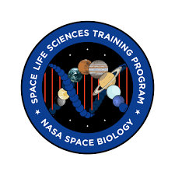

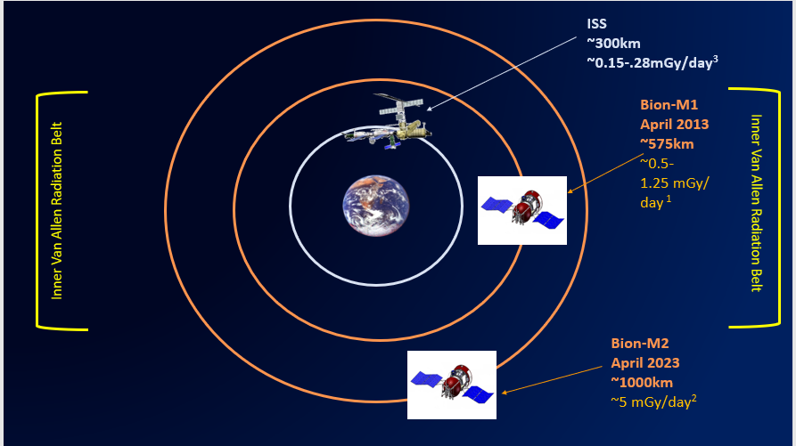
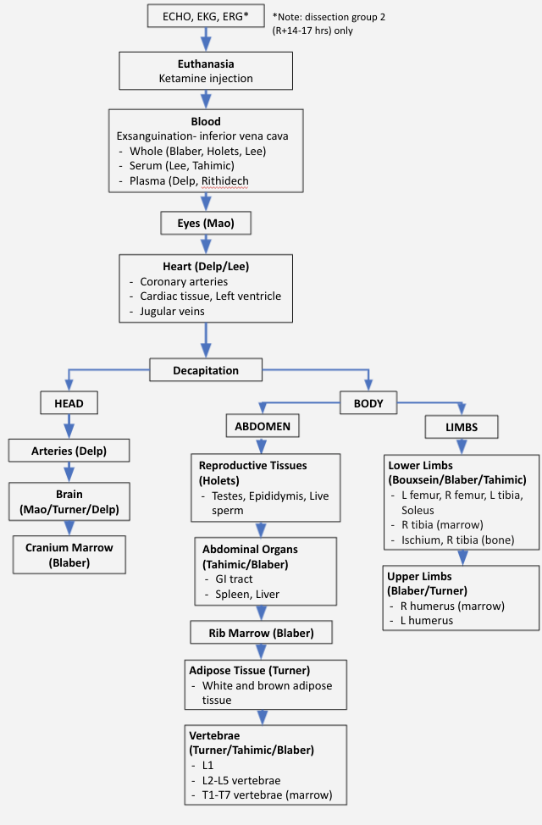
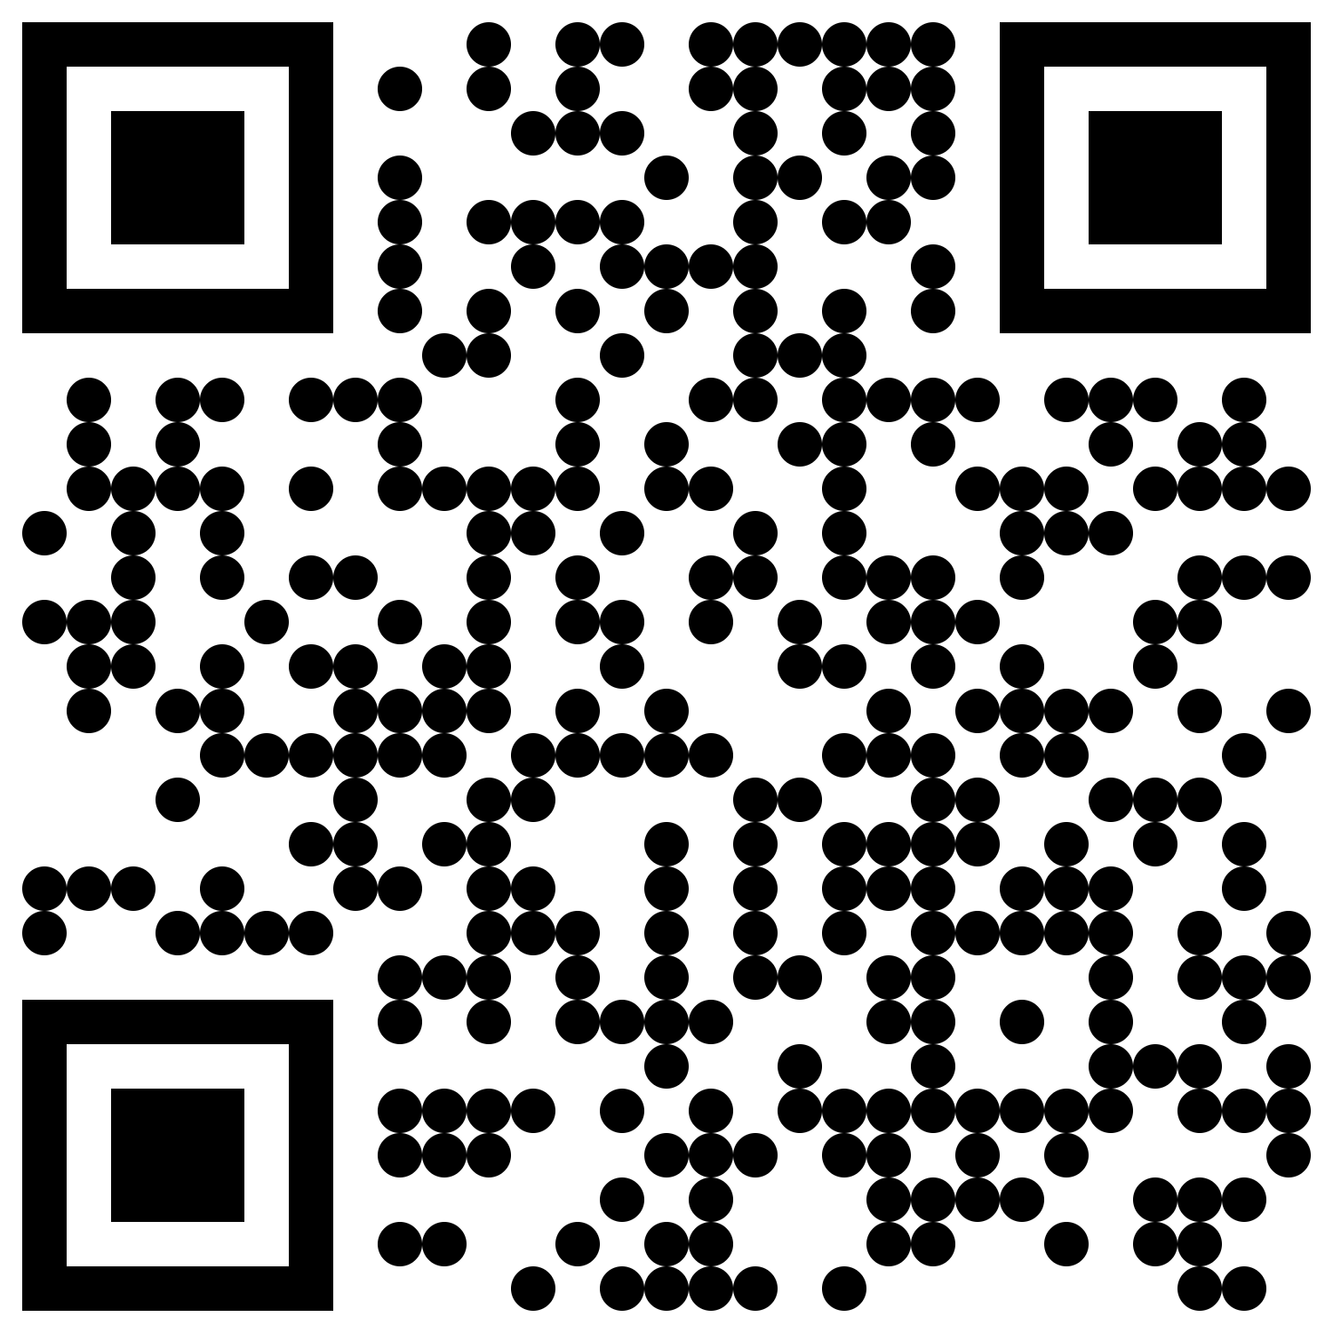
Bion-M2
Ama Luthens^{1,2} Diana Ly³, Dennis Leveson-Gower³ ¹NASA Ames Research Center, Space Life Sciences Training Program (SLSTP), Moffett Field, CA, ²KBR Technology Solutions, Houston, TX ³NASA Ames Research Center, Space Biosciences Division, Moffett Field, CA
Bion-M2 Mission Overview
Preliminary Tissue Dissection Flow
The Bion-M2 mission will explore how the space environment, emphasizing the combination of ionizing radiation (IR) and microgravity, affects living organisms. The biosatellite is scheduled to launch in April 2023 and it will spend at least 21 days in low earth orbit (LEO). Nine U.S. collaborators selected through a NASA Program Announcement will utilize tissue sharing for post-flight rodent experiments using C57/BL6 mice. The overarching goal of the Bion-M2 mission is to investigate systemic, cellular and molecular mechanisms underlying adaptation of mice to combined effects of microgravity, radiation and other spaceflight factors. Studies will also focus on post-flight re-adaptation.
Purpose
Determine how the tissues requested by the PIs will be divided post-flight to deliver the best overall science for the investigations
Bion-M2 Mission Objectives
Post-Flight Analysis
Complete a 21-day flight in LEO to study the combination of microgravity and IR on various biological systems
Conduct pre and post-flight studies focused on studying various physiological systems and processes in C57/BL6 mice.
Leverage and amplify findings from all the pre and post-flight research and using state-of-the art omics, molecular/systems biology tools and upload all omics data into NASA’s GeneLab database
Support international collaboration between the United States and Russia via continuation of the Bion/Bion-M and Foton-M series of biosatellite missions
Elizabeth Blaber, Ph.D., Single cell analysis of bone marrow progenitor following Bion-M2
Mary Bouxsein, Ph.D., Effects of Spaceflight and Reloading on Skeletal Muscle and Bone
Michael Delp, Ph.D., Effects of Bion-M2 on Arterial and Venous Vessels
Lesya Holets, Ph.D., Male reproductive health and fertility in mice on the Bion-M2 mission.
Peter Lee, Ph.D., Biomarkers Associated with Spaceflight-induced Cardiac Dysfunction
Xiao Wen Mao, Ph.D., Spaceflight-induced Effects on CNS
Kanokporn Rithidech, Ph.D., Proteomic analysis of mouse plasma after space flight with the Bion-M2 Mission
Candice Tahimic, Ph.D., Re-adaptation mechanisms after spaceflight
Russell Turner, Ph.D., Time Course for re-adaption of thermoregulation and bone following spaceflight
The Bion/Bion-M Series
Bion-M2 Major Project Milestones
Future Directions
SCAN ME TO LEARN MORE ABOUT PREVIOUS BION AND BION-M MISSIONS!
Finalize the tissue dissection flow as needed
Finalize contracts and move on to implementation phase of the project
Finalize all science procedures
Order science materials
Launch (April 2023)
Submit Final Reports
Finalize Science Procedures
Post-Flight Analysis, Data Collection
Euthanasia, Dissection
Virtual PI Meetings
Finalize Contracts
LAUNCH
PRE-FLIGHT
Acknowledgements: Thank you 2021 NASA SLSTP management, Sigrid Reinsch, Hami Ray, Desi Bridges, Elizabeth Keller, and Kim Cadmes. Thank you KBR/Wyle for supporting me financially and thank you to Diana Ly and Dennis-Leveson Gower for mentoring me throughout this project.
FLIGHT
POST-FLIGHT

