Slide 1


Leadership in a High Performing, High Reliability Organization
Insights from NASA’s International Space Station Mission Control
Ed Van Cise, NASA Flight Director
October 2021

Slide 2
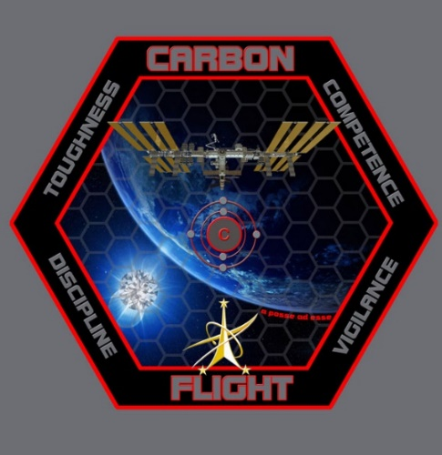
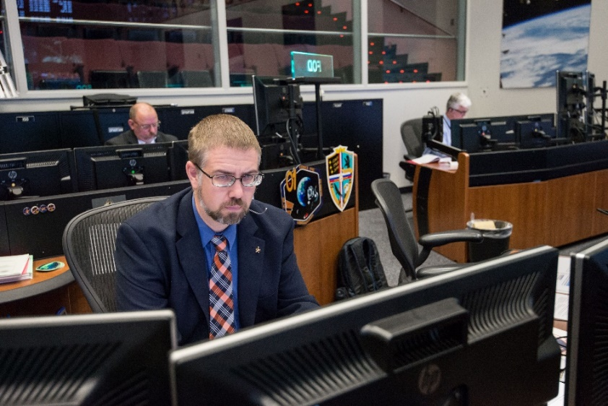
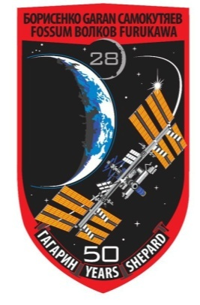



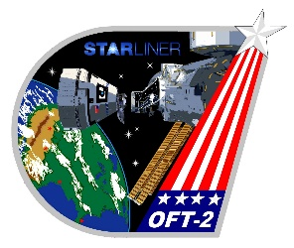

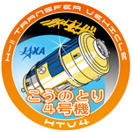
Personal Background
Early Years
  University of Michigan Bachelor’s in Aerospace Engineering, April 2000
    Co-oped at NASA starting in January 1998
Hired at JSC full time in Mission Operations for the International Space Station in 1998
  Operations Support Officer (OSO) Flight Controller for 5 years
  TITAN Flight Controller for 3 years
  Group Lead for the ISS Mechanisms & Maintenance Training Group for 2 years
  Selected in Flight Director Class of 2009, certified January 2010, call sign “Carbon Flight”
  Over 8,100 hours supporting operations from the ISS Flight Control Room since 2001
Other
  Over 90 minutes of zero gravity experience on NASA’s reduced gravity aircraft
  Multiple SCUBA dives on the full size ISS mockups in NASA’s Neutral Buoyancy Laboratory
Notes:
Co-oping benefits NASA and the student. NASA gets to see what you might be like as a full time employee. The student gets to “sample” a couple of jobs with NASA to see if this is really what they want to do after the graduate
At JSC you get to choose where you work, treated like a regular employee, given real assignments
Might decide there are certain areas where you don’t want to work
First tour was in Engineering. Even though I learned about nanotubes, I realized Engineering orgs was not where I wanted to be.
Confirmed I wanted to be in Mission Operations – Mission Control
2nd – 4th tours were all in Mission Ops.
All with the same group (OSO). Since they treated me as a “real” employee, did real work that not only benefited them, but since I later hired into the same group full time I got to continue that work as a full time employee
Might decide NASA’s not all you thought it would be
Might decide to change your major
Excellent opportunity to experiment and make changes before you’re fully committed to a career and I highly recommend it for any career or job field, be it a year-long co-op or a summer internship.
Taught me a different way to think about/approach school/homework
OSO
Describe OSO’s job, flight control and training
Working on co-op projects full time
STS-114/ULF1 lead turning into STS-114/LF1
Talk about the human element, Columbia, loss of friends?
TITAN
While also OSO lead for STS-114
Multiple systems, gaining seniority, experience, recognition (know the politics)
DA8 Program Integration
Exposure to Flight Directors
Learn about the “world” outside of MOD
DX42 Group Lead
Form a new group
Back to my roots, but on training side
Learn to lead a team
Debrief methodology paper – set goals but get their buy-in, make it their work so it will outlive your tenure
Flight Director
Selection in June 2009, certified in January 2010, call sign “Carbon Flight”
Major assignments – all are stretch goals that seem impossibly hard but by definition we rise to the challenge
X2EXTR6 before certified, Russian EVAs, Inc 28 (talk about Fossum, class of ’80), EVAs 18, 19, 21, FRAT, HTV4, Inc 41
HTV3’s abort, redesign of entire mission profile in 10 months
Can include discussion of complications due to structural loads considerations on solar arrays
The fun of EVAs 18, 19, 21. Talk about the ‘bad day feeling’ as EVA 18 went past 8 hours, the Toothbrush Hack for EVA 19, doing EVA21 in less than 36 hours

Slide 3
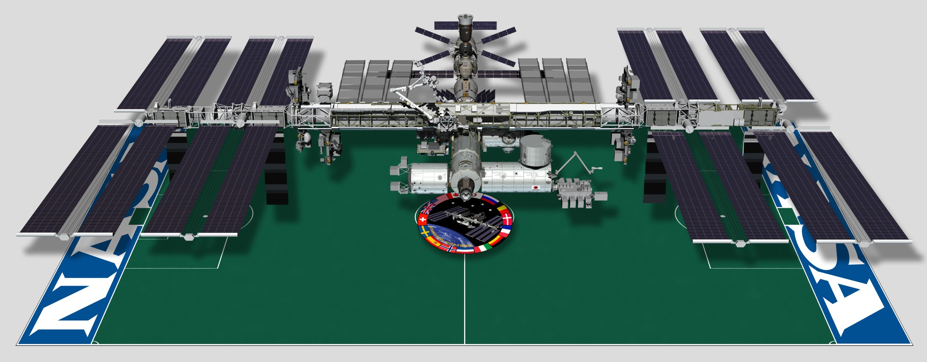
Earth’s Only Microgravity Research Laboratory
Truss: 360 ft
Solar Arrays:
115 ft
Modules:
170 ft
Mass: ~1,000,000 lbs
Habitable Volume: 43,000 ft³
(about the size of 3 US homes of 2,000 ft²)
Solar Power Generation Capability: 84+ kW
(~70 kW typical usage compared to ~1.5 kW for a home)
Altitude: ~250 mi
Orbital Speed: 17,500 mph (5 mi/sec)
Orbital Period: 90 minutes (16 sunrises/sunsets per day)
Notes:
First Elements launched in 1998, first inhabited in November 2000, currently home to a crew of 6
Assembly completed in 2011, now a fully operational one-of-a-kind laboratory
During a given 6-month period, ~200 tended and untended investigations are conducted, representing over 400 scientists on the ground.
Biology, biotechnology, Earth and space science, human research, technology development, physical science, educational & cultural activities
Human Health Research
Development of new medical technology and disease treatment
Advancement of telemedicine, nutritional health, and cell adaptation/behavior
Bone health and the prevention of bone loss due to aging
Earth Observation
Disaster Response support
Immediate input to and imagery of unexpected events and natural disasters (volcanic eruptions, earthquakes, hurricanes and tsunami flooding)
Understand & Resolve environmental issues, collecting data on global climate, environmental change
Future of Exploration
Improved processes for safe operations of long duration spaceflight
Preparedness and preventions for human health changes
Improved technologies for sustainability

Slide 4

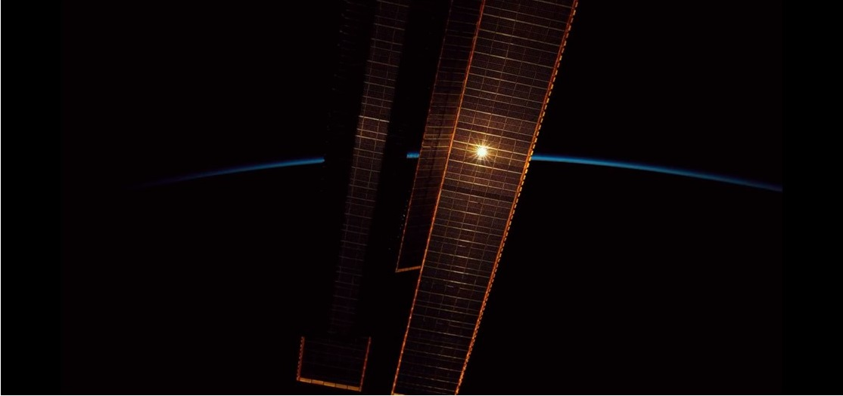
The Mission of the International Space Station
Basis for international and commercial human exploration partnerships
Enable long duration human spaceflight beyond Low-Earth Orbit (LEO)
Returning benefits to humanity through basic and applied research
Enabling the development of a commercial market in LEO

Slide 5
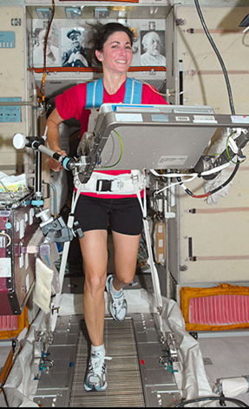
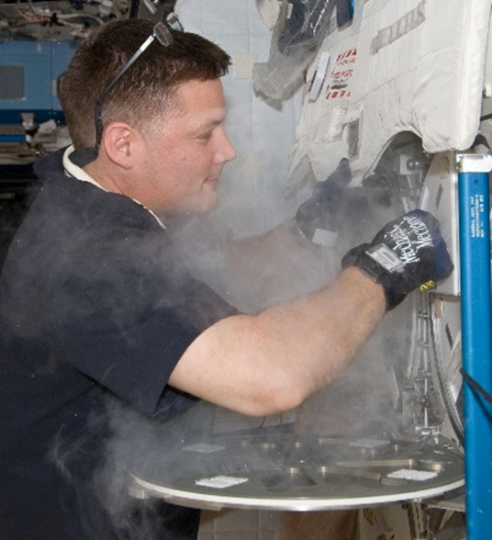
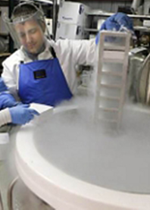
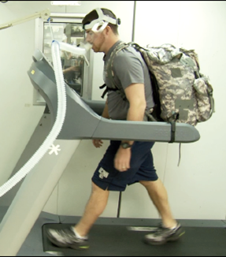
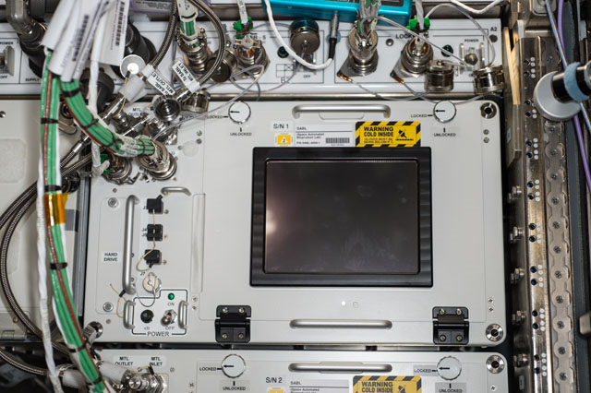
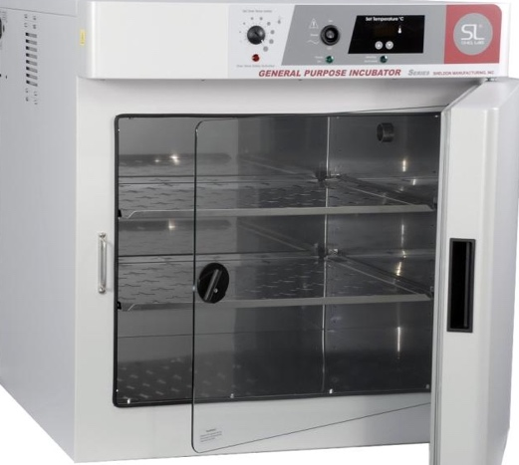
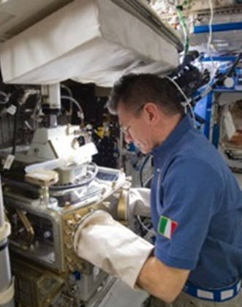
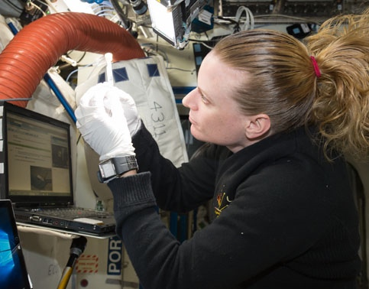
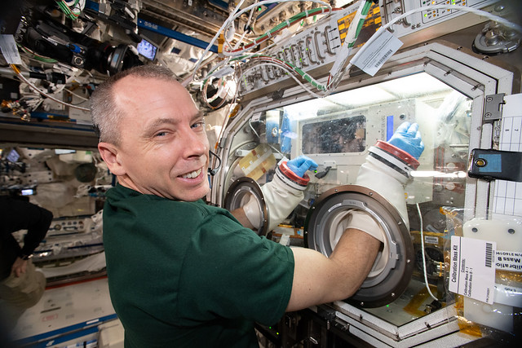

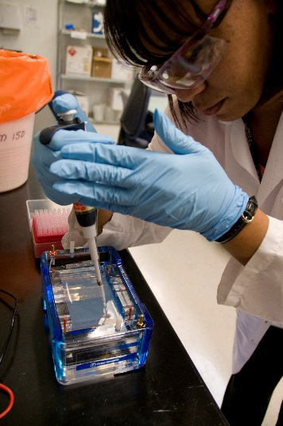
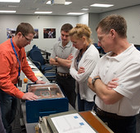
A Lab Like on Earth, Unlike Earth
Freezers
Incubators
Human Research
Microscopes
Genetic Analysis
Model Organisms

Slide 6
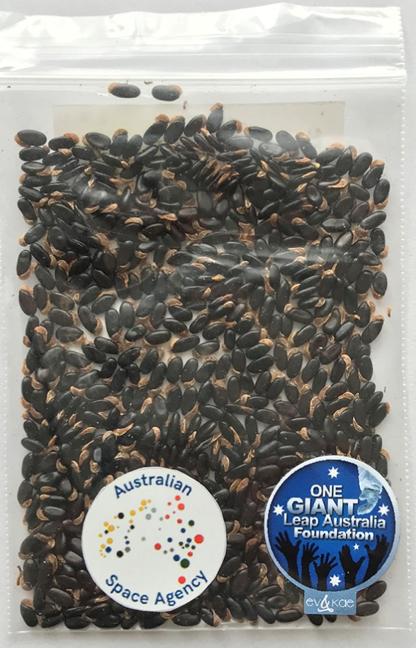
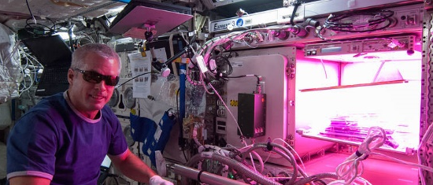
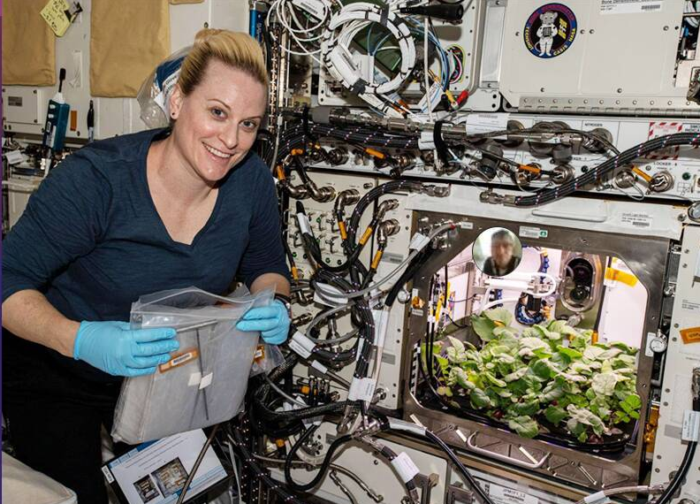
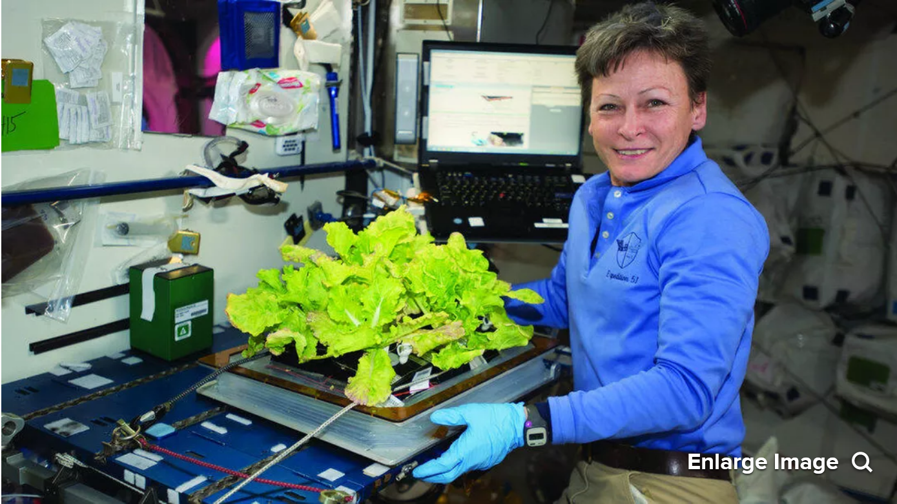
And Greenhouses too, Of Course!

Slide 7
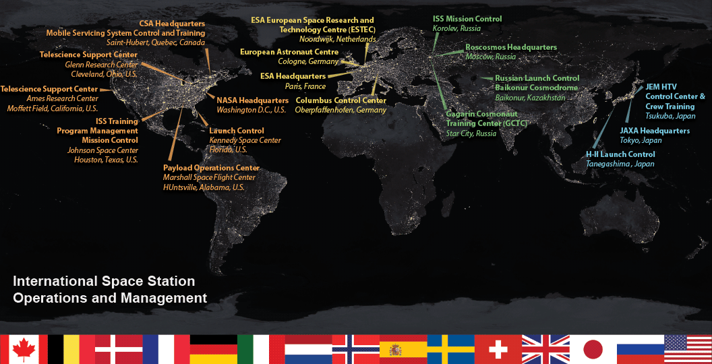
Australian Space Agency
Adelaide, SA

Slide 8
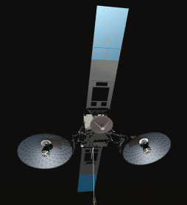
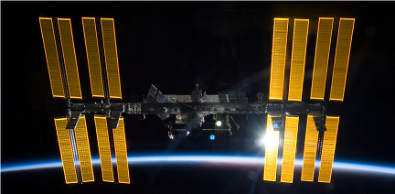
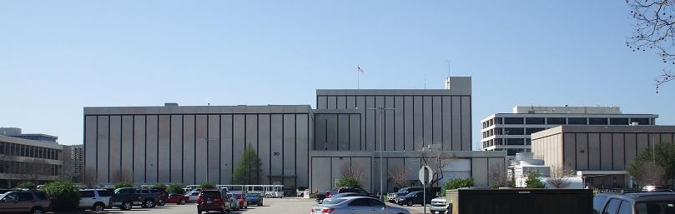



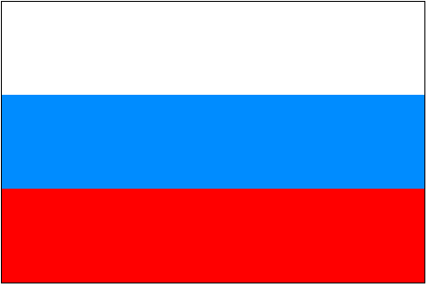
TDRS
Relay
Satellites
Mission Control Center - Houston
Space Station
Command
Telemetry
Video
Voice Links
Tsukuba
Control Center
Japan
Columbus
Control Center
Munich
Payload
Control Center
Huntsville, AL
MCC
Moscow
Russia
Notes:
5 Control Centers support ISS; MCC-H is a primary hub with Moscow also able to directly communicate with and command to their segment of ISS. With 5 control centers, need one that is “prime.” MCC-H is the Lead control center, responsible for not only the US modules but also the entire crew and vehicle.

Slide 9
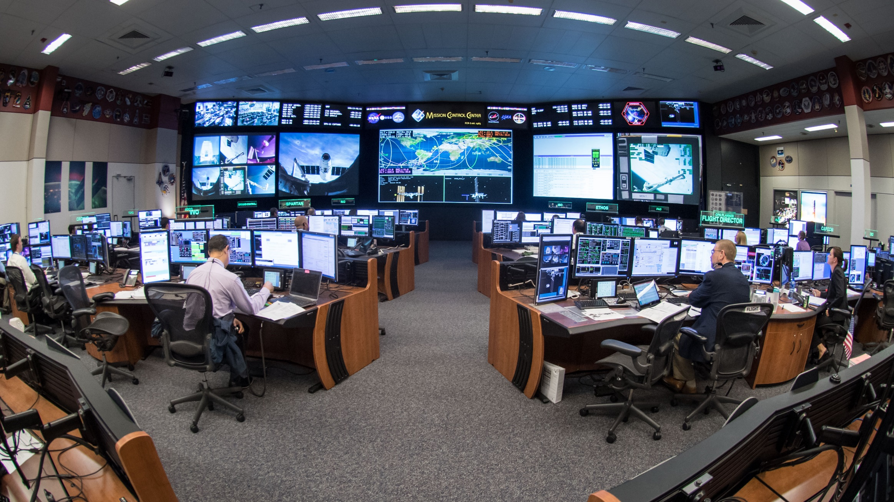
Mission Control Center – Houston
Established 1965 (Gemini IV)

Slide 10
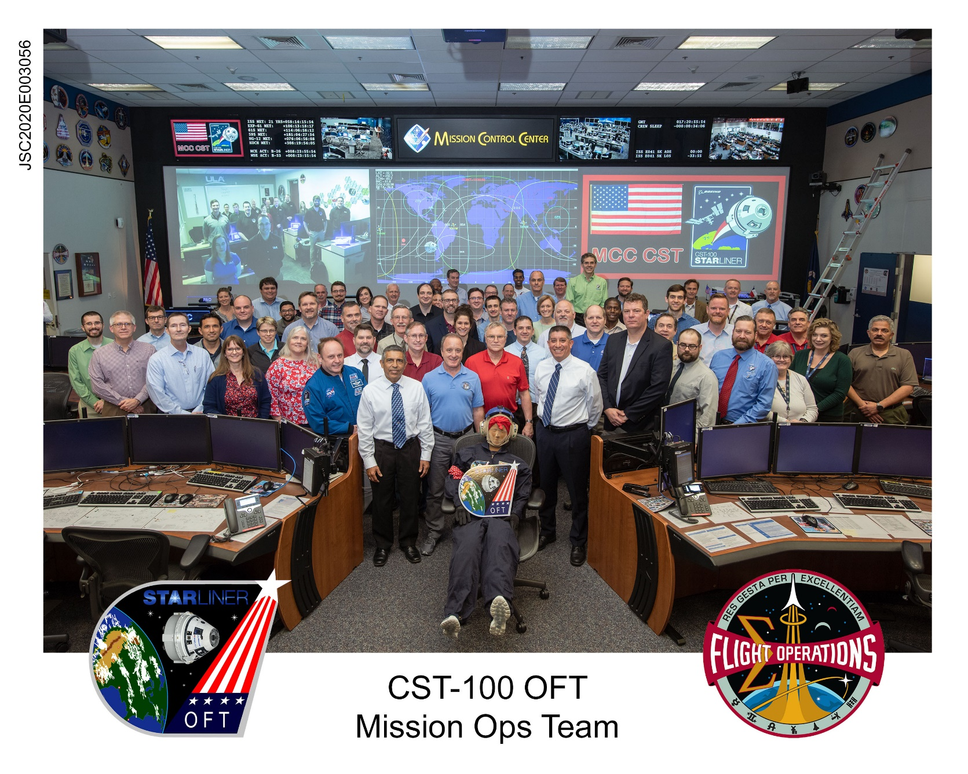
What is Mission Control?
Each console manages one subsystem (guidance, electrical, life support, timeline…)
Flight Controllers
  Specialize in operations
  Divides time between office and console
  Completes a documented training and evaluation plan for MCC ops, most including multiple computer driven simulations
Notes:
Photo is from when I was the Flight Director for the Planning Shift of STS-131. Shows how this is very much a team effort.

Slide 11
NASA/ISS Program
Oversight
Mission Management
Increment Lead
Flight Director
Flight
Director
Flight Controllers
Real Time
Decision Making
Risk Management
Nominal and Off-Nominal
System management
Crew
Office Support
Offline Analysis
Engineering Support
Development
Offline/Non Real Time Support
Notes:
Talk about the various support positions, Flight being on top in the real-time environment. Also being managed by ISS Program and an Increment Lead FD that manages the strategic pieces of the ISS mission (next week, next month, next 3-6 months)

Slide 12
Flight Operations - Plan/Train/Fly
Plan
Vehicle design – flyable, sensible, operable?
Analysis
Within experience base?
New hardware/software required?
New Ops Products required?
New Flight Controller/Crew Training required?
Overall plan operable/supportable?
Train
Final Analysis
Requirements Integration
Crew/Flight Controller Training
Next Worse Case Failure Preparation
Fly
Safety of Crew, Vehicle, Mission
Implement Requirements
Program Requirements and Objectives
Lessons Learned
All aspects of P/T/F embedded in Lessons Learned culture
  Encode, Duplicate successes
  Learn from, Avoid mistakes
All aspects of P/T/F provide feedback to the Program on the risks/concerns/recommendations of Program Requirements and Objectives
Notes:
Be here by 0:20
Busy chart that tries to explain PTF. This is my own creation, not an official FOD/NASA chart, that tries to explain at a high level what PTF is/means. Black and yellow lines are generally common to most orgs (take requirements, assess them, implement them, if it didn’t work, do an ‘after action’). Many orgs will also follow the yellow feedback arrows – along every step of the way tell your requirement generators what will and won’t work so they can do better, make changes, or tell you to do it anyway. More uncommon is doing Lessons Learned for successes as well as mistakes, and then implementing lessons learned back into every step of the process. This chart shows how we’ve operated human spaceflight missions from the very early days, evolving/refining as we’ve grown (and as we’ve failed/made mistakes).

Slide 13
High Performing, High Reliability Organizations
High Performing Organization
  A High Performance Organization (HPO) is an organization that achieves financial and non-financial results that are better than those of its peer group over a period of time of at least five to ten years.
High Reliability Organization
  A High Reliability Organization (HRO) is an organization that has succeeded in avoiding catastrophes in an environment where normal accidents can be expected due to risk factors and complexity

Slide 14

Characteristics of High Performing Organizations
Leadership – Leadership is aligned and effective deep within the organization
  Leadership in Mission Control
    Unambiguous chain of command within MCC-H and between Control Centers
    Leadership within a discipline is expected on and off console; “Lead Your Leader” reflects our goal for leadership development at all levels
      No “Screaming Monkeys!”
Design – The structure is lean and reflects the organization’s strategic focus
  Design in Mission Control
    Documented processes, training flows, and certification guides establish both the ends and the means; regularly reviewed to ensure the methods align with changing strategic goals
People – The organization effectively translates business strategy into a powerful people strategy, attracting and retaining the most capable individuals
  People in Mission Control
    Selective recruiting, Flight Controller Boot Camp, progressively complex training and simulations, regular skills assessments and pass/fail evaluations with documented pass/fail criterion
Source: Bhalla, Vikram; Caye, Jean-Michel; Dyer, Andrew; Dymond, Lisa; Morieux, Yves; Orlander, Paul (2011). “High-Performance Organizations, The Secrets of Their Success,” Used with permission
Notes:
Define HPO: Formally, “A high performance organization is an organization that achieves financial and non-financial results that are better than those of its peer group over a period of time of at least five to ten years.” Said in more laymen’s terms – HPOs do good stuff faster and better than its peers. For us, it means we are very, very good at human spaceflight operations – but why are we good and how do we get and stay there, and how can it be applied to your group?
Talk about how Mission Control is a HPO by walking through the 5 characteristics of an HPO. The definition of each characteristic comes first, then I describe how we implement that characteristic.

Slide 15
Characteristics of High Performing Organizations
Change Management – The organization can drive and sustain large-scale change and anticipate and adapt
  Change Management in Mission Control
    Mission Control is a balance between being nimble enough to adapt to unexpected change yet knowledgeable enough to ascertain whether the change is within accepted limits; Next Worse Failure planning
Culture and Engagement – The culture is shaped to achieve strategic goals. Employees pursue corporate objectives.
  Culture and Engagement in Mission Control
    Flight Controller Manifesto, Stone Tablets of Flight Control, Foundations of Flight Operations, Plan/Train/Fly, Next Worse Failure, Lessons Learned JOPs
      Part of Flight Operations training from Day 1
Source: Bhalla, Vikram; Caye, Jean-Michel; Dyer, Andrew; Dymond, Lisa; Morieux, Yves; Orlander, Paul (2011). “High-Performance Organizations, The Secrets of Their Success,” Used with permission

Slide 16
Core Values
Civil Air Patrol
  Integrity, Volunteer Service, Excellence and Respect
US Air Force
  Integrity first, Service before self, and Excellence in all we do
US Space Force
  Agility, Innovation, and Boldness
US Army
  Loyalty, Duty, Respect, Selfless Service, Honor, Integrity, and Personal Courage
US Navy
  Honor, Courage and Commitment
US Coast Guard
  Honor, Respect, and Devotion to duty
US Merchant Marine
  Respect, Honor, Service
NASA Flight Operations Directorate
  We want to fly, We are all in, We are motivated by the mission, We build partnerships, We are experienced, We evolve, We are leaders, We are family

Slide 17

Core Values Instilled in Culture
To instill within ourselves these qualities essential to professional excellence
  Discipline…Being able to follow as well as to lead, knowing that we must master ourselves before we can master our task.
  Competence…There being no substitute for total preparation and complete dedication, for flight will not tolerate the careless or indifferent.
  Confidence…Believing in ourselves as well as others, knowing that we must master fear and hesitation before we can succeed.
  Responsibility…Realizing that it cannot be shifted to others, for it belongs to each of us; we must answer for what we do or fail to do.
  Toughness…Taking a stand when we must; and to try again and again, even if it means following a more difficult path.
  Teamwork…Respecting and using the abilities of others, realizing that we work toward a common goal, for success depends upon the efforts of all.
  Vigilance...Being always attentive to the dangers of flight; never accepting success as a substitute for rigor in everything we do.
To always be aware that, suddenly and unexpectedly, we may find ourselves in a role where our performance has ultimate consequences.
To recognize that the greatest error is not to have tried and failed, but that, in the trying, we do not give it our best effort.

Slide 18
High Reliability Organizations
Mission Control is a “High Reliability Organization”
Characteristics of successful organizations in high-risk industries
  Preoccupation with Failure
  Reluctance to Simplify Interpretations
  Sensitivity to Operations
  Commitment to Resilience
  Deference to Expertise
Anticipation
(Prevention)
Containment
(Reacting)
Source: Weick, Karl E.; Kathleen M. Sutcliffe (2001). Managing the Unexpected - Assuring High Performance in an Age of Complexity. San Francisco, CA, USA: Jossey-Bass. pp. 10–17. ISBN 0-7879-5627-9
Notes:
Be here by 0:30
Define HRO: A High Reliability Organization (HRO) is an organization that has succeeded in avoiding catastrophes in an environment where normal accidents can be expected due to risk factors and complexity. Being an HPO is good but being good doesn’t mean you get it right or you do it safely. HROs have a tendency to do thing safely and manage risk effectively. Typically HROs involve expensive, rare assets where their operations directly impact human lives. With lives of astronauts living in a tin can in the vacuum of space at stake, mission ops needs to be an HRO.

Slide 19
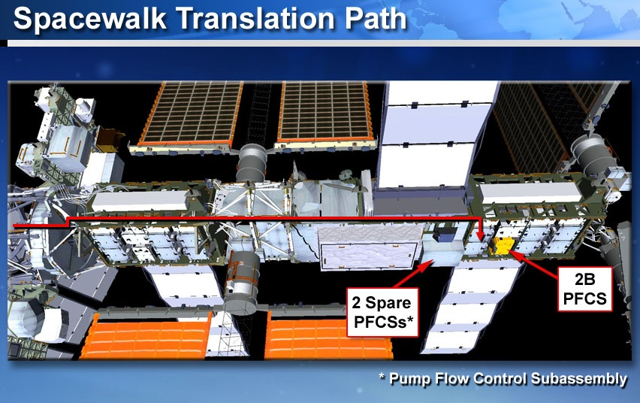
Example – US EVA 21, May 2013
Crew reported ‘snow flakes’ outside
MCC-H saw a large increase in a previously slow NH3 leak
Program and FOD decided to execute a contingency spacewalk (EVA) in 2 days to replace a pump
  We had never done an EVA in so short a time!
EVAs typically take 12+ months to plan and train
“Critical Contingency EVAs” need at least 9 days
Decision to do it so quickly based on
  Catch the leak while it was still leaking
    See where the leak was
    Prevent total loss of the NH3
  Before a crewmember returned to Earth in a Soyuz in 5 days
Notes:
There had been a slow leak for several years but the leak was so small that all we had to do was re-fill the NH3 every few years. But this was an order of magnitude bigger leak.
EVA 19 which we will talk about later was a contingency EVA but we took about a week to plan it and it was basically a repeat of EVA 18, just trying to figure out how to drive some pesky bolts that wouldn’t drive the first time

Slide 20
Should we have had an accident?
EVA is the most dangerous activity in human spaceflight outside of launch, entry, and landing
Two separate schools of safety said we were asking for an accident:
Hollnagel’s Efficiency-Thoroughness Trade-Off (ETTO)
  Never have enough time/ resources, so people must trade between efficiency and thoroughness
    Not doing the documented process -> variation -> error
    We certainly were rushed
Dekker’s Drift into Failure
  With very complex systems teams stove-pipe expertise/ processes and then hand-off products
    Teams make locally rational decisions that don’t make sense in the global context
    We certainly had a lot of teams over several shifts making locally rational decisions

Slide 21
So why didn’t we have an accident?
Because we were mindful that we had the right …
Circumstances
  Sensitivity to Operations
Processes
  Reluctance to Simplify Interpretations
Culture
  Preoccupation with Failure
  Commitment to Resilience
  Deference to Expertise
Notes:
Mindful: sounds very New Age but is a very prominent term in safety theory: defined as a rich awareness of discriminatory detail; to notice the unexpected even through weak signals and to respond vigorously
We didn’t get lucky. We very deliberately thought about the risks we’d need to manage if we were truly going to try to do an EVA in 2 days. We were mindful.

Slide 22

Circumstances
EVAs 18, 19 and 20 set us up
  Fall 2012; one was contingency
Many controllers had
worked together
Several had experience
in contingency planning
Astronauts were very experienced at this worksite
Only leak location we could repair was the pump
FOD, Engineering, ISS Program were already familiar with the technical details
Notes:
EVAs 18 and 19: experience with 1 type of bolt
EVA 19: experience with planning a contingency EVA
EVA 20: experience at that work site & other bolt type
Contingency planning (EVA 19 and Big 13)
Finke was Ground IV and Hatfield was on-orbit IV, both with a tremendous amount of experience
Marshburn and Cassidy had done an eva to that general worksite on STS-127
There were 3 places where the leak could be. In the radiator (EVA 20 eliminated that as a possibility), in the pump or in the piping. If it was in the piping, it would be near impossible to find and even less likely to figure out how to fix. So it was the pump or nothing.
Spare pump located next to leaking pump
Because all the technical discussions around EVA 20 had to do with the PVTCS, everyone already knew what the technical details and issues were. There was no requirements to have multiple meetings to bring them up to speed. It allowed the Program Office to rapidly define a very limited scope for EVA 21: R&R the pump. That very limited scope allowed the team to very rapidly determine what they needed to do and what they didn’t need to consider.
Transition: the second enabler was …

Slide 23
Processes
Matrix mgmt is bad, except when it’s good
ETTO says you need diversity of mental models
Drift into Failure says someone needs “The Big Picture” and to integrate across ‘silos’
‘Matrix mgmt’ is how we institutionalized these
Teams had to work
  Across disciplines (EVA, SPARTAN, Engineering, etc)
    Different mental models : “that is not what we need”
  Within disciplines
    Same mental models : “that is not what I thought”
  Leadership (HPO trait) at all levels enables Flight Directors and Program Managers to remain at the ‘Big Picture’ level to ask “Have you considered …”
Notes:
Matrix mgmt: reporting to multiple bosses
Mental model (MM): how you think something should work. You have mental model about how to do your job, how to interact with your team members, etc.
Big Picture: looking at the end to end process, and/or all the factors (system, vehicle, mission, environment, team, history, etc.). Someone who is looking across the ‘stove-pipes’
Matrix Mgmt: by that I mean, all the people and teams that have a say in whether we are doing the right thing
FD and PM: processing the details with the mindset of integrating the entire big picture, along with serving as a type of 'check valve' on the overall process and progress. Their job is to challenge assumptions, ensure that situation was properly and completely assessed and the plan was been thoroughly coordinated and vetted.
EVA thought about the EVA differently than the SPARTANs than did the MER. Because they all had different MMs, they exposed holes in each others MMs, hopefully making sure that nothing got missed across teams
Within a discipline, everyone should have had a similar MM – everyone in EVA should have a similar MM on how to do an EVA. So when someone has a thought that something isn’t right, it gives the team a chance to make sure that nothing got missed within the team, especially between shifts or tasks

Slide 24
Culture
You are allowed to be wrong
  Experts can make mistakes, co-ops can make big saves
It is a team event
  “All in” event (engagement)– even if one person’s role was simply making sure there were ample snacks to help reduce stress
  Leaders had to delegate tasks and trust the answers that came back
Okay and expected to have someone look over your shoulder (design)
It is okay to be the ‘squeaky wheel’
  Even if you know that it might mean causing a team to have to start over or perform major rework
EVA is one of the most dangerous things we do
  Solving/Fixing the problem is not nearly as important as the Priority 1 task – getting the crew back inside alive
Notes:
You’re allowed to be the expert but still make mistakes. This allows egos to not be in the way. No blame as long as you learn
We didn’t expect one person to do all the work: to be the hero to carry the entire project on his/ her shoulders
Everyone pitched in. People came in and offered to help. Sometimes just as little as bringing in snacks.
Leaders had the trust and confidence to delegate tasks
This is a 2 parter:
It is okay to have someone check your work without that being a sign we don’t trust you
There is an expectation that it is okay for you to look over people’s shoulder when you know they are stressed or tired or rushed, or when you know the task is safety critical or time critical
A short CRM briefing: it is your job to catch my mistakes, and it is my job to catch yours
It is okay to say that you have an issue or don’t think we are doing the right thing. It is even ok to be wrong about having an issue: it wasn’t an issue at all. Saying: the safety mentality of an organization is not how they treat someone who stops the team when there was a problem, but how they treat the person who stops the team when there really wasn’t a problem. Do you ‘counsel’ him (next time be sure before you stop the team) or thank him for having the courage?
Transition: the third enabler is

Slide 25
If we need to do a 2-day EVA in the future
Because we did it once does not mean we can do it again
  How are these circumstances different than what we had in EVA 21?
  Do we still have the same processes?
  Is our culture different?
How can we decide if we would (would not) be as safe as we were for EVA 21?
  Start from the beginning of the process and do not rely on “it worked before”
Notes:
Would we still have tried if
If the FCer who was the expert was on vacation
If we hadn’t done an EVA in over 6 months (no one had any recent experience)
The failure was more ambiguous
Cultures change very slowly overall but may be affected by intense pressure - What if we had only 1 day due to the leak size or the Soyuz schedule, would we have tried (I asked the answer is no)
But over time, as the ‘Old Guard’ retires is it possible for our culture to be less what we value in FOD?
FYI: two views on culture:
Something mgmt tries to steer/ instill
Something that emerges without plan over daily interactions
#1 gives the impression that mgmt can control culture; #2 says mgmt control may be minimal (the best they can do is notice the change and try to mitigate it at least over the short term)
Many of our ‘processes’ are not really ‘processes’ in the classic sense that they are vetted and documented (they are just too complex and context specific). More importantly people know their roles and people do what they should do and need to do keeps us safe. Will the next group of people know what they need to do, who they need to talk to about what, when and how?

Slide 26
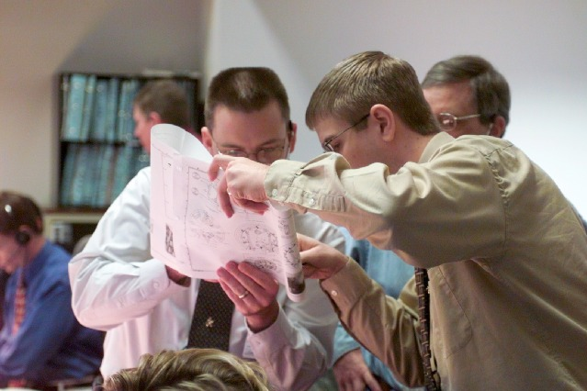
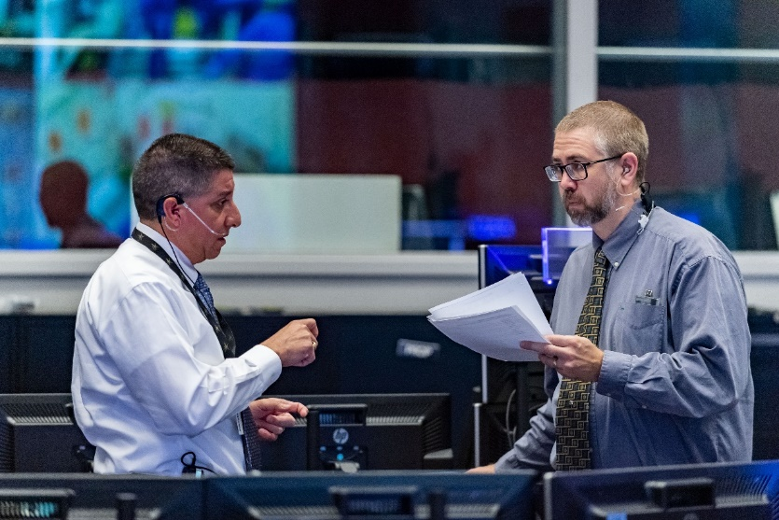
HROs and HPOs can exist independently but when an organization implements both the results can be considerably compounded
“Failure Is Not An Option” is more than a slogan
  Also not always correct
Leadership in High Reliability and High Performing Organizations often means
  Stepping back and letting others lead while at the same time retaining overall leadership and integration authority
    Trust but Verify
  Never relying solely on “what worked before” to get you through a situation
    But at the same time relying on established processes and culture to ensure consistency
  Ensuring both the failures and the successes of today enable the team to do it even better next time by performing “after action” reviews with defined actions for improvement
    Continuous Improvement is a way of life
Notes:
Be here by 0:45
HROs alone work risk and safety well. HPOs do good things and can do them quickly and effectively. HPOs that are HROs are a rare breed but something all complex orgs should strive for. It means you can do good things quickly and effectively but also safely while managing risk. We’re not perfect though, and that’s part of the process – when you make mistakes (big or small), you learn from them. When you have successes (big or small) you don’t just celebrate that it worked but you also learn the enablers so you can repeat your successes.

Slide 27
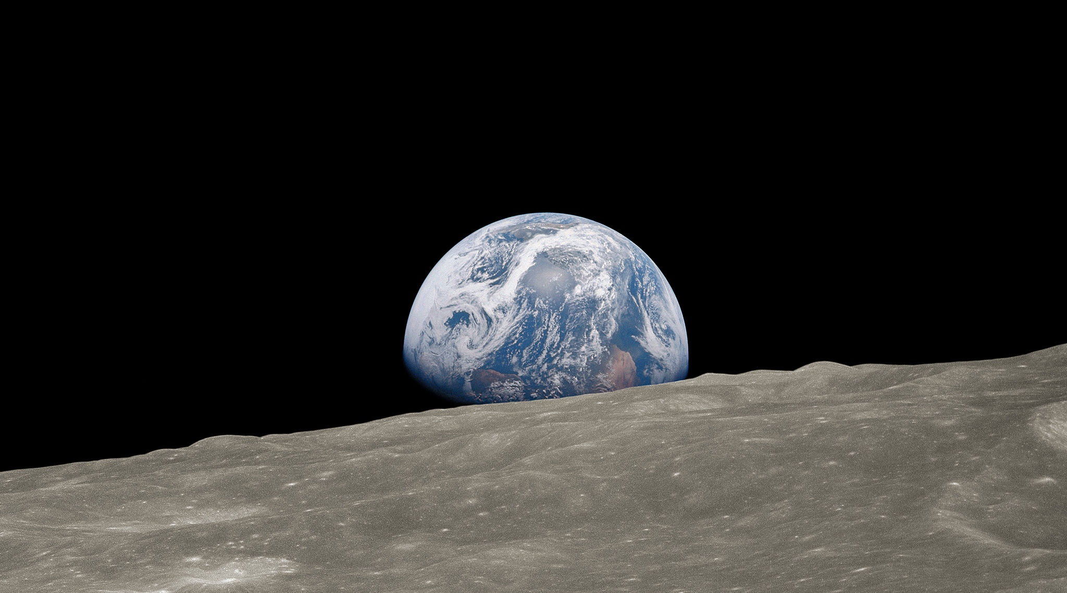
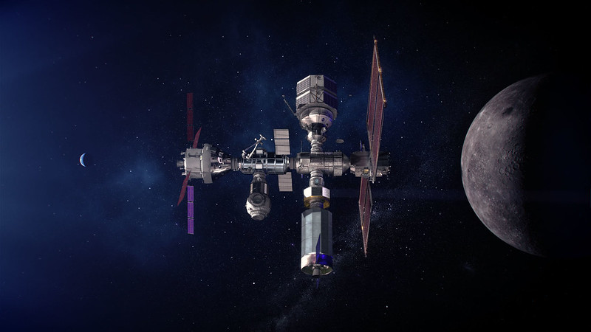
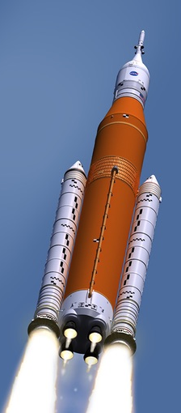
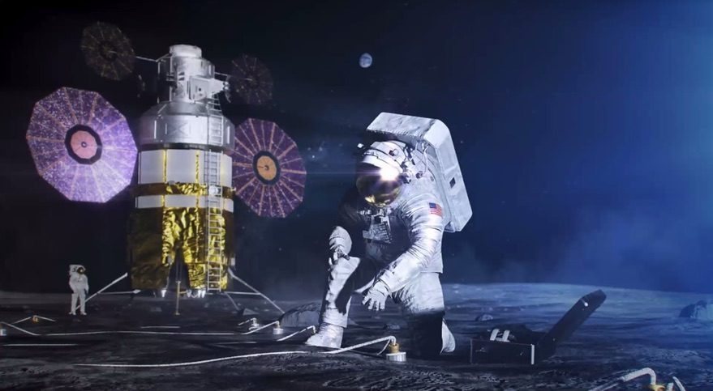
Moon to Mars
Artemis – Humans on the Moon and in Lunar orbit
  SLS
  Orion
  Gateway
  Long duration Lunar surface

Slide 28

Curiosity Rover, Mars
You are here.
On To Mars!
  237,000,000 mi from Earth (Moon is 238,900 mi)
    Mars is 992x farther from Earth than the Moon

Slide 29
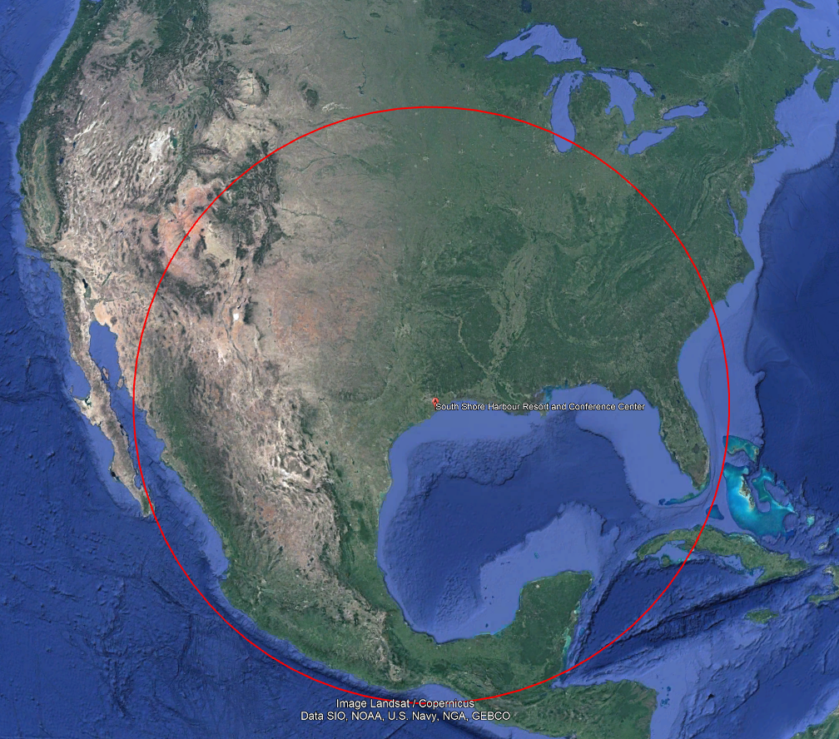
On To Mars!
Leverage Artemis experiences to learn to travel into deep space, stay there for lengths of time, explore surfaces for weeks or months, and develop technologies to live away from Earth for up to 2 years
You would prepare differently for a 1 mi walk to Starbucks and a 992 mi walk away from South Shore Harbour

Slide 30
Links and Information
Social Media
  Twitter
    Ed: @Carbon_Flight
    NASA: @NASA
    Space Station: @Space_Station
    Astronauts: @NASA_Astronauts
    Artemis: @NASAArtemis
Inside Look at Space Station Flight Control (eBook)
  https://blogs.nasa.gov/spacestation/tag/mission-control-center/
Websites
  Spot the Space Station from nearly anywhere on Earth: https://spotthestation.nasa.gov
  More on the Space Station: http://www.nasa.gov/mission_pages/station/main/index.html
  Commercial Crew Program: https://www.nasa.gov/exploration/commercial/crew/index.html
  More on Artemis and going beyond Earth: https://www.nasa.gov/topics/moon-to-mars/
  More on our solar system: http://www.nasa.gov/topics/solarsystem/index.html
Video:
  NASA Television: www.nasa.gov/multimedia/nasatv/index.html
  NASA High Definition Earth Views from ISS: http://www.ustream.tv/channel/iss-hdev-payload
  Live video (external or internal) from ISS: http://www.ustream.tv/channel/live-iss-stream
  ISS Symphony: https://youtu.be/wgdbZhnFD5g
  Paolo Nespoli and Soyuz: https://youtu.be/-l7MM9yoxII
  Riding the Boosters: https://youtu.be/2aCOyOvOw5c
  Longer booster video: https://youtu.be/cLl7oqdm_B8
  How We Are Going to the Moon: https://youtu.be/_T8cn2J13-4
  Artemis: We Are Going: https://youtu.be/vl6jn-DdafM
Notes:
1:00

Slide 31
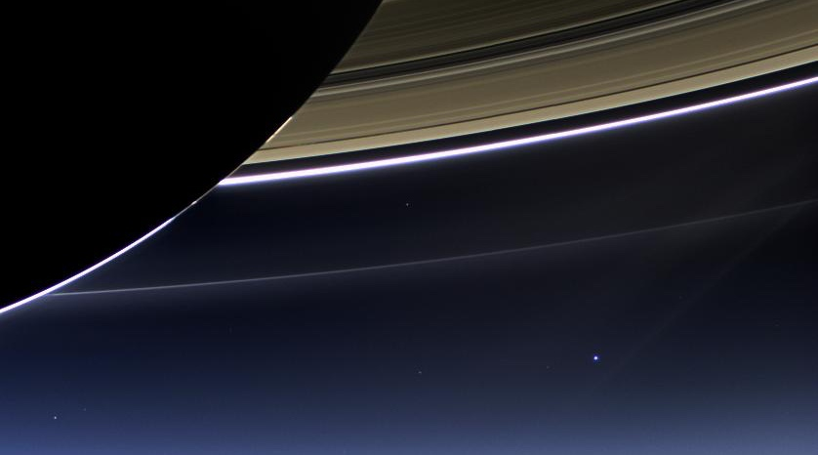
Cassini Spacecraft, Saturn
Questions?
You are here.
830,000,000 miles (~9 AU) from Earth

