Slide 1
Active full-shell grazing-incidence optics
Jacqueline Davis
NASA Marshall Space Flight Center
Astrophysics Group
X-ray Astronomy

Slide 2


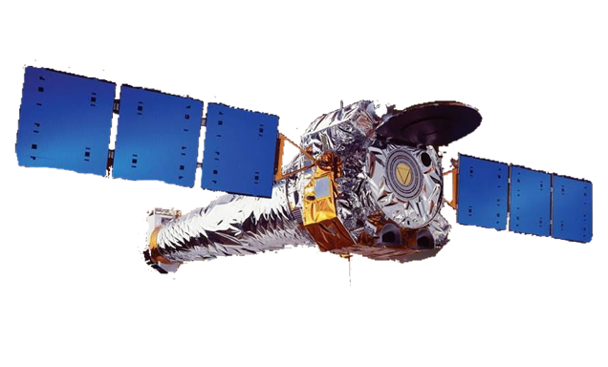

Scientific Discoveries with Chandra
BIGGER
BETTER

Slide 3
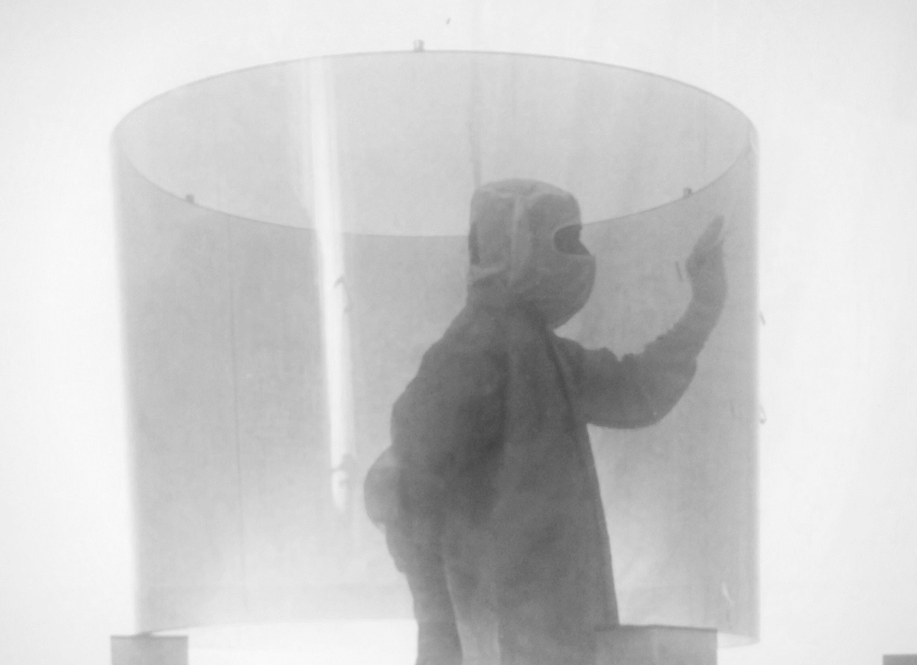
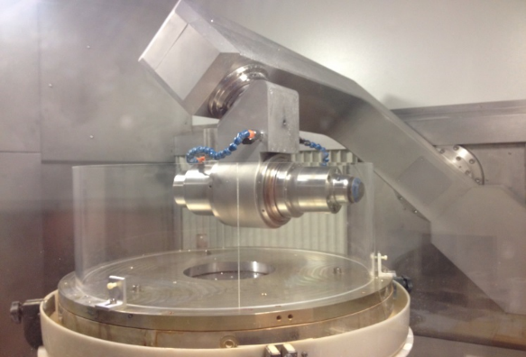
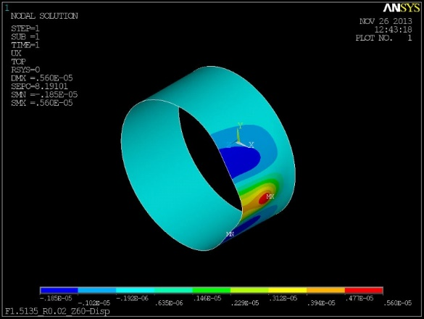
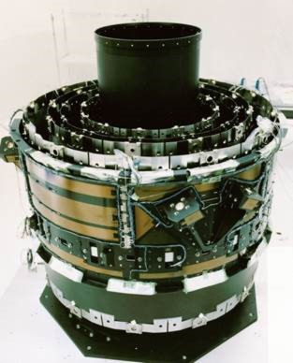
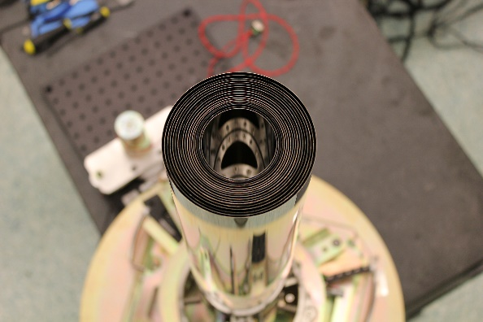
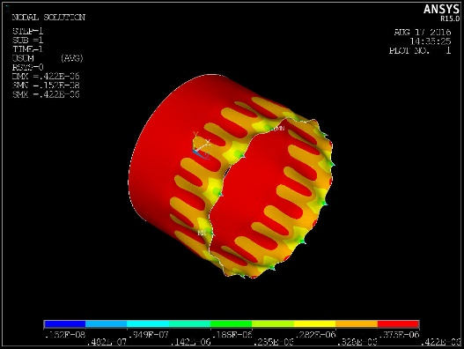
Increase Surface Area
Chandra optics
  0.5” HPD
  4 p-h shell pairs
  R_{outer} = 0.60 m
  l = 1.66 m
ART-XC optics
  25” HPD
  28 p-h shells
  R_{outer} = 0.075 m
  l = 0.58 m
Lynx optics
0.5” HPD
142 p-h shell pairs
R_{outer} = 1.5 m
l = 0.85 m
Manufacture thinner optics
Figure 3: left: manufacturing error of replicated shell;
right: analytical post-correction residual manufacturing
Assemble tightly nested, flimsy optics
Notes:
The overarching x-ray optics challenge is to achieve sub-arcsecond angular resolution ("Chandra-like“) with more collecting area. The latter necessitates thinner optics which can be heavily nested to improve efficiency, but which are more susceptible to distortions.

Slide 4
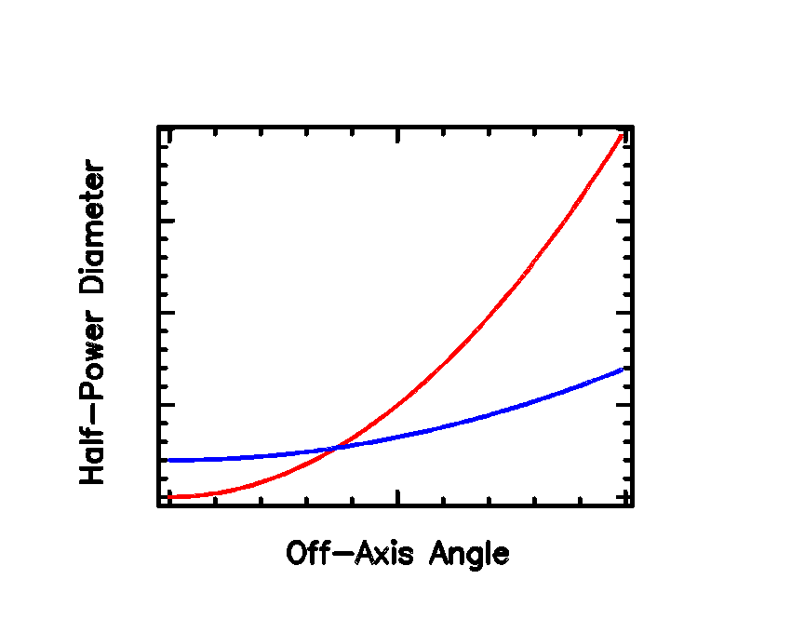
Off-axis Angular Resolution
Goal: achieve sub-arcsecond angular resolution across larger field-of-view
Active prescription switching
  ability to adjust optic in orbit
  polynomial prescription optimized for wide field of view
  Wolter I prescription, low angular-resolution for narrow field of view
Survey and pointing mission
Wolter I
polynomial
Notes:
Typically, the field of view (FOV) for an X-ray telescope is set by the prescription of the mirror or mirror assembly. A wide FOV, lower-angular resolution telescope is often used for surveying large fields, while smaller FOV, higher angular-resolution telescopes are used observe fine details of extended objects and to avoid source confusion at high redshifts (large distances). Both configurations are necessary and valuable to the astronomy community. Currently, the only way to have both wide-low-resolution and smaller-high-resolution FOVs requires multiple telescopes (either on the same payload or launched separately).

Slide 5
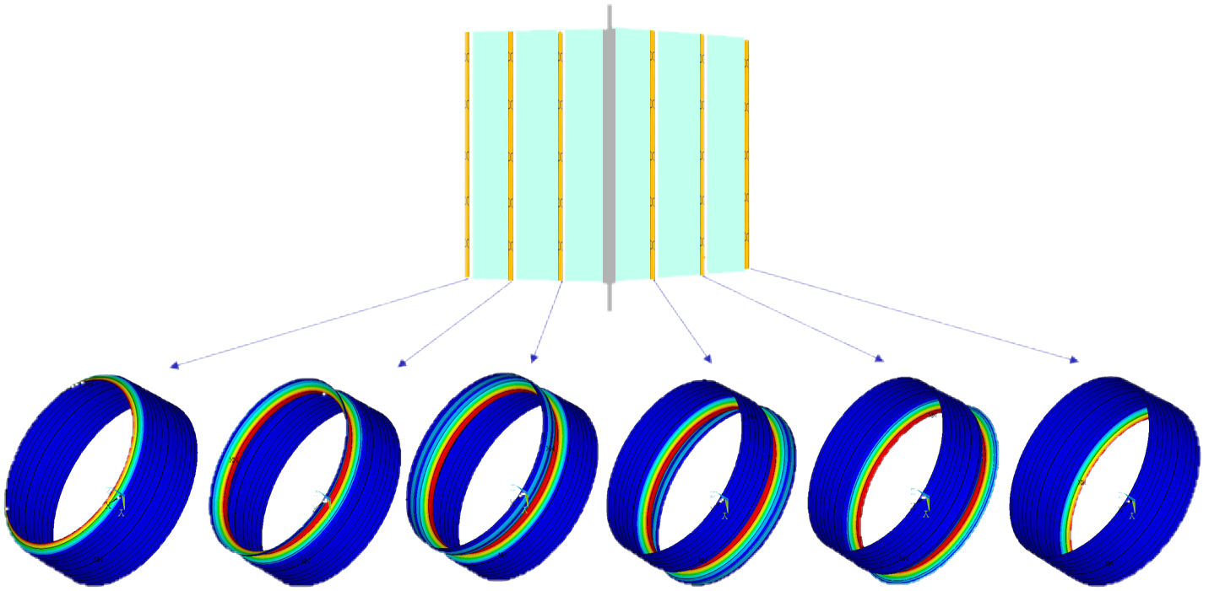
Pathfinder
finite element modeling of full-shell optics with various actuator configurations
induce low-spatial frequency figure changes in the full-shell
  reduces a large percentage of the RMS slope error
  combine with processes that remove mid- and high-spatial frequency errors
enable optics to switch prescriptions in flight
  moving from a polynomial prescription to a Wolter I prescription
  supporting a deep search with high resolution across a wide field
  pointed viewing with even better resolution in the narrow field

Slide 6
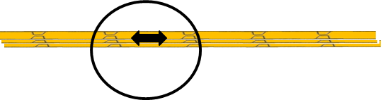
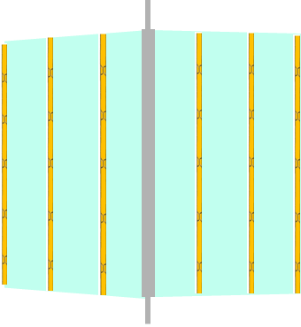
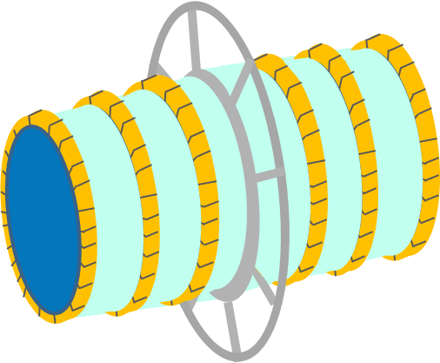
Potential Actuation
Bands of actuators at six positions along shell
  Using surface-parallel actuators
  Bond array of actuators into bands around full-shell grazing incidence optics
  Activated together or individually
individually activated
mount
surface-parallel actuator bands

Slide 7
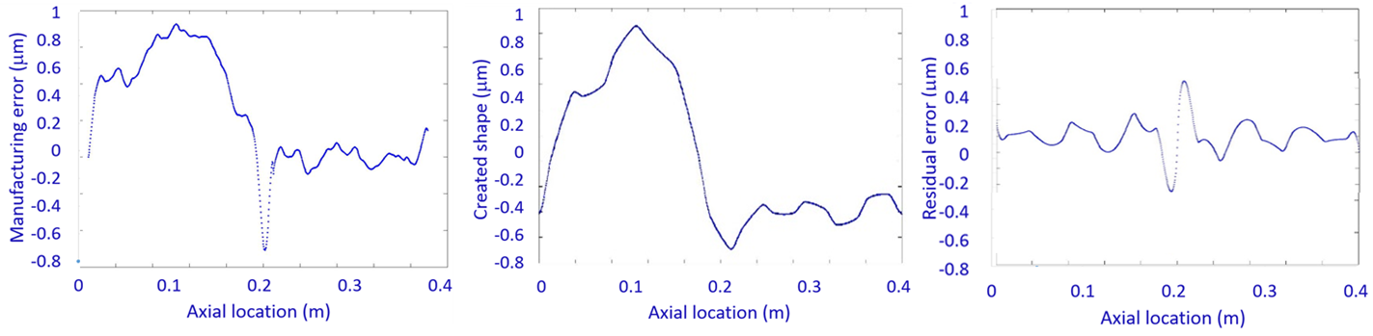
Analytical Results
Under a direct work package, multiple configurations of actuators were iterated with finite element models, and a point design (Figure 2) was chosen based on its capacity to induce large azimuthal slope changes with minimal aperture obstruction. Analytical influence functions from each actuator were combined to correct low-spatial frequency manufacturing error and also switch prescriptions. Below in Figure 3 is a typical MSFC full-shell x-ray optics manufacturing error, pre- and post-correction using the analytical influence functions. The ability to correct low-spatial frequency errors is significant, because they comprise a large percentage of RMS slope error.
As a demonstration of switching between prescriptions, the capacity of active full-shell optics was shown to switch between Wolter I and Wolter Schwarzchild prescriptions with 92% RMS surface accuracy; a future analysis will be performed to switch to a polynomial prescription.
Figure 3: left: manufacturing error of replicated shell;
right: analytical post-correction residual manufacturing

Slide 8
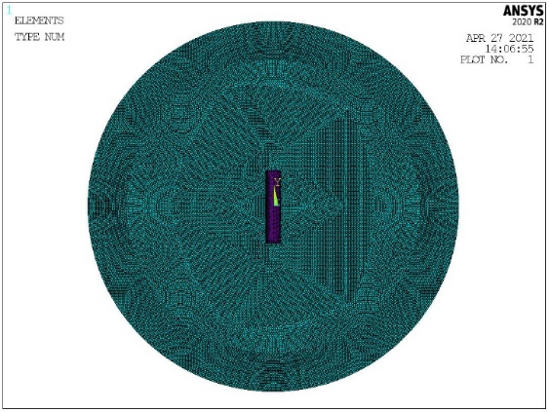
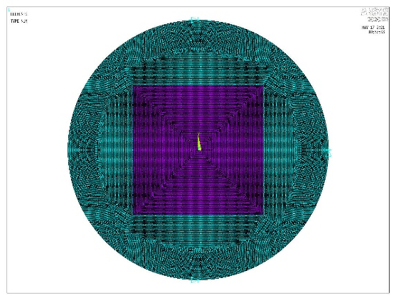
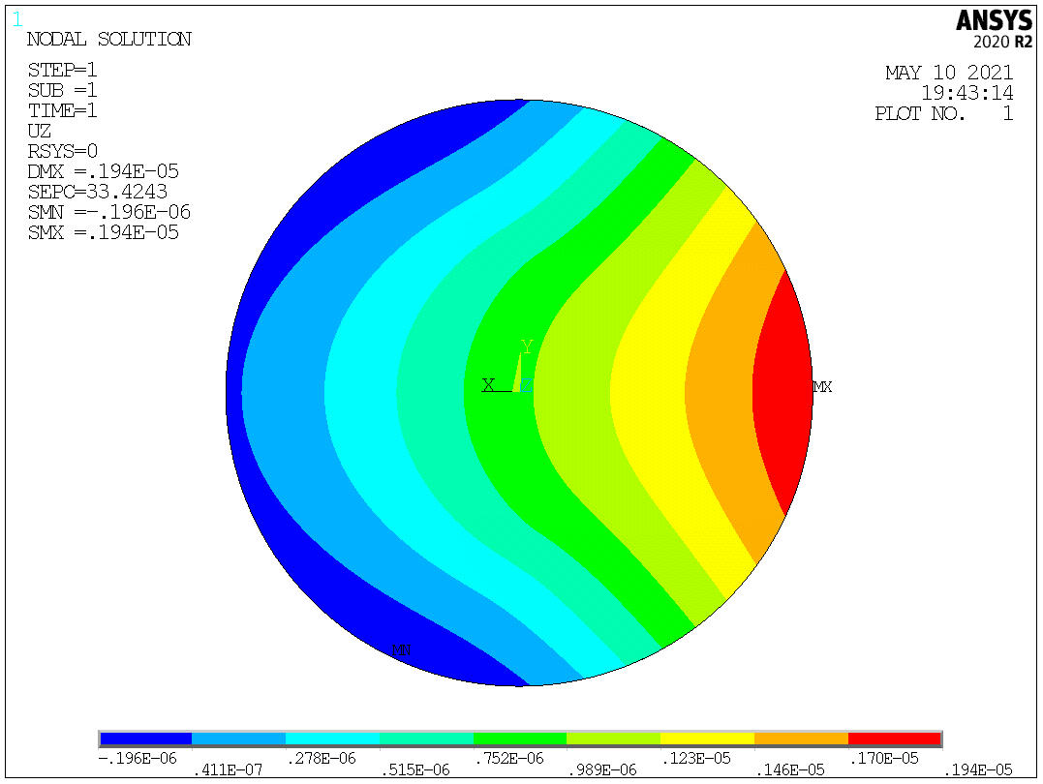
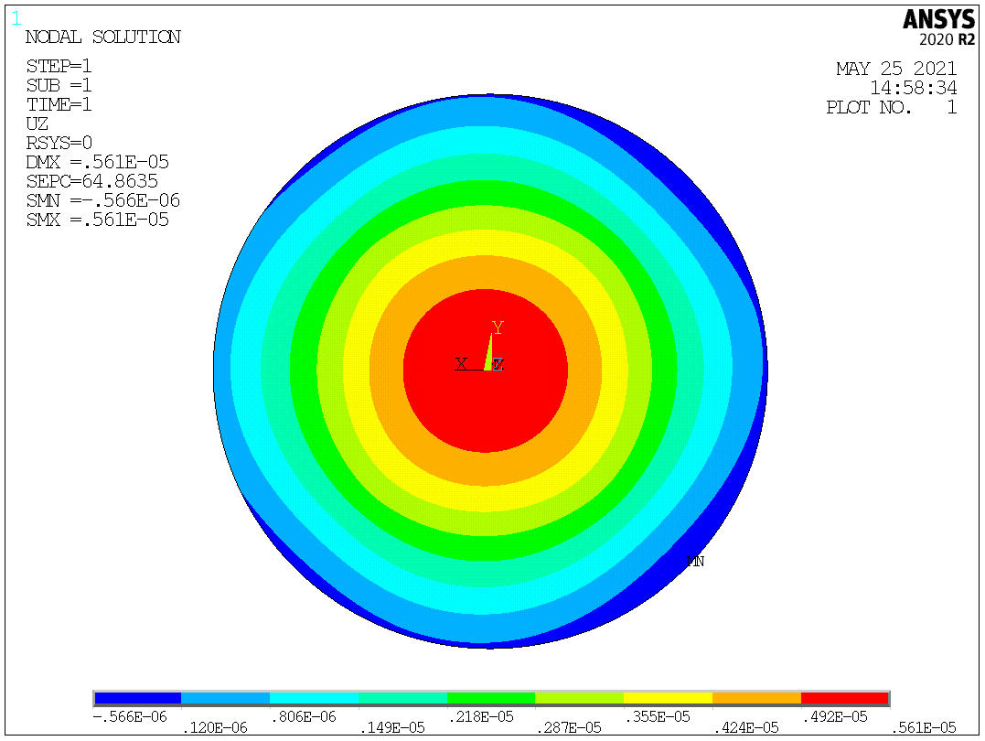
Coupon Configuration Analysis
surface-normal actuator
surface-parallel actuator
NiCo “pusher-pads”
NiCo replicated puck
NiCo replicated puck

Slide 9
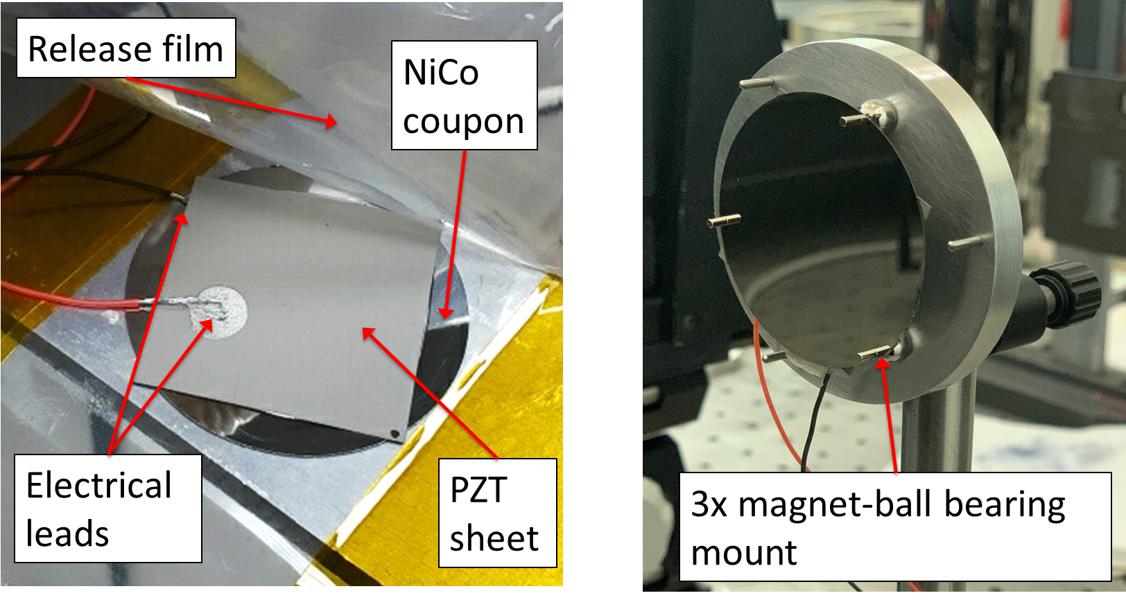
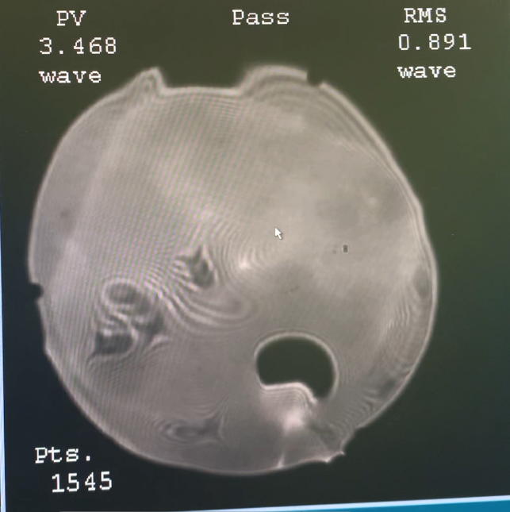
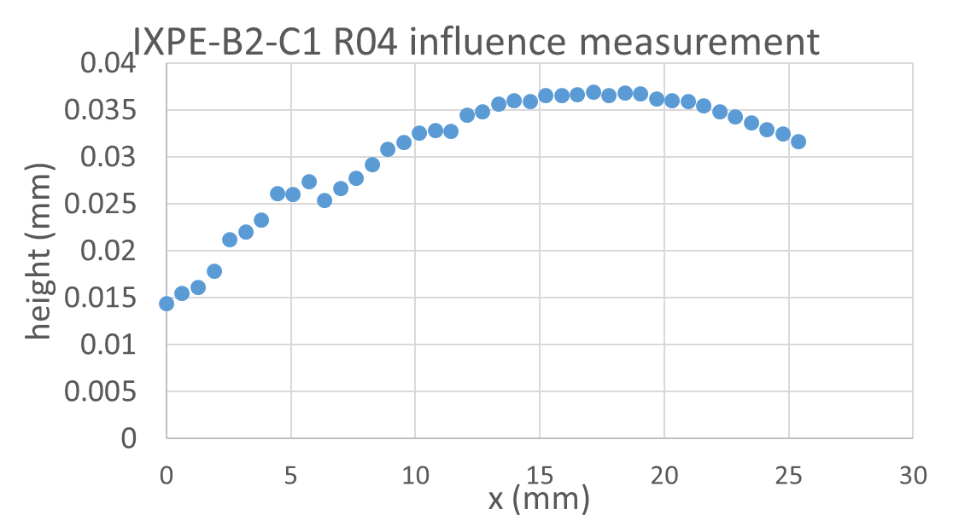
Active Optics Demonstrator
1.87” diameter nickel-cobalt flat
1.43” square sheet of piezo ceramic
1-D influence function at 65V, collected with Keyence LK-G10 laser displacement sensor

Slide 10
Potential Prototype Designs
IXPE shell
IXPE shell
surface-parallel actuators
surface-parallel actuators
choose after coupon studies
stiffness rings
Determine prototype design and build
Collect metrology data using actuators
Input influence functions to analytical design
  Calculate correctability of manufacturing errors and prescription switching
  Determine differences in analytical and measured influence functions

Slide 11
Continuation of Work
Bonding
Actuators
Collaborations
Modeling and analysis

