Slide 1
Developing A New Medical Condition List for Exploration Spaceflight
Amy Kreykes, MD, MPH
Rahul Suresh, MD, MPH, MS
Aerospace Medical Association
91st Annual Scientific Meeting
Denver, Colorado
September 2, 2021
“Expanding the Boundaries of Space Medicine and Technology”

Slide 2
Disclosure Information
91st Annual Scientific Meeting
Amy J. Kreykes, MD, MPH
I have no financial relationships to disclose.
I will not discuss off-label use and/or investigational use in my presentation
September 2, 2021
2

Slide 3

Outline
Background – Why IMPACT? Why a new condition list?
Overview development process for IMPACT 1.0 Condition List (ICL 1.0)
  Collaboration with subject matter experts
ICL 1.0 Preview
  Increased Scope
    Behavioral Health Conditions
    EVA Related Conditions
    Gravity Well Conditions
  “Conditions Not Explicitly Stated” in the title, but included in definitions
3

Slide 4
Background

Slide 5
Why IMPACT, Why a New Condition List?
For the last decade, NASA has utilized a probabilistic risk analysis tool called the Integrated Medical Model (IMM) for ISS operations¹
Planning for future missions to the Moon and Mars will require updated tools and evidence that consider the unique features of exploration missions.
To address this need, the Exploration Medical Capability (ExMC) Element of the NASA Human Research Program is developing an advanced trade-space analysis tool suite, Informing Mission Planning via Analysis of Complex Tradespaces (IMPACT).
As a part of this effort, ExMC has produced the IMPACT version 1 Condition List (ICL 1.0) which expands the scope and definition of medical conditions.
1. IMM Data Request D-20160309-348.
Notes:
Lynn B – Added the new IMPACT project name

Slide 6
Development process
September 2, 2021

Slide 7
Developing a New Condition List
9 Source Condition Lists Provided the Candidate Conditions for ICL 1.0:
  Integrated Medical Model Condition List (IMCL)
  Historical Spaceflight condition list (conditions from IMCL which have occurred in spaceflight)
  Evidence Library Pilot Project Toxic Exposures and Injuries Condition List
  Evidence Library Pilot Rochester Epidemiology Project (REP) Condition List
  Evidence Library Pilot Project Spaceflight Condition List
  Evidence Library Team Condition List
  Exploration Medical Condition List (EMCL)
  Artemis Phase I Missions: Functional Medical Concept of Operations
  Lunar EVA Incapacitation Conditions List

Slide 8
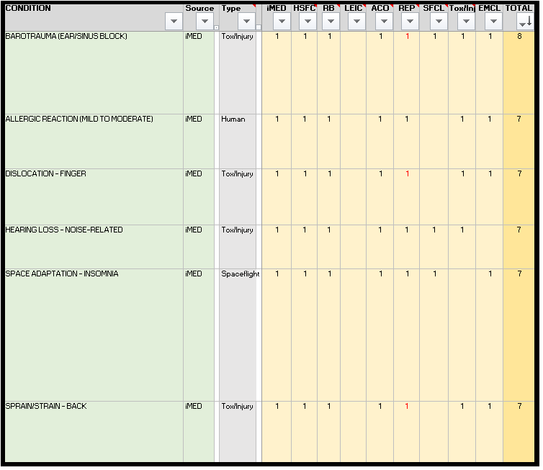
Concurrence Ranking
Notes:
Max concurrence ranking possible = 9
All conditions with a concurrence ranking of 3 or higher were discussed to consensus by the CST.

Slide 9
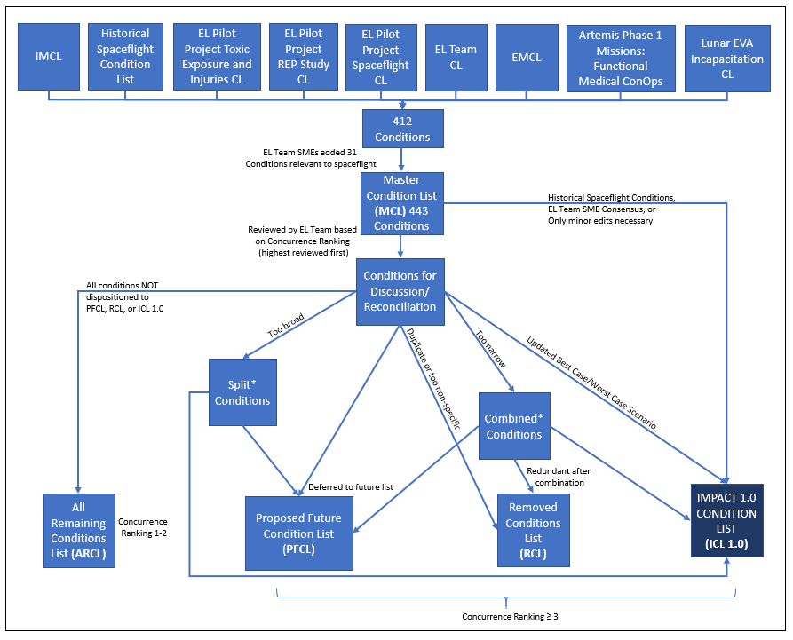
Talking Points
Notes:
CST backgrounds:
Physicians – Family Medicine, Internal Medicine, Emergency Medicine, Pathology, Physical Medicine & Rehabilitation, Sports Medicine, Aerospace Medicine, Public Health.
Nurses – Registered Nurse, Master of Science in Nursing (emergency nursing, critical care, nursing informatics)
Epidemiologist
Clinical Scientists
3 SME’s vetted the list and provided feedback for the conditions, BC/WC.
Physician astronaut, 2/3) 2 Operational Flight docs
All Remaining Conditions List (ARCL): (173 conditions)
Removed Conditions List (RCL): (68 conditions)
Proposed Future Conditions List (PFCL): (89 conditions).
*Note – the 120 conditions was determined as a time and resource feasible target by ExMC for IMPACT 1.0.

Slide 10
Collaboration with Subject Matter Experts
  Obstetrics and Gynecology (OBGYN) ‒ regarding Women’s Health conditions.
  Dentistry – regarding all dental conditions.
  Johnson Space Center (JSC) Behavioral Health and Performance (BHP) ‒ regarding all behavioral health-related conditions. BHP prioritized 8 conditions as candidates for inclusion in the ICL 1.0 and assisted in writing the best/worst case scenarios for these conditions.
  JSC Undersea and Hyperbaric Medicine, the EVA Physiology Laboratory, and JSC Musculoskeletal Medicine and Rehabilitation – regarding EVA related conditions.
  JSC Undersea and Hyperbaric Medicine and Orion/Multipurpose Crew Vehicle Operations – regarding altitude illness.
  JSC Optometry – regarding eye conditions.
  Aerospace Technology, Technical Management – regarding Lunar/Martian dust exposure.
  Aerospace Technology, Life Sciences Research – regarding toxic exposures and combustion products.
Notes:
Strove to include/collaborate with SMEs outside of ExMC for input into the ICL 1.0. (This was not done with IMM).

Slide 11
ICL 1.0 Preview

Slide 12
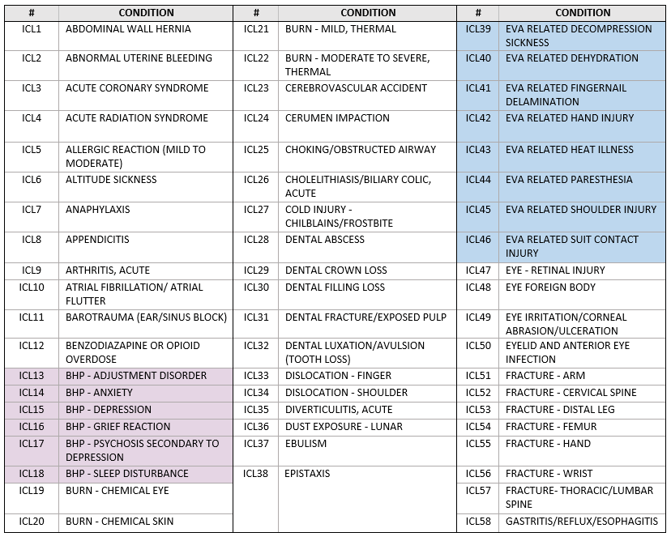
ICL 1.0 Preview of Increased Scope
Notes:
BHP – (Lavender) IMM had 3 conditions (Anxiety, Depression, Sleep Disorder).
Doubled in ICL 1.0 to 6 conditions
→ BHP assisted in the creation of these conditions and their BC/WC definitions.
EVA Related conditions (Blue) – IMM had 3 conditions (DCS, Fingernail delamination, Paresthesia secondary to EVA)
More than doubled in ICL 1.0 to 8 conditions

Slide 13
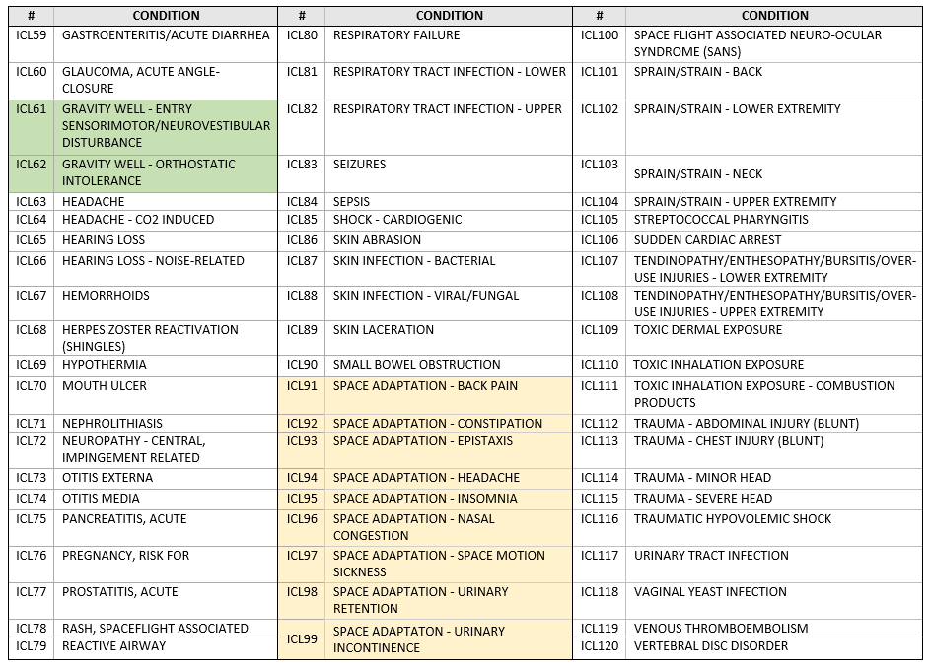
ICL 1.0 Preview of Increased Scope
Notes:
Gravity Well conditions – This is a new category of conditions that did not exist with IMM b/c this would be occurring post-flight. With exploration missions, they may occur inflight during surface operations during gravity well transitions.
The Space Adaptation Syndromes are still represented in ICL 1.0. (Yellow)

Slide 14
Conditions Not Explicitly Stated But Included by ICL 1.0
ID | CONDITION
1 | Anemia, Acute Hypovolemic
2 | Angina, Unstable
3 | Arthropathy, acute - Crystalline
4 | Back Pain, Acute Low
5 | Back Pain, Chronic Low
6 | BHP - Adjustment Reaction
7 | BHP - Apathy
8 | BHP - Circadian Rhythm-Sleep Wake Disorders
9 | BHP - Grief, Complicated
10 | BHP - Insomnia
11 | BHP - Irritability
12 | BHP - Low Motivation
13 | BHP - Mood Disturbance
14 | BHP - Panic Symptoms
15 | Cellulitis, Periorbital
16 | Concussion
17 | Deep Vein Thrombosis
18 | Diffuse Axonal Injury
19 | Dust Exposure (Lunar) - Pneumonitis
20 | EVA related - Contusions
21 | EVA Related - Heat cramps
22 | EVA Related - Heat Exhaustion
23 | EVA Related - Heat Stroke
24 | EVA related - Skin blister
25 | EVA related - Skin Chaffing
26 | Eye - Corneal Laceration
27 | Eye - Dry Eyes
28 | Eye - Hyphema
29 | Eye - Retinal Burn
30 | Eye - Retinal Tear
31 | Eye - Ruptured Globe
32 | Eye - Scleral Laceration
33 | Eye -Retinal Detachment
34 | Fecal Impaction
35 | Finger tendon injury
36 | Fracture - Capitate
37 | Fracture - Finger
38 | Fracture - Hamate
39 | Fracture - Humerus
40 | Fracture - Knee
ID | CONDITION
41 | Fracture - LE Stress
42 | Fracture - Lunate
43 | Fracture - Metacarpal
44 | Fracture - Pilon
45 | Fracture - Pisiform
46 | Fracture - Proximal Fibular
47 | Fracture - Radius (excluding radial head)
48 | Fracture - Scaphoid
49 | Fracture - Thumb
50 | Fracture - Tibial Shaft
51 | Fracture - Trapezium
52 | Fracture - Trapezoid
53 | Fracture - Triquetrum
54 | Fracture - Ulna (excluding olecranon)
55 | Fracture- Elbow (radial head / supracondylar / olecranon fracture)
56 | GERD
57 | GI - Indigestion
58 | GI bleed (upper)
59 | GI Ulcer - Duodenal
60 | GI Ulcer - Ulcer, Gastric
61 | Hearing Loss - Conductive
62 | Hearing loss - Sensorineural
63 | High Altitude Cerebral Edema
64 | High Altitude Headache
65 | High Altitude Pulmonary Edema
66 | Intracranial Bleed (Non-surgical)
67 | Intracranial Hematoma, Subdural
68 | Intracranial Hematoma, Epidural
69 | Menorrhagia
70 | Menses, Irregular
71 | Myocardial Infarction
72 | Neuropathy - Brachial plexus injury
73 | Neuropathy - Lateral femoral cutaneous nerve entrapment
74 | Neuropathy - Pain related to nerve root impingement/disc herniation
75 | Neuropathy - Sciatica/piriform syndrome
76 | Onycholysis
77 | Osteoarthritis, acute
78 | Oval Window Rupture
79 | Peritonsillar Abscess
80 | Post-Concussive Syndrome
ID | CONDITION
81 | Prostatic Abscess
82 | Pulmonary Embolism
83 | Pyelonephritis
84 | Respiratory Distress Syndrome, Acute
85 | Respiratory Tract Infection (Lower) - Bronchitis, Viral
86 | Respiratory Tract Infection (Lower) - Influenza
87 | Respiratory Tract Infection (Lower) - Pneumonia, Bacterial
88 | Respiratory Tract Infection (Upper) - Pharyngitis, Non-strep
89 | Respiratory Tract Infection (Upper) - Rhinitis, Allergic
90 | Respiratory Tract Infection (Upper) - Rhinitis, Viral
91 | Respiratory Tract Infection (Upper) - Sinusitis, Allergic
92 | Respiratory Tract Infection (Upper) - Sinusitis, Viral
93 | Shock - Anaphylactic
94 | Shock - Sepsis
95 | Shoulder - Labral Tear
96 | Sprain - Finger
97 | Sprain/Strain - Achilles tendon injury
98 | Sprain/Strain - Ankle
99 | Sprain/Strain - Elbow
100 | Sprain/Strain - Foot
101 | Sprain/Strain - Hip
102 | Sprain/Strain - Knee
103 | Sprain/Strain - Medial gastrocnemius muscle strain
104 | Sprain/Strain - Shoulder
105 | Sprain/Strain - Wrist
106 | Status Epilepticus
107 | Toxic Dermal Exposure - Can be applied to any substance in theory
108 | Toxic Inhalation Exposure - Can be applied to any substance in theory
109 | Toxic Inhalation Exposure - Carbon Monoxide poisoning
110 | Toxic Inhalation Exposure - Cyanide Poisoning
111 | Toxic Inhalation Exposure - Hydrocarbons
112 | Toxic Inhalation Exposure - Sulfur Dioxide
113 | Toxic Inhalation Exposure -Nitrogen Dioxide
114 | Transient Ischemic Attack
115 | Trauma (Abdominal Blunt) - Mesenteric Injury
116 | Trauma (Abdominal Blunt) - Peritonitis
117 | Trauma (Chest Blunt) - Hemomediastinum
118 | Trauma (Chest Blunt) - Hemopericardium
119 | Trauma (Chest Blunt) - Hemothorax
120 | Traumatic Brain Injury
Notes:
The ICL 1.0 has 120 conditions listed by name
BUT…. The best/worst case scenarios for the conditions were refined by the CST and they include an additional 120 conditions that are not listed explicitly in the condition titles.

Slide 15
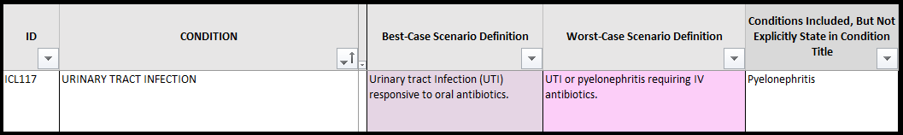
Example of a Condition Not Explicitly Stated But Included
Notes:
Example of a condition not explicitly stated in the title, but included in the best/worst case scenario –
Pyelonephritis is included in the WC of UTI.

Slide 16
Talking Points
Notes:
Recall that for forward planning for future iterations of IMPACT 1.0, there is a Proposed Future Conditions List as well as an archived “All Remaining Conditions List” from this process.

Slide 17
Summary
Exploration missions will present challenges requiring an updated condition list
The Clinical & Science Team of ExMC used 9 source lists to find candidate conditions for ICL 1.0 of which 120 were chosen via a systematic process of concurrence ranking and SME input
ICL 1.0 provides increased scope/breadth as compared to IMM
  SME input from outside of ExMC
  More conditions (120 vs. 100)
    Behavioral Health Conditions
    EVA Related Conditions
    Gravity Well Conditions
  120 additional Conditions Not Explicitly Stated, but included in definitions

Slide 18
Acknowledgements
Acknowledgements
Subject matter experts who contributed to the ICL 1.0
Clinical & Science Team
ExMC Leadership
September 2, 2021
Notes:
Especially Rachel Passmore w/ BHP
Rahul Suresh for his mentorship as I took on the lead for this project.
25 hours of consensus meetings with the entire CST (plus homework of reviewing conditions and providing feedback)

Slide 19
Questions?
“Expanding the Boundaries of Space Medicine and Technology”

