Slide 1
Augmenting Crew Autonomy with Clinical Decision Support
National Aeronautics and Space Administration
Brian Russell¹, Michael Krihak ¹, Dana Levin ¹,
Ben Easter ¹, Kris Lehnhardt ¹
¹ Exploration Medical Capability, ExMC, Johnson Space Center, NASA, Houston
Trade names and trademarks are used in this report for identification only. Their usage does not constitute an official endorsement, either expressed or implied, by the National Aeronautics and Space Administration.
https://www.nasa.gov/hrp/elements/exmc

Slide 2
Disclosure Information 91st Annual Scientific Meeting
The Authors and Presenters have no financial relationships to disclose
The Authors and Presenters will not discuss off-label use and/or investigational uses
Notes:
Disclosure statement.

Slide 3

Autonomy
No resupply
No evacuation
Delay communications
Potential limited knowledge, skills and ability (KSA)
Skills erosion over time
Crew time limited to identify symptoms,
  collect data, apply solutions and problem solve

Slide 4
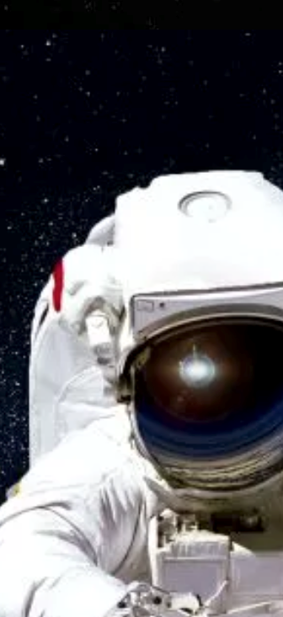
Clinical Decision Support System (CDSS)
Clinical Decision Support System (CDSS)assistant to adapt to level of acuity
Automation of time critical functions that
off load time critical tasks
CDSS designed to account for the Knowledge, Skills and Abilities (KSA) of the crew when making recommendations
Notes:
The CDSS’s role is to assist the CMO and rest of the crew in prevention, detection, diagnosis, and treatment of countless medical conditions that could arise in spaceflight, exacerbated by n decrements in sleep, cognition, nutrition, and exercise. While such demands exist today on the ISS, near real-time communications allows the burden on decision-making to remain on the ground. This will shift to the crew during exploration flights, and the CDSS is intended to support and optimize that process.
Assistance needs to augment the CMO and assist the non CMO crew. Context awareness is paramount to define what ‘assist’ means within the context of different scenarios.

Slide 5

How Can a Software Tool Help?
This includes ground and space systems.
Determine requirements from CONOPS describing ideal systems, human machine interfaces and technology:
  Increase “Scope of Practice” levels for crew
  Adapt to “Knowledge, Skills and Abilities (KSAs)” and fatigue
  Adapt to acuity and severity of scenario
  Adapt to resource constraints and mission duration
  Assist with data recall e.g., Electronic Health Record (EHR), pharmacy, resources
  Assist with decision making for expected conditions
  Remove unnecessary data on screen to aid understanding
  Optimization and enhance access through Graphical User Interface (GUI)
Notes:
TOPIC: We augment inflight autonomous medical decision-making by (i) describing use of ideal systems through a Concept of Operations (ConOps), (ii) outlining vehicle and human systems interfaces, and (iii) aligning technology and user interfaces with acuity and severity of conditions.
MOC QUESTIONS:
1. Which of the following functions will not be available in a clinical decision support system on a deep space exploration mission?
a. Guaranteed instantaneous contact to earth clinicians
b. Medical history of the crew
c. Diagnostics for expected medical conditions
d. Treatment recommendations taking into account available resources and the remaining duration of the mission.

Slide 6
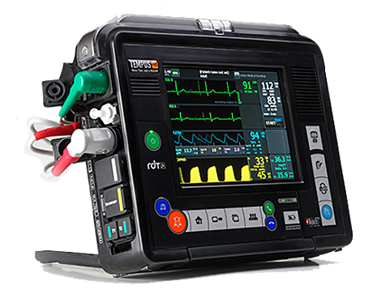
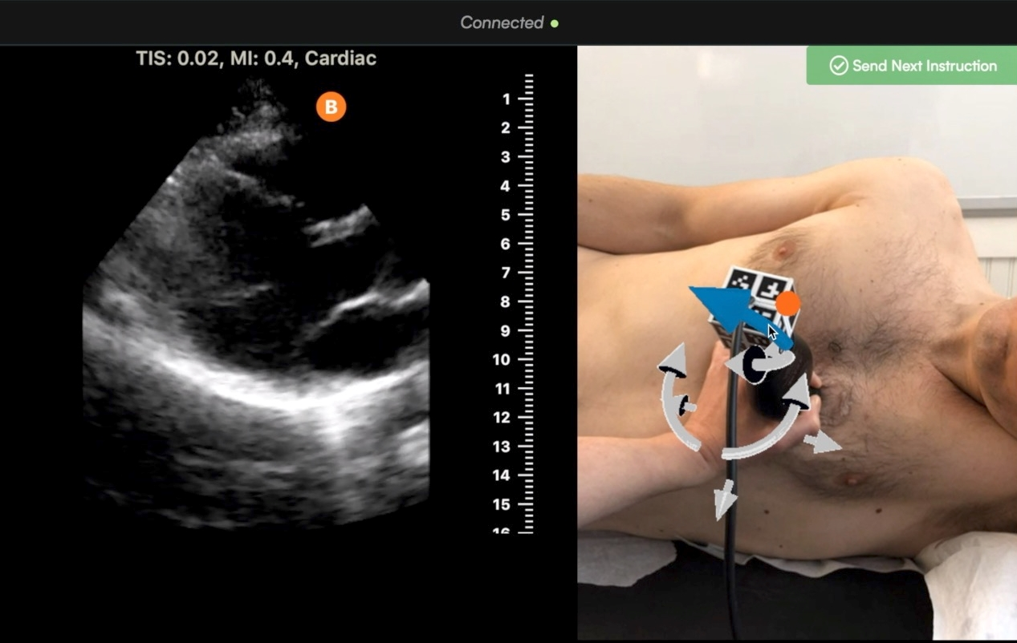
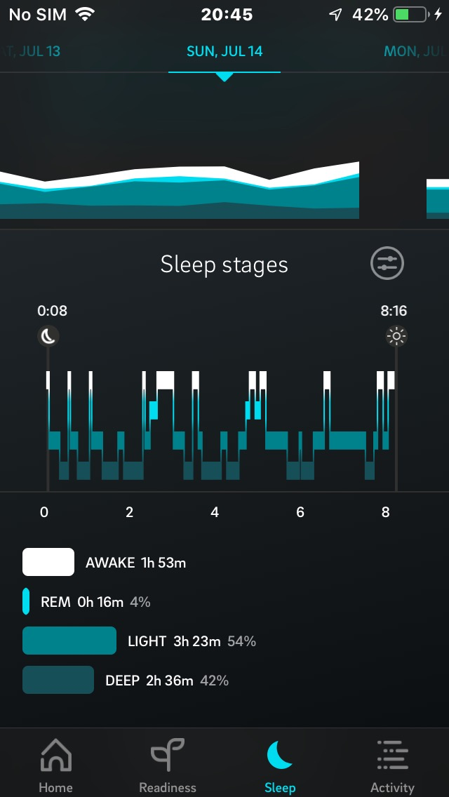
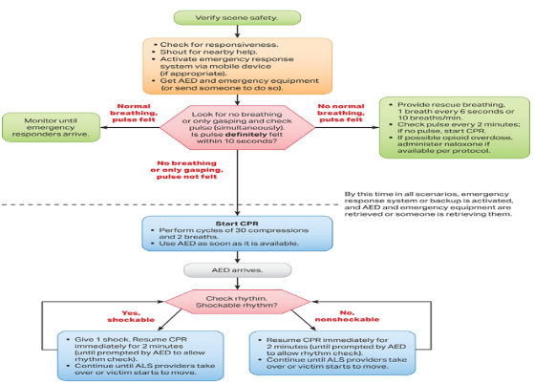
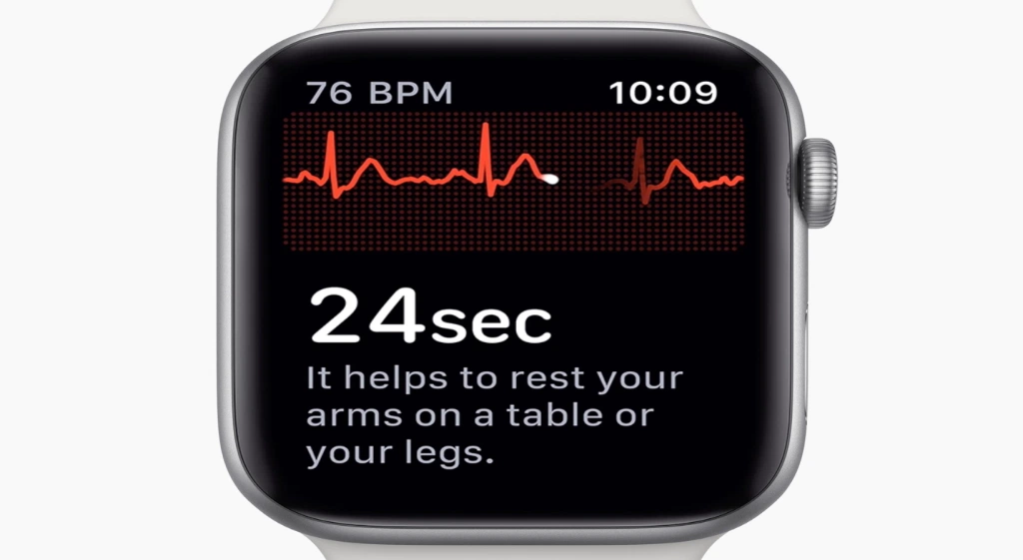

Terrestrial Equivalents to Learn From
Benefits of a CDSS are found in applications such as emergency assistance, alerts and notifications, prevention, training, guidance for exam procedures, monitoring crew performance and diagnosis of symptoms
Life Support, Philips Tempus Pro
Ai advisor for Ultrasound Guidance, Butterfly
Sleep Analysis, Oura Ring
iWatch ECG, Apple
ALS Algorithm, AHA
Notes:
APPLICATION: The ideal CDSS acts as an assistant to the crew and aids by guiding decision support based on the context of the scenario.
Benefits of a CDSS are found in applications such as emergency assistance, alerts and notifications, prevention, training, guidance for exam procedures, monitoring crew performance and diagnosis of symptoms.
Here we can see Ultrasound assistance with augmented reality, wearable ECG monitors and sleep monitors, Vital Monitors designed for defense and wilderness scenarios and ALS algorithms. All of these to some extent apply to exploration space missions.

Slide 7
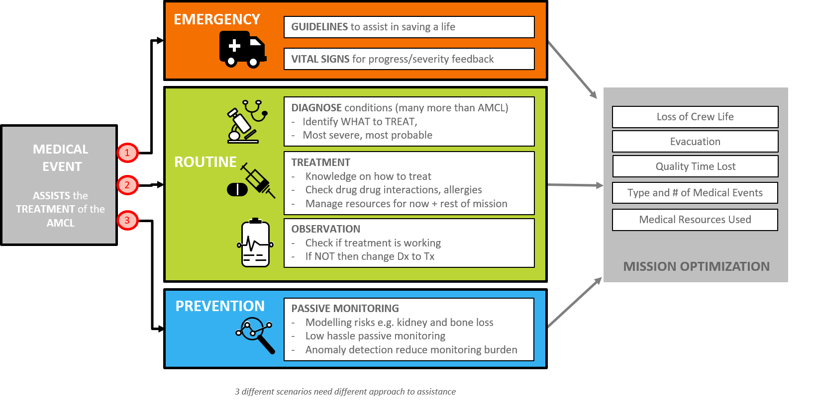
Optimize Mission
Notes:
Treating the accepted medical condition list requires the system to be context aware veiwed by three levels of acuity:
save life immediately, routine clinical work up using standard clinical practice, prevent onset of medical conditions using passive monitoring
A process to develop a CDSS for autonomous crews needs to align the technology with context aware user interfaces addressing scenarios that cover acuity and severity of illness or injury. For example the assistance required for a non medical crew member responding to a heart attack will differ from the medical officer investigating a likely kidney stone.
CARDIAC ARREST – Scene safety including communication with the vehicle systems (e.g. turn the lights up full and check CO levels), ABC’s buy minutes to save a life. Human Interface is simple comprehend under stress.
ROUTINE –complex decision making for diff diag, then treatment options. Observation and reassessment is timed and low hassle for the crew member
PREVENTION – low hassle back ground risk models that only alert of risk is above a threshold. Anomaly detection to reduce analysis burden.
What for the term “context aware” refer to?
a. The system changes the information shown based on the acuity of the condition
b. The system changes the information shown based on skill level of the operator
c. The system adjusts how it displays information to maximise the understanding of the operator in the simplest way possible
d. all of the above

Slide 8
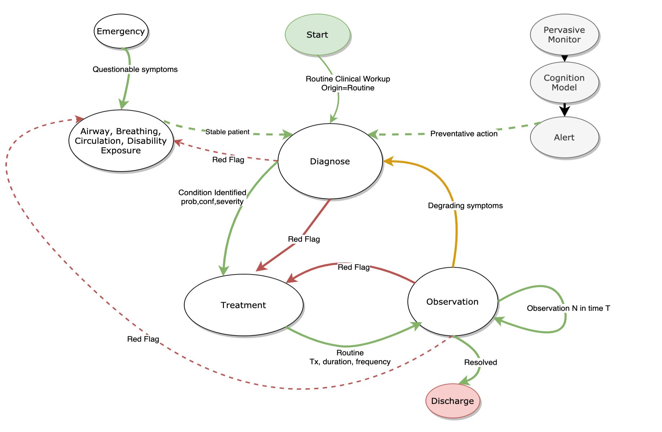
Clinical Workflow Between Scenarios
Emergency
Routine
Preventative
Notes:
This diagram shows how clinical care can start with an emergency, a routine inquiry or a passive monitor noticing and increased risk or decrement in performance. The patient and caregiver will be moving between these clinical contexts and the CDS needs to be the wingman using a principle of Naturistic decision making that mimics how humans make decision in high consequence low data scenarios.

Slide 9
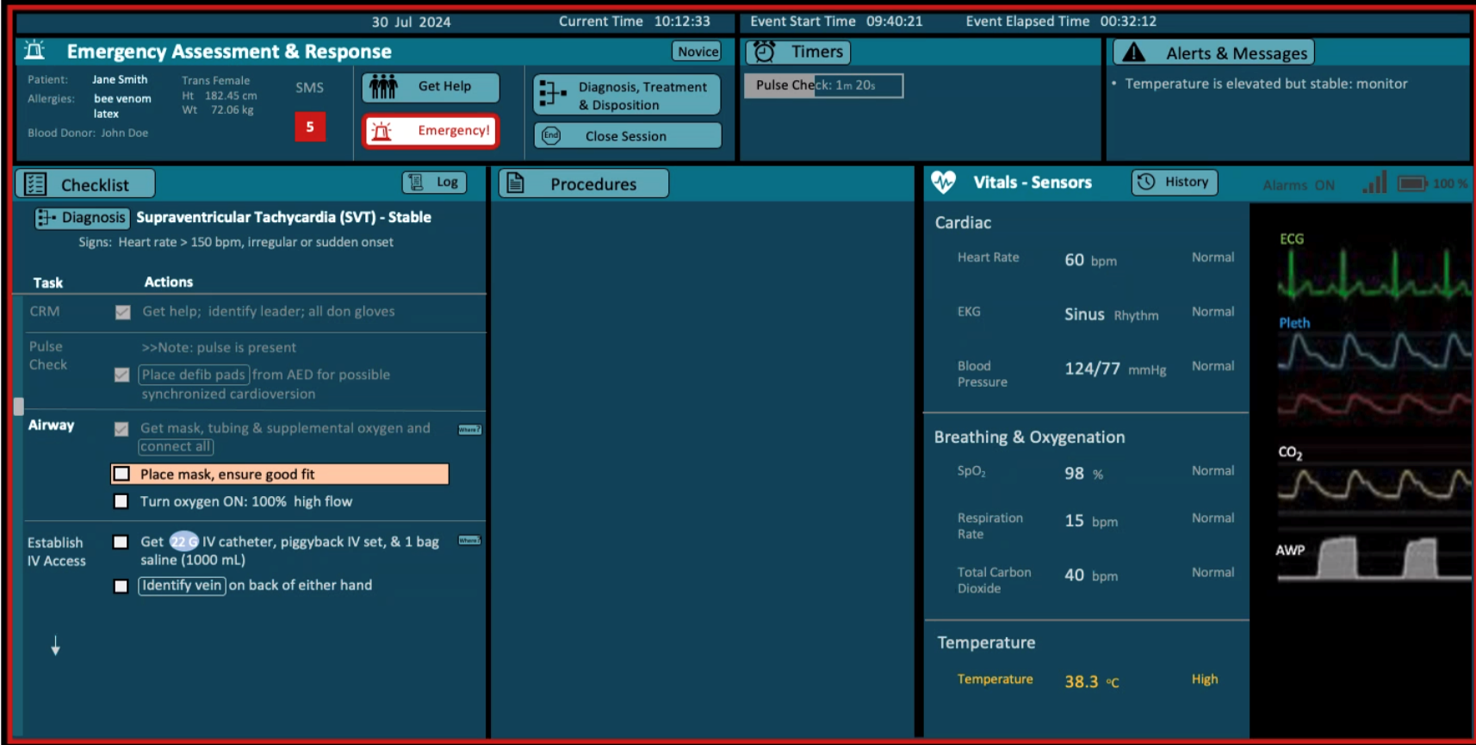
Emergency Context
Protocol Timer
Protocol Guide
On demand
Training
Vital Signs
Guide, Instruct, Monitor… leave out extraneous data
Notes:
The Emergency screen is about saving life with immediate diagnostic and immediate intervention. Simple, clear fast, effective. The work here includes work from the Human Systems Integrations division at NASA Ames Research Center in California including Barbara Burian and Bettina Beard.

Slide 10
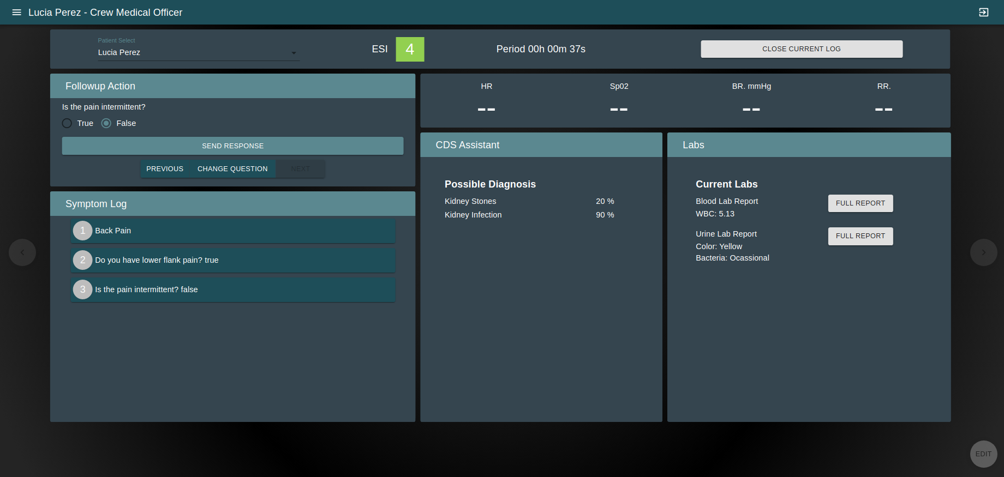


Differential Diagnostics
# | DISEASE | P R O B | S E V | CON
1 | Kidney Stones | 75 | 50 | 80
2 | Pyelonephritis | 22 | 50 | 70
3 | ACS | 11 | 90 | 40
4 | Anxiety | 15 | 20 | 55
5 | Atrial Fib | 05 | 80 | 43
6 | Heedache CO2 | 10 | 30 | 80
7 | Space Motion Sickness | 13 | 10 | 40
Vital Signs
Questions
Blood report
Lab Reports
Log
Diagnostic Report
Assisted decision making
Naturalistic decision making like a human (AMES)
Next best question with greatest positive predictive power
Probability, severity and confidence to aid decision making
Notes:
The differential diagnostic computational model is one of the most challenging tasks as it must assist in a parallel manner to the crew or CMO making a decision for 100’s of possible conditions starting with a chief complaint.
The knowledge base generation for this task is large and modelling approaches are constrained to be able to achieve this goal, be explainable and trusted and useful to the humans.
Additional information is provided to the human operator to help them assess how and if to trust the computed result as they work through the diagnosis. inclduign medical probability, condition severity and computation model confidence.

Slide 11
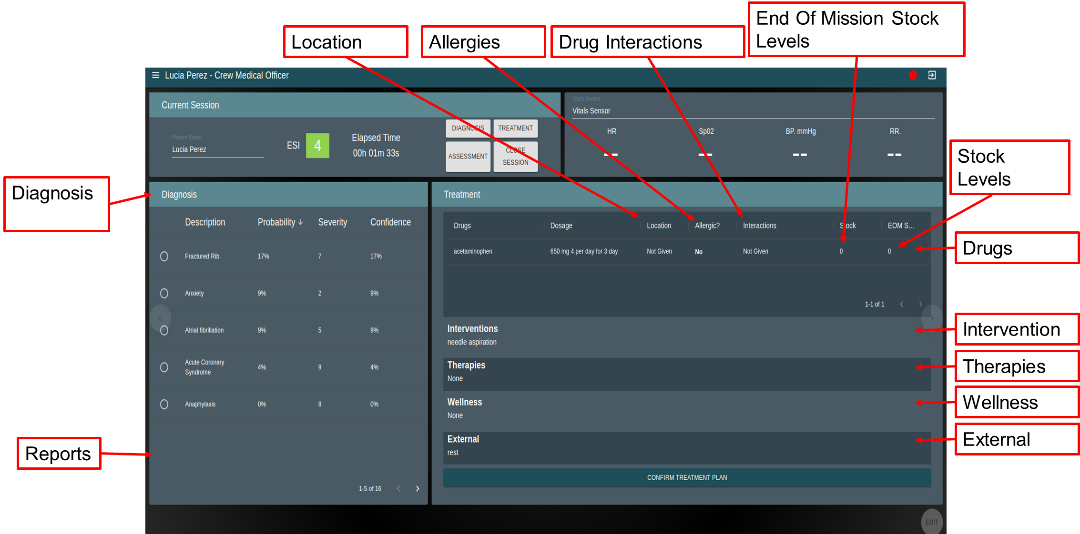
Treatment

Slide 12
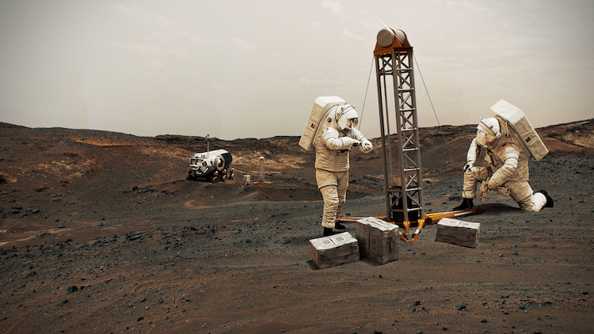
Use Case Scenario
Mars surface mission
No Comms or CMO
Crew member presents with chest pain
Notes:
Imagine two crew members on the surface of mars.
A crew member on surface duty complains of chest pain. They fell over an hour ago. Is it a broken rib, cardiac arrest or pneumothorax?
Returning to the vehicle they ask the CDS for assistance
The CDS asks questions like the CMO would, it knows the history, so starts with questions of context and symptom, vitals, environment etc
It has a low prob but high severity of MI so automates a blood test and gets low troponin so diagnoses a contusion and treats the pain.
On observing a few hours later the pain has not reduced and the CDS re-assessors and suggests a re-diagnosis, which after a guided physical exam results in a diag of Pneumothorax.
It guides the crew through a chest aspiration, supplemental O2 and observation. In 24 hours the crew is ready for light duties.

Slide 13
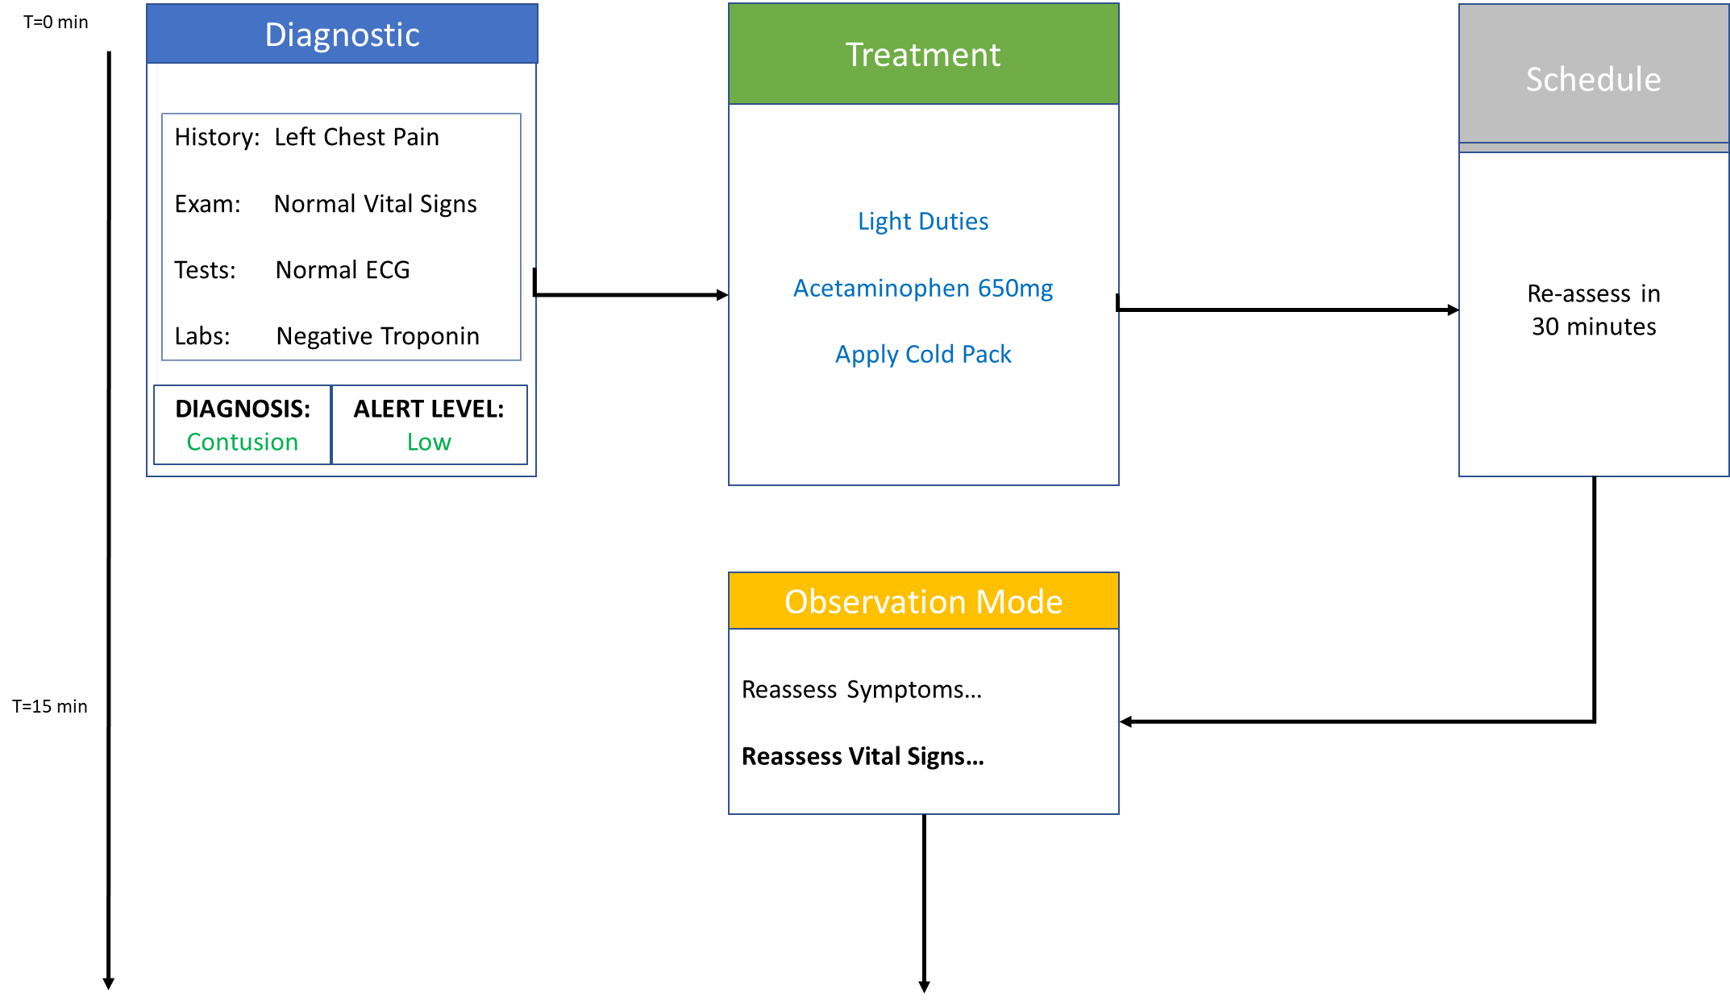
A Multi Diagnostic Scenario

Slide 14
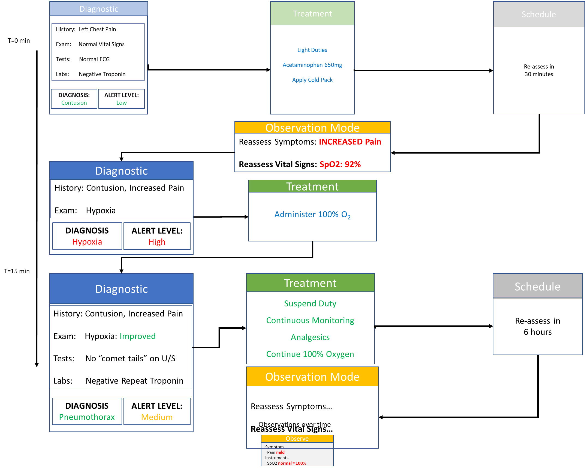
A Multi Diagnostic Scenario

Slide 15
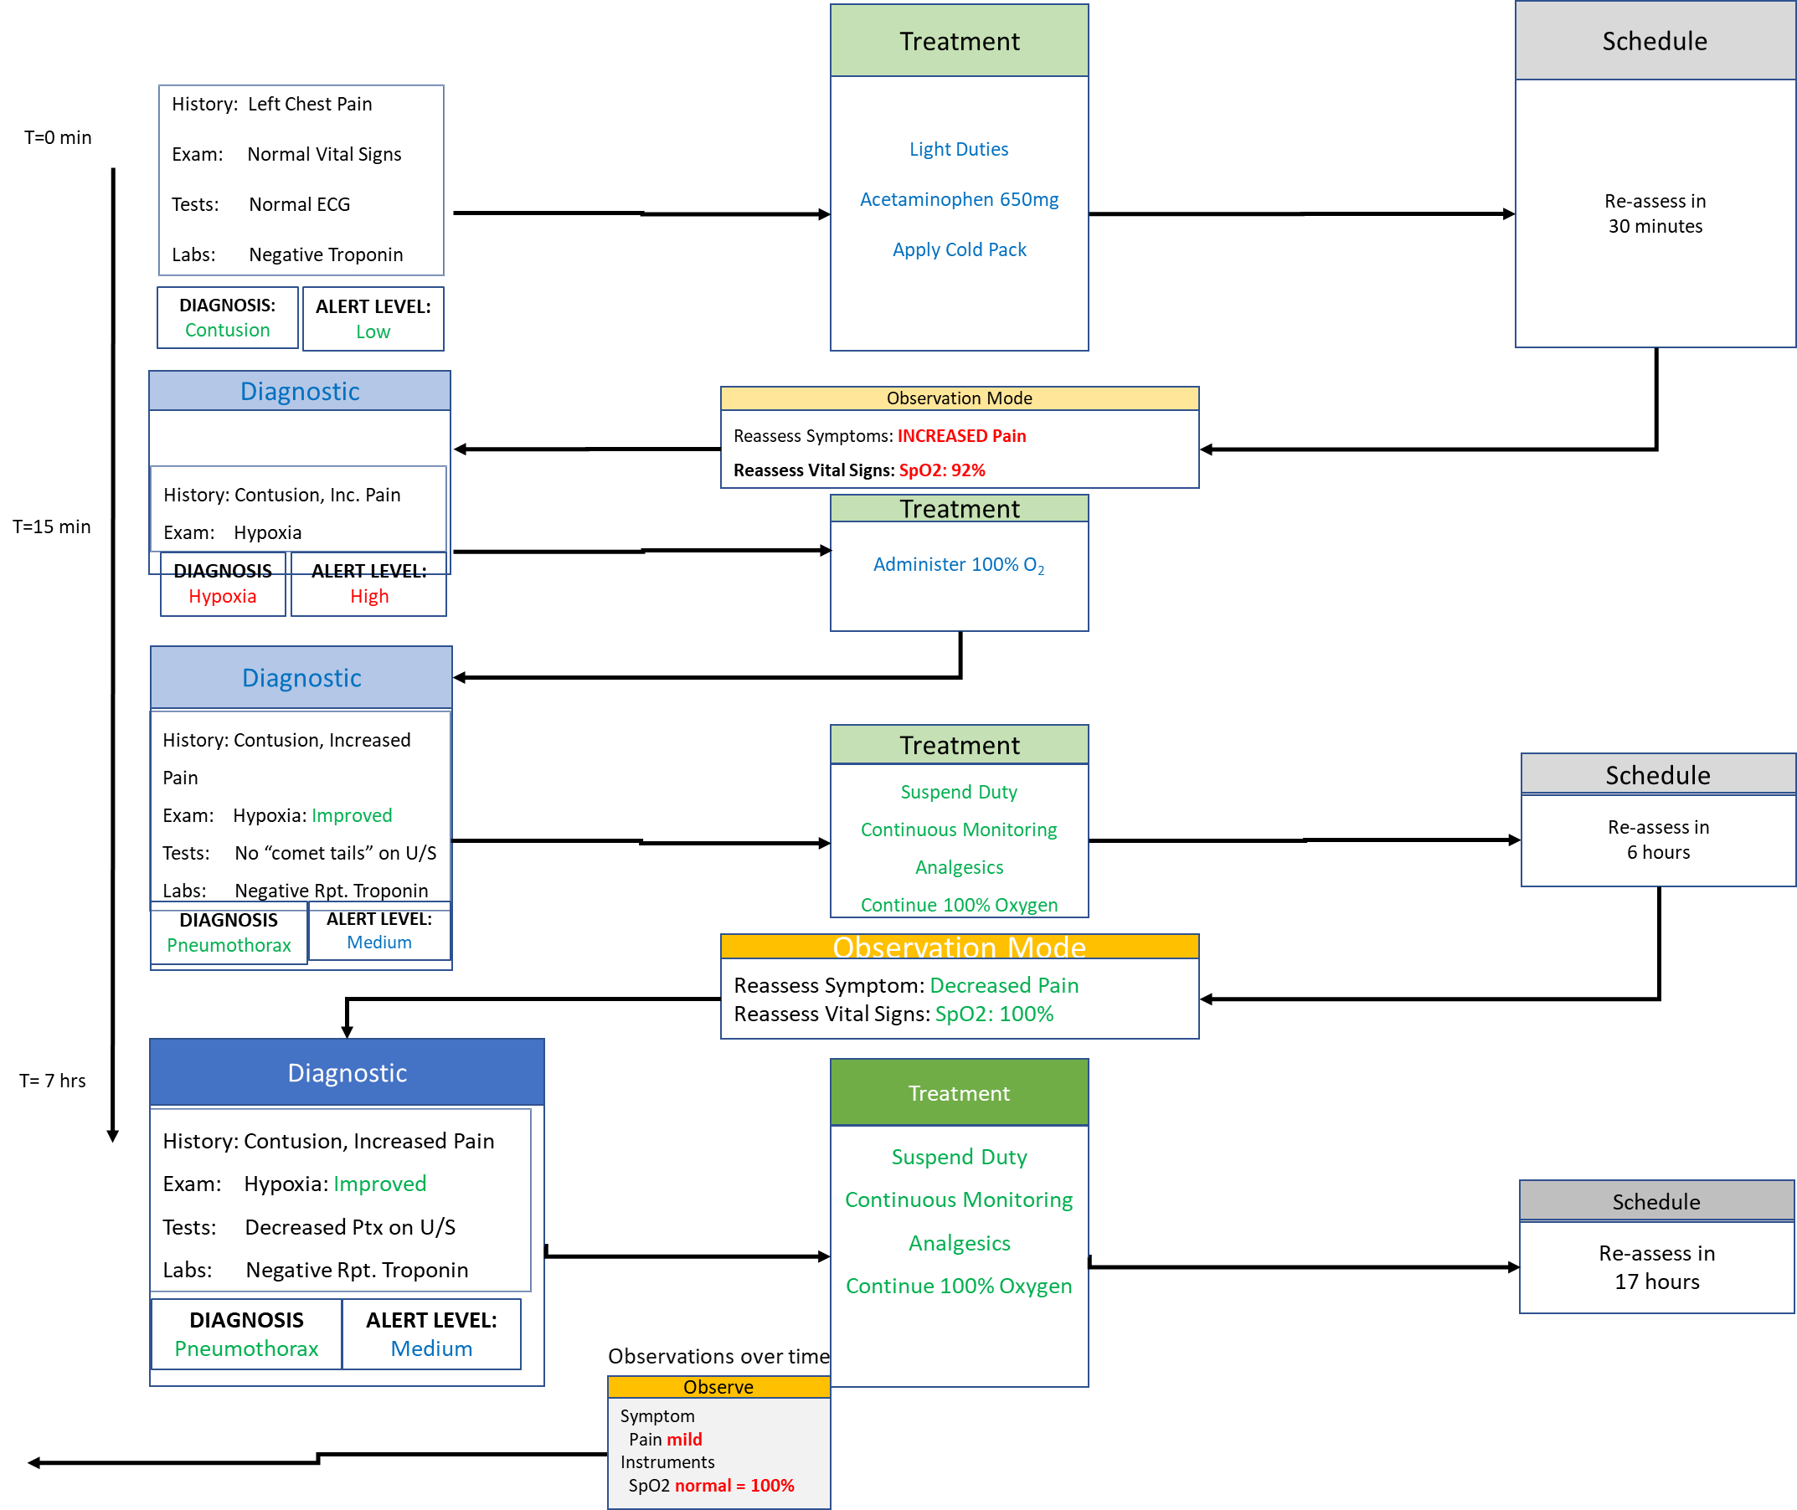
A Multi Diagnostic Scenario

Slide 16
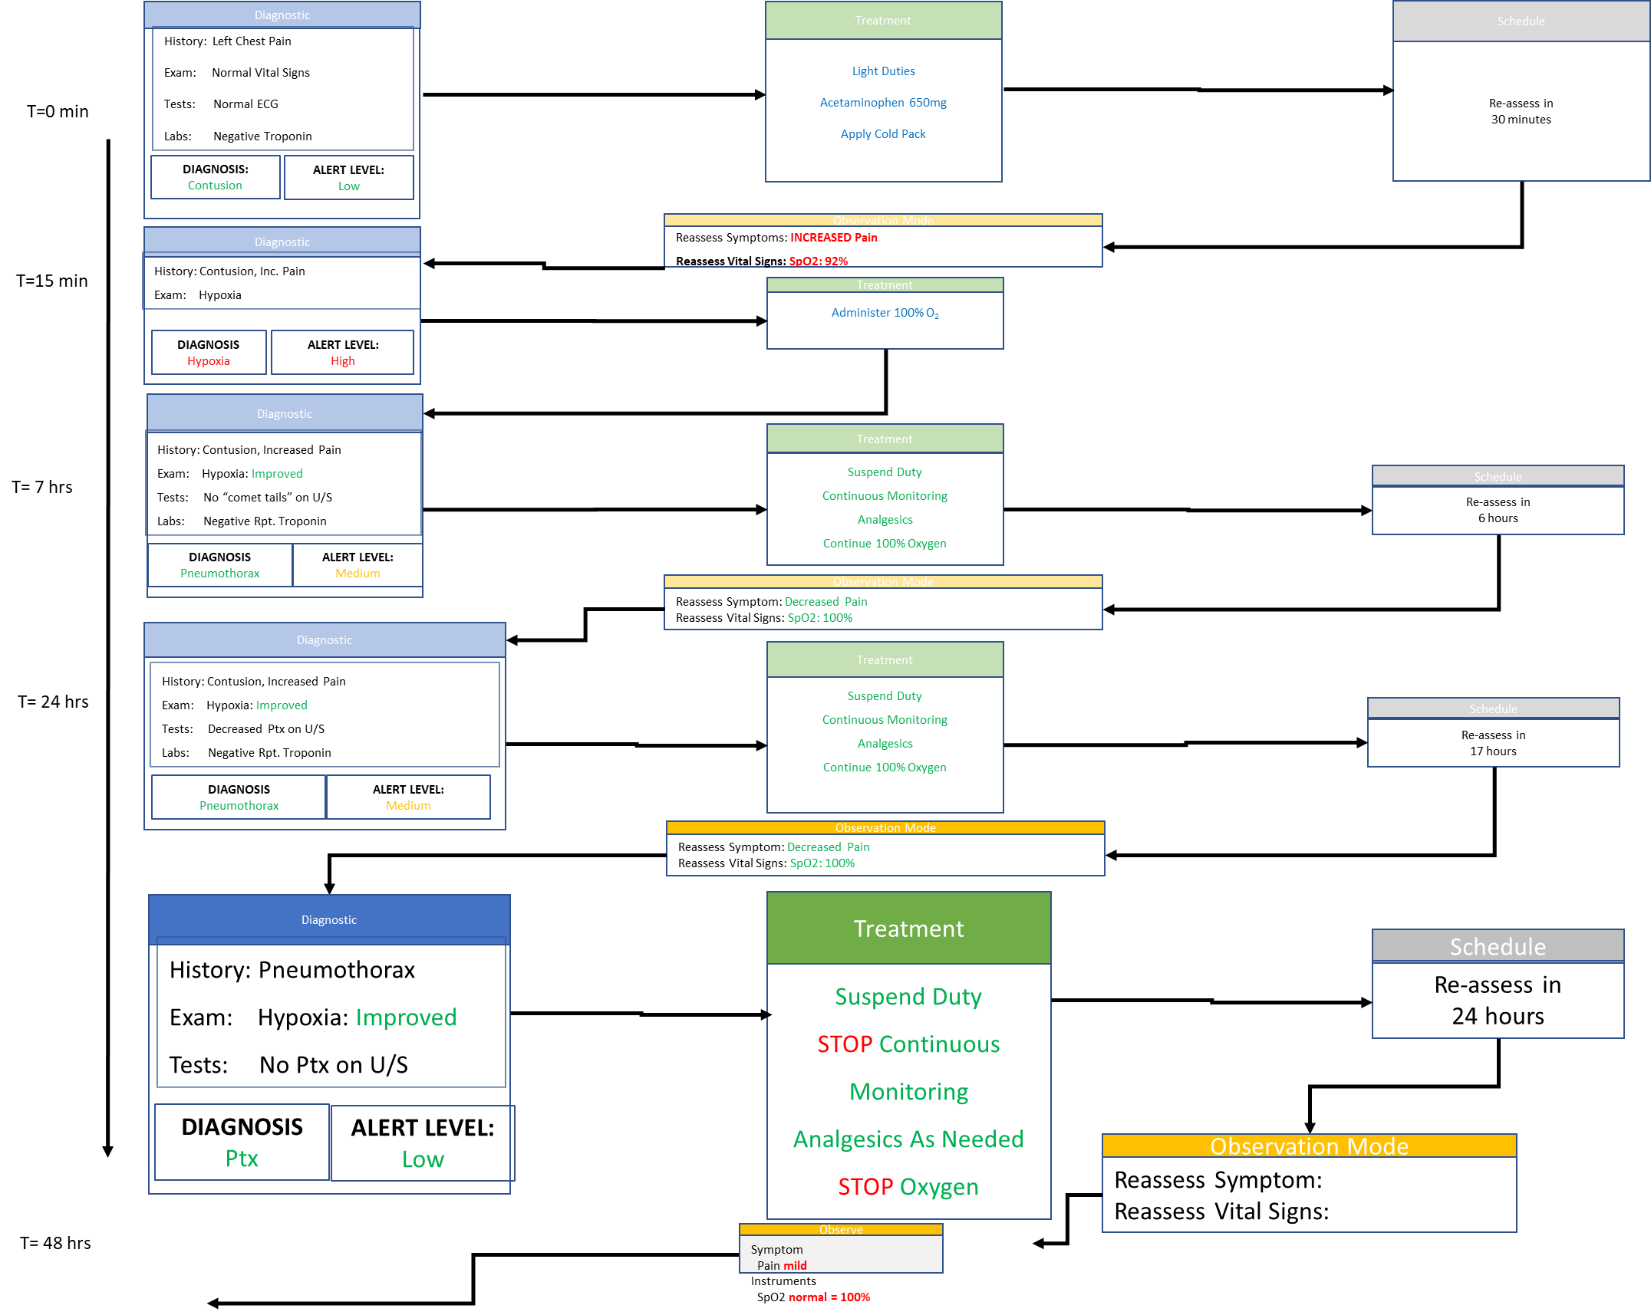
A Multi Diagnostic Scenario

Slide 17
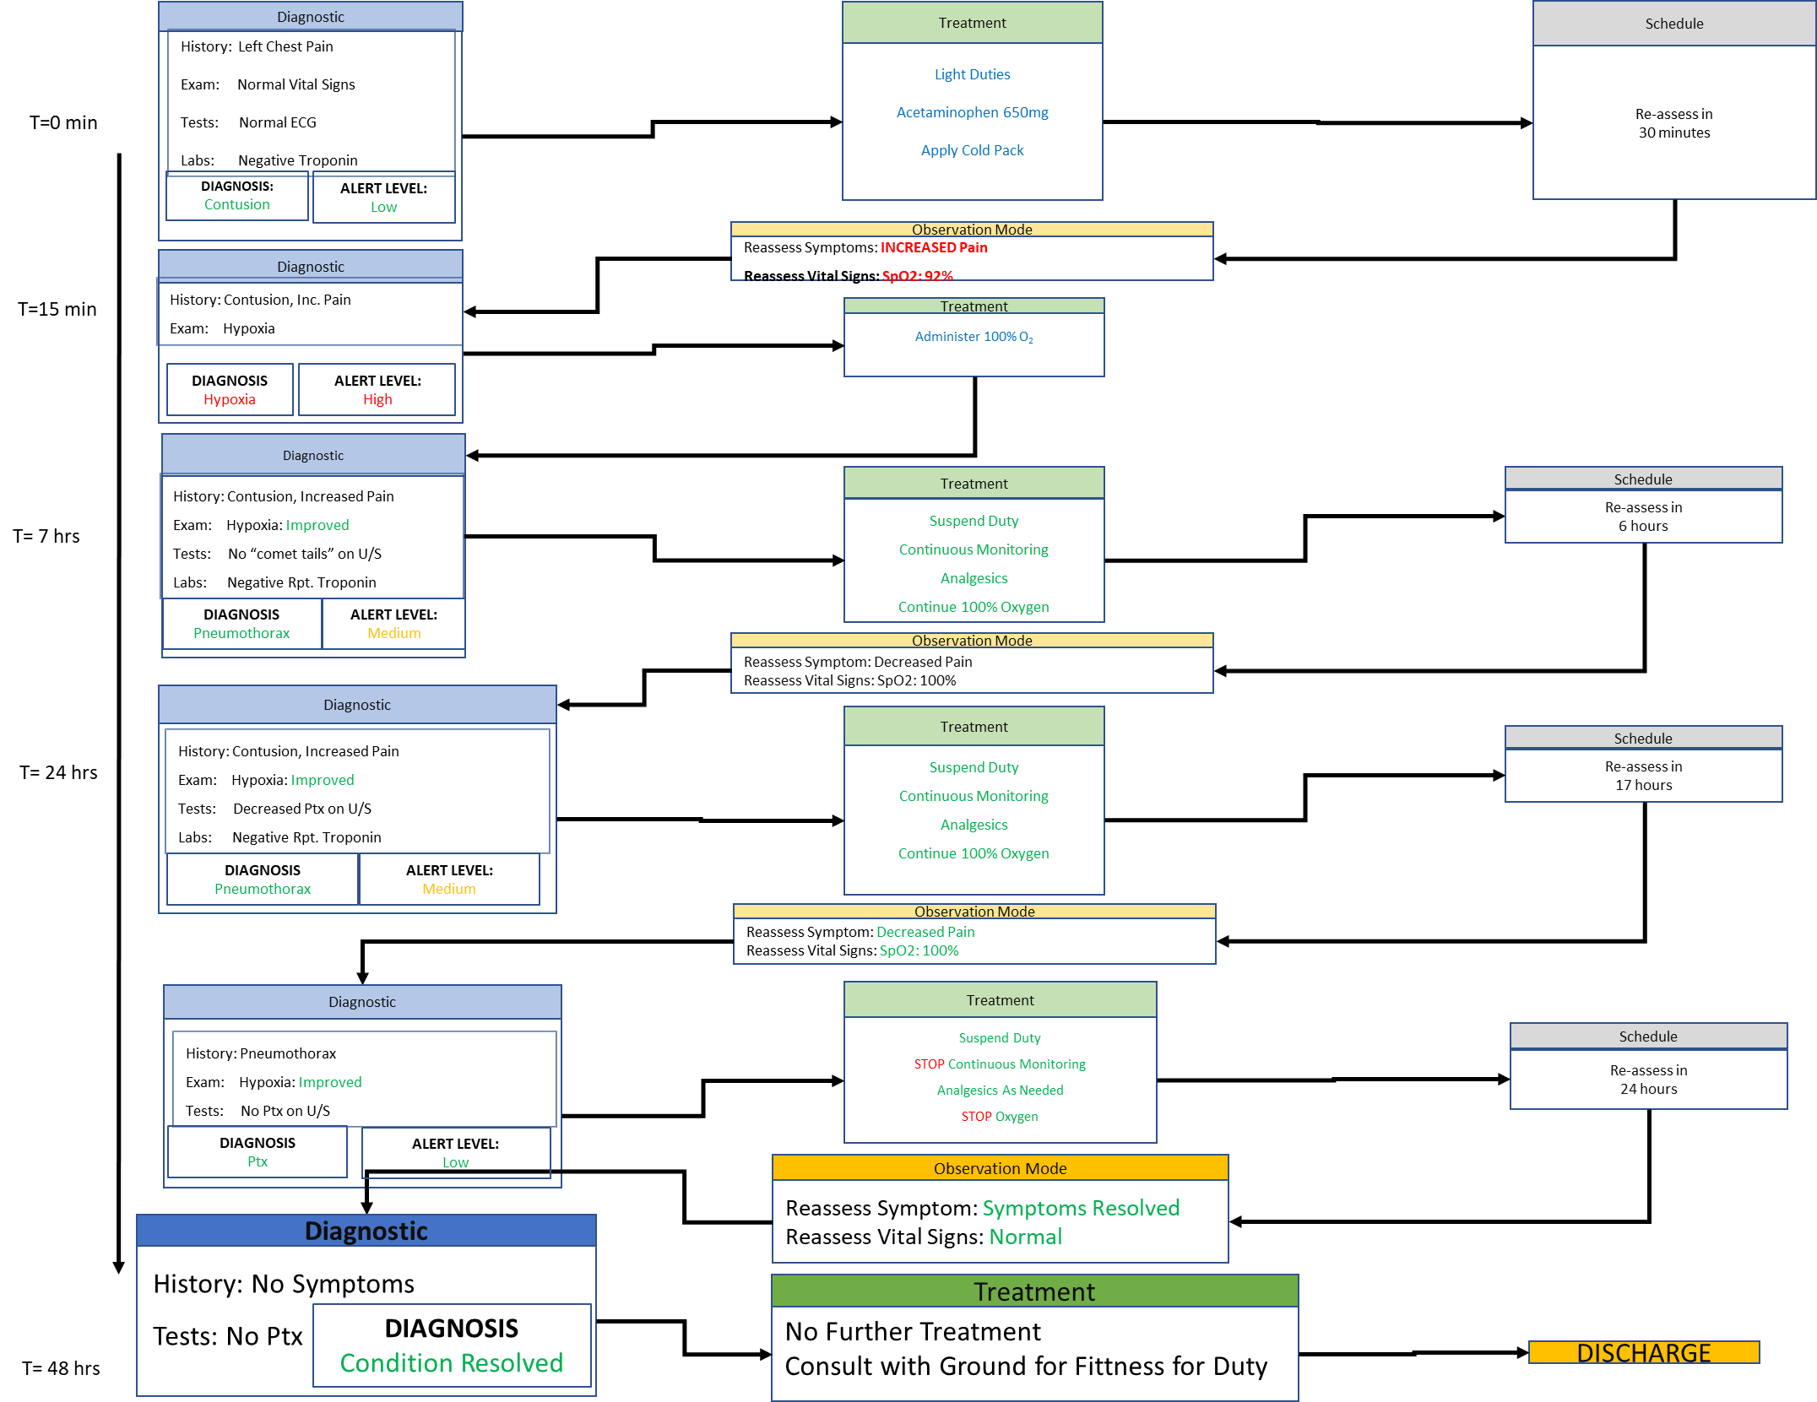
A Multi Diagnostic Scenario

Slide 18
Summary
CDSS will always assist the humans make decisions by increasing their on board KSA
Autonomy will increase with mission duration and complexity
CDSS can assist in different levels of acuity
Quick wins, automation examples – allergies, drug interactions
Complex challenges – diagnosis using probabilistic computation
Mission optimisation and risk reduction is the guide for development

Slide 19


SignOffPage
THE END
Notes:
NASA Presentation Sign-Off Page

Slide 20

Background – Human Research Program (HRP)
The goal of the HRP is to provide human health and performance countermeasures, knowledge, technologies, and tools to enable safe, reliable, and productive human space exploration.
Human Research Program
Human Factors Behavioral Performance
Space Radiation
Exploration Medical Capability (ExMC)
Research Operations and Integration
Human Health Countermeasures
Notes:
The goal of the human research program in NASA is to provide human health and performance counter measures, knowledge, technologies and tools to enable safe reliable and productive human space exploration.
The mission of Exploration Medicine Capability is to advance medical system design and risk-informed decision making for exploration beyond low earth orbit.
The CDSS research is based within Exploration Medical Capability under HRP.

Slide 21

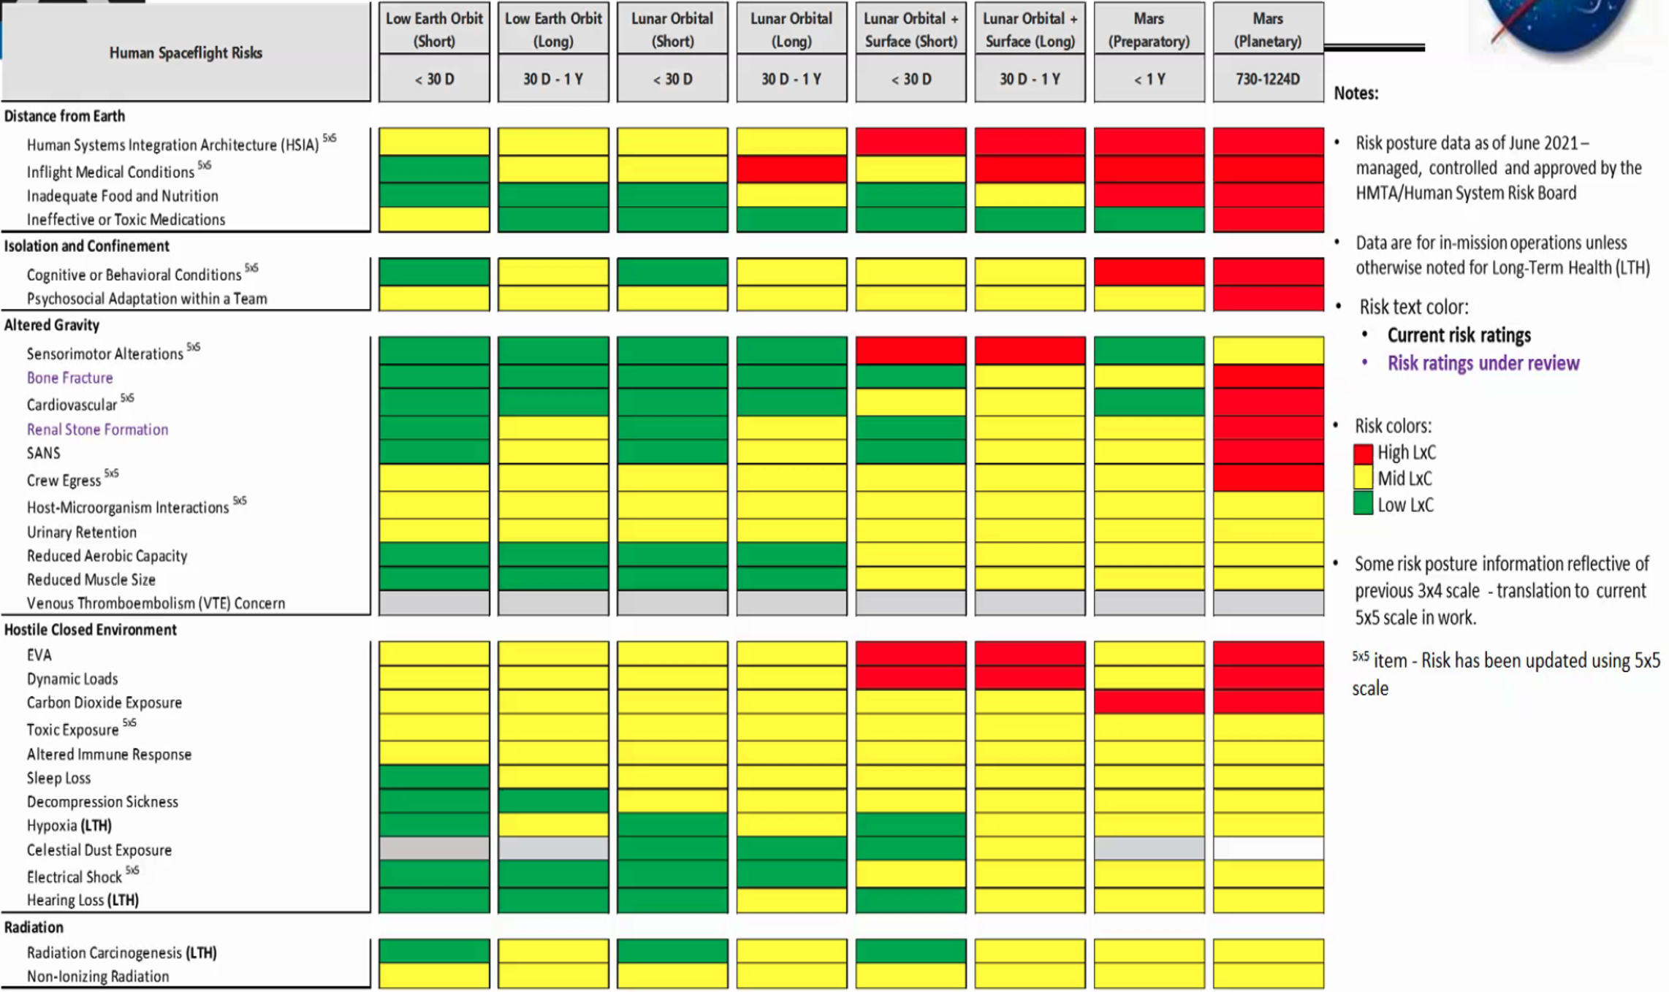
Human System Risk Summary
Risk by Hazard (as of June 2021)
v
v
Notes:
HRP catagorizes crew risk in five categories, Distance from earth, Isolation, altered gravity, hostile closed environment and radiation.
It assessors risk for different Design Reference Missions called DRMs.
Risk is calculated by Likelihood times Consequence.
Here you can see increasingly higher risk in red as the duration of the missions increase on the right of the screen.

Slide 22
Augment Clinical Treatment in Spaceflight
NASA Studies the risks and develops
HRP identified risks
MEDPRAT informs some CDS decisions
e.g. Predicted Resource Usage
IMPACT informs what to put
in the med kit for a mission
Artemis I
HRP RISKS
AMCL
Mission Profile
Crew Info
Artemis II
PRE MISSION PLANNING
Artemis III
MedID
MEDPRAT
MED KIT
CDS data
CDS
ExMC identified
conditions
and treatment
IN MISSION ASSISTANCE
Artemis …
Notes:
NASA researchers the risk, the medical conditions and plans the resources to mitigate the risks.
The outcome of this data enables pre mission planning and in mission decision support.

Slide 23
CDSS Capability
Extension from current terrestrial/ISS practice to autonomous care
CDSS Capability | Overarching Research Questions
Diagnosis (Dx) | What is optimal way acuity/KSA is modulated in the GUI? What types of probabilistic expert reasoning is needed to assist decision-making?
Treatment (Tx) | What is the optimal approach to assist with treatment to provide expert protocols and resource trade-offs?
Observation | What is the approach to clinically observe a crewmember in a work environment? What is the optimal approach to reduce clinical workload?
Passive Monitoring | What detection methods and indicators provide insight to early performance degradation and prevent disease?
Emergent Care | What are the types of assistance needed in time constrained scenarios? What will enable crew to move from emergent to routine clinical care? What are optimal ways of providing the assistance?
Non-Emergent Care | What are the types of assistance needed in scenarios where there isn’t a time constraint? What are beneficial types of analyses that should be performed when there isn’t a time constraint?

Slide 24
Method: Bounding the CDS Space
ExMC Identified Accepted Medical Condition List (AMCL)
Mission Condition List (MCL) determines conditions to be treated
CDS as a software tool assists crew as a carer to treat all MCL conditions
To accomplish treatment of all MCL conditions, CDSS must provide appropriate information at the right stage of the process
  in an easy way across KSA levels,
  while reflecting the proper level of acuity
Naturalistic Decision Making [1] and Metacognition [2] are frameworks on how to approach the high risk problem solving in demanding situation.
Given the above stated needs to treat MCL conditions and to approach to the problem, there are three scenario CDSS templates:
  Emergency
  Routine
  Preventative
In addition, CDS needs to adapt to different crew and mission profiles (e.g. crew demographics, mission duration, number of crew, number of EVAs)
Klein, Naturalistic Decision Making, Ames Research Centre, 2012, HUMANFACTORS, Vol. 50, No. 3, June 2008, pp. 456–460. DOI 10.1518/001872008X288385.
Shaban, Theories of clinical judgement and decision making a review of the theoretical literature , Australian journal of paramedicine, Vol 3, No. 2, 2012

Slide 25
Clinical Decision Support for
Orbit, Lunar and Mars
Emergency
Routine
Preventative
LevCare IV priority for CDS
operational use
CDS research for LevCare V
in lunar missions
CDS research for LevCare V
in lunar missions
 | Comms Delay/ Blackout | Evac | Resupply
ISS | realtime 100% | 12 h | 1 mth | call home | How do I treat this pain? Is this pain represnet a sickness? | detect and avoid injury or mistakes
Cis Lunar | 0.5s 100% | 1 day |  | call home with some assistance | Do I call home about this pain? Can I take a pill now for this pain? | Performance is degrading maybe take a break.
Lunar Surface | 1.3 s, 6 hours | 6 days | 1 mth | may be autonomous | What procedure to use?
Mars | 20 min 2 weeks | 3 yrs | 3 yrs | fully autonomous | how do I treat this | detect and avoid disease
nice to have
nice to have
nice to have
nice to have
nice to have
must have
nice to have
nice to have
must have
must have
must have
CDS has an operational need for emergency and research need for routine and preventative
QUESTION: Is automated emergency care needed with guided treatment algorithms or
a simple vital sign monitor.
QUESTION: Is CDS a research project for Mars and not required for LoC4?
Notes:
The context or acuity of scenarios can be viewed based on DRMS and eh subsequent challenges of duration, communication and resupply.

Slide 26
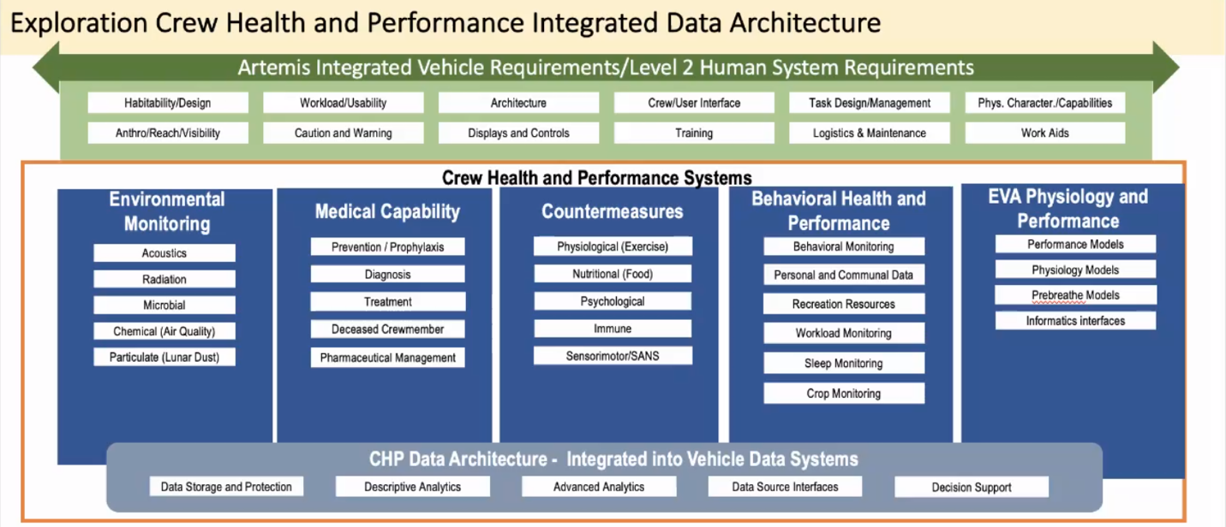
Clinical Decision Support
Part of Crew Health and Performance
Medical Capability
Emergency
Routine
Diagnose
Treatment
Observation
Preventative
Headache CO2
Cognition
Assessment
Vital Signs under load
26
Notes:
CDSS is a part of Crew Health and Performance
Each part of the CHP system interacts to maintain crew performance and treat conditions of they occur.

Slide 27
Integrated Crew Health and Performance Risk
Scientific Objective 1 | Define a new HSRB risk “Integrated Crew Health and Performance” Aggregate of all human system risks Goal is to: Understand the relative contributions of each of the constituent risks to the aggregate risk Understand the relative contribution of each of the constituent risk’s countermeasures to the buy down of the aggregate risk Recommend an optimized CHP system to minimize the aggregate risk
Scientific Objective 2 | Determine which capabilities and associated resources should be included in an exploration Crew Health and Performance (CHP) system considering the intra-CHP system trade space. Trades can occur at the sub-system, system, and vehicle level: 1. CHP Sub-System Medical- 1 kg of AED vs. 1 kg of ibuprofen 2. CHP System- Additional Food/Water vs. ARED-like device vs. a window 3. Vehicle- Faster rocket vs. more food, meds, etc. for crew

Slide 28
CDS Scientific Objectives
Scientific Objective 1 Define CDS | Characterize the technical, clinical and science required to implement an autonomous CDS system on an exploration mission (why will CDS be used, when will CDS be used, and how will it be used ? Risks to address for HCO including Clinical conditions).
Scientific Objective 2 Resources | Characterize the resource requirements of each capability (workflows/practice, datasets, models, architecture, collaboration partners).
Scientific Objective 3 Capabilities | Create a list of candidate capabilities for an exploration CDS system ordered based on “benefit-cost ratio” (defined as risk buy down achieved per development task. Many capabilities solve multiple end states).
Scientific Objective 4 Budget | Given a resource or risk constraint, determine which capabilities should be included in an exploration medical system considering the clinical/technology/science budget trade space. (Note the CDS will use existing resources that are determined for each mission by IMPACT)
Scientific Objective 5 Requirements | Translate CDS system capabilities into systems model and requirements.
Notes:
We are trying to solve the backpack problem-

Slide 29
FUNCTIONALITY OF CLINICAL DECISION SUPPORT
GUIDANCE
EMERGENCY
ROUTINE
PREVENTION
Scenarios
High Acuity
Low Acuity
CONTEXT AWARE SYSTEM
Emergency
Symptom
Scheduled
Alert
Inquiry
CLINICAL AND PERFORMANCE MANAGEMENT
Calibre 18 pt
Calibre 12 pt
PRIMARY LABEL
Secondary label
RESOURCES
Pharmacy, Consumables
MISSION TIME
Predicted remaining conditions
TREATMENT
KNOWLEDGE BASED
CARE GIVER/
CONTEXT BASED
PREVENTION
PERFORMANCE OPTI
KNOWLEDGE BASED
SCHEDULING
MEDICAL HISTORY
Existing conditions
DIAGNOSTICS
PROBABILISTIC CDSS
HEURISTIC - PERSON
SENSORS
INSTRUMENTS
LAB TEST
DERIVED DATA
CLASSIFICATION/
REGRESSION
DATA
Notes:
we are attempting to describe the aim by clinical functions and map them to technical implementation
guidance is the aim of CDS,
how guidance is provided is based on ESI = situational awareness = context aware of severity and acuity
how guidance is SUPPLIED OR PERFORMED is CP Management

Slide 30
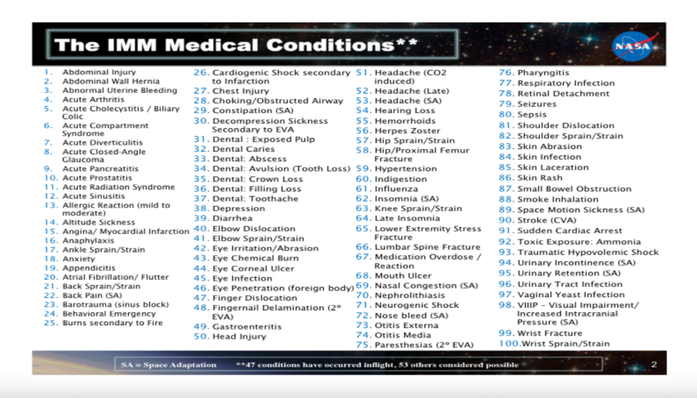
Medical Conditions to Treat
Notes:
AMCL is a place holder, the process holds for any treatable condition list. There are many more conditions to diagnose in order to allow this list to be identified and treated.
Prevention of these conditions will enable better mission outcomes and reduce resource usage.

