Slide 1
FAIRFAX COUNTY
Urban Development
Identifying Urban Heat Mitigation Strategies for Climate Adaptation Planning in Fairfax County, Virginia
W. Pierce Holloway, Rose Eichelmann, Patricia Murer, Ryan Newell, & Caden O’Connell
Virginia – Langley
Notes:
Hello, we are the Fairfax County Urban Development Team, made up of Pierce Holloway, Rose Eichelmenn, Patricia Murer, Ryan Newell, and Caden O’Connell. In our project, we worked to understand and visualize the effects of the urban heat island phenomenon throughout Fairfax County, Virginia. This presentation details the data we used to complete the project, how the data was used, and the results we found.

Slide 2
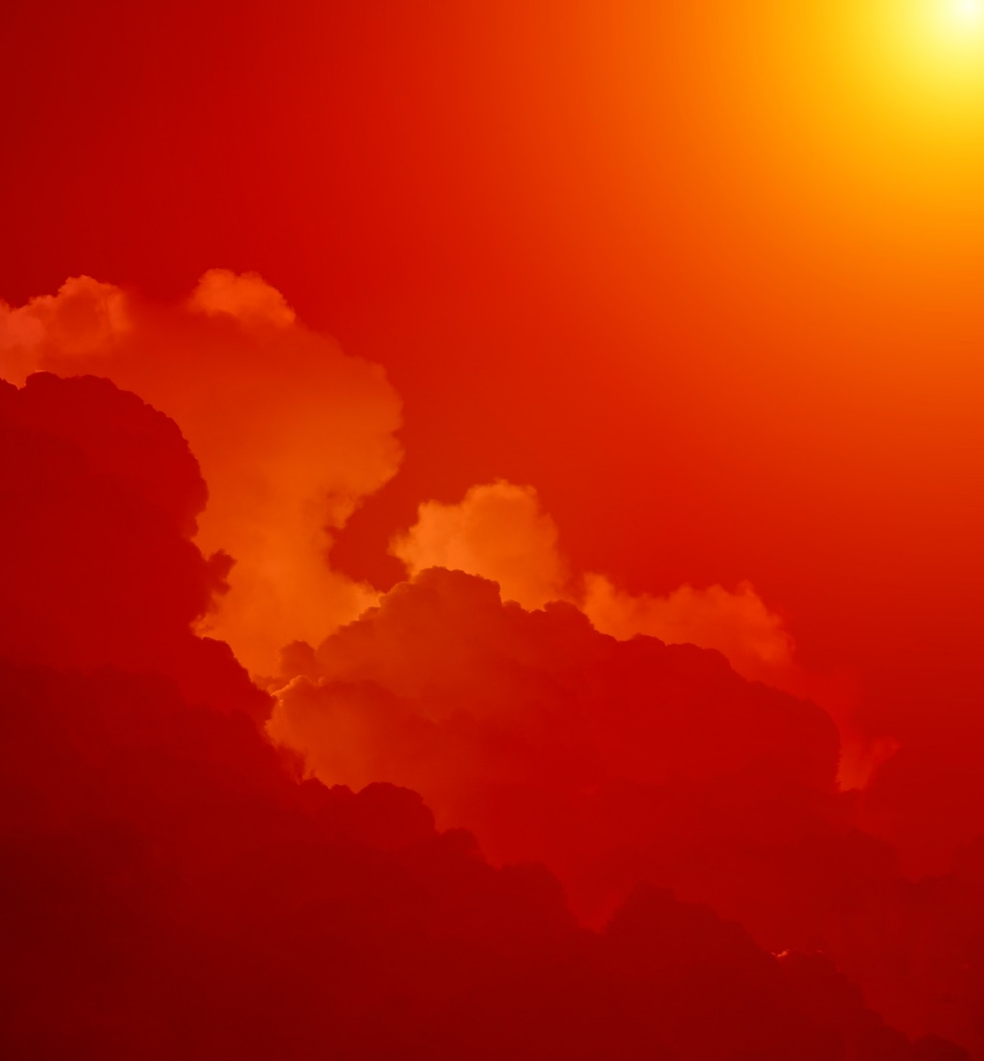

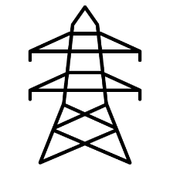

THE PROBLEM
Extreme hot temperatures are increasing in frequency and intensity, resulting in:
Detrimental consequences to human health and comfort
Increased energy consumption
Damage to infrastructure
Decline in productivity
Disproportionate effects on varying demographic groups
Illustrations credits: Pixabay photo and PowerPoint icons
Notes:
In summer months, temperatures can rise to extreme highs and in urbanized areas these effects can be exacerbated by the presence of impervious surfaces and lack of vegetation. As a result, citizens can experience local temperatures that far exceed the average temperature for a given day. As populations experience more and more extreme heat, they are introduced to greater risk of declined productivity, increased energy cost, damage to infrastructure, and detrimental health effects that can even lead to increased rates of death. These consequences can radically affect the lives of a community, and have been shown to be disproportionate between groups of different demographics and socioeconomic status.
------------------------------Image information and credits ------------------------------
Photo of clouds: Photo from Pixabay
Source: https://www.pexels.com/photo/white-clouds-under-orange-sky-during-daytime-36464/
License: free to use. No attribution required.
PowerPoint icons

Slide 3
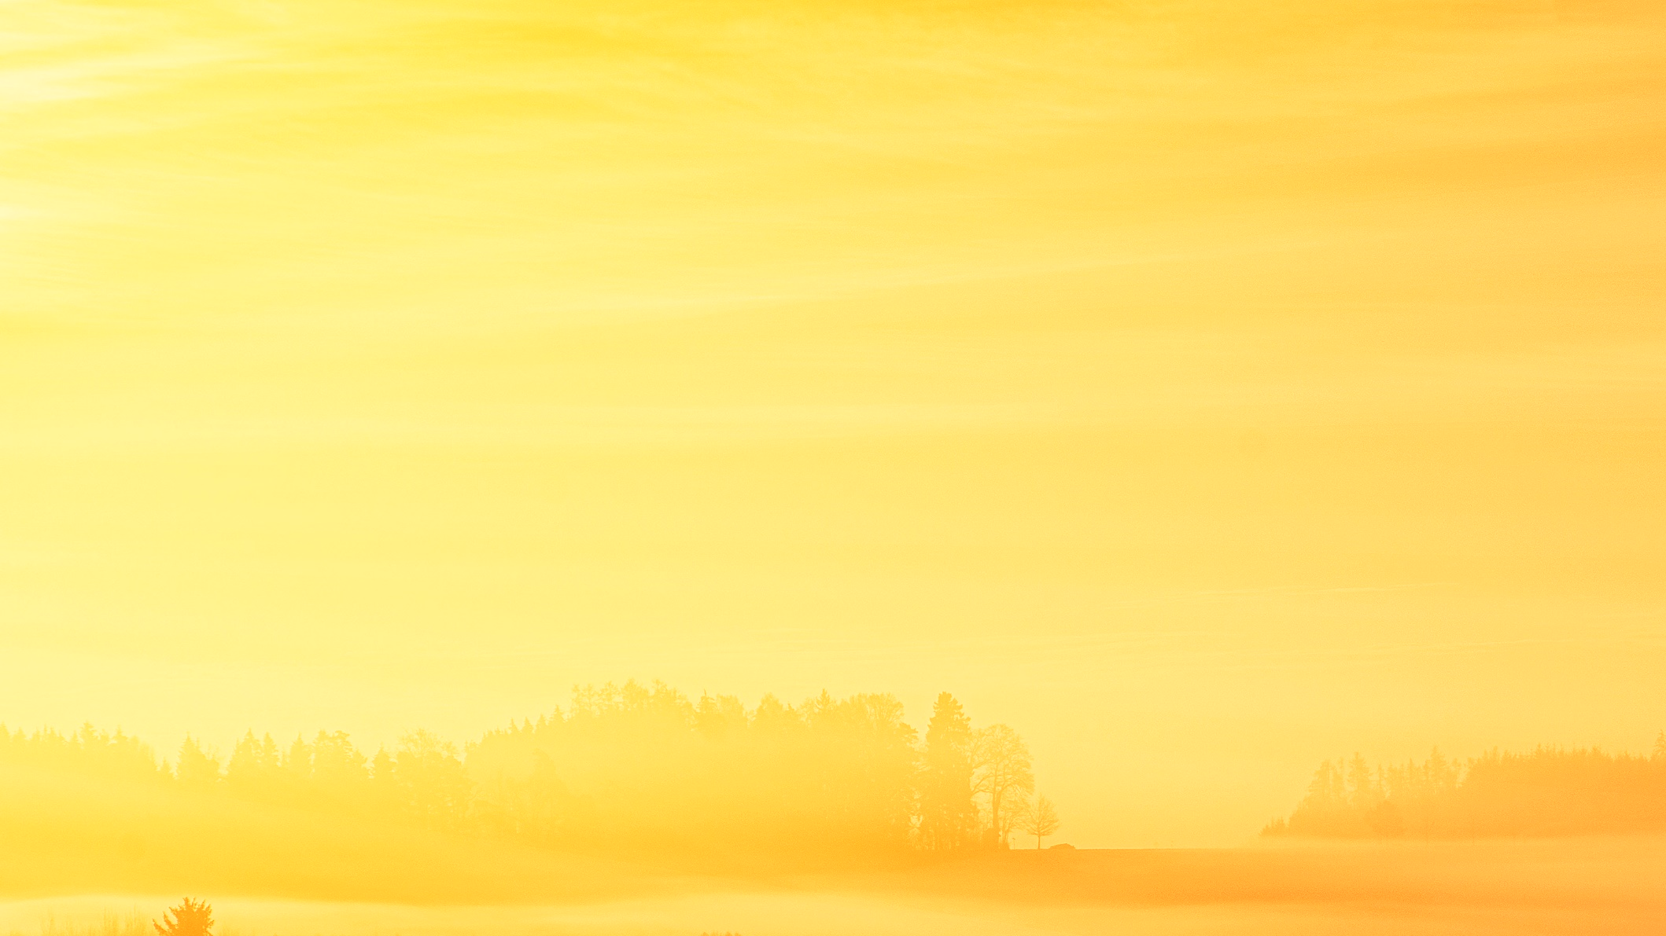
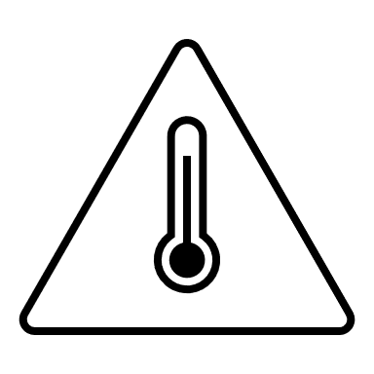



URBAN HEAT ISLAND EFFECT
Materials used in urban environments absorb and emit more heat
Heat is generated from human activities i.e., vehicles, industrial facilities
Reduced vegetation which provide shade and cool the air with evapotranspiration
“Heat Islands are urbanized areas experiencing higher temperatures than outlying rural areas.” - US EPA
Illustrations credits: background photo by Johannes Plenio from Pexels and PowerPoint icons
Notes:
The urban heat island effect briefly described in the last slide is defined in more detail here. In urbanized environments, the construction materials that make up buildings, roads, and other manmade facilities can absorb heat from the sun’s radiation. The heat accumulates in the impervious materials throughout the day and dissipates to their surroundings over time, increasing the local air temperatures. In addition, manmade heat generated by machinery such as industrial equipment and vehicles is also dissipated into the environment in more urbanized regions. Finally, vegetation typically mitigates extreme temperatures by absorbing the sun’s radiation for plant growth, and via a phenomenon called evapotranspiration which absorbs heat from its surroundings. As vegetation is often lacking in highly developed areas, these factors combine to produce exceptionally high local temperatures in some urbanized areas, and this phenomenon is known as the urban heat island effect.
------------------------------Image information and credits ------------------------------
Background photo by Johannes Plenio from Pexels, cropped and transparency set at 60%
Source: https://www.pexels.com/photo/sunset-view-on-the-forest-1110658/
License: free to use. No attribution required.
PowerPoint icons

Slide 4
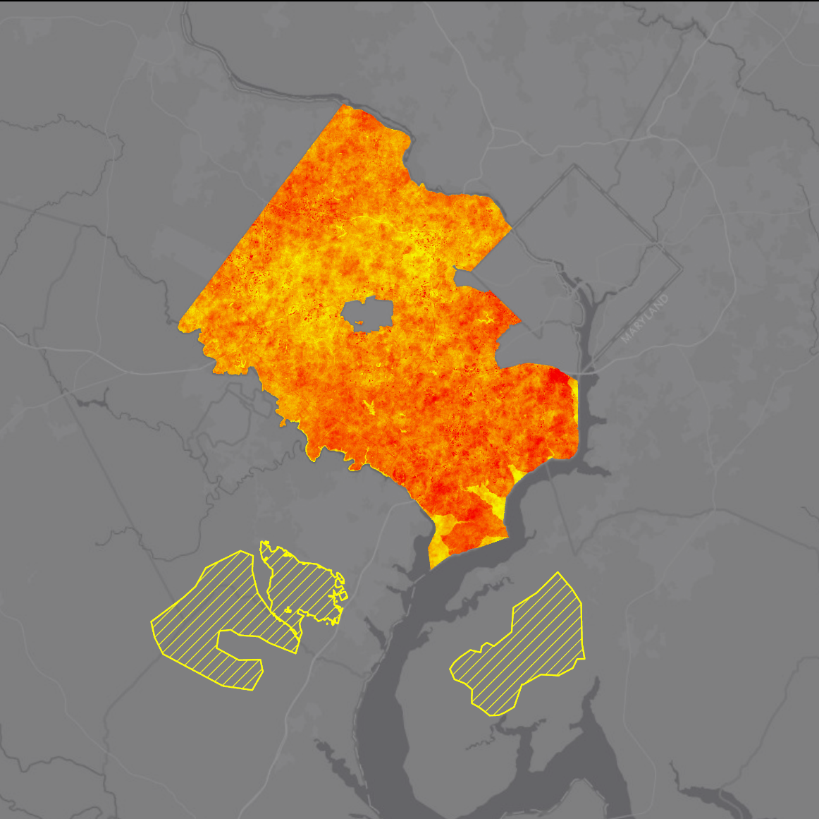



STUDY AREA
Study Area
Fairfax County, VA
Reference areas
Washington, DC
Fairfax County
Time period
June, July, August
Years: 2013 to 2021
N
0
5
miles
Notes:
For this project, we partnered with the Fairfax County Office of Environmental and Energy Coordination, or OEEC. The county government is executing an initiative called Resilient Fairfax, aimed at mitigating the effects of potential natural disasters among its roughly 1.1 million residents. We collected data for Fairfax County, Virginia over the hot summer months of June, July, and August from 2013 to 2021. Some datasets were only available from 2018 to 2021, and we will describe in more detail those datasets in a later slide. In order to model the urban heat island effect, we chose three rural, mostly wooded reference areas to extract a mean rural surface temperature value for comparison to the county temperatures.
------------------------------Image information and credits ------------------------------
Map credit: NASA DEVELOP 2020 Summer LaRC Fairfax County Urban Team
ESRI Dark Gray Canvas basemap at 30 % transparency

Slide 5
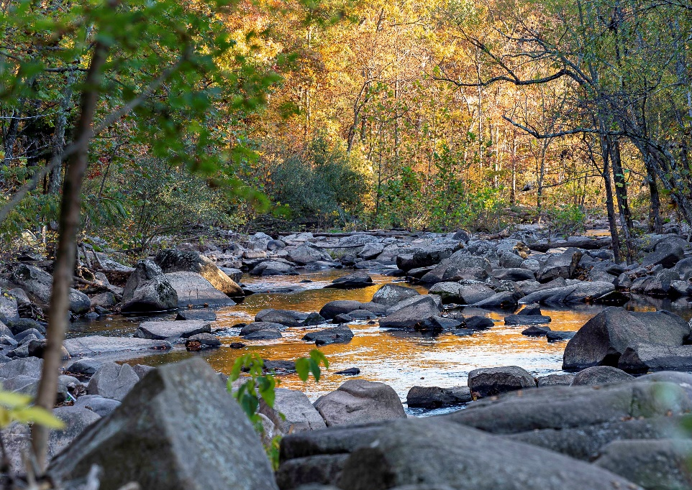
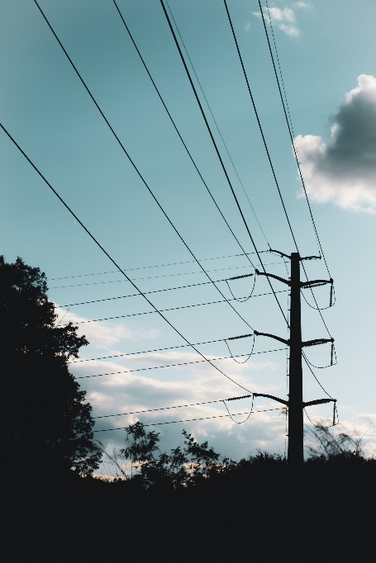
PARTNERS
Fairfax County, Office of Environmental and Energy Coordination (OEEC)
Illustrations credits Cub Run Stream photo by Sean Murphy and electrical lines photo by Mayer Maged on Unsplash.
Notes:
The Fairfax County Office of Environment and Energy Coordination (OEEC) is a relatively new organization, officially launching July 1st, 2019. The office is responsible for advancing environmental policies across the various Fairfax County organizations, and relies on engaging Fairfax County departments, authorities, residents, and businesses for input on priority and effectiveness of its programs. The OEEC has embarked on a formal effort aimed at promoting Fairfax County’s resilience to climate change by proactively identifying climate risks and potential mitigation strategies.
------------------------------Image information and credits ------------------------------
Cub Run Stream photo by Sean Murphy
Email permission given to use photo
Electric Transmission Poles: Photo by Mayer Maged on Unsplash
Source: https://unsplash.com/photos/yarLJ10VxzQ
License: All photos can be downloaded and used for free

Slide 6




OBJECTIVES
Visualize urban heat islands (UHI) in Fairfax County, VA
Identify the vulnerable populations impacted by the UHI effect
Model cooling capacity and compare the impacts of heat mitigation strategies
Illustration credits: PowerPoint icons
Notes:
The objectives of our study were focused on identifying potential priority areas for county cooling initiatives and heat mitigation strategies. To accomplish this, we set out to visualize the distribution of heat across the county, and more specifically to generate visual aids for identifying those areas most impacted by the urban heat island effect. We also set out to use demographic and socioeconomic data in concert with temperature information to identify the residents most vulnerable to extreme heat. To explore the effects of specific initiatives on cooling potential across the county, we aimed to model the effects of current and prospective land physiology on local capacity to mitigate extreme heat. Land physiology here refers to physical characteristics of the land, such as albedo or shade.
------------------------------Image information and credits ------------------------------
PowerPoint icons

Slide 7
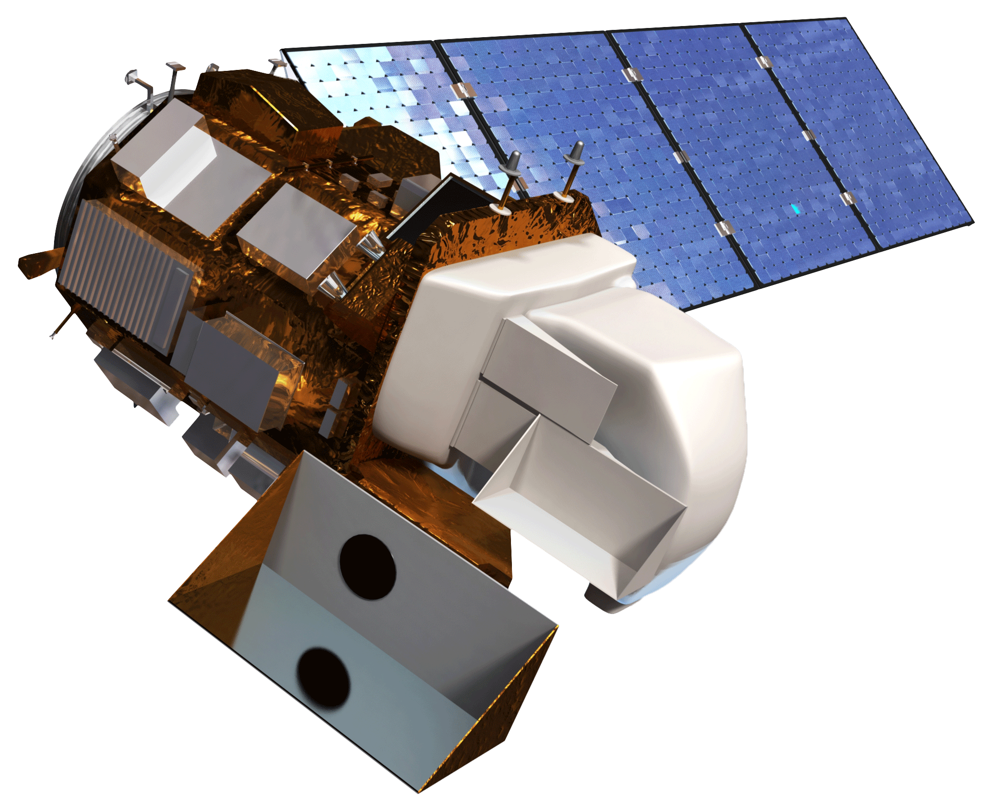
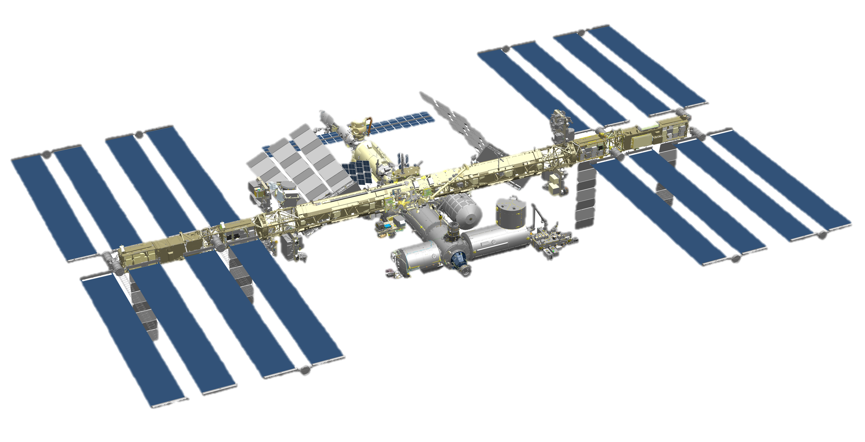
EARTH OBSERVATIONS
Landsat 8 OLI & TIRS
ISS ECOSTRESS
Illustration credits: NASA
Notes:
For our analyses, we leveraged data collected by sensors on two satellites; Landsat 8 and a system on the International Space Station called ECOSTRESS. We downloaded Landsat Provisional Surface Temperature and Landsat Surface Reflectance data from the USGS Analysis Ready Data Bundle for the years of 2013 – 2020 to be used in our calculations for mean daytime temperature and albedo, respectively. The ECOSTRESS data was downloaded from the AppEEARS portal for nighttime land surface temperature calculations and from NASA EarthData for evapotranspiration calculations for the years 2018 - 2021. Other datasets used in our study supported vulnerability analyses and cooling capacity models, and included land use/land cover, canopy cover, and U.S. Census data.
------------------------------Image information and credits ------------------------------
Satellite images from NASA, acquired on NASA DEVELOPedia
Source: http://www.devpedia.developexchange.com/dp/index.php?title=List_of_Satellite_Pictures

Slide 8
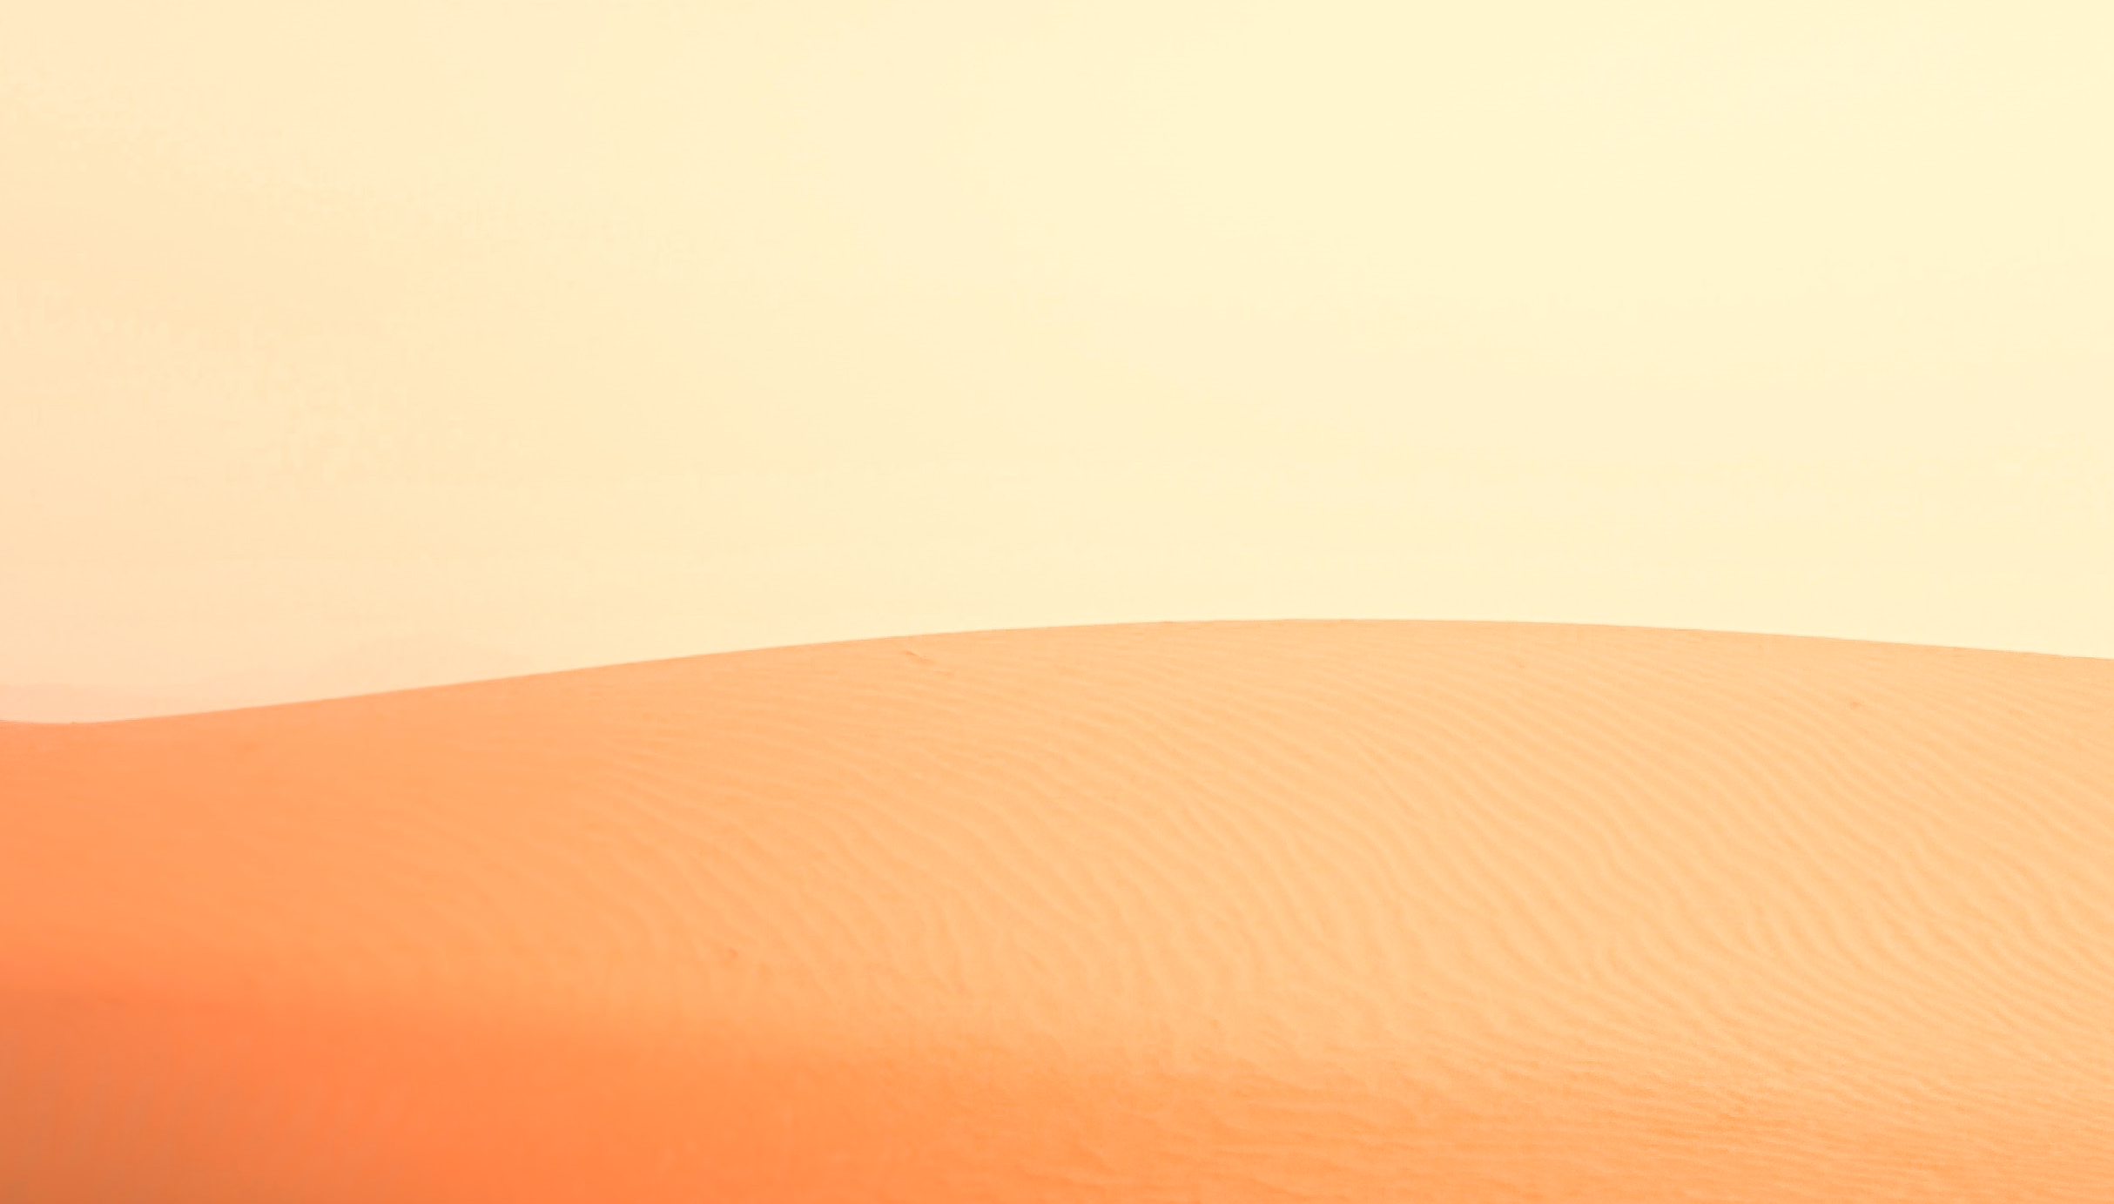

METHODOLOGY
Heat Anomalies
Surface Temperature (ST)
Remove shadows, clouds
Heat Anomaly =
Pixel mean minus zonal mean
Calculate pixel mean ST
Calculate county & reference mean ST
Illustrations credits: Photo by Pat Whelen from Pexels
Notes:
To illustrate the UHI effect, we generated maps of the heat anomalies across Fairfax County using both daytime and nighttime LST measurements. The process is illustrated here, and at a high level, is done by downloading each scene collected over our study area and period, using the corresponding pixel quality band to mask out contaminated pixels, such as clouds, then calculating average values of each pixel to generate a map for mean LST over the study period. The average of all resulting pixels within Fairfax County was taken to represent the mean County LST, and the average of each resulting pixel within the designated reference areas was taken to represent the mean reference area LST. Those specific mean values were subtracted from each pixel in the county LST map to produce anomaly maps with respect to the county and reference areas, respectively.
------------------------------Image information and credits ------------------------------
Background photo by Pat Whelen from Pexels
Source: https://www.pexels.com/photo/white-antelope-from-genus-of-oryx-in-desert-6026442/
License: All photos and videos on Pexels can be downloaded and used for free.
PowerPoint SmartArt

Slide 9
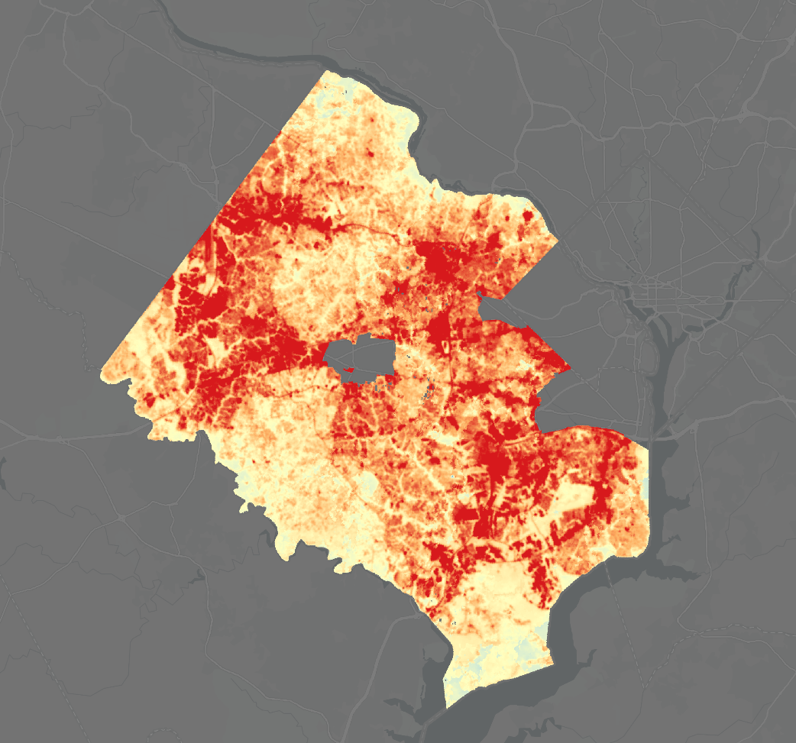
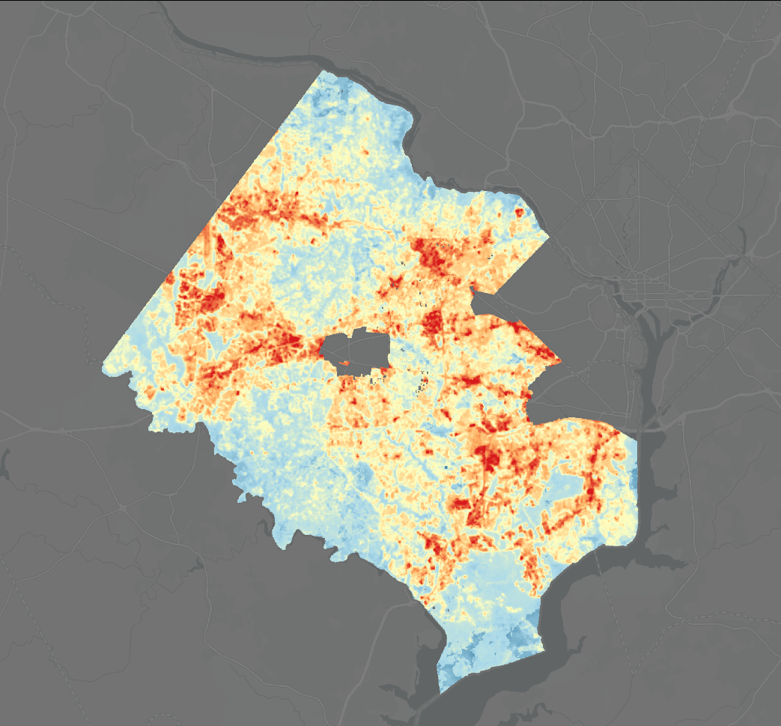


RESULTS
- Heat Anomalies - Daytime
Anomaly to
Reference
Mean
Anomaly to
County
Mean
Hottest place
Tyson’s Corner
˚F
+ 20
- 20
N
0
5
miles
Fairfax County temperatures compared to the mean temperature for the rural reference areas.
Fairfax County temperatures compared to the county mean temperature.
Notes:
The maps on this slide illustrate the heat anomalies described in the previous slide, representing daytime measurements acquired by Landsat 8. The image on the left shows the temperature anomalies with respect to the reference area mean, demonstrating that most of the area in the county experiences on average higher temperatures than the undeveloped reference areas. The image on the right shows the temperature anomalies with respect to the county mean, which communicates which areas of the county are cooler and warmer than the county average. Some of the most urbanized areas experience extreme heat in excess of 20 degrees above average, with the highest differences found along the urbanized areas of Reston, Herndon, Chantilly, Centreville, Fair Oaks, Tysons Corner, Springfield, Kingstown and the Route 1 Corridor. The highest observed temperature anomaly from the county mean was 36 degrees and the highest observed temperature anomaly from the rural reference area mean was 47 degrees.
Maps credit: NASA DEVELOP 2020 Summer LaRC Fairfax County Urban Team
Basemap: ESRI Dark Gray Canvas, at 30% transparency

Slide 10
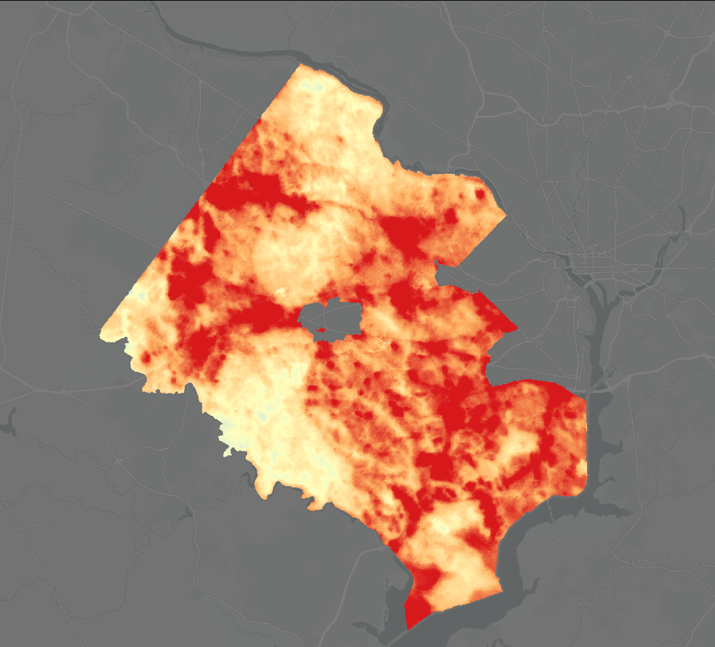
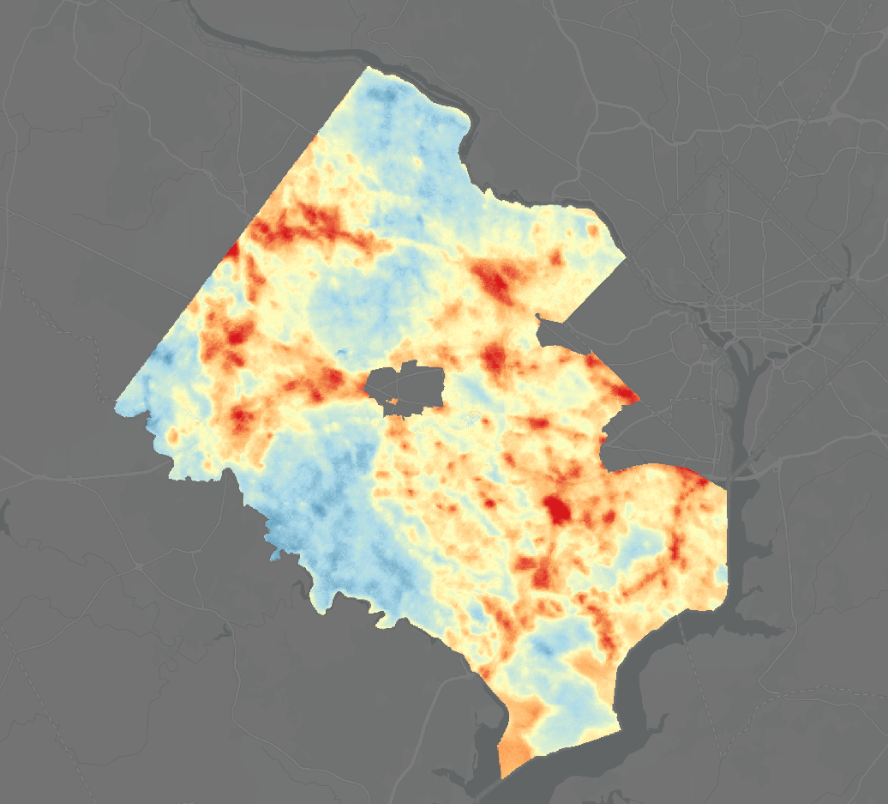
RESULTS
- Heat Anomalies - Nighttime
Anomaly to
Reference
Mean
Anomaly to
County
Mean
˚F
+ 20
- 20
N
N
N
0
5
0
5
miles
miles
0
5
miles
Fairfax County temperatures compared to the mean temperature for the rural reference areas.
Fairfax County temperatures compared to the county mean temperature.
Notes:
The two maps on this slide represent temperature anomalies in Fairfax County using nighttime LST measurements. Like in the previous slide, the left image shows anomalies with respect to the reference area mean, and the right image shows anomalies with respect to the county mean. The nighttime and daytime anomaly maps, calculated with respect to reference area mean, are used to identify the maximum magnitude of the urban heat island effect used later in the InVEST model, and are also used in a weighted average to create a temperature exposure map for our vulnerability analysis.
------------------------------Image information and credits ------------------------------
Maps credit: NASA DEVELOP 2020 Summer LaRC Fairfax County Urban Team
Basemap: ESRI Dark Gray Canvas, at 30% transparency

Slide 11
METHODOLOGY
Heat Vulnerability Index
Health variables
Economic variables
Demographic
& social variables
Vulnerability INDEX
Living conditions
Heat Exposure
Illustration credits: Photo by Pat Whelen from Pexels
Notes:
Using the heat exposure data in conjunction with economic, health, and sociodemographic variables, we generated an index for heat vulnerability that can be used to identify areas most in need of heat mitigation efforts. Economic, health, and sociodemographic variables were delineated by census tract. They include rates of poverty, low income, households without a vehicle, populations over the age of 65 or under 5 years old, populations with disabilities, existing health conditions such as asthma, COPD, and populations that speak English less than well. We separated the sensitivity variables into 4 categories, generated scores for each tract in each of those categories, then averaged the category scores to generate a sensitivity index value for each tract. The sensitivity score and exposure score for each census tract were then multiplied to get an overall vulnerability score per tract.
------------------------------Image Information and credits ------------------------------
Background photo by Pat Whelen from Pexels
Source: https://www.pexels.com/photo/white-antelope-from-genus-of-oryx-in-desert-6026442/
License: All photos and videos on Pexels can be downloaded and used for free.
PowerPoint SmartArt

Slide 12
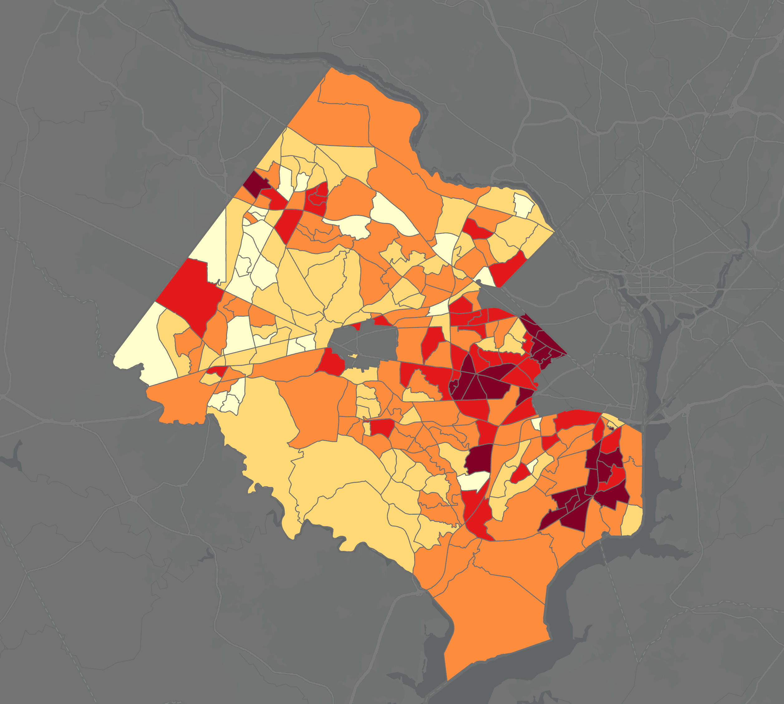
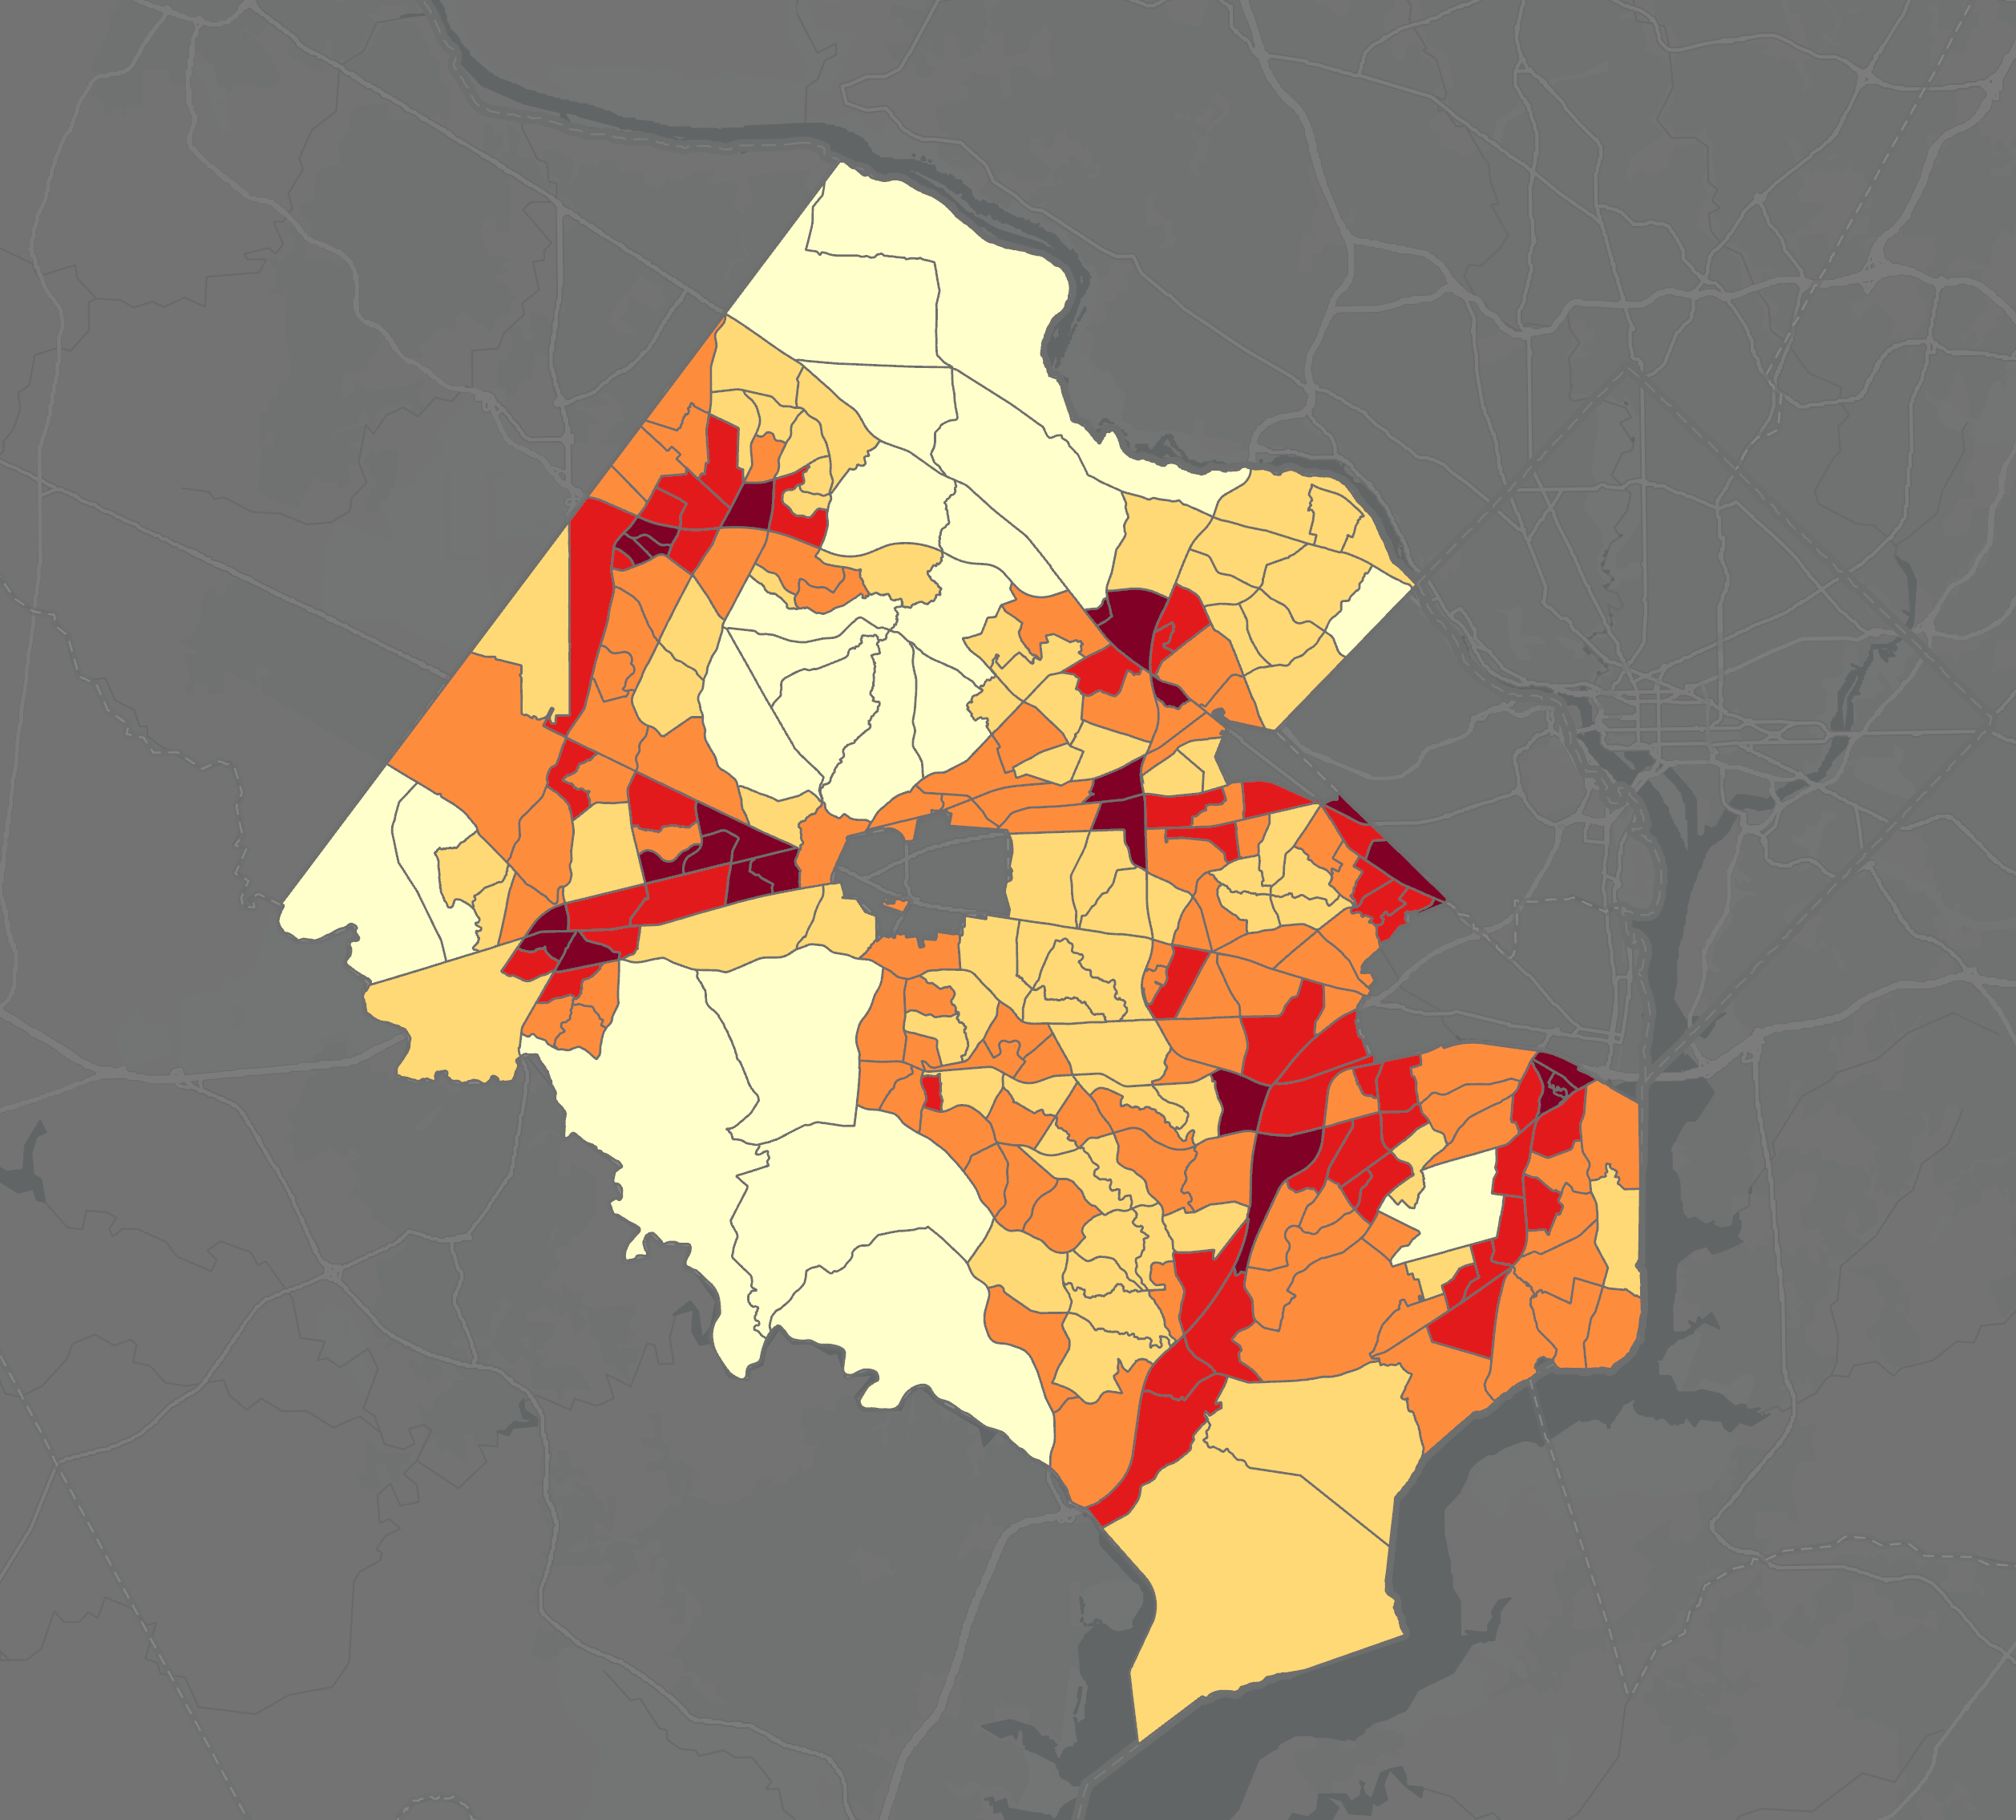
RESULTS
- Sensitivity and Exposure Indexes
Heat
Sensitivity Index
Heat
Exposure
Index
Index
5
4
3
2
1
N
0
5
miles
Heat Sensitivity Index map shows areas that have heat-sensitive populations.
Heat Exposure Index map shows areas that are more exposed to heat.
Notes:
Heat sensitivity and heat exposure are shown here on the left and right, respectively. We generated the heat sensitivity map as described in the previous slide, so the image represents the aggregated sensitivity index, taking into account all health, economic, and sociodemographic variables we considered in our study. For heat exposure, we considered a weighted average of nighttime and daytime temperature measurements.
------------------------------Image information and credits ------------------------------
Maps credit: NASA DEVELOP 2020 Summer LaRC Fairfax County Urban Team
Basemap: ESRI Dark Gray Canvas, at 30% transparency

Slide 13
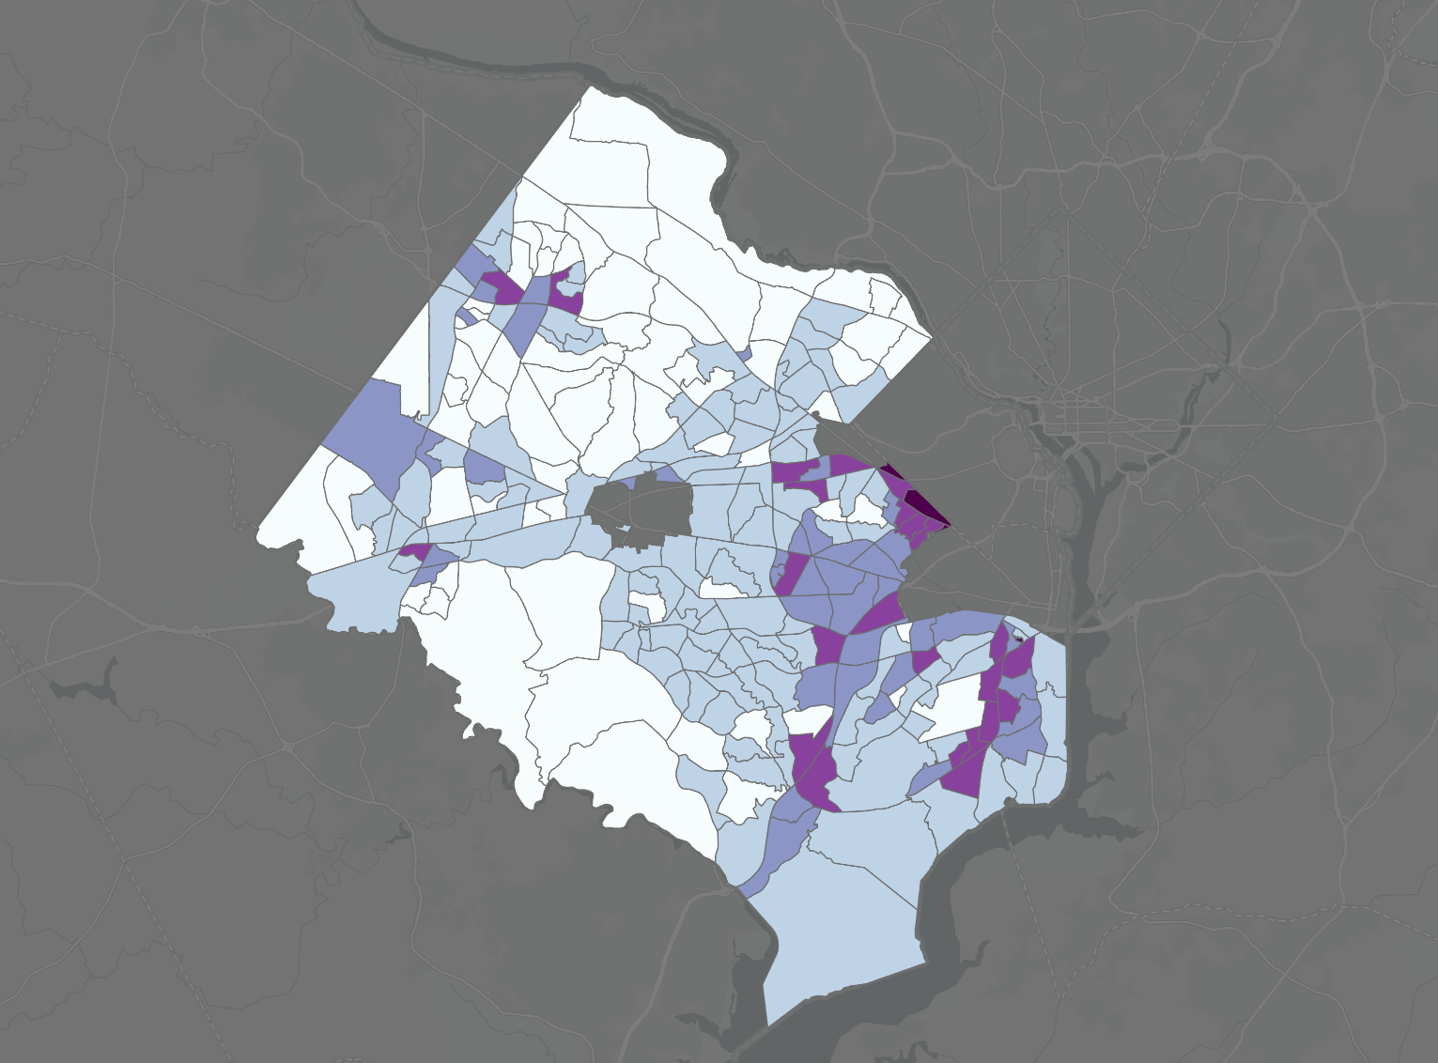

RESULTS
- Vulnerability Index
Land Use
Fairfax County, VA
Heat Vulnerability
Index
Heat Vulnerability Index map shows areas that have a combination of heat-sensitive populations and higher-than-average temperatures.
Categories
Index
5
4
3
N
N
2
1
0
5
0
5
miles
miles
Basemap: Esri Light Gray Canvas
Notes:
By multiplying the sensitivity scores by the heat exposure scores, we created a map showing vulnerability to extreme heat by census tract in Fairfax County. The vulnerability map shows areas that have a combination of sensitive populations and higher-than-average temperatures, potentially putting those areas at greater risk during extreme heat events.
------------------------------Image information and credits ------------------------------
Maps credit: NASA DEVELOP 2020 Summer LaRC Fairfax County Urban Team
Basemap: ESRI Dark Gray Canvas, at 30% transparency

Slide 14



METHODOLOGY
Land
Use
InVEST model
Albedo
Building Intensity
Shade
Tree Canopy
Energy use
Evapo-transpiration
Cooling Capacity
Illustration credits: Photo by Pat Whelen from Pexels
Notes:
Moving into modeling, we used the Natural Capital InVEST urban cooling model to calculate and visualize the cooling capacity of the various physiology of the county. The urban cooling model relies on inputs for land use/land cover, evapotranspiration, shade, albedo, and building intensity in its
calculations, and outputs are useful in determining how the infrastructure around the county is contributing to or mitigating the UHI effect. The image on the left … NEED DESCRIPTION
------------------------------Image information and credits ------------------------------
Background photo by Pat Whelen from Pexels
Source: https://www.pexels.com/photo/white-antelope-from-genus-of-oryx-in-desert-6026442/
License: All photos and videos on Pexels can be downloaded and used for free.
PowerPoint SmartArt

Slide 15
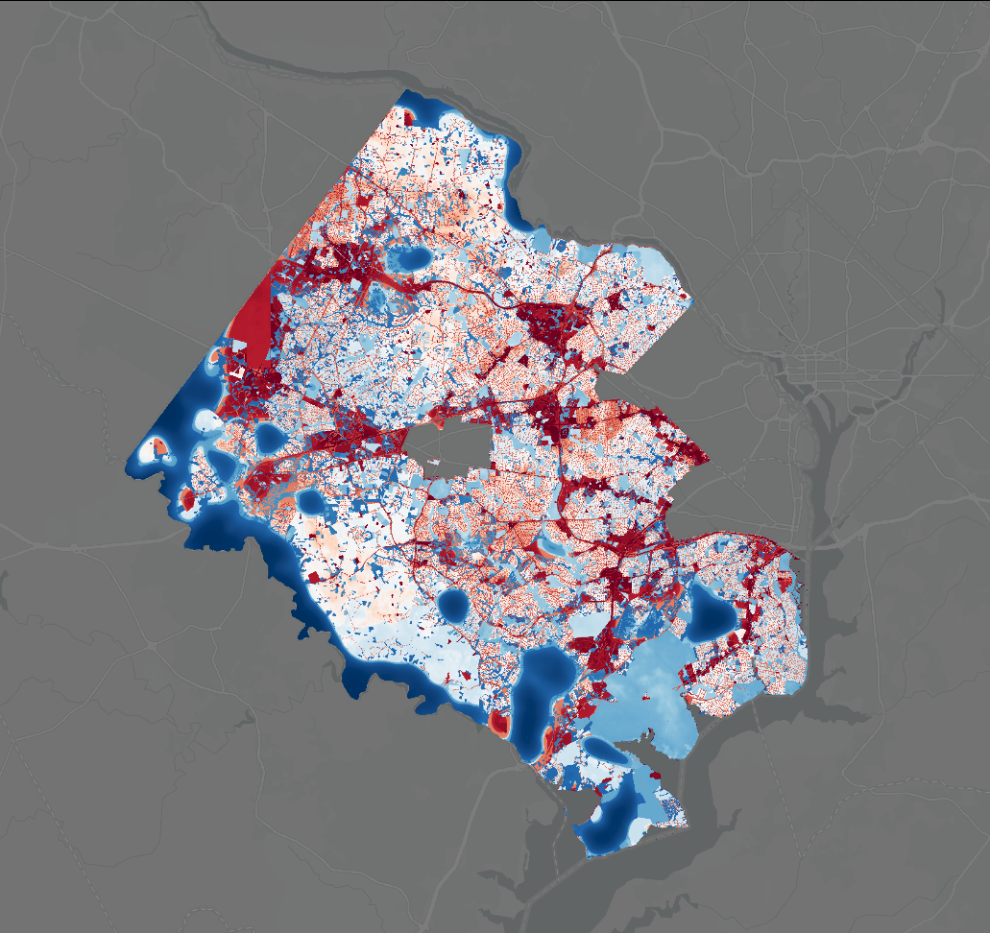
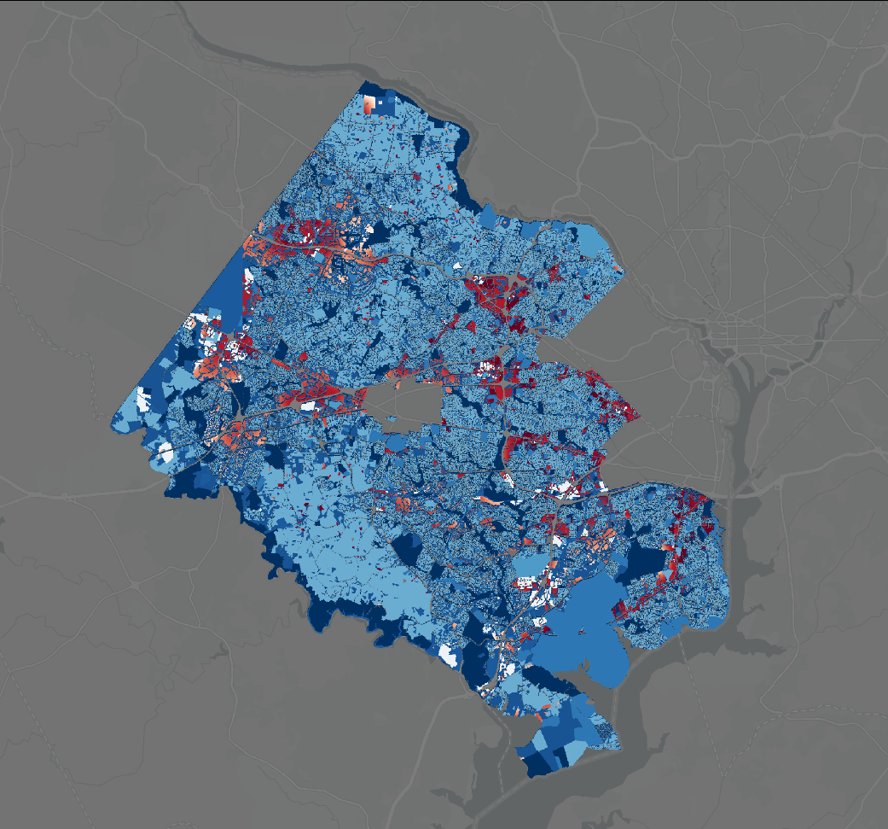
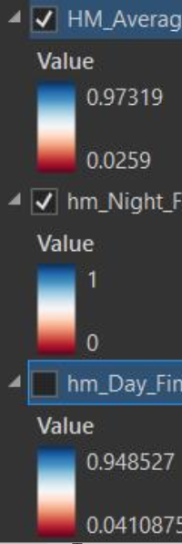
RESULTS
- InVEST Model
Daytime Heat
Mitigation
Index
Nighttime Heat
Mitigation
Index
Heat Mitigation Index
1
0
N
0
5
miles
Daytime heat mitigation capacity
Nighttime heat mitigation capacity
Notes:
Our heat mitigation index maps are shown here, representing daytime model on the left and nighttime model on the right. High values, shown in blue, represent areas that are effective at combating the UHI effect. Low values, shown in red, represent areas that are not effective at mitigating heat.
------------------------------Image information and credits ------------------------------
Maps credit: NASA DEVELOP 2020 Summer LaRC Fairfax County Urban Team
Basemap: ESRI Dark Gray Canvas, at 30% transparency

Slide 16

CONCLUSIONS
Heat Anomalies:
Hot spots clustered around urbanized areas
Hottest temp in Tyson's Corner
Reference areas always cooler than county
Vulnerability:​
Highest in East Fairfax County
Heat Mitigation Indices:​
Higher nighttime mitigation capacity
More mitigation capacity in vegetated areas
Illustration credits: background photo by Johannes Plenio from Pexels
Notes:
In conclusion, by utilizing NASA earth observations and socioeconomic data, our team analyzed the distribution of the urban heat island effect in Fairfax County, located the most heat vulnerable populations, and mapped heat mitigation capacity across the county.
The anomaly maps indicate that the hottest spots were located in the most urbanized areas, whereas low density residential and forested areas were cooler. In addition, while there were many areas that were cooler than the county mean, the county was always warmer than the mean of the rural reference areas, even in less urbanized locations.
The exposure map combined with our sensitivity map illustrate problematic areas where high temperatures and sensitive residents coincide, representing areas that would most benefit from heat mitigation efforts. We found that the most vulnerable areas were located on the Eastern side of Fairfax County.
The daytime heat mitigation capacity map displays a low HMI in urbanized areas and a higher HMI in areas with more vegetation. However, nighttime heat mitigation capacity was higher across the board.
With ever increasing temperatures in the face of climate change, it is imperative that cities implement cooling strategies to combat the consequences of extreme heat on human health, comfort, infrastructure, and energy consumption. The results of this project will aid Fairfax County in determining priority areas for heat mitigation strategies.
------------------------------Image information and credits ------------------------------
Background photo by Johannes Plenio from Pexels, cropped and transparency set at 60%
Source: https://www.pexels.com/photo/sunset-view-on-the-forest-1110658/
License: free to use. No attribution required.

Slide 17
ERRORS & UNCERTAINTIES
Fuzziness of ECOSTRESS LST data
Joining NLCD and county-level LULC data
Assumptions of vulnerability analysis
InVEST does not consider bodies of water
Impervious surfaces not utilized as standalone variable
Subjective interpretation of sensitivity variables
Illustration credits: background photo by Johannes Plenio from Pexels
Notes:
In our analyses, we identified a few key sources for potential error or uncertainty. As we embarked on analysis of the ECOSTRESS data, our maps displaying nighttime mean temperature values retained some non-uniformity attributed to imperfect acquisition conditions, and lack of sharpness, attributed to geopositional error. As a result, pixels for mean nighttime LST may represent as little as 8 samples, and consequently some numerical uncertainty is associated with mean values.
In addition, we leveraged a Fairfax County dataset for land cover, which had to be adjoined with NLCD data at the county peripheries to accommodate the InVEST modeling process. As a result, some inconsistency exists among land cover at the county borders and along roads. As the dataset we used assigned roads a building intensity value of zero, and the nighttime cooling model relies on building intensities to calculate cooling capacity, the cooling capacity along roads was erroneously high.
According to our best judgment, the roads were masked from any final cooling capacity results that incorporated building intensity.
In our sensitivity analysis, we grouped our variables according to our best judgment, and the resulting sensitivity indices are heavily influenced by how those variables are grouped. The final results best represent our interpretation of the variables and their influence on heat sensitivity, and the effects of our groupings persist into the vulnerability maps. Given the subjective nature of this aspect of the project, the results may vary depending on the judgment of those performing the sensitivity analysis.
------------------------------Image information and credits ------------------------------
Background photo by Johannes Plenio from Pexels, cropped and transparency set at 60%
Source: https://www.pexels.com/photo/sunset-view-on-the-forest-1110658/
License: free to use. No attribution required.

Slide 18
FUTURE WORK
Algorithm to fix ECOSTRESS geo-positional errors
InVEST building intensity issue
Explore weighting sensitivity variables
Illustration credits: background photo by Johannes Plenio from Pexels
Notes:
In our efforts throughout this project, we have identified a few opportunities for future work to expand upon our project, or other similar urban heat projects. In dealing with ECOSTRESS data, the geopositional errors can be corrected either manually or using an algorithm. Given the relatively small sample numbers associated with ECOSTRESS in this project, it is feasible to use feature alignment to produce sharper images. As acquisition continues and ECOSTRESS generates more data, project teams may elect to align images by comparing a set of masked scenes and realigning them using a least squares algorithm.
In the InVEST model, to overcome our issue with the building intensity associated with roads a project team could identify and assign a representative value to produce a more complete cooling capacity product.
When conducting our vulnerability analysis, we didn’t have time to delve into research on whether some variables of heat sensitivity contribute more to vulnerability than others, therefore our categories for health, income, demographics, and housing were weighted the same. Future projects could spend more time deducing whether certain variables should be weighted more than others.
------------------------------Image information and credits ------------------------------
Background photo by Johannes Plenio from Pexels, cropped and transparency set at 60%
Source: https://www.pexels.com/photo/sunset-view-on-the-forest-1110658/
License: free to use. No attribution required.

Slide 19
Partner:
Fairfax County Office of Environmental and Energy Coordination
Allison Homer
Matthew Meyers
Advisors:
Dr. Kenton Ross (NASA Langley Research Center)
Lauren Childs-Gleason (NASA Langley Research Center)
DEVELOP Fellow:
Adriana LeCompte (DEVELOP Langley node)
Notes:
We’d like to thank our partners at the Fairfax County OEEC, Allison Homer and Matt Meyers, our NASA advisors, Dr. Ken Ross and Lauren Childs-Gleason, and our node Fellow, Adriana LeCompte, for all their wonderful support throughout the project.

Slide 20
Questions?
Illustrations credits: background photo by Johannes Plenio from Pexels
Notes:
Thanks everyone for listening, we'll take any questions at this time.
------------------------------Image information and credits ------------------------------
Background photo by Johannes Plenio from Pexels, cropped and transparency set at 60%
Source: https://www.pexels.com/photo/sunset-view-on-the-forest-1110658/
License: free to use. No attribution required.

Slide 21
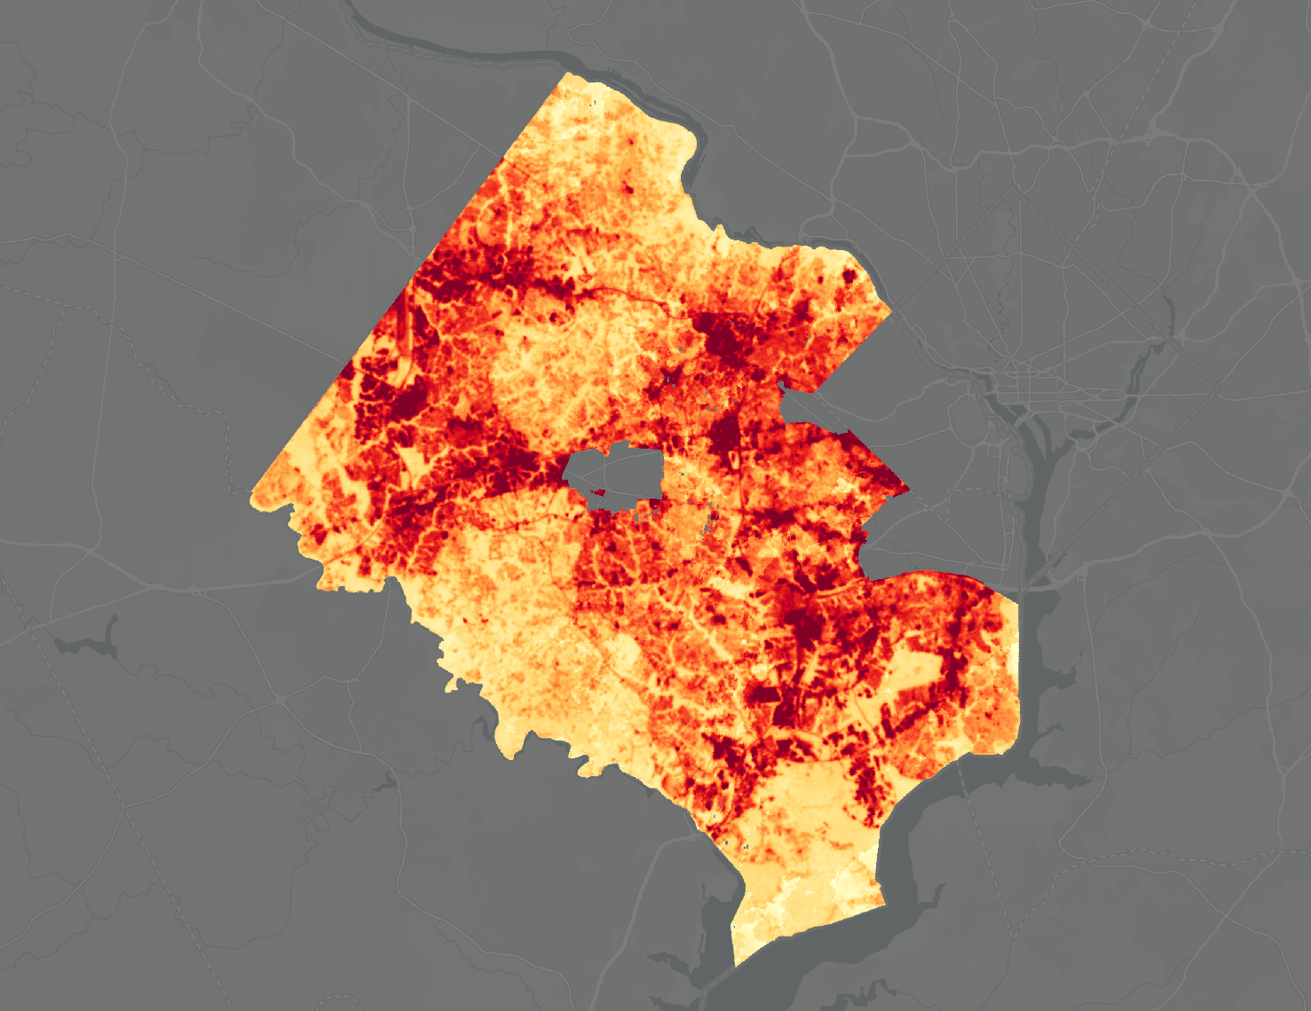
Mean Surface Temperature
Summer Mean
Surface Temperature
Fairfax County, VA
This map illustrates the 2013-2020 summer (June, July, August) mean surface temperature for
Fairfax County, VA.
˚F
125
N
0
5
60
miles
Basemap: Esri Light Gray Canvas
Basemap credit: ESRI Dark Gray Canvas
Notes:
The mean surface temperature map illustrates the 2013 – 2020 summer daytime mean surface temperature for Fairfax County, derived from Landsat 8 earth observations. Lighter yellows indicate the cooler areas, while dark reds indicate the hottest areas in Fairfax. The highest surface temperature observed was a whopping 125 degrees.
------------------------------Image information and credits ------------------------------
Maps credit: NASA DEVELOP 2020 Summer LaRC Fairfax County Urban Team
Basemap: ESRI Dark Gray Canvas, at 30% transparency

Slide 22
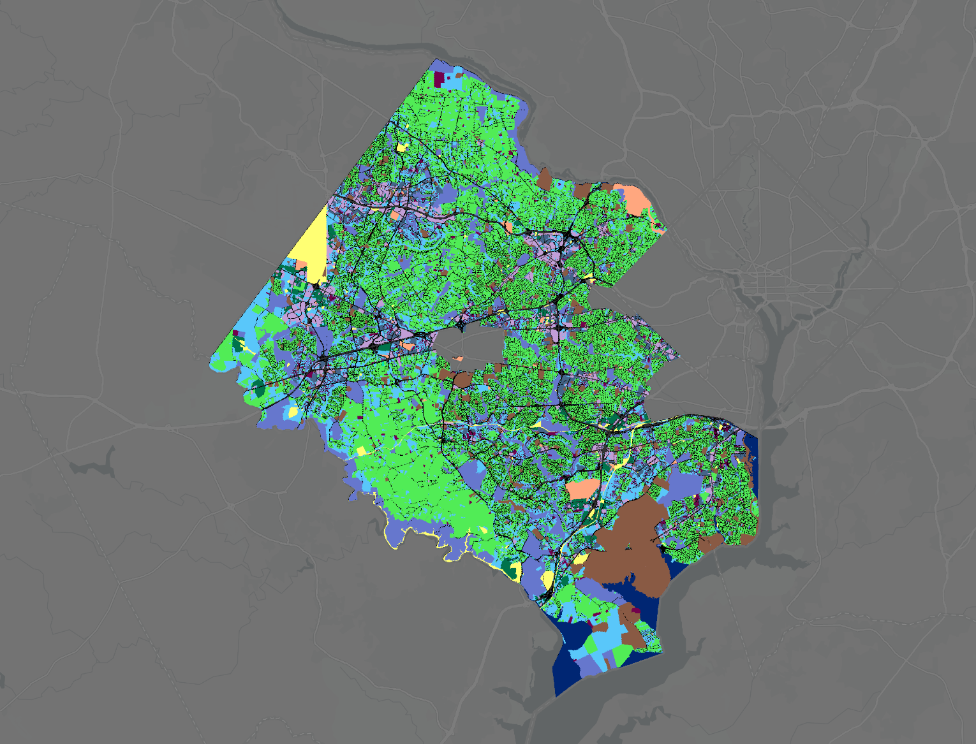
Land Use
Land Use
Fairfax County, VA
Low-density Residential
Medium-density Residential
High-density Residential
Commercial
Industrial, light and heavy
Public
Recreation
Institutional
Open-land
Low-intensity Road
High-intensity Road
Utilities
Agricultural
Open Water
This map displays the Fairfax County land-use categories with NLCD data to fill in.
N
0
5
miles
Basemap credit: ESRI Dark Gray Canvas
Notes:
We generated the Land Use map shown on this slide to support the calculations in the InVEST urban cooling model.
------------------------------Image information and credits ------------------------------
Maps credit: NASA DEVELOP 2020 Summer LaRC Fairfax County Urban Team
Basemap: ESRI Dark Gray Canvas, at 30% transparency

Slide 23
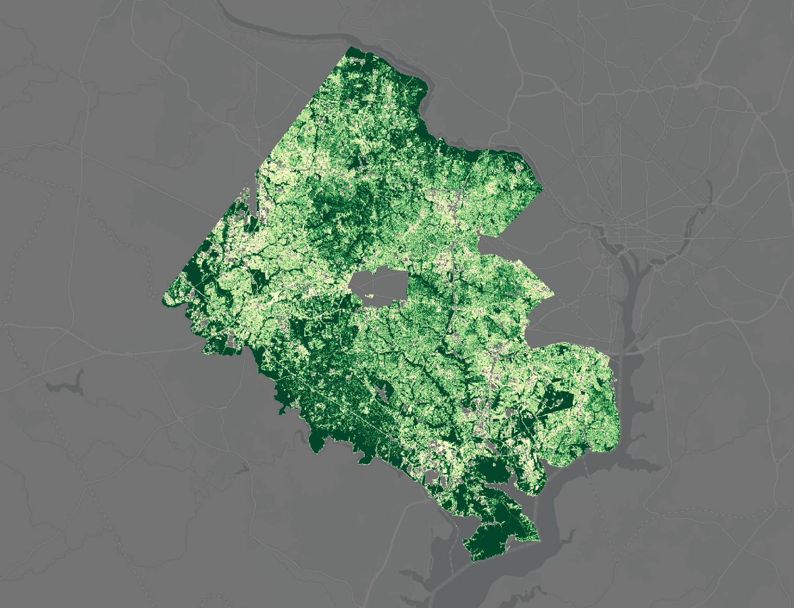

Tree canopy
Tree Cover
Fairfax County, VA
This map illustrates the percentage of tree canopy in Fairfax County, VA. Lighter yellows indicate less tree cover and darker colors indicate larger amount of canopy cover.
Cover Percentage
100 %
N
0 %
0
5
miles
Basemap: Esri Light Gray Canvas
Basemap credit: ESRI Dark Gray Canvas
Notes:
The tree canopy map shown here illustrates the tree coverage throughout Fairfax County. We used the canopy map in conjunction with the Land Use map to generate values of average shade for each land use category. Those values are stored in the Biophysical table.
------------------------------Image information and credits ------------------------------
Maps credit: NASA DEVELOP 2020 Summer LaRC Fairfax County Urban Team
Basemap: ESRI Dark Gray Canvas, at 30% transparency

Slide 24
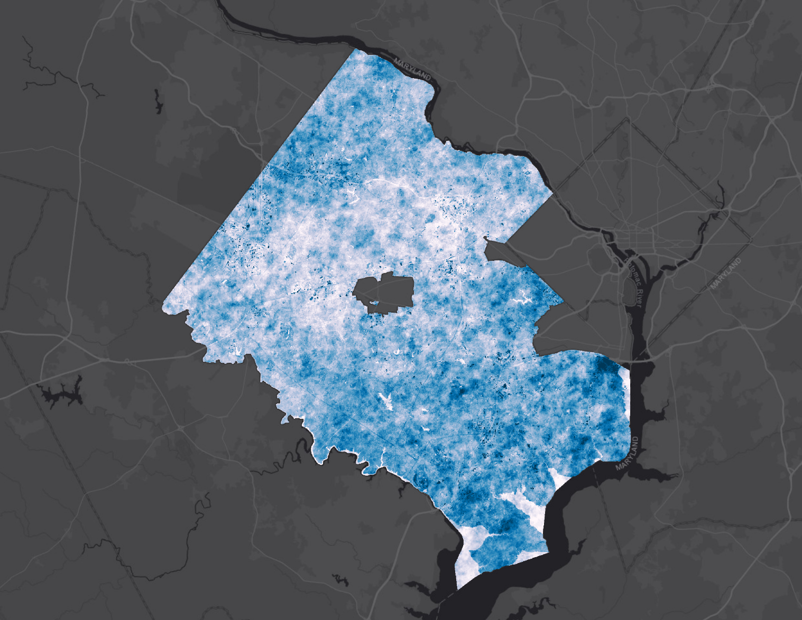

Albedo
Albedo Estimates
Fairfax County, VA
This map illustrates the albedo estimates for Fairfax County. Lighter blues indicate more reflectivity and darker colors indicate larger solar energy absorption.
Albedo
60 %
N
0
5
0 %
miles
Basemap: Esri Dark Gray Canvas
Basemap credit: ESRI Dark Gray Canvas
Notes:
Like the canopy map, the albedo map shown here was used to calculate average albedo values for each land use. The albedo values are also stored in the biophysical table. The illustration represents mean albedo values from our Landsat 8 dataset acquired from USGS Earth Explorer.
------------------------------Image information and credits ------------------------------
Maps credit: NASA DEVELOP 2020 Summer LaRC Fairfax County Urban Team
Basemap: ESRI Dark Gray Canvas, at 30% transparency

Slide 25
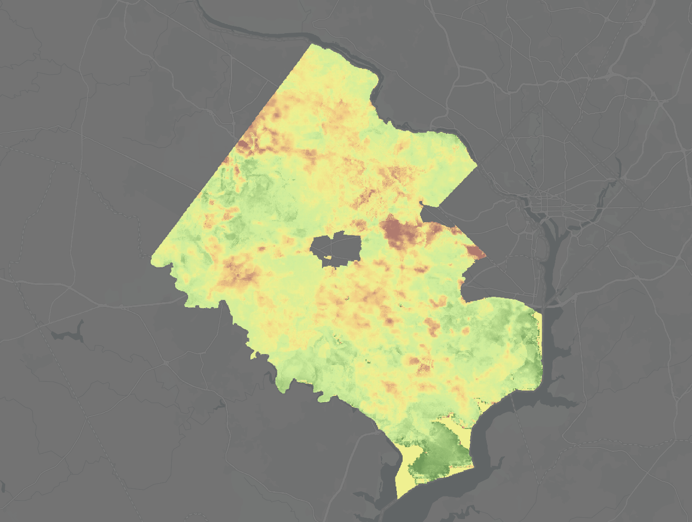
Evapotranspiration
Evapotranspiration
Fairfax County, VA
This map displays the amount of evapotranspiration in Fairfax County, VA.
Darker green colors indicate more evapotranspiration.
mm/day ⁻¹
1.6
N
0.0
0
5
miles
Basemap: Esri Light Gray Canvas
Basemap credit: ESRI Dark Gray Canvas
Notes:
The evapotranspiration map shows the distribution of evapotranspiration values across Fairfax County. The map represents median albedo values from a set of ECOSTRESS images acquired from NASA EarthData
------------------------------Image information and credits ------------------------------
Maps credit: NASA DEVELOP 2020 Summer LaRC Fairfax County Urban Team
Basemap: ESRI Dark Gray Canvas, at 30% transparency

Slide 26
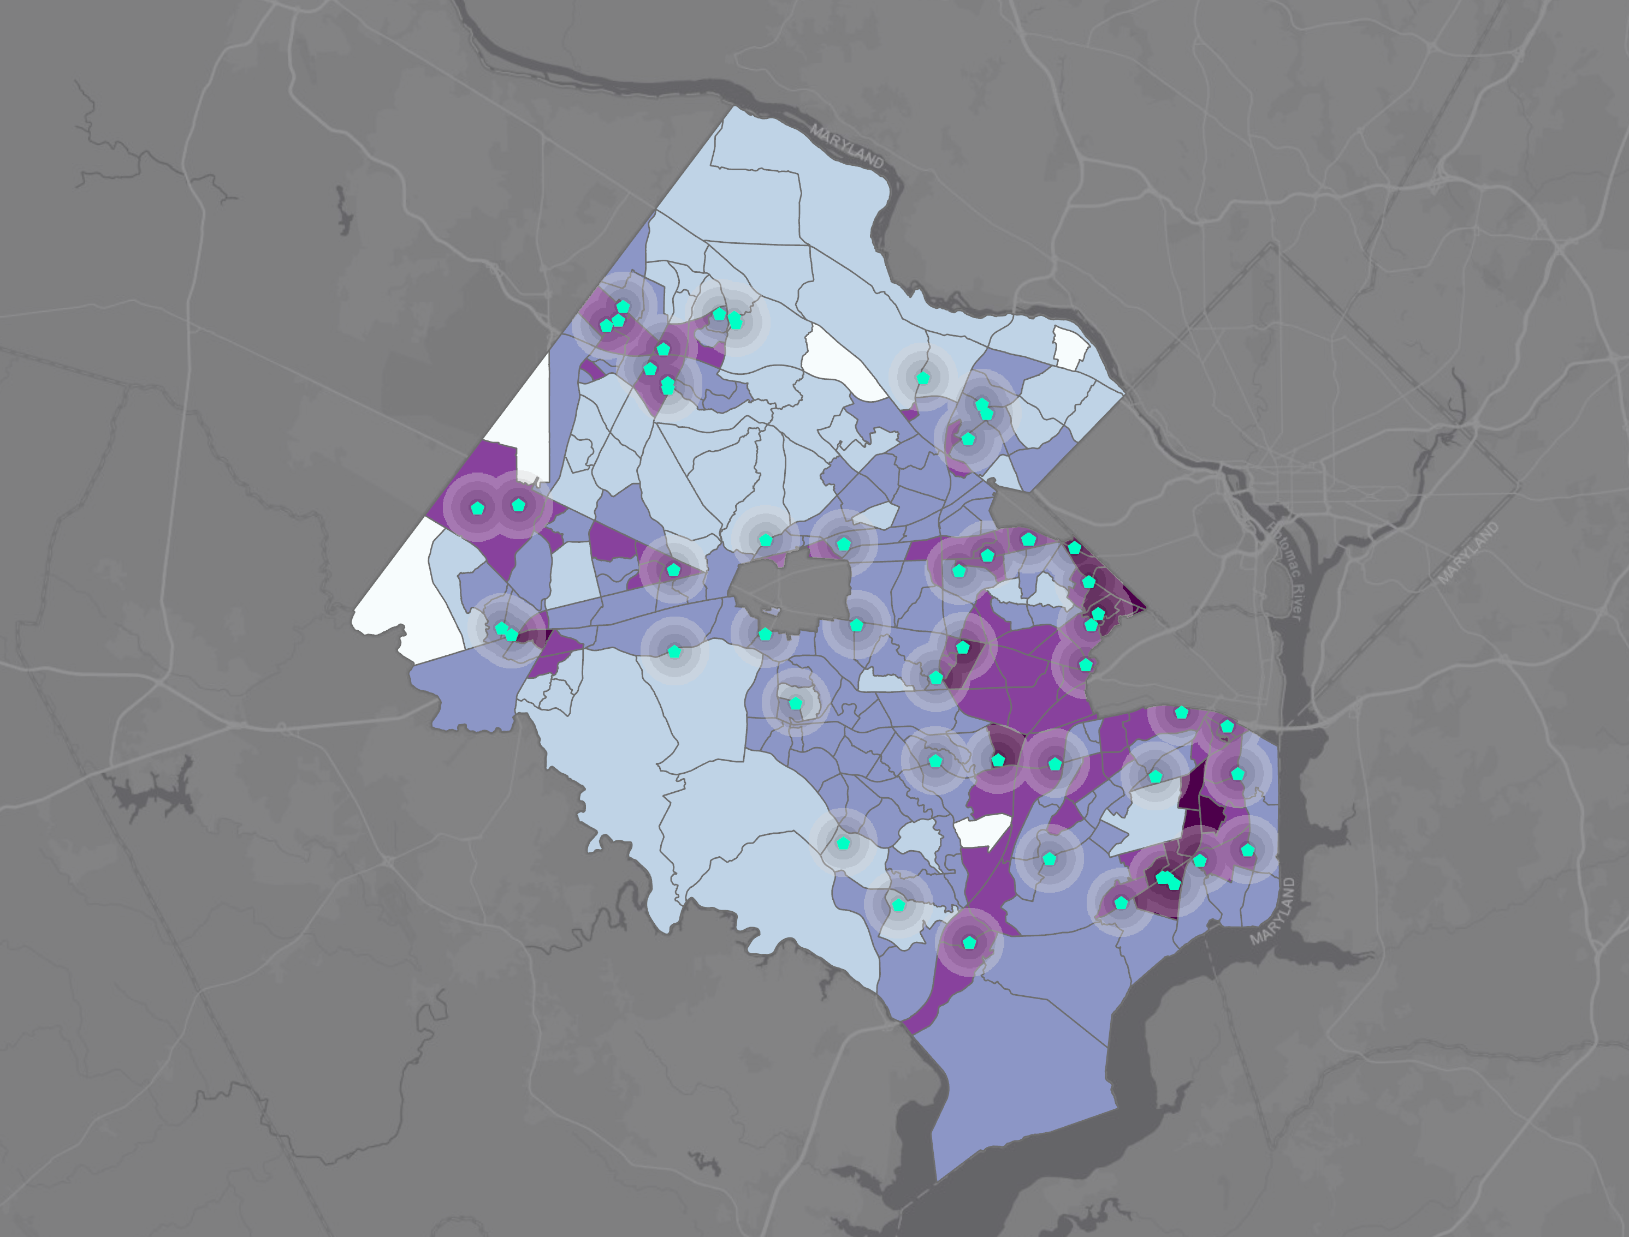
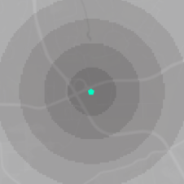
Cooling centers
Cooling Centers
Fairfax County, VA
This map depicts a 1-mile radius around cooling centers in relation to the census tracts with highest heat vulnerability.
Vulnerability Index
5
4
3
1-mile radius
N
2
Cooling Center
1
Basemap: Esri Light Gray Canvas
Basemap credit: ESRI Dark Gray Canvas
Notes:
This map displays distance to cooling centers, shown with a 1-mile radius, and is overlayed on top of the vulnerability index map. Areas which are especially vulnerable to heat should have cooling centers near by, as a way for citizens to escape the heat if needed.
------------------------------Image information and credits ------------------------------
Maps credit: NASA DEVELOP 2020 Summer LaRC Fairfax County Urban Team
Basemap: ESRI Dark Gray Canvas, at 30% transparency

Slide 27
New Methods and Lessons Learned
Python cloud-masking script
Surface reflectance negative numbers
QGIS range defaults
Illustrations credits: background photo by Johannes Plenio from Pexels
Notes:
New methods compared to other DEVELOP studies:
• We downloaded Landsat Provisional Surface Temperature and Surface Reflectance products from the USGS EarthExplorer site in place of collecting them from Google Earth Explorer. We had to develop a Python script to remove clouds and shadows using the Quality Assessment band as no other DEVELOP team had gone this route before. We now have an effective cloud-masking script for future teams to implement who are using Landsat data and did not derive data from GEE.
Lessons learned:
• Surface Reflection included negative numbers and values above the expected range. The digital numbers on the data are reported as the sensor perceived them and they may be affected by shadows and water. However, the histogram centers the values between 0 and 1 and only a few outliers.
QGIS defaults to displaying the range of a raster for 2% - 98% of the values to account for outliers.
------------------------------Image information and credits ------------------------------
Background photo by Johannes Plenio from Pexels, cropped and transparency set at 60%
Source: https://www.pexels.com/photo/sunset-view-on-the-forest-1110658/
License: free to use. No attribution required.

