Slide 1
Consolidating Lunar Regolith
Cayden Doyle
Sheila A. Thibeault, Jin Ho Kang, and Keith L. Gordon
2021 Summer Student Research Symposium

Slide 2
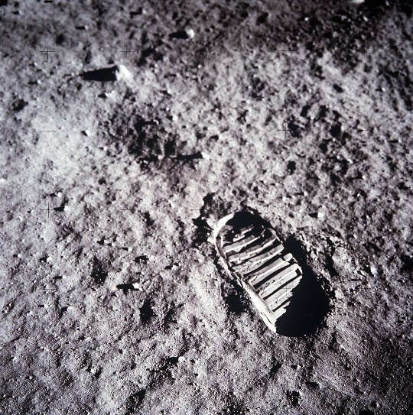
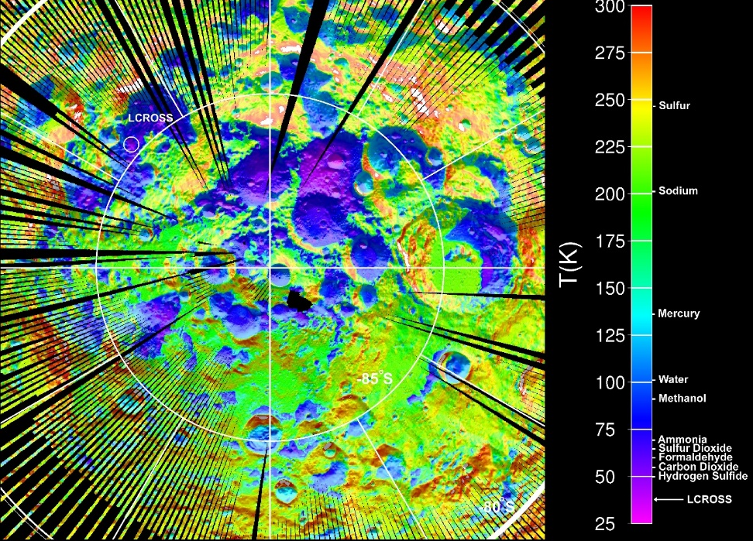
Challenge, Objective, and Approach
Challenge:
The Moon has a harsh environment compared with Earth
  Day and nighttime temperature cycling, radiation, solar exposure limits, etc.
In-situ utilization of lunar regolith
  Consolidation of regolith for construction
Objective:
The primary objective is to build a base on the Moon
  Artemis Program
Through this research, the construction of a base becomes possible
Approach:
Online research and summary of possible results
  Collected research papers on methods related to the project
  Created and suggested the most feasible methods to test
  Performed radiation dose calculations
Fig 1. Buzz Aldrin boot print on lunar surface (Image Credit: NASA)
Fig 2. Lunar Reconnaissance Orbiter recorded temperature map of south pole (Image Credit: NASA)

Slide 3
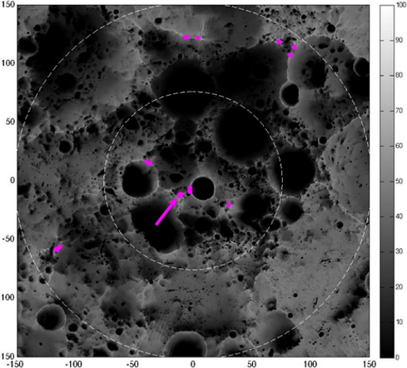
Results I
Table 1. Oxide content of regolith from Apollo missions and comparable simulants^{[1,2]}
Chemical composition of lunar regolith
  Required for simulations and other calculations
Environmental conditions
  Required for manufacturing and testing of consolidated regolith
Solar exposure
  Required for choosing a viable landing site
Material | Apollo 11 (10084) | MLS-1 simulant | Apollo 14 (14163) | JSC-1 simulant
SiO₂ | 42 | 42.8 | 47.3 | 47.71
TiO₂ | 7.54 | 6.77 | 1.6 | 1.59
Al₂O₃ | 13.55 | 12.1 | 17.8 | 15.02
FeO | 15.81 | 16.3 | 10.5 | 7.35
Fe₂O₃ | - | - | - | 3.44
MnO | 0.213 | 0.22 | 0.1 | 0.18
MgO | 7.88 | 6.19 | 9.6 | 9.01
CaO | 11.96 | 11.1 | 11.4 | 10.42
Na₂O | 0.438 | 2.22 | 0.7 | 2.7
K₂O | 0.135 | 0.2 | 0.6 | 0.82
P₂O₅ | 0.101 | 0.04 | - | 0.66
S | 0.11 | - | - | -
Gnomonic Y (km)
Illumination Rate (%)
Table 2. Lunar temperatures^{[3,4,5,6]}
Gnomonic X (km)
Temp Extremes (°C) | Average Temp (°C) | Equator Temp (°C) | South Pole Temp (°C)
-233 to 123 | -163 to 117 (night and day) | -178 to 117 (night and day) | -23 to -3 (night and day)
Fig 3. Grayscale image showing illumination of lunar south pole (in percent) over four lunar precession cycles (each approx. 18.6 years); highlighted points have greatest illumination; the arrow shows a 92% illumination rate location at surface level near Shackleton Crater (Image Credit: NASA)

Slide 4
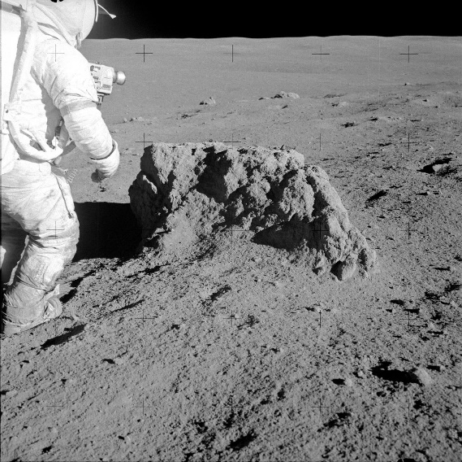
Results II
Desired Parameters
  Have an equivalent strength to concrete used on Earth (20-40 MPa)
  Minimizes the radiation dose in space
  Withstands vacuum conditions on the Moon (2x10⁻¹² torr)
  Manufacturable at lunar south pole temperature (-23 to -3°C)
Types of “lunar concrete”
  Sintered, polymeric, sulfuric, and geopolymeric concrete
Sintered
  Requires high temperature, but no binder is needed
  Highest strength and density by far
Polymeric
  Manufactured by addition of linear low-density polyethylene (LLDPE) to regolith simulant
  Requires melting of PE and heat treatment above 100°C to form
Sulfuric
  Manufactured by addition of sulfur to regolith simulant
  Requires casting in 140°C heated molds
Geopolymeric
  Manufactured by addition of activator solution (H₂O + Na₂O & SiO₂ mixed with NaOH)
  Can be formed without heat, but requires pressure
Table 3. Lunar concrete strength and manufacturing^{[7-16]}
Material | Manufacturing | Environment | Strength
Sintered | Requires furnace | - | >150 MPa
Polymeric | Requires at least 10 wt% PE | - | ≈12 MPa
Sulfuric | Requires 35 wt% Sulfur | Integrity significantly reduced | >30 MPa
Geopolymeric | Requires <6 wt% activator | Seems maintainable at south pole | > 30 MPa
Fig 4. Alan B. Shepard from Apollo 14 standing beside boulder on lunar surface (Image Credit: NASA)

Slide 5
Results III
Radiation dose simulations
  Radiation doses need to be researched to protect astronauts in space
  Radiation from three sources: galactic cosmic rays (GCR), solar energetic particles (SEP), trapped particles (low Earth orbit) (LEO)
Online Tool for the Assessment of Radiation In Space (OLTARIS)
  Radiation dose simulated through lunar concrete candidates (HZETRN based code)
  Four conditions: GCR dose in free space, SEP dose in free space, GCR dose in LEO, AP8 (trapped proton environmental model) dose in LEO
Fig 5. GCR dose rate vs depth in free space in tissue
Fig 6. Solar particle event (SPE) dose vs depth in free space in tissue
Fig 7. GCR dose rate vs depth in LEO in tissue
Fig 8. AP8 model dose rate vs depth in LEO in tissue
Legend:

Slide 6
Analysis/Summary
The lunar environment was summarized
  Temperature, solar exposure, pressure, and radiation
Several lunar concrete candidates were researched
  Data was presented for composition and manufacturing methods
  Pros and cons were suggested
Radiation dose from environmental radiation sources was simulated using OLTARIS
  Values for dose or dose rate versus depth were given
  Higher PE content coincided with greater radiation dose mitigation
Preliminary material selection was made possible from this research
  Through comparison of materials and their reactions to the lunar environment
  Polymeric and geopolymeric concrete seem to be the best options with current knowledge

Slide 7
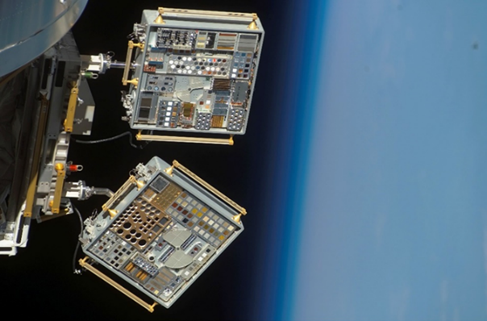
Next Steps/Outlook/Future Work
From this research, lunar concrete candidates have been selected
Next steps
  Begin fabrication of concrete in lab, ideally under lunar conditions, otherwise test post-lunar exposure
  Test concrete samples mechanically with ASTM standardized tests
  Use HZETRN, or other code, to simulate radiation doses more accurately
    Use lunar surface environment with OLTARIS for simulations
  Attach concrete samples to International Space Station (ISS) through Materials International Space Station Experiment (MISSE) program to test properties and possibly compare with HZETRN data
Summary
  This research serves as a preliminary investigation into the methods for fabricating lunar concrete and the test methods to measure their physical integrity and radiation shielding capabilities in space. From these data, the methods for establishing a base on the Moon narrows and a greater focus can be put on items contained within this research.
Table 4. Commonly used ASTM standards for lunar regolith testing (*needs to be updated)
Test Name | ASTM | Measured Value
Sieve Test | D421 (prep) and D422 | Particle Size Distribution > 75 μm
Hydrometer Test | D421 (prep) and D422 | Particle Size Distribution < 75 μm
Specific Gravity Test | D854 | Specific Gravity
Relative Density Test(s) | D4253 (max) and D4254 (min) | Max/Min Index Density
Triaxial Compression Test | D2850 | Compressive Stress vs Strain
Direct Shear Test* | D3080 | Shear Strength
Fig 9. MISSE-6 panels on ram side of ISS (Image Credit: NASA)

Slide 8
Acknowledgements
Idaho Space Grant Consortium
NIFS Program Coordinators (LaRC)
  Valerie Ellis, Jessica Gangitano, Patricia Sanchez, Jalisa Thomas, and Christine Dillard
Aerospace Technologist (for assistance with OLTARIS)
  Chris Sandridge (LaRC)

Slide 9
References
[1] Gustafson, Robert. “JSC‐1A Lunar Regolith Simulant Availability and Characterization.” Orbital Technologies Corporation.
[2] Planetary Simulant Database, Colorado School of Mines, 2021, simulantdb.com/.
[3] Dunbar, Brian. “The Moon.” NASA, NASA, 6 May 2015, www.nasa.gov/moon.
[4] Wong-Swanson, Belinda Gum-Hung. “Energy Analysis of Manufacturing Processes on the Moon.” The University of Arizona, The University of Arizona, 1991.
[5] Williams, David R. “Moon Fact Sheet.” NASA, NASA, 2020, nssdc.gsfc.nasa.gov/planetary/factsheet/moonfact.html.
[6] Spudis, P, et al. “Physical Environment of the Lunar South Pole from Clementine Data: Implications for Future Exploration of the Moon.” Mar. 1995.
[7] Meurisse, A., et al. “Influence of Mineral Composition on Sintering Lunar Regolith.” Journal of Aerospace Engineering, vol. 30, no. 4, July 2017, pp. 1–8. EBSCOhost, doi:10.1061/(ASCE)AS.1943-5525.0000721.
[8] Zhang, Xiang, et al. “Spark Plasma Sintering of a Lunar Regolith Simulant: Effects of Parameters on Microstructure Evolution, Phase Transformation, and Mechanical Properties.” Ceramics International, vol. 47, no. 4, Feb. 2021, pp. 5209–5220. EBSCOhost, doi:10.1016/j.ceramint.2020.10.100.
[9] Toutanji, Houssam A., et al. “Performance of Lunar Sulfur Concrete in Lunar Environments.” Construction & Building Materials, vol. 29, Apr. 2012, pp. 444–448. EBSCOhost, doi:10.1016/j.conbuildmat.2011.10.041.
[10] Grugel, Richard N., and Houssam Toutanji. “Sulfur ‘Concrete’ for Lunar Applications – Sublimation Concerns.” Advances in Space Research, vol. 41, no. 1, Jan. 2008, pp. 103–112. EBSCOhost, doi:10.1016/j.asr.2007.08.018
[11] Grugel, Richard N. “Integrity of Sulfur Concrete Subjected to Simulated Lunar Temperature Cycles.” Advances in Space Research, vol. 50, no. 9, Nov. 2012, pp. 1294–1299. EBSCOhost, doi:10.1016/j.asr.2012.06.027.
[12] Sik Lee, Tai, et al. “Manufacture of Polymeric Concrete on the Moon.” Acta Astronautica, vol. 114, Sept. 2015, pp. 60–64. EBSCOhost, doi:10.1016/j.actaastro.2015.04.004.
[13] Lee, Jaeho, et al. “Bottom-up Heating Method for Producing Polyethylene Lunar Concrete in Lunar Environment.” Advances in Space Research, vol. 62, no. 1, July 2018, pp. 164–173. EBSCOhost, doi:10.1016/j.asr.2018.03.039.
[14] Montes, Carlos, et al. “Evaluation of Lunar Regolith Geopolymer Binder as a Radioactive Shielding Material for Space Exploration Applications.” Advances in Space Research, vol. 56, no. 6, 2015, pp. 1212–1221., doi:10.1016/j.asr.2015.05.044.
[15] Davis, Gabrielle, et al. “Preparation of Lunar Regolith Based Geopolymer Cement under Heat and Vacuum.” Advances in Space Research, vol. 59, no. 7, 2017, pp. 1872–1885., doi:10.1016/j.asr.2017.01.024.
[16] Toutanji, Houssam A., et al. “Performance of Lunar Sulfur Concrete in Lunar Environments.” Construction & Building Materials, vol. 29, Apr. 2012, pp. 444–448. EBSCOhost, doi:10.1016/j.conbuildmat.2011.10.041.

