Slide 1
Modeling of Solid Electrolyte for
NASA SABERS Project
April A Rains
Dr. Vesselin Yamakov, Dr. Yi Lin and Dr. John Connell
2021 Summer NIFS Research Symposium

Slide 2
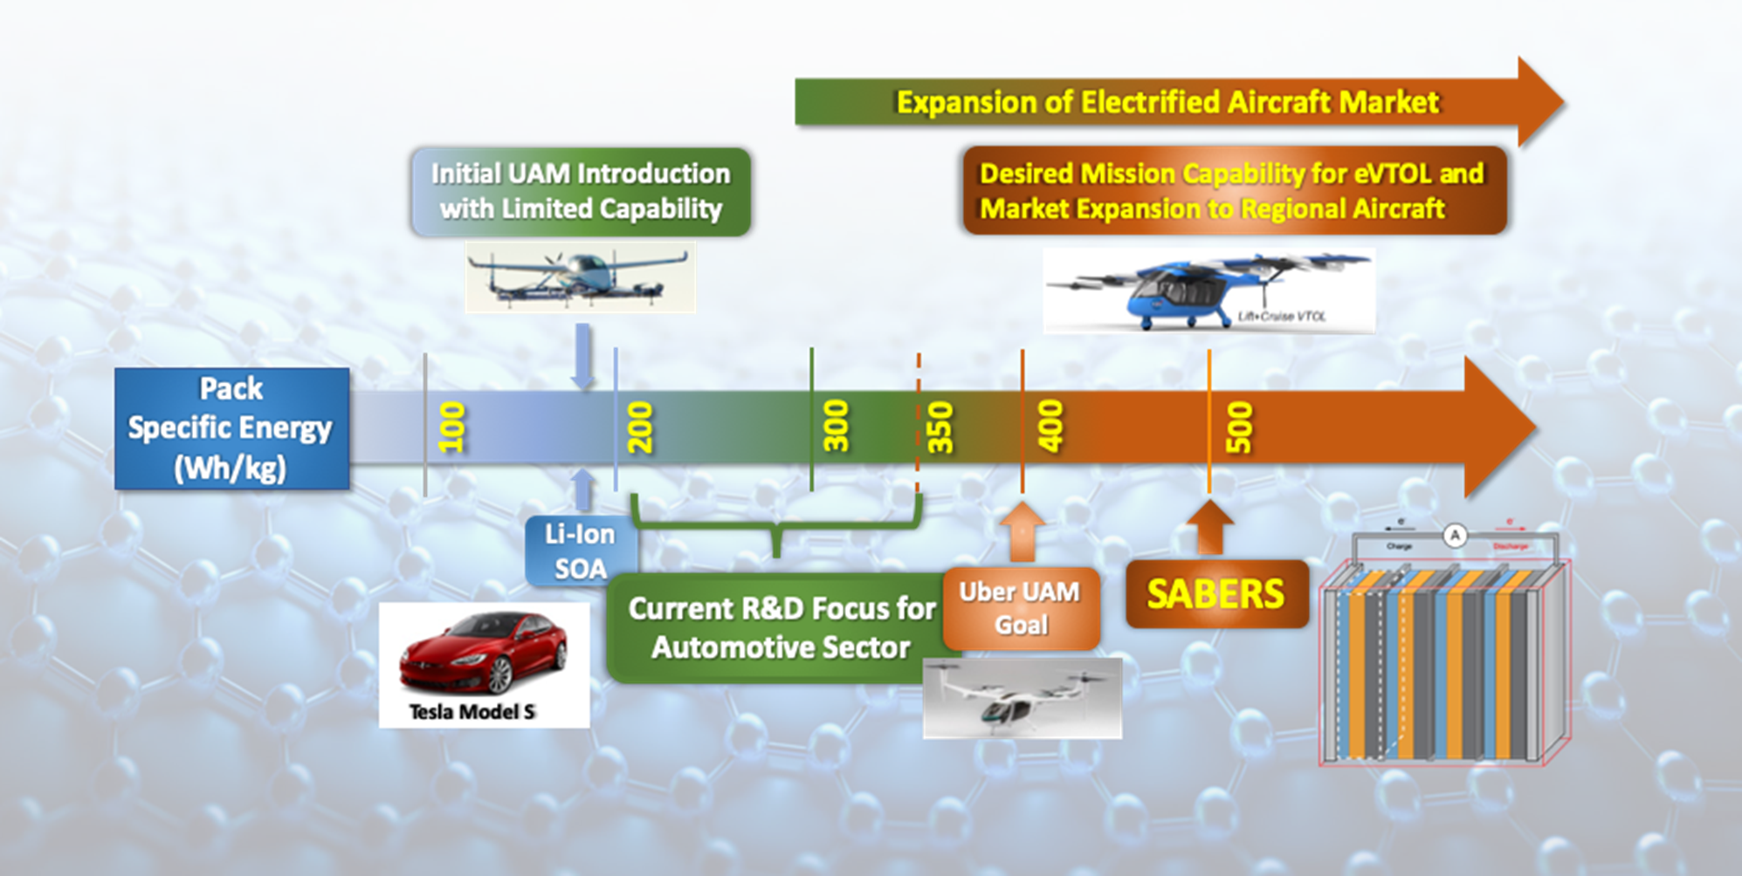
Solid-state Architecture Batteries for
Enhanced Rechargeability and Safety
SABERS
High performance all solid-state battery research focused on electric aircraft battery requirements
R. Viggiano, D. Dornbusch, J. Wu, J. Connell, Y. Lin, V. Yamakov. “Solid-state Architecture Batteries for Enhanced Rechargeability and Safety (SABERS) - A Transformative Solution to Meet Challenging Aerospace Requirements”, 2021 AIAA Aviation Forum (Virtual), 06/15/20 – 06/19/20.

Slide 3

Aviation Battery Requirements
Safety
Scalable
High energy density
Low weight packaging
Discharge rate performance
https://www.usfa.fema.gov/blog/cb-061819.html

Slide 4
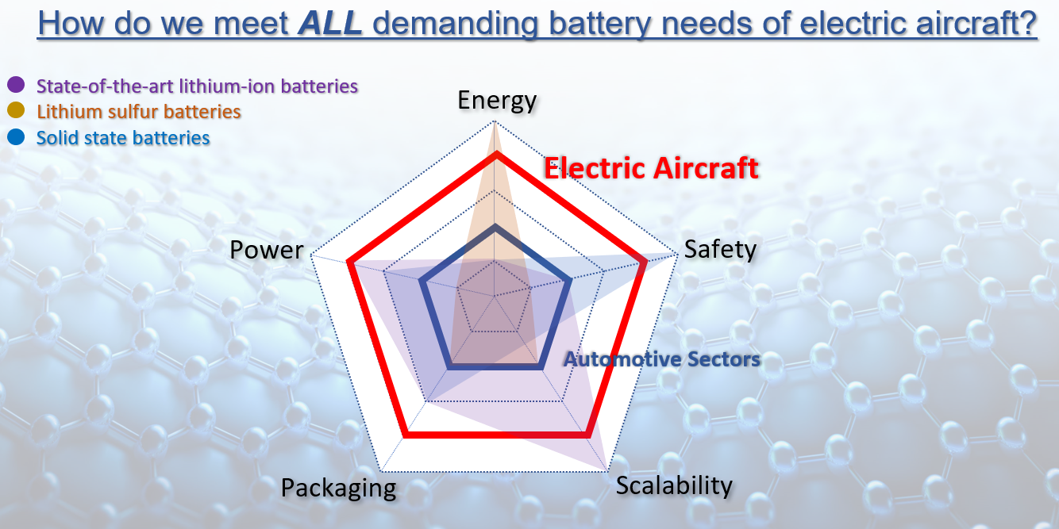
How to meet the battery requirements?
All Solid-State Li-S batteries
  Innovative holey graphene scaffold
  Improved power density with the addition of selenium
  Solid electrolyte
    Non-flammable
    Li dendrite suppression
    High ionic conductivity at room temperature
    Low interfacial resistance
R. Viggiano, D. Dornbusch, J. Wu, J. Connell, Y. Lin, V. Yamakov. “Solid-state Architecture Batteries for Enhanced Rechargeability and Safety (SABERS) - A Transformative Solution to Meet Challenging Aerospace Requirements”, 2021 AIAA Aviation Forum (Virtual), 06/15/20 – 06/19/20.

Slide 5
Objectives
To learn about the ionic conductivity of solid electrolytes through computational modeling
  The models that are generated provide useful information that can be used during the experimental portion of this project.
To find the optimal composition of the solid electrolyte

Slide 6
Methods
Solid Electrolyte Sphere Approximation Model – SESAM
Models were created for Al-doped LLZO electrolyte (lithium lanthanum zirconium oxide Li₇La₃Zr₂O₁₂)
    Hexagonal-close packing (HCP) models
    Random packing models
    For each system, HCP and random packing, different amounts of interfacial resistance were modeled
Spheres
Compress
Solver
Visualization

Slide 7
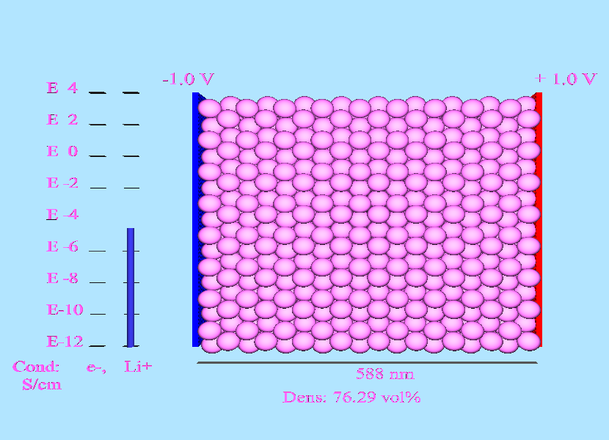
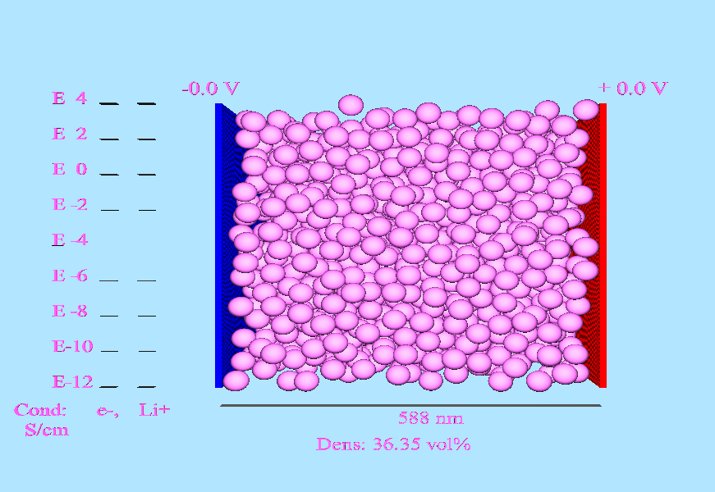
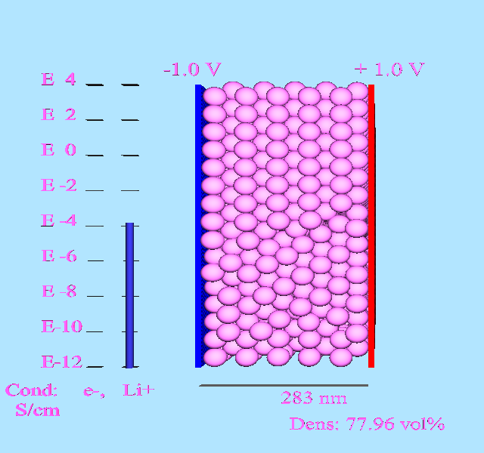
Electrolyte Modeling
Hexagonal Close-Packing
Random Packing
Compress

Slide 8
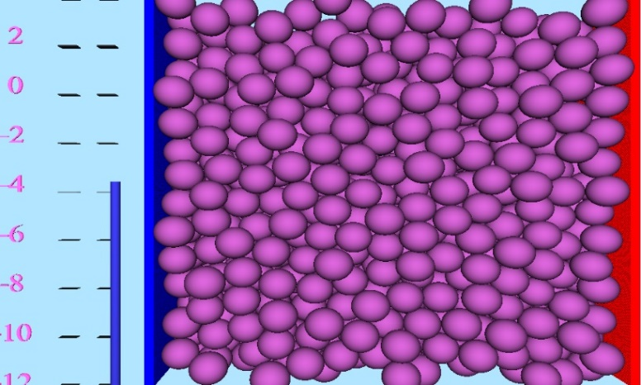
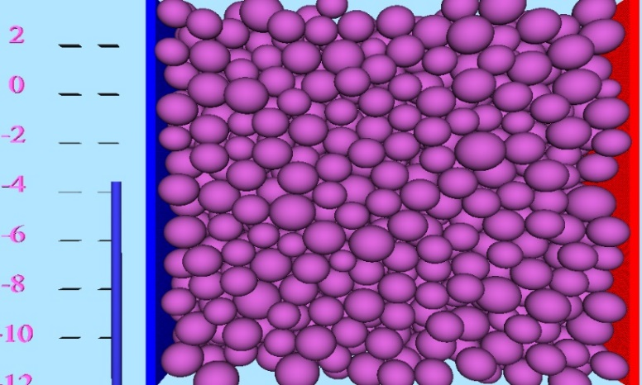
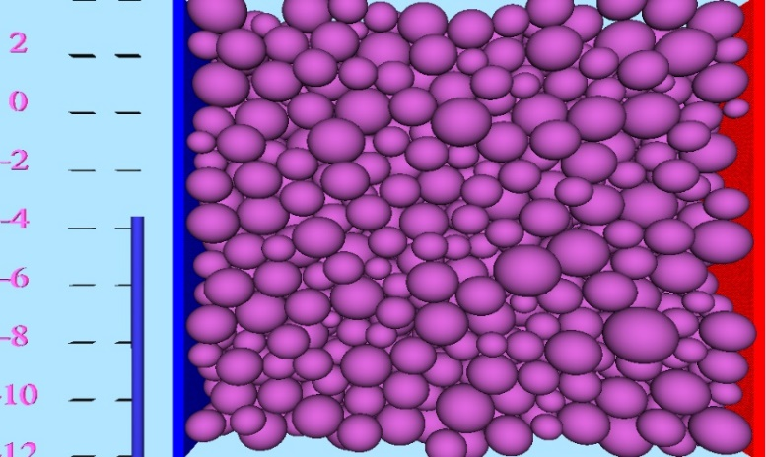
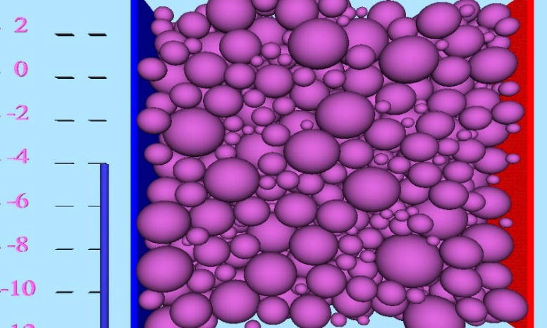
Electrolyte Modeling - Particle Size Affect
Particle size deviation 1 nm
Particle size deviation 4 nm
The small particle size deviation shows a packing system similar to HCP packing
The large particle size deviation allows for the smaller particles to fill the empty spaces thereby increasing the volume percent
Particle size deviation 8 nm
Particle size deviation 25 nm

Slide 9
Analysis
Using smaller particle sizes increased the volume percent of the system
All particle sizes showed a drop in the volume percent going from 1 nm deviation to 4 nm deviations
There was an upward trend in the volume percent after a deviation of 4 nm, as the ratio of particle sizes increase. This allows for the smaller particles to fit inside the empty spaces

Slide 10
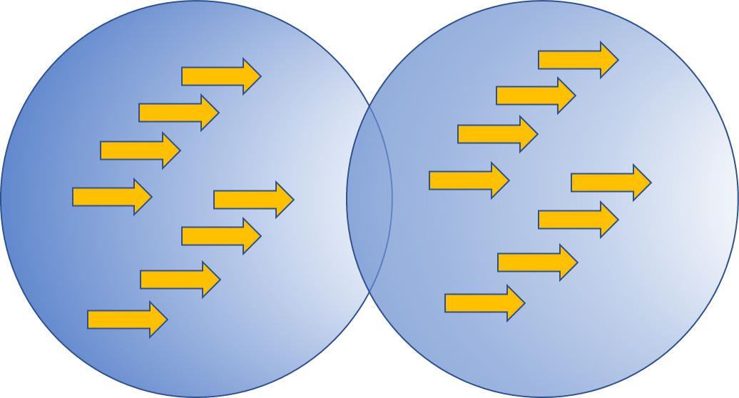
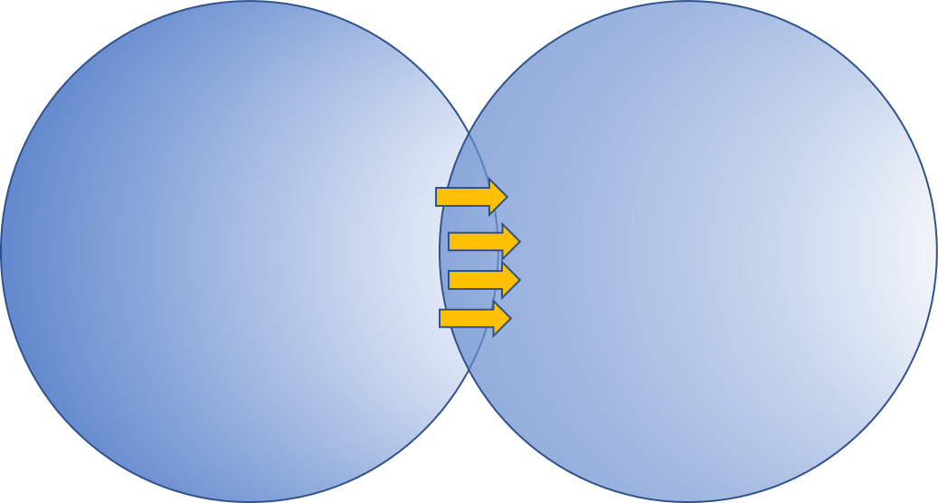
Analysis
Case II - Particle resistance is equal to interface resistance
Case I - Particle resistance is dominant
Case III - Interface resistance is dominant
Case I - Particle resistance is dominant
Case III - Interface resistance is dominant

Slide 11
Pressure Dependent Study – HPC and Random packing, 30 nm particles
SESAM Models:
Particle resistance is dominant
Particle and interface resistance are equal
Interface resistance is dominant
Experimental data:
Electrolyte – lithium phosphorous sulfide chloride (LPSCl)
The experimental data is in agreement with the simulation data from SESAM model

Slide 12
Conclusion
Models were generated using SESAM to show the effects of particle size distribution on the conductivity of the electrolyte
Models were also generated to show how pressure effects the conductivity of the electrolyte
  This pressure dependent study was validated by experimental results

Slide 13



Acknowledgements
My Amazing Mentors:
Dr. Yamakov
Dr. Lin
Dr. Connell
NASA Internship Team
Lab mates:
Brandon Walker, Elizabeth A Barrios, Malik A Satterwhite, and Justyn Lewis
Images from nasa.gov

Slide 14

Thank you
Image from nasa.gov

