Slide 1
Starling Mission: ROMEO Experiment for Autonomous Swarm Control
Ted Hendriks

Slide 2
Outline
Starling Mission Overview
  Partners
  Motivation
  Swarm Overview
ROMEO Overview
  Objective
  Setup
  Challenges
Future Work

Slide 3
Starling Summary
Multi-CubeSat mission to demonstrate swarm technologies
  4 – 6U spacecraft
  550km Sun-Synchronous orbit
  26-week mission set to launch in mid-2022
  Four onboard experiments

Slide 4
Starling Partners
Partners | Role
NASA Ames Research Center | Project Management Systems Engineering Payload Avionics & Software Propulsion System Spacecraft I&T Mission & Experiment Operations
Blue Canyon Technologies | Spacecraft Bus Spacecraft Operations
NASA Launch Services Program Launch Provider: Firefly Black Launch Integrator: Nanoracks | Launch
Stanford University | Relative Navigation Experiment
Emergent Space Technologies Inc. | Cluster Management Software
CesiumAstro Inc. | Crosslink Radios
L3 Harris | Flight Dynamics System Development

Slide 5
Starling Motivation
Starling is a tech demo to advance technologies in autonomous swarm control
Swarms are becoming more popular
Large swarms of spacecraft require more effort to maintain
More effort to maintain means more people
As swarms become more prevalent, technologies to control and maintain large swarms will need to be developed.

Slide 6
Onboard Experiments
Experiments | Partner | Approach
ROMEO - Onboard Cluster Flight Control | Emergent – Cluster Flight Application (CFA) Software | Implement CFA in Payload software and demonstrate automated cluster station-keeping
MANET - Crosslink/ Networking | CesiumAstro – CommPack S-band Crosslink Radio | Implement BATMAN networking protocol and demonstrate onboard network management
DSA - Distributed Spacecraft Autonomy | DSA Project out of NASA Game Changing Development (GCD) Program | Detect Total Electron Count (TEC) using bus L1/L2 GPS receiver, and have swarm autonomously change observation tactics
StarFOX - Relative Navigation | Stanford – Dr. Simone D’Amico for Relative Navigation algorithms | Use bus star tracker to image fellow swarm S/C over multiple orbits and run payload software to determine relative position

Slide 7
Swarm vs. Constellation
Swarm
Constellation
2+ distributed spacecraft
Relative navigation and control
Inter-satellite distance magnitude is fraction of orbital distance
2+ distributed spacecraft
Inter-satellite distance magnitude is same as orbital distance

Slide 8






Hill Frame
Relative motion modeled in the Hill frame (sometimes referred to as RIC, LVLH)
  Note: tangential direction is not the same as the in-track direction for non-circular orbits, relative motion analysis frequently assumes circular orbits (e~0)
Radial direction lies along position vector to chief
Tangential direction completes the right-handed triad
Normal direction lies along the chief orbit normal
$$\hat{T}$$
Deputy
$$\hat{R}$$
$$\hat{N}$$
$$\vec{ρ}$$
Chief
$$\vec{r}$$
Not to scale!

Slide 9
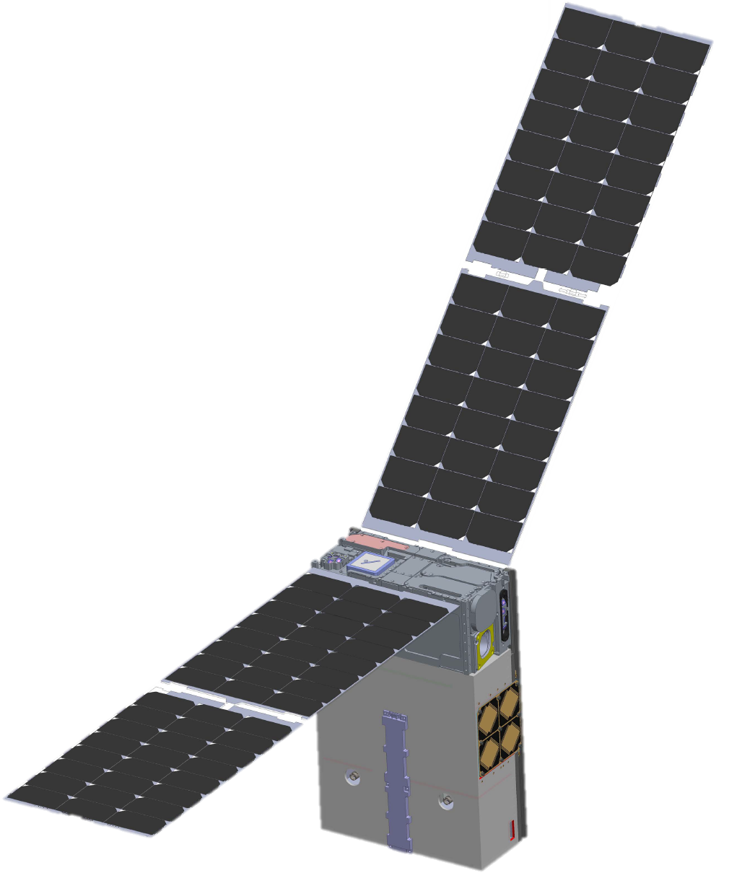


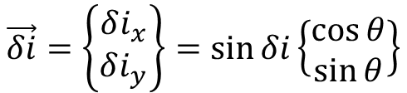



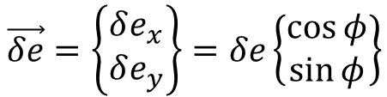
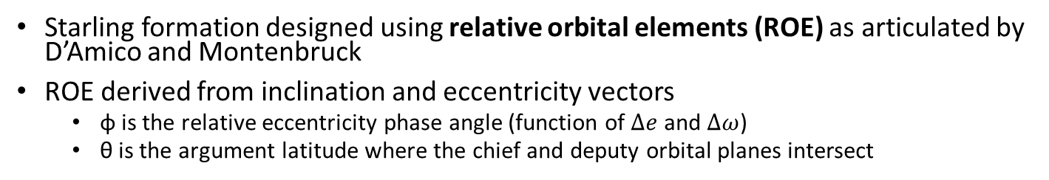






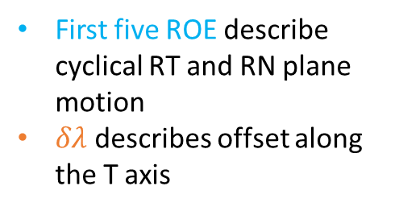



Relative Orbital Elements
Starling formation designed using relative orbital elements (ROE) as articulated by D’Amico and Montenbruck
ROE derived from inclination and eccentricity vectors
  φ is the relative eccentricity phase angle (function of $Δe$ and $Δω$)
  θ is the argument latitude where the chief and deputy orbital planes intersect
$$\{δa, δe_{x}, δe_{y}, δi_{x}, δi_{y}, δλ\}$$
$$\hat{R}$$
$$\hat{R}$$
First five ROE describe cyclical RT and RN plane motion
$δλ$ describes offset along the T axis
$$aδe$$
$$aδe$$
$$\hat{T}$$
$$\hat{N}$$
$$2aδe$$
$$aδi$$
$$\hat{R}$$
$$\vec{δe}=\left\{\begin{matrix}δe_{x} \\ δe_{y}\end{matrix}\right\}=δe\left\{\begin{matrix}\cos{φ} \\ \sin{φ}\end{matrix}\right\}$$
$$\hat{T}$$
$$\vec{δi}=\left\{\begin{matrix}δi_{x} \\ δi_{y}\end{matrix}\right\}=\sin{δi}\left\{\begin{matrix}\cos{θ} \\ \sin{θ}\end{matrix}\right\}$$
$$δλ_{2}$$
$$δλ_{3}$$
$$δλ_{1}$$
Images courtesy of NASA Ames Research Center

Slide 10
Swarm Design
Three different configurations throughout the mission
  4 Weeks of In-train
  7 Weeks of passive safety ellipses (PSE) configuration 1
  5 Weeks of PSE-2
Minimum inter-satellite distance of 63 km
Maximum inter-satellite distance of 200 km
Images courtesy of NASA Ames Research Center

Slide 11
ROMEO Overview
ROMEO (Reconfiguration and Orbit Maintenance Experiments Onboard) is an experimental software payload to demonstrate autonomous swarm maneuver planning and execution.
Objectives:
Perform autonomous relative orbit maintenance with respect to a reference ephemeris
Perform autonomous swarm maintenance with respect to a specified reference spacecraft
Perform autonomous swarm reconfiguration to a new, specified formation

Slide 12
Autonomous Mission Operations
Process for maintaining a swarm is the same regardless of what is performing the maintenance
Ground utilizes the Flight Dynamics System
ROMEO utilizes onboard software (Cluster Flight Application)
Determine S/C orbits
Evaluate current vs. desired ROE
Create maneuver plans
Swarm S/C execute maneuvers
Filter GPS data to determine the absolute orbits of all spacecraft, compute relative position of spacecraft in swarm
Compute ROE relative to either a selected spacecraft or a “virtual” reference, compare to desired ROE
Given initial state, compute maneuver(s) for spacecraft to achieve desired final state, accounting for propulsion performance
Generate command for spacecraft to execute maneuver, uplink/transfer to S/C CDH, perform required burns

Slide 13
Cluster Flight Application
Developed by Emergent Space technologies
Modular autonomous control system that ROMEO utilizes
  Calculates spacecraft position from onboard GPS measurements
  Determines if maneuver is necessary
  Computes optimal maneuvers through simulated annealing
  Coordinates maneuver across all vehicles in the swarm

Slide 14
Experiment Approach
ROMEO includes multiple cycles to demonstrate increasing degrees of onboard autonomy.
Shadow Mode
  Demonstrate experiment configuration validity
Activity Mode
  Demonstrate experiment configuration performance
Shadow Mode
Activity Mode
Configure ROMEO for shadow mode
Downlink ROMEO telemetry and ancillary data
Configure ROMEO for activity mode
Downlink ROMEO telemetry and ancillary data
Ground commands swarm maneuvers
Ground commands swarm maneuvers
Evaluate ROMEO performance
Evaluate ROMEO performance
Proceed If ROMEO performance nominal

Slide 15
Experiment Phases
Baseline plan for ROMEO includes 4 experiment configurations
  May be executed multiple times and/or in different formation phases
Exp’t | Formation | Mode | Crosslink | Passively Safe?
1 | In-Train | Maintenance | No | No
2 | PSE-1 | Maintenance | No | Yes
3 | PSE-1 or -2 | Maintenance | Yes | Yes
4 | PSE-2 | Reconfiguration | Yes | Yes

Slide 16
Non-Crosslink Enabled Experiment
SV1
OD
Receive Ephemerides from Ground
Swarm Management
Maneuver Plan
ΔV
time
SV2
Swarm Management
Maneuver Plan
OD
ΔV
SV3
Swarm Management
Maneuver Plan
OD
ΔV
SV4
Swarm Management
Maneuver Plan
OD
ΔV
Images courtesy of NASA Ames Research Center

Slide 17
Crosslink Enabled Experiment
SV1
OD
Exchange ephemerides
Exchange Maneuver Plans
ΔV
time
SV2
OD
ΔV
SV3
OD
Swarm Management
Maneuver Plan
ΔV
SV4
OD
ΔV
Images courtesy of NASA Ames Research Center

Slide 18
Evaluation Criteria
Quantitative comparison between ground commanded maneuvers and autonomous formation maintenance
Performance | Metric | Data Source
Swarm Maintenance Efficiency | ΔV [cm/s] | Commanded maneuvers
Swarm Maintenance Accuracy | σ_{ROE} [n.d.] | Definitive ephemerides
Swarm Maintenance Complexity | n_{mnvrs} [n.d.] | Commanded maneuvers

Slide 19
Experiment Challenges
Crosslink is necessary for full demonstration of autonomous capability
  During earlier stages of the mission, Crosslink radios are not available
  CFA can operate each vehicle independently of each other but requires knowledge of other vehicle positions
Two autonomously operated swarms pose significant risk to each other
  No cross-swarm communication
  Mitigated by screening Starling maneuvers on the ground
    Large impact on experiment ConOps
    Impacts CFA performance

Slide 20
Experiment ConOps
Ground uploads CFA configuration prior to experiment window
CFA Generates a maneuver plan
  1+ hours
Plan is screened by ground for potential collisions
  7+ hours
24-hour notification period for maneuvers to be distributed to relevant parties
  Allows for abort command to be sent
Maneuvers executed
Ground performs orbit determination and evaluates maneuver performance

Slide 21
Future Work and Goals
System to have distinct swarms communicate with each other needs to be developed
As technology gains maturity need for ground validation is reduced
Use demonstrated technologies on larger swarms

Slide 22
Questions?

