Slide 1
Designing a Self-Sterilizing and CO₂ Sequestering Surface Coating from an ISRU Perspective
Julia Wood
Dr. Sang-Hyon Chu and Dr. Cheol Park
2021 Summer Student Research Symposium

Slide 2

About Me
Clemson University
Rising junior undergraduate studying Chemical Engineering
Involvement
Clemson Tigers for Green Innovation Club
Clemson Undergraduate Student Government
Deep Griha Society Volunteer
Research Experience
Experiences in Undergraduate Research, Exploration, and Knowledge Advancement (EUREKA!) Program in Dr. Hong Luo’s lab
Undergraduate Researcher in Dr. Marc Birtwistle’s lab on the Multiplexing using Spectral Imaging and Combinatorics (MuSIC) Project
Working from home in Columbus, Ohio

Slide 3
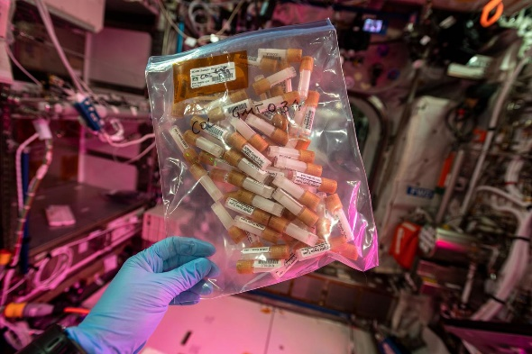
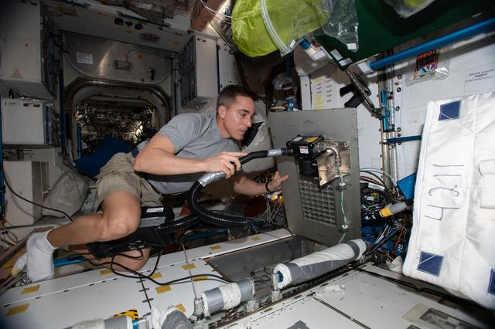
Challenge
A safe living environment is essential to a long-term human space presence.
Space Microbiome
Containing human-related microorganisms, the microbiome of the International Space Station (ISS) is similar to a home
Pathogenic bacteria found on ISS include Staphylococcus aureus and Bacillus cereus
Some evidence of increased microbial resistance in the microgravity environment of space
Astronauts experience immune dysregulation during spaceflight which can increase risk of infection
Biofilm formation can damage structural components of the habitat and equipment on board
Sustainable Solutions
For prolonged deep space exploration, in-situ resource utilization (ISRU) is an important factor when designing widespread solutions
Current Technology
Surfaces on the ISS are wiped with antimicrobial wipes weekly
Air on the ISS is purified by AiroCide technology which eliminates airborne bacteria, fungi, and viruses
Figure 1: Samples for the Three-dimensional Microbial Monitoring (3DMM) of ISS Environment study; Credits: NASA
Figure 2: An astronaut cleans life support equipment on ISS;
Credits: NASA
Notes:
What challenge or issue was your project focused on addressing?
What is the history of the challenge?
What has been done to address that challenge in the past?

Slide 4
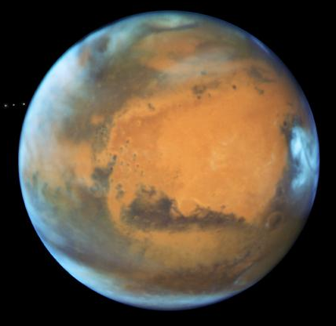
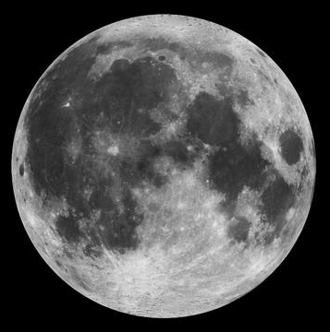
Objective
Develop a multifunctional surface treatment for the inner lining of space habitats that:
Self-sterilizes under visible light and in the dark
Transforms readily available carbon dioxide (CO₂) to methane (CH₄) for fuels
Can be synthesized sustainably by utilizing resources already in the Martian and Lunar environments
Focus of Summer 2021:
Optimize photocatalytic efficiency of TiO₂
Applying photocatalyst surface coating to inner lining
Consider ISRU capabilities of proposed systems
Figure 3: Images of Mars and the Moon; Credits: NASA
Notes:
What is the objective of the entire research project?
What is the objective of your specific work?
How does your work tie in with the overarching project research objectives?
he image was taken by the left Navigation Camera, or Navcam, aboard the agency's Perseverance Mars rover from a distance of 210 feet (

Slide 5
Approach
Gain a background knowledge on the project
Examine the mechanism of photocatalytic disinfection, photoreduction of CO₂, and photocatalytic memory
Identify factors which affect photocatalytic efficiency
Investigate standard inner lining materials of space habitat
Explore literature surrounding the modification of TiO₂ for optimization
Evaluate potential dopants considering memory photocatalytic ability
Analyze TiO₂ photocatalyst synthesis considering crystal composition and structure
Consider ISRU capabilities of potential modifications
Assess TiO₂ coating methods on space habitat inner lining
Analyze prevalence and extraction of needed materials within the Martian and Lunar regolith
Notes:
What did you do?
How did you do it?
How does it contribute to your research objectives?

Slide 6
Background
O₂
Photocatalytic Disinfection
Mechanism
When a photocatalyst is excited by light, electrons in the valence band can jump to the conduction band
Photoinduced electrons (e_{cb}) and holes (h_{vb}) can convert absorbed oxygen and water to reactive oxygen species (ROS)
ROS are used for disinfection because they destroy the cell membrane by damaging DNA, RNA, and proteins
TiO₂ Photocatalyst
Efficient, economical, and safe to humans
Crystal Polymorphs
Anatase, rutile, and brookite
Individually, anatase is considered the best polymorph for photocatalysis
Dopants
TiO₂ is excited by UV light which would not be readily available on human occupied space habitat
Adding a dopant to TiO₂ can narrow the bandgap, shifting absorption to the visible light region
TiO₂
Photocatalystggg
Conduction Band
∙O₂⁻
ROS
Generation
Light
Valence Band
H₂O
H⁺
∙OH
Figure 4: Visual representation of the TiO₂ photocatalyst
Figure 5:
Generation of four ROS (∙OH, H₂O₂, ∙O₂⁻, ∙OOH) when water and oxygen are absorbed on TiO₂ photocatalyst in the presence of light
TiO₂ + hv → e_{cb}⁻ + h_{vb}⁺
h_{vb}⁺ + H₂O → ∙OH + H⁺
∙OH + ∙OH → H₂O₂
e_{cb}⁻ + O₂ → ∙O₂⁻
∙O₂⁻ + H₂O₂ → ∙OH + OH⁻ +O₂
∙O₂⁻ + H⁺ → ∙OOH

Slide 7
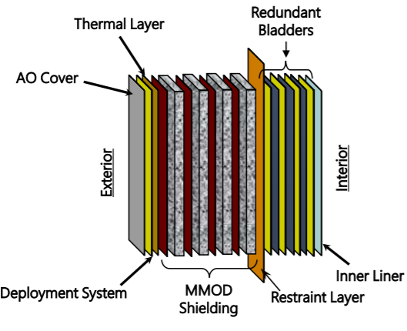
Background
Photoreduction of CO₂
Absorbed CO₂ can be reduced to several products
The binding energy of intermediates to the photocatalyst surface impacts product selectivity
Surface ligand, taurine, has been shown to increase CH₄ production (Jeong, S. et al. The Journal of Physical Chemistry, 2019; 123(48), 29184-29191)
CH₄ can be used for fuels on Mars
Photocatalytic Memory
The ability to store photogenerated electrons for later use when light is not available
This capability is important for a human-habitat application
Space Habitat Inner Lining
The TransHab is an inflatable space habitat concept
Its inner liner is composed of 95% Nomex, 5% Kevlar woven fabric
The inner lining is designed to be flame resistant, durable, and easy to clean
Figure 6: TransHab structural layers
Credits: NASA

Slide 8
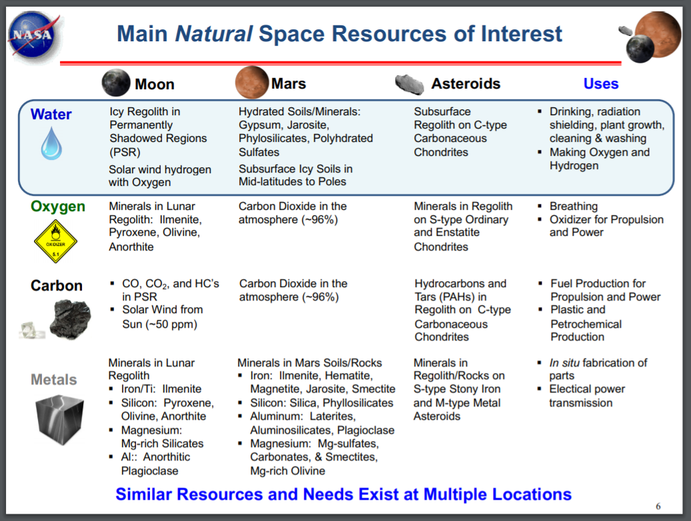
Results: TiO₂ Photocatalyst Design
Iron and Copper Dopants
Copper is a common dopant of TiO₂ due to its antimicrobial properties, but it is not prevalent within Martian and Lunar regolith
Although less commonly seen, iron has also been coupled with TiO₂ for photocatalytic disinfection under visible light
From an ISRU perspective, iron would be a better choice of dopant since it is prevalent within Martian and Lunar regolith
Photocatalytic memory
The TiO₂-Cu₂O system has demonstrated photocatalytic memory via the multielectron-storage mechanism (Sakar et al. ChemSusChem, 2018; 11(5), 809-820)
Since there is a large difference in the conductive band potential of TiO₂ and Cu₂O, an electron trapping center can form where electrons flow to and from the conductive bands of TiO₂ and Cu₂O
When partnered with Ni(OH)₂, Fe-TiO₂ has demonstrated photocatalytic memory via oxidative energy storage (Yang et al. Journal of Materials Chemistry, 2011; 7; 2288-2293)
TiO₂ and Ni(OH)₂ form a p-n semiconductor junction
Ni(OH)₂ is oxidized to form an energy storing intermediate (NiO_{x}(OH)_{2-x})
Figure 7: Main natural space resources of interest
Credits: NASA JSC- Gerald Sanders (Presentation to the NAC Technology, Innovation, and Engineering Committee Meeting; Dec. 7, 2018)

Slide 9
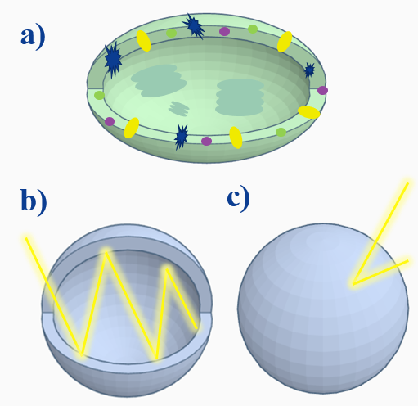
Results: TiO₂ Photocatalyst Design
Crystal Composition
A combination of anatase and rutile can be more effective than a pure anatase photocatalyst (Tan et al. Chemical Engineering Journal, 2016; 283; 1254-1263)
The anatase/rutile phase junction allows for efficient electron-hole separation with less recombination
Anatase has a higher electron affinity so photogenerated electrons flow to from rutile to anatase, while photoinduced holes flow from anatase to rutile
The annealing temperature can be used to control crystal phases for the optimum composition
Hollow Structure
Nanoparticles are commonly used in photocatalytic coatings, however some of the current research focuses on optimization through structural modifications (nanospheres, nanotubes, nanorods, etc.)
A photocatalytic hollow structure has the potential to increase light absorption, reduce charge transfer, decrease density, and allows for creativity in modifying outer and inner surfaces (Xiao et al. Advanced Materials, 2019; 31; 1801369)
This structure was designed to model the naturally occurring photosynthetic system
Hollowness is often achieved via Ostwald Ripening
TiO₂ Coatings
For a space habitat application, it is important for the coating to be durable
TiO₂ sols (colloidal suspension) can be sprayed onto substrates
TiO₂ nanoparticles have been incorporated into epoxy resin and tested for antibiofilm formation (Santhosh et al. Coatings, 2015; 5(2), 95-114)
Figure 8: Naturally occurring photosynthetic system (a), and the hollow sphere modification with increased light scattering capabilities (b) compared to the solid sphere structure (c)

Slide 10
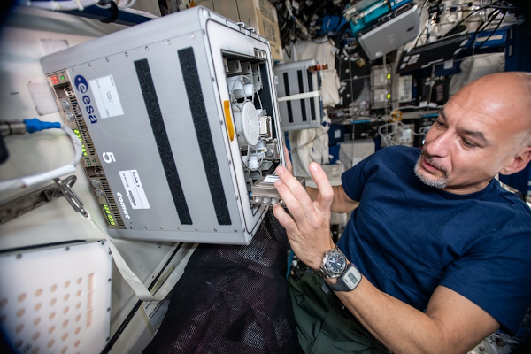
Results: ISRU Potential
Iron Biomining
Iron has been extracted from Martian and Lunar regolith simulants using S. oneidensis, an iron reducing bacteria (Castelein et al. PLoS One, 2021; 16(4))
S. oneidensis uses Fe³⁺ as terminal electron acceptor, producing Fe²⁺
When Fe²⁺ reaches critical concentration, Fe₃O₄ (magnetite) precipitates which can be extracted magnetically
Compared to using only magnetic extraction, the addition of S. oneidensis extracted 5.8 times higher quantity of iron
Biomining has been tested in different gravities on the ISS (microgravity, Earth gravity, Mars gravity) and no statistical significance was seen between performance of microorganisms in different gravities (Cockell et al. Nature Communications, 2020, 11, 5523)
Ilmenite Nanoparticles
Ilmenite is main natural space resource of interest for the Moon and Mars
TiO₂ nanoparticles have been synthesized from ilmenite via HCl leaching (Lee et al. Advanced Powder Technology, 2018, 29(8), 1779-1786)
HCl concentration can alter crystal phase, surface area, and concentration of Fe dopant
Photodegradation of RB 5 dye was exhibited
Figure 9: BioRock experiment on ISS, testing the effect of different gravities on biomining; Credits: NASA

Slide 11
Results: Testing Photocatalytic Efficiency
Dyes
Synthetic dyes are often used to test photocatalytic disinfection efficiency because they can be degraded similarly to microbes via ROS (Ajmal et al. Royal Society of Chemistry Advances, 2014; 4, 37007-37026)
It is important to note that dyes can enhance photocatalytic efficiency
Dyes can absorb visible light and transfer this energy to the photocatalyst
ROS Scavenging Technique
In order to verify ROS are responsible for the degradation of a dye or microbe, different radical scavengers can be introduced to the system (Ali et al. Materials Research Express, 2017; 4, 15022)
For instance, isopropanol (IPA) will scavenge hydroxyl radicals (∙OH)
When a radical scavenger is introduced to the system, photocatalytic action should decrease

Slide 12
Summary
A dopant should be added to shift light absorption of TiO₂ to the visible range. Iron has great ISRU potential as it is one of the main resources of interest on the Moon and Mars, and its extraction has been studied via bioleaching. The photocatalytic memory of an Fe-TiO₂ system should be further explored as iron has exhibited energy storing capabilities.
Optimal crystal composition can be controlled by altering the annealing temperature.
Although synthesis may be more complex, hollow nanospheres have shown promising light absorption efficiency compared to a solid structure.
Synthetic dyes can be used for further testing of the designed photocatalyst. A scavenging technique can explore the activity of different ROS in the degradation process.

Slide 13
Future Work
Continue to optimize TiO₂ photocatalyst synthesis for Martian and Lunar compatibility
Materials and synthesis techniques used should be further studied, specifically considering Fe-TiO₂ as a memory photocatalyst
The Fe-TiO₂ system should be further tested to verify antimicrobial efficiency and methane selectivity
The intensity and prevalence of light on a space habitat should be reviewed
The effect of different gravities on microorganisms (specifically the cell membrane) should be further explored

Slide 14
Acknowledgements
This research was made possible through mentorship from Dr. Cheol Park and Dr. Sang-Hyon Chu at NASA Langley and financial support from the South Carolina Space Grant Consortium.
Thank you to Jessica Gangitano, Patricia Sanchez, and Jalisa Thomas for coordination of the NIFS Program.
Best wishes to my colleague interns, Calista Lum and Kelly Chen, in their future endeavors.

