Slide 1
MISSE – Space Environmental Effects on Materials
Sheila A. Thibeault
Advanced Materials and Processing Branch
NASA Langley Research Center, Hampton, Virginia
Physical Sciences Lunar Surface Science Workshop
August 18-19, 2021
All Images Credit: NASA

Slide 2
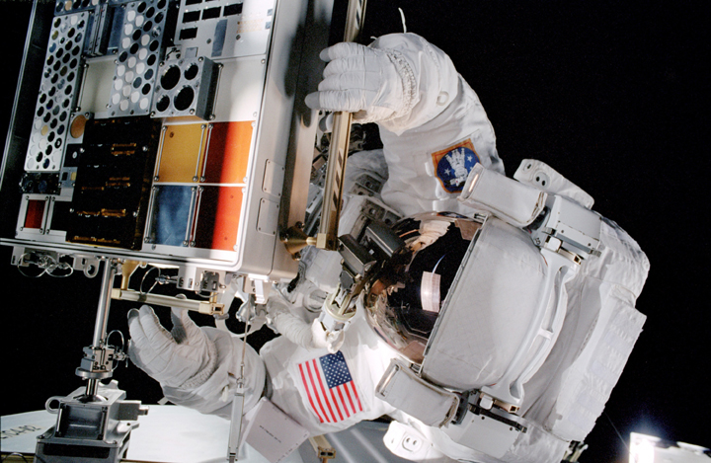
Introduction - MISSE
MISSE - Materials International Space Station Experiment
Began at NASA Langley in 1999
First external payload on ISS
Contains individual test specimens - materials and devices - exposed to the space environment
All specimens returned to Earth for analysis
Purpose is to determine the effects on the specimens due to the space environment
MISSE platform was originally 2-sided (shown in figure)
Platform is now called MISSE-FF (Flight Facility) and is 4-sided
Currently working on the MISSE-16 mission
Wake side of MISSE-2, during deployment on the ISS in 2001

Slide 3
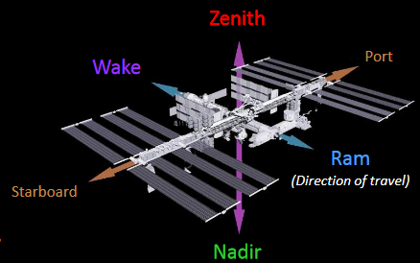
MISSE - Orientations on the ISS
  Ram Direction - Facing in the direction of ISS travel, highest atomic oxygen (AO) and moderate solar exposure
  Wake Direction - Facing away from the direction of ISS travel, essentially no AO and moderate solar exposure
  Zenith Direction - Facing away from Earth, grazing AO and highest solar exposure
  Nadir Direction - Facing toward Earth, grazing AO and lowest solar exposure
MISSE directions on ISS

Slide 4
Low Earth Orbit (LEO) versus Lunar Surface
LEO Environment
  Atomic oxygen (AO)
  Ultraviolet (UV) radiation
  Micrometeoroids
  Orbital debris
  Charged particles (electrons, protons, light ions, heavy ions)
  Extreme temperatures
  Thermal cycling
  Vacuum
  Microgravity
MISSE provides testing of all these LEO
environmental parameters
AO (in the Ram direction) is the most dominant
threat to materials in LEO
Lunar Surface Environment
  No atomic oxygen (AO)
  Ultraviolet (UV) radiation
  Micrometeoroids
  No orbital debris
  Charged particles (electrons, protons, light ions, heavy ions)
  Extreme temperatures
  Thermal cycling
  Vacuum
  Reduced (1/6 of Earth) gravity
  Secondary neutrons
  Dust
MISSE can provide testing of most of these lunar surface environmental parameters
To simulate lunar surface environment on MISSE, do NOT use the Ram direction

Slide 5
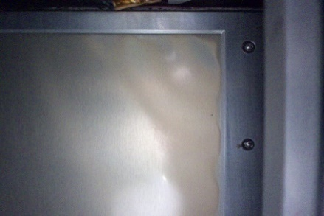
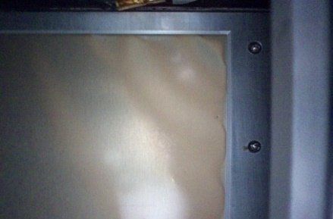
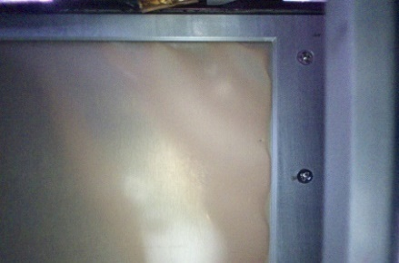
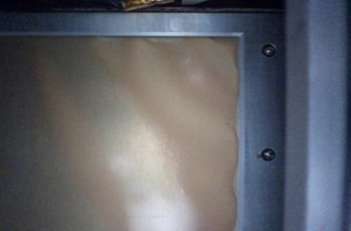


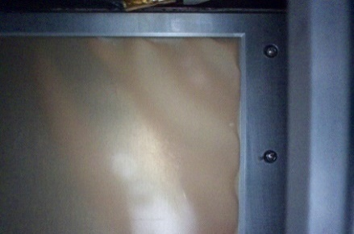
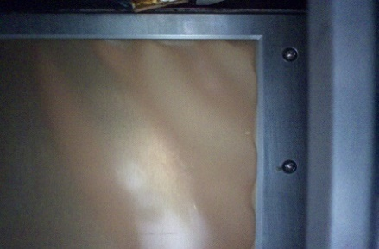
On-Orbit Photographic Images of Materials
High-resolution cameras scan and take photographs of specimens about once a month to detect changes as a function of time
June 2019
July 2019
August 2019
September 2019
October 2019
December 2019
January 2020
February 2020
On-orbit images of specimen # MIR1 (Polyvinyl fluoride) on MISSE-11 in Ram direction

Slide 6
Results of Qualitative Analysis of Images
We have complete image data for MISSE-9, MISSE-10, MISSE-11, and we have partial image data for MISSE-12, MISSE-13
The results for the 70 exposed specimens are as follows:
  48% of the materials did not show a change
  17% demonstrated a change in color only
  6% demonstrated a change in both color and texture
  29% cannot yet be determined

Slide 7
MISSE Space Exposure Durations
The space exposure durations vary, for examples:
  MISSE-9, Ram, Carrier 2: 280 days, 17 hours, 13 minutes
  MISSE-9, Wake, Carrier 3: 198 days, 23 hours, 32 minutes
  MISSE-9, Zenith, Carrier 3: 198 days, 4 hours, 24 minutes
  MISSE-10, Ram, Carrier 1: 426 days, 0 hours, 32 minutes
  MISSE-10, Zenith, Carrier 2: 250 days, 7 hours, 52 minutes
  MISSE-10, Nadir, Carrier 3: 174 days, 0 hours, 20 minutes
  MISSE-11, Ram, Carrier 3: 150 days, 3 hours, 25 minutes
  MISSE-11, Wake, Carrier 2: 313 days, 3 hours, 4 minutes
  MISSE-11, Zenith, Carrier 3: 318 days, 4 hours, 55 minutes

Slide 8
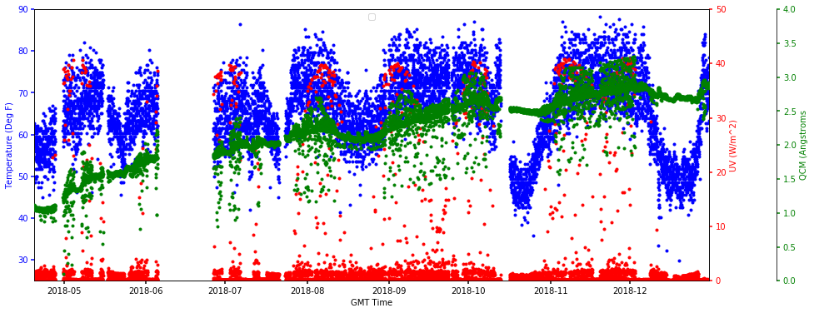
MISSE Environment Flight Data
Temperature, UV, and QCM (Contamination) from May 2018 to December 2018 on the Wake side of MISSE-9

Slide 9
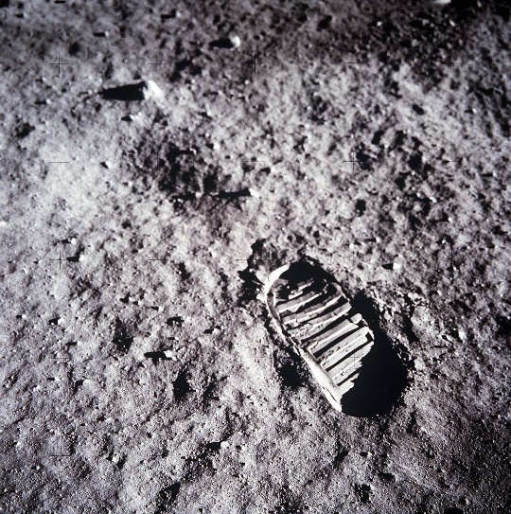
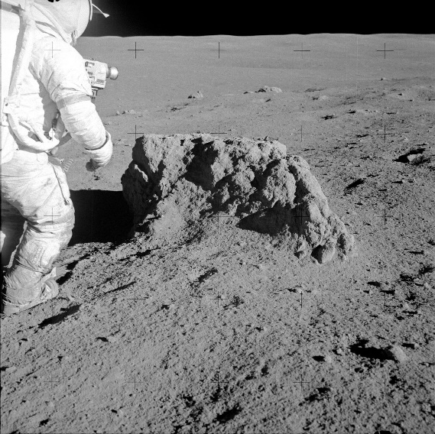
Upcoming Flights
RAC (Regolith Adherence Characterization) - lunar payload, under the Lunar Surface Instrument and Technology Payloads (LSITP) program, to understand how the lunar regolith interacts with materials
Same materials as RAC specimens to be flown on MISSE-16 in the Zenith direction for comparison
MISSE-17, MISSE-18, etc., in roughly 6-month intervals
Buzz Aldrin’s boot print on lunar surface
Alan Shepard beside boulder on lunar surface

Slide 10
THANK YOU!
Questions?

