Slide 1
Modeling of Electrolyte Conductivity in a Solid State Cathode Structure
Malik Satterwhite-Austin
Vesselin Yamakov and Yi Lin
2021 Summer Student Research Symposium

Slide 2

Background
SABERS – (Solid-state Architecture Batteries for Enhanced Rechargeability and Safety).
Solid-State battery:
  Non flammable solid materials inside of the battery.
Illustrated by: Dr. Rocco Viggiano, Dr. James Wu, and Dr. John Connell

Slide 3
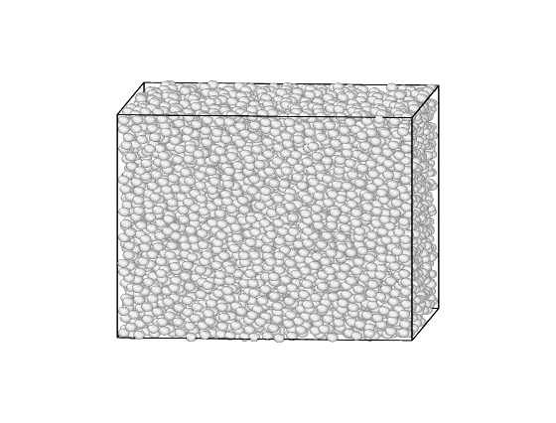
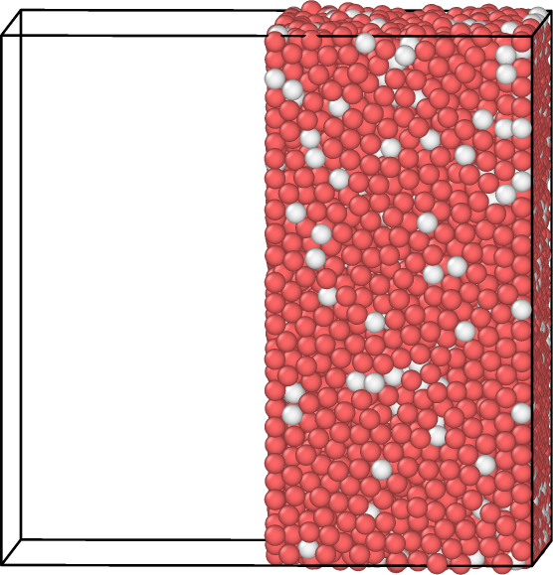
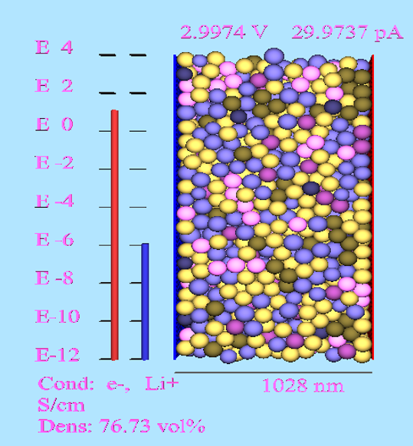
SESAM
Solid Electrolyte Sphere Approximation Model
Spherical particles are randomly placed inside the cathode
The cathode is then compressed to achieve the optimal density
Power output:
  Electron and Lithium-ion conductivity
Figure 1: 40 nm sized spheres randomly placed in a simulated cathode
Figure 2: The spheres in Figure 1 condensed to reach a higher density
Figure 3: The tested power output in the cathode.

Slide 4
Why/Purpose
Create an improved cathode composition for an efficient solid-state battery
Study the conductivity, σ, of the cathode constructed of conductive and non-conductive randomly compacted spheres subject to Maxwells equation:
  σ/σ_{o} = ½(3p- 1);
  p = fraction of conductive spheres
  σ_{o} = conductivity at p=1

Slide 5

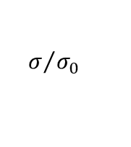

Results
$$σ/{σ_{0}}$$
$$\left(p −1\right)$$
$$\frac{1}{2}\left(3p −1\right)$$

Slide 6
Maxwell’s formula for conductivity
Maxwells' formula presumes that equation 1/2(3p-1) (p= fraction of the conductive spheres) will approximately equate to the corresponding σ/σ_{o} point
The more insulating spheres added the less conductive the mixture becomes
Simulated data is consistent with the experimental data published by J.P. FITZPATRICK PHYSICS LETTERS 47A (1974) 207.

Slide 7
Next Steps/Outlook/Future Work
With more time on this project, I would:
  Continue to study Maxwells equation using different sized spheres in my simulations.

Slide 8
Acknowledgements
My Mentors: NASA Internship Team:
Dr. Yamakov Langley Research
Dr. Lin Center
My lab mates:
Brandon Walker, Elizabeth A Barrios, April Rains,
and Jystin Lewis

Slide 9
Questions

