Slide 1

HLS-UG-001, Lunar Thermal Analysis Guidebook
Brian Hamill
8/4/2020

Slide 2
Agenda
L-TETT Charter
Lunar Thermal Analysis Guidebook Intro
LTAG Overview
Detailed example (Orbital)

Slide 3
Lunar Thermal Environments Task Team
The Lunar Thermal Environments Task Team (L-TETT) chartered by HLS to support MSFC/EV44 in formulating Sections 3.3.9.1 and 3.4.6 of the Cross-Program Design Specification of Natural Environments (DSNE) as stated. It will also develop and document thermal analysis methodologies for orbital and surface missions.
Responsibility for defining Lunar Thermal Environments for DSNE belongs to MSFC/EV44.
The L-TETT will generate a companion document to DSNE to aid thermal analysts in appropriate application of Lunar Thermal Environments.
L-TETT will be led by MSFC/EV34 (including assigning a “L-TETT Coordinator”) with support from the Core Membership list to develop the guidebook document.
The Support Membership will provided review to the product and feedback to the Core Membership.
  Core Members represent their organization/project in the L-TETT.
  Supporting Members are stakeholders in the products and will be provided draft versions of the documentation products to be reviewers.

Slide 4
Lunar Thermal Analysis Guidebook
The guidebook describes methodologies for performing lunar thermal analyses in support of the Human Landing System (HLS) Program.
Developed by the HLS Lunar Thermal Environments Task Team (L-TETT) composed of members from Marshall Space Flight Center (MSFC) Natural Environments team and members of the thermal discipline from across NASA,
  Including Marshall Space Flight Center (MSFC), Johnson Space Center (JSC), Glenn Research Center (GRC), and Jet Propulsion Laboratory (JPL).
Core Team Membership:
  MSFC Nat Env: Robert Suggs, Leo Paez, Anthony DeStefano, Caleb Fasset, Michael Zanetti
  MSFC Thermal: Callie Mckelvey, Greg Schunk, Brian Hamill, Brian O’Conner
  JSC: Lisa Erickson, Angel Alvarez-Hernandez, Clark Craig
  GRC: Ryan Edwards
  JPL: Eric Sunada

Slide 5
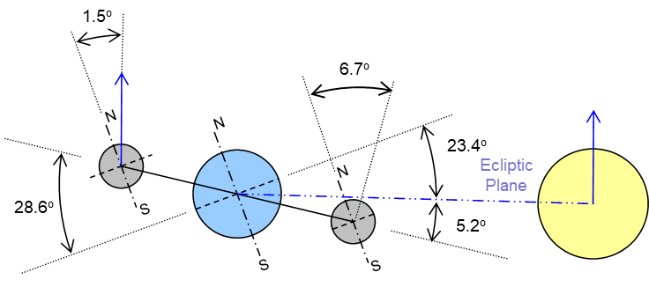
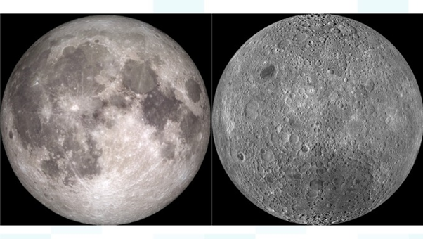
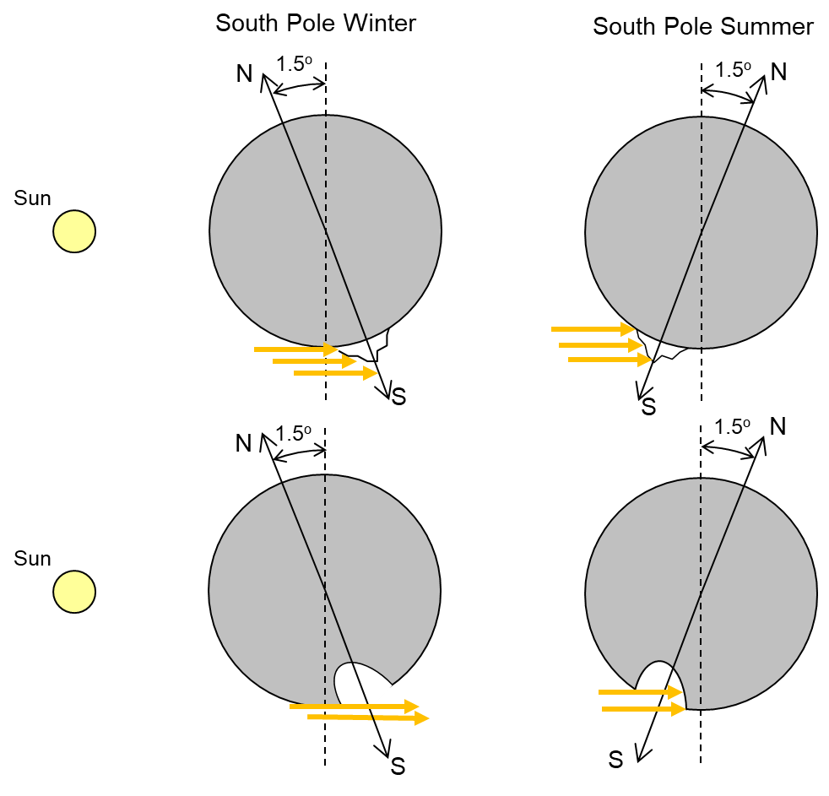
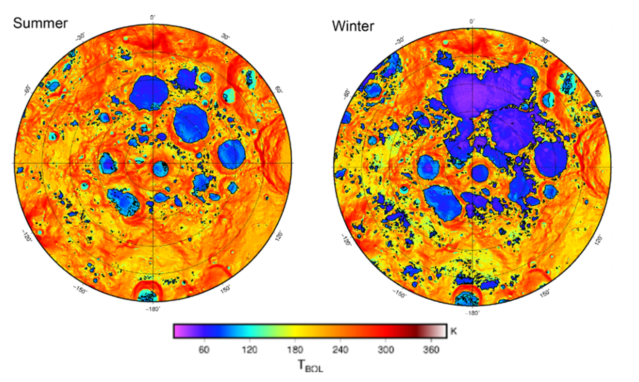
Lunar Thermal Analysis Guidebook
Earth’s Moon
Figure 3.2‑1: Lunar Orbit
Figure 3.1‑1: Near and Far Sides of the Moon
Figure 3.2‑4: Diviner Maximum Bolometric Temperatures of the South Pole (85°-90°S) Split into Seasons
Figure 3.2‑3: Seasonal Variation on the Moon

Slide 6
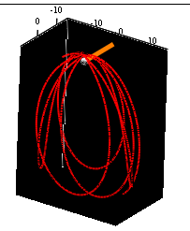
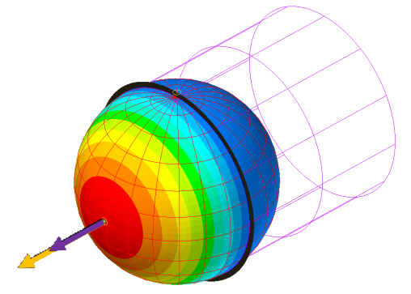
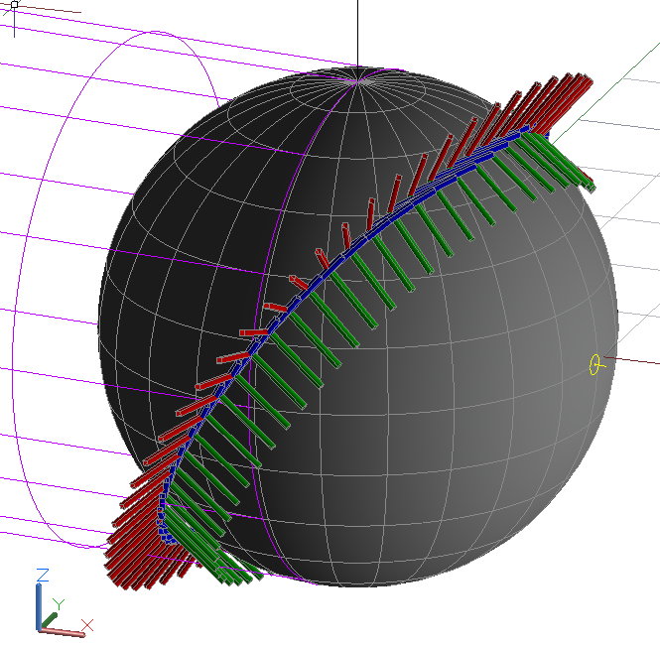
Lunar Thermal Analysis Guidebook
Orbital Environments
  NRHO
  LLO
  Decent/Ascent
Orbital Modeling Techniques
Table 8.1.2.2‑1: Keplerian Approximation Orbital Parameters
Orbital Parameter | Hot (Beta 0°) | Cold (Beta 0°) | Cold (Beta 90°)
Orbit Inclination | 90 | 90 | 90
Right Ascension of Ascending Node (RAAN) | 270 | 270 | 90
Argument of Periapsis | 88 | 88 | 90
Right Ascension of the Sun (RAS) | 90 | 270 | 0
Right Ascension of the Prime Meridian | 0 | 0 | 0
Figure 8.3.2‑2: Images of lander
orientation during descent.

Slide 7
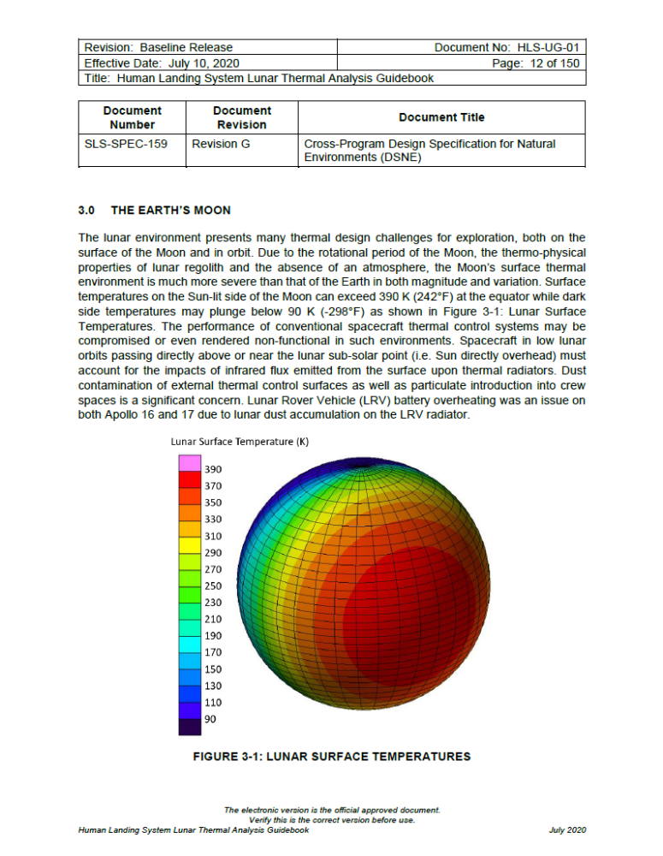
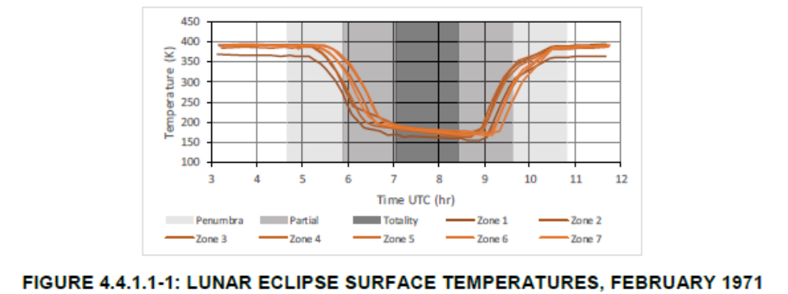
Lunar Thermal Environments
Given the properties of Lunar regolith:
A vehicle may receive almost as much energy from the Lunar surface (Albedo and Planetshine) as Direct Solar.
  1250W/m² OLR + 170W/m² Albedo vs 1426 W/m² Solar
Unlike Earth, Surface cannot be set to a fixed boundary and interacts with vehicle.

Slide 8
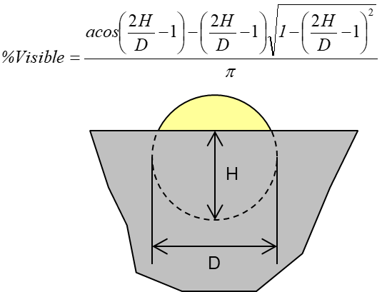
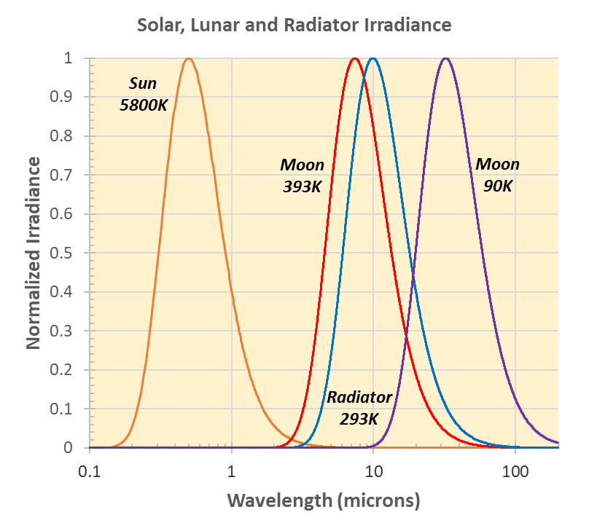
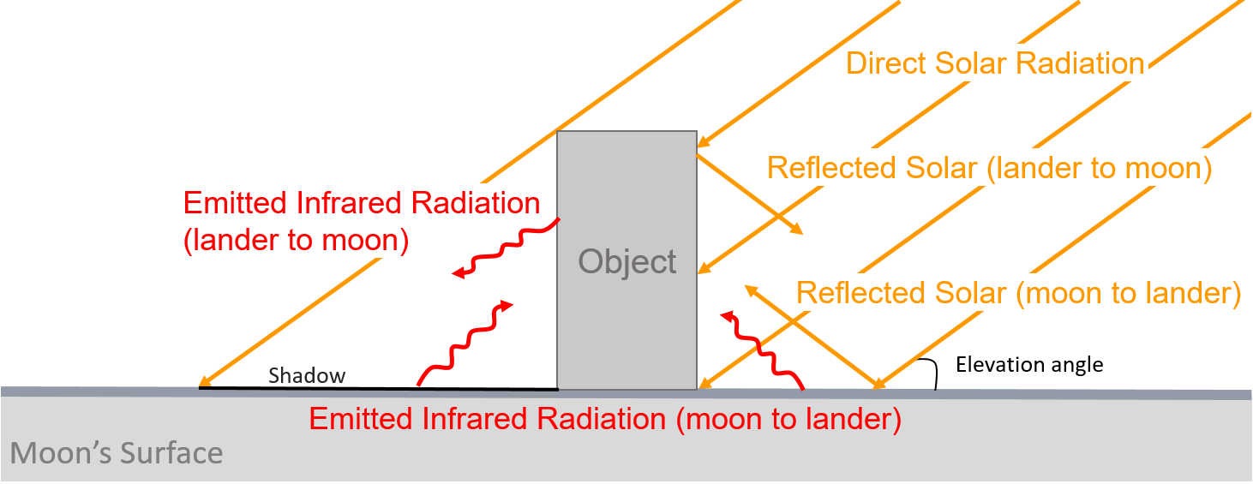
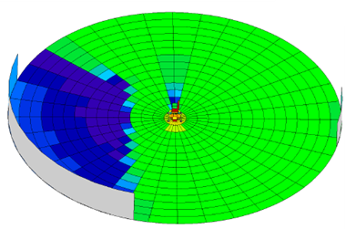
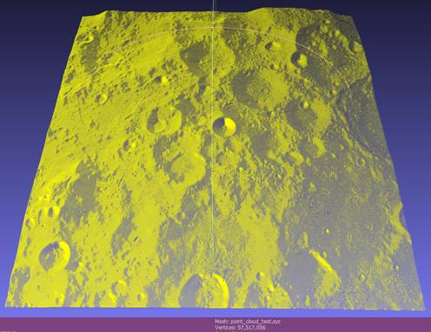
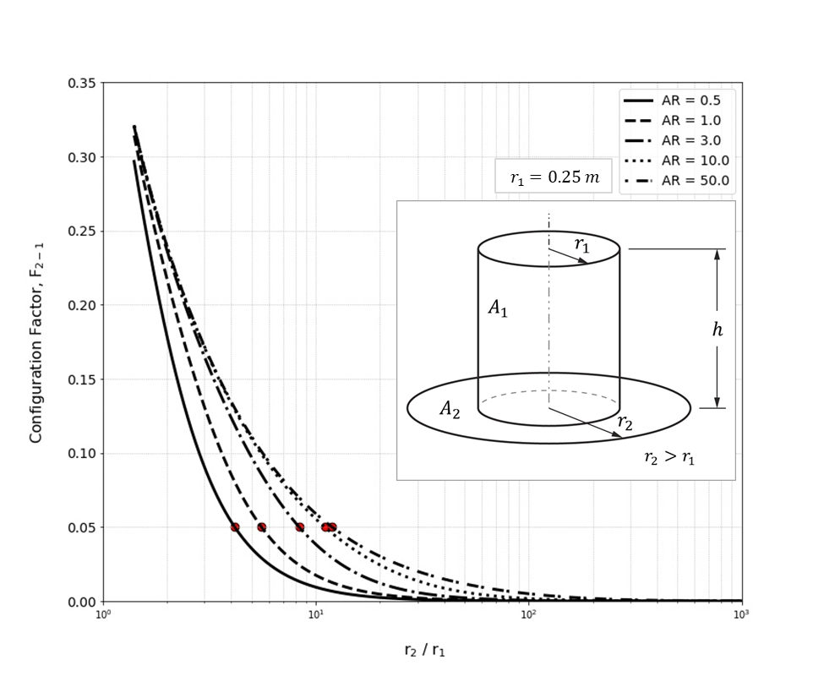
Lunar Thermal Analysis Guidebook
Surface Environments
Surface Modeling Techniques
  Ground Plane
  Subsurface
  Terrain
  Dust
  Special Considerations for
  Permanently Shadowed
  Regions (PSRs)
Solar Occultation based
on Height and Diameter
Ground Plane Sizing
LUNA 27 FAR-FIELD BOUNDARY
Terrain Modeling

Slide 9
LTAG Environments Definition example
Creating inputs for planetshine – orbital cases
  Can use planetary coordinate system, requiring care to calculate the subsolar point with respect to the lunar coordinate system including lunar declination.
  Or use option in Thermal Desktop (or other software) to utilize a subsolar coordinate system
$${\text{Q}}_{\text{IR}}\text{ =}\left(\text{cos}\left({\text{Long}}_{\text{planetary} }\text{−} {\text{Long}}_{\text{subsolar}}\right)\text{∙ }\left({\text{Lat}}_{\text{planetary}}\text{− }{\text{Lat}}_{\text{subsolar}}\right)\right)\text{∙}\left(\left(\text{1−}\text{a}\right)\text{ ∙ }{\text{S}}_{\text{0}}\text{− }\text{σ}\text{ ∙ }\text{ε}\text{ ∙ }{{\text{T}}_{\text{Dark}}}^{\text{4}}\right)\text{+ }\text{σ}\text{ ∙ }\text{ε}\text{ ∙ }{{\text{T}}_{\text{Dark}}}^{\text{4}}$$
$${\text{Q}}_{\text{IR}}\text{ = }\text{sin}\text{(}{\text{Lat}}_{\text{SS}}\text{) ∙}\left(\left(\text{1 − }\text{a}\right)\text{ ∙ }{\text{S}}_{\text{0}} \text{− }\text{σ}\text{ ∙ }\text{ε}\text{ ∙} {{\text{T}}_{\text{Dark}}}^{\text{4}}\right)\text{+ }\text{σ}\text{ ∙ }\text{ε}\text{ ∙} {{\text{T}}_{\text{Dark}}}^{\text{4}}$$

Slide 10
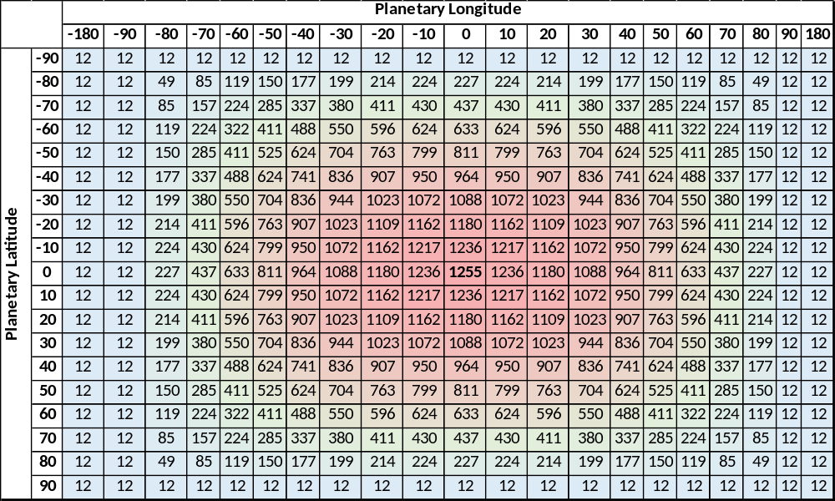
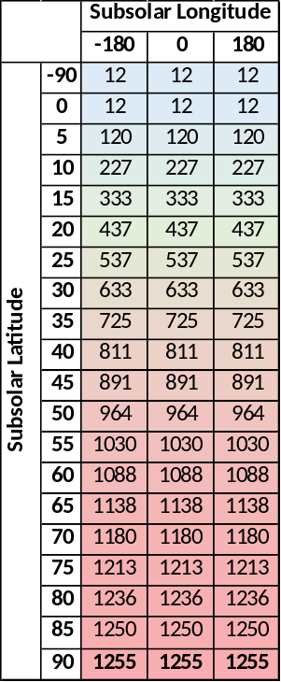
LTAG Environments Definition example
Subsolar definition results in a simpler input table
  Could have been defined as 2 columns, but 0 Longitude included for clarity.
Using the subsolar coordinate system also avoids another issue…

Slide 11
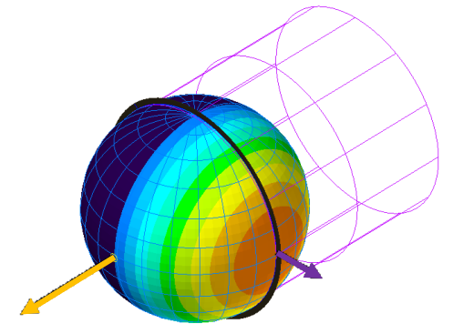
LTAG Environments Definition example
Aligning Subsolar and Planetshine maximums
  Solar and Planetshine environments are input separately in many analysis softwares. (Thermal Desktop used here for example)
  If care is not taken when using planetary coordinate system for planetshine, the solar and OLR environments may not be aligned.
    At time of publication, there was no way to align coordinate systems when using Sun/Planet Vector orbit definition, so subsolar coordinate system MUST be used.

Slide 12
LTAG Modeling example – NRHO Orbits
For NRHO orbits, Sun/Planet Vector lists describing an as flown NRHO can be used. L-TAG users are directed to the Gateway Program Documentation.
  Difficult to visualize in post processing, or when using complex orientations.
  Hard to create bounding orbital thermal environments from “as flown” trajectories.
  Does not utilize Thermal Desktop features like inserting orbit positions at terminator.
  If inputs aren’t curated carefully model may incur unnecessary calculation durations.
Keplerian Orbits can offer a close approximation.
  Keplerian orbit may be “tuned” to provide close approximation of NRHO trajectory while providing for worst case thermal analysis.
Orbit Parameter | NRHO Trajectory | Keplerian Approx. | Keplerian Approx.
Apolune | 71283 km (avg) | 71283 km | 65122 km (adj)
Perilune | 3354 km (avg) | 3354 km | 3354
Period | 6.58 days (avg) | 7.47 days | 6.58 days

Slide 13
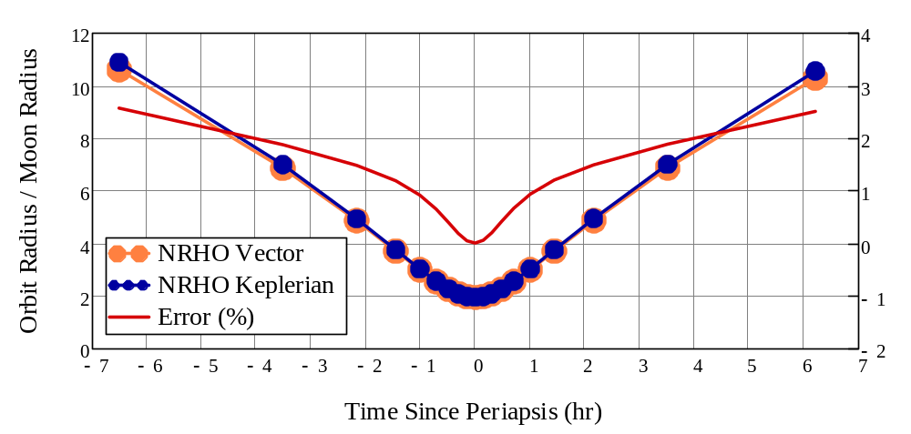
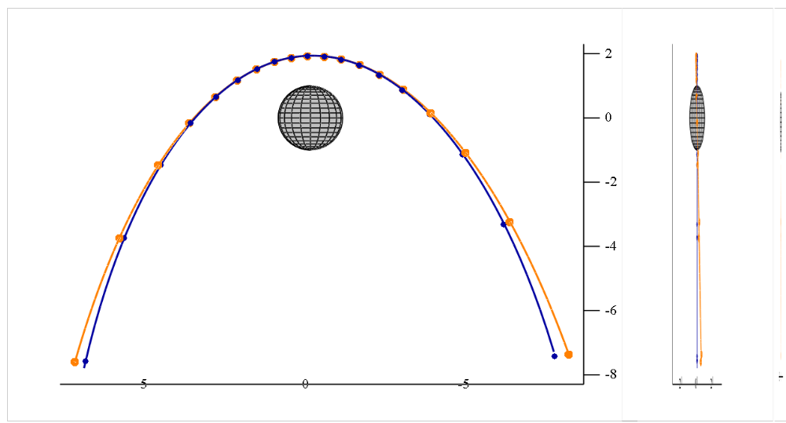
LTAG Modeling example – NRHO Orbits
Orbital Parameter | Hot (Beta 0°) | Cold (Beta 0°) | Cold (Beta 90°)
Orbit Inclination | 90 | 90 | 90
Right Ascension of Ascending Node (RAAN) | 270 | 270 | 90
Argument of Periapsis | 88 | 88 | 90
Right Ascension of the Sun (RAS) | 90 | 270 | 0
Right Ascension of the Prime Meridian | 0 | 0 | 0
2°
FIGURE 8.1.2.2‑2: COMPARISON OF NRHO AND KEPLERIAN ORBITAL RADII NEAR MOON
FIGURE 8.1.2.2‑1: COMPARISON OF NRHO AND KEPLERIAN PERILUNE TRUE ANOMALY
-Thanks to Jonah Smith for collaborating on these sections

Slide 14
Questions?
LTAG: Human Landing System Lunar Thermal Analysis Guidebook - NASA Technical Reports Server (NTRS)
DSNE: Cross-Program Design Specification for Natural Environments (DSNE) Revision H - NASA Technical Reports Server (NTRS)
Lunar Thermal Environments Task Team (LTETT): msfc-ltett@mail.nasa.gov

Slide 15



