Slide 1
V&V for Autonomy
Dr. Guillaume Brat
NASA Ames Research Center
Intelligent Systems Division
Robust Software Engineering

Slide 2
Introduction
CAST: Core Avionics and Software Technologies
  cFS/cFE based FSW
  Model-based development
  Swarm simulation
  Small spacecraft swarm
  FSW Monitoring & Review
ESMD: LCROSS, LADEE
HEOMD: BioSentinel
SMD: RP, VIPER
STMD: Starling, DSA
ARC: CASAS
ASSET: Automated Software & System Engineering Technologies
  Formal methods
    Requirement Elicitation/Analysis
    Design Model Analysis
    Static Code Analysis
    Run-Time Analysis
  Adaptive stress testing
  Assurance Cases
  Machine learning V&V
ARMD
  AOSP: System-Wide Safety
    Aviation software assurance
    Autonomous systems assurance
  Low Boom Flight Demonstrator
Others
  Gateway contractors V&V
  BlueOrigin: ROS 2 V&V
  DoD Autonomous Systems T&E
Traditional Aviation
  US Airframers, OEMs, Airlines
  FAA, NTSB
  AFRL
Emerging Markets
  Urban Air Mobility
  Plant inspection, disaster response, precision agriculture, USGS

Slide 3
Focus elements
Our strategy for the V&V of autonomy is focusing on the following elements:
  Explaining why a system is safe, and remains safe in operations, through dynamic safety cases
  Identifying more hazards, especially when a system is complex or adapting to changing conditions
  Formalizing requirements to facilitate safety analysis and traceability
  Computing “provenly” safe bounds of operations
  Addressing verification of machine learning components

Slide 4
Dynamic Safety Cases
‘A safety case is a structured argument, supported by a body of evidence, that provides a compelling, comprehensible and valid case that a system is safe for a given application in a given operating environment’
- NASA System Safety Handbook ver. 1 (2014)
We have developed a tool called AdvoCATE for creating and visualizing safety cases
AdvoCATE Barrier models
  Risk scenarios showing chain of events leading to accidents, loss, or harm
  Represented using Bow Tie Diagrams
  Barrier = Risk reduction mitigation
    Prevention or recovery function
    Reduction of event probability and severity

Slide 5
Dynamic Safety Cases
System simulation
Operational testing
Monitoring
Extend AdvoCATE into a dynamic dashboard to reason about safety during operations and support risk-based decision making
Integration of risk-based design, development, and assurance in AdvoCATE
Demonstrated in March 2021 on a centerline tracking example implemented with DNNs
Coverage / validation of assurance argument
Assessment of system / safety performance measures
Tracing and Impact Analysis
Linking operational anomalies and performance violations to hazards
Risk & assurance impact
System & assurance case updates
Evaluation, risk-based decisions
Design choices
Design alternatives, Objectives, Criteria

Slide 6
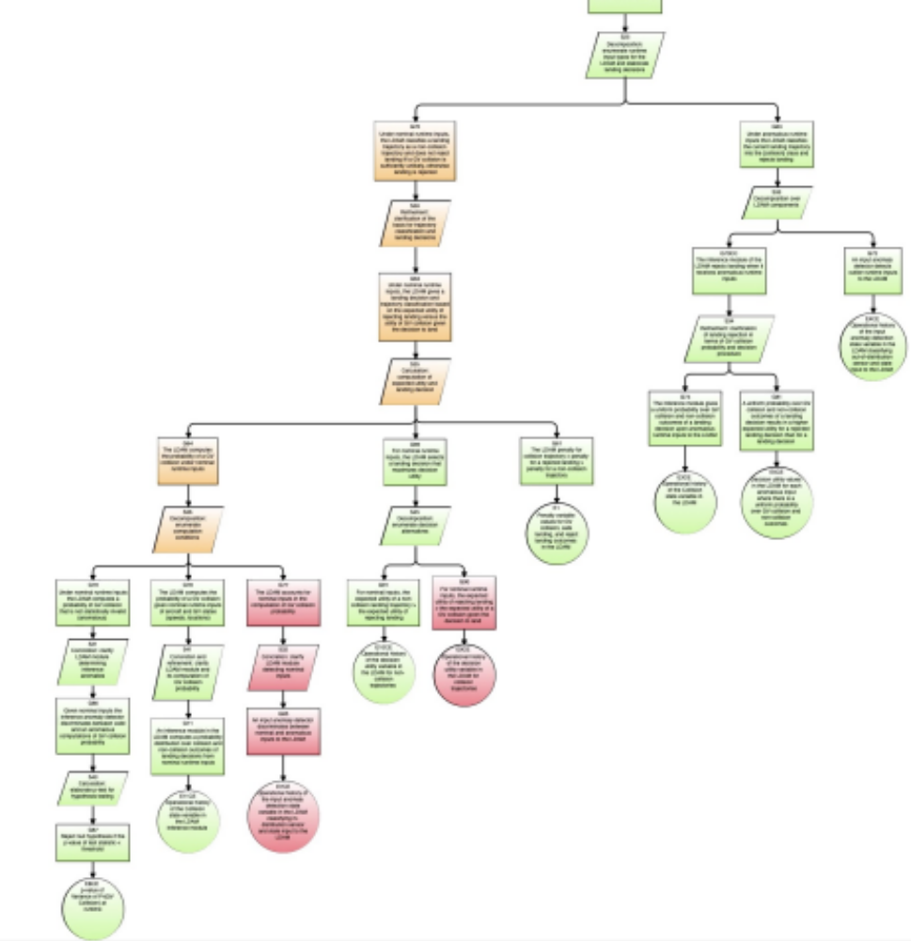
Dynamic Safety Cases
Trade trees record decision alternatives (e.g., design decisions) to be presented with
  impact of each alternative on baseline risk levels, as well as on existing assurance artifacts,
  decisions about alternatives to be made and recorded, and
  justifications of those decisions to be provided as assurance arguments.
Integration of decision-making, assurance impact analysis, and (safety) assurance case development within a common framework.
Sample Trade Decision Tree

Slide 7
Identifying More Hazards
Identifying more hazards, especially when a system is complex or adapting to changing conditions
  Adaptive Stress (AdaStress) testing
  Functional and fault modelling with Fmdtools
  Use of NLP for mining historical data and identify hazards that are often overlooked

Slide 8
Identifying More Hazards: AdaStress
AdaStress (Adaptive Stress testing) is a software package for an accelerated simulation-based stress testing method for finding the most likely path to a failure event
It has been successfully demonstrated to industry
  It has been adopted by GE Aviation Systems and is being incorporated in their continuum testing environments.

Slide 9
Identifying More Hazards: Fmdtools
Fmdtools (Fault Model Design tools) is a design and analysis environment, which enables a designer to
  represent the system in the early design process,
  simulate the effects of faults, and
  quantify corresponding resilience metrics.

Slide 10
Formalizing Requirements
We have developed a tool called FRET that allows a user to specify requirements in a quasi-natural language in order to formalize them into various logics
This helps support formal analysis in later stages of the development process
  E.g., for formalizing requirements that we want to prove on Simulink models using the CoCoSim tool.
It also allows us to perform formal analysis on requirements
  E.g., detecting inconsistencies between requirements

Slide 11
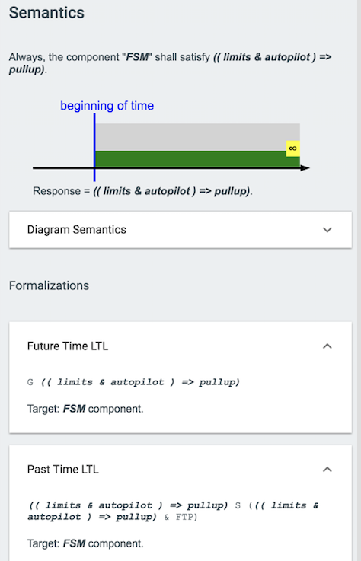
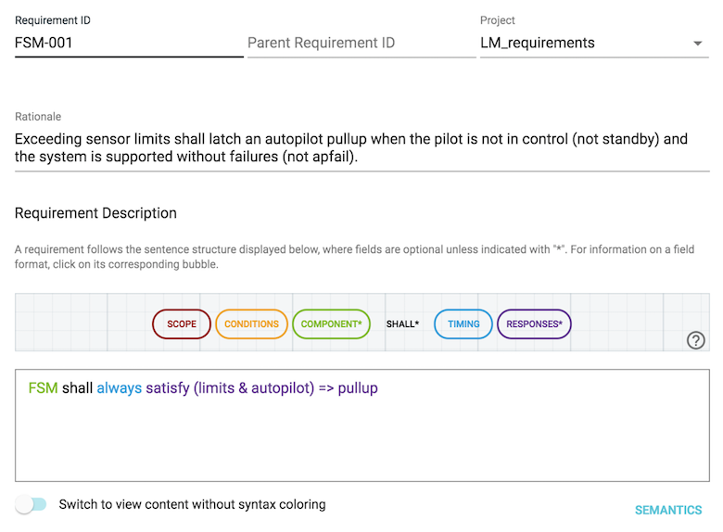
Formalizing Requirements
parser recognizes fields and
color codes them dynamically
FRET
generates
formal
semantics
user types
requirement

Slide 12
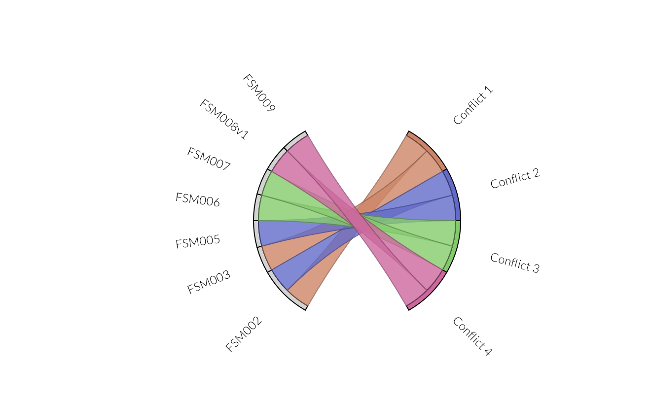
Formalizing Requirements
Checking realizability of requirements, which aims at determining whether an implementation exists, always complying with a set of requirements, regardless of the stimuli provided by the system’s environment.

Slide 13
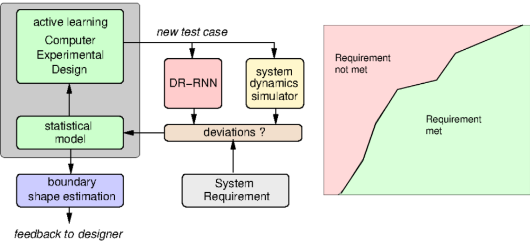
Computing Safe Bounds of Operations
Perturbations in the operational phase due to fluctuations in the data input and prediction output or in the model itself.
  Use of SysAI (new branch of MARGInS) to evaluate the Taxinet example with noisy data.
  Perturbations in the design phase could also be found using SysAI.

Slide 14
V&V of Machine Learning
Field of application
Artificial Intelligence (AI)
A technology that appears to emulate human performance. Includes both model-driven and data-driven approaches.
E.g., Expert System
We focus mostly on off-line-trained, supervised DNNs
Some of our results apply only to ReLU DNNs
Machine Learning (ML)
Algorithms whose performance improves as that they are exposed to data
E.g., Classification (Clustering)
Deep learning (DL)
Subset of machine learning in which multilayered neural networks learn from vast amount of data
E.g., Computer vision (CNNs) or Natural Language Processing (RNNs)
Type of ML
Supervised
Unsupervised
Reinforcement

Slide 15
V&V of Machine Learning
Prophecy Key Idea:
  Infer “likely” properties, aka contracts, of a NN
  Prove them using a decision procedure
What is a contract? σ => P
  σ is a precondition (“safe region”)
  P is a postcondition; desired output behavior (e.g. some prediction)
σ
If holds for
satisfies P

Slide 16
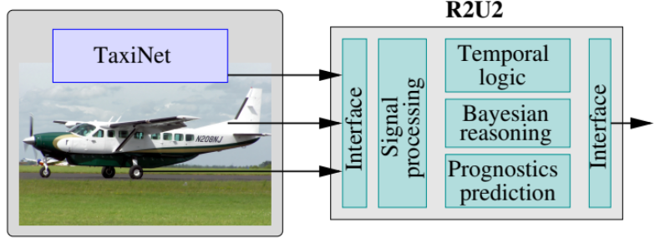
V&V Techniques Working together
Use of runtime monitoring (R2U2 tool) to monitor inputs based on pre-conditions computed by Prophecy
  Or by MARGInS or SysAI
Prophecy
R2U2 is a run-time monitoring and V&V tool that combines Metric Temporal Logic observers, Bayesian Network reasoners, and model-based prognostics.
FRET can also be used to generate formal monitors for R2U2 based on safety requirements.

Slide 17

Conclusions
RSE is developing tools to make the software and system engineering processes more efficient.
Most of the funding has been coming from ARMD, hence a focus on aviation systems
Since we believe they make a difference, we are also injecting these tools in our small Sat missions
We have created an internal mission called Troupe1, which we use to
  Train new staff for missions
  Evaluate the use of new tools and processes
Image courtesy of NASA Ames Research Center

Slide 18
RSE Software Engineering Tools
Tools | Description | Availability | Technical POC | POC Email
FRET | Requirement elicitation and analysis | Open Source | Dimitra Giannakopoulou | dimitra.giannakopoulou@nasa.gov
CoCoSim | Simulink model analyzer | Open Source | Khanh Trinh | khanh.v.trinh@nasa.gov
IKOS | Static code analysis for C/C++ | Open Source | Guillaume Brat | guillaume.p.brat@nasa.gov
AdvoCATE | Assurance case automation toolset | Open Source | Ewen Denney | ewen.w.denney@nasa.gov
MARGInS | ML/statistical libraries for system testing | Usage Agreement | Carlos Paradis | carlos.v.paradis@nasa.gov
SysAI | ML/statistical libraries for system testing | Not available yet | Yuning He | yuning.he@nasa.gov

Slide 19
RSE Software Engineering Tools
Tools | Description | Availability | Technical POC | POC Email
AdaStress | Adaptive stress testing | Open Source | Ritchie Lee | ritchie.lee@nasa.gov
RACE | Runtime for Airspace Concept Evaluation | Open Source | Peter Mehlitz | peter.c.mehlitz@nasa.gov
MESA | Run-time analysis of live data streams | Open Source | Nastaran Shafiei | nastaran.shafiei@nasa.gov
Prophecy | Formal analysis of Neural Networks | Not available yet | Corina Pasareanu | corina.s.pasareanu@nasa.gov
R2U2 | Vehicle-level run-time analysis | Usage Agreement | Johann Schumann | johann.m.schumann@nasa.gov
Drishti | NLP for requirement traceability | Not available yet | Nija Shi | nija.shi@nasa.gov

Slide 20
Other Topics From Ames Research Center
TECHNICAL SESSIONS
Mission Operations and Autonomy: Design and Testing of Autonomous Distributed Space Systems
Science/Mission Payloads: The Pandora SmallSat: Multiwavelength Characterization of Exoplanets and their Host Stars
Constellation Missions: Design and Validation of an Autonomous Mission Manager towards Coordinated Multi-Spacecraft Missions
NASA SHORT TALKS
Framework for Autonomous Planning of Distributed Space Systems
How to Partner with NASA and Use Patented Technologies
NASA Art in Space: A Rich History and The PACE-1 Flight Mission
NASA Flight Opportunities: Competitive Access to Suborbital Flight Testing
NASA SSTP’s SmallSat Technology Partnerships for Universities
Novel Communication Experiments in the Nano-Orbital Workshop (NOW) Series, Closing the Link to Geostationary Orbit with Automated Doppler Correction

