Slide 1
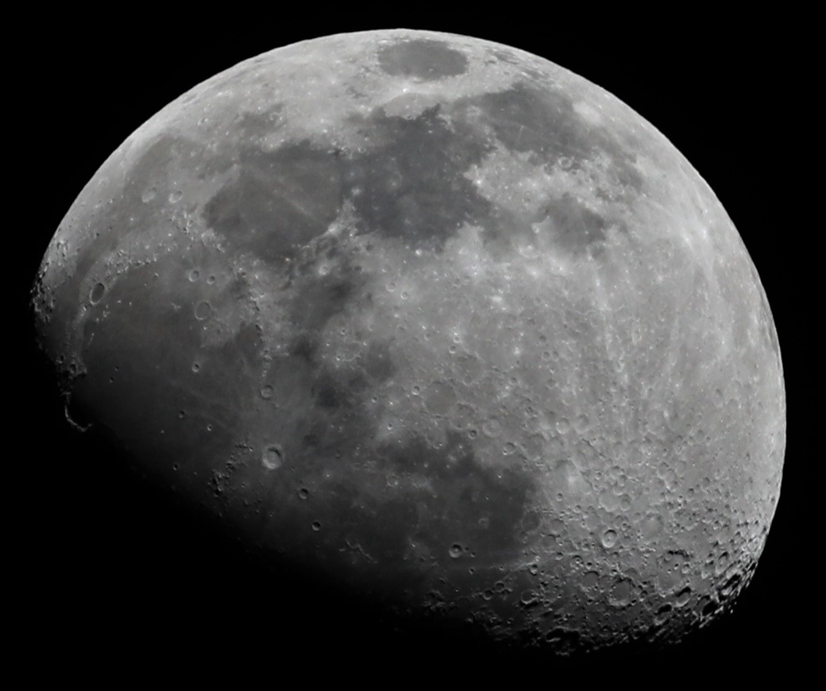

Biological Dosimetry for Astronauts
Honglu Wu
NASA Johnson Space Center
University of the District of Columbia, August 10, 2021

Slide 2
The Space Radiation Environment
INNER RADIATION BELT
SOLAR PARTICLE EVENT
(Protons)
(Protons to Iron Nuclei)
N
OUTER RADIATION BELT
(Electrons)
OUTER RADIATION BELT
(Electrons)
S
GALACTIC COSMIC RADIATION (GCR)
SOUTH ATLANTIC ANOMALY
(Protons to Iron Nuclei)
(Protons)
Space radiation : Energetic charged particles, high-LET (linear energy transfer)

Slide 3
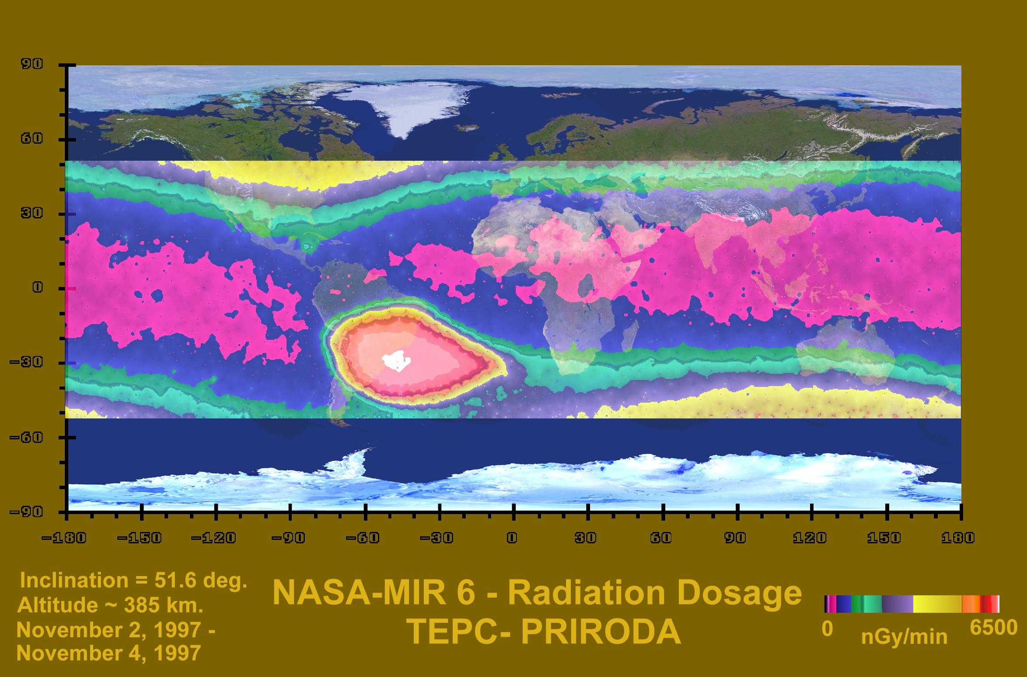

Slide 4
Health Risks from Space Radiation Exposure
Cancer risks
Central nervous system risks
Degenerative tissue risks
Acute radiation syndrome

Slide 5
What are the evident biological effects of space radiation in astronauts?

Slide 6
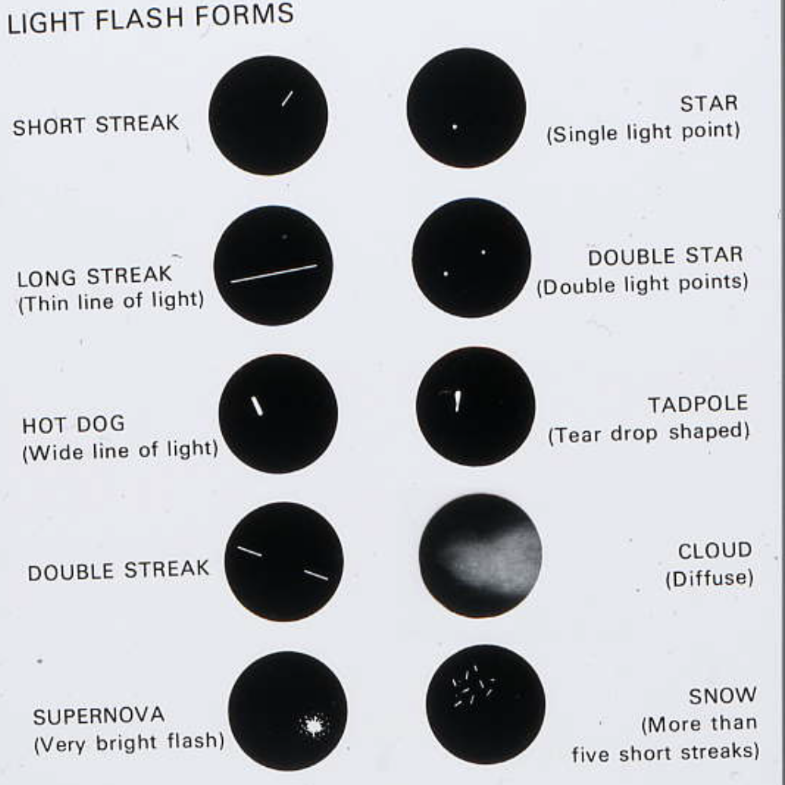
Light Flashes

Slide 7
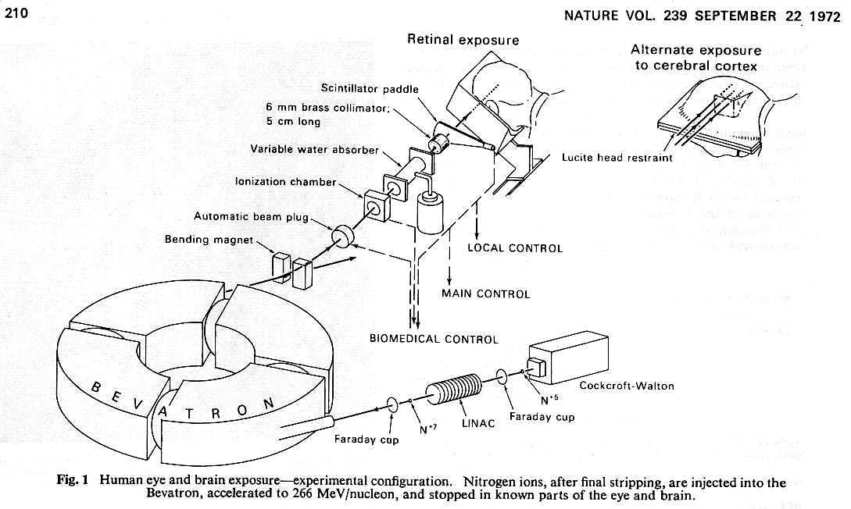
Budinger, Lyman and Tobias

Slide 8
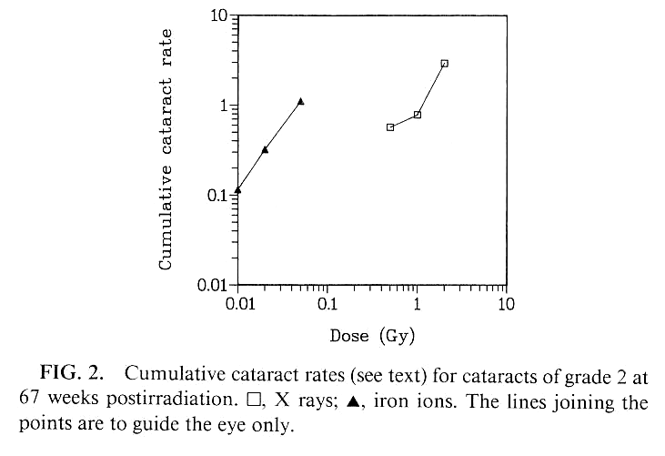
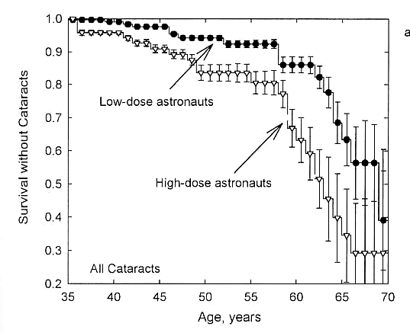
Cataracts
Brenner et al. Rad. Res. 1993
Cucinotta et al. 2001

Slide 9
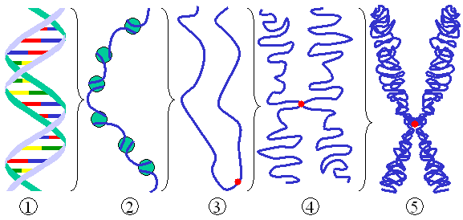
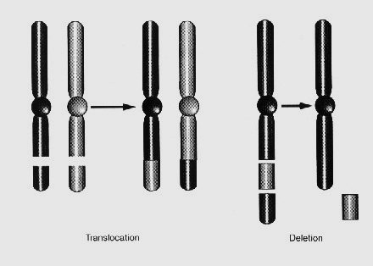
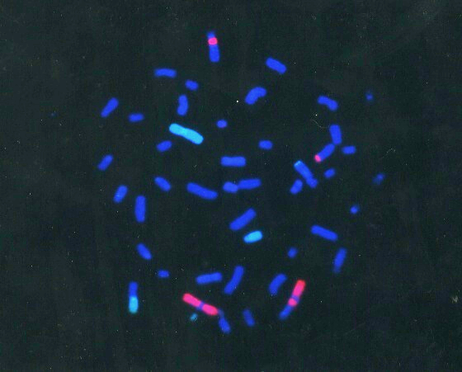
Chromosome Aberrations Observed in
Astronauts’ Lymphocytes

Slide 10
Biodosimetry
The use of physiological, chemical or biological markers of exposure of human tissues to ionizing radiation for the purpose of reconstructing doses to individuals or populations (NCRP 2009).
Objectives of biodosimetry for ISS astronauts
  Complement the measurement using physical dosimeters
  Take into account the individual susceptibility
  Take into account the self-shielding of the body
  Take into account the possible synergistic effect of other spaceflight factors
  Hopefully use as a marker to predict risk

Slide 11
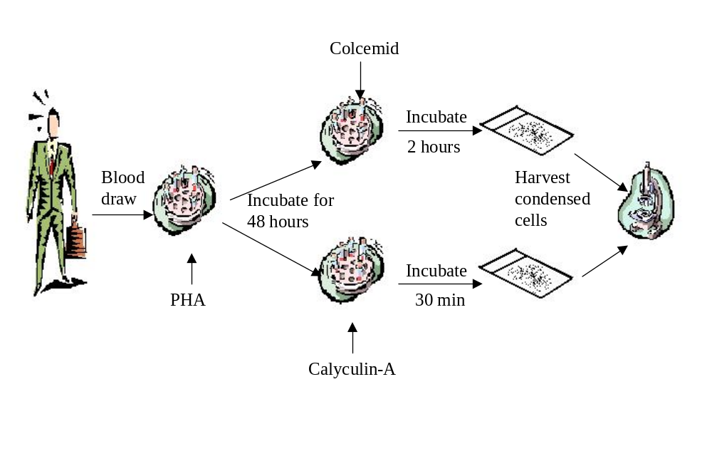
Biodosimetry procedure

Slide 12
ISS Biodosimetry Study
Biodosimetry samples collected from 43 ISS crewmembers were analyzed.
Pre-flight blood was collected at ~2 weeks before launch. The blood sample was also exposed ex vivo to gamma rays acutely at a set of doses from 0 to 2 Gy.
The 1st post-flight sample was collected at ~2 weeks after landing and the 2nd at 6-12 mo. after landing.
Five (5) of the 43 crewmembers flew twice on the ISS.
Chromosome aberrations were analyzed using fluorescent in situ hybridization (FISH) with 3 chromosomes stained in 3 different colors.
Chromosome aberrations were compared to cytokines measured before, in and after mission for 22 of the 43 crewmembers

Slide 13
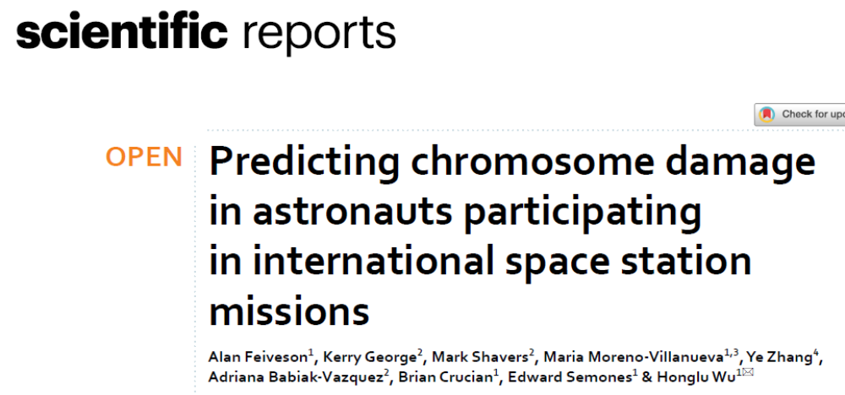
Data of total chromosome aberrations is presented.

Slide 14
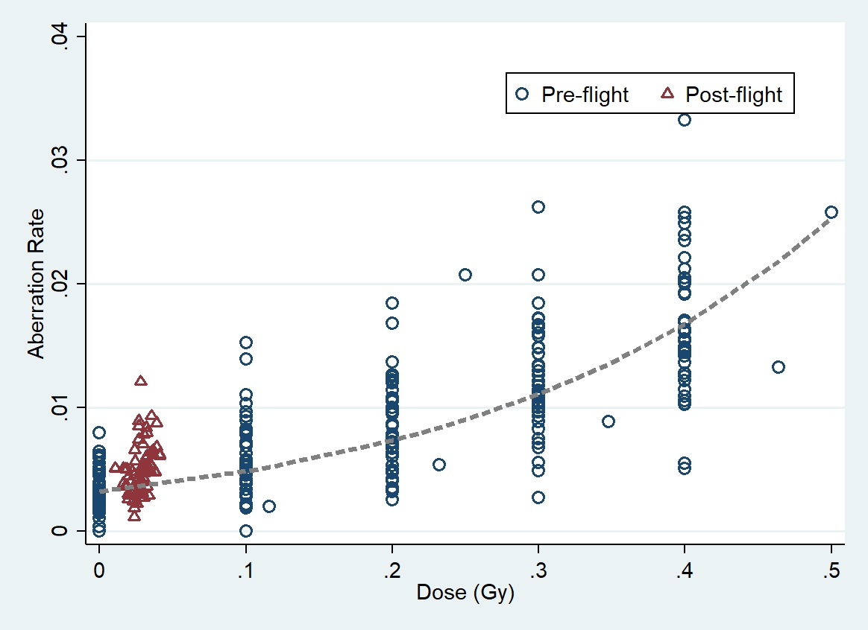
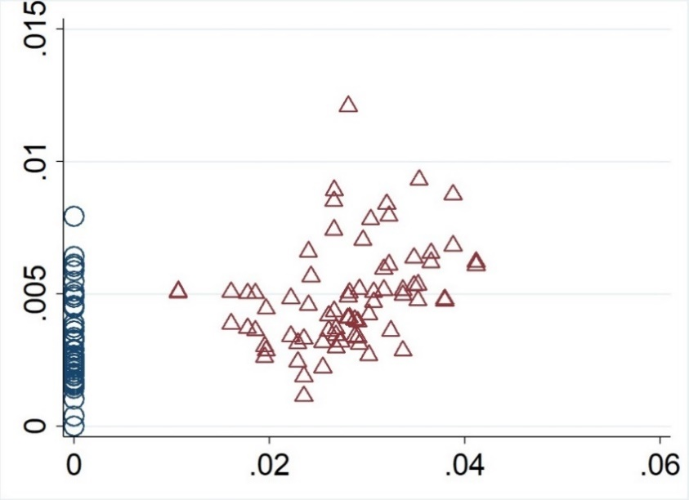
Chromosome aberration rate (CAR) in lymphocytes, collected pre-flight from the ISS crewmembers, after exposure to gamma rays ex vivo (blue circles) as a function of dose. Red triangles represent the post-flight AR as a function of the estimated BFO dose for the individuals. The average BFO dose received during ISS missions was 0.028 Gy, and the average AR post-mission was 0.0049, resulting in an average RBE of 3.2.

Slide 15
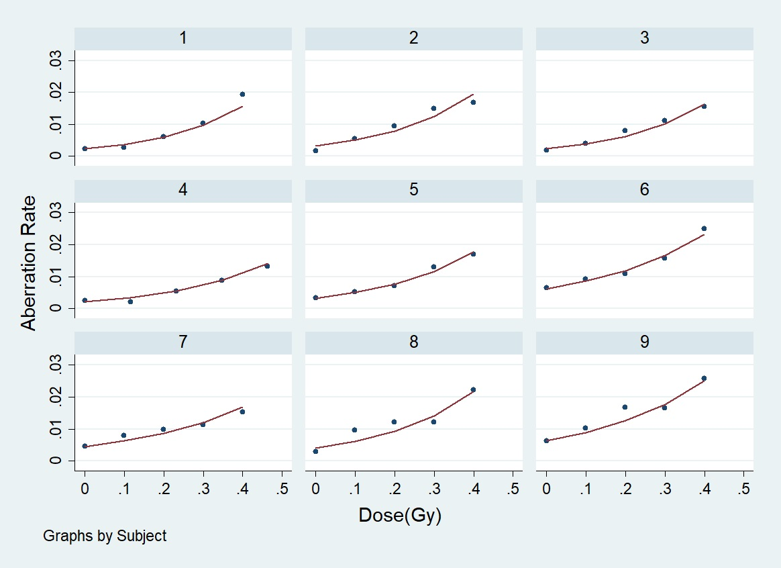
Poisson regression of pre-flight dose response for individual crewmembers
Preflight yields of chromosome aberrations and ex vivo dose response to gamma irradiation varied considerably among individuals .

Slide 16
Question
Is the post-flight chromosome aberration rate in the ISS crewmembers dependent on the individual radiosensitivity determined in pre-flight blood samples?

Slide 17


Poisson Regression
Pre-flight Model. Let $x_{ij}$ be the gamma-ray dose in Gy for the j-th exposure of cells from the i-th subject, and let $k_{ij}$ be the corresponding observed total aberration count in $n_{ij}$ cells. Then we used the following random-effects version of a Poisson regression model for $k_{ij}$:
$k_{ij}\sim Poisson\left(n_{ij}λ_{ij}\right)$
log $λ_{ij}=β_{0}+{W_{0i}+(β}_{1}+W_{1i})x_{ij}+β_{2}{A50}_{i}+β_{3}F_{i}$
where, ${A50}_{i}$ is the subject’s age centered at 50 yrs, and $F_{i}$ is an indicator variable for gender (0 = male, 1 = female). The random effects $W_{0i}$ and $W_{1i}$ are subject-specific perturbations to the intercept ($β_{0}$) and slope with respect to dose ($β_{1})$.
Post-flight Model. The post-flight Poisson regression model resembled Eqs. 1 and 2 in form, but with the following differences:
$k_{i0}$ denotes the baseline (pre-flight, no irradiation) aberration count for the i-the subject
$k_{ij}$ denotes the aberration count for the j-th post-mission sample of cells from the i-th subject (j = 1, 2, . . .)
For j > 0, $x_{ij}=B_{i}$, where $B_{i}$ is the BFO mission dose for the i-th subject.
For j = 0, there is no irradiation, so $x_{i0}=0.$
$w_{0i}$ and $w_{1i}x_{ij}$ are included as additional explanatory variables along with age and gender.
With the incorporation of the above, Eq.2 is replaced by Eq.3 for the post-flight prediction model:
log $λ_{ij}=β_{0}+{U_{0i}+β}_{1}x_{ij}+β_{2}{A50}_{i}+β_{3}F_{i}+β_{4}w_{0i}+β_{5}w_{1i}x_{ij}$.
In this model, $U_{0i}$, like $W_{0i}$, is also a subject-specific perturbation to the intercept.

Slide 18
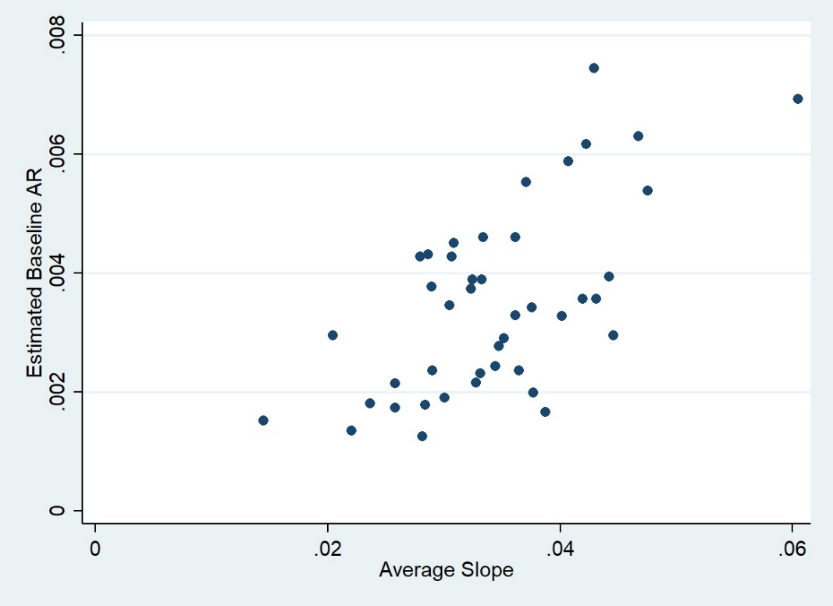
Pre-flight CAR baseline vs. slope (radiosensitivity)
Pre-flight radiosensitivity tended to be higher for individuals having a higher background CAR, suggesting that individuals with greater radiosensitivity can be more sensitive to other environmental stressors encountered in daily life.

Slide 19
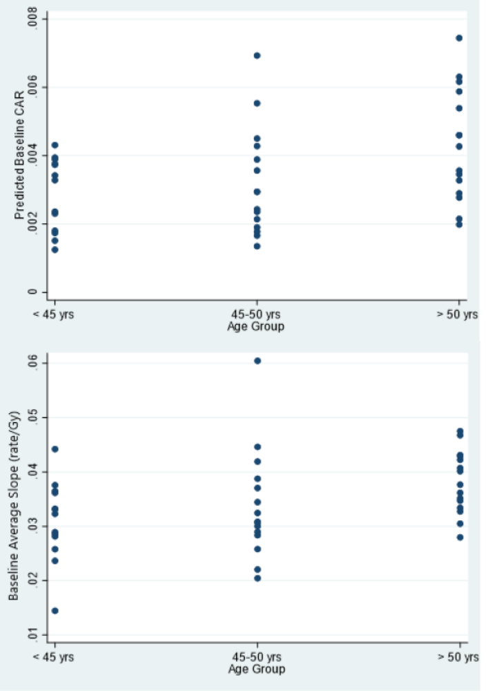
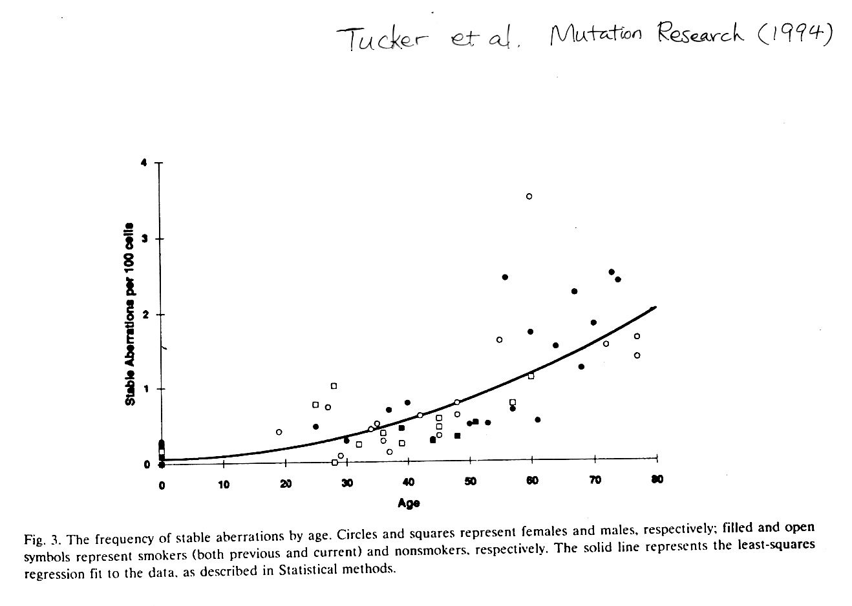
Age effects of chromosome aberrations and radiosensitivity
Although highly variable, both background chromosome aberration rate and radiosensitivity increase with age.

Slide 20
Post-flight CAR vs. Pre-flight slot (radiosensitivity)
Post-flight AR as a function of the average preflight dose response for individual ISS crewmembers, indicating that radiosensitivity determined preflight is a predictor for post-flight AR.

Slide 21
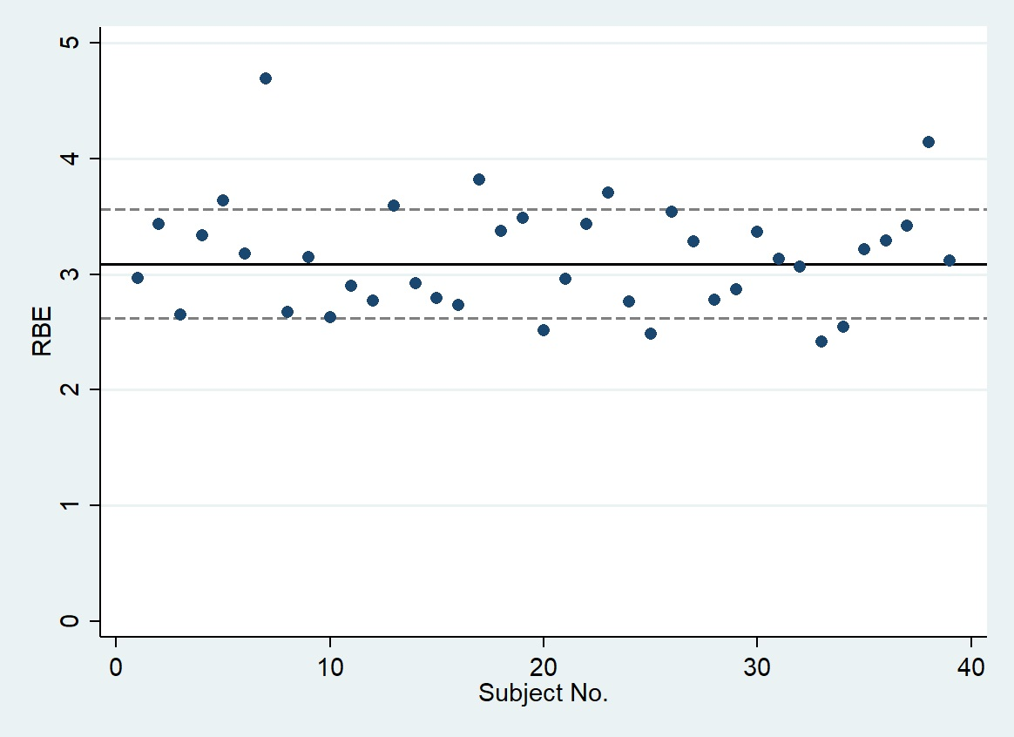
Individual relative biological effectiveness (RBE) for chromosome aberrations
The average RBE value of all crewmembers is about 3.

Slide 22
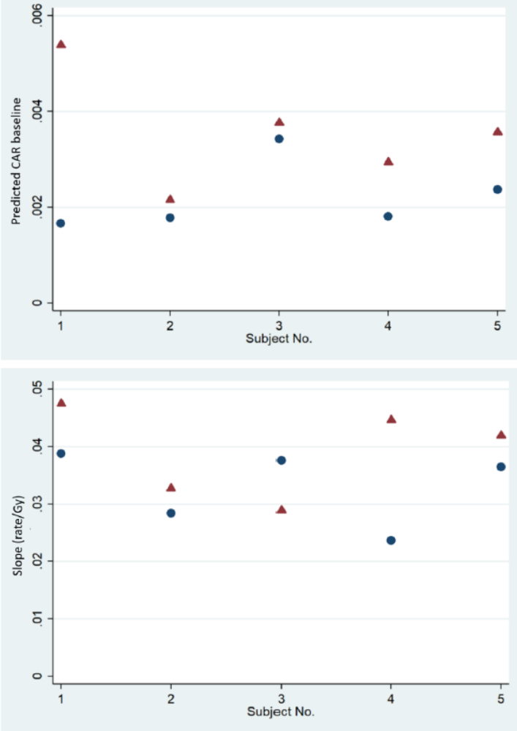
Comparison between the 1st and 2nd ISS missions for the 5 repeat fliers.
Background (top panel) and average slope (bottom panel) for the first (blue circle) and second (red triangle) ISS missions for 5 repeated flyers. The background was higher for the second flight for all 5 astronauts, whereas the average slopes were higher for the second flight for 4 of the astronauts.

Slide 23
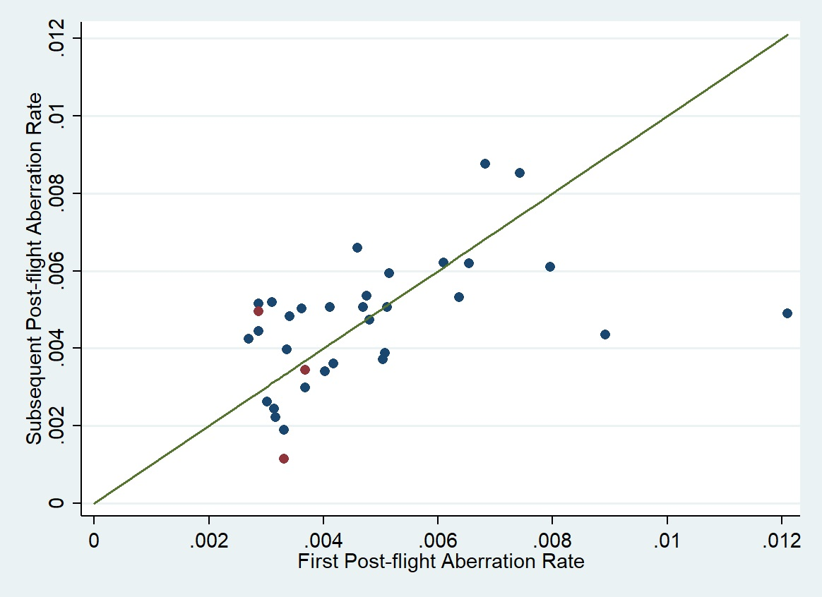
Comparison of CAR between blood samples collected at the first time point (~ 2 weeks post landing) and the second time point (6-12 mo. after landing)
The chromosome aberration rate is not statistically different between these two time points, suggesting that the chromosome damage detected post-flight reflected mostly that in the bone marrow.

Slide 24
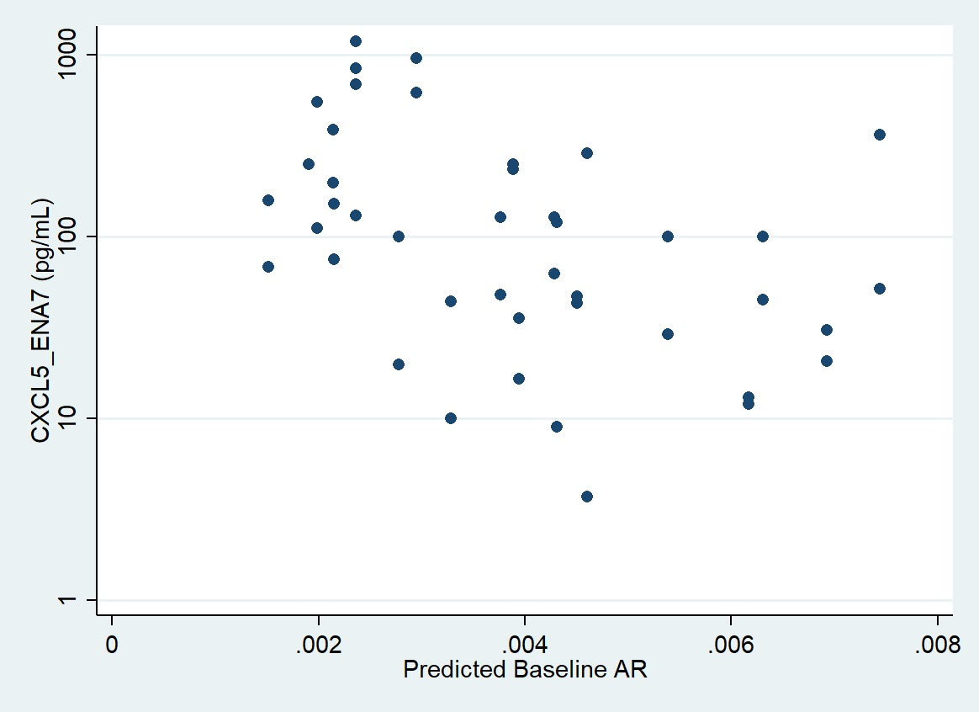
Relationship between cytokine and baseline chromosome aberration rate
Levels of CXCL5_ENA7 in plasma collected preflight decreased as a function preflight aberration rates.

Slide 25
Summary
The dose response slopes determined in pre-flight blood samples tend to be higher for crewmembers having a higher chromosome aberration background, suggesting that individuals with greater radiosensitivity can be more sensitive to other environmental stressors encountered in daily life.
Post-flight chromosome aberration rates (CAR) between individuals are dependent on the radiosensitivity determined in pre-flight samples.
There appears to be little if any gender difference, but the mean CAR and the radiosensitivity increase as a function of age.
The relative biological effectiveness (RBE) in comparison to the ex vivo dose response to gamma irradiation is ~ 3.
There was no significant difference between the observed CAR shortly after mission and at >6 months post-mission, suggesting that the damage detected post-mission may reflect damage in bone marrow cells.
In general, cytokine levels were not predictive of CAR, although subjects with higher pre-flight levels of CXCL5_ENA7 tended to have lower CAR background.

Slide 26
Acknowledgement
Alan Feiveson
Kerry George
Mark Shavers
Maria Moreno-Villanueva
Ye Zhang
Brian Crucian
Eddie Semones
Francis Cucinotta

