Slide 1
Applied Sciences Program 20th Anniversary
Monica Namo and Teresa Purello
Notes:
Notes:
Teresa: Hello I am Teresa Purello
Monica: and I am Monica Namo
Teresa: We are interns with the Capacity Building Program and today we will celebrate the 20th anniversary of the Applied Sciences Program by looking at its history

Slide 2
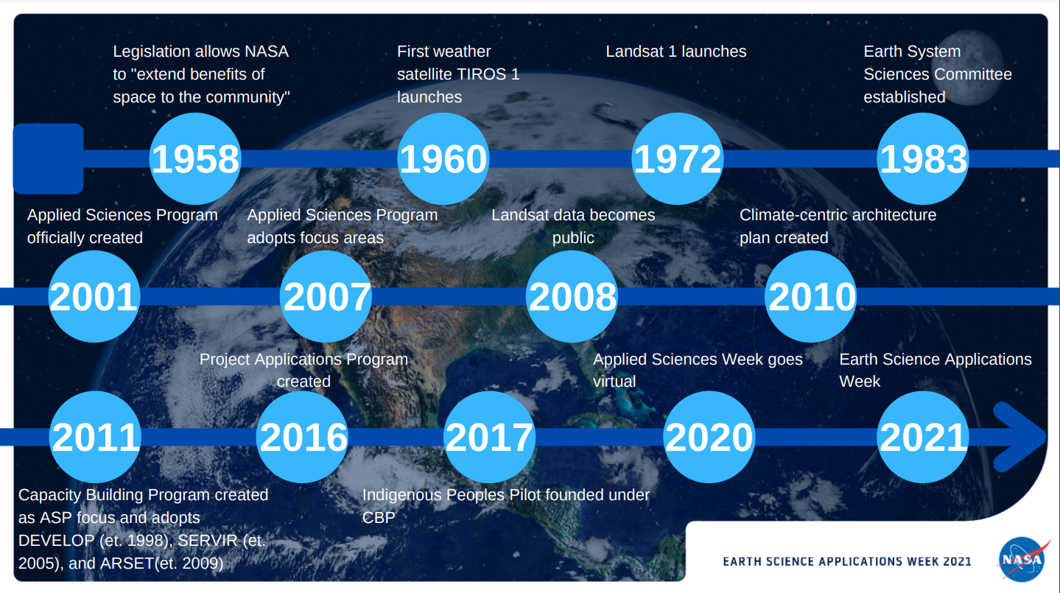

Notes:
Notes:
Teresa: This is an timeline of some of the major events that have happened with applied sciences at NASA since NASA's beginning. Over the past 20 years and before, NASA has impacted many people through its applied sciences work

Slide 3
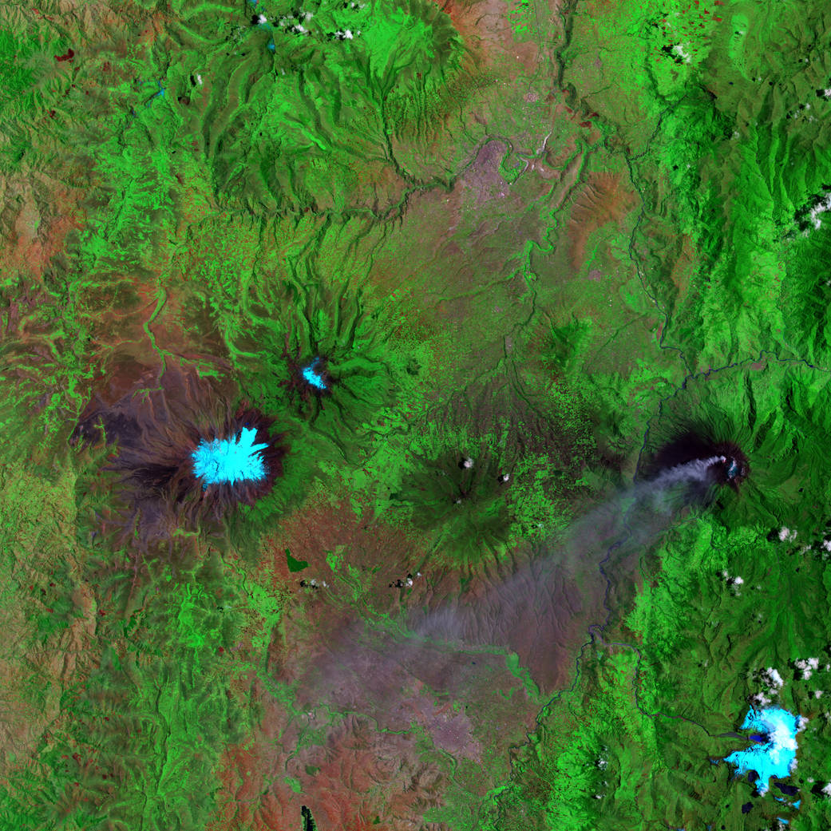
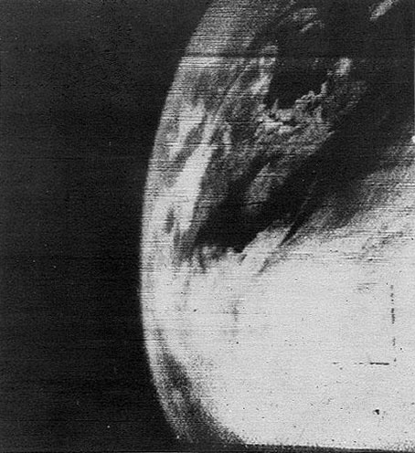
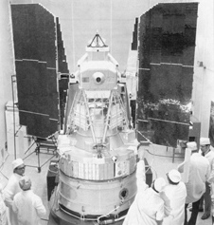
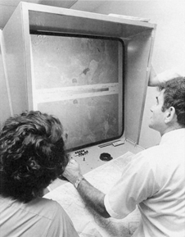
1958 - 2001
Landsat Satellites
Landsat 1 launched July 23, 1972
Landsat 7 launched April 15, 1999
TIROS 1 – First Weather Satellite​
  Launched April 1, 1960
  ​First television image from space
Landsat 1
Scientists viewing Landsat imagery in 1972
Credit: NASA
Credit: NASA
Between 1960 – 2001, applied sciences at NASA were done on a demand basis with universities and local governments
Landsat 7 image from 7/16/01 of Ecuador's Mount Chimborazo
Credit: NASA
Credit: NASA
First television image from space
Notes:
Notes:
Teresa:
Legislation was passed in 1958 that allowed NASA to do applied sciences work. In 1960, the first weather satellite, TIROS was launched. This gave us our first television image of Earth from space and proved that scientists could use space to better understand our planet. Over the next 40 years, NASA launched the first 7 Landsat satellites which have become key sources of Earth observations data. In this time, most of the applied sciences work was at the request of university researchers and local governments rather than NASA leading projects. This changed in 2001 --
Image Credits:
TIROS - 60 Moments in NASA History
Landsat 1 - NASA - Landsat Looks and Sees
Scientists - NASA - Landsat Looks and Sees
Landsat image - Chimborazo and Tungurahua | NASA

Slide 4
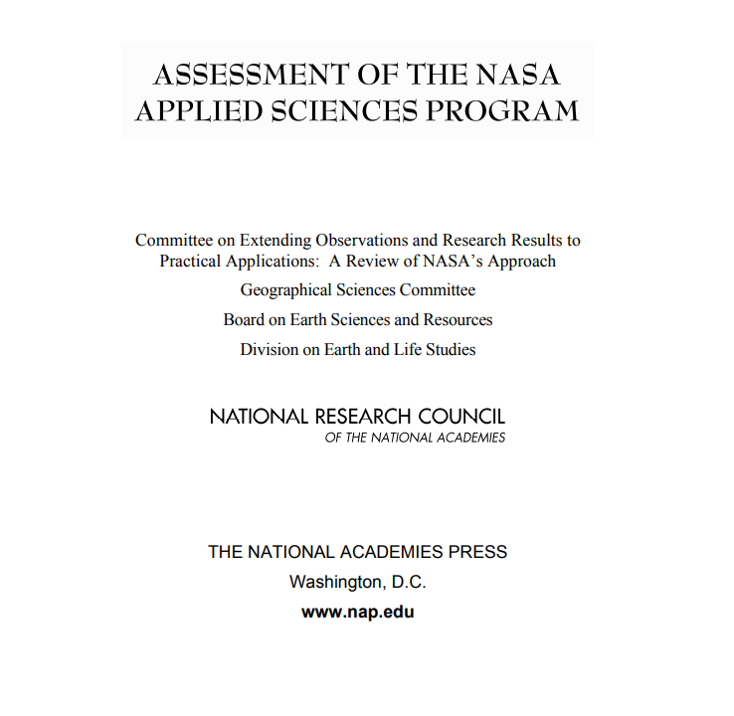

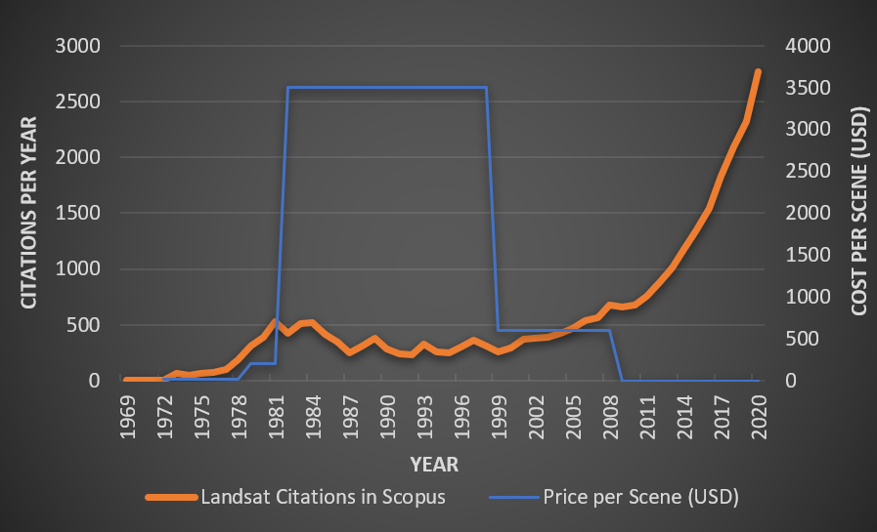
2001 - 2011
The Applied Sciences Program was officially created in 2001
  Original focus areas: Agricultural Efficiency, Air Quality, Aviation, Carbon Management, Coastal Management, Disaster Management, Ecological Forecasting, Energy Management, Homeland Security, Invasive Species, Public Health, and Water Management
  Led to more partnerships with federal agencies and a top-down applications approach
The Program was reviewed in 2007
Landsat data became available to the public in 2008
Credit: NASA
Credit: NASA
Credit: USGS
Landsat data usage overtime
Notes:
Notes:
Monica:
From 2001 to 2011 there were initially 12 Application focuses and as NASA Applied Sciences expanded, this led to greater partnerships alongside local, federal, and international institutions, to further establish additional application focuses especially as Satelettie data became more readily avaiable and free for anyone to utilize. For example, in 2008, Landsat data became free and open source for anyone to use and as the graph showcases, this data was used signifigatly more after 2008!
Image Credits:
Applied Sciences - About Applied Sciences | NASA Applied Science
Assessment - Assessment of the NASA Applied Sciences Program (sharepoint.com)
Landsat usage - https://www.usgs.gov/media/images/landsat-citations

Slide 5










2011 - 2021
Currently funded areas: Capacity Building Program, Disasters, Ecological Forecasting, Food Security and Agriculture, Health and Air Quality, and Water Resources
Capacity Building Program created in 2011​
  Adopted DEVELOP (et.1998),
  SERVIR (et.2005), and
  ARSET (et.2009)​
  Indigenous Peoples Pilot
  created in 2017​
Other areas: Urban Development, Transportation and Infrastructure, and Energy​
Over the past 10 years, ASP has become more involved in the planning stages of Earth Science missions
Notes:
Notes:
Monica:
Through 2011 and now, our current 6 funded areas under the applied sciences as well as 3 additional focus groups, you will also be hearing more about their work throughout this week! In 2011, the CBP was founded which now manages three program areas; DEVELOP, ARSET, and SERVIER. Moreover, Over the past 10 years, ASP has become more involved in the planning stages of Earth Science missions.
Image Credits:
Logos – NASA Applied Sciences
Earth – Earth Science Applications Week icon

Slide 6
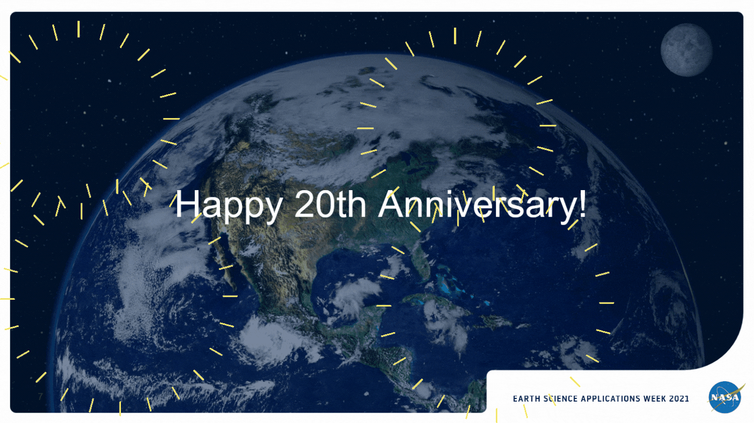
Notes:
Notes:
Teresa: That brings us to today. We look forward to seeing the impact of the program over the next 20 years and thank you for celebrating with us!

