Slide 1
Exploration of Scalable Methods to Fabricate Synthetic Lunar Minerals for Engineered Regolith Simulants
Dr. Holly Shulman^{1,2}
C. Howard², J. LaPaglia², D.L. Rickman³, M.R. Effinger⁴
¹DrHollyShulman, LLC, Belmont, NY, 14813
²Alfred University, Alfred, NY, 14802
³Jacobs Space Exploration Group/NASA Marshall Space Flight Center, Huntsville, AL 35812
⁴NASA Marshall Space Flight Center (MSFC), EM31, Huntsville, AL, 35812
Fundamental and Applied Lunar Surface Research in Physical Sciences August 18–19, 2021

Slide 2
Overview
Goals
Scalable Methods
Laboratory Results
Conclusions and Next Steps

Slide 3
Goals
Develop scalable methods to fabricate synthetic lunar simulants focused on Highlands
Characterization to confirm and/or modify as needed for high fidelity to lunar regolith
Ultimate goal sufficient materials for large scale construction experimentation focusing on microwave densification

Slide 4
Scalable Methods: Solid State Reaction
Solid State Reaction- Mixed Oxide Method
Oxides (and carbonates) powders intimately mixed, e.g. ball mill
Powders heated to react
Diffusion controlled; time and temp critical; must be in appropriate phase field
Must avoid reaction with container
Batch Kiln- powders in saggers
Rotary Kiln- powders in large rotating tube

Slide 5
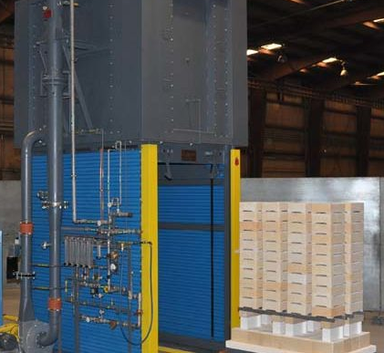
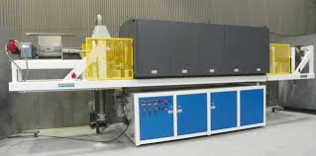
Scalable Methods: Solid State Reaction
Toll firing examples: Harrop Industries
1A. Batch Furnace (Periodic)
Electric Kilns
Volume up to 27 cu. ft., Temp to 1,600°C Controlled atm.
Gas Kilns
Volume up to 57 cu. ft., Temp to 1,700°C
1B. Rotary Kiln (Continuous)
Ceramic tube
Variable rotation speed, tube inclination angle
Temp to 1,400°C
Elevator Kiln
Rotary Kiln

Slide 6
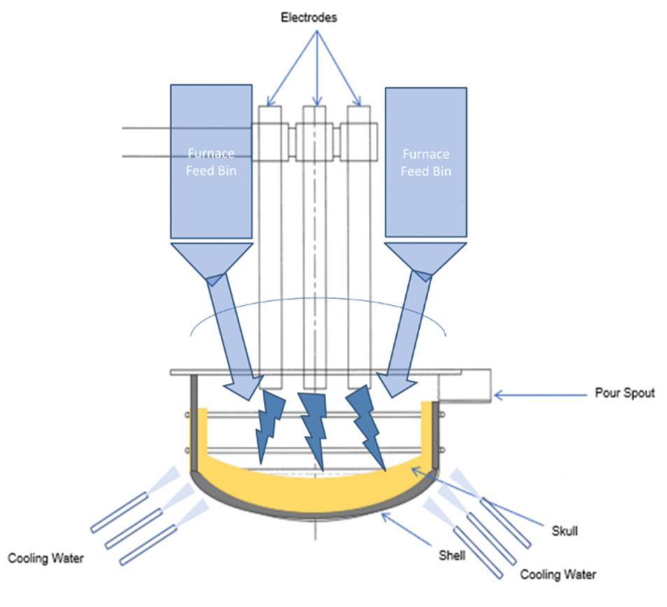
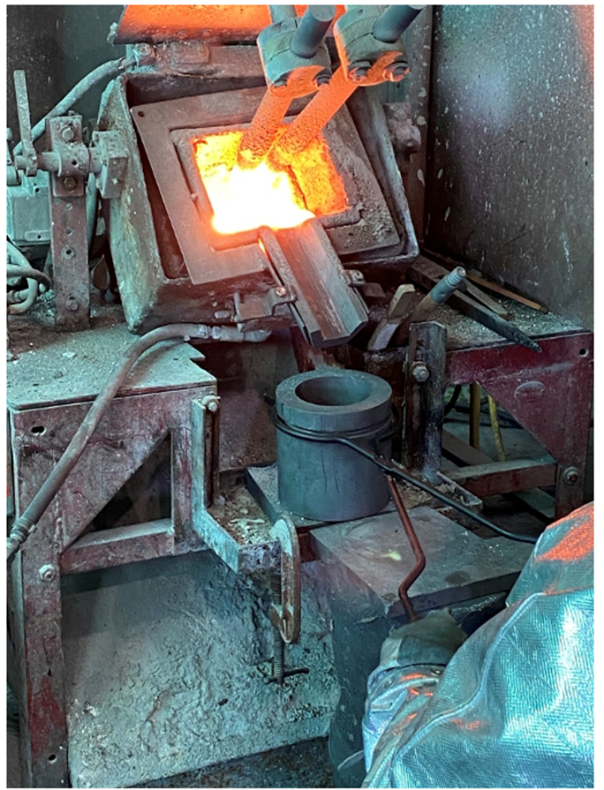
Scalable Methods: Reaction from Melt
Toll firing example: Washington Mills
2. Fusion from Melt - Arc Electrode Method
Power supply, graphite electrodes and vessel
Arc generated between electrodes >3000°C

Slide 7
Laboratory Challenge
Ming, D. W. (1992). Lunar sourcebook, Endeavour 16(2). Data compiled from Table 5.1, pg 123
Target:
Anorthite (plagioclase CaAl₂Si₂O₈)
Diopside (pyroxene CaMgSi₂O₆)
Enstatite (pyroxene Mg₂Si₂O₆)
Olivine (solid solution (Mg,Fe)₂SiO₄)
Variables:
Process method
Raw materials
Temperature
Dwell Time, Heating and Cooling Rate
Container material
X-Ray Diffraction feedback

Slide 8
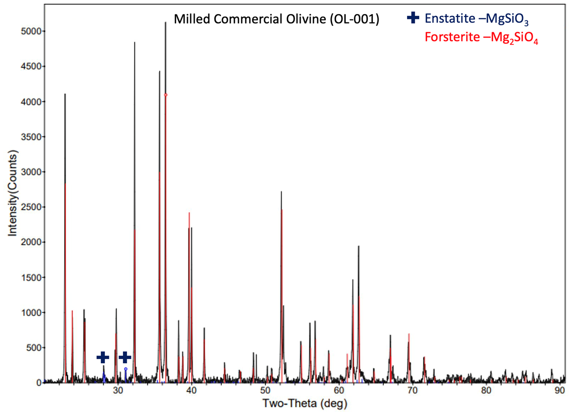
Olivine (Mg,Fe)₂SiO₄)
High purity natural sources available
End member synthetic forsterite standard commercial product via arc fusion method
Olivine solid solution available custom commercial product with controlled Fe/Mg+Fe ratio to match Highlands range
Natural olivine- Titon Supply Company

Slide 9
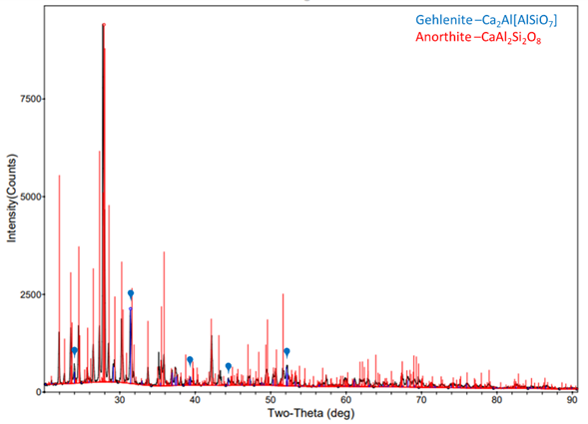
Anorthite (CaAl₂Si₂O₈)
XRD Anorthite via solid state method 1300°C using CaCO₃, high purity Al₂O₃, and highly reactive fumed SiO₂. Appearance of minor spinel phase likely due to Mg impurity in the CaCO₃. This can be replaced with high purity CaCO₃. Use of a less reactive amorphous SiO₂ showed residual unreacted Al₂O₃ at these process conditions.
XRD Anorthite via arc electrode method >3000°C, using CaO, Al₂O₃, SiO₂. Appearance of minor Gehlenite phase likely due to short reaction time. More time can be applied to allow better mixing of the melt.

Slide 10
Diopside (CaMgSi₂O₆)
XRD Diopside via solid state method 1250°C using MgCO₃ + CaCO₃ + amorphous SiO₂. Appearance of minor phase forsterite. No reaction with alumina crucible. Slight reaction with alumina crucible occurred for fumed SiO₂ blend, and reaction for both SiO₂ sources with alumina crucible at higher calcination temperature.

Slide 11
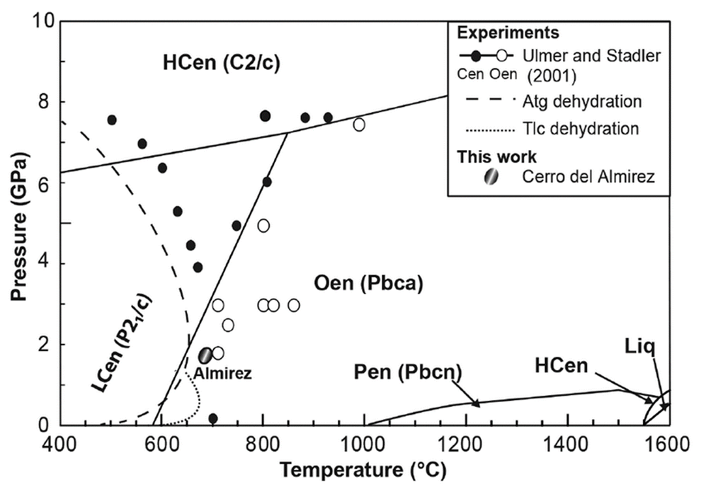
Enstatite (Mg₂Si₂O₆)
Complicated due to polymorphs
Desired phase orthoenstatite, also referred to as enstatite
Protoenstatite converts slowly to orthoenstatite ~ 1080 °C, highly sensitive to cooling rate
Ref. Clément, Padrón-Navarta et al. 2018
Phase field of enstatite polymorphs: Orthoenstatite (Oen) is the desired phase (enstatite). Protoenstatite (Pen) Clinoenstatite (High Hcen and Low LCen). Oen is stable phase at RT, however, requires long holds and slow cooling to induce transition from Pen. Transition begins at ~1080 C 1 ATM, and is slow to reverse. Cen phases occur mostly due to mechanically induced transitions in Oen and Pen, as lamellae in the host crystal.

Slide 12
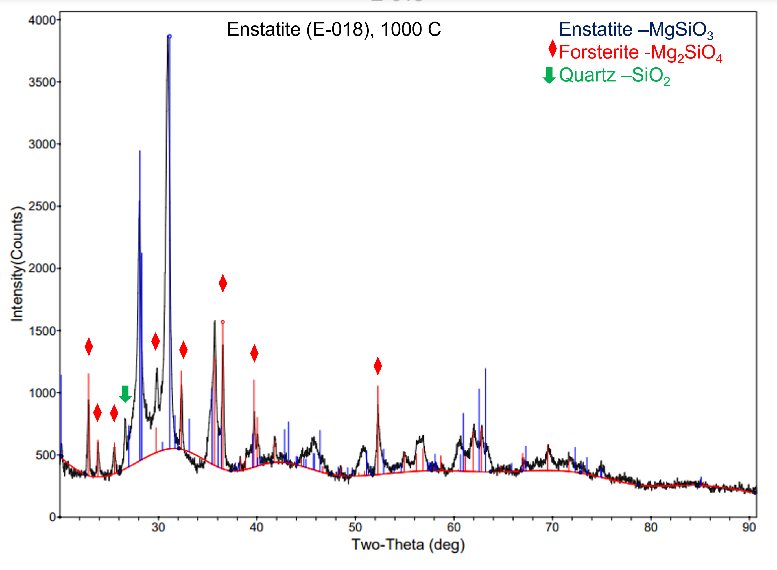
Enstatite (Mg₂Si₂O₆)
XRD orthoenstatite (enstatite), synthesized from Talc (Mg₃Si₄O₁₀(OH)₂) and MgCO_{3,} at 1000 °C for 48 hours. Minor phases quartz and forsterite. Reaction to forsterite is favored in the the orthoenstatite phase field.

Slide 13
Enstatite
Effect of temp on phase formation: 48 hr dwell
950 °C
Starting materials Talc (Mg₃Si₄O₁₀(OH)₂) + MgCO₃
Higher enstatite peaks 1000 °C than 950 °C, no change at 1040 °C
Commercial method - Possible to remove quartz via a reduction to SiO and evaporation process
Phase pure protenstatite readily formed >1100 °C should convert to othoenstatite with long dwell time. Tests are ongoing.
Arc fusion method with controlled cooling to be investigated.
1000 °C
1040 °C

Slide 14
Summary
Solid state reaction and arc fusion methods are commercial methods for making synthetic minerals at ton scale.
Olivine readily available as natural mineral and commercial synthetic product.
Demonstrated synthetic anorthite via solid state and arc fusion methods.
Demonstrated synthetic diopside via solid state method. High probability of arc fusion success based on phase stability.
Demonstrated synthetic enstatite, however need for further refinement to achieve phase pure orthoenstatite.

Slide 15
Suggested next steps
1. Lab scale
Down select scalable method and starting materials
Prepare 3-5 Kg batches of synthetic lunar minerals
Characterize and modify particle size distribution e.g. laser light scattering and BET, milling to change particle size
Make glass melts and pseudo agglutinates from blends e.g. via arc electrode quenching
Batch synthetic minerals + glass
Add minor phases, e.g nano Fe
Measure dielectric properties
2. Scale up
Use same method from lab scale (solid state or arc electrode) 50-100 Kg batches of minerals
XRD confirm phases
Modify particle size distribution (e.g. milling)
Same procedures to make synthetic lunar glasses from quenching mineral blends
Add minor phases
Measure dielectric properties and other characterization

