Slide 1
Thermal Testing and Analysis Techniques for Wires and Wire Bundles
S L Rickman¹, B I Furst² and K L Johnson³
¹ NASA Engineering and Safety Center (NESC), Johnson Space Center, 2101 NASA Parkway, Houston, TX 77058, USA
² Jet Propulsion Laboratory, California Institute of Technology, Pasadena, CA 91109, USA
³ NESC, Marshall Space Flight Center, Huntsville, AL 35812, USA

Slide 2
Presentation Contents
Background
Test
Test Apparatus
Test Design
Analysis
Physics-Based Models and Correlation to Test Data
Regression Model
Concluding Remarks
Acknowledgements
References

Slide 3
Background
Determining wire and wire bundle amperage capacity (i.e., “ampacity”) currently relies on the use of standards to derate wire ampacity when in a bundle configuration.
The feasibility of developing physics-based and regression thermal models of single wires and wire bundles to determine ampacity using a customized test apparatus was investigated during a pathfinder study.
A wire bundle test apparatus was developed for measuring the temperatures of single wires and wire bundles and collected wire conductor temperature data under high vacuum and atmospheric conditions and varying environmental temperatures and currents for the two most common wire types used on spacecraft.

Slide 4
Background (continued)
Physics-based thermal models of single wires and wire bundles were developed and demonstrated.
Predictions were validated by comparing analysis results with the experimental data.
Test results also correlated well with published wire bundle derating standards [1] and [2].
A regression model was developed that could accurately predict the data.
If successful, and ultimately matured and validated, these models could supplant reliance on current standards’ narrow tables to derate allowable current flow so as to prevent exceeding wire temperature limits due to resistive heat dissipation within the wires or wire bundles.

Slide 5
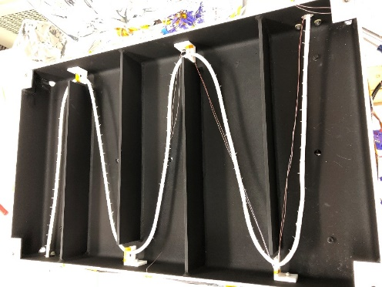
Test Apparatus
Test apparatus developed to measure the temperature of a single wire or wire bundle carrying varying levels of DC electrical current in a controlled vacuum and thermal environment.
Apparatus was designed to simulate an infinitely long wire carrying a fixed current in a uniform thermal environment at steady state conditions.
Test configuration consisted of a wire/wire bundle test article suspended in a temperature-controlled shroud within a pressure-controlled (i.e., vacuum) chamber.
Temperature controlled shroud
Wire bundle test article
Test shroud interior with a wire bundle test article

Slide 6
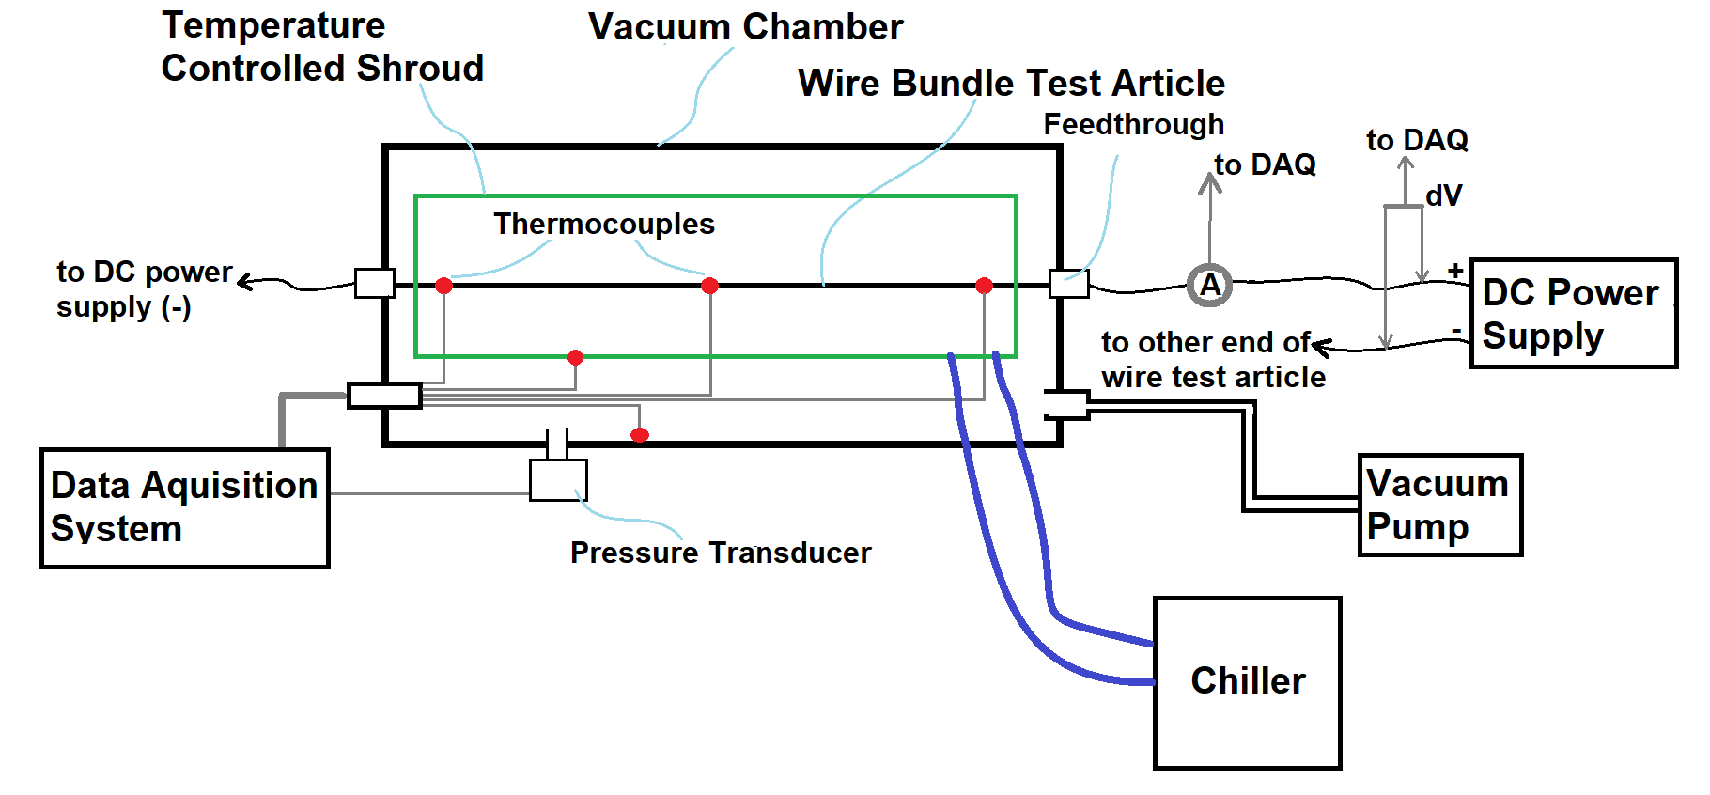
Test Apparatus (continued)
A DC power supply was used to control the current flowing through the wire.
Fine gauge thermocouples soldered directly onto the conductors measured wire/wire bundle temperatures.
Wire harness thermal test bed schematic

Slide 7
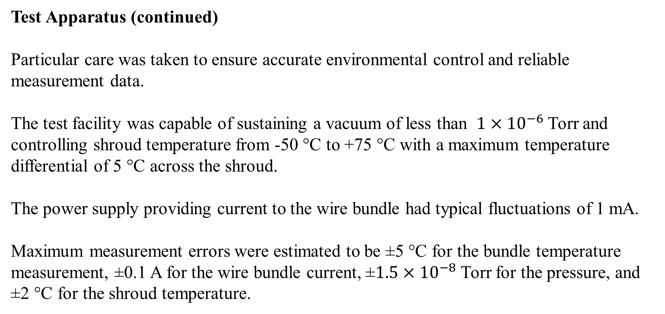
Test Apparatus (continued)
Particular care was taken to ensure accurate environmental control and reliable measurement data.
The test facility was capable of sustaining a vacuum of less than $1×{10}^{−6}$ Torr and controlling shroud temperature from ‑50 °C to +75 °C with a maximum temperature differential of 5 °C across the shroud.
The power supply providing current to the wire bundle had typical fluctuations of 1 mA.
Maximum measurement errors were estimated to be ±5 °C for the bundle temperature measurement, ±0.1 A for the wire bundle current, ±$1.5×{10}^{−8}$ Torr for the pressure, and ±2 °C for the shroud temperature.

Slide 8
Test Design
Efficient Design of Experiments (DOE) methods used to set up the experiment which enabled combining the data into a single mathematical analysis, reducing the number of test runs required.
Changing current between each observation required a turn of a dial and time for temperature to equilibrate.
Changing chamber pressure and shroud temperature was done after several current changes.
Changing test articles was performed after each test article went through several chamber pressure/environment temperature setting changes.
Analysis of the data as well as planning of the original test matrix was performed using JMP® software version 13.

Slide 9
Physics-Based Analytical Models
Physics-based analytical thermal models were developed for both single wire and wire bundle cases.
For the single wire analysis, key input wire properties such as resistance per unit length at a reference temperature, the temperature coefficient of resistance, and bundle geometry were measured directly. The single wire thermal model was a steady state heat balance expression including the effects of wire gauge as measured by conductor and insulation jacket radius, wire jacket material thermal conductivity, current flow and, both, radiative and convective heat transfer from the wire jacket [5]. Calculations were correlated to test data by adjusting an effective wire jacket infrared transmissivity and, for atmospheric cases, a convective scaling factor.
Forty-one cases were within 5 °C of test data, 3 were within 10 °C, and 4 within 18 °C.

Slide 10
Physics-Based Analytical Models – Single Wire Model
The single wire model is composed of a system of equations:
$$I^{2}R_{L0}\left[1+α\left(T_{c}−T_{0}\right)\right]=2πr_{s}f_{h}h\left(T_{s}−T_{e}\right)+2πr_{s}σε\left(T_{s}^{4}−T_{e}^{4}\right)+2πr_{c}στ\left(T_{c}^{4}−T_{e}^{4}\right)$$
$$I^{2}R_{L0}\left[1+α\left(T_{c}−T_{0}\right)\right]=\frac{2πk_{w}\left(T_{c}−T_{s}\right)}{ln\left({r_{s}}/{r_{c}}\right)}+2πr_{c}στ\left(T_{c}^{4}−T_{e}^{4}\right)$$
where…
$R_{L0}$ Resistance/length at a reference temperature
$T_{0}$ Reference temperature
$α$ Temperature coefficient of resistance
$r_{c}$ Conductor radius
$r_{s}$ Jacket radius
$k_{w}$ Jacket effective thermal conductivity
$I$ Current flow
$ε$ Jacket infrared emissivity
$τ$ Jacket infrared transmissivity
$h$ Convective heat transfer coefficient
$f_{h}$ Convection coefficient scaling
$T_{c}$ Conductor temperature
$T_{s}$ Jacket surface temperature
$T_{e}$ Environment temperature
$σ$ Stefan-Boltzmann constant

Slide 11
Single Wire Thermal Model Correlation to Test Data

Slide 12
Physics-Based Analytical Models – Wire Bundle Model
Wire bundles were modeled using a thermal network and included the effects of wire gauge, number of wires in the bundle, wire jacket material, current flow, wire resistance as a function of temperature, wire-to-wire radiation and contact conductance, and radiative and convective heat transfer from the wire bundle exterior [3].
The thermal network model was solved for steady state conditions using the Systems Improved Numerical Differencing Analyzer/Fluid Integrator (SINDA/FLUINT) and correlated to test data by adjusting the wire-to-wire contact conductance and, for atmospheric cases, an external convective scaling factor.
Nineteen cases were within 5 °C of test data, 6 were within 10 °C, and 2 within 13 °C.

Slide 13
Wire Bundle Thermal Model Correlation to Test Data

Slide 14
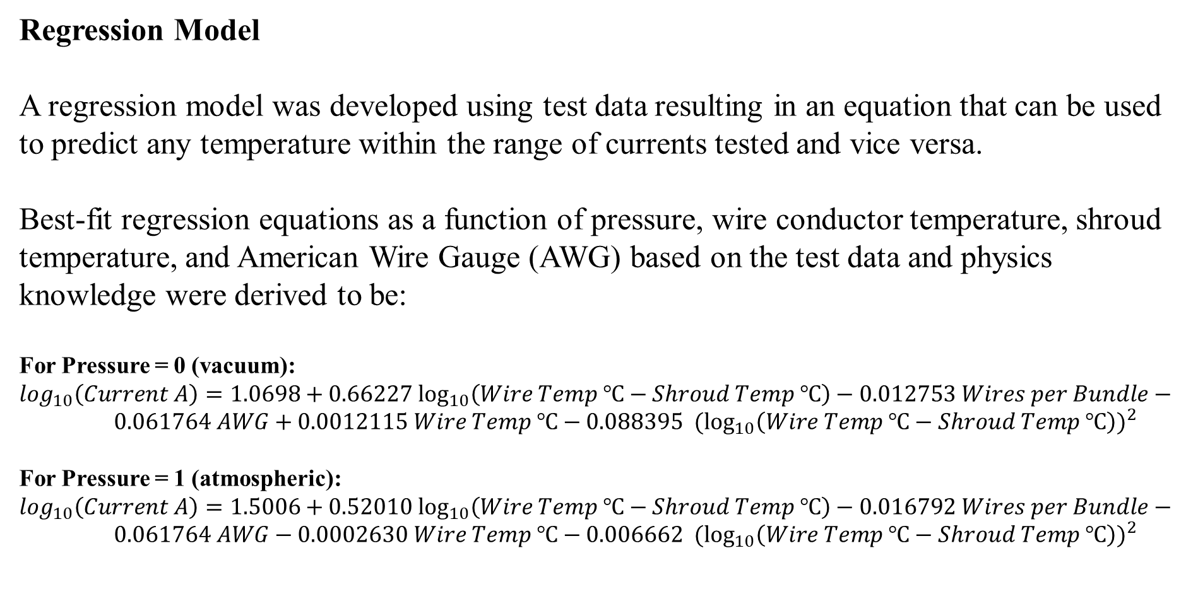
Regression Model
A regression model was developed using test data resulting in an equation that can be used to predict any temperature within the range of currents tested and vice versa.
Best-fit regression equations as a function of pressure, wire conductor temperature, shroud temperature, and American Wire Gauge (AWG) based on the test data and physics knowledge were derived to be:
For Pressure = 0 (vacuum):
$\log_{10}\left(Current A\right)=1.0698+0.66227\log_{10}\left(Wire Temp ℃−Shroud Temp ℃\right)−0.012753 Wires per Bundle−0.061764 AWG+0.0012115 Wire Temp ℃−0.088395 {{ (log}_{10}\left(Wire Temp ℃−Shroud Temp ℃\right))}^{2}$
For Pressure = 1 (atmospheric):
$\log_{10}\left(Current A\right)=1.5006+0.52010\log_{10}\left(Wire Temp ℃−Shroud Temp ℃\right)−0.016792 Wires per Bundle−0.061764 AWG−0.0002630 Wire Temp ℃−0.006662 {{ (log}_{10}\left(Wire Temp ℃−Shroud Temp ℃\right))}^{2}$
.

Slide 15
Regression Model (continued)
At 200 °C, the model overpredicted the test data by less than 0.1 A on average with root mean square (RMS) error less than 0.2 A.
This equation could thus be used to predict ampacity of the wires in this test. The model is imperfect; as is, it assumes for instance that there is a smooth function between using one wire and a bundle of 32.
Bias between the regression model and SAE AS50881G’s Table 3 calculation for any particular condition depended on environment temperature and AWG.
The range of biases was approximately ±1 A for single 20, 22 and 26 AWG wires at atmospheric pressure and environment temperatures between -50 and 200 °C. SAE AS50881G Table 3 tended to slightly underpredict single wire 200 °C test data.
Though a rigorous comparison was not performed during this study, AS50881G predictions for the 32-wire data appear to be quite conservative as compared to test data.
.

Slide 16
Concluding Remarks
The results of the present study strongly support further model development and validation testing, which will allow the model to provide significant insight into wire bundle current carrying capacity design and to replace published wire derating standards.
Based on limited testing and analysis conducted during this pathfinder study the assessment team concluded both the response surface model and physics-based thermal model developed during this assessment correlate with the pathfinder test data and single-wire estimates from SAE AS50881G.

Slide 17
Acknowledgements
The authors thank Dr. Elham Maghsoudi, Ms. Subha Comandur, Ms. Antonietta Conte, Ms. Emma Nelson, and Mr. Anthony Bautista, of the NASA-Jet Propulsion Laboratory, Dr. Christopher J. Iannello of the NESC, Dr. Daniel Wentzel of the NASA-White Sands Test Facility, Mr. George Slenski of AMA, and Mr. Thomas Evans of Millennium Engineering and Integration Co. for their contributions to this study.

Slide 18
References
Spacecraft Design and Fabrication Requirements for Electronic Packaging and Cabling, JPL D-8208, Rev. I, Section 3.12, 2002.
SAE International 2019 AS50881™G Wiring Aerospace Vehicle (Warrendale, PA, USA: SAE International).
Rickman, S L, et al., Re-Architecting the NASA Wire Derating Approach for Space Applications, NASA/TM-2018-220114, November 2018, pp. 77-88.
The Society of Plastics Industry, Inc. 2015 Fact Finding Report on Power over Local Area Network Type Cables (Washington, DC: The Society of Plastics Industry, Inc.).
Rickman, S L, Iannello, C J, Heat Transfer Analysis in Wire Bundles for Aerospace Vehicles, WIT Transactions on Engineering Sciences, Vol. 106, 2016, pp. 55-63.

