Slide 1
NASA’s Space Life Sciences Training Program
(SLSTP)
November 6, 2021
American Society for Gravitational and Space Research (ASGSR)
Elizabeth Keller (KBR) for Sigrid Reinsch (NASA ARC)

Slide 2
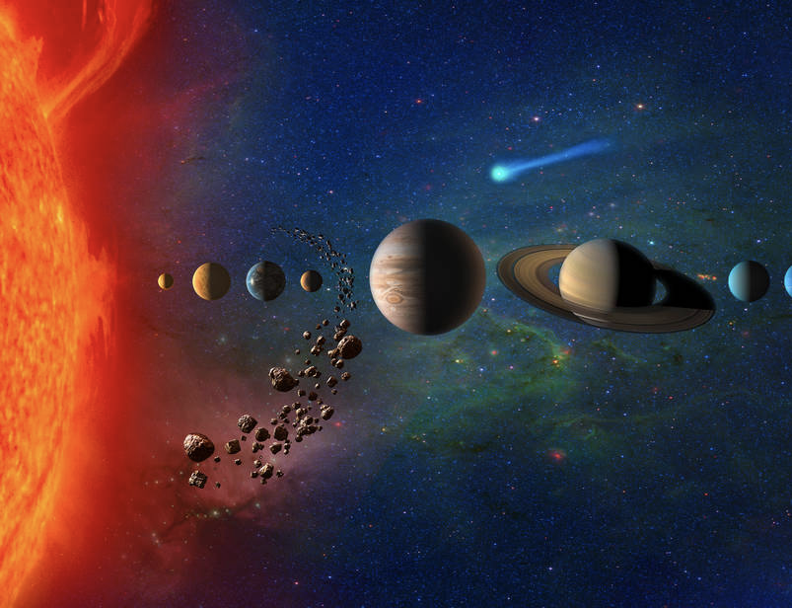
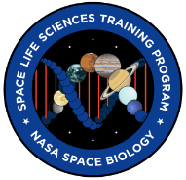
SLSTP
Program Goal: “to inspire the next wave of space biologists and engineers early in their academic and professional careers”
Notes:
The NASA Space Life Sciences Training Program (SLSTP) provides undergraduate students entering their junior or senior years with professional experience in space life science disciplines. Students work closely with NASA scientists and engineers on cutting-edge research and technology development. SLSTP participants are exposed to a broad scope of space biosciences research performed by NASA scientists. While learning about the tools and methodology that enable biological experiments to be conducted in flight, students acquire skills and knowledge required for the design and execution of life science research conducted in microgravity.
2020 was held virtually
Applications for 2021 are now open and will be held virtually

Slide 3
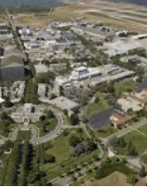
SLSTP at NASA Ames 2013-2019 + Virtual 2020-21
Fully funded program – Research Associates (RAs) receive a stipend and reimbursement of travel/conference costs
10 weeks during summer
10 students per year (most years)
Selected on a competitive basis
Mentor-guided research (80%), team project (20%)
Research and technology development experience
Lectures, professional development, and tours
Notes:
To train the next generation of scientists and engineers, enabling NASA to meet future research and development challenges in the space life sciences
10 week summer program
(virtual – 2020, 2021)
networking opportunities with NASA scientists/engineers, Space Biology community, academia, industry, SLSTP alumni, etc
direct mentorship with NASA scientists on individual research project
professional development
opportunities to expand skillset
group research project/team building opportunities
publication opportunities
field trips and tours
(virtual – 2020, 2021)
exposure to NASA culture
Stipend
Housing and travel allowance (2013-2019)

Slide 4
Who do we recruit?
STEAM majors including:
Life Sciences
Chemistry
Engineering
Math
Physics
Computational Science
Notes:
To train the next generation of scientists and engineers, enabling NASA to meet future research and development challenges in the space life sciences
10 week summer program
(virtual – 2020, 2021)
networking opportunities with NASA scientists/engineers, Space Biology community, academia, industry, SLSTP alumni, etc
direct mentorship with NASA scientists on individual research project
professional development
opportunities to expand skillset
group research project/team building opportunities
publication opportunities
field trips and tours
(virtual – 2020, 2021)
exposure to NASA culture
Stipend
Housing and travel allowance (2013-2019)

Slide 5
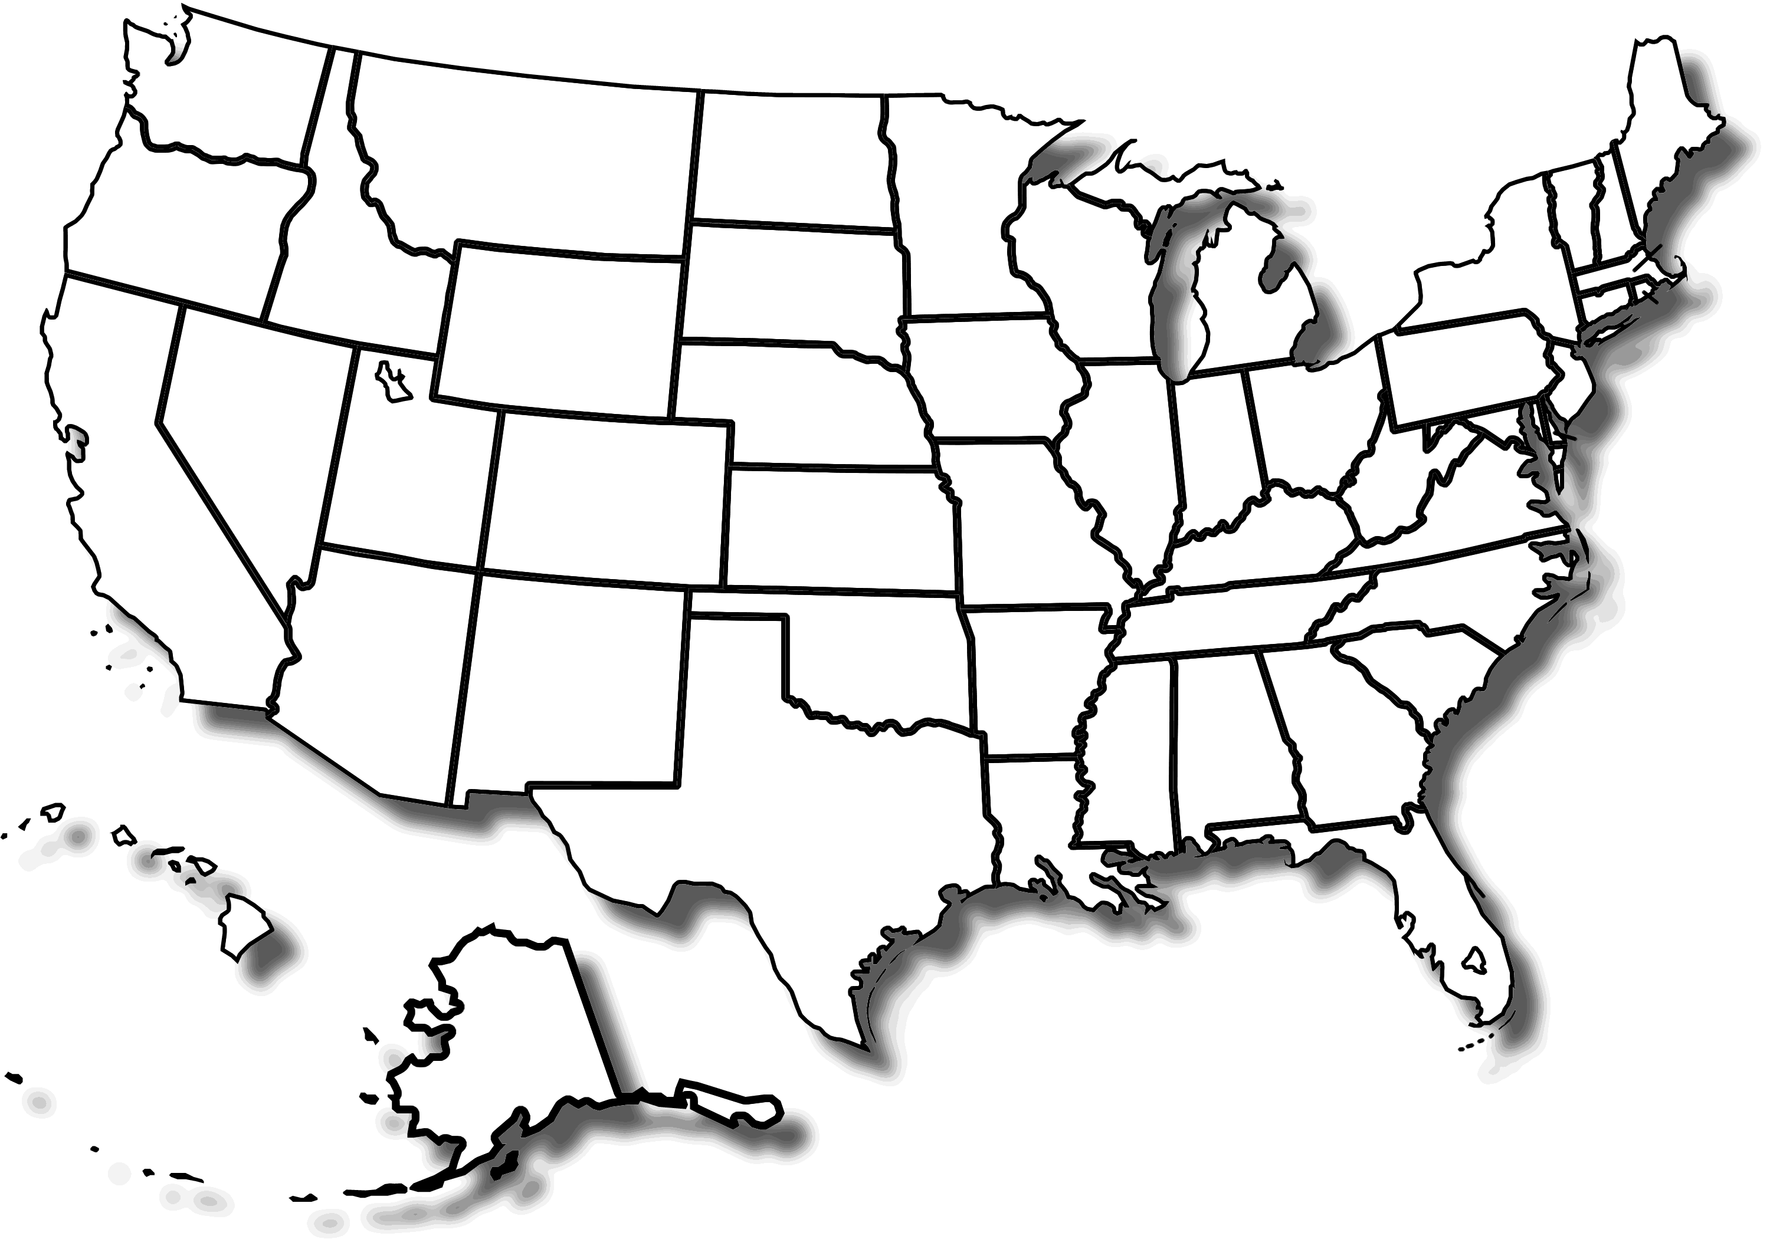
Universities and Colleges
SLSTP at NASA Ames since 2013
101 students from 64 different Universities in 28 U.S. States
Arizona State University (3)
Binghamton University
Brooklyn College
Carnegie Mellon University
Clemson University
College of Mount Saint Joseph
Columbia University
Cornell University (3)
CUNY City College, New York
Embry Riddle Aeronautical University (3)
Florida State University (2)
Georgia Institute of Technology
Harvard University (2)
Johns Hopkins University
Kent State University
Louisiana State University
Massachusetts Institute of Technology (3)
Michigan Technological University
Mitchell Community College
North Carolina State University
Northwestern University (IL)
Oakland University (2)
Ohio State University
Oregon State University
Pacific University
Point Loma Nazarene University
Pomona College (2)
Purdue University
San Diego State University
San Jose State University (3)
Stony Brook University
Temple University
Tufts University (2)
University of Alabama
University of Arizona
University of California - Los Angeles (3)
University of California Berkeley (6)
University of California Davis
University of California San Diego (2)
University of California Santa Barbara (2)
University of California Santa Cruz
University of Chicago
University of Colorado - Boulder (2)
University of Colorado Denver
University of Florida
University of Houston
University of Kentucky
University of Maine
University of Maryland Baltimore County
University of Maryland College Park
University of Michigan
University of Minnesota Twin Cities
University of Missouri-Columbia
University of Nebraska
University of New Mexico
University of Pennsylvania (2)
University of Pittsburg
University of San Francisco
University of Texas - Dallas
University of Utah
Vassar College (NY)
Washington University
Wesley College
Yale University (2)
1
1
1
3
6
6
1
1
4
2
1
1
1
2
21
2
2
1
1
1
4
1
1
1
1
1
3

Slide 6
Demographics from voluntary survey at application website

Slide 7
Year | Female RAs | Male RAs | Total number of RAs
2013 | 1 | 5 | 6
2014 | 4 | 8 | 12
2015 | 4 | 6 | 10
2016 | 4 | 7 | 11
2017 | 7 | 3 | 10
2018 | 10 | 2 | 12
2019 | 6 | 4 | 10
2021 | 7 | 4 | 11
Totals | 37 | 34 | 101

Slide 8
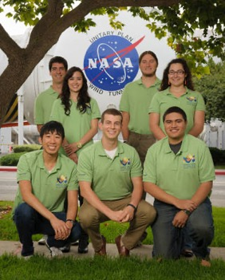
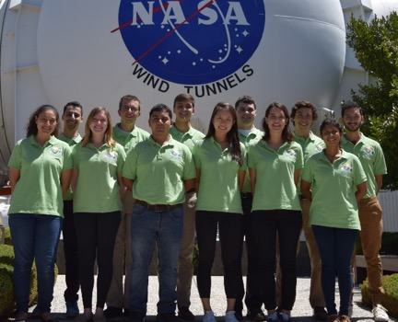
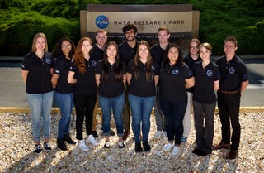
SLSTP at NASA Ames since 2013
2013
2014
2015
2016
2017
2018
2019

Slide 9
SLSTP Virtual!
4 time zones!
SLSTP 2020 Cohort

Slide 10
Space Life Sciences Training Program (SLSTP)
2021 Cohort
Project | Mentor | Code | RA | University | Major
Conservation of Stress Response Genes Versus Metabolism in Spaceflight Relevant Microbes | Jared Broddrick | SCR | Iris Irby | University of Florida | Microbiology
BioSentinel and Other New Space Biology Technologies | Sergio Santa Maria | SCR | Bijan Harandi | Tufts University | Biology
BioSentinel and Other New Space Biology Technologies | Sergio Santa Maria | SCR | Nick Syracuse | North Carolina State University | Biochemistry
Changes in Cognitive Performance and Behavior Induced by Spaceflight-like Environment | Stephanie Puukila | SCR | Olivia Siu | Embry-Riddle Aeronautical University (FL) | Aerospace Physiology
Microbes in Microgravity: Stress Response and Population Dynamics | Jessica Lee | SCR | Rocky An | Cornell University | Mechanical Engineering
Microbial Bioinformatics Toolkit: GeneLab and Outreach Applications | Jessica Lee | SCR | Katie Blackwell | University of Texas - Dallas (undergrad) | Biochemistry
Space Systems Biology | Jonathan Galazka | SCR | Alicia Gibbons | University of California - Los Angeles | Micro, Immuno, Mol Gen
Neuroimmune Outcomes of Deep Space Radiation | Egle Cekanaviciute | SCR | Kristina Sattler | College of Mount Saint Joseph (undergrad) | Biology
Microbial Factories for Solar System Exploration | John Hogan | SCB | Amy Rees | Clemson University | Biology
Data Collection and Analysis for Biosignature Studies | Diana Gentry | SGE | Tao Sheng | University of Pittsburgh | Computational Biology
Experimental Evolution in the Spaceflight Environment | Craig Everroad | SSX | Nadjet Cornejal | Brooklyn College | Biology
Staffer | Sergio Santa Maria | SCR | Simon Ng | University of California-Los Angeles | Bioengineering
Staffer | Diana Ly | SC | Ama Luthens | University of Colorado-Boulder | Neuroscience
Time Zone
EDT
MDT
PDT
CDT/EDT
10

Slide 11
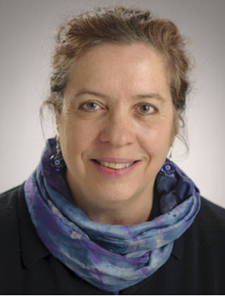
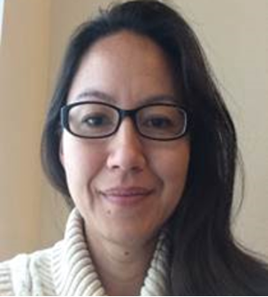
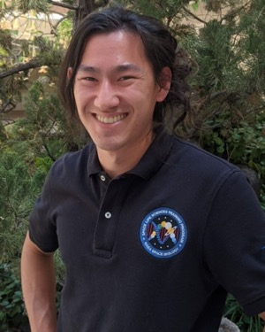
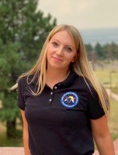
SLSTP Team
Management
Director: Sigrid Reinsch, Ph.D.
Hami Ray, Ph.D. Desi Bridges
Staffers
Simon Ng Amalia Luthens
Kim Cadmes Elizabeth Keller
50% SLSTP student management, 50% individual research
Notes:
Add pictures to slide?

Slide 12
Program Components

Slide 13
Research
80% Individual Mentor
20% Team Project

Slide 14
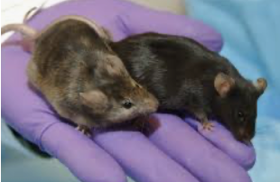

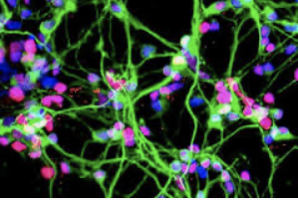
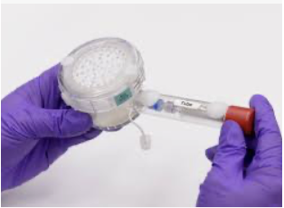
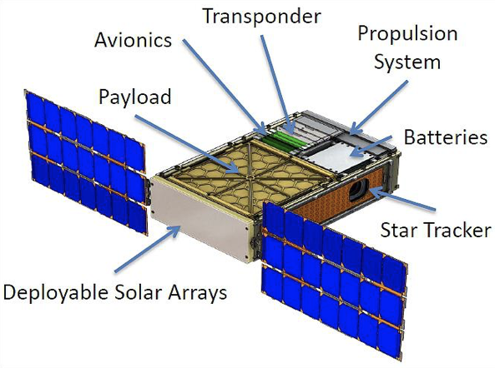

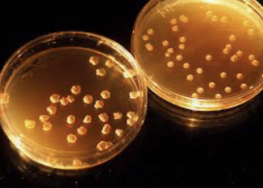
Life Detection
Research Areas
2021
Behavior Analysis
Synthetic Biology
Neuro-Immunology
Microbial Biology and Modeling
Space Systems Biology
Payload Development

Slide 15
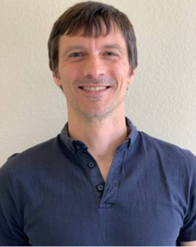
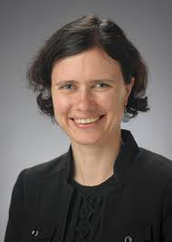
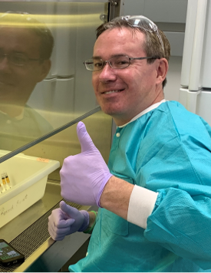
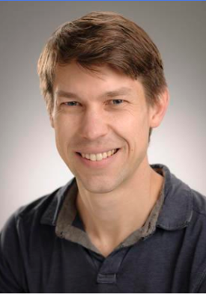
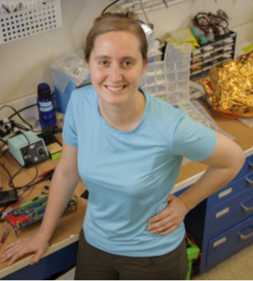
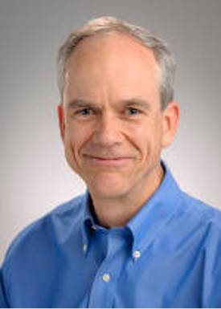
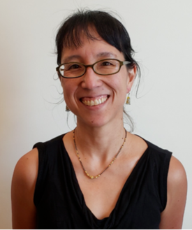
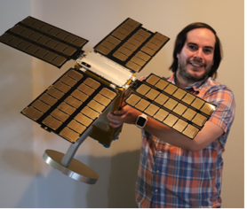
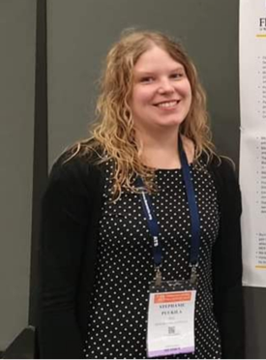
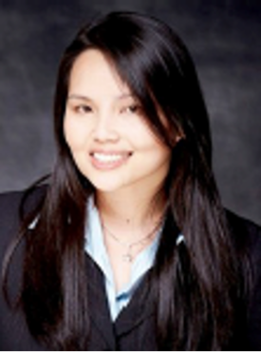
SLSTP 2021 Mentors
Jared Broddrick
Egle Cekanaviciute​
Craig Everroad
Jonathan Galazka
Diana Gentry
John Hogan
Jessica Lee
Sergio Santa Maria
Stephanie Puukila
Diana Ly
Sergio Santa Maria

Slide 16
Program Requirements
Midterm Oral Presentation
Final Oral Presentation
Final Paper in the form of a scientific journal manuscript
Submission of an abstract to a scientific conference
Group project proposal/paper

Slide 17
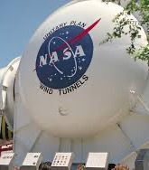
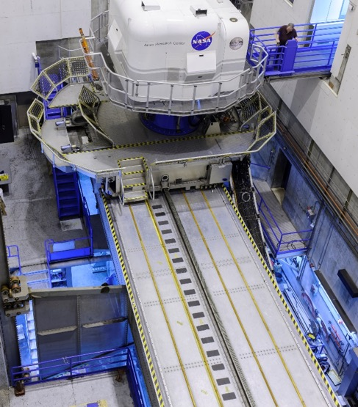
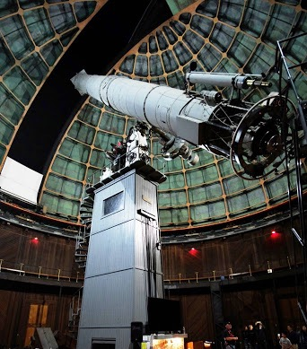
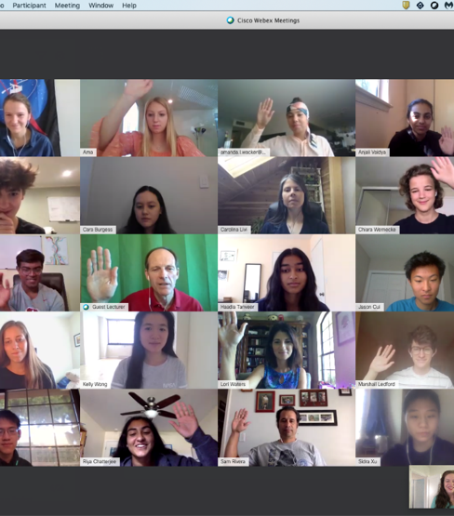
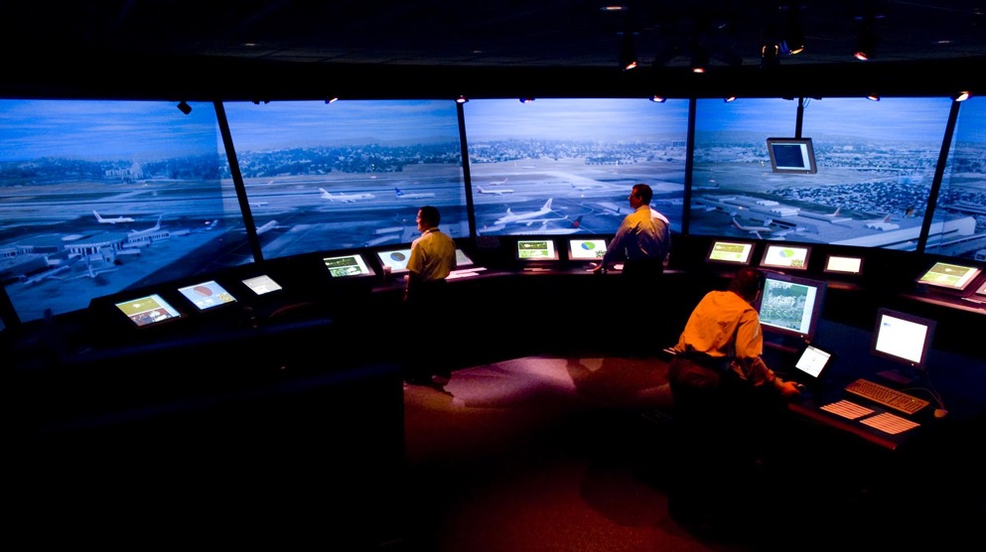
SLSTP Virtual Tours
Virtual Motion Simulator
Future Flight Central
Arc Jet
Wind Tunnels

Slide 18
SLSTP Professional Development
Preparing students for the STEM workforce
​
​
SLSTP aims to prepare students (post-internship) in the following areas:​
Pursuing a Career in Space Biology​
Communicating effectively orally and digitally​
Taking on leadership roles​
Asking Relevant Questions​
Cooperating as an Active Team Member​
Presenting Oneself Professionally​
Seeking Opportunities Outside of Comfort-Zone​
Thinking Critically about Space Biology Concepts​
Expanding Research & Acquire New Skills​
Public Speaking
Proposal Writing Tips
Midterm/Final Presentations
Presentation Tips
Networking
CV Guidance
Mentorship

Slide 19
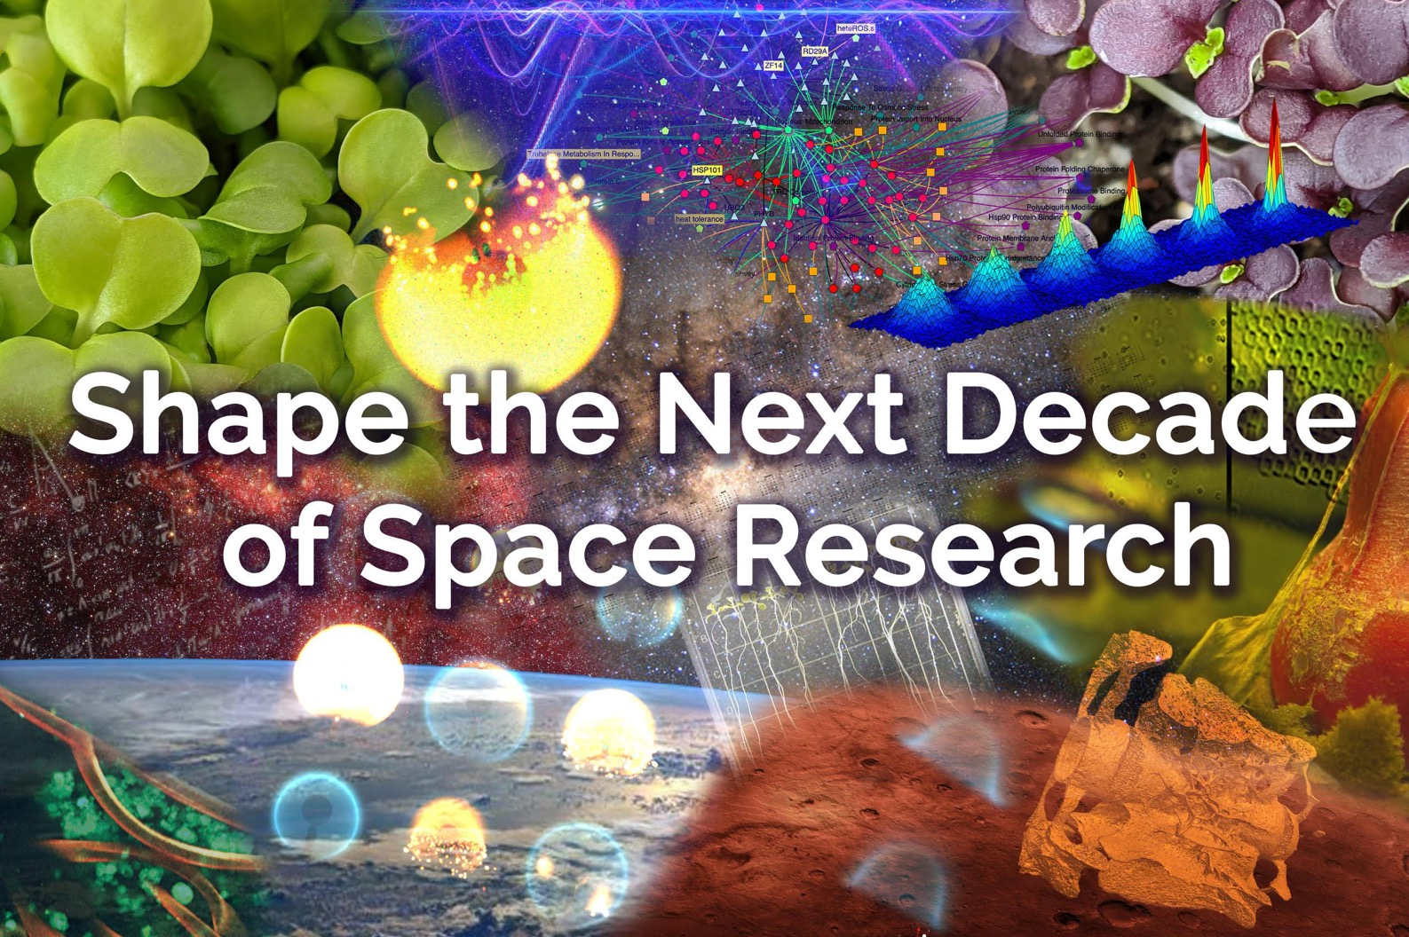
SLSTP 2021 Group Project

Slide 20
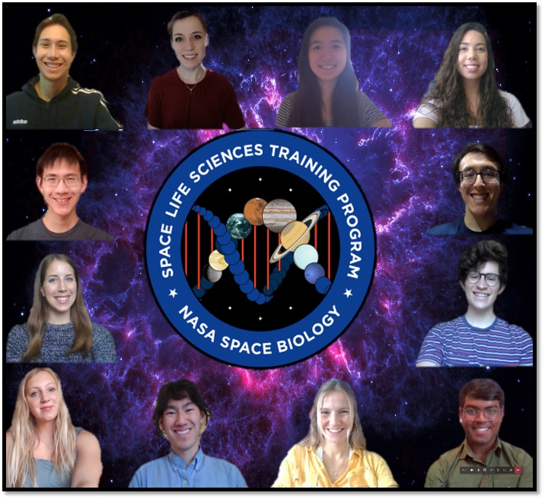

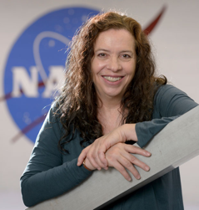
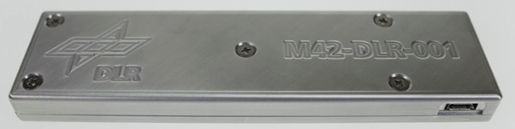
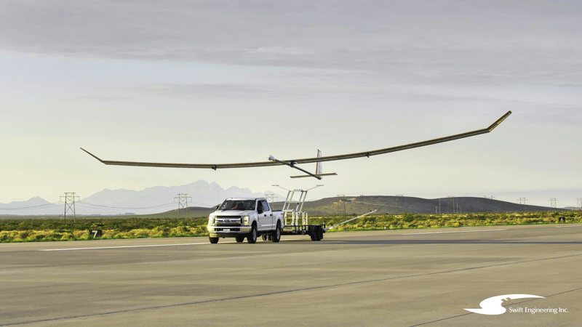
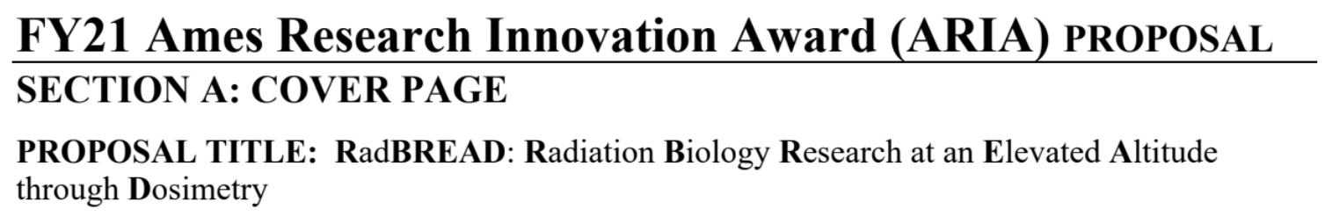
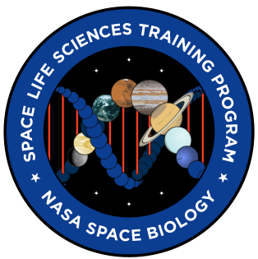
Summer 2020 Virtual – funded project now in development for 2022 flight
$
+Biology?
M42: Ionizing radiation dosimeter
(i.e. galactic cosmic radiation)
Notes:
also Group project: opportunity to collaborate as cohort during our brief NASA internships
Summer 2020 we students put together a plan and *submitted ARIA grant proposal, which we were awarded*! Buuut, we found out in March, half a year after the summer internship ended. Only some students could continue working, school, jobs.
Suffice to say, threw a $50k pizza party for those of us who stayed on
Dosimeter image modified from The German Aerospace Center M-42 radiation detector—A new development for applications in mixed radiation fields

Slide 22
SLSTP publications
RA | SLSTP YEAR | Mentor | Title | Journal | Year
Ada Kanapskyte | 2020 | Santa Maria | Space Biology Research and Biosensor Technologies: Past, Present, and Future | Biosensors | 2021
Jordan McKaig | 2018 | Jon Rask (Group) | A High-Altitude Balloon Platform for Space Life Sciences Education | Gravitational and Space Research | 2019
Tristan Caro | 2017 | David Smith | Ultraviolet light measurements (280-400 nmg) acquired from stratospheric balloon flight to assess influence on bioaerosols | Aerobiologia | 2019
Tristan Caro | 2017 | David Smith | Sierra Nevada sweep: metagenomic measurements of bioaerosols vertically distributed across the troposphere | Scientific Reports | 2020
Ons M'Saad | 2017 | Schreurs | Dietary countermeasure mitigates simulated spaceflight-induced osteopenia in mice | Scientific Reports | 2020
Nicole Tanenbaum | 2019 | Bhattacharya | Asparagine Biosynthesis as a Mechanism of Increased Virulence of Serratia marcescens in Simulated Microgravity Environments | iScience (in review)
Ama Luthens | 2020 | Rubenstein | The effects of simulated microgravity and Placental-Expanded (PLX-PAD) stromal cell treatment on the behavior and correlation with cytokine profiles in female mice | (pending - to be submitted)
Elizabeth Talburt | 2018/19 | Chakravarty | Temporal RNA Integrity Analysis of Archived Spaceflight Biological Samples | Gravitational and Space Research | 2020
Anna Hayden | 2015 | Delzeit | Development of the Continuous-fill Brine Evaporation Bag (BEB) System | 46th International Ceonference on Environmental Systems | 2016
Caleb Felker | 2014 | Delzeit | Development of the Continuous-fill Brine Evaporation Bag (BEB) System | 47th International Ceonference on Environmental Systems | 2017

Slide 23
Alumni Quotes
“This experience has changed my life forever. Being able to pursue one of my dreams working for NASA, has completely changed my career trajectory. This program really gave me the opportunity to see myself doing space science for a career--something I thought was unattainable before, so thank you!”
“SLSTP is the only reason I had the privilege of getting into space biology. It changed my life and made me excited to be in research.”
“Best experience during my undergraduate career. I've been looking to get back to a research position at NASA because of it.”
“The research element of SLSTP, as well as the field trips to JPL, the USS Hornet, Armstrong etc. made this a summer to remember, and I can only hope that the program expands to other NASA centers.”
“Overall one of the best research experiences I have had. I learned a lot about NASA and potential careers. This experience has helped guide me into what I will be researching in graduate school at Michigan State University”

Slide 24
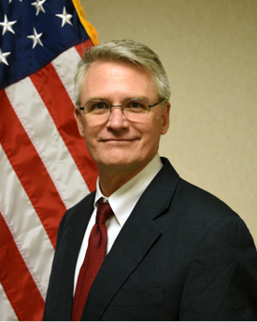
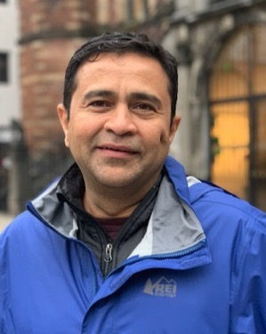
Funding
NASA Space Biology Program
Ames Space Biology Management
Robert Vik Diana Ly Parag Vaishampayan, Ph.D.
https://science.nasa.gov/biological-physical/programs/space-biology
Notes:
Add pictures to slide?

