Slide 1


RadBREAD: Radiation Biology Research at an Elevated Altitude through Dosimetry
A student-designed payload
Simon Ng (SLSTP 2020)
for
Sigrid Reinsch
NASA Ames Research Center
November 5, 2021
Notes:
Hi Friends!
Good afternoon.
In fact, not Dr. Sigrid Reinsch.
Simon Ng, was part of the summer 2020 Space Life Sciences Training Program cohort that initiated this project, still working on it now, 1.5 years later along with some other students in the crowd. Graduated UCLA bachelors in bioengineering and environmental engineering
Student project, RadBREAD, radiation biology research at an elevated altitude through dosimetry.
Designing microbial experiment and building hardware for a novel high-altitude aircraft to study effects of radiation and a mars-analog environment.

Slide 2
Swift
Project background
Mars analog
Science payload
Carrier
  Heating?
Future directions
Acknowledgements
Notes:
Mental break from lightening fast science

Slide 3
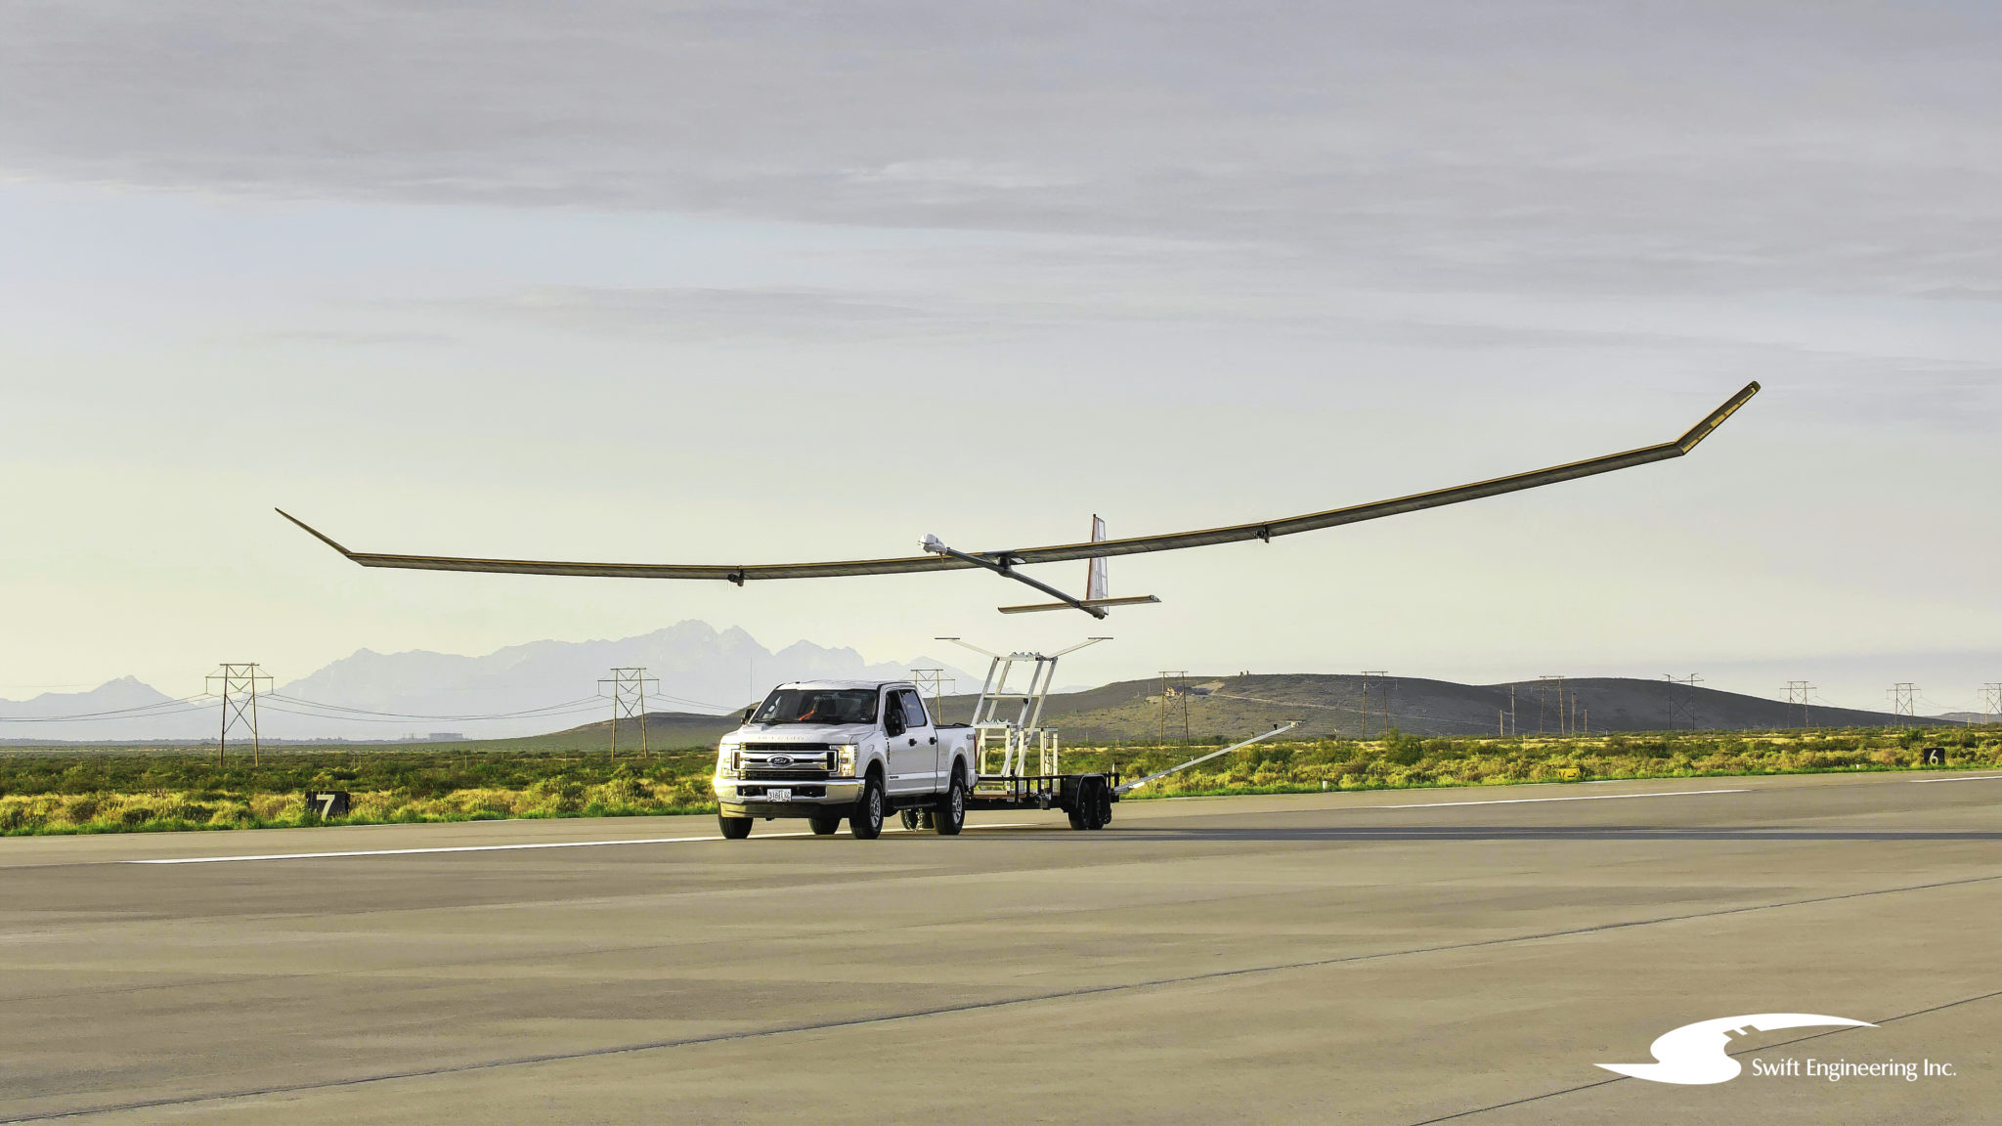
Swift Engineering Inc.’s aircraft
High altitude long endurance unmanned aerial system (HALE UAS)
Altitude: Stratosphere (~21 km, ~70000 ft)
Duration: ~2 weeks
Small space for secondary payload in wing
15 lb primary payload
in nose
Solar powered
Notes:
start w vehicle, HALE UAS
Flies in stratosphere, 21km altitude, or 70000 ft, twice altitude of commercial airplanes most of us got to this conference on
Very light, solar powered, so it can stay in the sky for up to 2 weeks
Room for payload in the nose, for our flight, taken up with a wildfire spotting camera from forest service. But also small space where wing connects to body that we convinced Swift to let us try putting a small piggyback payload into.
image from https://swiftengineering.com/american-made-swift-high-altitude-long-endurance-uas-completes-landmark-first-flight/

Slide 4

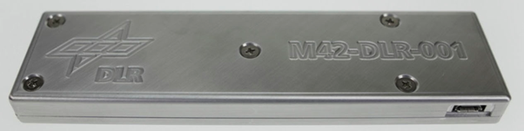
NASA Ames Space Life Sciences Training Program gets involved
M42: Ionizing radiation dosimeter
(i.e. galactic cosmic radiation)
Notes:
Is a student payload, so feel need to explain how this came about.
Plans to fly ionizing radiation dosimeter (M42 being used for Artemis missions) as secondary payload, collaboration with Germany Aerospace Center (DLR), *seemed like good opportunity to fly biological samples to correlate with the radiation data. Little bonus for the dosimeter data.
Dosimeter image modified from The German Aerospace Center M-42 radiation detector—A new development for applications in mixed radiation fields

Slide 5
NASA Ames Space Life Sciences Training Program gets involved
+Biology?
M42: Ionizing radiation dosimeter
(i.e. galactic cosmic radiation)
Notes:
Plans to fly ionizing radiation dosimeter (M42 being used for Artemis missions) as secondary payload, collaboration with Germany Aerospace Center (DLR),*
seemed like good opportunity to fly biological samples to correlate with the radiation data. Little bonus for the dosimeter data.*
Sigrid Reinsch, program director of NASA Ames Space Life Sciences Training Program, suggested the 2020 cohort take on the challenge as our group project.
Dosimeter image modified from The German Aerospace Center M-42 radiation detector—A new development for applications in mixed radiation fields

Slide 6
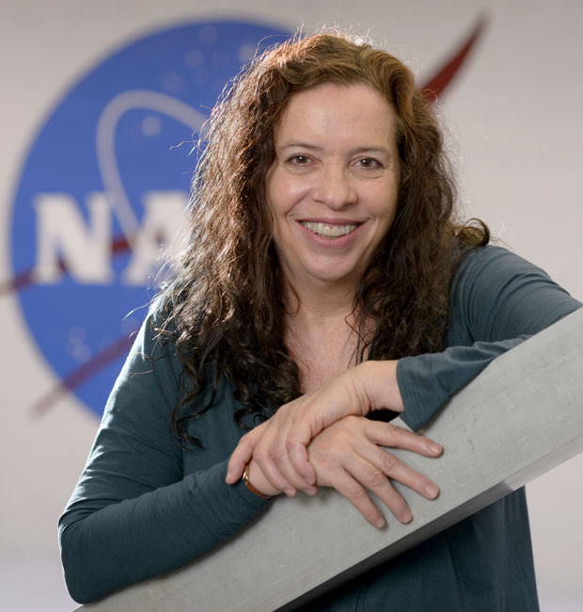

NASA Ames Space Life Sciences Training Program gets involved
+Biology?
M42: Ionizing radiation dosimeter
(i.e. galactic cosmic radiation)
Summer 2020 internship
Notes:
brought up possibility of flying biological samples to correlate with the radiation data.*
Sigrid Reinsch, program director of NASA Ames Space Life Sciences Training Program, suggested the 2020 cohort, virtual btw, take on the challenge as our group project.
SLSTP a dozen undergraduate students from around the country each get paired with NASA Ames mentor for summer research.*
Group project: freeform opportunity to collaborate as cohort during our brief NASA internships
*Researched, talked with experts, submitted ARIA grant proposal, which we were awarded, in March, 6 months after the summer internship ended.
Tricky part, summer internship ends, people have school, jobs, other things to do. Some students wanted to continue, working with $50k and a flight deadline in 5 months. $50k pizza party
Dosimeter image modified from The German Aerospace Center M-42 radiation detector—A new development for applications in mixed radiation fields

Slide 7
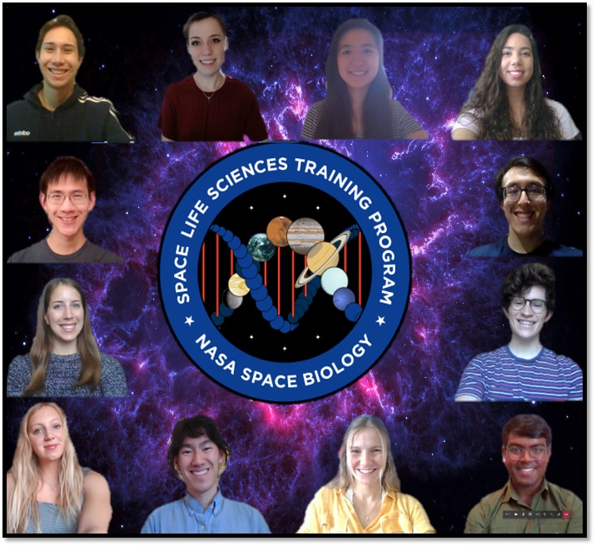
NASA Ames Space Life Sciences Training Program gets involved
+Biology?
M42: Ionizing radiation dosimeter
(i.e. galactic cosmic radiation)
Summer 2020 internship
Notes:
dozen undergraduate students from around the country each get paired with NASA Ames mentor for summer research.*
also Group project: opportunity to collaborate as cohort during our brief NASA internships
Summer 2020 we students put together a plan and *submitted ARIA grant proposal, and we were awarded!* Buuut, we found out in March, half a year after the summer internship ended
Dosimeter image modified from The German Aerospace Center M-42 radiation detector—A new development for applications in mixed radiation fields

Slide 8
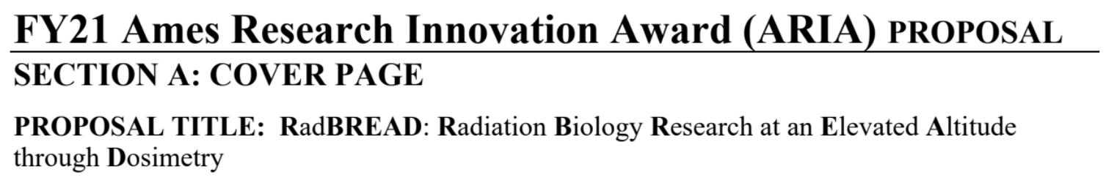
NASA Ames Space Life Sciences Training Program gets involved
$
+Biology?
M42: Ionizing radiation dosimeter
(i.e. galactic cosmic radiation)
Summer 2020 internship
Notes:
also Group project: opportunity to collaborate as cohort during our brief NASA internships
Summer 2020 we students put together a plan and *submitted ARIA grant proposal, which we were awarded*! Buuut, we found out in March, half a year after the summer internship ended. Only some students could continue working, school, jobs.
Suffice to say, threw a $50k pizza party for those of us who stayed on
Dosimeter image modified from The German Aerospace Center M-42 radiation detector—A new development for applications in mixed radiation fields

Slide 9
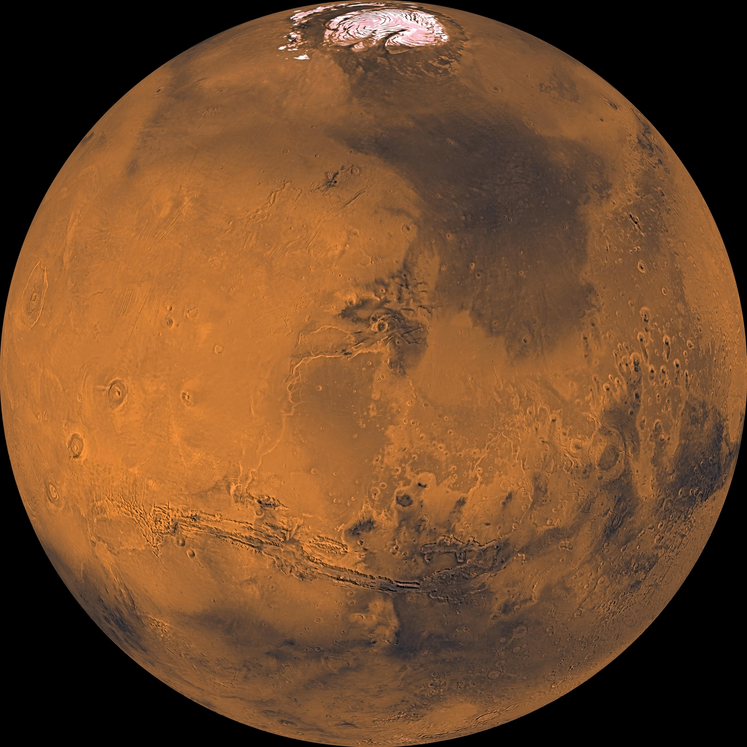
Stratosphere is Mars analog environment
Swift HALE UAS provides long duration access to low dose radiation, replicating Mars conditions.
Location | Earth: New Mexico | Swift: stratosphere | Mars: Gale crater
Temperature (ºC) | -4 to +35 | -80 to +20 | -70 to +20
Pressure (kPa) | 100 | 4 to 10 | 1
Ionizing radiation (mGy) | 0.08 | 1.8 | 3.1
UV (mW/cm²) | Low | 6 | 5
Notes:
Why it’s actually interesting to fly biology in stratosphere. Mars analog environment.
Table compares temperature, pressure, ionizing, and ultraviolet radiation on surface of earth, the stratosphere, and surface of Mars. Stratosphere and Mars are cold, low pressure, and high radiation, though ionizing radiation isn’t objectively that high compared to deep space, why we can’t use brookhaven beams like probiotic presentation before me. Beams can’t give that low level radiation.
Also why long duration aircraft is useful, low level, long duration, want to see effects.
Could be relevant for planetary protection, microbial biotech development
We get to design a microbial experiment for this mars analog stratosphere environment and also to construct payload carrier that can integrate into the Swift HALE aircraft, could to be used by other investigators for long duration access to mars analog environment
Familiar with MarsBox, Ames balloon experiment by David Smith; short duration in this environment, hours, rather than weeks.
table sources: https://docs.google.com/document/d/1KKIEAnFj5RocXnlUfs7v2LflPIuRKFw-/edit#heading=h.gjdgxs
MarsBox has slightly different mars #s: https://drive.google.com/drive/u/6/search?q=mars%20uv

Slide 10




Environmental and aircraft constraints
Low mass allowance: 0.5 kg
Cold: -80 to -20C
Limited dimensions, especially depth (1”)
High UV: 6 mW/cm²
Battery power only - no aircraft power available
Notes:
What are challenges of designing a science mission and payload carrier for our Mars-analog stratosphere environment?
We get to design our own biology experiment, the original goal, but also the carrier, which can be used beyond our own experiment for other Mars-analog research
Snowflake: https://www.clipartmax.com/middle/m2i8G6m2N4N4b1m2_hexagon-clipart-snowflake-snowflake-vector-transparent-background/
Feather simple: https://pixabay.com/vectors/feather-silhouette-sticker-clipart-2781343/
Ruler: https://www.cleanpng.com/png-ruler-portable-network-graphics-clip-art-computer-7052426/download-png.html
Battery: https://www.clipartmax.com/download/m2K9A0A0Z5i8K9G6_black-and-white-battery-clip-art-battery-coloring/

Slide 11
Science mission design
(2) FLIGHT
NO UV EXPOSURE
(3) FLIGHT
PARTIAL UV EXPOSURE
(1) GROUND
RED: Saccharomyces cerevisiae at different cell densities.
GREEN: Yeast at pre-flight optimal cell density
BLUE: Yeast pre-treated with L-ascorbic acid, a potential antioxidant countermeasure
Stressors: Desiccation
Stressors: Desiccation,
low temperatures, low pressures, ionizing radiation
Stressors: Desiccation, low temperatures, low pressures, ionizing radiation, UVA + UVB
Notes:
Reward for staying this long, tell you what we’ve actually planned and done
Fly desiccated S cerevisiae, so looking at recovery post-flight
Pre-flight ground testing to determine expected optimal plating density, but want to confirm optimal density for future missions with varying density.
L-ascorbic to provide desiccation protection, aid with the stress response
Ground control, as well as plates with and without UV shielding. Each plate is exposed to compounding levels of stress, from desiccation, to low temp and pressure and ionizing radiation, to UV radiation too
Survival and growth curve assays
Expect more heavily exposed samples to have lower survival and slower growth. Freeze most samples immediately after landing to decide best assays given results of survival and growth assays, could include transcriptomics, expect to see upregulation of DNA damage repair
RED: WT at different cell densities. To determine the optimal amount of yeast needed for post-flight analysis. Survival/growth curve results from these samples will be useful in designing future yeast experiments on the HALE UAV. Note: the number of wells devoted to this section will likely be reduced.
GREEN: WT yeast at optimal density determined during pre-flight tests.
BLUE: WT yeast at optimal density determined during pre-flight tests and pretreated with L-ascorbic acid. To test a potential countermeasure against stressors. Expect to see increased survival since antioxidants will help with surviving desiccation process as well as protect the yeast from free radicals generated from ionizing radiation at high altitudes. (Beyer, Saffi et al. 2013, Branduardi et al. 2007)
Comparing data from plates (1) vs (2)/(3) will tell us the effects of the stratosphere environment as a whole.
Comparing data from plates (2) vs (3) will isolate effects of UV exposure.

Slide 12
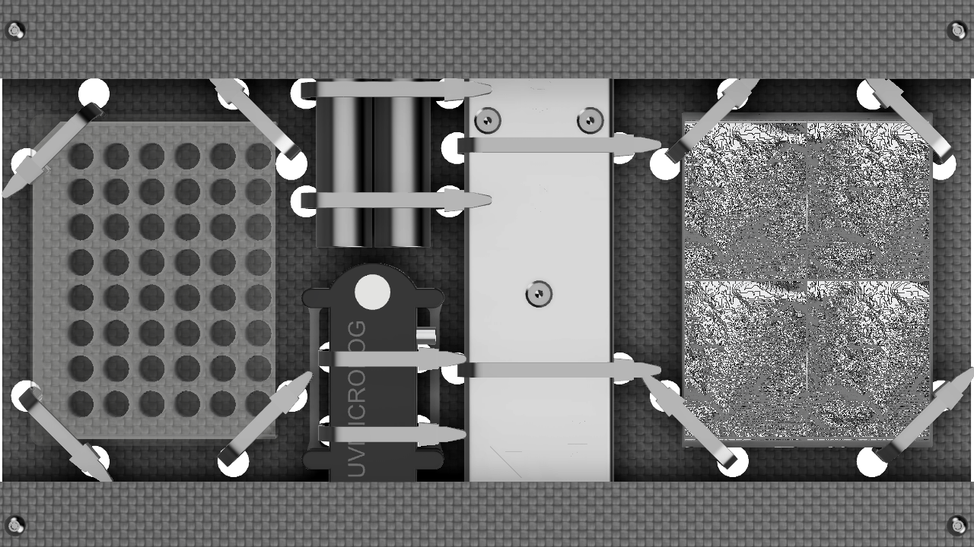
Payload layout
(3) Partial UV exposure
(2) No UV exposure
M42C ionizing radiation dosimeter
UV microloger
Notes:
M42 ionizing radiation dosimeter from DLR, also commercial UV microloger so we capture full radiation data

Slide 13
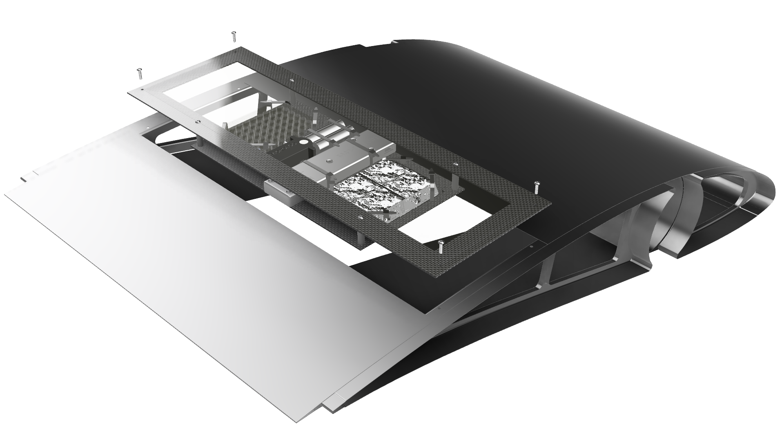
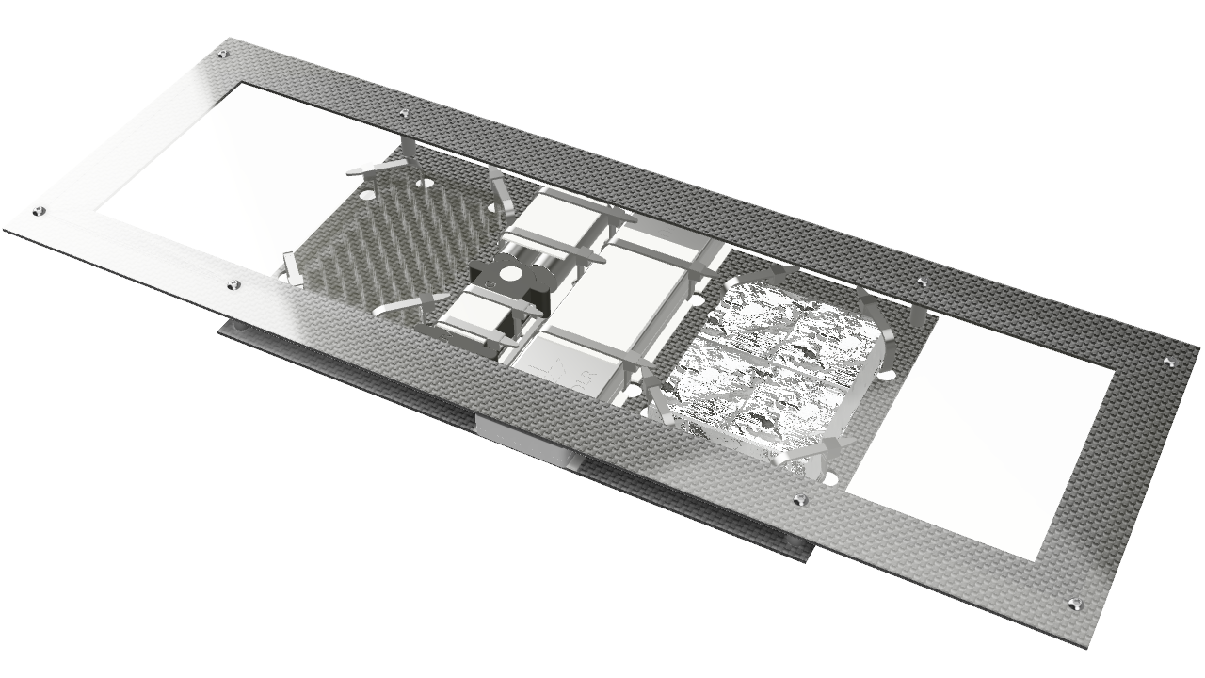
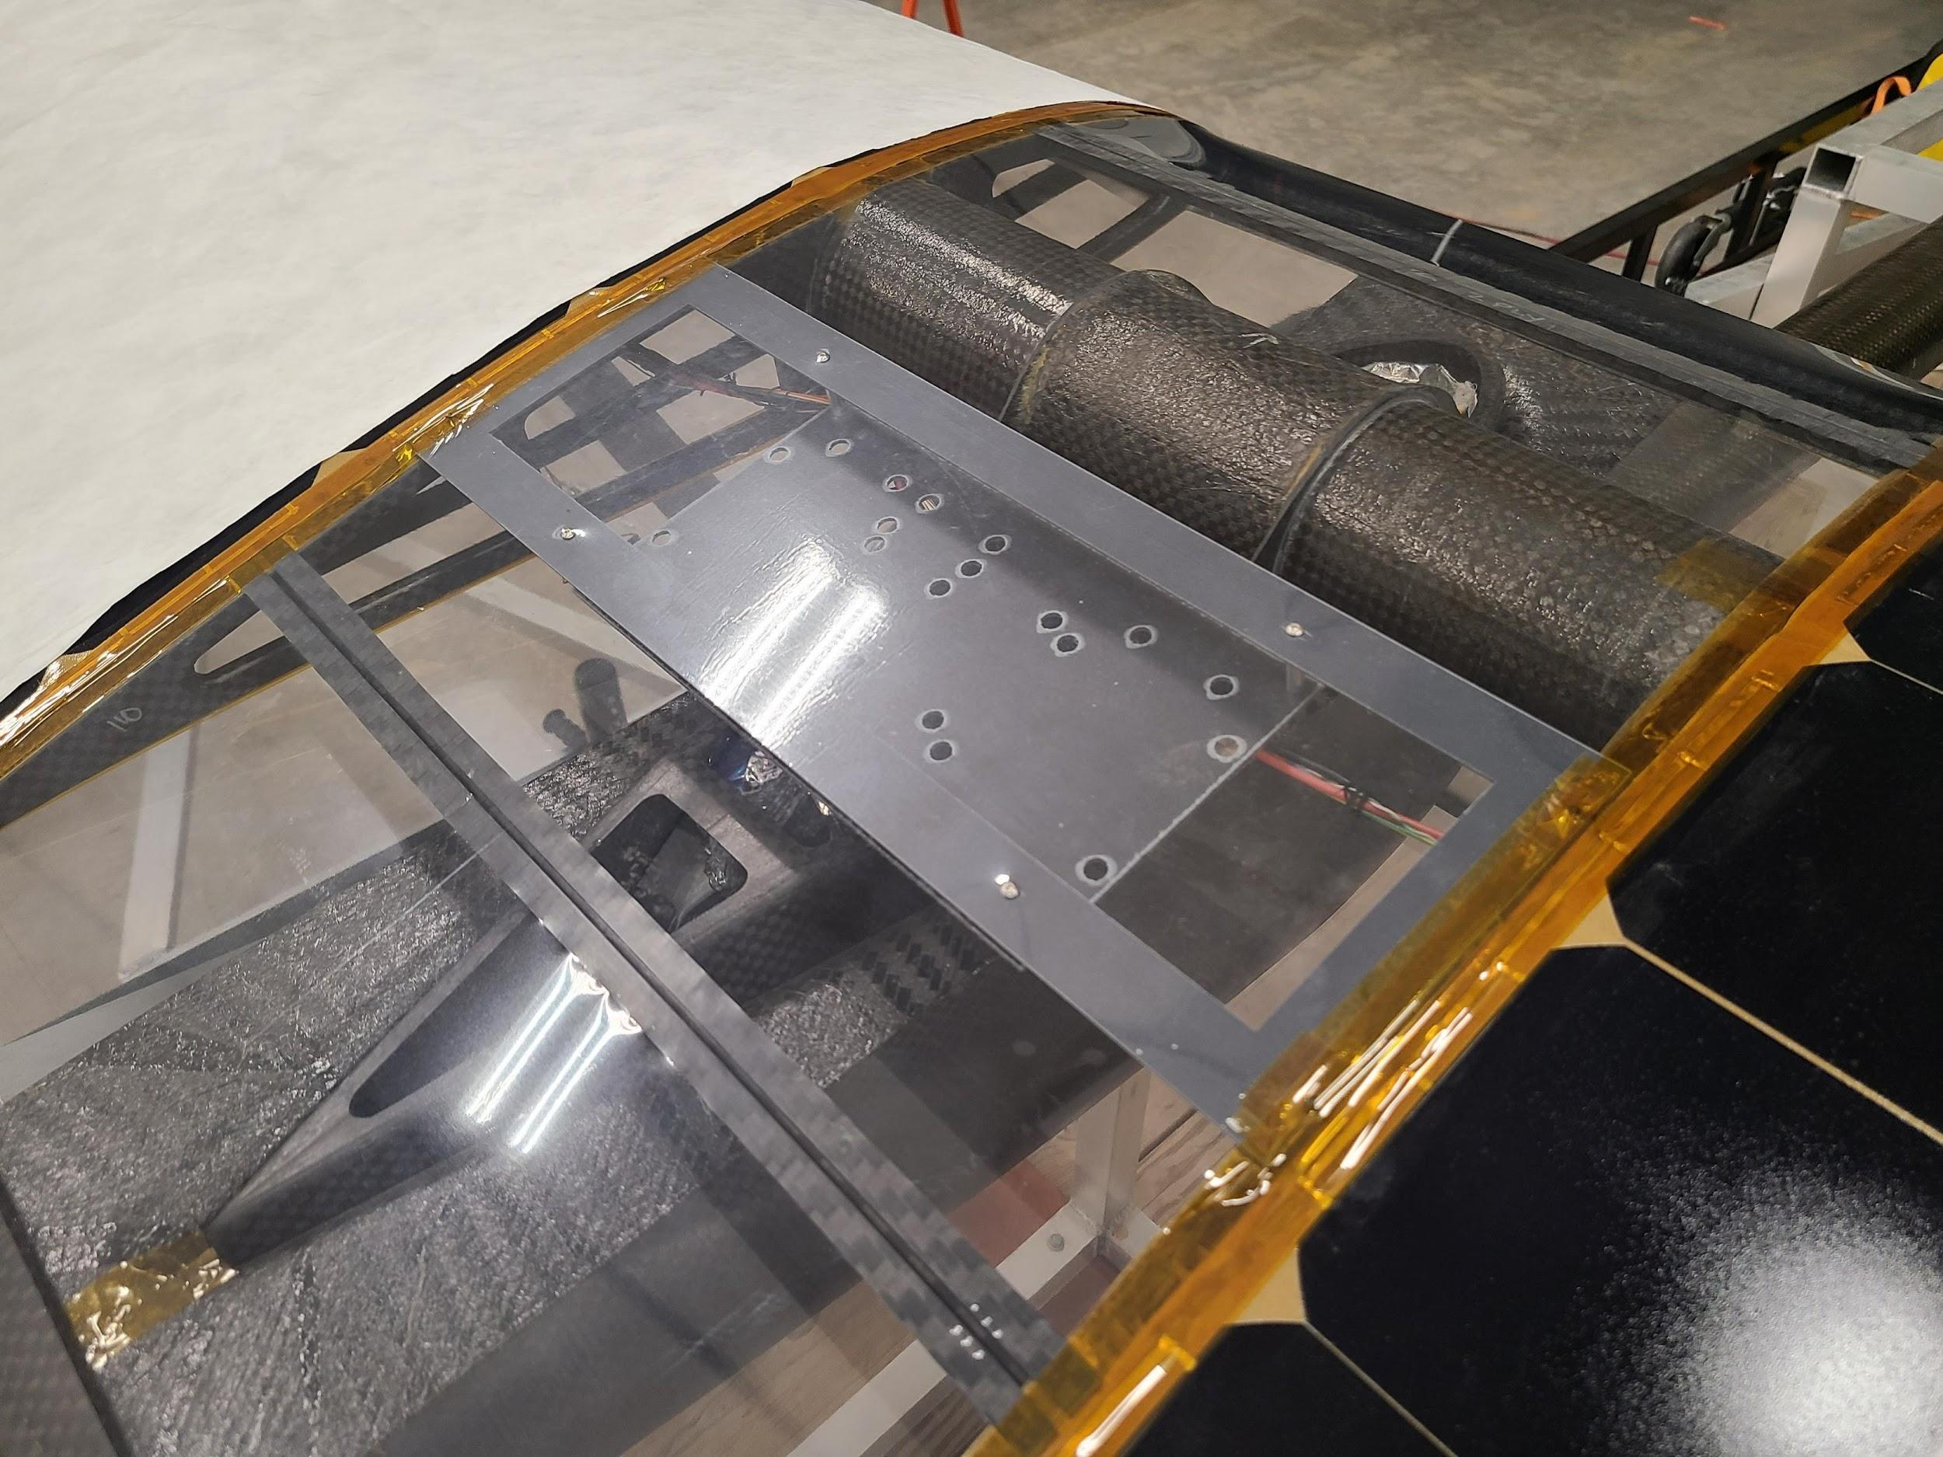
Payload carrier - integrates science with aircraft
Aerogel insulation
HALE aircraft
Aluminum standoffs
18”
Screw-connections
to aircraft
UV-transmissible
acrylic
Steel
cable ties
6”
Carbon
fiber composite
1”
Notes:
Also design carrier that integrates into aircraft to give UV exposure and hold biology and dosimeters. All materials had to be compatible with extreme cold and UV and light.
Aerogel insulation to help electronics stay warm, still only expect them to last 1 day before draining battery due to cold
Screws into hole cut in top frame of aircraft
Ames machine shop cut and assembled prototype which was successfully integrated into the aircraft and flown briefly
Remember how it’s cold? And how we can’t plug into aircraft heating? And have very limited mass that must go into actually carrying our science and dosimeters? Well, no weight for batteries to heat those dosimeters. And electronics don’t like being that cold. Based on thermal modeling, expect them to last 1

Slide 14
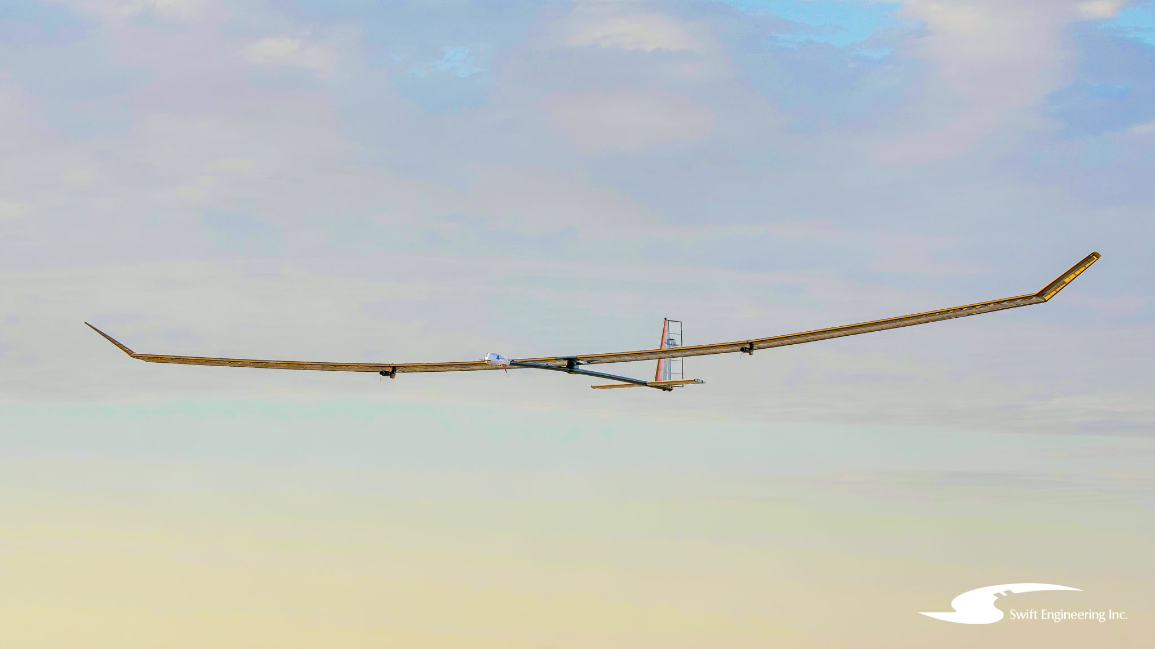
Next steps
Next steps and conclusion
1. Pre-flight biology studies
2. FLY summer 2022!
3. Execute science analysis
Stratosphere is Mars analog environment
Swift HALE UAS could provide long duration (weeks) exposure
RadBREAD biology experiment and carrier inform and enable future Mars analog missions
Find RadBREAD poster #42 at Undergrad & HS poster session!

Slide 15
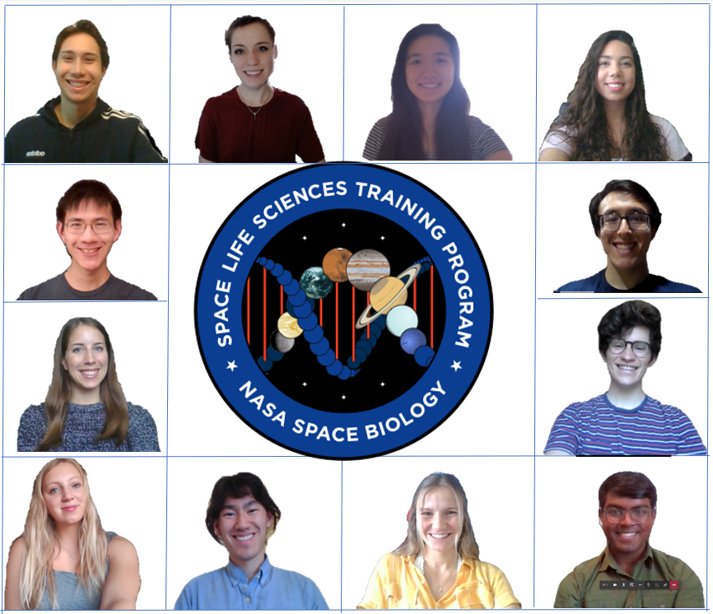
Acknowledgements
NASA Ames:
Sigrid Reinsch (PI)
Hami Ray
Matt Fladeland
Sergio Santa Maria
Jack Miller (LBL)
Jonathan Galazka
Antonio Ricco (Stanford)
Rob Vic
Ali Kashani
Ric Kolyer
Linda Timucin
Sylvain Costes
Elizabeth Hyde (USGS)
Isaac Anderson (USGS)
Ames Machine Shop
SLSTP 2020
Simon Ng
Benjamin Alva
Philip Li
Ama Luthens
Ada Kanapskyte
Kelly Wong
Marshall Ledford
Finsam Samson
Avram Bar-Meir
Amanda Wacker
Ella Hawkins
Jerika Christman
and
Katerina Angjeli (WPI)
DLR
Thomas Berger
Karel Marsalek
Bartos Przybyla
Swift Eng.
Fernando Gomez
Shawn Barge
Andrew Streett
Swift Eng.
Fernando Gomez
Shawn Barge
Andrew Streett
Funding provided by the Ames Research Innovation Award (ARIA) and the Ames Space Biology Program
Note: in 2021 the RadBREAD project has been largely developed by students and scientists volunteering their time
Notes:
Kelly
I put our group photo here, but IDK, do we want photos of all the people helping us instead?

Slide 16

References
Hassler, D. M., Zeitlin, C., Wimmer-schweingruber, R. F., Ehresmann, B., Rafkin, S., Eigenbrode, J. L., Brinza, D. E., Weigle, G., Böttcher, S., Böhm, E., Burmeister, S., Guo, J., Köhler, J., Martin, C., Reitz, G., Cucinotta, F. A., Kim, M., Grinspoon, D., Bullock, M. A., … Team, M. S. L. S. (2014). Mars’ Surface Radiation Environment Measured with MSL’s Curiosity Rover. Science, 343(January), 1–7.
Karathia, H., Vilaprinyo, E., Sorribas, A., & Alves, R. (2011). Saccharomyces cerevisiae as a Model Organism: A Comparative Study. PLoS ONE, 6(2). doi:10.1371/journal.pone.0016015
Liu, Wei et al. “From Saccharomyces cerevisiae to human: The important gene co-expression modules.” Biomedical reports vol. 7,2 (2017): 153-158. doi:10.3892/br.2017.941
Maria, S. R., Marina, D. B., Tieze, S. M., Liddell, L. C., & Bhattacharya, S. (2020). BioSentinel: Long-Term Saccharomyces cerevisiae Preservation for a Deep Space Biosensor Mission. Astrobiology. doi:10.1089/ast.2019.2073
Murtey, M. D., & Ramasamy, P. (2016). Sample Preparations for Scanning Electron Microscopy – Life Sciences. Modern Electron Microscopy in Physical and Life Sciences. doi:10.5772/61720
Outten, Caryn & Falk, Robert & Culotta, Valeria. (2005). Cellular factors required for protection from hyperoxia toxicity in Saccharomyces cerevisiae. The Biochemical journal. 388. 93-101. 10.1042/BJ20041914.
Tong (2012) Spot Assay for Yeast. Bio-protocol 2(1): e16. DOI: 10.21769/BioProtoc.16.
Tran K. and Green E. (2020). Assessing Yeast Cell Survival Following Hydrogen Peroxide Exposure. Bio-Protocol. doi: 10.21769/BioProtoc.3149
Atmosphere diagram: https://scied.ucar.edu/shortcontent/stratosphere-overview
Notes:
Kelly

Slide 17
Acknowledgements
ARIA
Space Biology
SLSTP 2020
...

Slide 18
Supplemental slides

Slide 19
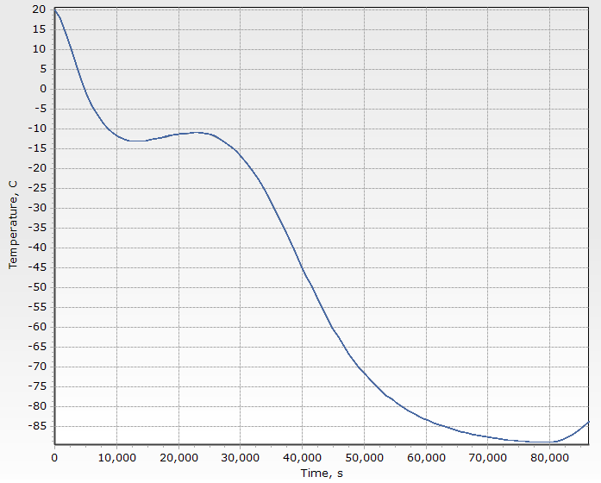
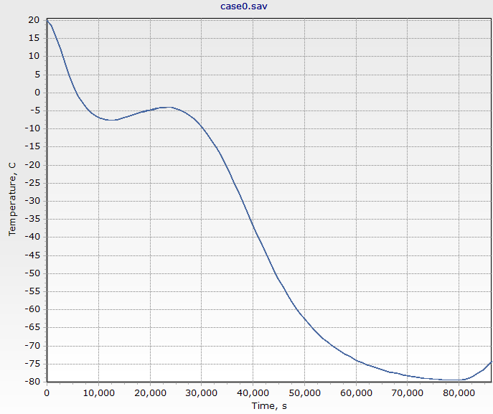
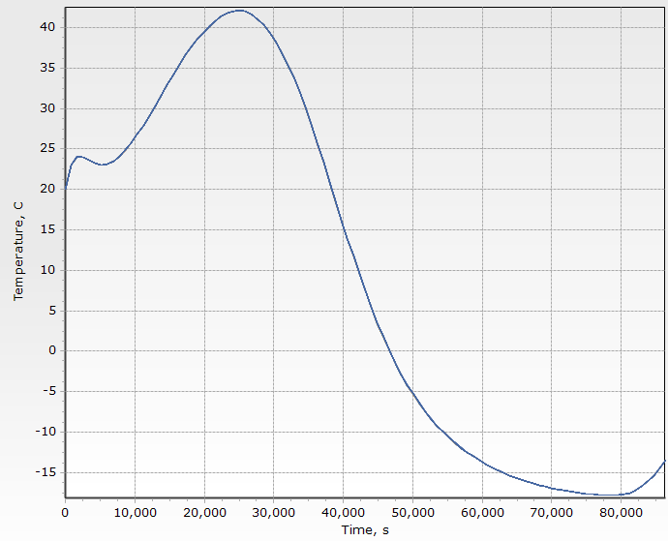
Thermal management:
Little difference between 0 and 0.14W
-80C @ 15hrs
-80C @ 21hrs
Maintained > -15C
No heating
Heating unit supplying 0.14W
Heating unit supplying 1.14W

Slide 20
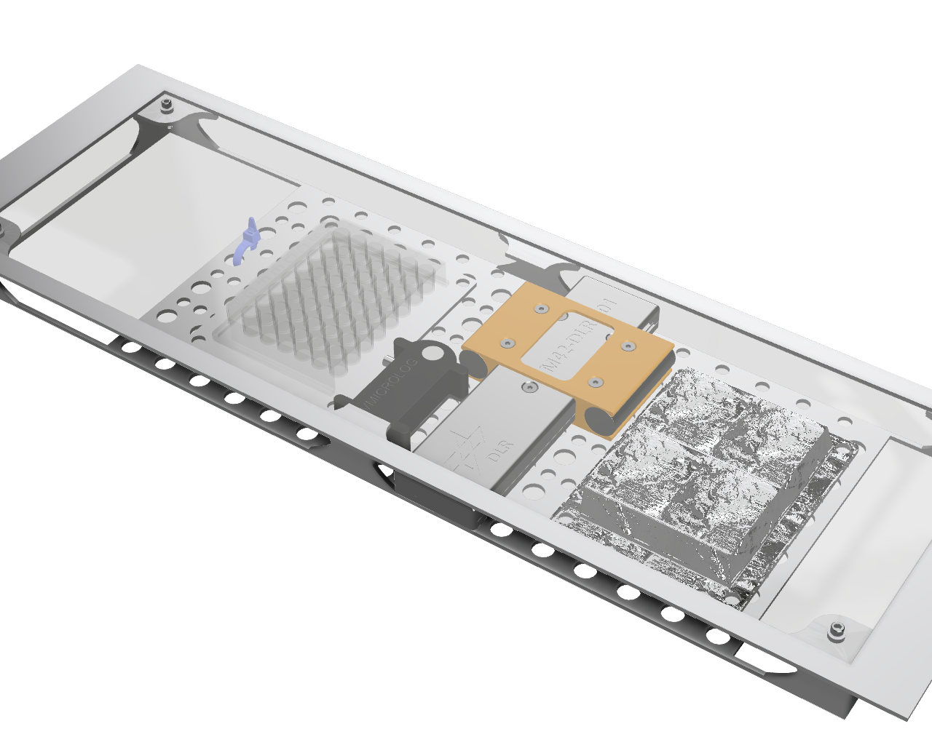
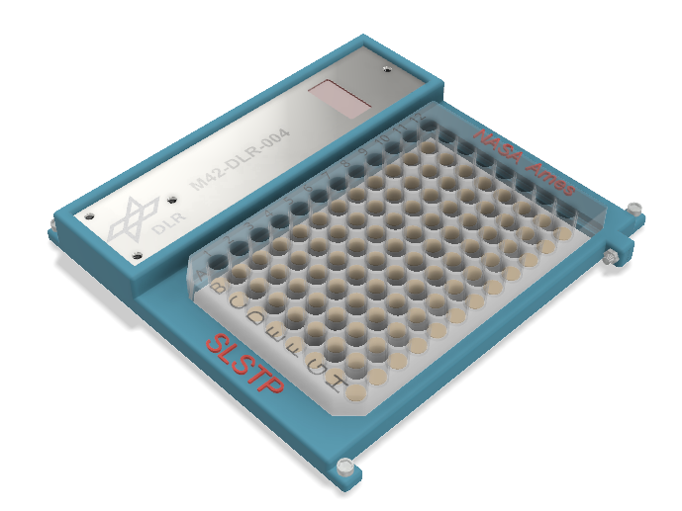
Carrier design evolution
Notes:
If we want to show the development from our original idea to where we are now

Slide 21
A student project
Students cycle in and out depending on other commitments
Flight mission - delays
Bring on additional students to sustain project

Slide 22
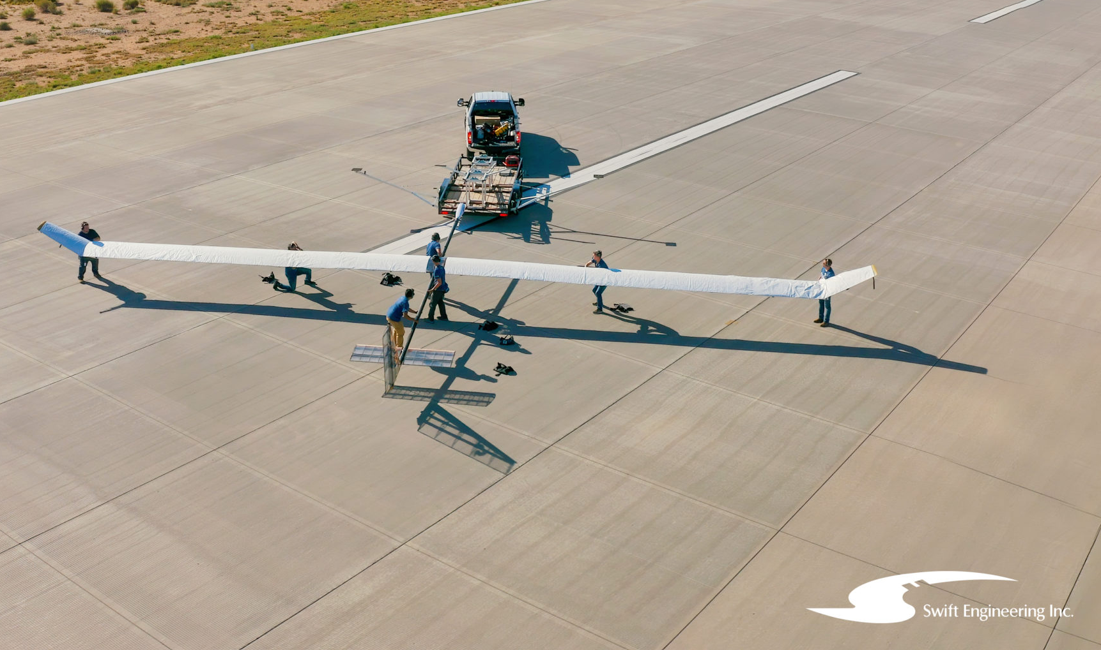
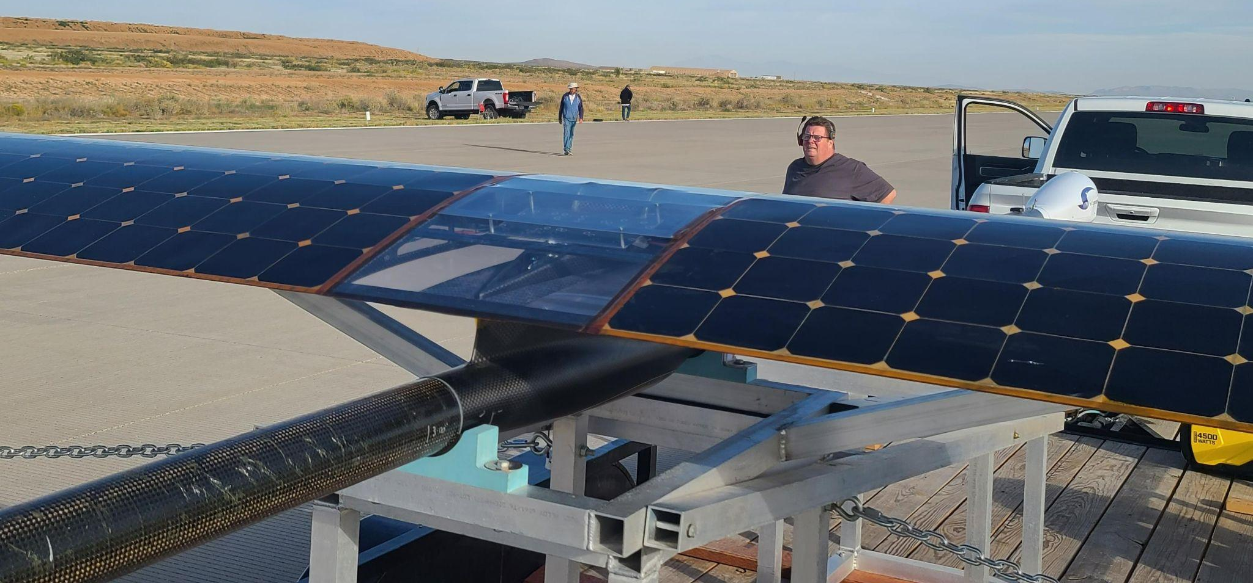
Prototype payload carrier built and flown!
Notes:
Fabricated at NASA Ames Machine shop. Me and other engineering team students designed this payload, found appropriate materials, etc, haven’t touched any of it. Haven’t even been on base. Covid’s been weird.

Slide 23
(2) FLIGHT
NO UV EXPOSURE
(3) FLIGHT
PARTIAL UV EXPOSURE
(1) GROUND
RED: WT at different cell densities. To determine the optimal amount of yeast needed for post-flight analysis. Survival/growth curve results from these samples will be useful in designing future yeast experiments on the HALE UAV. Note: the number of wells devoted to this section will likely be reduced.
GREEN: WT yeast at optimal density determined during pre-flight tests.
BLUE: WT yeast at optimal density determined during pre-flight tests and pretreated with L-ascorbic acid. To test a potential countermeasure against stressors. Expect to see increased survival since antioxidants will help with surviving desiccation process as well as protect the yeast from free radicals generated from ionizing radiation at high altitudes. (Beyer, Saffi et al. 2013, Branduardi et al. 2007)

Slide 24
(2) FLIGHT
NO UV EXPOSURE
(3) FLIGHT
PARTIAL UV EXPOSURE
(1) GROUND
Stressors: Desiccation
Stressors: Desiccation, low temperatures, low pressures, ionizing radiation
Stressors: Desiccation, low temperatures, low pressures, ionizing radiation, UVA + UVB
Comparing data from plates (1) vs (2)/(3) will tell us the effects of the stratosphere environment as a whole.
Comparing data from plates (2) vs (3) will isolate effects of UV exposure.

Slide 25
NASA Space Life Sciences Training Program
SLSTP 2020 VIRTUAL
10 weeks Summer 2020
10 Research Associates (RAs) + 2 staffers – 4 time zones
Upper division college students – Rising juniors/seniors
  Individual research project with individual NASA Ames Mentors
  Group project requirement – student driven

Slide 26
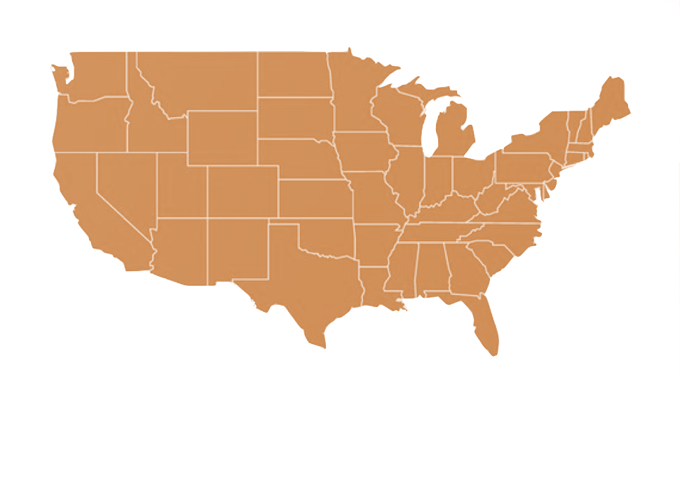











SLSTP 2020 Cohort
Ben
Jerika
Simon
Finsam
Marshall
Kelly
Ama
Avi
Ella
Philip
Ada
Amanda
Notes:
Marshall

Slide 27

Opportunity: Biological Payload on Autonomous Aircraft
Opportunity: fly a biological experiment on an autonomous aircraft as a piggy-back payload equipped with a radiation dosimeter

Slide 28
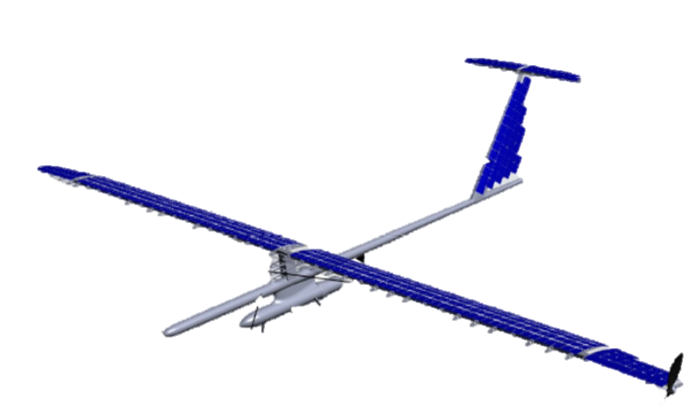
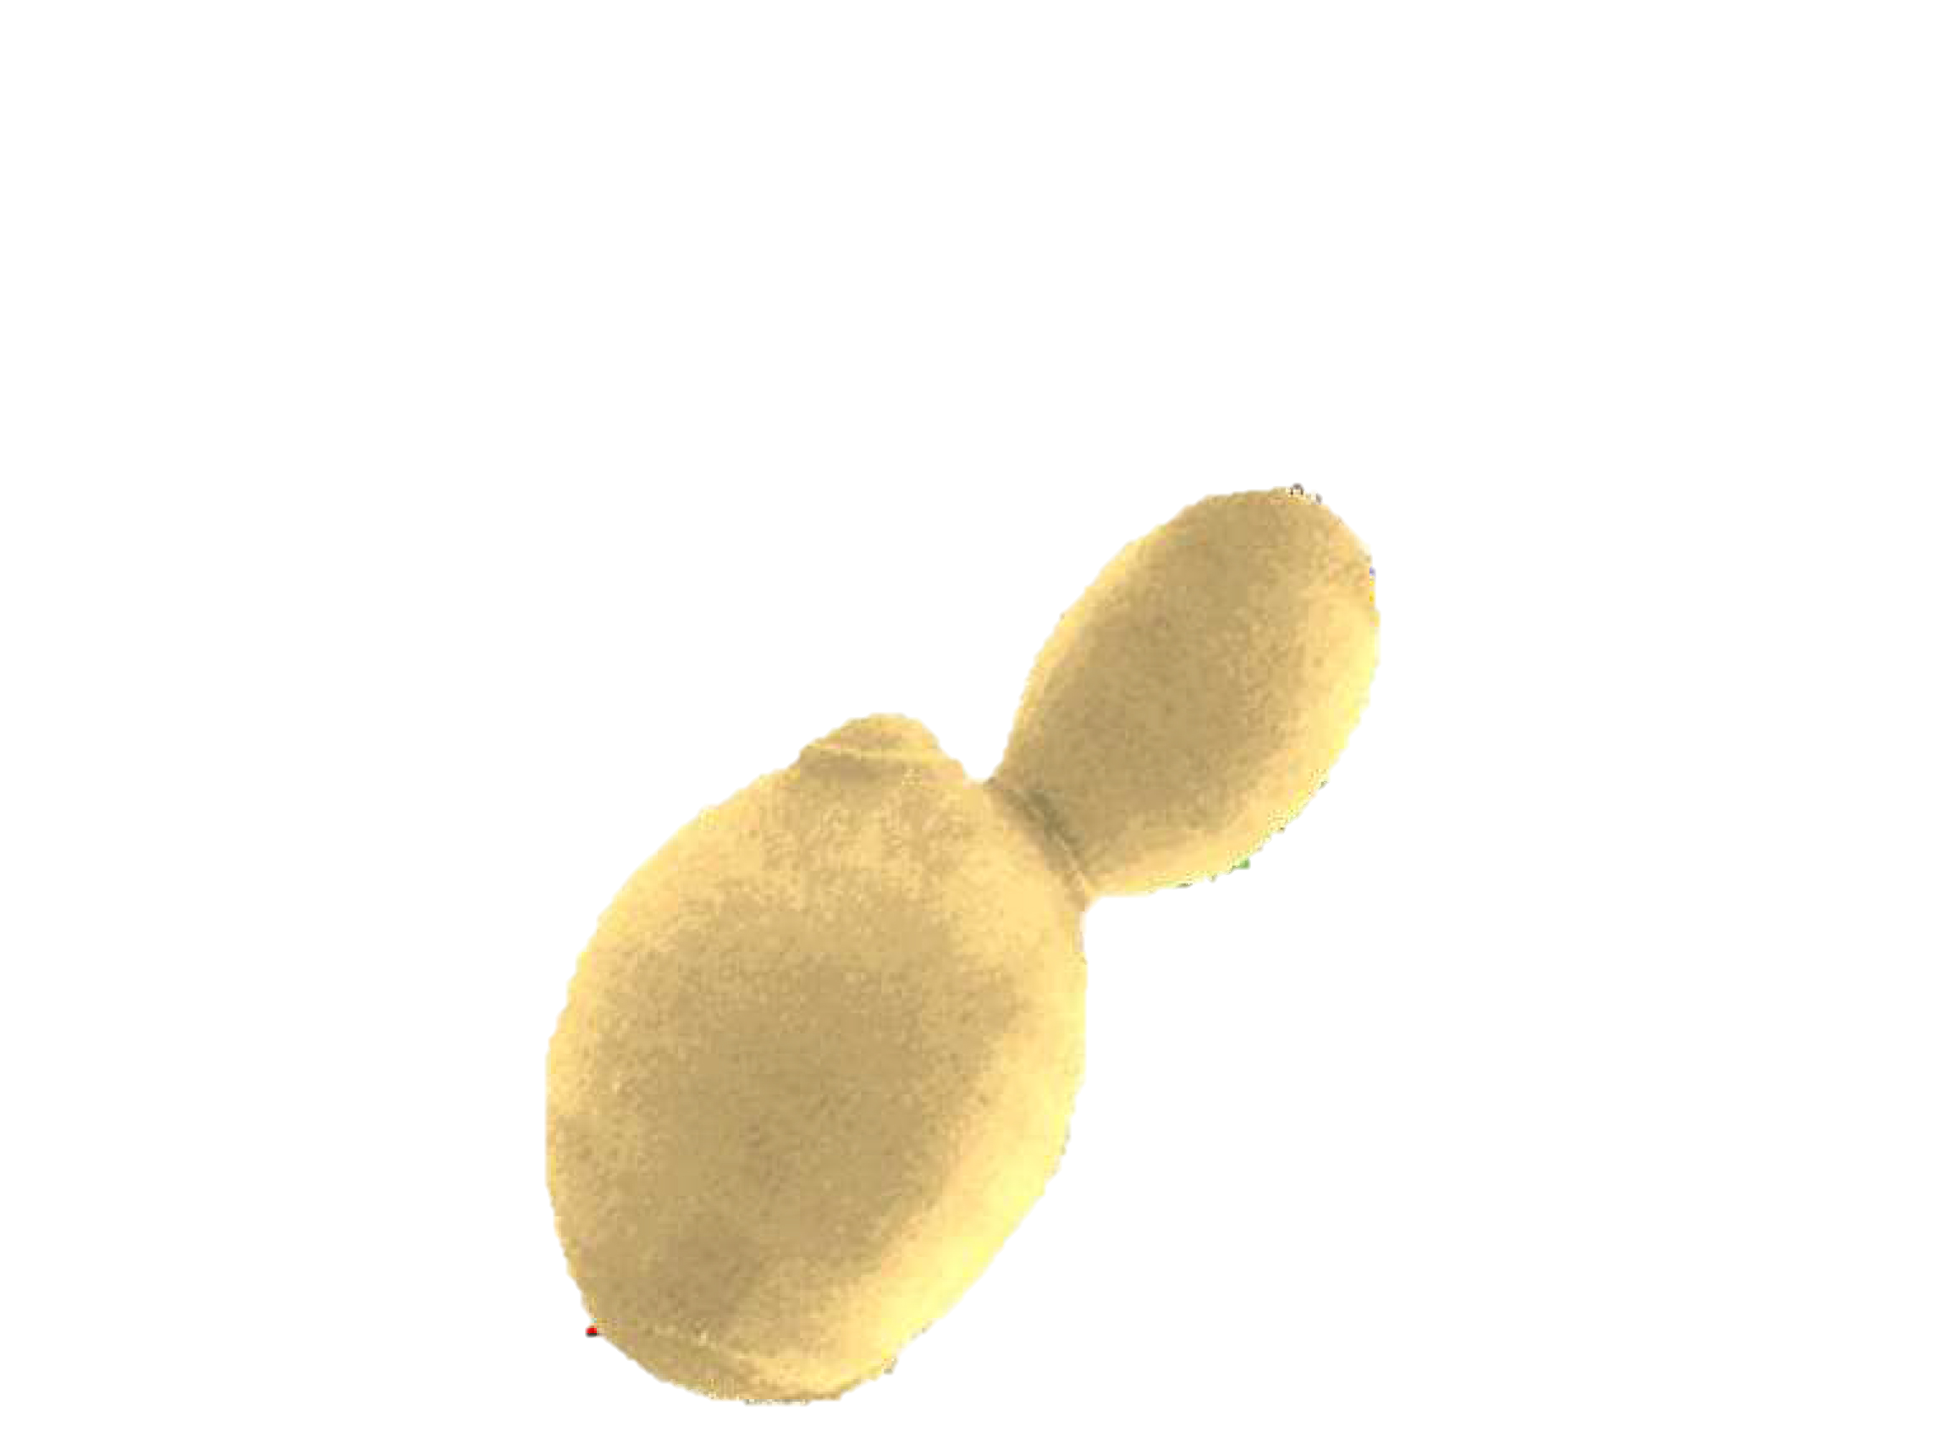
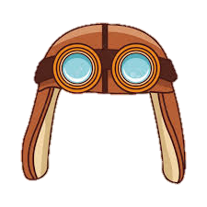

Big Question: How are organisms affected by the extreme conditions of the stratosphere?
‹#›

Slide 29
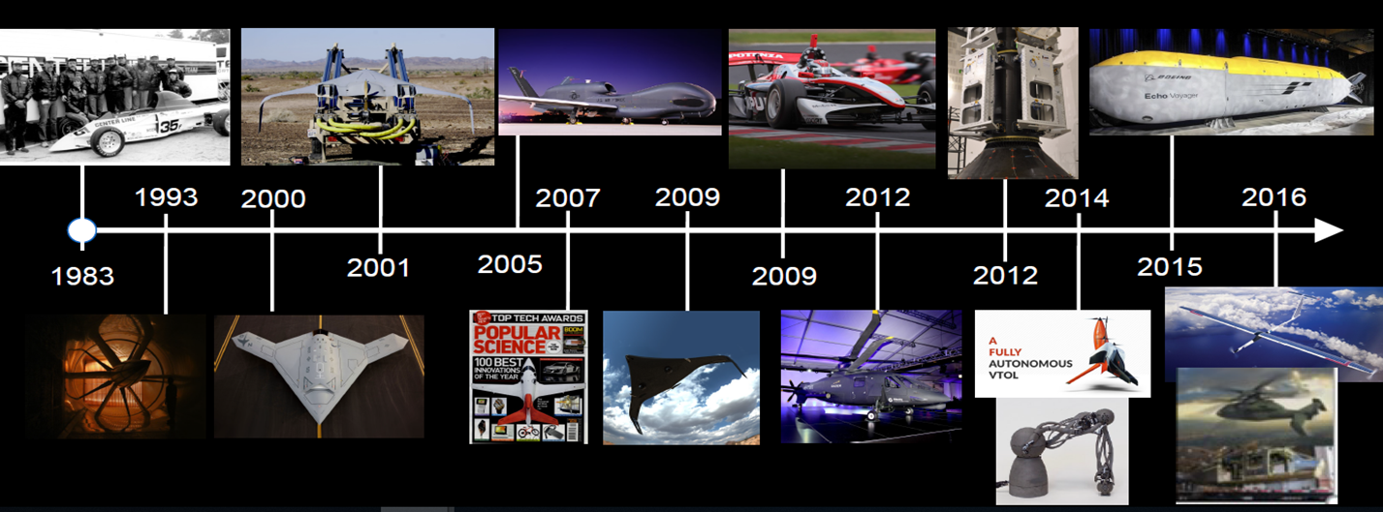
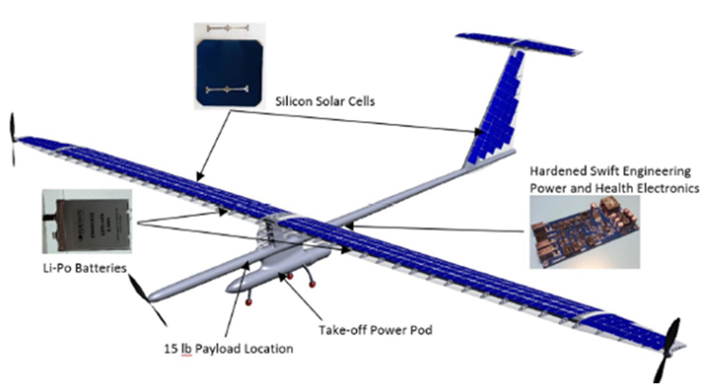




What is Swift?
Swift Engineering: company that builds various vehicles such as UAS and HALE
Our project: Swift-X Case study
Swift High Altitude Long Endurance Unmanned Aerial System (Swift HALE UAS)
Notes:
Ada
Notes:
This opportunity is provided by Swift, an engineering company based in California. Our vehicle is called the Swift High Altitude Long Endurance Unmanned Aerial System, which is part of their Swift X-Case Study project. The vehicle is fully autonomous, solar powered, can reach an altitude up to 21 km, and it will be carrying a forestry surveillance payload in addition to our payload. This is a truly exciting and unique opportunity for our group. Specifically, we have the chance to provide novel insights and a proof of concept for coupling a biological experiment with a dosimeter in a high altitude, low radiation dose environment.

Slide 30
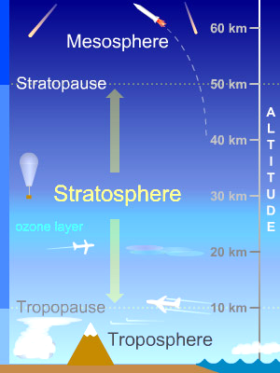
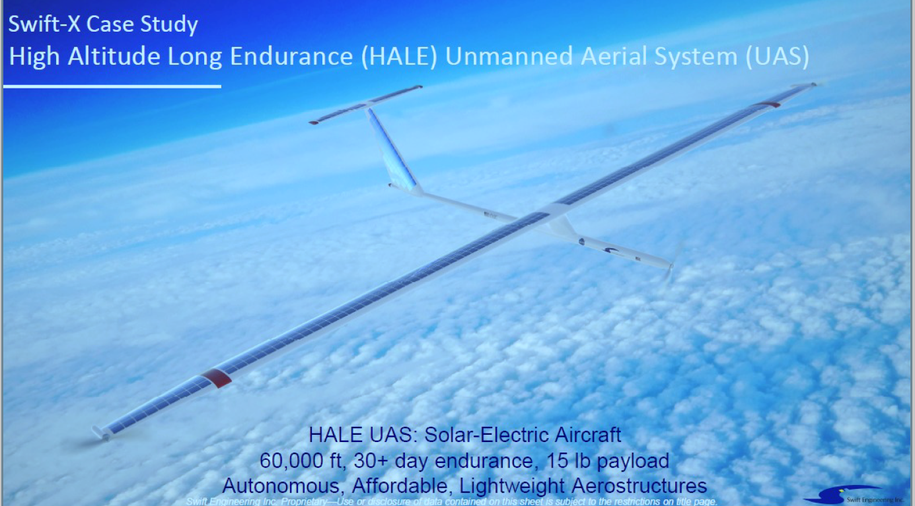
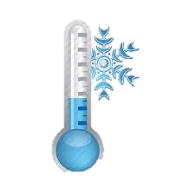
Swift HALE Environmental Conditions
1.8 mGy ionizing
radiation
1.8 mGy
Ionizing radiation
4 – 10 kPa
UCAR
-80°C – -55°C
Clipart Library
Notes:
Simon
What are specific conditions on Swift?
We are in stratosphere, during day, cruise around 22 km, during night, drop down to 17 km
We are chiefly concerned with temperature, pressure, and radiation
Expect temperature fluxuate around -80 to -55 C
Pressure 40-100 mBar compared to 1000mBar at sea level
Over 2 week flight, expect 1.8 mGy ionizing radiation, equal to 2-3 days on the ISS
Comments:
-include all specific information, i.e. altitude
-look at Sigrid’s slides for reference
Add mars analog slide or info here?
https://climate.ncsu.edu/edu/Structure

Slide 31
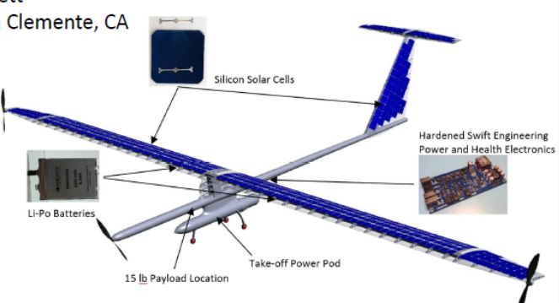
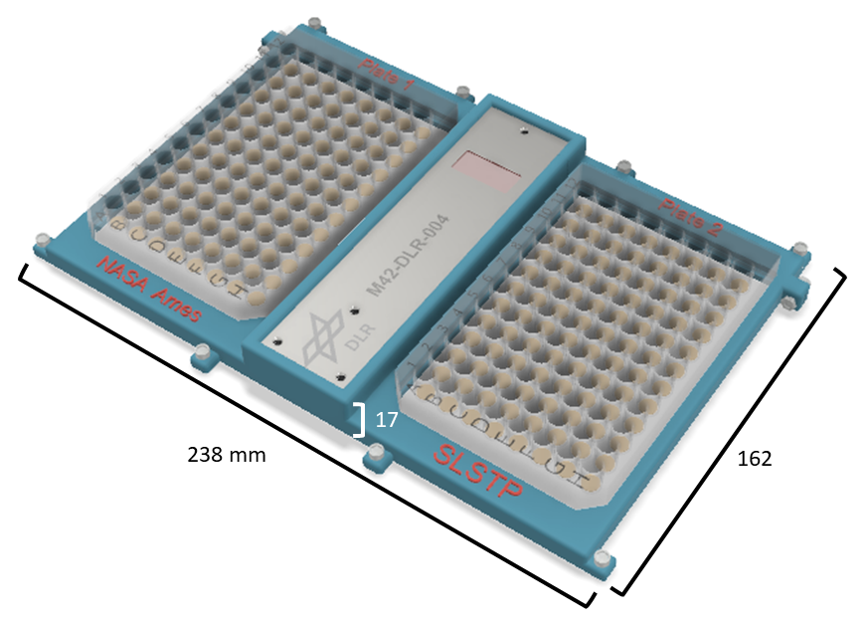
Payload opportunity/constraints
Payload Details:
Total Payload: 7 kg
Primary Payload: ~5 kg
  USFS Forestry cameras
Biological payload: small, ~0.5 kg
  Radiation dosimeter: ~0.25 kg
  Payload will be enclosed in plane
  No environmental controls
  Dosimeter actively gathers data and has power
2-week flight – constrained to summer months
Notes:
Ben
Comments
Cannot show the figure – proprietary
Can show the location of the 2 lbs – inside or outside
Dosimeter ~ 0.5 lbs
Include the time of the flight
Say that there’s potential for other test flights throughout the year
Would be nice to see the info more graphically

Slide 32
Features and Constraints RadBREAD
Radiation: Low total dose and low dose rate
Mass: payload must be less than 0.5 kg
Power: payload can only rely on battery power, not aircraft power
Limited/no environmental control
Unique feature: DLR M-42 Radiation Dosimeter
Challenge: Choose a biological system that is responsive to low doses of radiation so we can correlate biological changes to the dosimeter readings
Notes:
Kelly

Slide 33
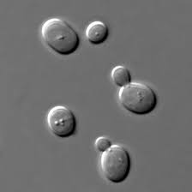
Payload Model Organism
Saccharomyces cerevisiae
Easily genetically manipulated (Karathia, et al., 2011)
Many available mutant and reporter strains can highlight radiation and damage from flight stressors
How will the biology survive 2 weeks without human interaction?
  Aqueous glycerol solution
Eukaryotic
  and contains human homolog genes (Lui et al., 2017)
Multiple strains readily available at Ames
Notes:
Kelly
Comments:
Looks good, maybe more diagrams?
Emphasize that strains are available at Ames + the expertise
S. cerevisiae possesses exceptional resistance to desiccation.
Can be transformed allowing for either the addition of new genes or deletion through homologous recombination.
Could grow S. cerevisiae as a haploid simplifies the creation of gene knockout strains.
As a eukaryote, it shares the complex internal cell structure of plants and animals without the high percentage of non-coding DNA that can confound research in higher eukaryotes.
S. cerevisiae research is a strong economic driver, at least initially, as a result of its established use in industry.

Slide 34
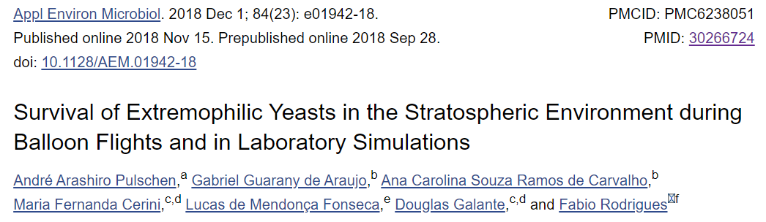

Previous Similar Work
Extremophile yeasts + Saccharomyces cerevisiae
  Desiccated
Exposed directly to the stratosphere for 100-120 minutes
  Sensors for pressure and temperature
Rehydrated
Survival assays
Looked at radiation effects but had no measure of radiation levels experienced during flight.
Notes:
Amanda

Slide 35
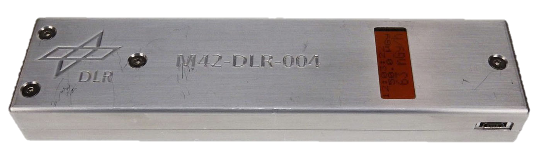
The Dosimeter: M42C - DLR
38 mm
13 mm
142 mm
Radiation dose and rate
Notes:
Philip scale bar
How having dosimeter is different from previous work
The radiation dosimeter is critical to interpreting any spaceflight experiments. This small dosimeter will be implemented on the Orion EM-1 flight. This is a test for the dosimeter - also a collaboration with the German Space Agency (DLR) so this project is part of a very important international collaboration. Our payload should be a similar size.

Slide 36
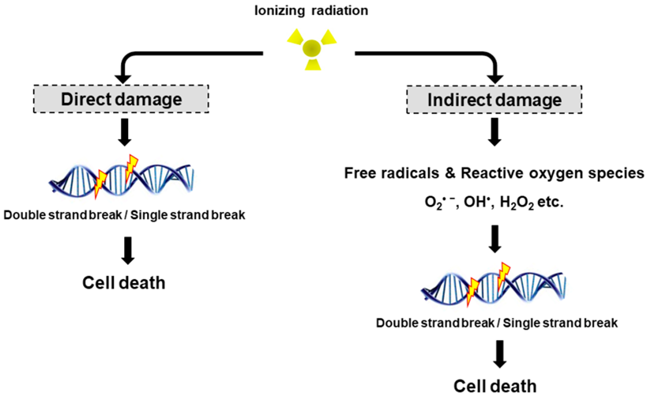
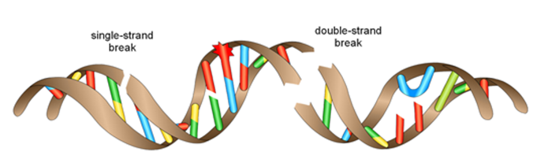
Factors We Are Addressing: Radiation
Focus on:
DNA damage
DNA repair pathways
Radiation can cause various levels of DNA damage
Strain selection: DNA repair mechanisms and reporter strains
Goal: focus on the kind of damage radiation causes
(Liddell 2020)
Notes:
Philip
Notes:
Radiation exposure can induce significant generation of ROS
ROS shown to induce damage to nucleic acids, proteins and lipids 🡪 can lead to cell death
Accumulation of ROS has been shown to mediate apoptosis, or in extreme accumulation, necrosis.

Slide 37
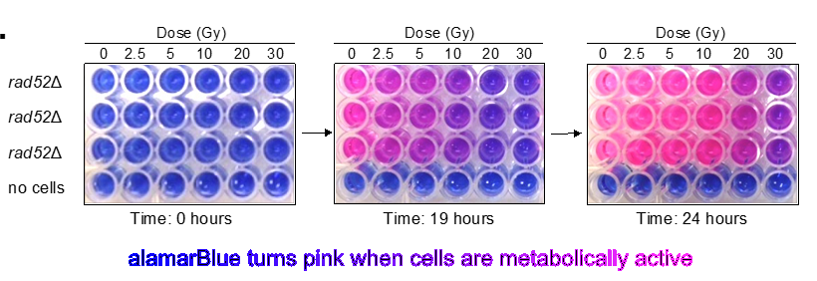
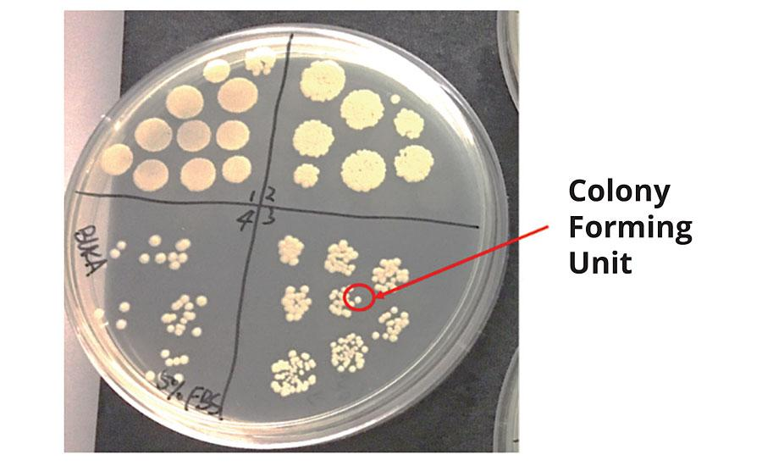

Potential Analyses
Survival
  Count colony forming units (cfu)
Metabolism
  alamarBlue reduction
Mutagenesis
GeneLab omics
Liddell, 2020
Dubiel 2017
Notes:
ELLA
After the flight and payload retrieval, we will be performing survival assays, where we rehydrate our samples, dilute them, plate them, and count colony forming units, which corresponds to the number of viable cells in that dilution for that experimental condition and strain. We would expect to see less survival in DNA damage sensitive strains. We may also perform a metabolism assay such as an alamarBlue reduction assay. Alamarblue changes color from blue to pink to clear as it is reduced and metabolized, so the rate of the color change correlates to the rate of the metabolism of the cells in a given sample. Previous studies have shown that exposure to radiation decreases the rates of metabolism of sensitive strains compared to WT strains. We are hoping our reporter strains will also be able to provide us insight into the rates of mutagenesis due to the flight.
We may also do high throughput transcriptomics analysis of ground and flight samples to determine changes caused by the flight.

Slide 38
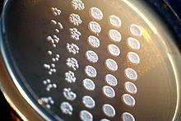
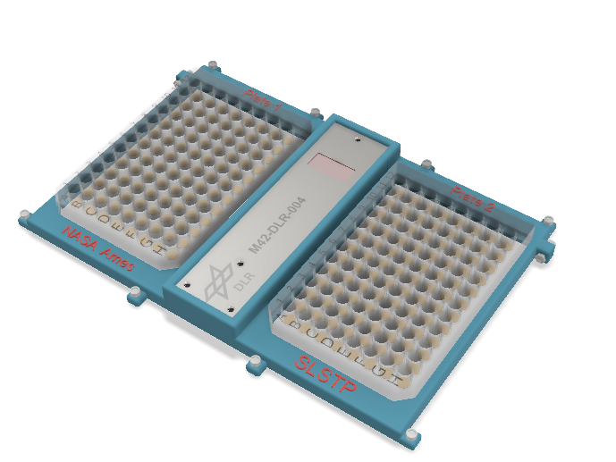
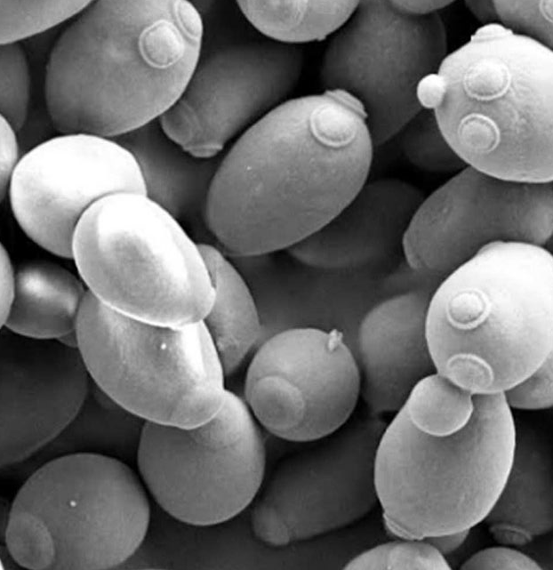
Summary of Experiment
Experiment: test the effects of HALE flight conditions on model organism survival, gene expression, and metabolism
Organism: Saccharomyces cerevisiae
Flight: 2 weeks in stratosphere
Post-flight:
  Survival assays
  Metabolic assays
  Mutagenesis assays
  GeneLab omics analysis
  Correlate results with dosimeter data & ground control
Notes:
AVI
Notes:
In summary, we are proposing to examine the effects of the HALE flight environment on biology as a test of the HALE platform for future extreme-environment biological missions.
For many reasons, we have chosen the model organism Saccharomyces cerevisiae. They will being exposed to stratospheric conditions over the two week duration of the flight.
As mentioned, we have several post-flight analyses planned. Importantly, we will be correlating our findings with the M42 dosimeter radiation readings.
_______________
Experimental organisms will go aboard SULE in the designed enclosure and fly in LEO for over two weeks
Test different experimental conditions on the organisms (yeast?) based on biological questions of interest
Perform survival assays and potentially omics analyses on organisms and compare results between experimental conditions
Correlate results with dosimeter data and a ground control
Comments:
- Talk about omics analysis with GeneLab?
https://en.wikipedia.org/wiki/Viability_assay
https://aip.scitation.org/doi/10.1063/1.5122301

Slide 39
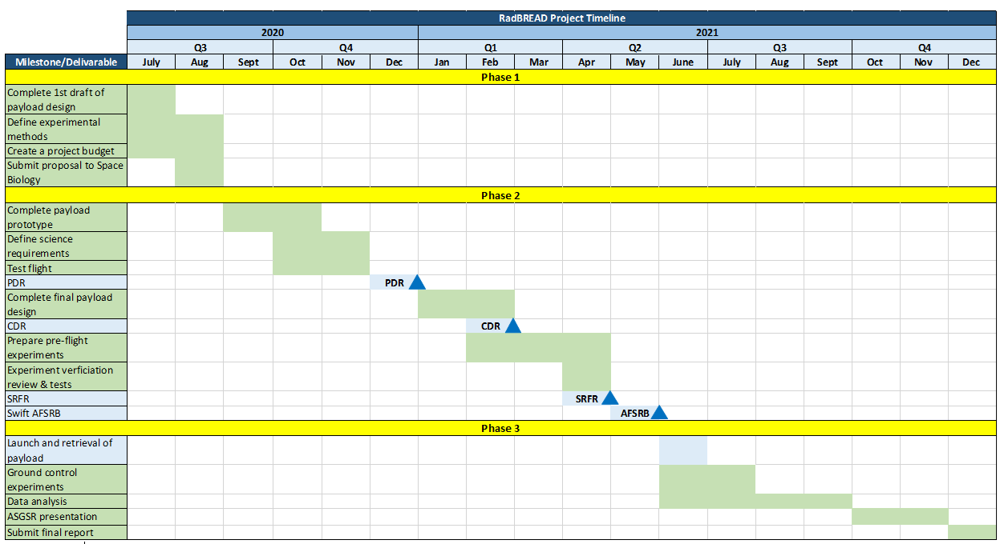
Timeline
We are here
Notes:
Finsam
Mention Phases/working during the academic year, reviews, and when the flight is supposed to launch

Slide 40

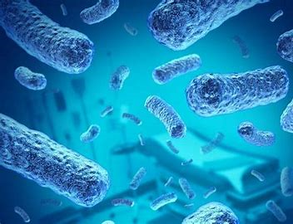
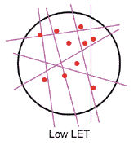
Future Directions and Implications
HALE platform
  Unique radiation exposure profile
  Pilot experiment 🡪 proof of concept
  Mars analog
  Opportunity for larger payloads
M-42 Dosimeter
  Test with other biological payloads
  Determine effects of long duration low dose radiation exposure on yeast
Notes:
Finsam
Pilot experiment
Testing M-42 dosimeter in conjunction with other biological payloads
Testing HALE has a Mars analog and platform for testing biology in extreme conditions
Understand the effects of long duration low dose radiation exposure on yeast
Future opportunities for larger, more complicated payloads on Swift HALE
Organisms other than yeast

Slide 41
Questions?
Notes:
Kelly

Slide 42
Swift HALE as a Mars Analog
Location | Earth: New Mexico | Swift: stratosphere | Mars: Gale crater
Temperature (ºC) | -4 to 35 | -80 to -55 | -70 to -10
Pressure (mBar) | 1000 | 40 to 100 | 10
Radiation (mGy) | 0.08 | 1.8 | 3.1
Notes:
Simon
Make case for Swift conditions as a Mars analog
Here we're comparing the temperature, pressure, and radiation on surface of earth, on swift, and surface of Mars
Temperature where swift flies stratosphere and mars almost identical around -60
Atmospheric pressure on swift is 10x higher than mars, but still much lower than pressure at sea level on Earth
Radiation, stratosphere is order of magnitude higher than background radiation on surface of earth, and within the same order of magnitude as expected on mars
No analog is perfect, conditions of swift flight appear to capture important environmental conditions we face sending biology to mars for first time
Earth Radiation: https://www.nasa.gov/pdf/284273main_Radiation_HS_Mod1.pdf
“On Earth, we receive an average of 2 mSv every year from background radiation alone.” 1mSv=1mGy.
2mSv/1yr*1yr/52wk*2wk=0.08mGy
Swift pressure and temp estimate/second source: https://climate.ncsu.edu/edu/Structure / https://www.avs.org/AVS/files/c7/c7edaedb-95b2-438f-adfb-36de54f87b9e.pdf
Mars temp: https://mars.nasa.gov/all-about-mars/facts/#?c=inspace&s=distance
Mars pressure: https://phys.org/news/2012-09-temperatures-gale-crater-higher.html
Mars radiation: from Hassler et al Curiosity rover: 0.2mGy/day * 14 days = 2.8mGy

Slide 43
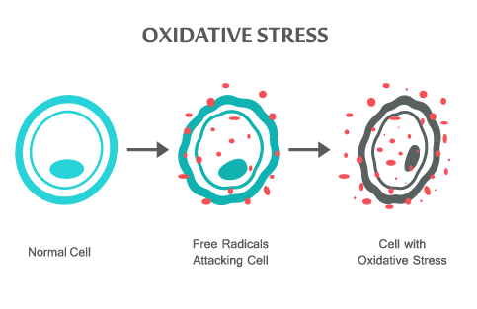
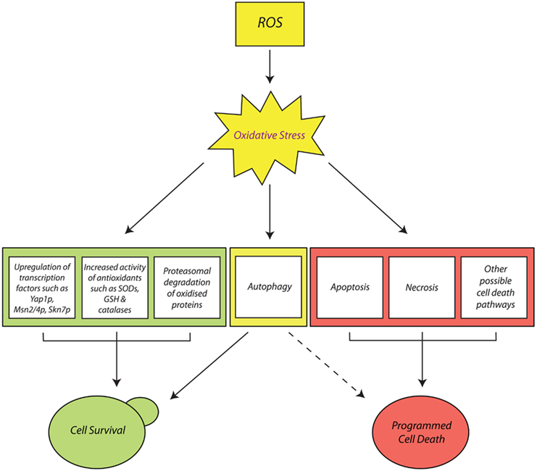
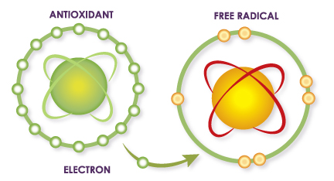
Factors We Are Addressing: Oxidative Stress
What’s the significance of ROS?
(Farrugia, 2012)
Notes:
Phillip
References:
Antioxidant pic: https://chicagointernalcleansing.com/free-radicals-and-antioxidants-explained/
Oxidative stress: https://skinandshit.co.uk/2018/03/27/free-radicals-antioxidants-explained/
Pathway: https://www.ncbi.nlm.nih.gov/pmc/articles/PMC3380282/#:~:text=Yeast%20antioxidants%20and%20their%20role,ROS%20and%20restore%20redox%20balance.

Slide 44
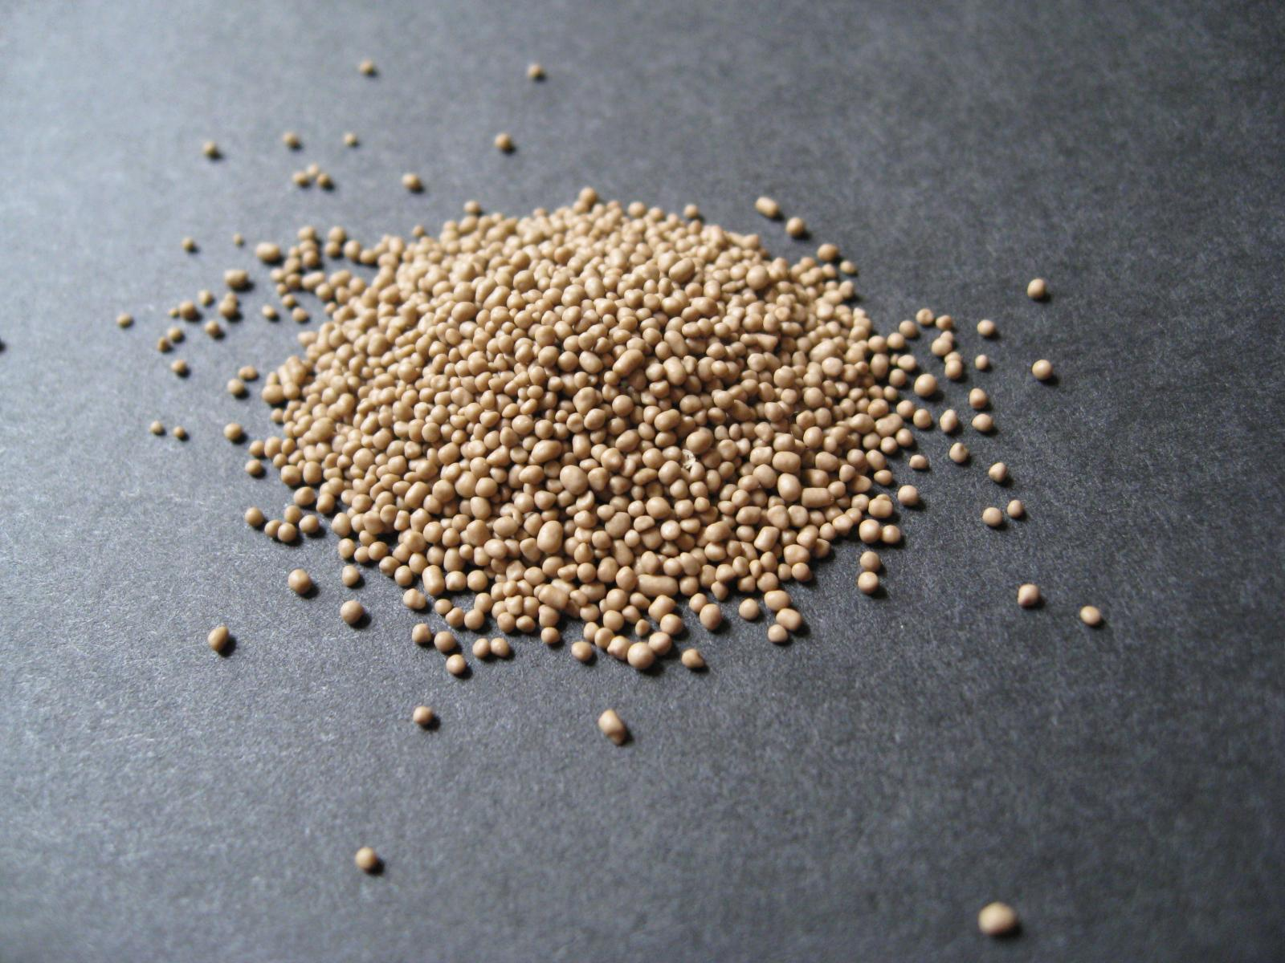
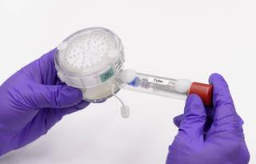
What Are Possible (More Specific) Biological Questions?
Do the extreme stressors of the Swift flight select against yeast modified with biosynthetic pathways? (i.e. do biosynthetic pathways decrease organism fitness?)
Homemadeloaves.co.uk
How do different desiccation methods affect yeast survival?
NASA's Ames Research Center/Dominic Hart
Notes:
Ama
Desiccated yeast: http://www.homemadeloaves.co.uk/2012/08/yeast-different-types-and-how-to-use.html

Slide 45
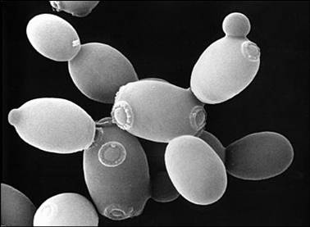
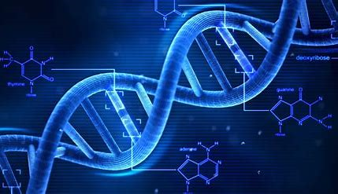


What Are Possible (More Specific) Biological Questions?
Are there mutant strains that increase rate of survivability?
Fahd Nasr
Do different yeast strains have a higher survival rate than others?
hfanatic
How can we protect the yeast strains using antioxidants or knockouts?
Candida albicans, medicineworld
Glutathione, wordpress
Notes:
Ama
DNA strand pic: https://www.hispanicfanatic.com/tag/socioeconomic-improvement/
S-cerevisie pic: https://yeastwonderfulworld.wordpress.com/about/
C. albicans pic: http://medicineworld.org/cancer/lead/10-2007/how-candida-albicans-transforms.html
Antioxidant pic: https://babyfoodsteps.wordpress.com/2012/11/12/g-is-for-glutathione/

Slide 46
Academic year
Academic Year (September 2020-May 2021) in Detail
PDR and CDR; continue fundraising via Universities
Interns @ Ames
Air Readiness Review and FRR
March
April
May
September
October
November
December
January
February
Notes:
PDR and CDR= completed through NASA; will be modified to fit our school schedules
ARR: we will be doing this review in conjunction with the primary payload and the entire aircraft
FRR: we may or may not need to participate (according to Matt); depends on how the ARR goes

Slide 47

Future Directions
Decide on a simple and specific biological question
Proposal for funding/reach out to sources for funding​
Budget breakdown
Notes:
Finsam
Comments:
Decide on a simple and specific biological question that capitalizes on the the expected radiation dose and that will use M42 dosimeter to enable interpretation of the results.

Slide 48
Budget
Payload Materials
Item | Vendor | Cost
Payload materials (sensors, encasing materials) | Amazon, Minco, Adafruit, etc. | Relatively high
Aluminium encasing | Ames Machine Shop | Moderate cost
Pre and Post Flight Assays
Item | Vendor | Cost
Intern #1 (April-June) | TBD | high
Intern #2 (July-September) | TBD | high
Publication costs | TBD | low
Travel Funds
Item | Vendor | Cost
Travel funds to allow team travel to/from Spaceport America (NM) | NASA Ames Space Biology Program | high
Notes:
AMA
In pre and post flight assays talk about how we have contributions at no cost to us from Sergio
say we have applied to ARIA and have a draft of our Space Biology Proposal

Slide 50
Slide Divider

