Slide 1
Lunar Surface Science Workshop
Fundamental and Applied Lunar Surface Research in Physical Sciences
August 18–19, 2021
John Vickers | Principal Technologist | NASA Space Technology Mission Directorate

Slide 2

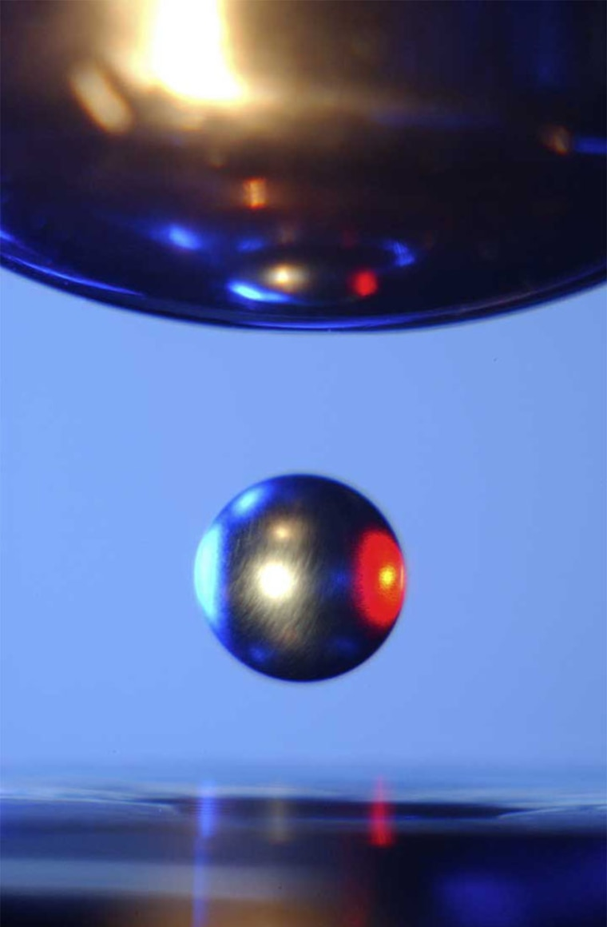
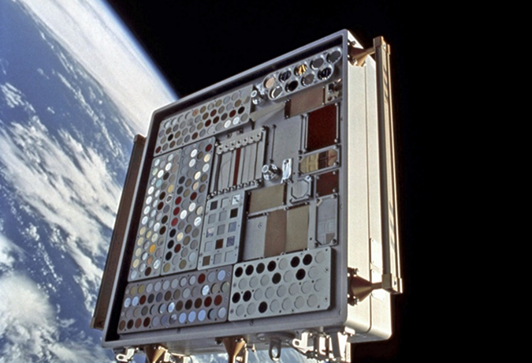
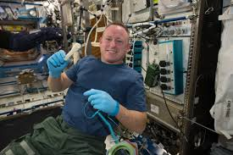

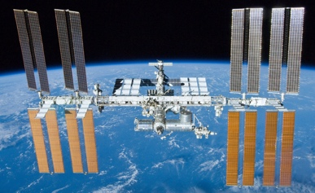

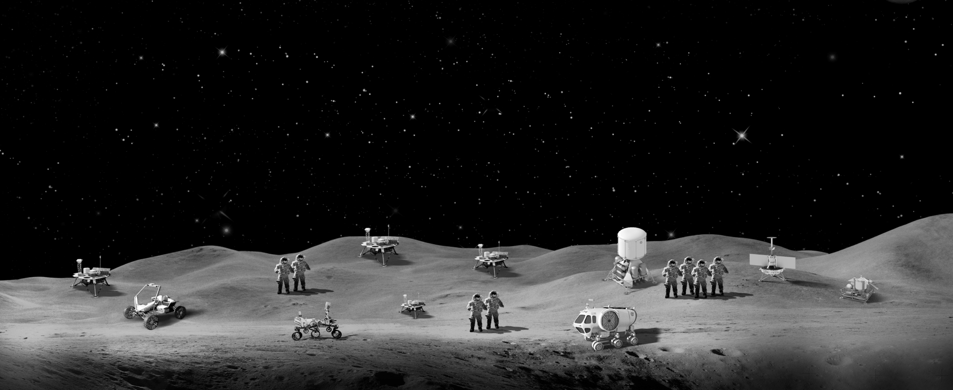


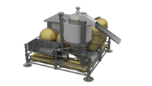
The Fifth Industrial Revolution
The Industrialization of Space – Linking Science, Technology, and Commerce
In-space materials and manufacturing technologies are evolving rapidly and bit by bit pioneering a sustainable path to Mars
A nation which depends upon others for its new basic scientific knowledge will be slow in its industrial progress and weak in its competitive position in world trade, regardless of its mechanical skill. Vannevar Bush, head of the U.S. Office of Scientific Research and Development during World War II

Slide 3
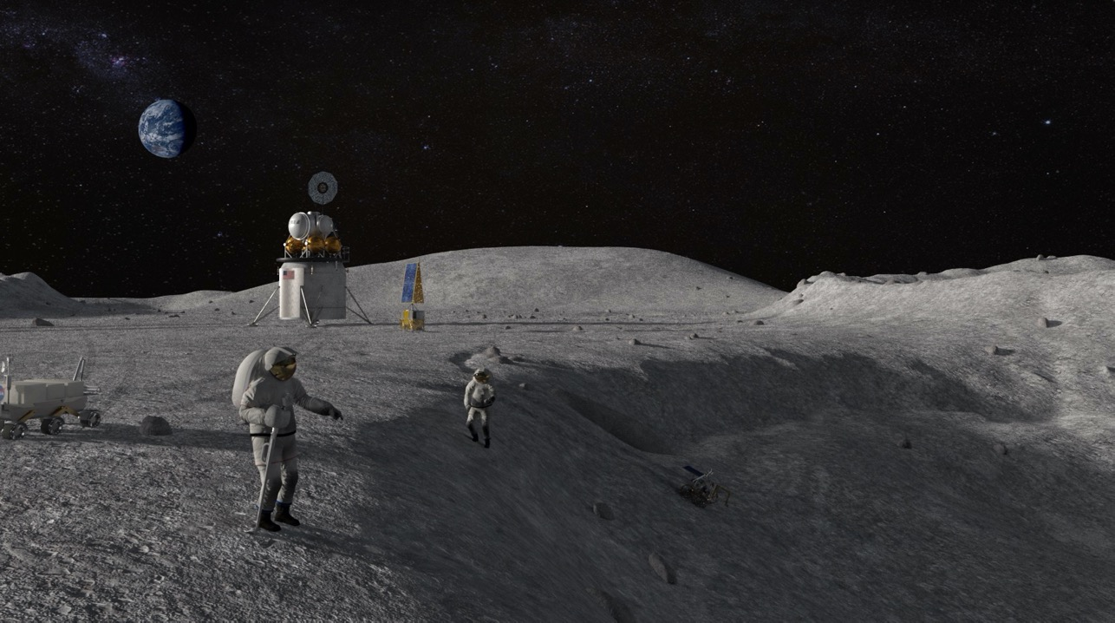

Technology Drives Exploration
Thank You!
john.h.vickers@nasa.gov

