Slide 1

Medical Task Support for Autonomous Space Exploration Missions
Team AMOS
sponsored by
Exploration Medical Capability:
Doug Ebert
Vicky Byrne
Ashot Sargsyan
Marlei Walton
RKT Creative
Research Operations and Integration
Aerospace Medical Association
91st Annual Scientific Meeting
August 30, 2021
Marlei Walton, Ph.D., M.S.E.
marlei.walton@nasa.gov

Slide 2

Disclosure Information
91st Annual Scientific Meeting
Marlei Walton
I have no financial relationships to disclose.
I will not discuss off-label use or investigational use in my presentation

Slide 3
Agenda
Introduction: Exploration context
Topic: Autonomous Medical Officer Support (AMOS)
  AMOS description
  Technology Demonstration (Tech Demo)
Conclusion/Application

Slide 4
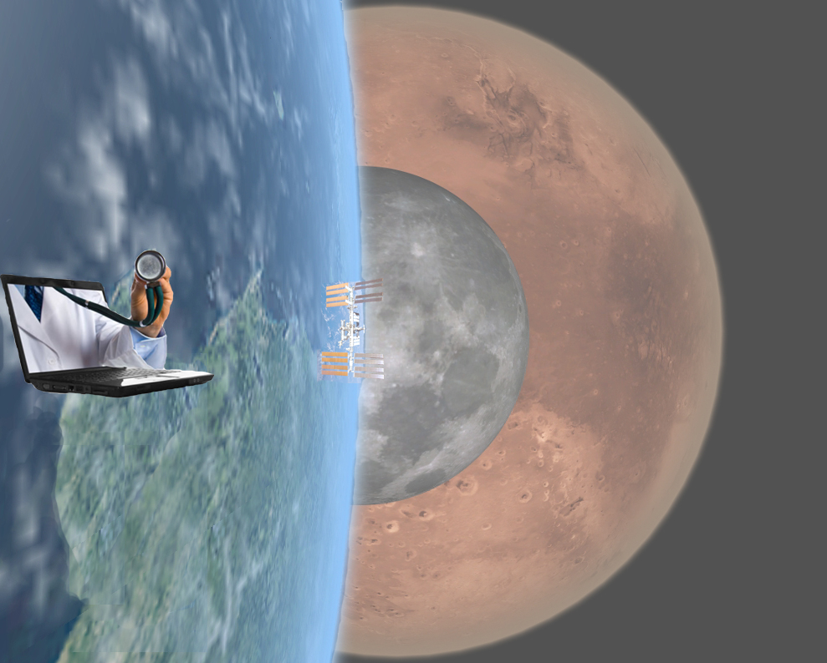
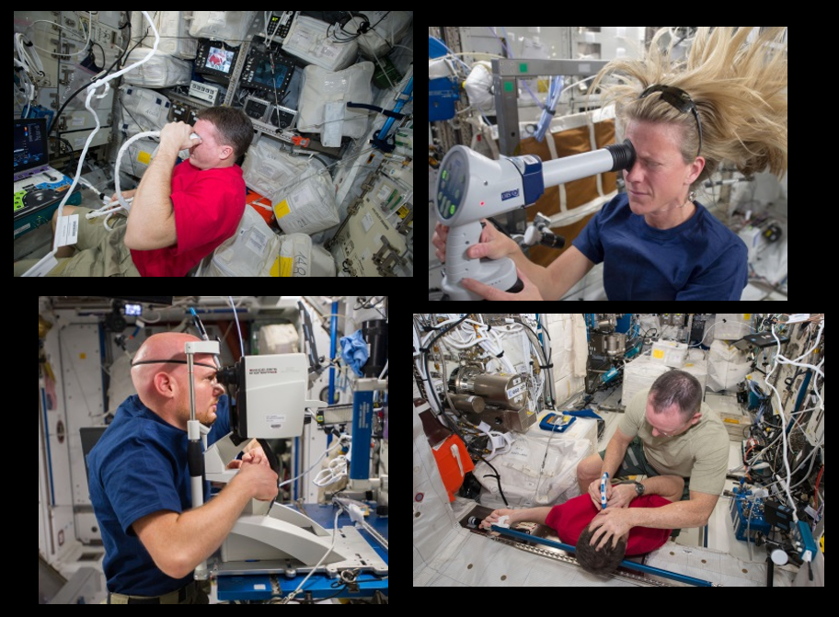
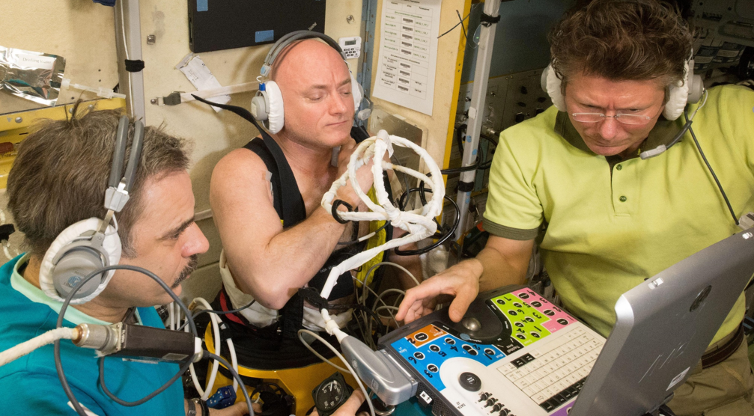
Now: ISS Operations

Slide 5
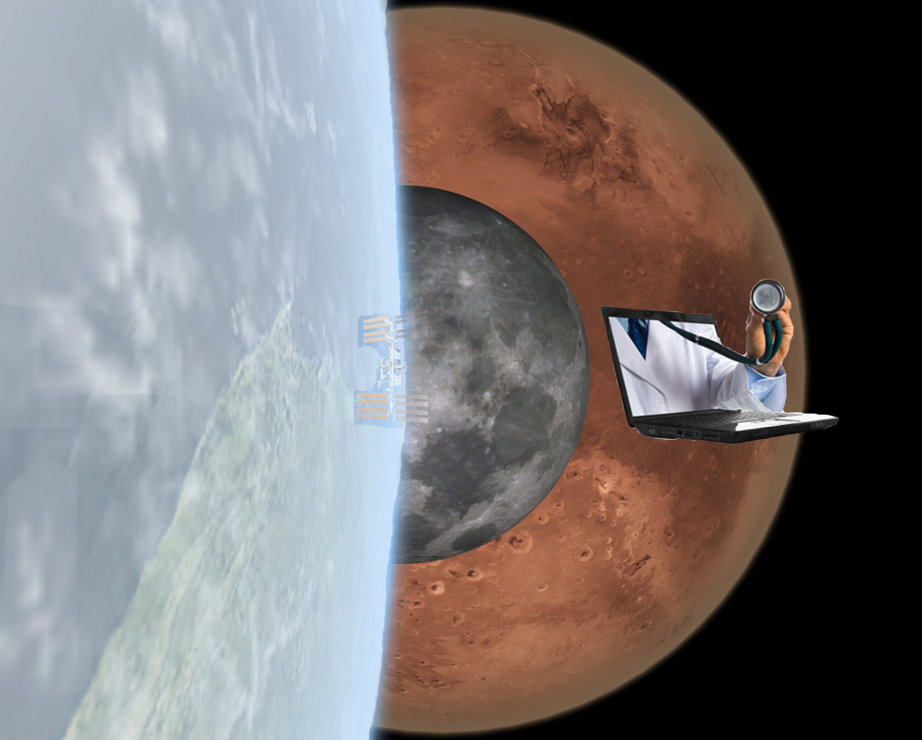
Beyond Low Earth Orbit
5

Slide 6
Training Paradigm Shift
Current
Proposed
Preflight
instruction
Instructional Just In Time (JIT)
guidance
26 hours
6-18 months preflight
In-flight
refresher
Preflight:
-JIT tool familiarization
-Selected procedures trained
Inflight:
-Review and use
In-flight
procedure

Slide 7

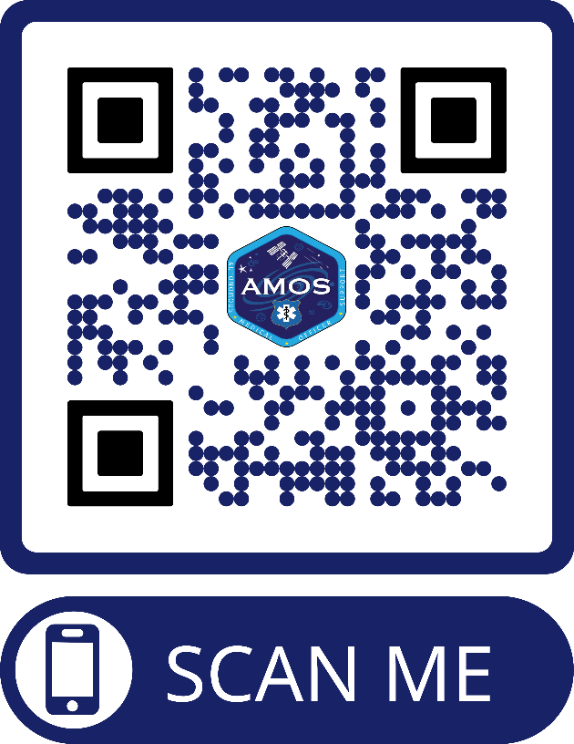
Autonomous Medical Officer Support (AMOS)
Fulfills all three functions:
  Prefight training
  Onboard JIT or refresher training
  Guidance for autonomous medical procedures
Intuitive menu-driven, human-centered, modular design
Re-coded for flexibility and compatibility with ISS systems
Current modules include kidney and urinary bladder ultrasound
Integrated use tracking and evaluation features
Platform technology - extensible to other subject areas
Notes:
Change weblink – QR code!

Slide 8
AMOS Purposes and Applications
Enhance telemedicine capability; introduce asynchrony
Enable autonomous procedure performance
Streamline the process of skill management
Reduce preflight training load
Repeated similar ISS Demos could reduce exploration kidney stone and urinary retention risks (improved monitoring)

Slide 9
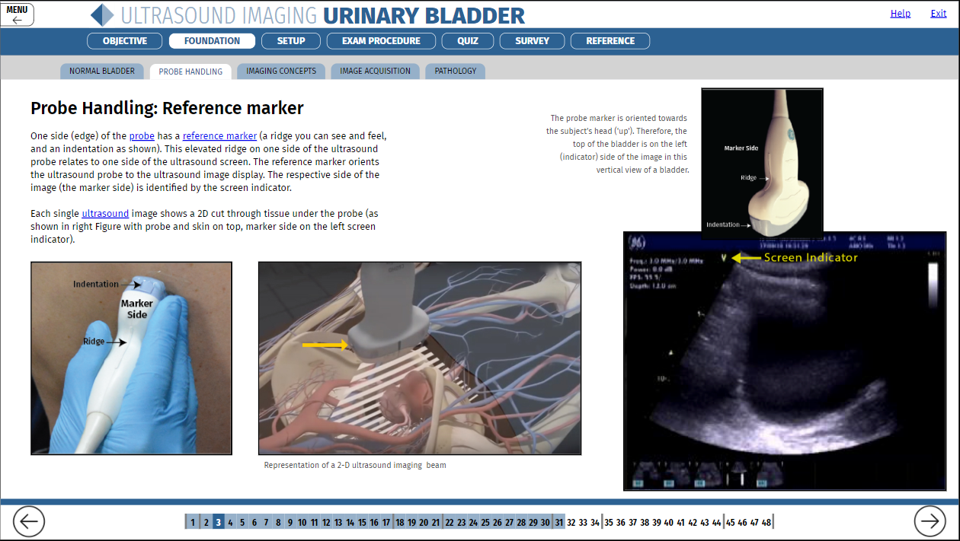

Slide 10
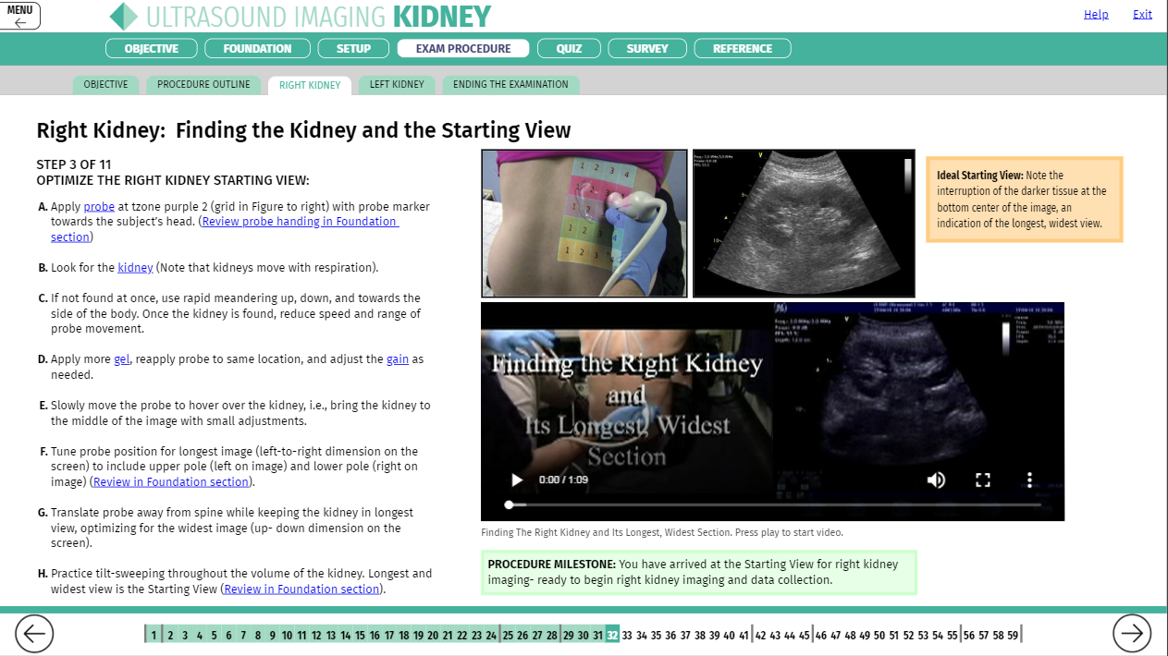

Slide 11
AMOS - Tech Demo Procedures
Flown as ExMC payload – supported by ROI
AMOS installed on ISS (3/31 - 4/2/2020)
Demo occurred 4/9/2020 (PI team observed remotely - COVID-19)
Crew Procedures:
  BEFORE scanning, operator reviews AMOS “Foundations” material
  Deploy Ultrasound2 per nominal procedures
  Set up cabin video
  Open AMOS application
  Perform bladder scan (full), perform bladder scan (post void)
  Perform kidney scan (right and left)
Postflight debrief 5/26/2020

Slide 12
AMOS - Objectives
Installation / use of AMOS in the ISS server environment (IT objective)
Use of AMOS for autonomous imaging in operational setting (telemedicine proof of concept objective)
  Obtain click tracking data
  Collect ultrasound images - urinary bladder and kidneys (irrespective of quality or compliance)
Collect crew feedback – AMOS implementation (telemedicine and AMOS improvement objective)
Record in-cabin and ultrasound scanhead video data – technical and human factors assessment (telemedicine and AMOS improvement objective)
Collect crew feedback – integrated training and procedure support (training, telemedicine, and AMOS improvement objective)

Slide 13
AMOS: Bladder Results (N=1 operator/subject)
EVALUATED DICOM INSTANCE GROUPS | NUMBER OF INSTANCES (CINE-LOOPS) | PROCEDURE EXECUTION (0-3) | INCLUSION OF TARGET ORGAN VOLUME (0-3) | IMAGING PLANE ORIENTATION (0-3) | SWEEP SPEED ADEQUACY (0-3) | AVERAGE IMAGE QUALITY (0-3) | MEASURABILITY (0-3) | EFFECTIVE IMAGING CONTENT (0-3) | SUCCESS SCORE (0-3) | SUCCESS (Y/N)
Full bladder Horizontal | 3 | 3 | 3 | 3 | 3 | 3 | 3 | 3 | 3 | Y
Full bladder Vertical | 3 | 3 | 3 | 3 | 3 | 3 | 3 | 3 | 3 | Y
Post-void Horizontal | 3 | 3 | 3 | 3 | 3 | 3 | 3 | 3 | 3 | Y
Post-void Vertical | 3 | 3 | 3 | 3 | 3 | 3 | 3 | 3 | 3 | Y
TOTAL NUMBERS AND AVERAGE SCORES | 12 | 3 | 3 | 3 | 3 | 3 | 3 | 3 | 3 | Y

Slide 14
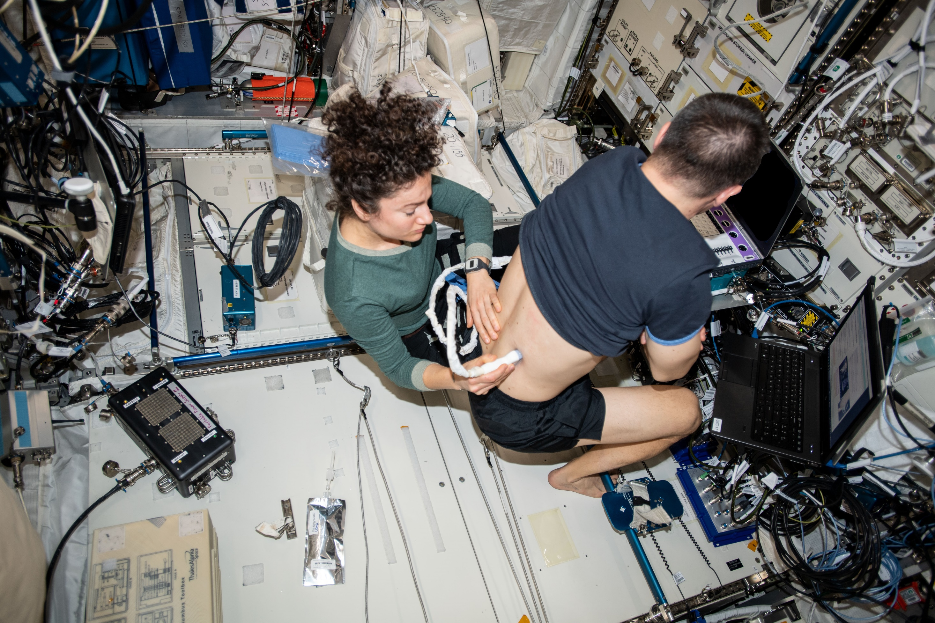
Notes:
iss062e140431

Slide 15
AMOS: Right Kidney Results (N=1 operator/subject)
RIGHT KIDNEY INSTANCE (CINE-LOOP #) | PROCEDURE EXECUTION (0-3) | INCLUSION OF TARGET ORGAN VOLUME (0-3) | IMAGING PLANE ORIENTATION (0-3) | SWEEP SPEED ADEQUACY (0-3) | AVERAGE IMAGE QUALITY (0-3) | MEASURABILITY (0-3) | EFFECTIVE IMAGING CONTENTS (0-3) | SUCCESS SCORE (0-3) | SUCCESS (Y/N)
Instance 1(0001) | 3 | 2 | 1 | 3 | 2 | 0 | 2 | 2 | Y
Instance 2 (0002) | 3 | 2 | 2 | 3 | 3 | 1 | 2 | 2 | Y
Instance 3 (0003) | 3 | 2 | 1 | 3 | 2 | 2 | 2 | 2 | Y
Instance 4 (0004) | 3 | 2 | 2 | 3 | 3 | 2 | 3 | 2.5 | Y
Instance 5 (0005) | 3 | 2 | 2 | 3 | 2 | 1 | 2 | 2 | Y
Instance 6 (0006) | 3 | 1 | 2 | 3 | 1 | 0 | 1 | 1 | N
*Instance 7 (0037) | 3 | 3 | 2 | 3 | 3 | 3 | 3 | 3 | Y
*Instance 8 (0038) | 3 | 3 | 3 | 3 | 3 | 3 | 3 | 3 | Y
*Instance 9 (0039) | 3 | 3 | 3 | 3 | 3 | 3 | 3 | 3 | Y
*Instance 10 (0040) | 3 | 3 | 2 | 3 | 3 | 3 | 3 | 3 | Y
AVERAGE SCORES | 3 | 3 | 2 | 3 | 2.6 | 1.8 | 3 | 2.8 | Y

Slide 16
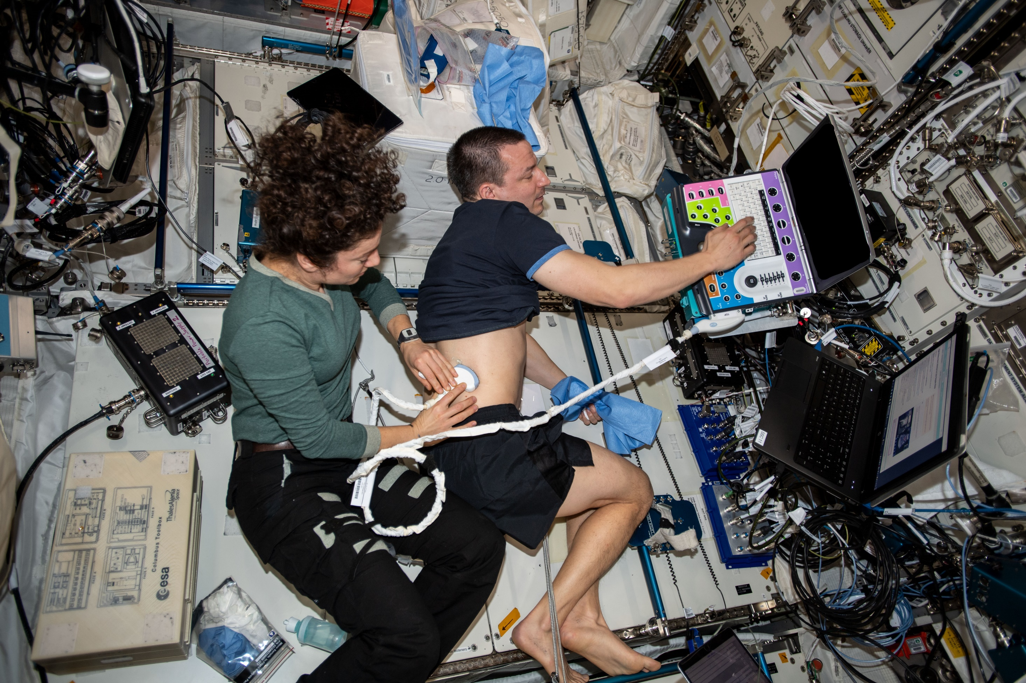
Notes:
iss062e140649

Slide 17
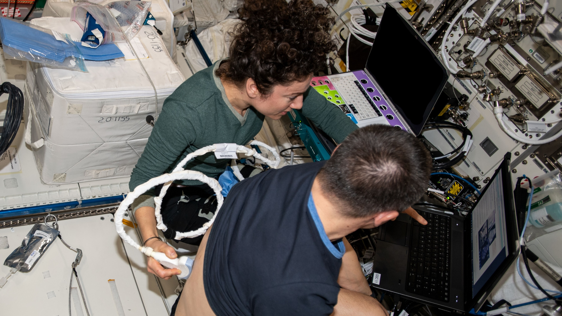
Notes:
iss062e140375

Slide 18
AMOS: Left Kidney Results (N=1 operator/subject)
TARGET ORGAN; ACTIVITY; INSTANCE (CINE-LOOP #) | PROCEDURE EXECUTION (0-3) | INCLUSION OF TARGET ORGAN VOLUME (0-3) | IMAGING PLANE ORIENTATION (0-3) | SWEEP SPEED ADEQUACY (0-3) | AVERAGE IMAGE QUALITY (0-3) | MEASURABILITY (0-3) | EFFECTIVE IMAGING CONTENTS (0-3) | SUCCESS SCORE (0-3) | SUCCESS (Y/N)
Kidney Left Instance 1 (0010) | 3 | 2 | 2 | 2 | 3 | 2 | 2 | 2 | Y
Instance 2 (0011) | 3 | 2 | 1 | 1 | 2 | 0 | 1 | 1.5 | N
Instance 3 (0012) | 2 | 1 | 1 | 1 | 2 | 0 | 1 | 1.5 | N
Instance 4 (0013) | 3 | 3 | 3 | 2 | 3 | 3 | 2 | 2.5 | Y
Instance 5 (0014) | 3 | 2 | 3 | 3 | 3 | 2 | 3 | 2.5 | Y
Instance 6 (0015) | 3 | 3 | 3 | 3 | 3 | 3 | 3 | 3 | Y
AVERAGE SCORES | 2.8 | 3 | 2.1 | 2 | 2.6 | 1.6 | 3 | 2.8 | Y

Slide 19
AMOS – User Experience
Nine acceptability statements
Rated: 1= “Strongly Disagree” to 5 = “Strongly Agree”
  usability
  content organization and level of detail
  media presentation type
  general satisfaction
Kidney module:
Bladder module:
Strongly Agree | Agree
6/9 | 3/9
Strongly Agree | Agree
7/9 | 2/9

Slide 20
Conclusion/Application
Initial AMOS demonstration highly successful
  All objectives met
  Bladder and kidney images = acceptable to excellent
  Crew feedback = excellent
AMOS platform promising as autonomy-enabling tool
  Exploration
  Ideal for gradual integration into operations / gain confidence
    Crew
    Surgeon
    Ops community
    Program

