Slide 1
Gynecological Considerations for Long-Duration Spaceflight
ASMA 2021 #4233
Jon G. Steller, MD; Rebecca S. Blue, MD, MPH; Roshan Burns, BS; Tina M. Bayuse, PharmD; Erik L. Antonsen, MD, PhD; Varsha Jain, MD; Michele M. Blackwell, MD; Richard T. Jennings, MD, MS

Slide 2
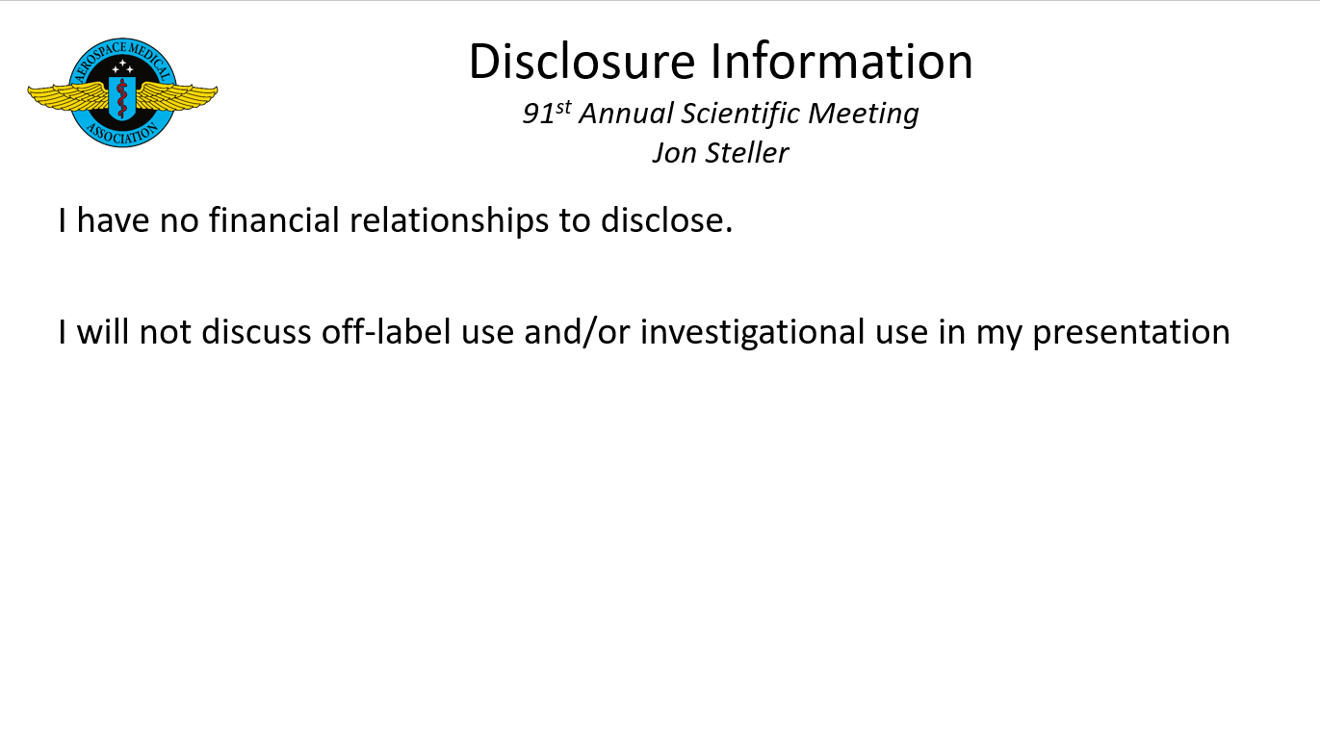
Notes:
I have no disclosures other than that my thesis research was funded by an internal grant at University of Colorado, and I am also one of the physicians on the Exploratory Medical Capabilities Element.

Slide 3
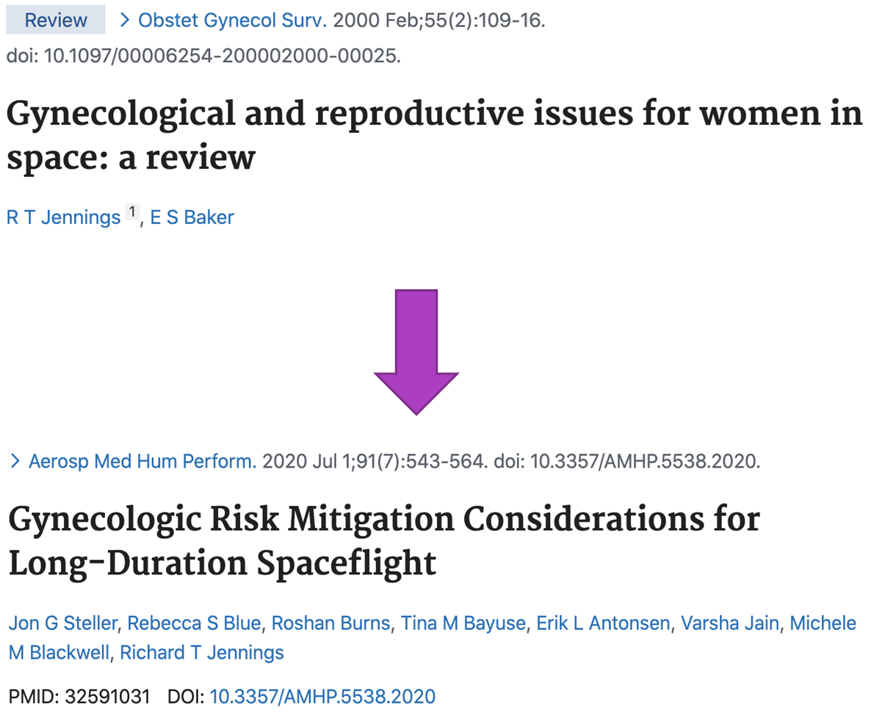
Notes:
While my research interest is rooted in the theoretical, the other half of Obstetrics and Gynecology is much more practical. However, as with OB, this area is also not well studied. The last major review of gynecologic health was performed by Dr. Jennings 21 years ago, thus it was time for a new comprehensive review inclusive of all of the gynecologic considerations NASA and private industry should be considering for long-duration spaceflight.
Our team recently published this follow up article in the Blue, and we will spend the rest of our time introducing some of the salient topics therein.

Slide 4
INTRODUCTION
Very little known how microgravity and space radiation may affect:
Normal menstruation
Fertility
Gynecologic pathology
Terrestrial analogs
Bed rest studies did not alter menstruation
HLU in rodents altered estrous cycling
Gynecologic outcomes have not been well-documented historically
AUB
Anemia
BMD
VTE
Ovarian cyst production/torsion
Cancer risk
Further, we do not know how hormonal modalities during spaceflight affect alter these risks

Slide 5
ABNORMAL UTERINE BLEEDING
BACKGROUND
Affects 14%-25% of reproductive-aged women in the US
Etiology can be structural and nonstructural
  PALM: polyps, adenomyosis, leiomyomas, malignancy/neoplasia
  COEIN: coagulopathy, ovulatory dysfunction, endometrial disorders, iatrogenic, not otherwise classified
Notes:
AUB affects nearly a quarter of all reproductive-aged women in the US and its etiologies are encompassed within the PALM-COEIN acronym. Without suspending too much reality, now imagine these things occurring in space.

Slide 6
ABNORMAL UTERINE BLEEDING
BACKGROUND
Unknown what % of female astronauts have experienced AUB
Unknown how the space environment affects AUB
  Simulated microgravity (hind-limb unloading) can affect estrous cycling in mice
  Bed rest studies have not affected the menstrual cycle
Notes:
Unfortunately, outcomes related to women’s health have not been tracked or are not available for review. Thus, it is unknown what percent of astronauts have experienced AUB before, during, or immediately following flight and it is difficult to hypothesize how the spaceflight environment might alter menses. AUB has not officially been reported in the past, however, given its prevalence terrestrially, is an important consideration for the future.
Upon review of terrestrial analogs, one study in mice has found that estrus cycles were affected by hindlimb unloading, however, bed rest studies where humans were placed in Trendelenburg for prolonged periods of time have not shown any affect.

Slide 7
ABNORMAL UTERINE BLEEDING
PREFLIGHT CONSIDERATION - STRUCTURAL
Preflight TVUS (transvaginal US) recommended for all female astronauts
Consider diagnostic ± therapeutic hysteroscopy if any concern for endometrial or intramural pathology
Notes:
In the absence of data, as will be the case for most of these gynecologic concerns, we must consider mitigation strategies. Thus, an ultrasound is recommended for all astronauts pre-flight irrespective of a history of AUB. And if structural pathology is noted, consideration is made for hysteroscopic investigation.

Slide 8
ABNORMAL UTERINE BLEEDING
PREFLIGHT CONSIDERATIONS – NON-STRUCTURAL
Screening for PCOS, thyroid dysfunction, prolactinoma
Screening for personal/family history of bleeding disorders
Screening and treatment of iron deficiency/anemia
Management of non-structural AUB:
  Progesterone-only or progesterone/estrogen therapy
  LNG IUDs are first line agents for treating new-onset AUB and preventing recurrence
Notes:
Further consideration is made for non-structural causes, and patients are screened for at baseline for thyroid dysfunction, bleeding disorders, and iron deficiency and screened for a history concerning for PCOS or prolactinoma pre-flight. Management is consistent with terrestrial recommendations.

Slide 9
ABNORMAL UTERINE BLEEDING
PREFLIGHT CONSIDERATIONS – OVARIAN SUPPRESSION
Combined hormonal contraceptives (CHCs) and LNG IUD achieve highest rates of amenorrhea if desired
  LNG IUD:
    No risks/side effects of systemic estrogen
    Remains efficacious for 5-7 years
    Function is not dependent upon strict daily compliance
  CHCs:
    May be associated with less BMD loss
    Can suppress ovarian cyst formation
    Avoids IUD-associated migratory risks
    More cumulative spaceflight experience
Notes:
Relatedly, even in the absence of AUB, suppression of menses has long been a mitigation strategy for preventing AUB. While astronauts have complete autonomy to choose a contraceptive regimen of their choice, some astronauts have chosen to place a levonorgestrel IUD and many astronauts have used continuous OCPs as both a contraceptive and suppressive modality. Motivations for this choice have included perceived benefits to bone health and prevention of ovarian cyst formation; and another driver is the practical application of amenorrhea. Storage, weight, volume, and filtration must all be considered. Whether considering it costs 1 million dollars a pound to launch goods or that storage space on long-duration missions is extremely limited, the weight and volume of contraceptives, tampons, pads, and modalities to treat AUB must be included in the equation.
Thus one our main goals currently is to consider how to delicately balance astronaut autonomy, engineering innovation, and AUB mitigation, with modalities that, at best, are 60% successful at even causing amenorrhea (if that is desired), and also have risks as we will circle back to.

Slide 10
SUPPRESSION AND CONTRACEPTION
Historically – majority have used COCs or LNG-IUD
  Terrestrial amenorrhea rates with continuous COCs 60-88%
    Dependent on daily use and adherence to dosage timing
  LNG-IUD amenorrhea peaks at 60% after 12 mo
    Paucity of evidence at >12 mo continuous use
  Limitations
    Increased risk of breakthrough spotting in first 2-3 months use
    Paucity of evidence at >12 mo continuous use
Alternative modalities
  Etonorgestrel implants – reported use during spaceflight
  Transdermal patch, vaginal ring, depot medroxyprogesterone – no reported use in spaceflight literature
Notes:
Historically, the majority of astronauts have used either COCs or the levonorgestrel IUD continuously. While COCs require remembering to take the pill every single day of the year, they have the highest amenorrhea rates at one year: upwards of 60-88%. Amenorrhea rates for the LNG-IUD peak at around 60%, but don’t require this daily compliance. They just need to be placed one time. With both modalities, there can be some abnormal spotting the first few months, and then amenorrhea rates escalate from then on.
The goal of these birth control modalities terrestrially has always been to prevent pregnancy rather than prevent menses and thus amenorrhea has always been a side effect of birth control modalities rather than an end point. Thus there has not been heavy interest in evaluating long-term amenorrhea rates. However, as there is good safety data to support continuous use and growing data that women may desire amenorrhea, there is hope that the pharmaceutical industry may consider the development of modalities that not only optimize pregnancy prevention, but also long-duration amenorrhea rates as this may be desired by many women in aerospace, the military, and in general terrestrially.
While the subdermal implant has been reported in spaceflight, the other combined hormonal modalities like the patch and the ring have not yet been reported.

Slide 11
ABNORMAL UTERINE BLEEDING
INFLIGHT CONSIDERATIONS
No perfect modality of inducing amenorrhea or preventing AUB inflight
Advanced surgical options likely unavailable
  Pharmacologic management = mainstay of treatment
Consider CMO preflight or JIT training for digital pelvic examination
  Speculums likely will not be available
Point-of-care lab tests may include CBC & pregnancy test
TAUS (TVUS if available)
Notes:
While our best treatment for AUB is preventing AUB, it will occur in flight. If severe AUB occurs, procedural options will likely not be available. Even examination will be limited, however, just in time training of the crew medical officer including digital pelvic examination is recommended by our team. While a speculum exam would be indicated terrestrially, it is unlikely that sterile speculums will be included in limited medical kits and may not be particularly useful to a non-gyn trained CMO. Ultrasound, particularly transvaginal ultrasound if available, may be a preferred diagnostic modality. Point of care CBC and urine pregnancy test would also be indicated.

Slide 12
ABNORMAL UTERINE BLEEDING
INFLIGHT CONSIDERATIONS FOR NEW-ONSET AUB
Hormonal treatments:
  Continue LNG IUD or current CHC
  Consider adding a burst taper of CHCs
  GnRH agonists/antagonists
Nonhormonal treatments:
  TXA: prevents fibrin/clot degradation w/o increasing VTE risk
  NSAIDs: shown to decrease duration and volume of menses
  Doxycycline: low risk adjunctive medication to hormonal modalities
Extreme scenarios
  IV Fluids, uterovaginal tamponade
Notes:
Thus, management will likely include adding a burst taper of OCPs. A GnRH analog has been reportedly used once before, as reported by Dr. Jennings in the literature, and could be considered for future formularies. TXA, NSAIDs, and Doxycycline may be considered for a future formulary and could be used. Under extreme circumstances, IV fluids and uterovaginal tamponade may also be implemented.

Slide 13
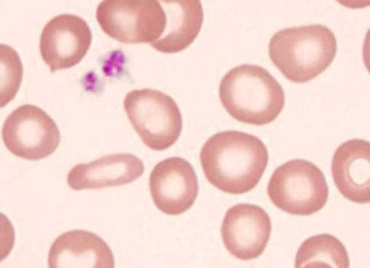
ANEMIA/IRON DEFICIENCY
PREFLIGHT CONSIDERATIONS
Anemia incidence (independent of contraceptive use) in reproductive-aged women = 10.4%
  Defined by Hb < 12 g · dL⁻¹
  Iron deficiency: MCV < 80 fL, ferritin <40 mg · L⁻¹
    In the absence of anemia, iron deficiency associated with:
      Weakness
      Fatigue
      Difficulty concentrating
Spaceflight experience:
  Association between physiological adaptation to µG
    Decline in RBC mass 10-15%
    Decrease in circulating erythropoietin
    Menstrual-associated anemia has NOT been identified

Slide 14
ANEMIA/IRON DEFICIENCY
INFLIGHT CONSIDERATIONS
Menstrual suppression through hormonal contraception:
  Reduces risk of anemia
  LND-IUD (progesterone-releasing) may stabilize or elevate iron stores after 24mo
  CHCs decrease menstrual blood loss and increase iron stores
  HOWEVER:
    Increased risk of ischemic stroke due to upregulating transferrin and inducing hypercoagulability
      Consider increased screening for iron deficiency prior to spaceflight?

Slide 15
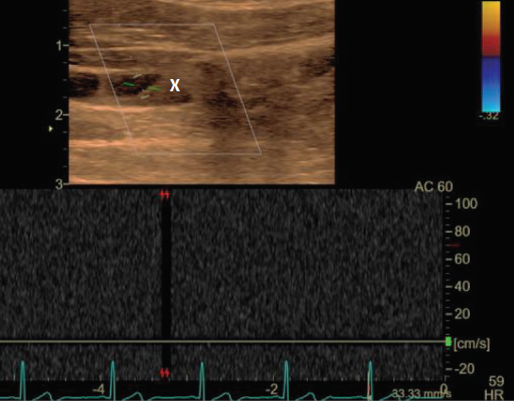
VTE
PREFLIGHT CONSIDERATIONS
Spaceflight-associated risk factors:
  Microgravity-induced blood flow / stasis
  Decreased lower limb mobility
  Altered fluid distribution
  Increased stress
  Immunosuppression
  ? Endogenous or exogenous estrogen
Terrestrially:
  VTE risk while on hormonal therapy = 0.7-1.2% (4-6x increase from baseline)
  Increased risk with:
    Higher doses of estrogen
    First 3 months after initiation of therapy
    3rd/4th gen COCs > 1st/2nd gen COCs
    COCs > or < Ring/Patch? (First-pass metabolism)
    Thrombophilias
Notes:
First-pass metabolism source: https://www.ncbi.nlm.nih.gov/pmc/articles/PMC3025417/
https://www.fertstert.org/article/S0015-0282(16)62847-9/pdf

Slide 16
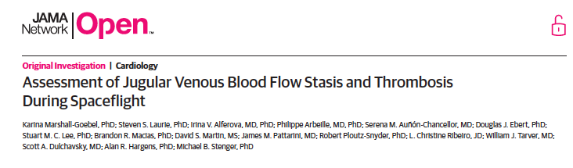
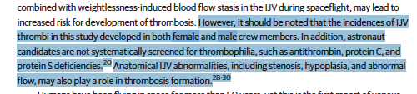
VTE
Risk of VTE
Extensive use of hormonal supplementation in spaceflight
NO evidence that hormonal supplementation has directly contributed to the development of VTE
NO clinically significant VTE to date
Alterations of venous flow observed in MALE AND FEMALE crewmembers
Notes:
https://www.rankred.com/space-radiation-causes-astronauts-to-lose-bone-and-muscles/

Slide 17
BONE MINERAL DENSITY
PREFLIGHT/INFLIGHT CONSIDERATIONS
Astronauts lose ~1% bone mass/mo during spaceflight
Estrogen
  Shown to be protective against cortical / cancellous BMD loss in microgravity analogs and spaceflight
  Evidence is inconclusive for LNG IUD
Recommend vitamin D and calcium supplementation
Recommend resistive exercise
May consider bisphosphonate
Notes:
Regarding bone mineral density, astronauts routinely perform resistive exercise and take calcium and vitamin D supplements. Estrogen in COCs has been shown to be protective in spaceflight, and while bisphosphonates are being considered, long-term data are not yet available and one safety concern includes VTE.

Slide 18
OVARIAN CYSTS
PREFLIGHT CONSIDERATIONS
Ovarian cyst production is common following ovulation
  Present in 5-7% of reproductive-aged females
  Most will resolve spontaneously
  Theoretically, large/complex cysts can prompt ovarian torsion
Preflight management:
  Observation vs. laparoscopic management for simple cysts
  Work-up for malignancy if concern
Notes:
Ovarian cysts are very common in all reproductive-aged females, and most often resolve if they are simple and under 6cm. As noted before, all astronauts undergo pre-flight TVUs and if an ovarian cyst is found it must be observed with consideration for removal if there is concern that it may not resolve, carries a torsion risk, or carries a malignancy risk.
While there are no reported cases of ovarian torsion in the astronaut population to date, there will always be concern for a spontaneous large cyst to lead to complications including torsion, rupture, or hemorrhage

Slide 19
OVARIAN CYSTS
INFLIGHT CONSIDERATIONS
Acute abdominopelvic pain during flight:
  Consider torsion
  TAUS (or TVUS if available) may be diagnostic
Management of Torsion:
  Terrestrially: surgical emergency for preservation of ovarian tissue and prevention of rare but severe morbidities
  Inflight management: conservative measures including of pain control and management of sequelae
    Long-term risks likely low
Notes:
In-flight torsion workup may include transabdominal ultrasound and in-flight management includes pain control and supportive measures. With successful expectant management of true torsion leading to ischemia of that ovary, data suggest that the non-affected ovary may compensate for the lack of hormone production from the necrosed ovary and long-term risks of osteoporosis or infertility are low.

Slide 20
Contraception
Bone Mineral Density
Amenorrhea
Ovarian Cysts
VTE
Notes:
I think it is fair to say that this most recent thrombosis has reignited fears of the additive risk of estrogen-containing contraceptives carry and how we think of the complex risk/benefit interplay regarding contraceptives in the operational medical group.

Slide 21
ENDOMETRIOSIS
PREFLIGHT/INFLIGHT CONSIDERATIONS
Endometriosis affects 10% of reproductive-aged women
Gold standard diagnosis: Laparoscopy
Therapeutic options:
  Continuous CHCs
  High-dose progestins
  GnRH agonists/antagonists with add-back estrogen
Notes:
Endometriosis affects 10% of all reproductive age women and it is also unknown how endometriosis can complicate spaceflight. It was long feared that microgravity could make this process worse by exacerbating retrograde menstrual flow into the pelvis, however, this has not been observed. Laparoscopy is gold standard diagnostic modality with no alternative non-invasive screening modalities that can accurately diagnose endometriosis prior to spaceflight, thus it is not screened for beyond taking a history and performing an ultrasound. However, without serious dysmenorrhea, endometriomas, or pelvic adhesive disease, endometriosis is not a disqualification for spaceflight

Slide 22
HEALTH MAINTENANCE
PREFLIGHT/INFLIGHT CONSIDERATIONS
Recommend preflight screening for STIs / Pap Smear within 12 months of flight
  Chlamydia, Gonorrhea, Trichomonas, Syphilis, HSV, HIV, HPV
Consider HSV suppression during flight
  If affected, consider prophylaxis
HPV vaccine encouraged for all astronauts
  Early colposcopic management if necessary
Notes:
Some of the pre-flight screening recommendations include: screening for STIs such as Chlamydia, Gonorrhea, Trichomonas, Syphilis, HSV, HIV, HPV) and performing a Pap Smear within 12 months of flight
HSV suppression during flight can be considered for patients with history of HSV.
Lastly, the HPV vaccine should now be encouraged for all astronauts given the liberalization of ages allowed to receive it

Slide 23
HEALTH MAINTENANCE
PREFLIGHT/INFLIGHT CONSIDERATIONS
Screening for perimenopausal symptoms, urogynecologic symptoms, vulvar/vaginal dermatoses prior to flight
Screening for family history of gynecologic/breast cancers as well as familial cancer syndromes
Annual clinical breast exams
Diagnostic mammograms ± US/MRI PRN starting at age 35
Notes:
Others include screening for perimenopausal symptoms, urogynecologic symptoms, vulvar/vaginal dermatoses prior to flight, screening for family history of gynecologic/breast cancers as well as familial cancer syndromes, annual clinical breast exams, and diagnostic mammograms ± US/MRI as needed starting at age 35
Recommendations are population-specific. We have a high-risk operational environment; thus, use of more frequent exams, even when associated with a higher false-positive rate and the need for additional testing, is a reasonable option to buy down risk in a resource-limited mission environment.

Slide 24
CANCER/NEOPLASM
PREFLIGHT/INFLIGHT CONSIDERATIONS
Life-time cancer risk and cancer-related mortality in terrestrial women is 27% and 18%, respectively
Breast and gynecologic cancers have not been found to be increased in astronauts
CHCs are known to reduce the incidence of ovarian (30-50%), endometrial (30%), and colorectal (15-20%) cancers
  LNG-IUDs may actually reduce these risks as well
CHCs may be associated with slightly higher risk of breast cancer (7%)
  However, this appears to be more associated with triphasic OCPs and decreases after use
Notes:
https://www.cancer.gov/about-cancer/causes-prevention/risk/hormones/oral-contraceptives-fact-sheet

Slide 25
PREGNANCY / FERTILITY
PREFLIGHT/INFLIGHT CONSIDERATIONS
Discuss fertility desires and timing before mission assignment
  Discuss age-related risks associated with advanced maternal age if delaying parity
  Fertility outcomes have not been robustly studied post-flight
Discuss contraceptive modalities, the risk of pregnancy inflight is > 0%
Routine pregnancy testing with final preflight pregnancy test performed ~10 days prior to flight
Notes:
While the majority of fertility risk will likely be age-related rather than spaceflight-related, fertility desires should be discussed prior to flight to empower astronauts to make a patient-centered decision regarding timing of parity and/or possible future consideration of assisted reproductive technologies if delaying parity.
It goes without saying that the risk of pregnancy, even with contraception during flight, is not zero percent.
Lastly, routine pregnancy testing is performed with the last one ~10 days prior to flight, however, any pregnancy event that happens within the pre-launch timeframe may not be captured by this 10-day out timeframe.

Slide 26
Conclusions
Women’s Health = Astronaut Health
  All considerations are intended to address risk mitigation and reduction of onboard needs for medical resources or skillsets
Long-duration spaceflight will introduce continued and novel challenges for maintenance of gynecological and reproductive health
There is a driving need for increased data collection and analysis to properly characterize and mitigate women’s health risks in future spaceflight
Women’s Health = Astronaut Health
  All considerations are intended to address risk mitigation and reduction of onboard needs for medical resources or skillsets
Long-duration spaceflight will introduce continued and novel challenges for maintenance of gynecological and reproductive health
There is a driving need for increased data collection and analysis to properly characterize and mitigate women’s health risks in future spaceflight
Notes:
Women’s Health = Astronaut Health. All considerations are intended to address risk mitigation and reduction of onboard needs for medical resources or skillsets
Long-duration spaceflight will introduce continued and novel challenges for maintenance of gynecological and reproductive health
There is a driving need for increased data collection and analysis to properly characterize and mitigate women’s health risks in future spaceflight

Slide 27
References
Women’s Health = Astronaut Health
  All considerations are intended to address risk mitigation and reduction of onboard needs for medical resources or skillsets
Long-duration spaceflight will introduce continued and novel challenges for maintenance of gynecological and reproductive health
There is a driving need for increased data collection and analysis to properly characterize and mitigate women’s health risks in future spaceflight
Steller et al 2020
Aunon-Chancellor et al 2020
Marshall-Goebel et al 2019
Blue et al 2019
Daniels et al 2018
Munro et al 2018
Antonsen et al 2017
Ronca et al 2014
Jennings et al 2000
ACOG PB 73 2006
ACOG PB 210 2010
ACOG CO 602 2014
ACOG PB 174 2016
ACOG PB 128 2012
ACOG PB 136 2013
ACOG PB 168 2016
ACOG PB 179 2017
ACOG PB 182 2017
ACOG PB 186 2017
ACOG PB 129 2012
Notes:
EVIDENCE LIBRARY
MED PROBALISTIC RISK ANALYSIS TOOL (MED PRAT)
ACCEPTED MEDICAL CONDITION LIST

Slide 28


  

