Slide 1
ISS Crew Medical Officer Training
Rachel Richardson, BSN, RN, CEN, CPEN
Health Maintenance System Instructor
Space Medicine Operations
NASA Johnson Space Center
2 September 2021
Co-authors:
Piper, S., Hailey, M.
Aerospace Medical Association
91st Annual Scientific Meeting
Denver, Colorado
Approved for public release – HHPC PubPress/ STRIVES – TBD Date

Slide 2
Disclosure Information
I have the following financial relationships to disclose:
Rachel Richardson: HMS Instructor, KBR
Steven Piper: Flight Surgeon, Medical Operations, NASA
Ron Moomaw: Psychiatrist, TBD
Melinda Hailey: Integrator/Instructor, Axiom Space
I will not discuss off-label use and/or investigational use in my presentation
Notes:
Once all the presentations in the panel are seamed together, this slide will likely be absorbed into the first pitch from Kris (that’s how we did it last time)

Slide 3
Objectives
Increase familiarity with ISS Crew Medical Officer training and role of ground medical support
- Current Practice – In flight Medical Operations
- Current Practice – Ground and In flight CMO Training
Notes:
In order to more clearly see the path to exploration, we need to understand where we are today.
This talk will provide context for how medical care is provided in flight today, as well as how we prepare the crew to enable that care.

Slide 4
In Flight Medical Operations – Current State of Medical Decision Making
Vehicle Medical System
Ground Medical System
Ground:
SME -Physicians
SME - Psychologist
SME – Imaging, Laboratory, Dietitian, Strength & Conditioning
SME – Medical Consultants
SME- Engineering
Flight:
CMO – Non physician
CMO – Physician (intermittent)
Medical procedures
In-flight training tools
Notes:
ISS Operations place significant burden of medical decision support on the ground medical system
Near real time communication (voice definitely, video for a significant amount of time) enables the flight system to be dependent on ground system for access for knowledge enhancement and clinical decision making.
Ground medical system has access to diverse community of experts to optimize crew health during a mission as well as intervene in the event of an unexpected medical event.
By design, this limits the training burden to ISS CMOs and places it upon the SME ground system, optimizing crew time prior to launch to focus on gaining knowledge, skills, and abilities for more pertinent tasks (EVA, science/research operations, etc).

Slide 5
Current Practice – In flight Medical Decision Making
Current Practice - In flight Medical Operations
  Unplanned, emergent events
  Unplanned, non-emergent events
  Planned, non-emergent events
Notes:
Medical events fall into three categories that make it easier to think about where the burden of medical decision making occurs – Unplanned – Emergent, Unplanned – NonEmergent, and Planned-NonEmergent.

Slide 6
Current Practice – Inflight Medical Decision Making
  Unplanned, emergent events:
  Fully autonomous response
  All crew trained to provide same level of response
  Conditions/Capabilities
    Anaphylaxis first response (Epinephrine auto injector)
    Choking (abdominal thrusts)
    Cardiac arrest (airway, assisted ventilation, defibrillation, epinephrine via intraosseous device)
    Psychological emergencies – safety of crew and vehicle
Ground Medical System
Vehicle Medical System

Slide 7
Current Practice – Inflight Medical Decision Making
  Unplanned, non-emergent events:
  Limited crew autonomy expected, ground-based flight surgeon/BHP directs care
  Crew medical officer has specialized training with access to a limited amount of written procedural guidance (4 extra hours of training)
  Capabilities include med administration, wound care, bladder catheterization, etc.
Ground Medical System
Vehicle Medical System
Notes:
Content for crew medical training is based on the ops concept for inflight medical decision making
’All crew’ includes all USCV crewmembers as well. Private astronaut mission requirements are still being discussed, will likely be purchasing a la carte training flows (space flight participant level – HMS OV only, USER level, CMO Specialist)

Slide 8
Current Practice – Inflight Medical Decision Making
  Planned, non emergent events:
  Amount of autonomy is based on the task with telemedicine support from ground
  Crew medical officer has specialized training with access to a limited amount of written procedural guidance
  Capabilities– straddle medical and research domains
    Limited physical exam
    Limited imaging
    Blood sample collection
Ground Medical System
Vehicle Medical System
Notes:
Content for crew medical training is based on the ops concept for inflight medical decision making
’All crew’ includes all USCV crewmembers as well. Private astronaut mission requirements are still being discussed, will likely be purchasing a la carte training flows (space flight participant level – HMS OV only, USER level, CMO Specialist)

Slide 9
Current Practice – Ground and Inflight CMO Training
Current Practice – Ground and Inflight CMO Training

Slide 10
Current Practice – Crew Training
  Training Duration/Timing - Ground:
  Total duration of formal ground training = 8.75 – 16 hours (does not include imaging/research)
  90% of training is delivered in the 18-20 months prior to launch
  Training Duration/ Timing – In Flight:
    Planned: computer-based training at monthly intervals during mission for CMO (.5 hrs duration?)
    Planned: Medical Contingency Drill – whole crew, early in mission (not a simulation) (1 hr duration?)
    Unplanned: new hardware/software/ops, medical contingencies – Just in Time or Scheduled, duration TBD
Notes:
Crew training methods are employed to match with the ops concept for inflight medical decision making.
Lecture and return demonstration is used initially for all trained content, but simulation is layered into the training plan to help build competency and autonomy

Slide 11
Current Practice – Crew Training
  Training Methods/Content:
  Lecture, return demonstration
    Using hi fi hardware, task trainers, and manikins
    Examples include giving injections, vital sign collection, performing bladder catheterization, CPR, placing supraglottic airway, etc
  Simulation (med & high) using task trainers, hi fi hardware, manikins, and human subjects
    Simulations are selected to build:
      Competency and autonomy for emergent conditions (initial anaphylaxis, choking, cardiac arrest, emergent control of bleeding)
      Competency and efficiency for planned medical events that are more complex or require space: ground choreography (imaging, phlebotomy)
    Simulations for emergent conditions are done as a crew (no less than 2 times preflight)
  Optional – field training in local healthcare facility (40 hrs)
Notes:
Crew training methods are employed to match with the ops concept for inflight medical decision making.
Lecture and return demonstration is used initially for all trained content, but simulation is layered into the training plan to help build competency and autonomy

Slide 12
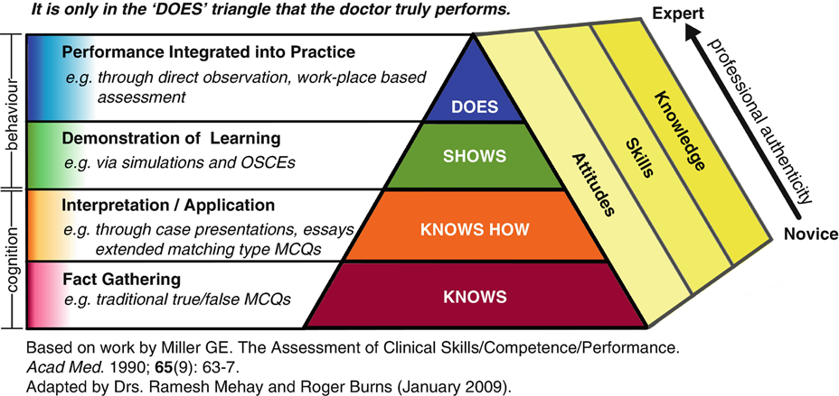
Transitioning to Exploration and Autonomy
Shifting medical decision making from ground to flight has consequences to astronaut training and maintenance of competency
  Current training for non-physician astronauts places them closer to the novice end of the novice-to-expert continuum
  Future efforts will need to push the CMO towards the expert end of the continuum
Making this transition requires reconsidering current assumptions on:
Duration of ground-based training
Training methods employed to generate competency and autonomy
Scope of skill set as it relates to agency’s comfort with medical risk in flight
Types of inflight tools use to support medical decision making
Environment of care
Equipment availability
Graphic shared with permission – Roger Daglius Dias,
Notes:
In the upcoming talks, you will hear from speakers providing more context to these areas (duration, training methods, scope of skill set, types of inflight tools).
NOTE: This slide is intended to be a transition to the next speakers in the panel – they will be speaking about the technical challenges of providing healthcare in space (touching on the ‘what do we train;?’ part, In flight medical decision support framework and software based tools, as well as how training should modify to support the CMO of the future.
Re: second bullet re: scope of skill set – might be a more competent way to say this, but trying to communicate that there is no point teaching astros how to be neurosurgeons if we aren’t going to be doing neurosurg in space. Requires a focus on defining critical inflight capabilties, defining what capabilities require inflight augmentation (cdss, knowledge support, etc)
Image credit: From Roger Dias, MD, shared with permission

Slide 13
Questions?
rachel.c.richardson@nasa.gov

Slide 14
Backup Charts

Slide 15
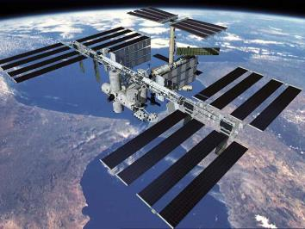
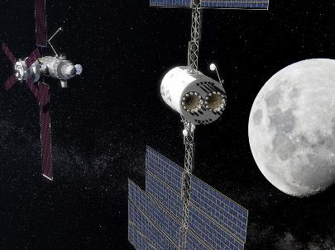
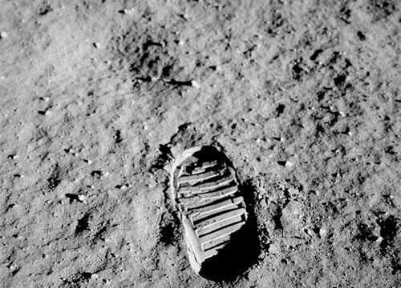
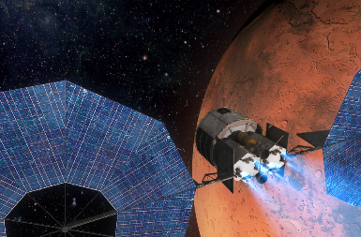
Risk Drivers for Medical and CHP System Needs
Mission Duration
&
Hazard Exposure
Resupply &
Evacuation
Capability
On-Board
Decision Making
(comm delay)
On-Board
Capabilities
Shorter
Possible
Minimal
Less
Influencers
Mission duration and high-level objectives
Distance from Earth
Acceptable mission risk
Time to definitive medical care
Health and performance needs
Level of training for on-board medical provider(s)
Technology developments and medical advances
Crew selection and pre-flight health status
Longer
Impossible
Substantial
More

Slide 16
NASA-STD-3001 Levels of Care
Level 1
LEO <8d
Space Motion
Sickness
First Aid /
Anaphylaxis
Response
Basic Life
Support
Private Audio
Level 2
LEO <30d
Clinical
Diagnostics
Ambulatory
Care
Private Video
Private
Telemedicine
Level 3
Post LEO <30d
Limited
Dental Care
Limited
Advanced
Life Support
Trauma
Care
Level 4
Lunar >30d
Medical
Imaging
Dental Care
Sustainable
Advanced
Life Support
Limited
Surgical Care
Level 5 *
Lunar/Planetary
>210d
Autonomous
Ambulatory
Care
Autonomous
Advanced
Life Support
Basic
Surgical Care
* Physician-level training required only at Level 5

Slide 17
Exploration – Crew Training
Medical Decision Making
Crew Training
  Unplanned, emergent events:
  Will the whole crew be trained to provide same level of response?
  What conditions are applicable for this level of response?
  Unplanned & Planned, non emergent events:
  Crew autonomy expected with CMO (physician)as the provider with some specialist ground consultation expected
  How do you scope medical capabilities to the physician astronaut vs non-physician (backup) to ensure redundancy?
  Training Methods:
  Probably no deletions from current methods
  Consider adding hands on, live patient care to curriculum
  Training content:
  Likely will need to be modified, based on
    New conditions of concern due to new environment/mission tasks/duration of mission
    Increased complexity of medical capabilities required due to shift towards inflight medical autonomy
  Timing:
  To ensure inflight competency, will need to reevaluate the duration and environment of ground-based crew training
  How can you shift some of this training into the inflight domain?
Notes:
We need to have more insight into exploration missions and plans for inflight medical decision making to help inform how the training paradigm should shift

