Slide 1


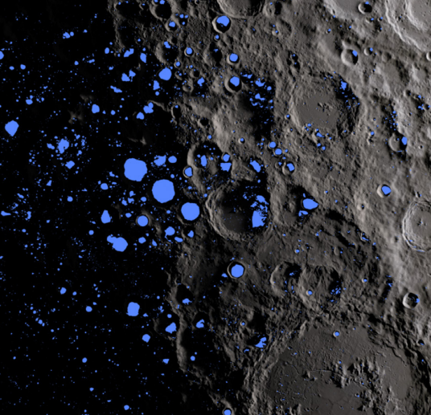
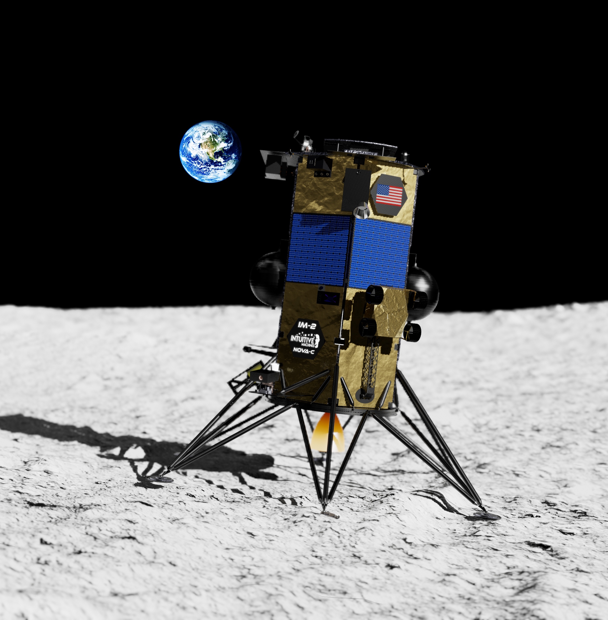
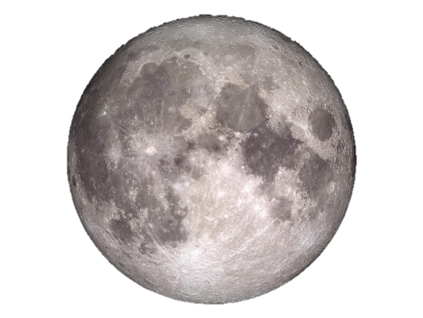
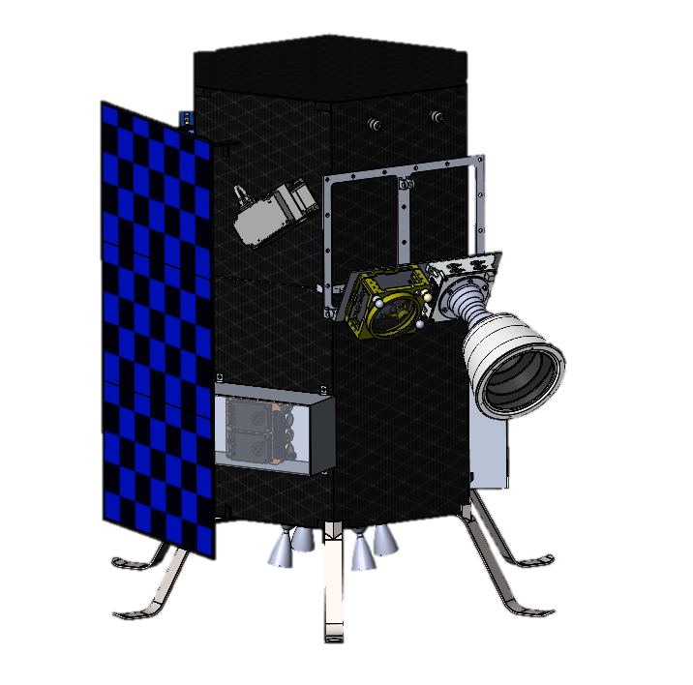
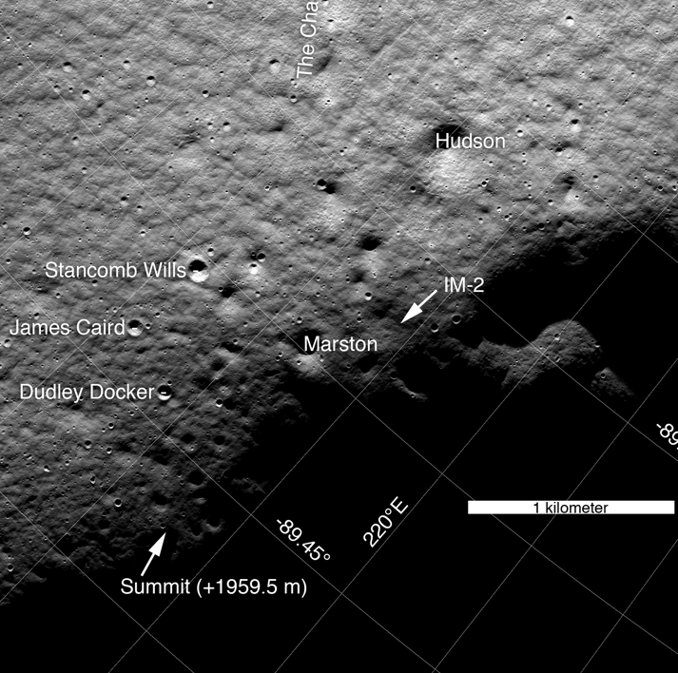
Intuitive Machines Deployable Lunar Hopper “𝝁-Nova”
a.
Project Overview
As part of Tipping Point Topic 2, “Lunar Surface Innovation Initiative Technology Demonstration”, Intuitive Machines (IM) will develop and demonstrate on the lunar surface a deployable robotic hopper (𝜇Nova) which will provide access to extreme environments not accessible by rovers or other technologies. A science payload provided by Arizona State University (ASU) will fly on this first demonstration of 𝜇Nova. 𝜇Nova is enabling for lunar surface science by providing a low-cost secondary payload option for CLPS landers. The platform is flexible to accommodate different payloads on different mission profiles.
Technical Approach
The project leverages mature landing system technologies developed for the Nova-C platform. IM will develop, build, test and fly 𝜇Nova, delivering the ASU science payload data to NASA.
Results/Summary
IM has completed a kick-off meeting with NASA, set Key Performance Parameters, conducted PTR#1 (similar to a PDR), procured long lead items, developed the Payload Integration Plan and the baseline mission design with landing site selection.
d.
b.
a. Map of permanently shadowed regions at the lunar south pole
b. CAD model of the current 𝜇Nova design
c. Landing site for demonstration mission
d. Nova-C, IM’s lander which will be delivering 𝜇Nova as well as other payloads during IM-2
c.

Slide 2
Contributing Partners
Intuitive Machines as well as Arizona State University contribute funding for 𝜇Nova.
Infusion and Transition Plan
Once the demonstration mission is complete, 𝜇Nova will be at TRL 9. This retires substantial technical and programmatic risk for principal investigators and lunar prospectors searching for ways to access extreme locations on the lunar surface. By retiring this risk, IM demonstrates the capability to market and sell to prospective payload customers in government, academia and industry. 𝜇Nova will be a commercially available space technology. 𝜇Nova is designed with the capability to integrate onto other landers and there are plans and designs for a scaled-up variant that could host larger payloads.
a.
d.
b.
a. Map of permanently shadowed regions at the lunar south pole
b. CAD model of the current 𝜇Nova design
c. Landing site for demonstration mission
d. Nova-C, IM’s lander which will be delivering 𝜇Nova as well as other payloads during IM-2
c.

