Slide 1
Planetary Protection Overview
Mars Sample Return NEPA Team PP Overview
J. Nick Benardini, PhD
NASA Planetary Protection Officer
July X, 2021

Slide 2
Overview
Planetary Protection Objective
UN Treaty to NASA Policy
Planetary Protection Categorization
Types Biological Contamination
Forward Planetary Protection
Backward Planetary Protection
  Restricted Earth Return Identification
  Break-the-chain
  Multiple elements considered for back planetary protection

Slide 3

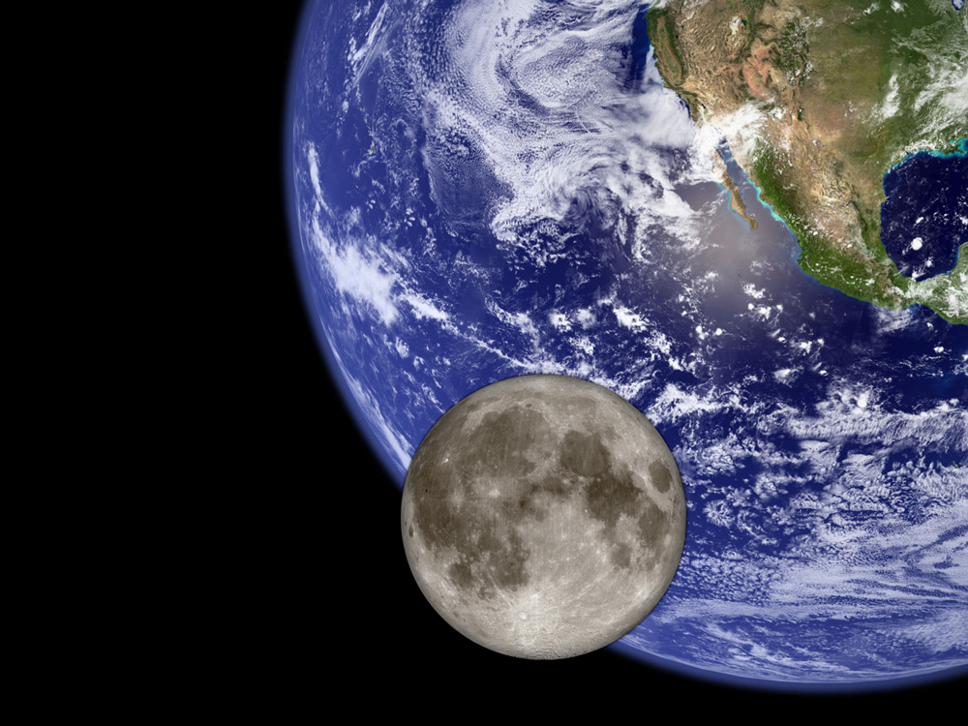
Planetary Protection Objective
Protect current and future scientific investigations by limiting biological and relevant molecular contamination of other solar system bodies through exploration activities and protecting the Earth’s biosphere by avoiding harmful biological contamination carried on returning spacecraft, as described in the Outer Space Treaty.
Forward PP - Understand and control harmful contamination of other worlds by terrestrial organisms, organic materials, and volatiles from spacecraft
Backward PP - prevent harmful biological contamination of the Earth-Moon system by potential extraterrestrial life and bioactive molecules in returned samples

Slide 4
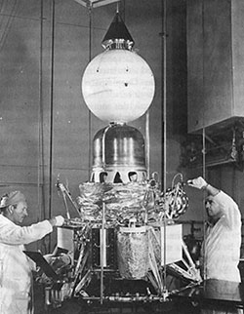
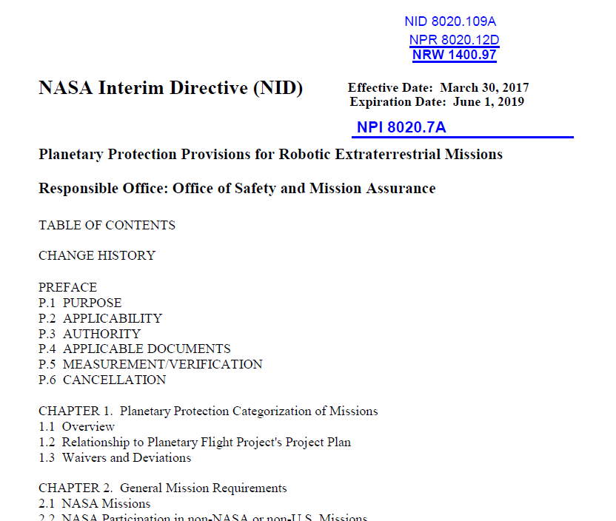
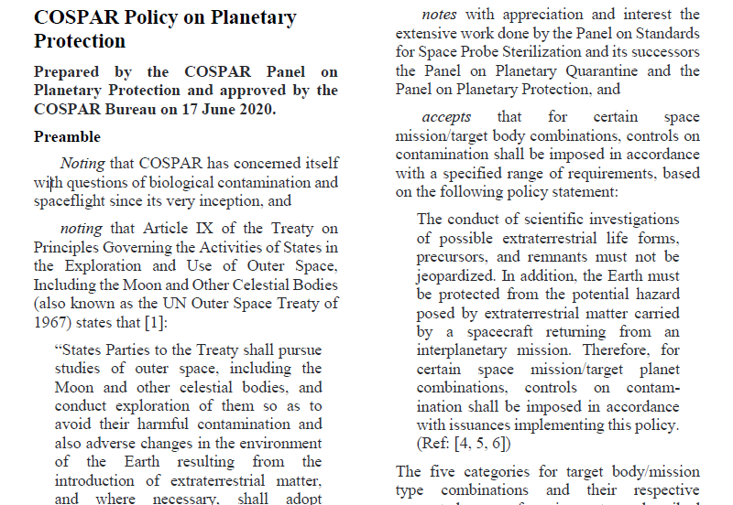
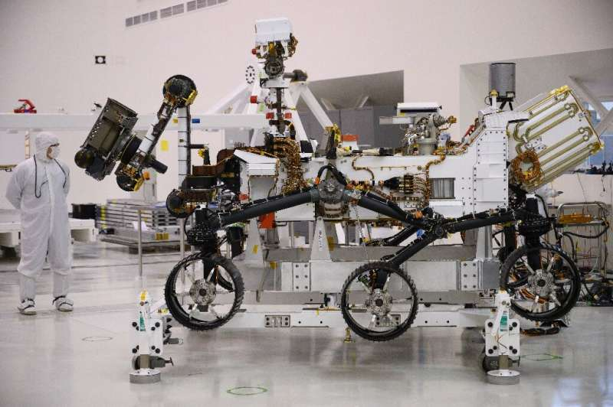
Over 60 Years of Planetary Protection…
Committee on Space Research (COSPAR) – first code of conduct and responsibility for Planetary Protection (October 1958)
The UN Outer Space Treaty of 1967 “Article IX. States Parties to the Treaty shall pursue studies of outer space, including the Moon and other celestial bodies, and conduct exploration of them so as to avoid their harmful contamination and also adverse changes in the environment of the Earth resulting from the introduction of extraterrestrial matter…”
Credit: NASA
1961 – Ranger Project 1st to Implement PP
2020 – Mars 2020 last launch of a bioburden controlled mission
Space Research Today, No 208, August 2020, Pages 10-22
NID 8020.109A / NPR 8020.12D

Slide 5
Planetary Protection Categorization – Outbound + Inbound
Planetary Target Priority | Mission Type | Planetary Protection Category | Example Target Bodies
Not of direct interest for understanding the process of chemical evolution or where exploration will not be jeopardized by terrestrial contamination. | Any (Flyby, Orbiter, Lander) | I | Undifferentiated, metamorphosed asteroids, Io
Of significant interest relative to the process of chemical evolution but only a remote chance that contamination by spacecraft could compromise future investigations. | Any (Flyby, Orbiter, Lander) | II | Earth’s Moon (Cat. IIa & IIb), Venus, Comets, Asteroids, Jupiter; Jovian Satellites (excluding Io, Ganymede and Europa), Saturn; Saturnian Satellites (excluding Titan and Enceladus), Uranus, Uranian Satellites, Neptune, Neptunian Satellites (excluding Triton), Kuiper-Belt Objects <1/2 the size of Pluto
 |  | II* | Jovian Satellites: Ganymede, Saturnian Satellites: Titan, Neptunian Satellites: Triton, Pluto/Charon
Of significant interest relative to the process of chemical evolution and/or the origin of life and for which scientific opinion provides a significant chance that contamination by spacecraft could compromise future investigations | Flyby, Orbiter | III | Mars, Europa, Enceladus, Others to be determined
 | Lander, Probe | IV | Mars (Cat. IVa, IVb & IVc), Europa, Enceladus, Others to be determined
Any Solar System Mission | All Earth Return | V(r): Restricted Earth Return | Restricted Earth Return: Mars Europa Enceladus Others to be determined
 |  | V(u): Unrestricted Earth Return | Unrestricted Earth Return: Earth’s Moon Venus Most asteroids and comets (e.g., Bennu, Ryugu) Others to be determined

Slide 6
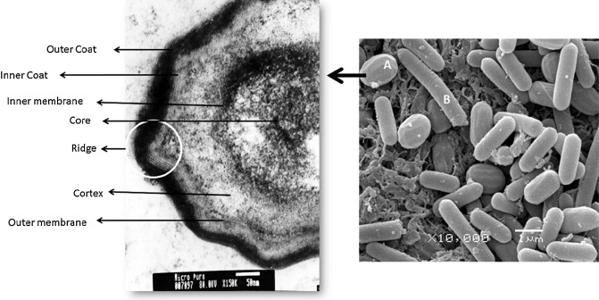
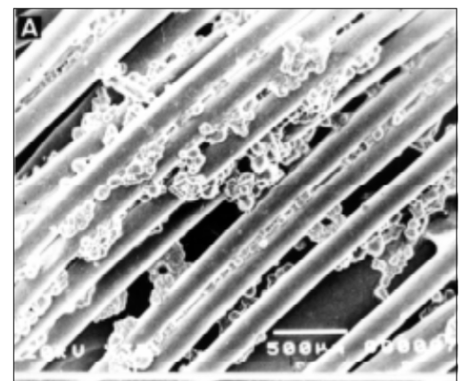
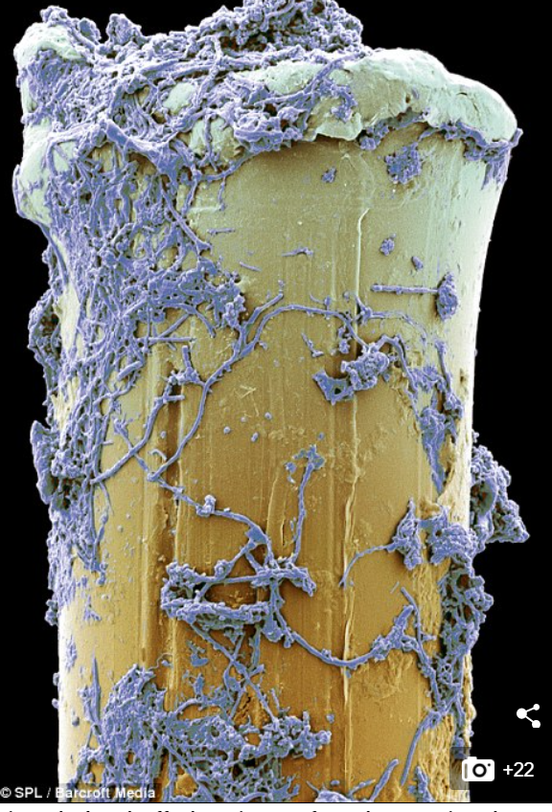
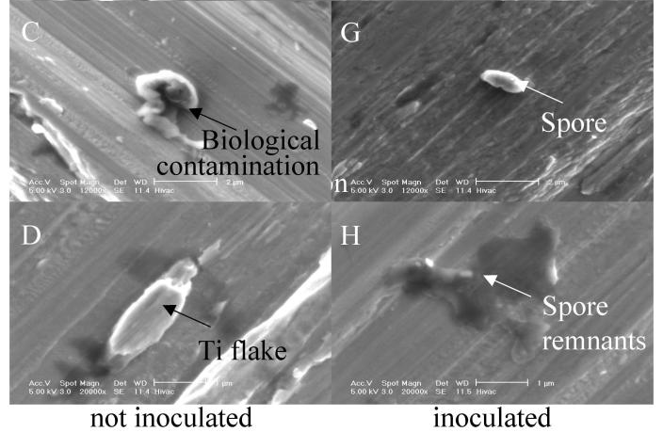
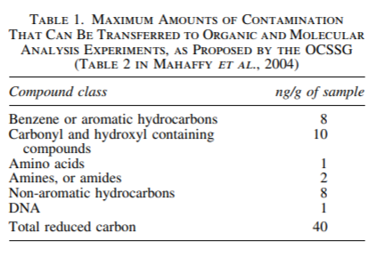
Examples of Biological and Relevant Molecular Contamination
Credit: Sella et. al. 2014
Bacterial Spore
Credit: Filho et. al. 2000
Bacteria on a toothbrush fiber
Credit: Venkateswaran et. al. 2004
Titanium Spacecraft Coupon

Slide 7
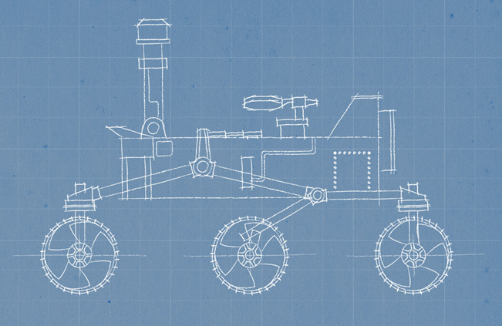
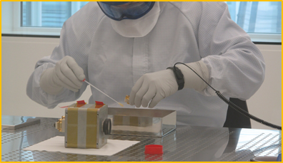
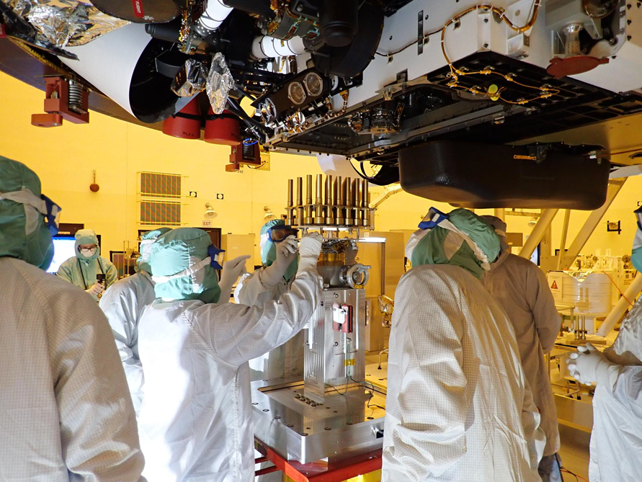
Forward Planetary Protection
Hardware Design
(Systems Engineering)
Hardware Implementation (Clean)
Recontamination Prevention
(Keeping it Clean)
Establish Driving Requirements
Bioburden Allocation
Implementation Planning
Microbial Reduction (e.g. heat microbial reduction, etc)
Verification of cleanliness (e.g. NASA Standard Assay for spores)
Cleanroom assembly and test
Launch environment cleanliness
Hardware cleaning and covering
Late critical system installation
5 x 10⁵ spores total
3 x 10⁵ spores landed
300 spores / m²
Credit: NASA / JPL
Credit: ESA
Credit: NASA / JPL
Verification – Swab of the ExoMars camera
Late integration of the Mars 2020 Sample Tubes
Planetary Protection starts in early mission phases

Slide 8
Mars Restricted Earth Return – Key PP Requirements
COSPAR PP Policy
Key Theme / Implementation Implication
The Moon must be protected from back contamination of other celestial bodies to ensure unrestricted Earth-Moon travel
Unless the samples to be returned from Mars are subjected to an accepted and approved sterilization process, the canister(s) holding the samples returned from Mars shall be closed, with an appropriate verification process, and the samples shall remain contained during all mission phases through transport to a receiving facility where it (they) can be opened under containment.
The mission and the spacecraft design must provide a method to “break the chain of contact” with Mars. No uncontained hardware that contacted Mars, directly or indirectly, shall be returned to Earth. Isolation of such hardware from the Mars environment shall be provided during sample container loading into the containment system, launch from Mars, and any in-flight transfer operations required…
Earth-Moon system protection
Sterilization of biologicals not contained
Containment of samples not sterilized
Facility should have containment if samples are not sterilized
Break-the-chain – hardware that contacted Mars needs to be contained or sterilized prior to entering in Earth-Moon system

Slide 9
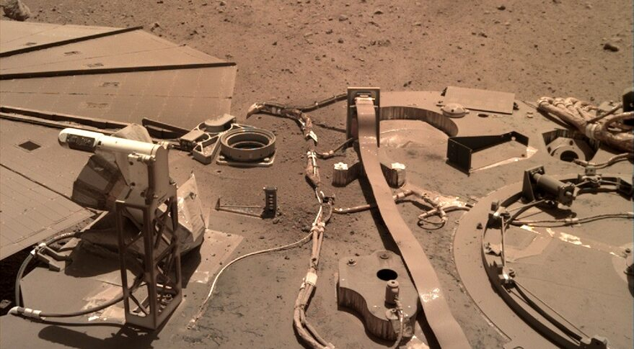
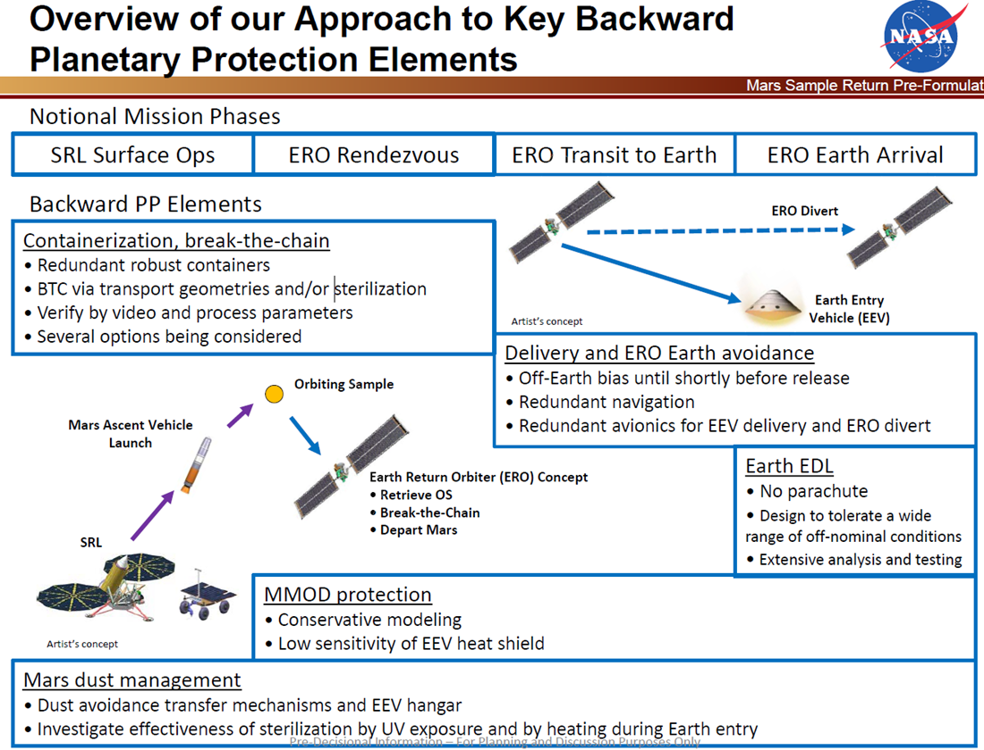
Break-the-chain concept
“No uncontained hardware that contacted Mars, directly or indirectly, shall be returned to Earth. Isolation of such hardware from the Mars environment shall be provided during sample container loading into the containment system, launch from Mars, and any in-flight transfer operations” – COSPAR 2020
Implementation Distillation
Determine source contamination - indirect and direct vectors of Mars particles
  Direct – e.g. OS exterior, hardware that OS touches
  Indirect – e.g ERO exterior
Control / Mitigation – containerization, sterilization, diversion
  Containerization – hardware sealing to prevent biological transfer (Matryoshka nesting doll concept)
  Sterilization – biological reduction using industry approved standard (e.g. heat, chemical, etc).
  Hardware disposition – ERO divert prior to Earth-Moon orbit insertion, jettison of CCRS hardware in Mars orbit
Credit: NASA / JPL
Mars dust is a potential source of Mars biologicals
Orbiter Diversion Maneuver

Slide 10
Mars Sample Return Back PP Compliance – High Level Approach

Slide 11
Mars Sample Return Back PP Compliance –
Notional Details of an Approach
Back PP Implementation is NOT just several defined activities it’s the collective activities and robustness of the system throughout the mission phases!
Systems Engineering Activity | Detail
Credible Vector and Pathway Assessment | Identification of hardware and environments for Mars exposure to include the following: surface operations, Mars atmosphere during launch and orbit operations, OS orbit transfer operations, Orbiter. OS + Orbiter exterior surfaces = surfaces for BPP mitigation.
Biological Knowledge Capture | Cataloguing and archiving of biologicals present on the hardware and cleanroom during assembly and test. Could be directly tested, witness coupons, or hardware surrogates. Serves as a reference library for potential contamination for Return Sample Science.
BTC Contamination Gradient / Dust Mitigation | Hardware design and operational requirements to minimize dust accumulation on OS and MAV surfaces during tube loading on Mars surface. Objective to minimize the number of <50nm particles.
Jettison “Dirty” Hardware at Mars | Hardware involved in the capture and containment of the orbiting sample not required once it conducts the capture and sealing. Surfaces will be exposed to Mars environment prior to loading and sterilization in Earth Entry Vehicle. Extra hardware requires more fuel to move and poses a contamination risk thus jettisoning in upper Mars environment.
BTC = Containerization + Sterilization of Seals | Containerization of OS in multiple layers, sealed with high heat to mechanically weld and sterilization the surface of potential harmful Mars biologicals.
Reliability of Spacecraft Systems | Use of dual string redundancy and high heritage / fidelity parts to maximize spacecraft reliability.
Mission Design | Software, mission design, and flight operations leveraging high heritage from NASA/ESA to ensure orbiter maneuverability and commanding reliable.
Earth Return Orbiter Divert | Orbiter contamination – Earth Entry Vehicle jettisoned at safe orbit that balances success of sample return and ability of orbiter escape the Earth-Moon system. Navigation and avionics redundant to ensure high probability of operations.
Earth Entry Vehicle Reliability | Ballistic trajectory – no parachute increasing risk profile
Ground Operations – Nominal | NASA established recovery operation protocols for astrobiological materials and spacecraft retrieval tailored to incorporate existing biosafety and biosecurity measures.
Ground Operations – Off-nominal | NASA established lessons learned protocols for astrobiological materials and spacecraft retrieval tailored to incorporate existing biosafety and biosecurity measures.
Containment of Vehicle Upon Landing | Proposed methods to containerize or tent Vehicle prior to containerization
Remediation of Landing Site | Proposed remediation of landing site for the 30m crater zone
Approved Container | Earth Entry Vehicle will be sealed in an appropriate biosafety and biosecured container that meets NASA needs and regulations for further off-site transport the facility
BSL-4 Capabilities at Landing Site | Trailer or on-site lab
Transport | Biosafety and secured transport as per tailored regulations

