Slide 1
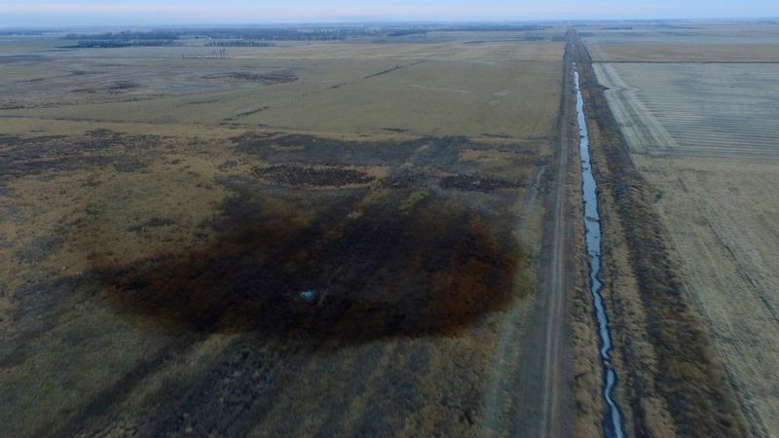

Emerging Spaceborne Technologies for Oil Spill Detection
Ben Poulter
NASA Goddard Space Flight Center, Earth Sciences Division
AP Press; https://www.smithsonianmag.com/smart-news/keystone-pipeline-leak-was-twice-big-previously-thought-180968722/

Slide 2

Informing climate policy with scientific monitoring from space
NASA’s 2017 Decadal Survey
Transient Climate Response to Cumulative Emissions
IPCC AR6 WGI SPM

Slide 3
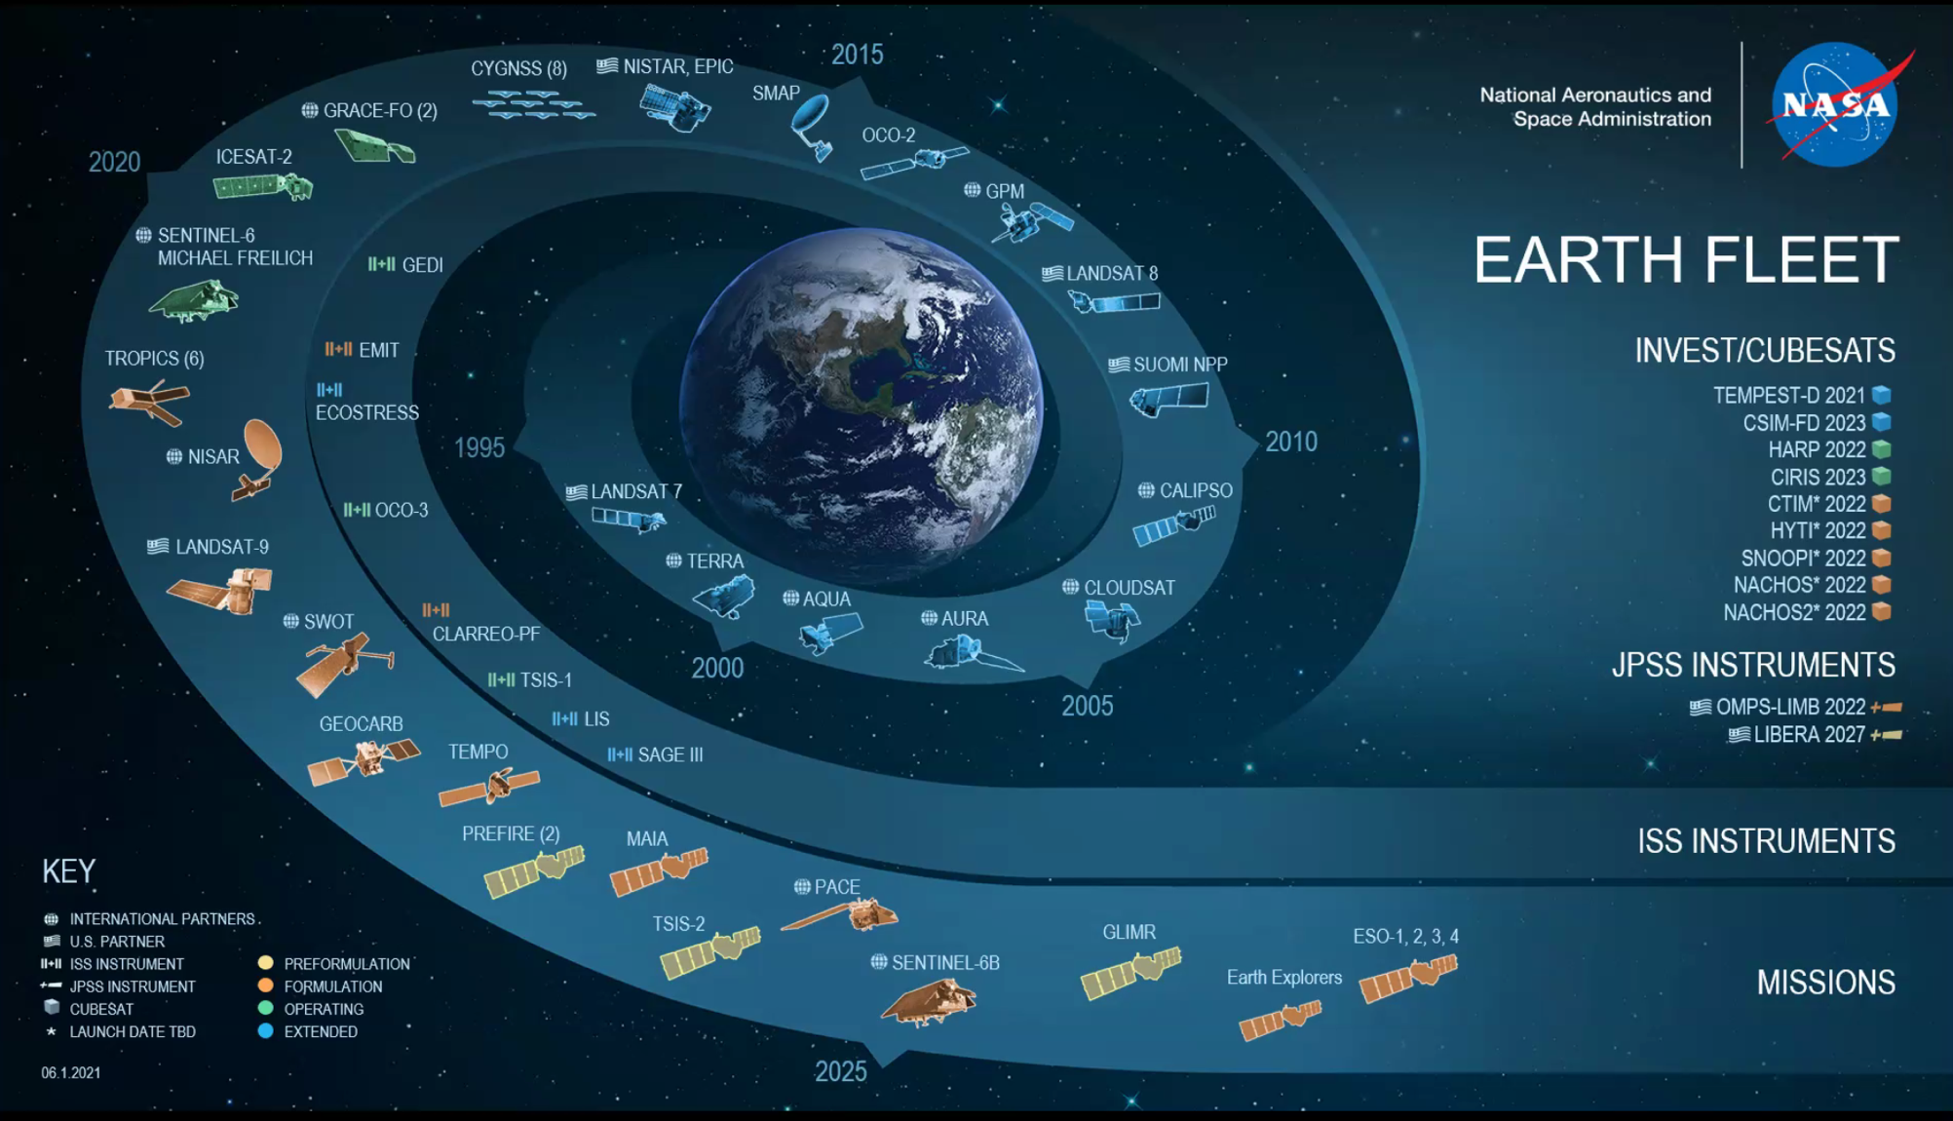

Slide 4
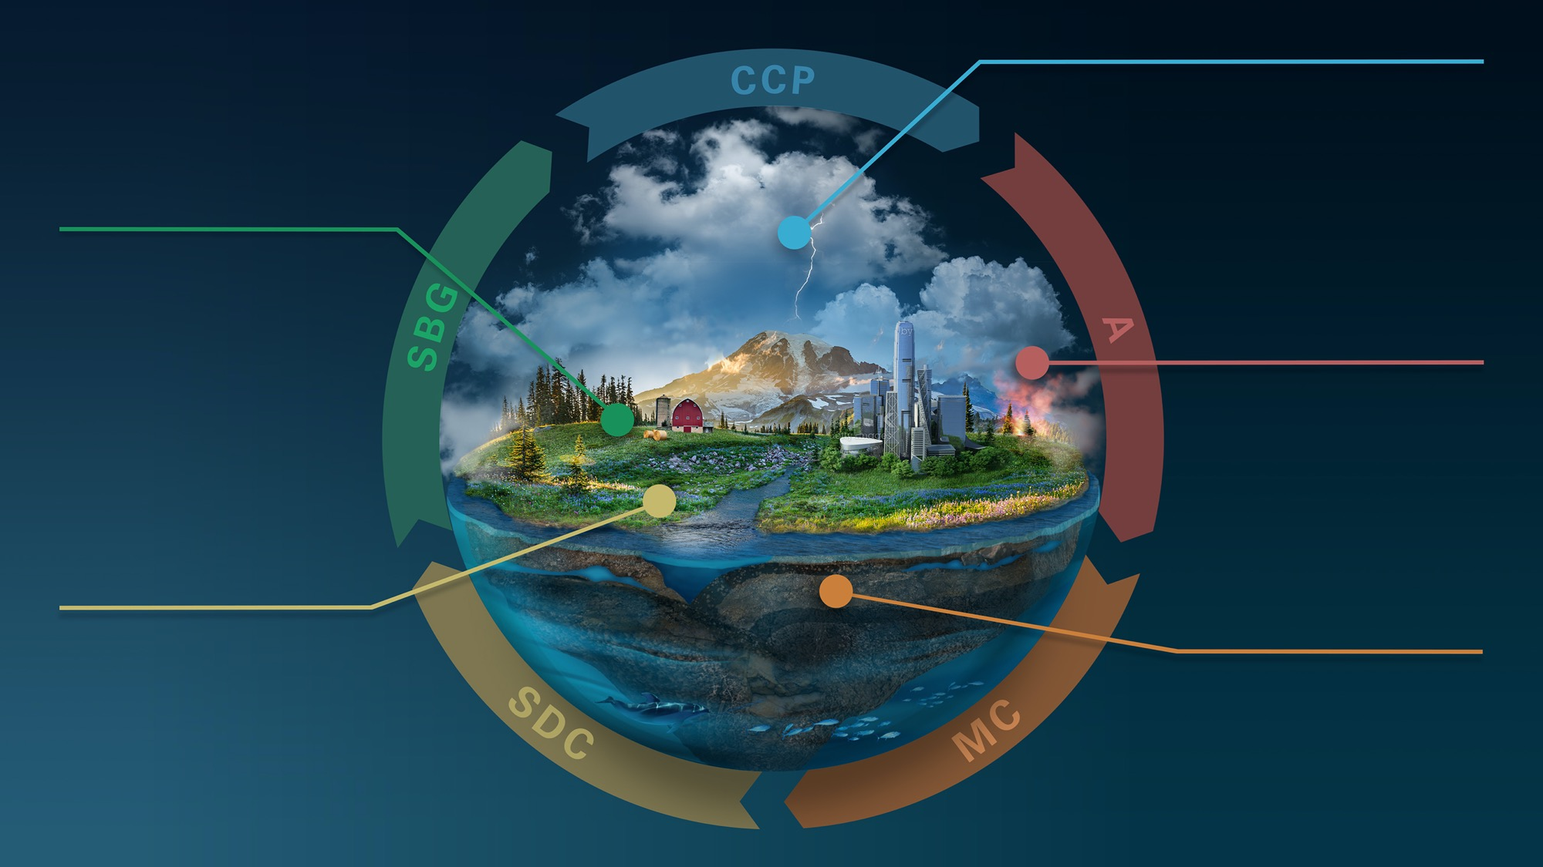
EARTH SYSTEM
OBSERVATORY
CLOUDS, CONVECTION
AND PRECIPITATION
Water and Energy in
the Atmosphere
SURFACE BIOLOGY
AND GEOLOGY
Earth Surface & Ecosystems
AEROSOLS
Particles in the
Atmosphere
SURFACE DEFORMATION
AND CHANGE
MASS CHANGE
Earth Surface Dynamics
Large-scale Mass
Redistribution

Slide 5
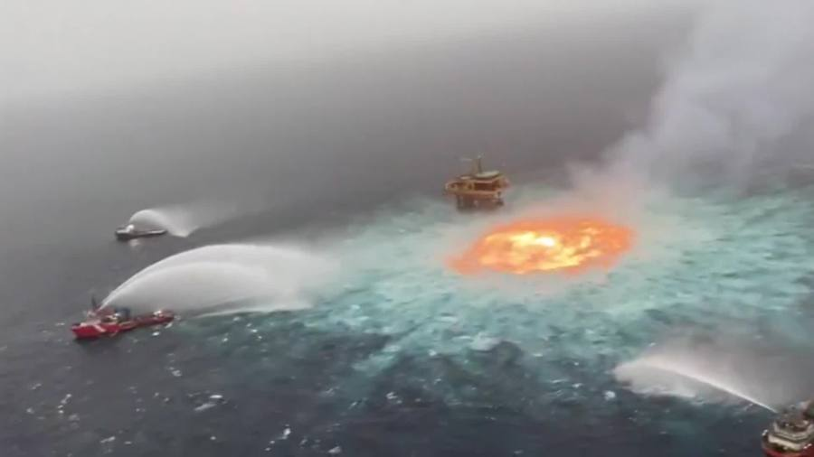
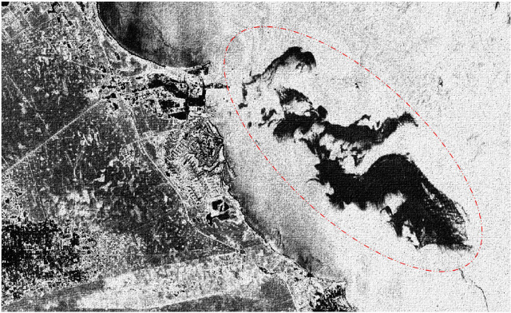
Applying Spaceborne Assets to Pipeline Leaks:
Offshore detection
Offshore oil spill detection is fairly mature using synthetic aperture radar (SAR)
Dark patches versus speckled background – enable classification
Numerous false positives w ice and natural features (kelp, cloud shadow, pollen, plankton etc.)
Gulf of Mexico ‘eye of fire’
Sentinel 1 (SAR C)
AP Video; https://fox8.com/news/watch-video-shows-massive-underwater-fire-in-gulf-of-mexico-after-pipeline-ruptures/
Chaturvedi et al., 2020

Slide 6
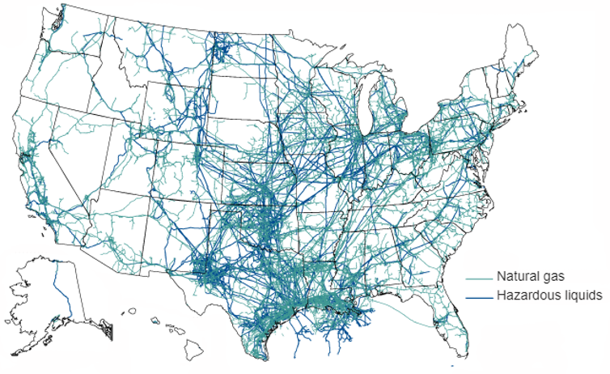
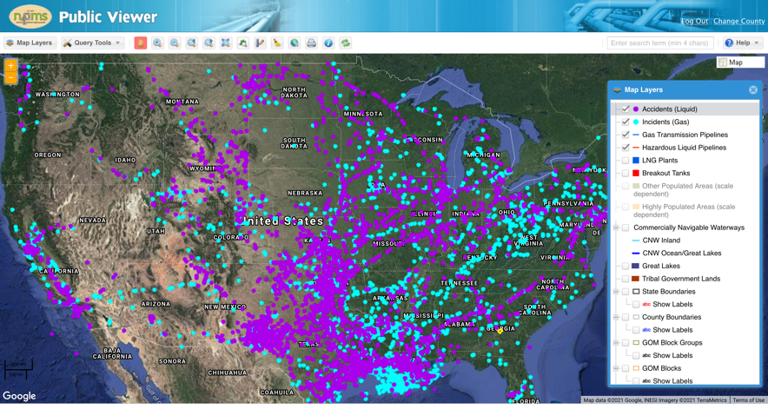
Applying Spaceborne Assets to Pipeline Leaks:
Onshore detection
The challenge:
Massive infrastructure > 500,000 miles
Leaky, since 2002: +7000 liquid leaks (+2000 gas)
Observing requirements:
Sensitivity
  Spectral features
  Spatial resolution
Wall-to-wall coverage
Frequent revisit
  Tasking/pointing
  Cloud/smoke/snow avoidance or removal
Mature detection algorithms
  Incl. flow quantification
Low latency / delivery time
GAO & USDOT

Slide 7
Applying Spaceborne Assets to Pipeline Leaks:
Onshore gas detection
Strong spectral absorption features in SWIR by CH₄ and CO₂
Detection of gas blowouts and leaks (CH₄ and CO₂) has advanced rapidly
Multiple national (JAXA, ESA, NASA) & commercial satellites (GHGSat) used for GHG retrievals
Estimate of fluxes possible using mass balance approach
Cusworth et al. 2021

Slide 8
Applying Spaceborne Assets to Pipeline Leaks:
1. Sensitivity – spectral features
Direct detection:
Hydrocarbon contamination in soil shows strong spectral features at 1720-1760 nm and ~2300 nm (e.g., Achard et al., 2021)
Indirect detection:
Vegetation health, or greenness, is reduced with hydrocarbon exposure (Adamu et al., 2018)
Andreoli et al., 2007
Adamu et al., 2018

Slide 9
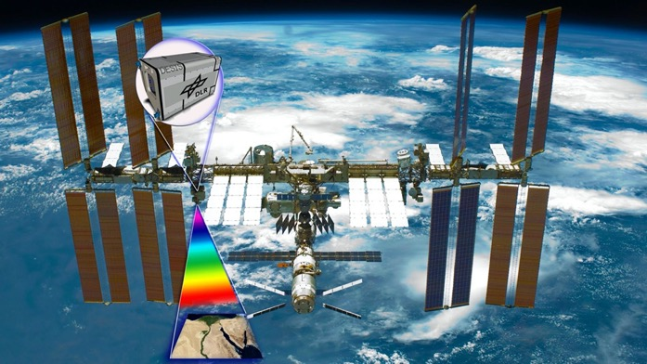
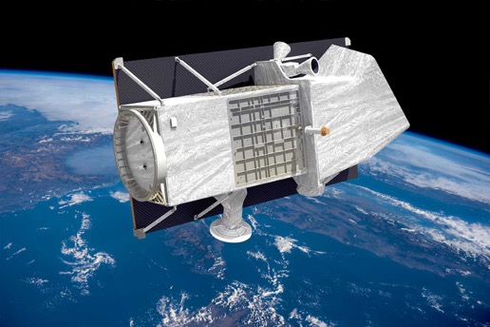
Applying Spaceborne Assets to Pipeline Leaks
1. Sensitivity: spatial resolution
https://www.dlr.de/content/en/images/2018/2/desis-hyperspectral-earth-observation-instrument-on-the-iss_30167.html
Yokoya et a., 2017 (IEEE)
https://www.asi.it/en/earth-science/prisma/

Slide 10
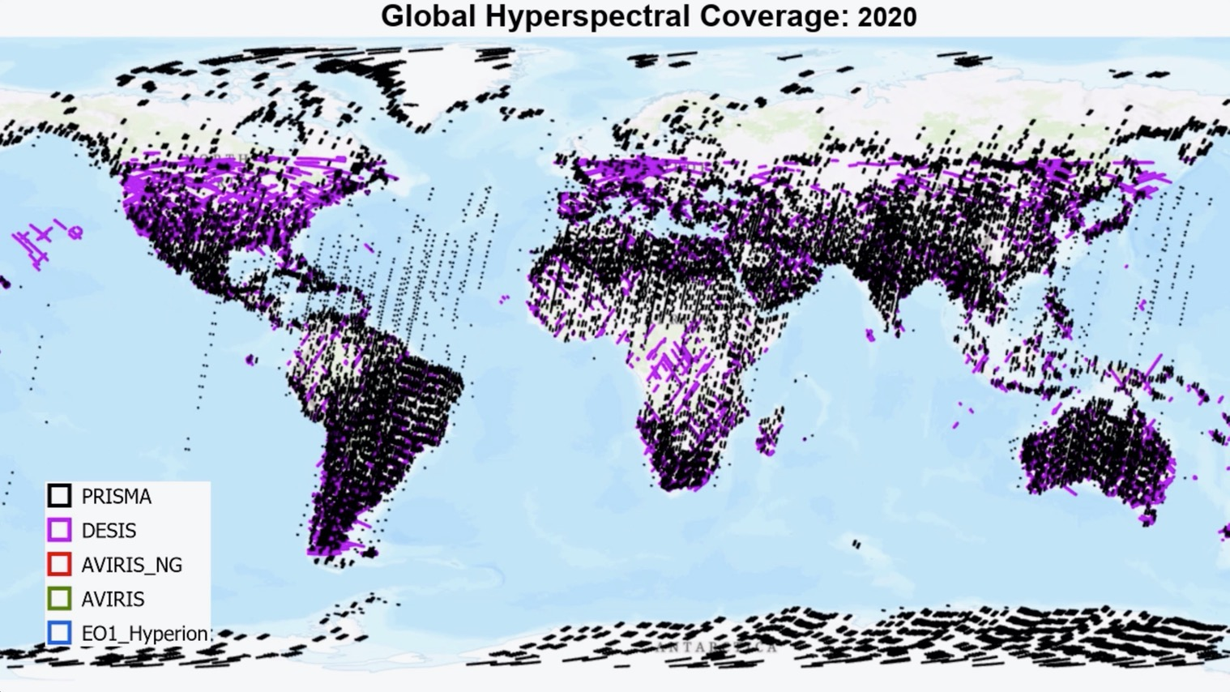
Applying Spaceborne Assets to Pipeline Leaks
2. Wall to wall coverage
NASA ARC

Slide 11
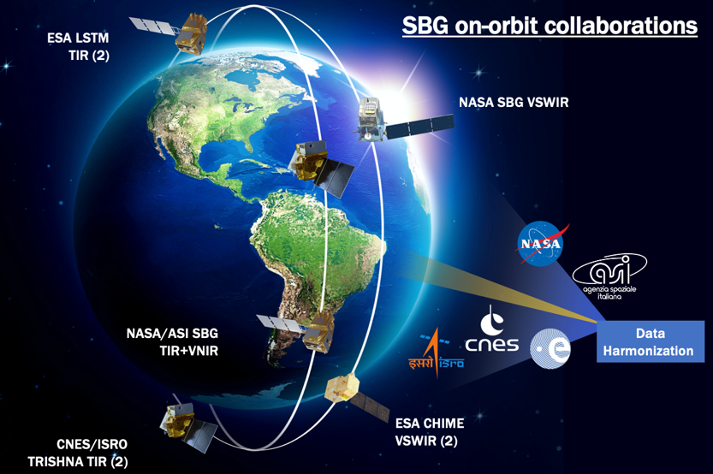
Applying Spaceborne Assets to Pipeline Leaks
3. Frequent revisit
September 16, 2021 launch of Landsat 9
5-day hyperspectral revisit (by late 2020s)
S2A+B
L8+9
S2A+B
L8+9
Li et al., 2020
NASA SBG

Slide 12
Applying Spaceborne Assets to Pipeline Leaks:
4. Detectability and classification
Approaches (using optical data)
Spectral indices, spectral matching, spectral unmixing, vegetation health, cloud+smoke removal
Issues
False positives from vegetation and soil (wet), or shaded slopes,
Needs
Flow rates (rate of spread, depth)
Dubucq et al., 2019

Slide 13
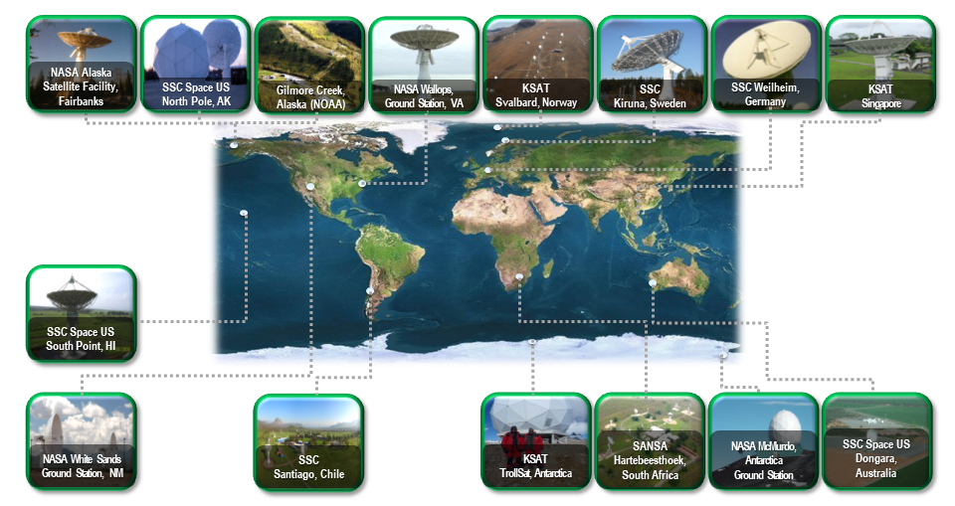
Applying Spaceborne Assets to Pipeline Leaks
5. Data latency
Near Earth Network & expanding downlink option (Ka band)
“Application Ready” data
Satellite retrievals
Onboard payload module
Science data system
User
(<24 hours)
https://www.nasa.gov/directorates/heo/scan/services/networks/nen

Slide 14
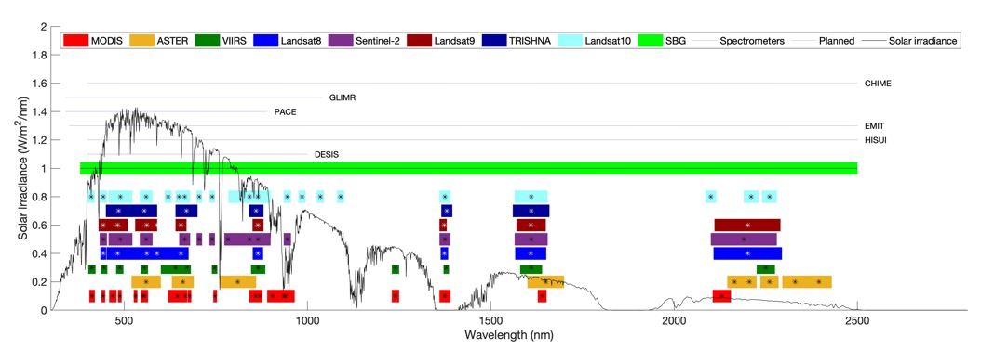
Applying Spaceborne Assets to Pipeline Leaks:
Outlook and opportunity
Opportunities to expand onshore leak detection methods using hyperspectral instruments
  New missions & pathfinders
    NASA SBG, ESA CHIME, ASI PRISMA, DESIS, HISUI,
  Advances in algorithms using machine learning, deep learning, AI
  Calibration and validation needs
    Spectral libraries (hydrocarbon/soil mixtures, stressed vegetation indices)
    Historical ground data needed for testing existing imagery archives
NASA SBG
Andreoli et al., 2007

