Slide 1


Coronal Diagnostic Experiment (CODEX) Radiator Panel Acoustic Analysis
Rachel Berley (WFF-548), Salisbury University & UMD College Park
Mentor: Dr. Geoffrey Rose (WFF-548)
Thank you to: my mentor, the CODEX team, all of Code 548, Ms. Pat Benner, Sarah Alspaw, and my funding source Salisbury University!

Slide 2
Project Description
Objective
Perform simplified acoustic analysis on a notional radiator panel.
Approach
Utilize methods found in the Code 542 random vibration seminar for converting acoustic to random spectrums. Model panels using FEMAP and run NASTRAN random analysis.
Results
Radiator panel deformation and stress were found to be within acceptable limits and exhibited positive factors of safety.

Slide 3
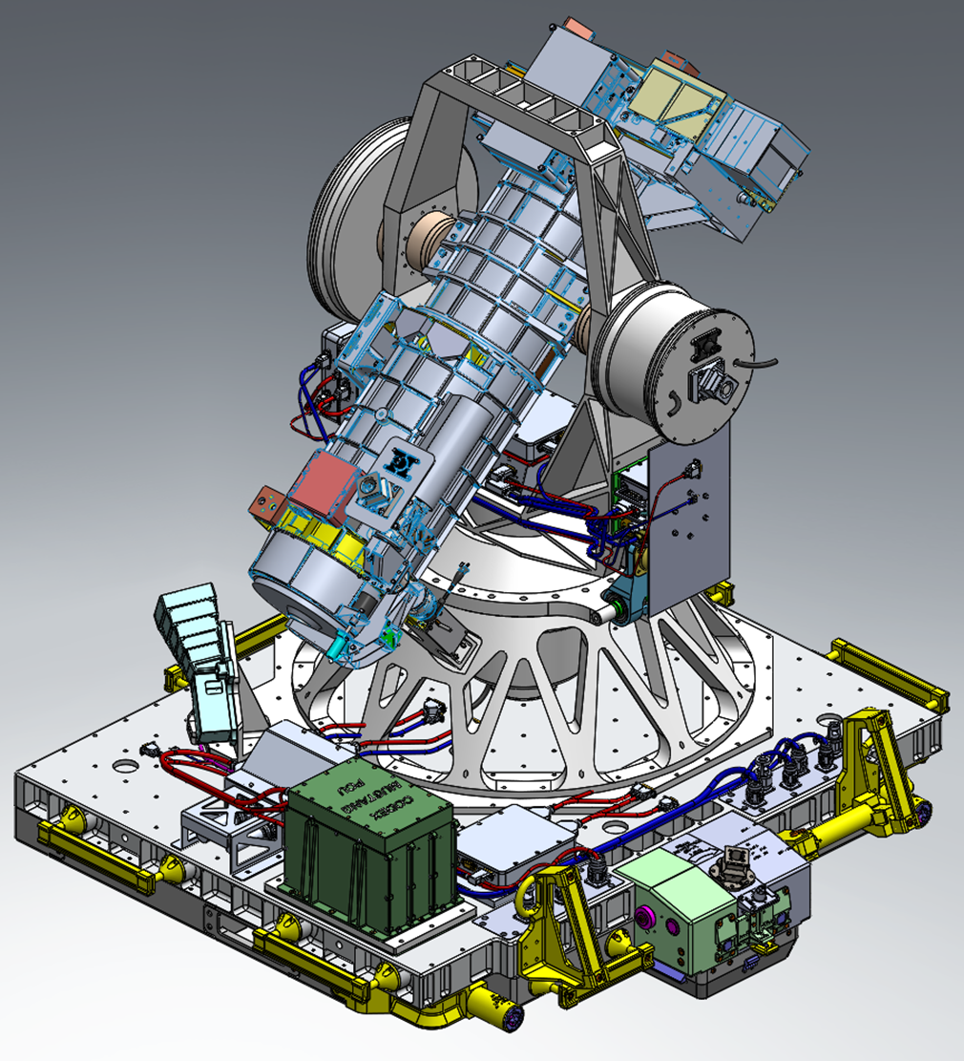
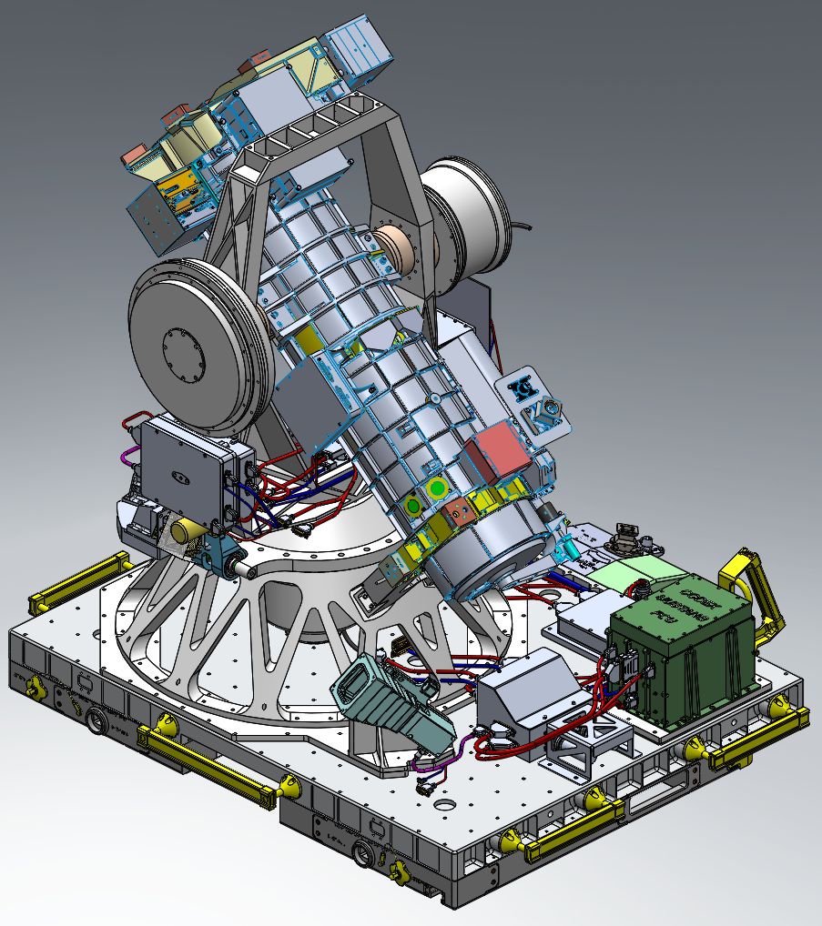
Radiator Panel
CODEX Payload attached to FRAM for installation on ISS

Slide 4
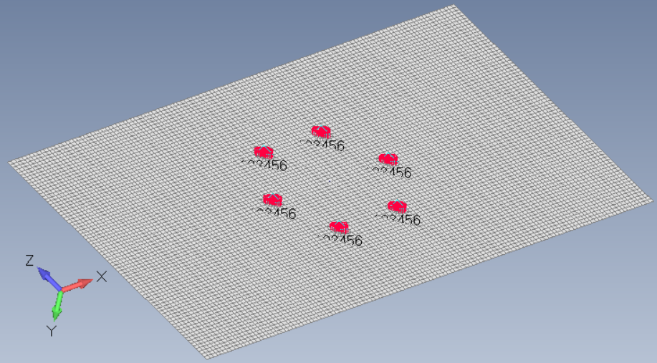
Finite Element Model (FEM) Verification
Radiator panel modeled using shell elements.
Sources for analytical solutions of plates under various boundary and loading conditions were identified.
Static analysis with uniform pressure applied to the panel was performed.
Finite Element (FE) results were compared to theory to confirm proper selection of element type and mesh density.

Slide 5
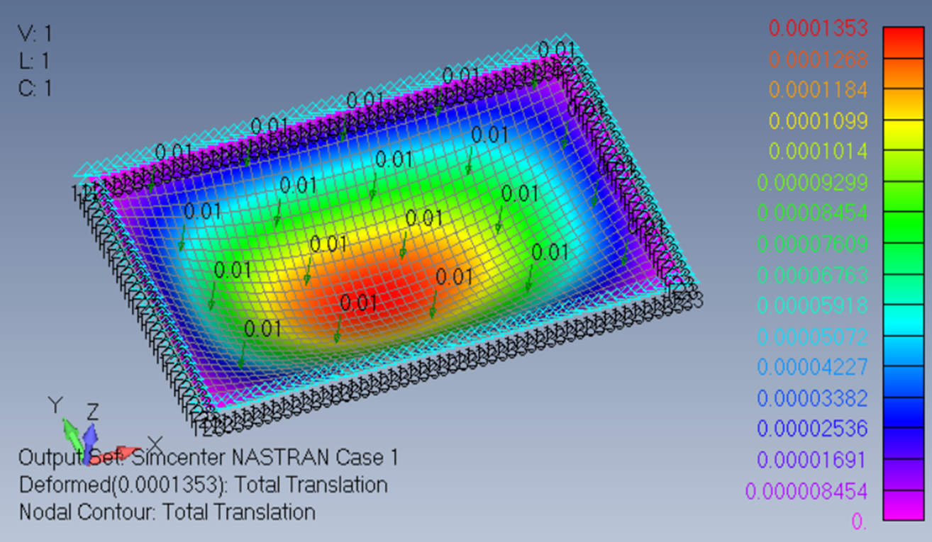
FEM Solution of Simply Supported Plate
Static deflection of the 12.275 x 7.25 x 0.125 inch panel under uniform 0.01 psi pressure. The FEM predicts 1.35e-4 inch max deflection in the center of panel. Panel material is aluminum 6061-T651.

Slide 6
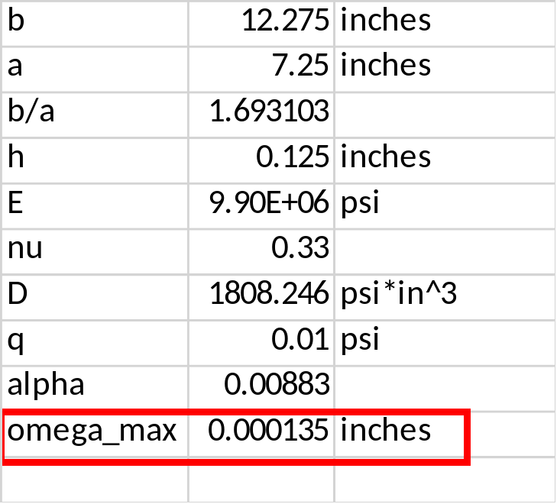



Analytical Solution of Simply Supported Plate
Analytical solution and FEM results are similar verifying proper element size and type for the model.
Ref: S. Timoshenko, S. Woinowsky-Krieger, “Theory of Plates and Shells,” 2nd ed.
FE Results:

Slide 7

Plate Normal Modes Verification
Perform modal analysis of the FEM to obtain natural frequencies and mode shapes of the radiator panel.
Verify results by comparing to theory.
Natural frequencies for a simply supported plate are obtained using various integer combinations of m and n.
Ref: T. Irvine, “An Introduction to Shock and Vibration Response Spectra,” Rev. A.

Slide 8
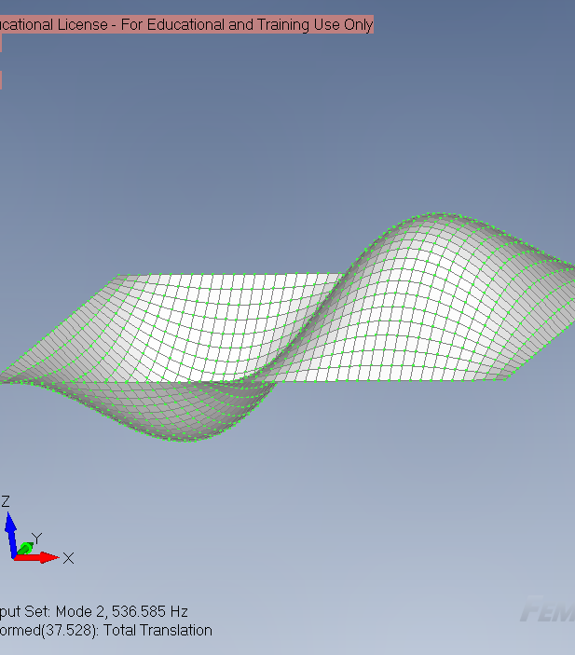
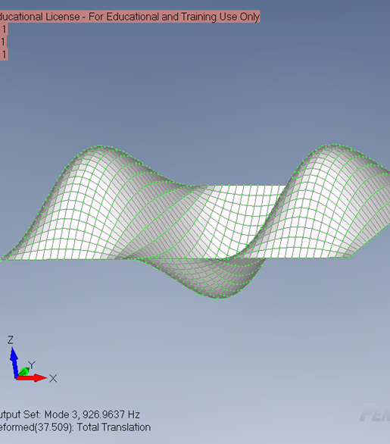
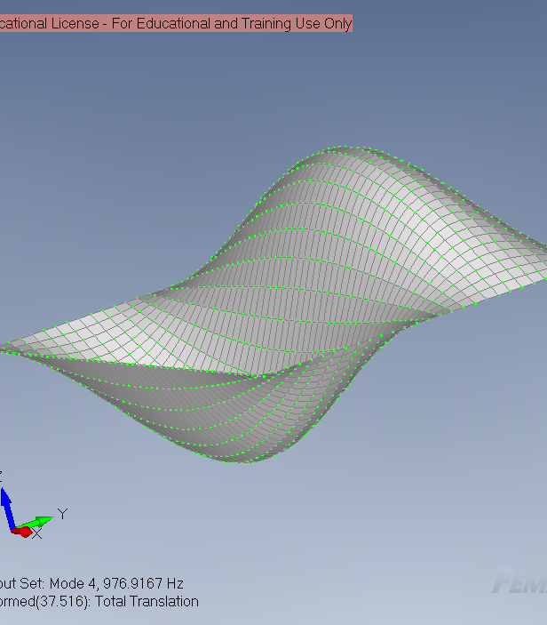
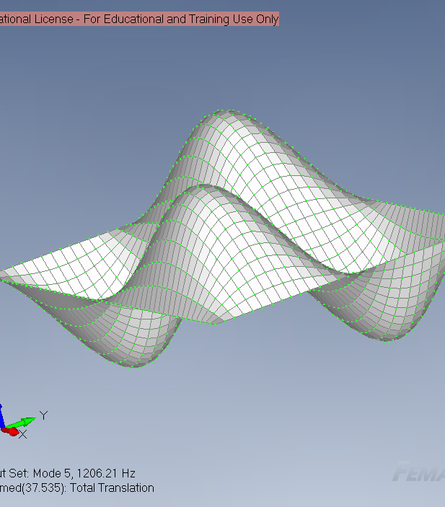
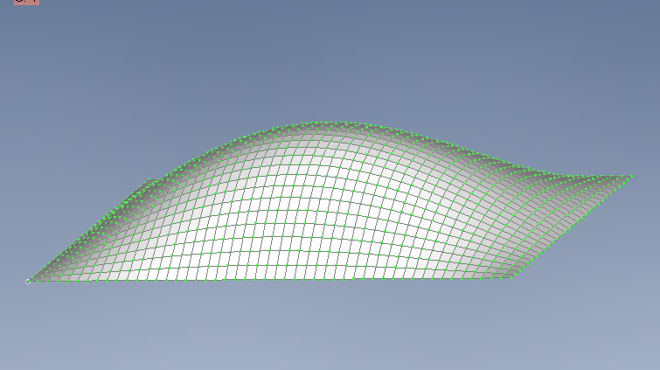
FE solution for modes and mode shapes
Mode 2
Mode 3
Mode 4
Mode 5
Mode 1
302.879 Hz

Slide 9
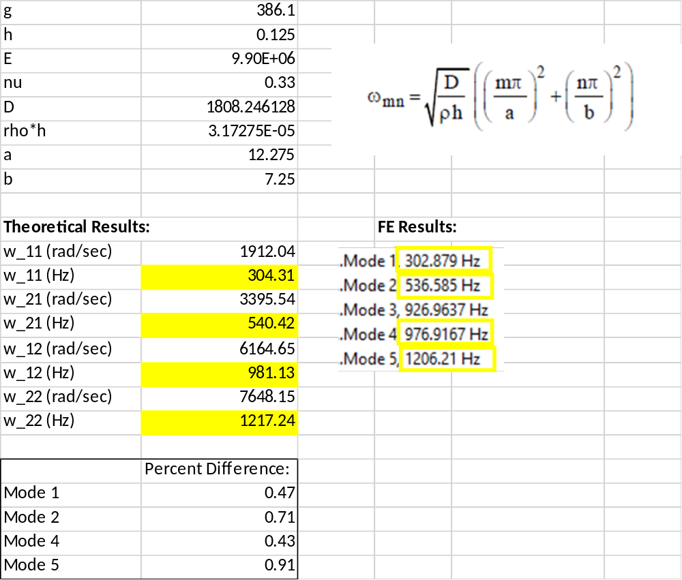
Analytical Solution for Plate Natural Frequencies
Theory vs. FE results. The FE eigenvalue solution procedure provides for an additional mode as compared to the partial differential equation (PDE) based analytical equation. Percent difference in matched modes is less than 1% confirming model suitability for dynamic analysis.

Slide 10


Sample Acoustic Spectrum
The acoustic spectrum defined using Sound Pressure Level (SPL) in decibels (dB) is converted to a Power Spectral Density (PSD) function to enable use of the NASTRAN random vibration solution procedure for predicting panel response under frequency dependent pressure loading. The CODEX specific spectrum, not shown, was used for the actual analysis.
Ref: S. Gordon (GSFC Code 542), “Random Vibration Seminar Series Session II – Random Vibration Theory (Cont),” 2014.
Ctr_Freq (Hz) | SPL (dB) | del_f (Hz) | p_0^2 (psi^2) | PSD (psi^2/Hz)
20 | 115 | 4.63 | 2.66E-06 | 5.74E-07
40 | 124 | 9.26 | 2.11E-05 | 2.28E-06
80 | 128 | 18.53 | 5.31E-05 | 2.86E-06
160 | 129 | 37.05 | 6.68E-05 | 1.80E-06
200 | 129 | 46.31 | 6.68E-05 | 1.44E-06
300 | 126 | 69.47 | 3.35E-05 | 4.82E-07
400 | 125 | 92.63 | 2.66E-05 | 2.87E-07
500 | 123 | 115.78 | 1.68E-05 | 1.45E-07
600 | 121 | 138.94 | 1.06E-05 | 7.62E-08
800 | 119 | 185.25 | 6.68E-06 | 3.61E-08
1000 | 117 | 231.56 | 4.21E-06 | 1.82E-08
1300 | 115 | 301.03 | 2.66E-06 | 8.83E-09
1600 | 113 | 370.50 | 1.68E-06 | 4.53E-09
p_ref = | 2.90E-09 | psi

Slide 11
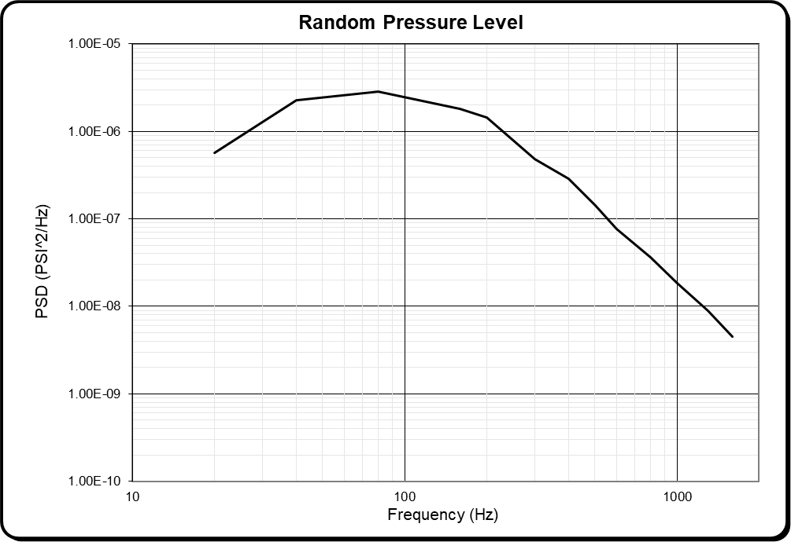
Sample Acoustic Pressure Spectral Density Function
Input Values: |  |  | Calculated Values:
Frequency | PSD Level | delta-dB | PSD +delta-dB | Slope "M" | Segment | Total
Hz | PSI^2/Hz | dB | PSI^2/Hz | (dB/Oct) | Mean Square | RMS
20 | 5.74E-07 | 0 | 5.74E-07
40 | 2.28E-06 | 0 | 2.28E-06 | 5.99 | 2.67E-05 | 0.0052
80 | 2.86E-06 | 0 | 2.86E-06 | 0.99 | 1.04E-04 | 0.0114
160 | 1.80E-06 | 0 | 1.80E-06 | -2.01 | 1.79E-04 | 0.0176
200 | 1.44E-06 | 0 | 1.44E-06 | -3.01 | 6.44E-05 | 0.0193
300 | 4.82E-07 | 0 | 4.82E-07 | -8.14 | 8.45E-05 | 0.0214
400 | 2.87E-07 | 0 | 2.87E-07 | -5.42 | 3.72E-05 | 0.0223
500 | 1.45E-07 | 0 | 1.45E-07 | -9.22 | 2.05E-05 | 0.0227
600 | 7.62E-08 | 0 | 7.62E-08 | -10.61 | 1.06E-05 | 0.0229
800 | 3.61E-08 | 0 | 3.61E-08 | -7.83 | 1.05E-05 | 0.0232
1000 | 1.82E-08 | 0 | 1.82E-08 | -9.22 | 5.16E-06 | 0.0233
1300 | 8.83E-09 | 0 | 8.83E-09 | -8.29 | 3.83E-06 | 0.0234
1600 | 4.53E-09 | 0 | 4.53E-09 | -9.69 | 1.91E-06 | 0.0234

Slide 12
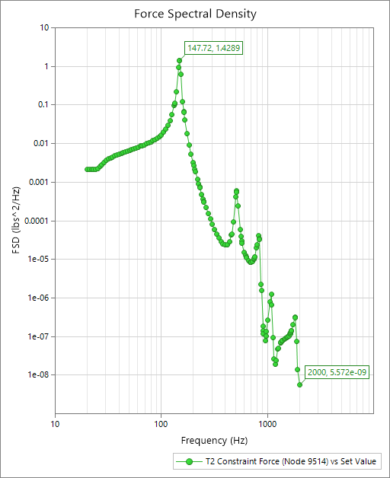
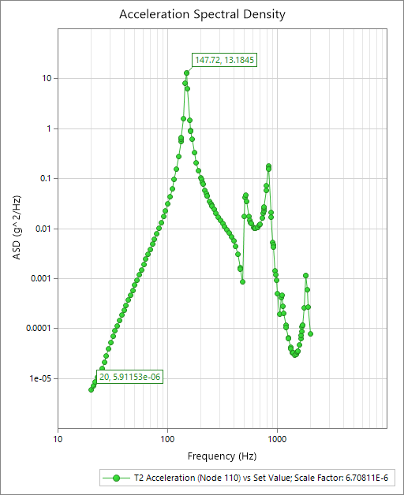
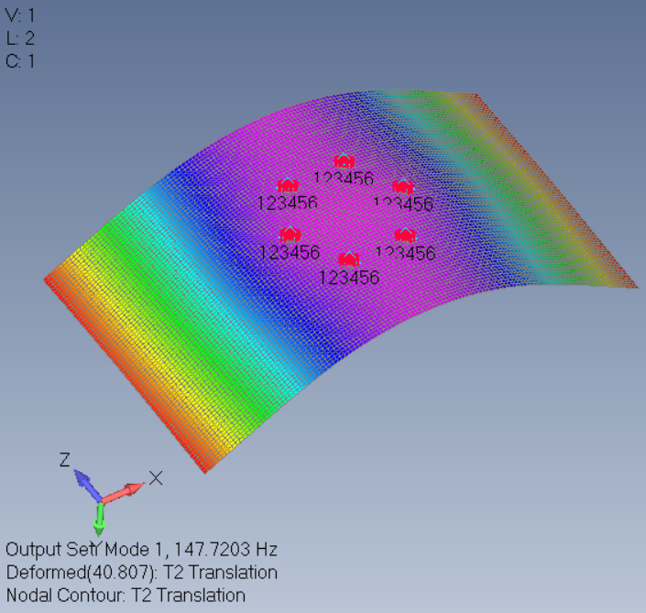
Panel Corner Response and Fastener Force
Output for max fastener force and acceleration of panel corners. Max response over the frequency range occurs at mode 1. Peaks on graphs correspond to various natural frequencies of the panel. Assumed damping in the model limits peak response.

Slide 13
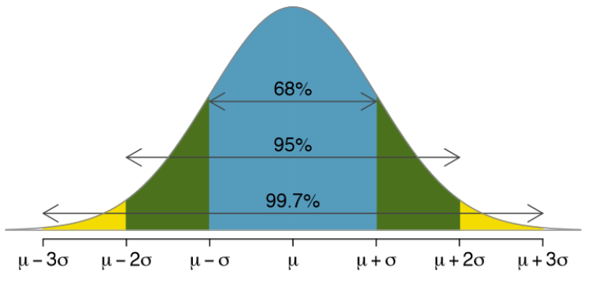
Panel Response RMS Values
 |  | 1-sigma RMS |  |  | *3-sigma RMS
Nodes | Description | T2 Translation (in) | T2 Acceleration (in/s^2) | T2 Constraint Force (lbs) | T2 Translation (in) | T2 Acceleration (g) | T2 Constraint Force (lbs)
110 | panel corner | 0.0058 | 5155.3955 |  | 0.0173 | 40.0575
3761 | panel corner | 0.0058 | 5155.3960 |  | 0.0173 | 40.0575
6240 | panel corner | 0.0058 | 5155.3970 |  | 0.0173 | 40.0575
7659 | panel corner | 0.0058 | 5155.3975 |  | 0.0173 | 40.0575
9514 | panel fastener |  |  | 4.2379 |  |  | 12.7138
9515 | panel fastener |  |  | 0.9553 |  |  | 2.8659
9516 | panel fastener |  |  | 0.9553 |  |  | 2.8659
9517 | panel fastener |  |  | 4.2380 |  |  | 12.7139
9518 | panel fastener |  |  | 0.9553 |  |  | 2.8659
9519 | panel fastener |  |  | 0.9553 |  |  | 2.8659
*These are the design loads and deflection assuming a normal distribution of data.
Results for select nodes and elements. 1-sigma RMS values are obtained by integrating area below PSD curves (see previous chart) and taking the square root of that value.
A normal distribution of zero mean is assumed for random vibration data such that 3-sigma levels are used for design or sizing of components.
Elements | Plate VonMises Stress (psi) | *Plate VonMises Stress (psi)
925 | 1891.21 | 5673.64
929 | 1891.21 | 5673.64
1036 | 1891.24 | 5673.71
1049 | 1891.24 | 5673.71
*These are 3-sigma design stress levels
Max corner displacement is 0.0173 inch.
Max corner acceleration is 40 g.
Max fastener force is 12.7 lbs.
Max panel stress is 5.7 ksi.
Ref: T. Irvine, “An Introduction to Shock and Vibration Response Spectra,” Rev. A.

Slide 14
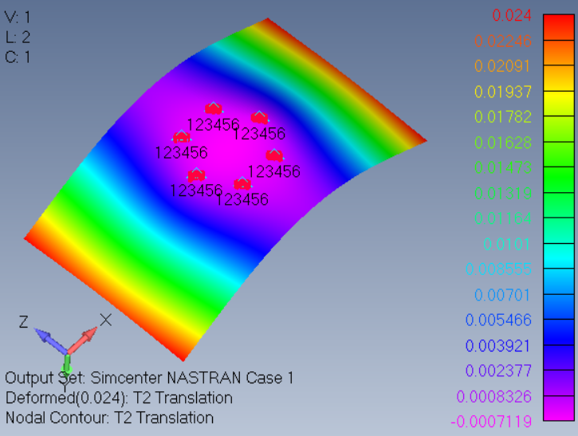
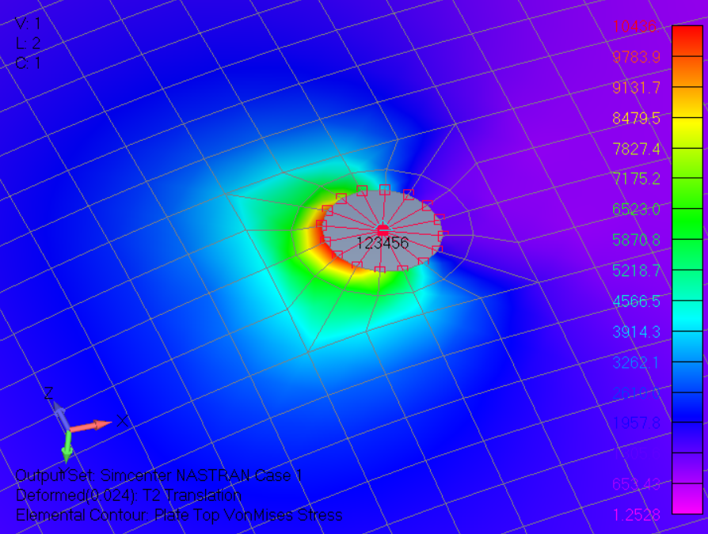
Panel Static Loading
Fty = | 35 | ksi
Ftu = | 42 | ksi
FSy = | 3.35 | yield safety factor > 2.0
FSu = | 4.02 | ultimate safety factor > 2.6
Aluminum material yield (Fty) and ultimate (Ftu) material stress and corresponding Factors of Safety (FS) with respect to project requirements.
An equivalent static pressure load that produces a similar resultant constraint force as compared to random analysis was applied to the panel for purpose of investigating stress and displacement contours. This loading produces larger max displacement and stress as compared to random RMS values but can conservatively be used for evaluating the panel design and material selection. Max panel deflection is 0.024 inch. Max panel stress is 10.4 ksi.

Slide 15
Conclusions
Max panel deflection at corner locations is considered reasonable and does not pose risk of damage to other components.
Max panel stress near fastener holes is below allowable limits and meets project factor of safety requirements.
Constraint forces are very low as compared to allowable loads for high-strength #10 fasteners.
The panel design is considered acceptable, and no additional design or analysis work is required.

Slide 16
Extras
Mission Planning Lab (MPL): MagCon (Magnetospheric Constellation)
ETD (Engineering Technology Directorate) newsletter article
~50 virtual presentations on varying topics
Antares Launch
Met other interns ☺ (virtual and in-person)
Dr. John C. Mather Nobel Scholar

Slide 17
Questions/Suggestions?

