Slide 1
Developing Arctic OSSEs
Nikki Privé
24 August 2021

Slide 2
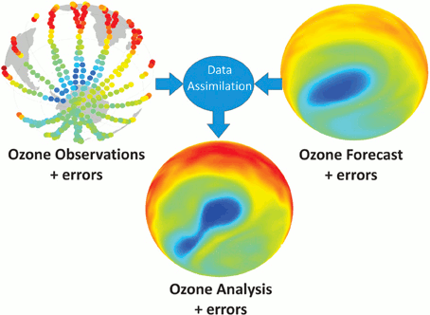
How NWP Uses Observations
Data assimilation combines observations and a prior forecast to generate a new initial condition (“analysis”)
The estimated errors of the observations and forecast are used as weighting by the data assimilation system
Image: Lahoz, W. and P. Schneider, Front. Environ. Sci., 2014

Slide 3
What is an Observing System
Simulation Experiment?
An OSSE is a modeling experiment used to estimate the impact of
new observing systems on numerical weather prediction when actual observational data is not available.
A long free model run is used as the “truth” - the Nature Run
The Nature Run fields are used to back out “synthetic observations” from all current and new observing systems
Realistic errors are added to the synthetic observations
The synthetic observations are assimilated into a different operational model
Forecasts are made with the second model and compared with the Nature Run to quantify improvements due to the new observing system
Notes:
3
3

Slide 4
OSSEs vs. the Real World
Real world forecasts
verification
observation
DAS
Forecast model
Reality
Data
Analysis
Forecasts
background
OSSE forecasts
Nature Run
interpolation
Synthetic data
DAS
Forecast model
Analysis
Forecasts
background
verification
Notes:
Flowchart comparing OSSEs to operational data assimilation. The two main differences are the replacement of the actual atmosphere with the Nature Run (NR), and the use of the NR to verify forecasts (and analyses) in the OSSE instead of self-analysis verification.

Slide 5
Why do an OSSE?
You want to find out if a new observing system will add value to NWP analyses and forecasts
You want to make design decisions for a new observing system
    Sampling studies to determine requirements for observing strategies
    Test different scenarios or designs
You want to investigate the behavior of data assimilation systems in an environment where the truth is known
    Useful for development and implementation of new data assimilation algorithms
Notes:
The “classic OSSE” is the first item on this list – testing new observing system designs in a controlled framework when actual observations are not available (instrument doesn't exist, too expensive, etc).
A potentially valuable study is to compare design possibilities for a new instrument – for example, decisions about scan characteristics, orbits, channels, for a new satellite. This can be used to determine if a less expensive alternative design will still yield useful results in comparison to the full design.
The third point is valuable in the context of design and understanding of data assimilation systems. In the OSSE, the availability of the truth for verification allows the direct calculation of analysis errors, as well as adjoint and other observation impact metrics, to determine exactly how the ingestion of different observations affects the skill of the analysis. These calculations are not possible in the real world environment.

Slide 6
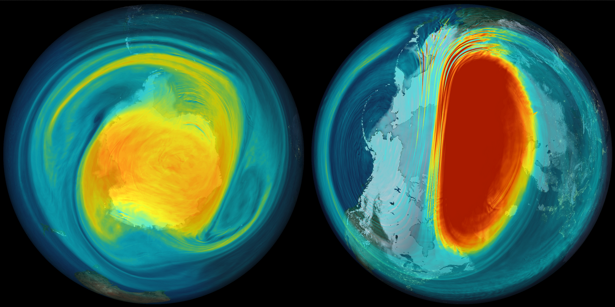
Nature Runs
G5NR snapshot of EPV, March ‘2006’
Notes:
Both re/analysis based and model based NR are found in the literature. The model-based NR are often considered preferable to analyses/reanalyses.
Nature Runs act as the 'truth' in the OSSE, replacing the real atmosphere.
Usually, a long free (non-cycling) forecast from the best available model is used as the NR
Preferably a different model base is used for the NR and the experimental forecast model to reduce incestuousness
Must be able to realistically model phenomena of interest
In addition to the phenomena of interest, the NR should realistically replicate fields needed to generate synthetic observations
Can't validate everything; corollary – don't expect a NR to come pre-validated for your needs

Slide 7
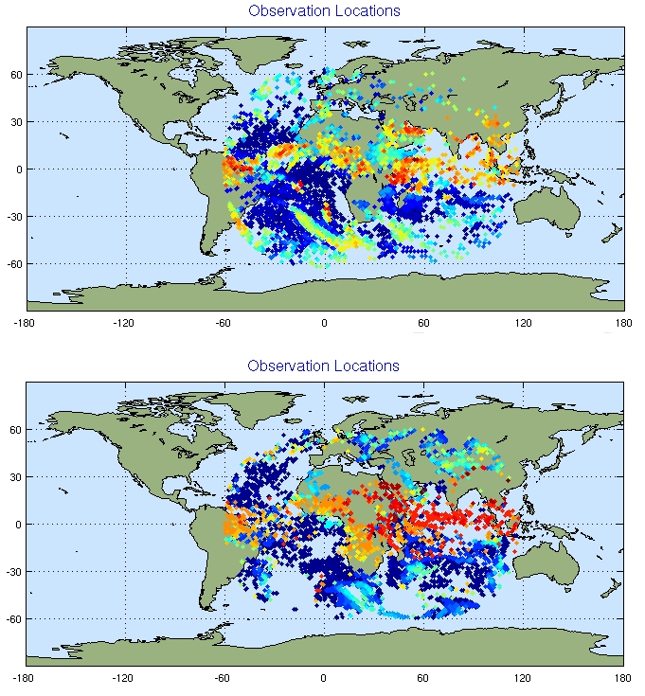
Synthetic Observations
Example of METEOSAT
AMV observations at
0000 UTC 10 July
Real
Simulated
Notes:
The simulated and real results should not be identical because, at any particular time, the real and NR clouds may be in different locations. The character of the plots should be similar however, like the typical sizes of the cloudy patches, wherever they may be.
The most common practice for making synthetic obs for existing data types is to use the archived temporal and spatial distribution of observations as a basis for the synthetic observations. The observation value itself is interpolated and/or calculated with an observation operator from the NR fields, using the time and location of corresponding real observations as a base. This works for most data types, but needs to be modified to account for factors that are influenced by the atmospheric fields themselves – ie cloud contamination of radiance observations, or the spatial and temporal location of AMVs (which depend on the NR cloud field), or the advection of raobs/dropsondes by the NR wind field as they ascend/descend.
7

Slide 8
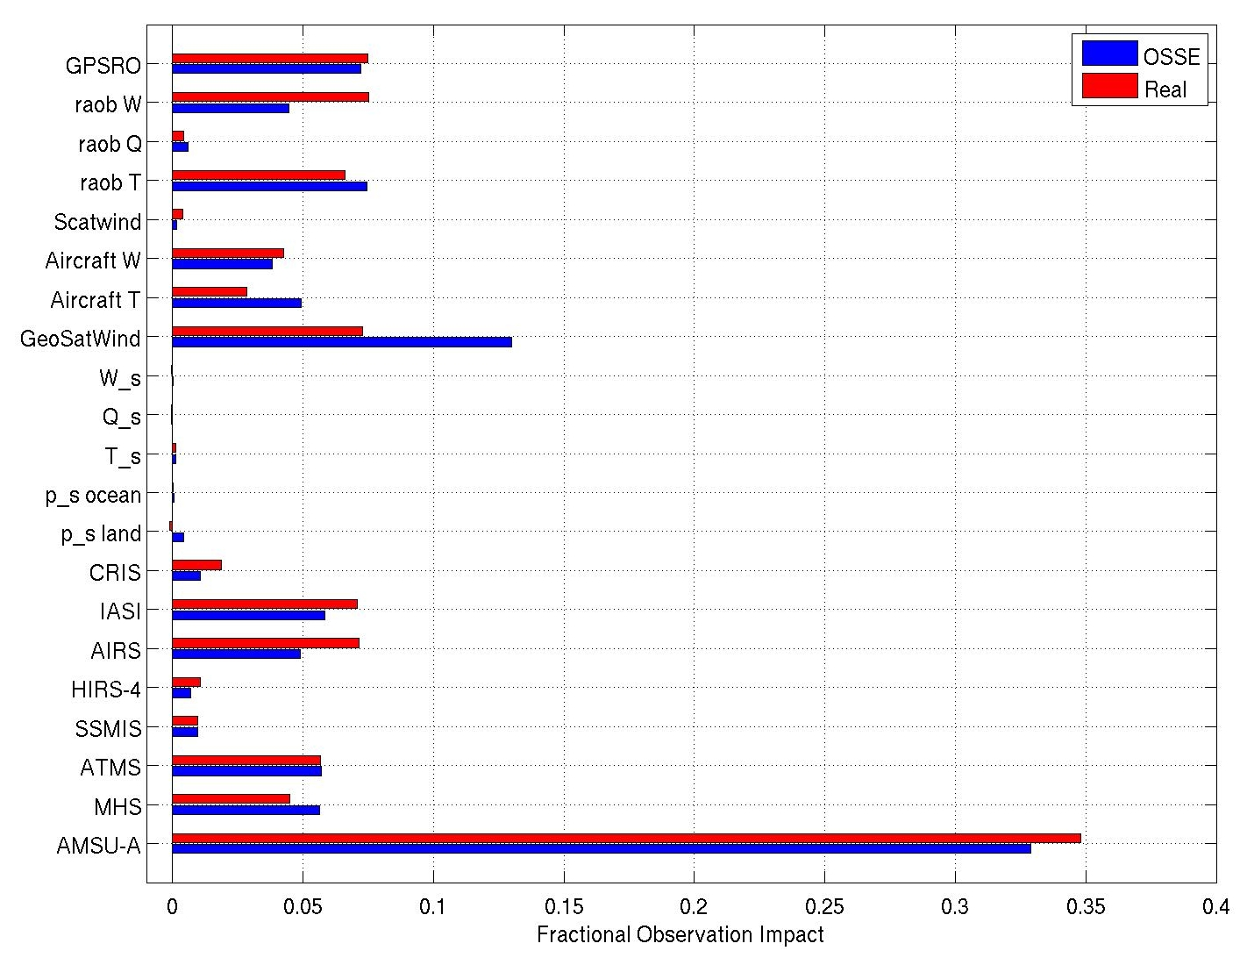
Why believe OSSE results?
Notes:
Given that calibration cannot fix all the problems with forecast skill, analysis and background quality, etc, what can we actually get that is useful from the OSSE? One metric that can frequently yield good results is observation impact – whether by data denial experiments or adjoint (above bar graph).
Observation impacts can be manipulated somewhat by adjusting observation errors – however the interplay between observation errors and impact is complex.
For data denial experiments, increasing the observation errors increases the magnitude of the effect the observations have on the analysis state (increasing the analysis increment) up to the point where quality control begins to eliminate the observations. In this case, the effect of the observations is not judged as to whether it has a positive or negative impact on the analysis state.
In the adjoint, where observations are judged by their impact on the 24 hour forecast skill, increased observation errors have complicated effects. If the observation errors are ingested and retained in the analysis, these errors may grow and increase the error of the background state of the next analysis state, thus allowing the observations to do more work (and have a larger impact) at the next cycle time. If the observation errors are increased on all observation types, many of the data types may see (good) increases in the adjoint impact. If only one data type has increased errors, however, the impact of that data type may be reduced while the impact of other data types increases to compensate for the greater error of the background.
In general, adjoint impacts in OSSEs may be smaller for all observing types than for real data, due to the too-skillful background state from insufficient model error. However, the relative impact of different data types is well-reproduced, so a new observing type can be put into context with the current observing systems.

Slide 9
Arctic OSSEs - Challenges
Nature Run should have realistic arctic processes
  Interactive Sea Ice
  Coupled ocean?
  Arctic clouds
  Boundary layer dynamics – ex. correct representation of inversions
  Snow and surface characteristics, including melt
Simulated observations
  Surface emissivities over ice and snow
  Orography (Antarctica and Greenland)
Data assimilation handling of arctic observations may need development
Experiment forecast model needs to be sufficiently different from NR model, especially physics parametrizations

