Slide 1

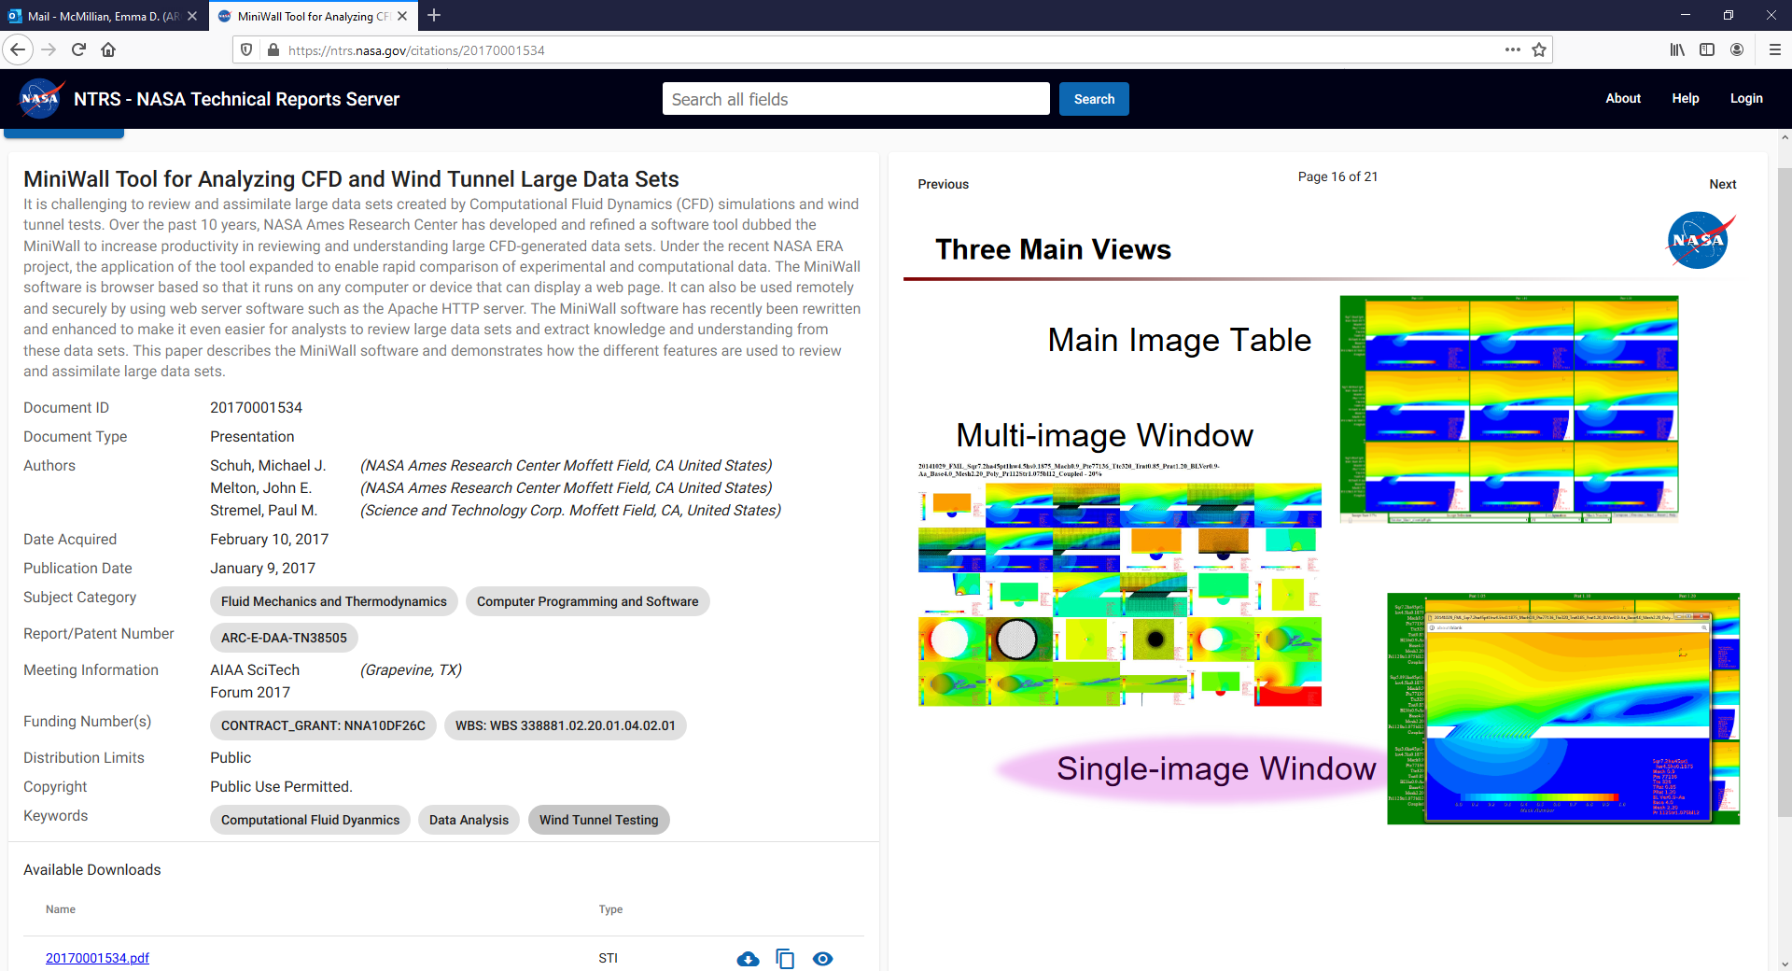
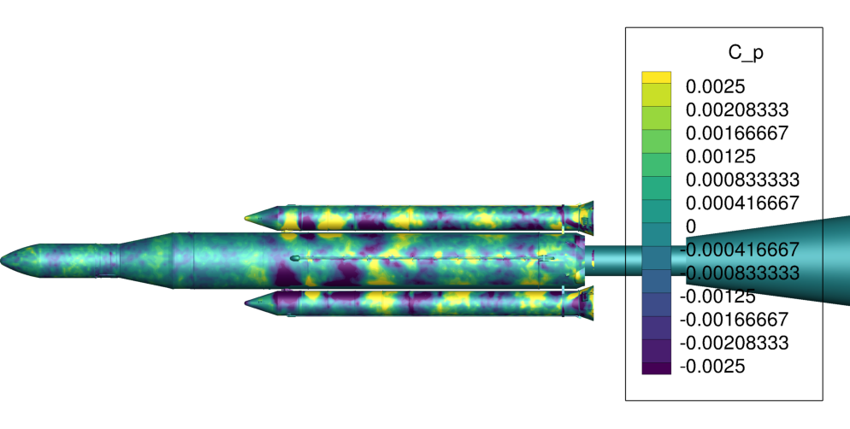
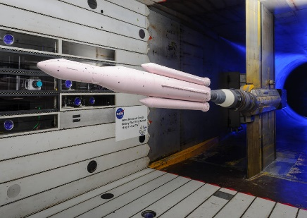
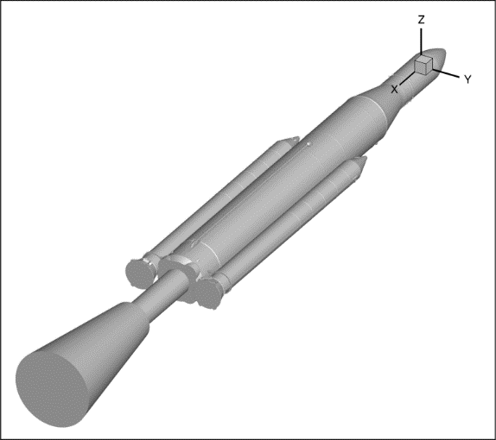
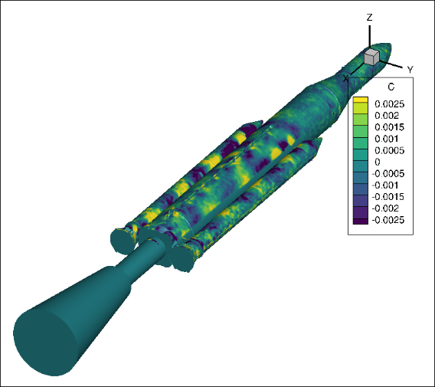
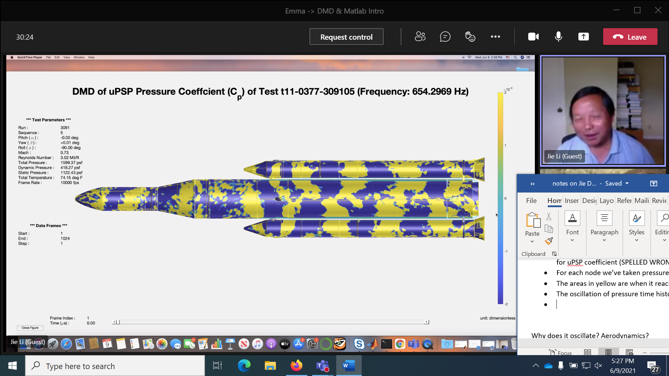
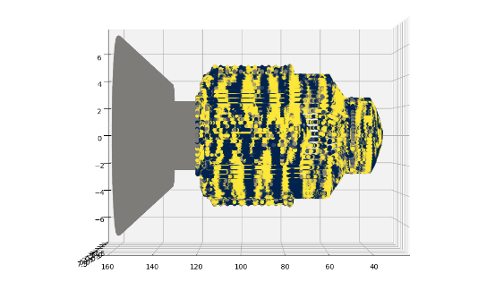

National Aeronautics and Space Administration
Visualizing Unsteady Pressure-Sensitive Paint Data with Python
Emma McMillian^{1,2}, Mentor: Lucy Tang³
NASA Internship at NASA Ames Research Center¹, Washington University in St. Louis², NASA Ames Research Center³
ABSTRACT
RESULTS
The Unsteady Pressure-Sensitive Paint (uPSP) projects uses Pressure-Sensitive paint applied over aerospace models during wind tunnel testing to collect pressure data with high spatial and temporal resolution in order to inform unsteady aerodynamics studies. For each of the 800+ experimental runs, four cameras generate up to 50 GB of video data, which must then be processed, analyzed, and visualized on the NASA Advanced Supercomputing system (NAS) to assess the result. One of the final data analysis products is the dynamic modal decomposition (DMD) results, which decomposes the pressure reading signals by their frequency component. The goal of this project is to visualize the DMD results over a 3D rendering of the model, using efficient and parallelized python routines. The software uses the pytecplot library, a high-level API that connects python scripting to a Tecplot 360 engine. Tecplot is an industry standard high-performance visualization tool that can handle large datasets and workflow. Various animation, rendering, and image-combination techniques were investigated to generate the final videos using OpenCV on the NAS. The final result is a software tool that takes in data products from the uPSP processing chain and generates high resolution visualization videos in parallel for every data file, allowing researchers to view their results efficiently and at an unprecedentedly detailed level.
METHODS
DMD of uPSP Pressure Coefficient (C_p)
OBJECTIVES
(6)
Develop a software tool to visualize uPSP data using python
Investigate different python libraries and packages to determine which library yields the best image and video results
Generate videos in parallel that can be viewed on the mini-wall
(4)
The final software tool provides the uPSP project with a more efficient way to generate video visualizations for DMD and other data analysis products. This software can generate 200 frames per hour and be run in parallel to produce a video for each of the binary data files.
The generated videos will be viewed on the miniwall (fig 6), which is a data product grid that enables researchers to view many videos simultaneously. They are then able to see how the data changes with respect to experimental variables, such as frequency or Mach number.
Future developments may include the parallelization of generating frames (cutting runtime to a few minutes) and automating job script creation.
(1)
Fig. 4: A frame of a video generated using the python visualization software.
A python script with an argument parser was written to read in the inputs: the plot3d file of the model and binary file of DMD data. Every 4 bytes from the binary file gets converted into a float value which is mapped onto the plot3D grid. Then pytecplot is used to contour the model and save a png of each frame. OpenCV is used to combine pngs into a single video, because it has a video writing method that makes it easy to stitch together images quickly. One job script per binary dataset is created to run on a GPU node on the supercomputer. They can be run in parallel so that hundreds of videos can be generated at the same time.
(1)
BACKGROUND
(21)
(22)
(23)
The uPSP system consists namely of pressure-sensitive paint and high-resolution cameras. The PSP is applied over the full model surface, and measures surface pressure by luminescing conversely to the pressure exerted on it. PSP provides a much higher spatial resolution of pressure data than current methods which use pressure sensors embedded on a model. There are hundreds of terabytes of data generated from the wind tunnel tests: for the 800+ experimental runs, 4 cameras each generate between 25-50GB of data.
The pressure-time measurements from these tests can be decomposed with respect to frequency bins by a data analysis technique called Dynamic Mode Decomposition (DMD). The resulting data needs to be visualized efficiently using high resolution 3D renderers. MATLAB, Matplotlib, and Pytecplot were possible solutions that were investigated as part of this work.
Video Generation Analysis
CONCLUSION
With large rotor blades, the camera can easily pick up the strips of tape at the end
This software renders the decomposed pressure data with extremely high detail. A typical video that comes from the DMD data analysis will take 30min-5hrs to generate so the ability to run this software overnight and in parallel is helpful to enhance performance. The generated videos can be put on the miniwall so that aerodynamics researchers can observe and draw conclusions from the data more easily.
MATLAB (fig. 11) | Matplotlib (fig. 5) | Pytecplot (fig 10.)
Low resolution | Low resolution, shrinks (fig. 5) | High resolution
250 frames/ 1hr | 514 frames/ 1hr | 200 frames /1hr
Can't run on NAS | Can run on NAS | Can run overnight on NAS
(3)
(2)
(8)
(9)
ACKNOWLEDGMENTS
(5)
I would like to thank my mentor Lucy Tang, as well as Nettie Roozeboom, Marc Shaw-Lecerf, Tim Sandstrom, Jie Li, Paul Stremel, and Lara Lash for all their help and support throughout this project.
References:
1. Pressure Sensitive Paint for Measuring Unsteady Launch Vehicle Aerodynamic Buffet, Feb. 17, 2017
2. Recent Development in NASA’s Unsteady Pressure-Sensitive Paint Capability. Roozeboom, Nettie. AIAA Conference 2020.
3. Fluid for Thought: SLS Rocket Aerodynamics Featuring Pressure-Sensitive-Paint. Tang, Lucy, SWE Conference 2020.
Contact information:
For questions please email: emmamcmlln@gmail.com
*All photos and figures credited to NASA
(11)
(5)
(10)
(3)
(12)
www.nasa.gov
NASA/SP-2017-219550

