Slide 1
Predicting Provider Time Cost for Unplanned Medical Events in Long Duration Spaceflight
Medical Officer Occupied Time (MOOT)
Preston Fedor MD¹, Quinn Dufurrena MD², Dana Levin MD MPH¹, Shean Phelps MD MPH²
ASMA 2021
¹NASA Johnson Space Center; ²University of Texas Medical Branch at Galveston

Slide 2
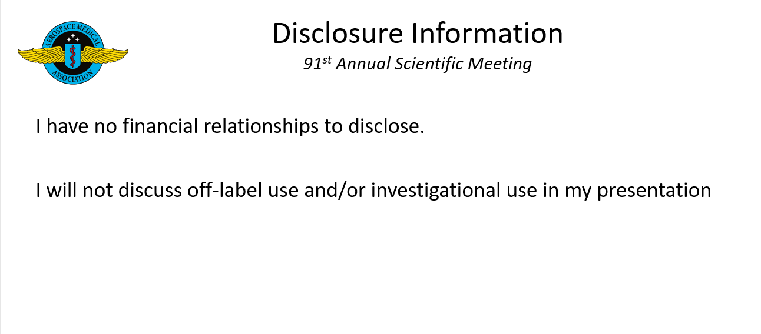

Slide 3


Medical Officer Occupied Time
Unplanned Medical Events Carry Costs
One Of The Major Costs Is Patient Recovery Time
Another Is The Time Required To Care For Ailing Crew Members
Crew Time Is A Precious Resource
The Flight Medical System Must Be Optimized To Accommodate Limited Resources Such As Mass, Volume, And Time.
Notes:
We cannot predict the future, but we can be reasonably certain that the longer a mission goes on, the more likely the chance that a medical event will affect mission goals
One of the major projects ExMC has focused on is estimating the incidence and risk outcome of unplanned medical events in flight to help inform spacecraft design
When an unplanned medical event occurs it incapacitates the patient
It also removes the care giver from regular duties in order to “repair” the damaged human, this also costs time
The time this medical officer is occupied is often a function f their training and experience, e.g. an experienced attending will take less time to place a chest tube than an intern.

Slide 4
IMPACT
Models Medical Event Incidence And Outcomes
Estimates Patient Downtime
Includes List Of Medical Tasks Necessary For Treatment
Can This Task List Be Used To Estimate Medical Officer Occupied Time?
How Does Provider Skill Level Affect This Time?
Notes:
IMPACT is designed to estimate indicence and outcomes in medical events based on a computational engine (MEDPRAT) pulling information from a carefully constructed medical database
This database also prodices estimations of the duration for illnesses broken down by both time for diagnosis and time for recovery (or progression) with and without treatment
At present these numbers do not account for medical officer occupied time
but it does list the specific tasks a provider must perform in order to treat the patient for each condition.

Slide 5
Methods
Subjective Survey Using Interview And Digital Formats
Capability Listed, With A Slider To Estimate Time
Convenience Sampling Of Emts, Medics, Nurses, Residents, Physicians
Medics And Nurses Were Military Trained
Pilot Project To Develop Method And Determine Viability
Face Validation Of Obtained Data
Limited Statistical Assessment
Notes:
IMPACT is designed to estimate indicence and outcomes in medical events based on a computational engine (MEDPRAT) pulling information from a carefully constructed medical database
This database also prodices estimations of the duration for illnesses broken down by both time for diagnosis and time for recovery (or progression) with and without treatment
At present these numbers do not account for medical officer occupied time
but it does list the specific tasks a provider must perform in order to treat the patient for each condition.

Slide 6
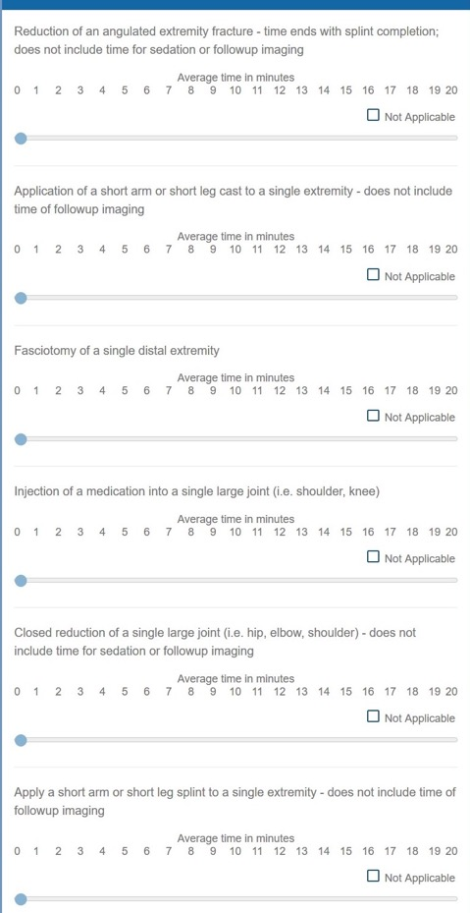
Medical Officer Occupied Time: Pilot
Included 77 Capabilities
Capabilities were drawn from a
Preliminary task list for 3
conditions
Out of Scope Tasks were listed
As “Not Applicable”
ICL89 | SKIN LACERATION
Best Case Definition | Worst Case Definition
An uncomplicated, linear, laceration that is not under significant tension with minimal or no foreign body contamination that heals spontaneously or requires a single layer closure. | A laceration meeting one or more of the following criteria: complex, stellate, multi-layer closure, under significant tension, and/or involving foreign body contamination requiring exploration and removal.
Notes:
The survey was based on a preliminary task list for 3 conditions; Skin laceration, distal leg fracture, Eye Foreign Body
Each condition has a best case and a worst case definition and capabilities were derived by a team of clinicians using this definition as a guide and practice guidelines and clinical expertise as part of the evidence library project

Slide 7
Medical Officer Occupied Time
172 Respondents
Notes:
The Pilot was organized and administered over the course of a 1 month resident rotation early in 2020.
The goal was primarily to assess the viability of this as a data collection method, the quality of returned data, and identify areas for improvement
There were 172 respondants but most did not complete the surveys 77 items

Slide 8
Example Data: Skin Laceration
Simple Laceration Repair by Method and Provider Level
(Means in minutes)
 | Sutures | Staples | Adhesive Strips | Skin Adhesive
Attending | 9.45 | 3.87 | 4.00 | 4.58
PA/NP | 10.63 | 8.14 | 4.33 | 4.00
Nurse | 8.08 | 3.88 | 3.79 | 4.12
Paramedic | 8.15 | 4.29 | 3.97 | 4.12
EMT | 15 (n=1) | 10 (n=1) | 1.00 (n=2) | 2.00 (n=1)
Total Mean w/95% CI | 9.39 (8.65-10.1) | 5.86 (5.27-6.45) | 3.68 (3.42-4.52) | 3.97 (3.21-4.31)
Notes:
This is an example of the kind of data retuned from the survey for the condition “laceration repair”
The only significant difference between training level for capability here is the PA/NP “staples” estimation which is nearly twice as long as the other groups.
However for a condition like “laceration repair” the time required is pretty standard for anyone who has ever performed one.
The EMT data was not evaluated for significance as laceration repairs are not in the scope of practice for an EMT, however, one did complete the survey with a “best guess” before realizing that this was not our intention .

Slide 9
Lessons Identified
The Good
Inexpensive, Fast Data Acquisition, Can Provide Approximate Medical Task Times By Level Of Training
Can Be Administered To Large Numbers Of Providers In A Short Time
Uses Existing Information Generated For The IMPACT Medical Database
Task Completion Time Likely Does Vary Across Training Levels
The Bad
High Drop Out Rate
Long Survey
Definitions For Tasks Were Not Clear
Some Tasks Are Not Particularly Relevant “Like Accessing The EMR"
Subjective Assessment
Cannot Capture Data On “Out Of Practice Scope” Conditions
Limited To Terrestrial Time Assessments
Notes:
It’s worth noting that this was a pilot project conducted almost 1.5 years ago and the project has progressed rendering much of the original presentation…well…Moot.
(The capabilities list is different, the conditions included are much broader, the methods for the next version of time data capture are very different)
The next phase of the project is already underway and takes on a very different form that is not yet ready for prime time.
(As an example recent work with simulated open appendectomies showed a 50% time increase between an experienced attending surgeon and a senior resident, a nearly 100% increase between the attending and a junior resident and a 300% increase between the attending and an emergency physician performing the procedure with remote guidance.) – Levin, Kamine 2021 unpublished research
However, the lessons from this pilot informed the next phase so its’ still worth presenting what was learned from that perspective even though the specific data is not useful
The good parts of this project are listed in the slide
As are the parts that needed correction

Slide 10
What’s Next?
The Ideal Version Of This Would Include A Mixture Of;
  Real World Time Data For Common Tasks
  Simulation For Uncommon Or “Out Of Practice Scope” Tasks
  Surveys For Difficult To Capture Information
Better Definitions To Ensure Accurate Time Estimations
Shorter Surveys, Or Passive Time Collection To Avoid High Drop Outs
Capture Data On Years Of Practice Experience As Well As Training Level
Include Capabilities For All 120 Conditions In The IMPACT Medical Database
Include procedure time data in microgravity (in an ideal world)

