Slide 1

Aerospace Applications and Relaxation Prediction of Polyether Ether Ketone (PEEK) Composites
NIFS Exit Presentation
Michael Soroka
Mentors: Jin Ho Kang, Keith Gordon and Sheila Thibeault
20 August 2021

Slide 2
Overview
Motivation
Review of Polyether ether Ketone (PEEK) for Aerospace Applications
  What is PEEK?
  Advantages of thermoplastic composites
  Thermosets vs. thermoplastics
  Thermoplastics and PEEK in aerospace applications
Time-Temperature Superposition (TTS) Master Curve Generation
  Modeling TTS master curve using 3 term vs. 4 term stretched exponentials
  Examination of relaxation at year 1
  Review of goodness of fit for 4th term
Comparison of Fitting of 20°C Master Plot to 20°C Relaxation Curve
Summary and Future Work

Slide 3
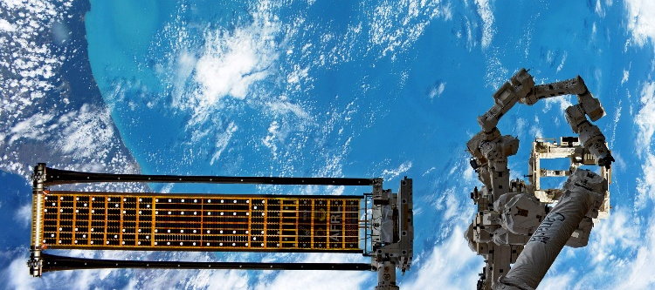
Background
Thin-shelled rollable composite booms are of particular interest in space applications due to their low storage volume, low coefficients of thermal expansion and high-stiffness [1,2].
Such booms have applications in solar panels, antennas, telescopes, and solar sails [1].
Although rollable composite booms have seen some flight testing, most notably the ROSA (Roll Out Solar Array) in 2017, many engineering and design challenges still need to be overcome before implementation is possible [3].
ROSA
Fig. 1. Roll Out Solar Array (ROSA) in low earth orbit (Image Credit: NASA).

Slide 4
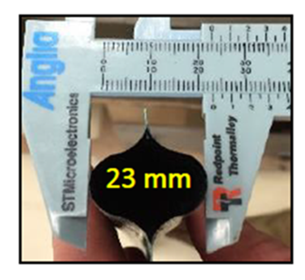
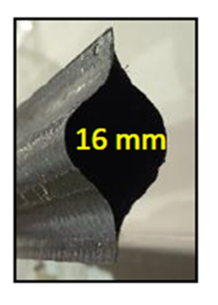
Motivation
In order to achieve their incredibly low storage volumes, booms are collapsed and rolled onto spools, where they are stored under strain until deployment.
  This period could last several months.
Successful deployment of the boom depends on the retention of dimensional stability during this period.
Unfortunately, due to the viscoelastic behaviors of the polymers used in the composite resins, significant relaxation resulting in a 28% reduction in boom diameter was found after only a month of storage [2].
  A reduction of 25% of the boom diameter results in a 33% loss of the area moment of inertia [2].
One month
stowage
(-28%)
Fig. 2. Dimensional reduction in boom after storage.

Slide 5
Motivation
Designing booms with high dimensional stability during storge is key to mission success.
It has been shown that the choice of polymer for the resin used for boom construction can have a dramatic effect on the relaxation of the composite, and therefore dimensional stability of the boom.
Kang [2] used TTS to evaluate several thermoset and thermoplastic polymers used in composites and found the estimated relaxation at the one-year interval to vary between 20% for Cycom 5250-4 Bismaleimide thermoset polymer to 98% for LaRCTM IA thermoplastic polymer. The results of the other materials tested are presented on the next slide.
Although lab tests showed thermosets to be superior, the PEAK family of advanced polymers were not evaluated.

Slide 6
What is PEEK?
Semi-crystalline thermoplastic polymer that is a member of the PAEK (Polyaryle Ether Ketone) family which includes PEK (Polyetherketone), PEKK (Polyetherketoneketone) and PEEKK (polyetheretherketoneketone).
All members are known for their high strength and high operating temperature.
PEEK is the common high performance polymer member used in industry [5].
High performance polymers are a group of polymer materials that are known to retain their desirable mechanical, thermal, and chemical properties when subjected to harsh environments such as high temperatures, high pressures, and corrosive chemicals [6].
Specialized polymers which represent only a small fraction of polymer production (0.2 %) [7].

Slide 7
Advantages of Thermoplastic Polymers
Superior chemical and heat resistance [8].
Prepregs can be stored indefinitely and do not require refrigeration like thermosets [8].
Reusable and recyclable.
Can be reheated and reformed [8].
Can be welded (Most significant benefit).
  Large parts can be made separately and attached without fasteners.
  Ties into reparability – Thermoplastic composites take well to joining by local melting [9].
Does not require a long cure time – repaired components can be returned to service more quickly.

Slide 8
Limitations of Thermoplastic Polymers
As shown from the previous slide, thermoplastic polymers have much higher processing temperatures than thermosets.
This is the primary reason why they have seen limited use in the aerospace industry (that trend is changing however).
Generally considered more difficult and costly to produce a single part.
  However, lower cure times and repeatability make them cheaper for multiple part production [8].

Slide 9
Current Aerospace Applications of Thermoplastic Composites
Aircraft
A380 leading edge J-Nose assembly
  Constructed entirely out of glass fiber/polyphenylene sulfide (PPS).
  Fiberglass because it is stiff enough to resist deflection but can flex more easily along the wing's length [13].
  Presented significant manufacturing challenges due to its size.
    Parts were assembled by hand-lay-up and were vacuum bagged. Sections measured approximately 10 feet each. Components were welded together to form the complete J-nose section [13].
  At the time of this article (2006) PEEK was still considered too expensive of an option due to its higher processing temperature of 350°C (290°C for PPS).
Gulfstream G-650 tail section (horizontal stabilizer and rudder)
  Constructed out of carbon fiber (CF)/PPS.
  Final assembly conducted by induction welding [14].

Slide 10
PEEK in Aerospace
PEEK has seen limited use in aerospace due to high initial cost and high processing temperature.
As a result, current applications have focused on using CF/PEEK for metal replacement [15].
  PEEK’s mechanical strength, machinability, and fatigue resistance make it an excellent candidate.
For example, a door fitting on the Airbus A-350 was created to replace a metal component for a 40% weight savings and reduced production cost.
  VICTREX™ PEEK 90HMF40.
  Only notable example of PEEK used in transport category aircraft.

Slide 11
Potential Future Applications of PEEK
High vacuum stability, low density, and low coefficient of thermal expansion make PEEK an excellent candidate for space applications [16].
  PEEK based antenna reflectors can reduce weight by 40% [16].
  Also offers better formability over traditional aluminum structures reducing reflective error.
PEEK can be utilized in additive manufacturing allowing complex, high-strength parts to be produced at a reduced cost [17].
  Applications in cube/nano satellites.
  Can offer 40-70% mass savings compared to metallic structures.
  Also allows for the possibility to repair parts in space.

Slide 12
TTS Master Curve Generation for CF/PEEK Composite
Samples of CF/PEEK thermoplastic composite were prepared.
  Layup consisted of unidirectional CF tape with two CF fabric layers offset 45 degrees to the length (45/U/45).
Relaxation curves were produced using a TA Instruments Q800 dynamic mechanical analyzer (DMA).
  3-point bending.
  20°C – 130°C at 10°C increments.
  Isothermal for 20 minutes, displace 60 minutes, recover 10 minutes.
From these relaxation curves, TTS master curves were generated [2,18].

Slide 13
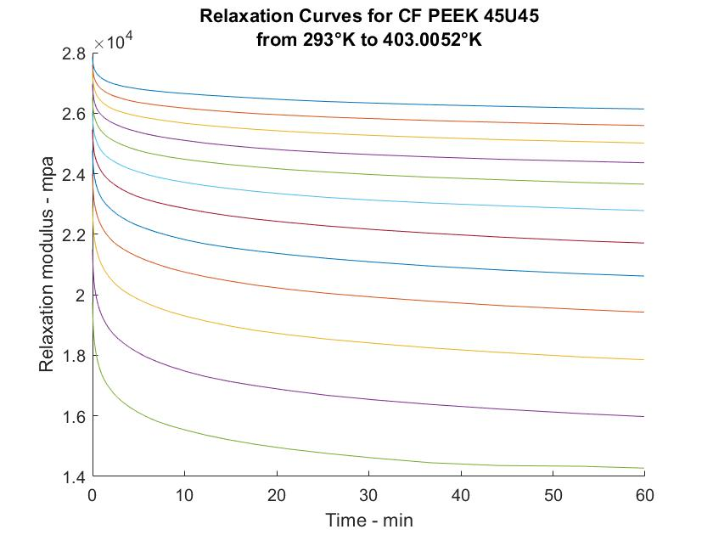
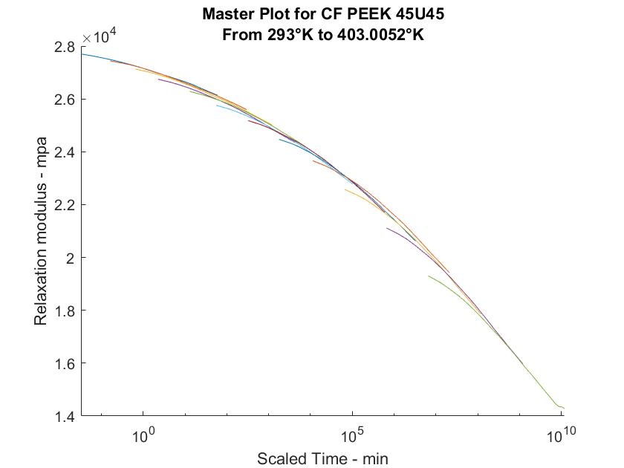
TTS Master Curve Construction for CF/PEEK Composite
Fig. 3. Raw relaxation curve for CF/PEEK (45/U/45) from 20°C to 130°C
Fig. 4. Generated Master Curve by TTS

Slide 14
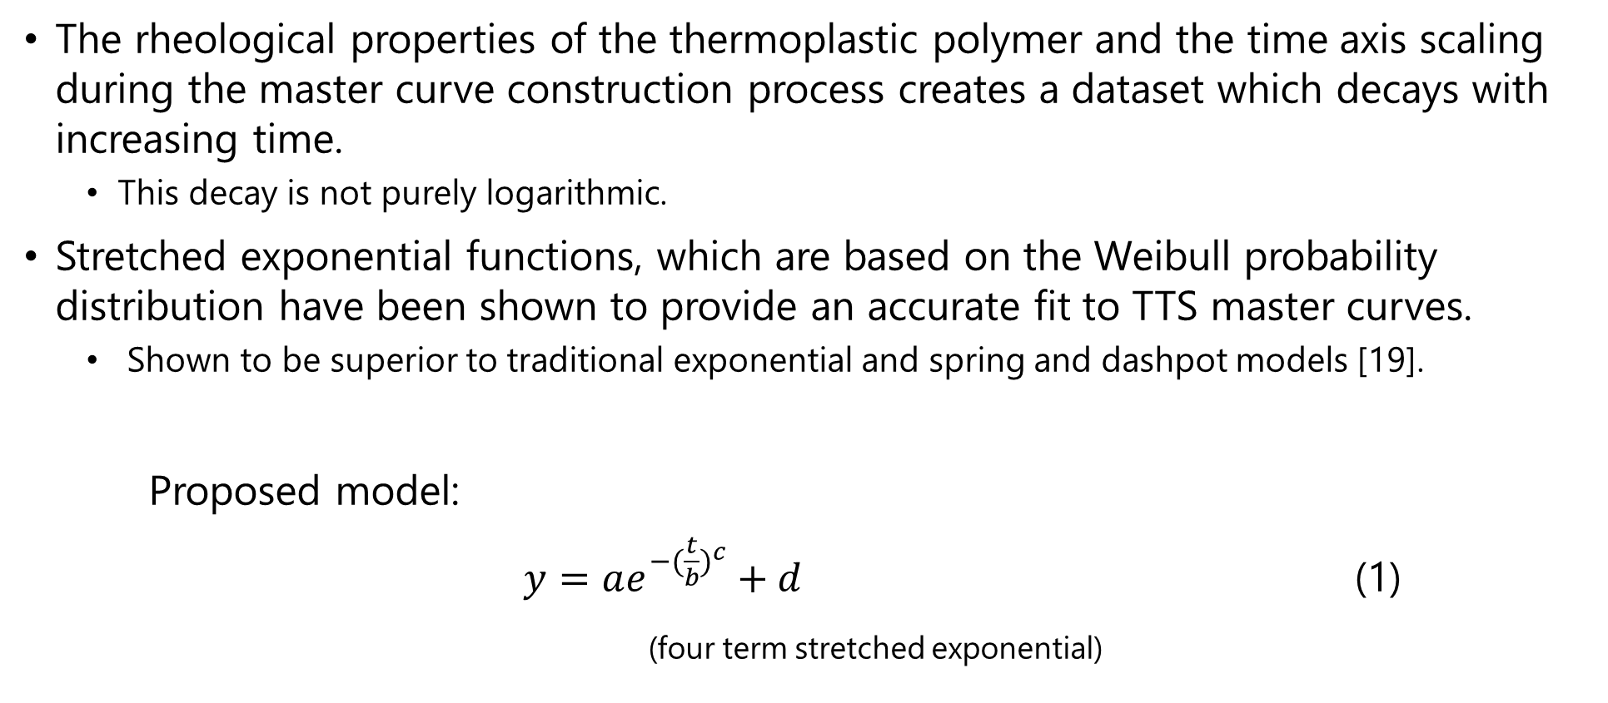
Modeling TTS Data
The rheological properties of the thermoplastic polymer and the time axis scaling during the master curve construction process creates a dataset which decays with increasing time.
  This decay is not purely logarithmic.
Stretched exponential functions, which are based on the Weibull probability distribution have been shown to provide an accurate fit to TTS master curves.
  Shown to be superior to traditional exponential and spring and dashpot models [19].
Proposed model:
$y=ae^{{−(\frac{t}{b})}^{c}}+d$ (1)
(four term stretched exponential)

Slide 15
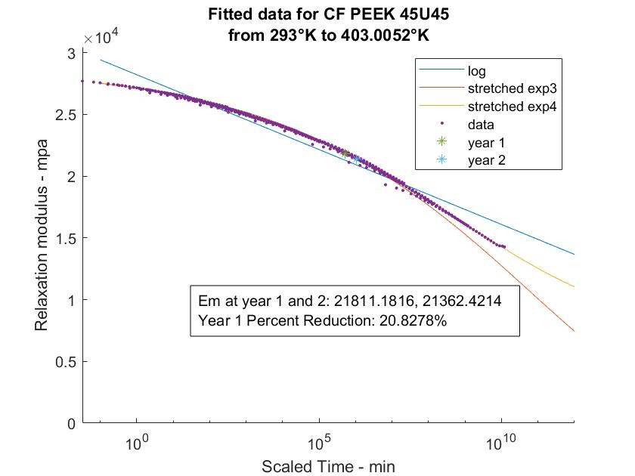
Fitted Master Curve for CF/PEEK
TTS master curve data for CF PEEK is plotted and fitted using three different models. The 4-term exponential (exp4) produced the best fit.
Using this model, the relaxation at one year was estimated and the value was determined to be 20.8%
Fig. 5. Fitted data for the master curve of CF/PEEK (45/U/45)

Slide 16
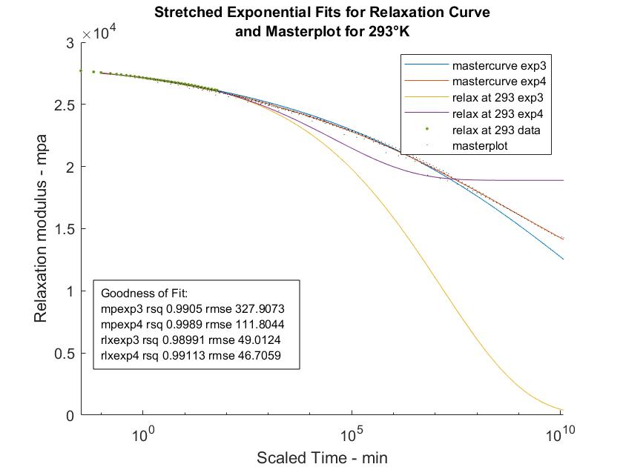
Review of Goodness of Fit
Stretched exponential fits are applied to both the raw relaxation curve for 20°C and the master curve. The R-squared and root mean square error (RMSE) values for each function reveals high degree of correlation between the model and data.
Fig. 6. Stretched exponential fits for raw relaxation curves and mater curve for 20°C

Slide 17
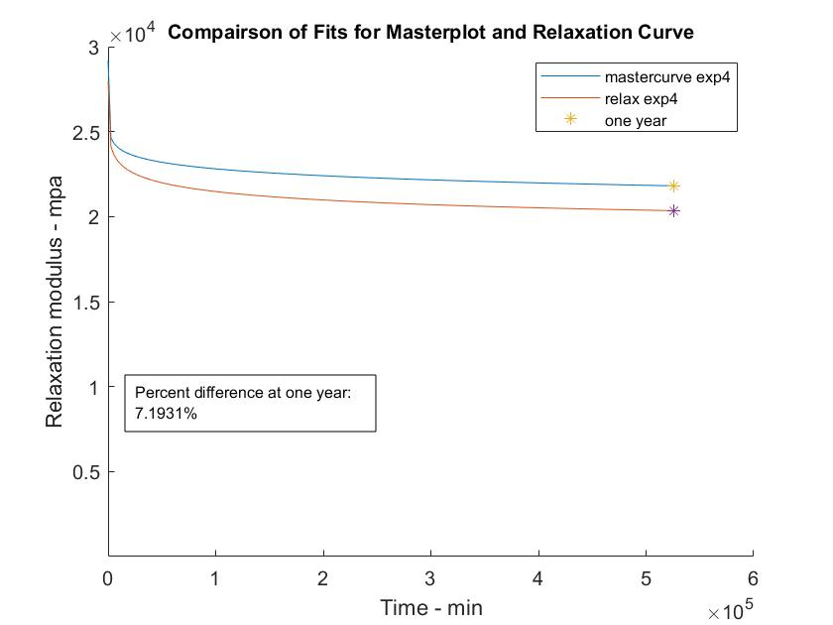
Comparison of Master Plot Fit to Relaxation Fit
Four term exponential models of the master curve and relaxation curve are presented. The difference in the plots at the one-year mark is 7.2%, indicating the TTS master curve is valid.
Fig. 7. Comparison on fits for raw relaxation curve and master curve

Slide 18
Summary and Future Work
A literature review of aerospace composites was conducted.
  A need for high-strength, high-stiffness composite booms for space applications was identified.
  A problem with polymer relaxation in these booms was identified.
A TTS master curve was generated for CF/PEEK composite material from data obtained from dynamic mechanical analysis.
Stretched exponential fits to the data were evaluated and a high degree of correlation between the model and the data was found.
Fits of the master curve and the relaxation curve were compared and an error of 7.2% was found at the one-year time interval. This indicates validity of the master curve.
Future work will focus on comparing TTS master curves of PEEK with low relaxation thermosets polymers. This could reveal an ideal candidate matrix for deployable composite booms.

Slide 19
References
[1] Fernandez, J., , et al., “Advanced Deployable Shell-Based Composite Booms For Small Satellite Structural Applications Including Solar Sails,” International Symposium on Solar Sailing, 17 January 2017, Kyoto Japan.
[2] Kang, J. H., et al., “Viscoelastic Characterization of Polymers for Deployable Composite Booms,” Advances in Space Research, Vol. 67,1 May 2021, p. 2727.
[3] “Roll Out Solar Array Experiment Deploys,” (20 June 2017), from https://www.nasa.gov/image-feature/roll-out-solar-array-experiment-deploys
[4] Gorner, S., et al.,“ Advanced Composite Solar Sail System,” NASA Ames Research Center, ARC-E-DAA-TN71909.
[5] “Polyaryletherketones(PAEK),” Kunststoffe international, October 2013, from www.kunststoffe-international.com
[6] Leon, A., “High performance polymer nanocomposites for additive manufacturing applications,” Reactive and Functional Polymers, Volume 103, June 2016, p. 141.
[7] Grasmeder, J., “High-Performance Polymers explained (part 1)” (20 August 2019), from https://www.victrex.com/blog/2017/high-performance-polymers
[8] Grand, H., “Using Thermoplastic Composites for Aerospace Applications,” (1 December 2017), from https://www.aerodefensetech.com/component/content/article/adt/features/articles/27952
[9] Reis, J. P., “Thermoplastic Composites and Their Promising Applications in Joining and Repair Composites Structures: A Review”, Materials, 21 December 2020, vol. 13, issue 24, p. 5832
[10] “PMT-F7,” Patz Materials and Technologies, retrieved 3 August 2021, from https://www.patzmandt.com/
[11] “VICTREX™ PEEK 450G”, Victrex, retrieved 3 August 2021, from https://www.victrex.com
[12] “HexPly® 8552,“ HEXCEL, retrieved 3 August 2021, from https://www.hexcel.com/
[13] “Thermoplastic composites gain leading edge on the A380,” (1 March 2006), from https://www.compositesworld.com/articles/thermoplastic-composites-gain-leading-edge-on-the-a380
[14] Jacob, A., “Thermoplastic composites fly on G650 tail,” (6 May 2010), from https://www.materialstoday.com/composite-applications/news/thermoplastic-composites-fly-on-g650-tail/
[15] Macdonald, J. “Using Thermoplastics in Aerospace Applications,” (1 August 2018), from https://www.aerodefensetech.com/component/content/article/adt/features/articles/32727
[16] Sahil, K., et al., “Investigations on the suitability of PEEK material under space environment conditions and its application in a parabolic space antenna,” 8 June 2018, Advances in Space Research, Vol. 63, p. 4039.
[17] Rinaldi, M., et al., “Additive Manufacturing of Polyether Ether Ketone (PEEK) for Space Applications: A Nanosat Polymeric Structure,” Polymers, 24 November 2020, vol. 13, p. 11.
[18] Franck, A.J., “Generating Master curves,” TA Instruments, retrieved Aug 3, 2021, from http://www.tainstruments.com
[19] Fancey, K., “A Mechanical Model for Creep, Recovery and Stress Relaxation in Polymeric Materials”, Journal of Materials Science, 2005, vol. 40, p. 4827.

Slide 20
Acknowledgements
I would like to express my sincere gratitude to
NIFS coordinators
  Jessica Gangitano
  Valerie Ellis
  Jalisa Thomas
  Patricia Sanchez
  Christine Dillard
Mentors
  Sheila Thibeault
  Keith Gordon
  Jin Ho Kang
IT support
  Gabrielle Snyder

Slide 21
Backup Slides

Slide 22
Motivation
Material | Specification | Manufacturer | % Relaxation at 1 year, 20°C
PTM-F7 | Baseline, Novolac epoxy | Patz Materials and Technology | 49
D.E.R 332 | Difunctional Epoxy D.E.R. 332 | Dow Corning | 68
MY720-1 | Tetrafunctional epoxy1 (1:0.38 ratio) Araldite MY720 | Huntsman | 34
MY720-2 | Tetrafunctional epoxy1 (1:0.44 ratio) Araldite MY720 | Huntsman | 26
Ultem 1000 | Thermoplastic Polyetherimide | GE Plastics | 73
LaRCTM IA | Thermoplastic Polyetherimide | Imitec, NASA LaRC | 98
LaRCTM SI | Thermoplastic Polyetherimide | Imitec, NASA LaRC | 29
LaRCTM RP46 | Thermoplastic Polyetherimide, RP46 | NASA LaRC | 23
LaRCTM PETI-5 | Thermoset polyimide | Imitec, NASA LaRC | 22
Compimide 353RTM | Bismaleimide (BMI) | Evonic | 27
Cycom 5250-4 | Bismaleimide (BMI) | Cytec | 20
Table 1. Percent relaxation of modulus candidate polymers for deployable structures
As indicated on the left, thermoset resins, in general, have a greater resistance to relaxation.
Even the best-case resin, Cycom 5250-4 is predicted to show significant relaxation at the one-year mark.

Slide 23
Comparison of Physical Properties of PEEK to Thermoset Resins
 | PEEK – VICTREX 450G [11] | HexPly 8552 (Thermoset) [12] | PTM-F7 (Thermoset) [10]
Glass Transition Temperature (°C) | 143 | 200 | 227
Modulus (GPa) | 4.0 | 4.6 | 3.0
Tensile Elongation (%) | 45 | 1.7 | 4.14
Tensile Strength (MPa) | 98 | 51 | 71
Curing / Processing Condition | 350°C | 4 hours 180°C | 4 hours thermo cycle + 2 hours additional cure 177°C
Melting Point (°C) | 343 | N/A | N/A

