Slide 1

Development and Fracture Testing of Amorphous Carbon
Chloe Zeller
ARC-TSM, Justin Haskins & Lauren Abbott
University of Minnesota, Dr. Ellad Tadmor
August 13, 2021

Slide 2
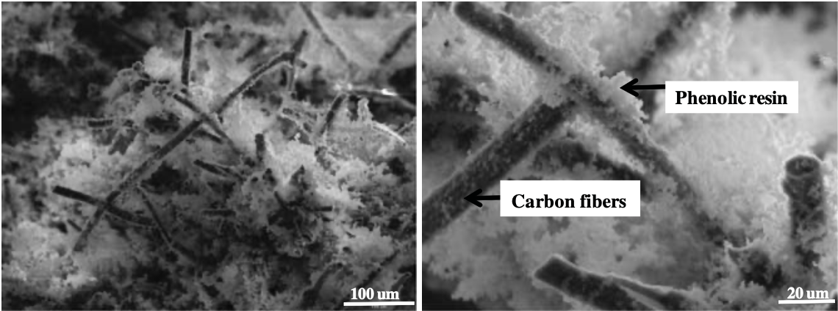
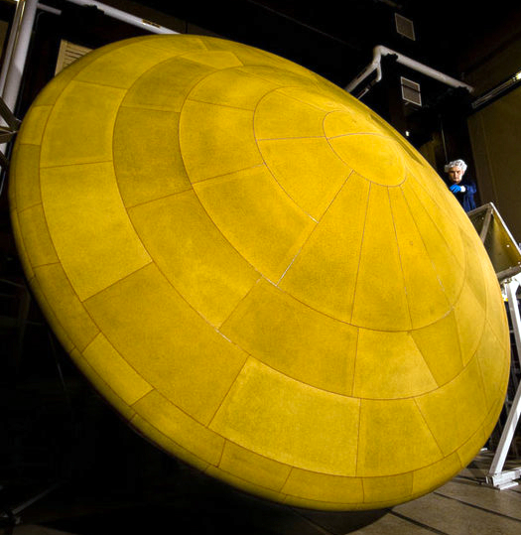
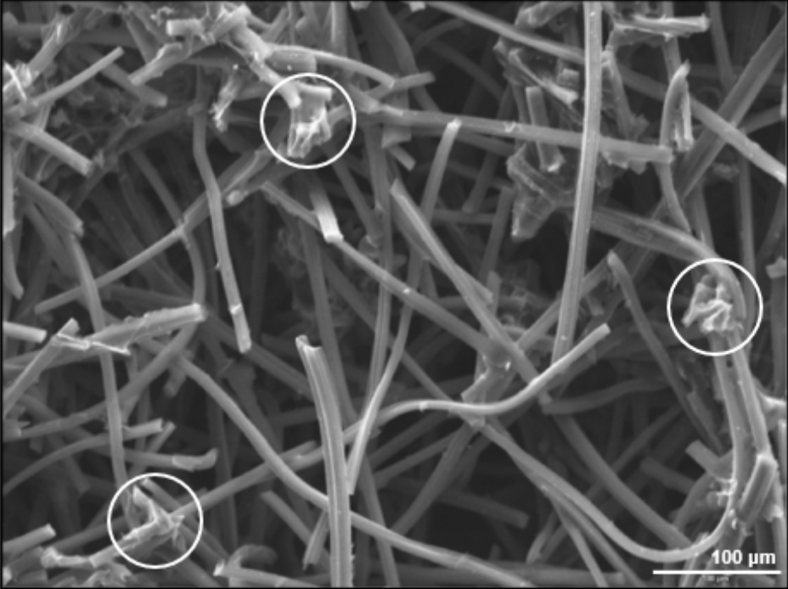
Thermal Protection Systems -- PICA
Amorphous carbon
PICA heat shield on Mars Science Laboratory (2012)
Agrawal and Chavez-Garcia, Journal of Spacecraft and Rockets, 2013.

Slide 3
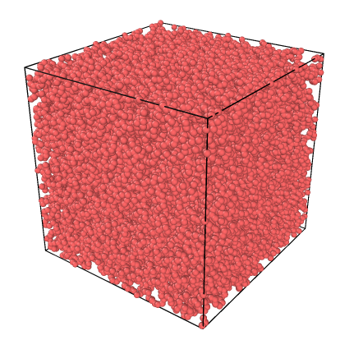
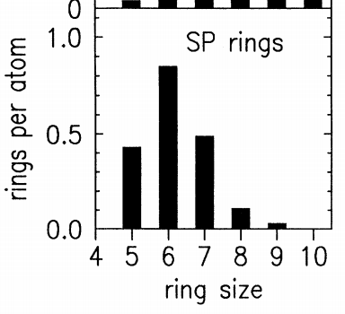
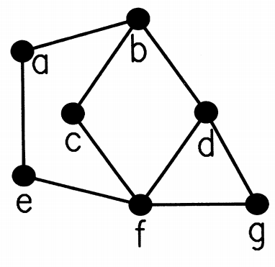
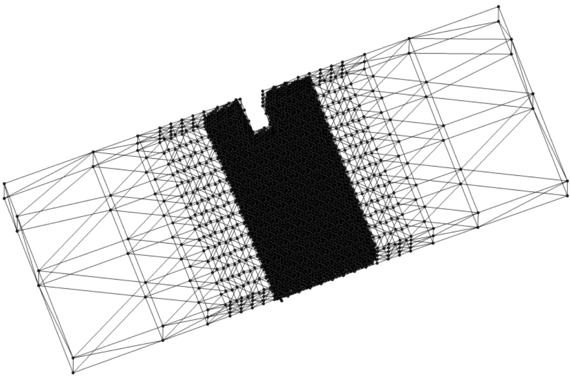
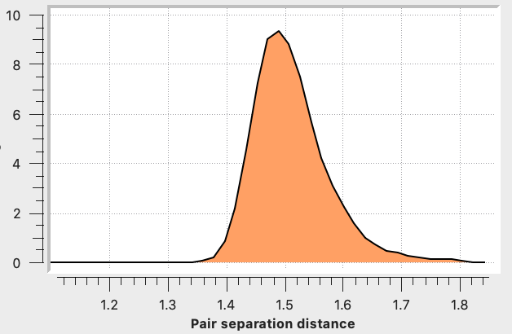
Project Overview
Goal: Develop and improve amorphous carbon as a binding material for thermal protection systems on space vehicles
40 nm
7.578 nm
15 nm

Slide 4
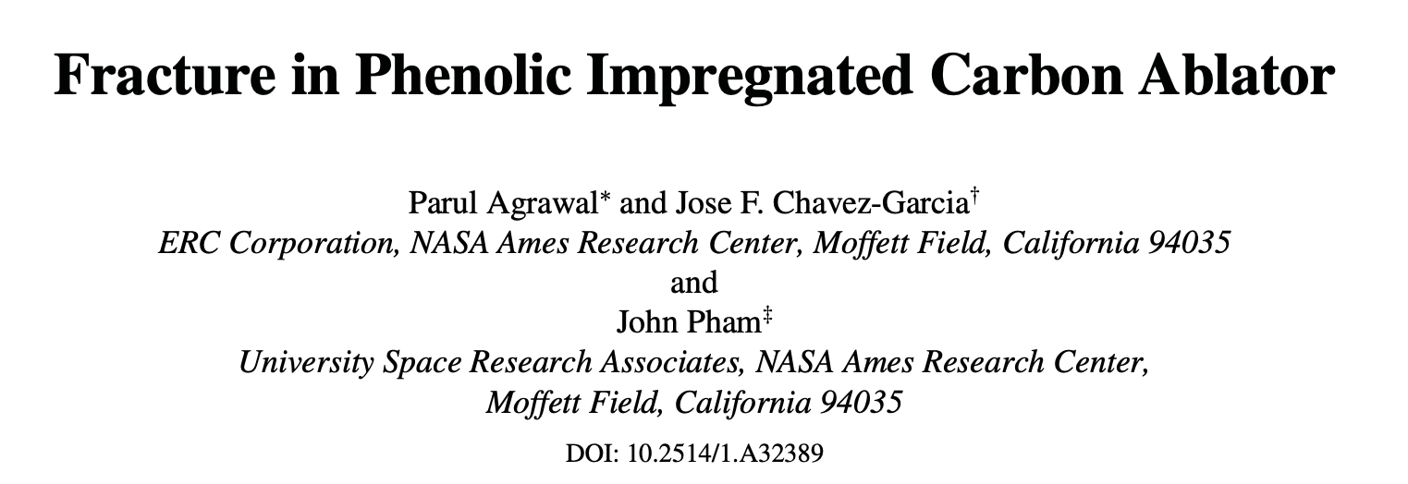

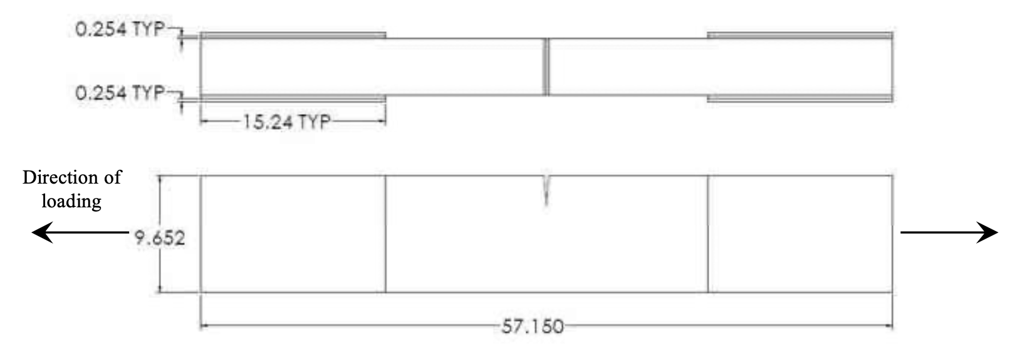
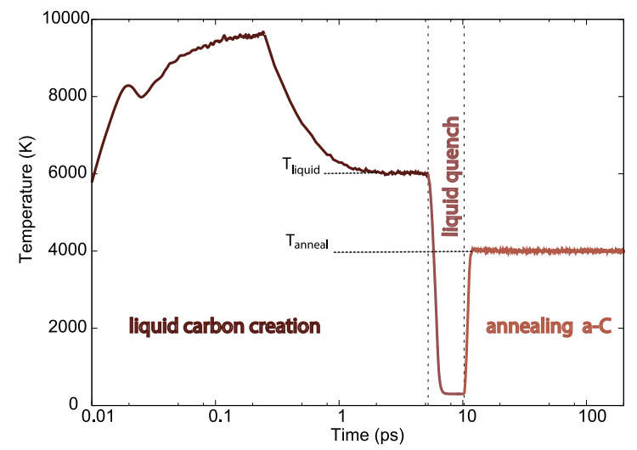
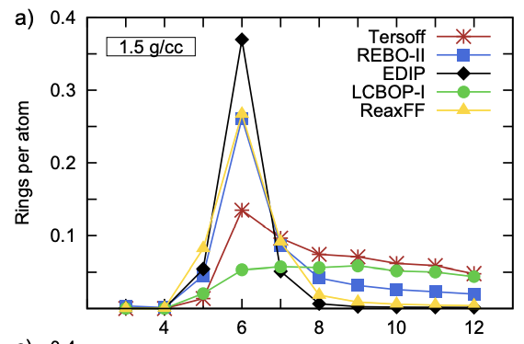
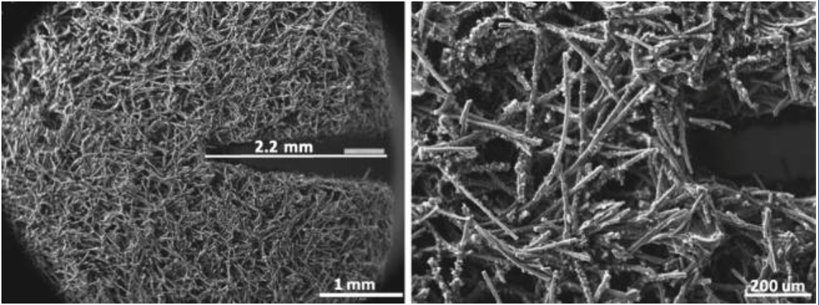
Reference Papers
De Tomas, Carla, et al., Carbon, vol. 109, 2016, pp. 681–693.
Agrawal and Chavez-Garcia, Journal of Spacecraft and Rockets, 50:735-741, 2013.
Notes:
Interatomic potentials: models that describe the atomic interactions between an arrangement of atoms (nuclei) as a function of their positions
Tersoff = bond-order potential, this potential (energy) has the functional form:

Slide 5
Interatomic Potential: Tersoff

Slide 6
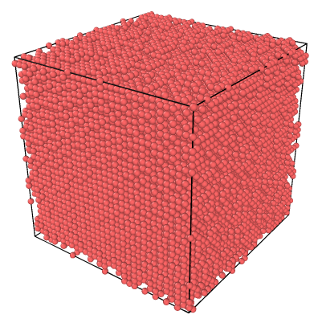
Algorithm for Generating Amorphous Carbon
Slightly randomized simple cubic lattice
Supercell of 32x32x32 carbon atoms (32,768 atoms)
Density: 1.5 g/cc
Interatomic potential: Tersoff (OpenKIM, https://openkim.org)
Temperature simulation
  Initial temperature: 100 K
  Unstable structure → melting (NVE)
  Equilibrate at T_{liquid} = 8000 K (NVT)
  Quench to 300 K (NVT)
  Anneal at T_{anneal} = 5000 K (NVT)
De Tomas, Carla, et al., Carbon, vol. 109, 2016, pp. 681–693.

Slide 7
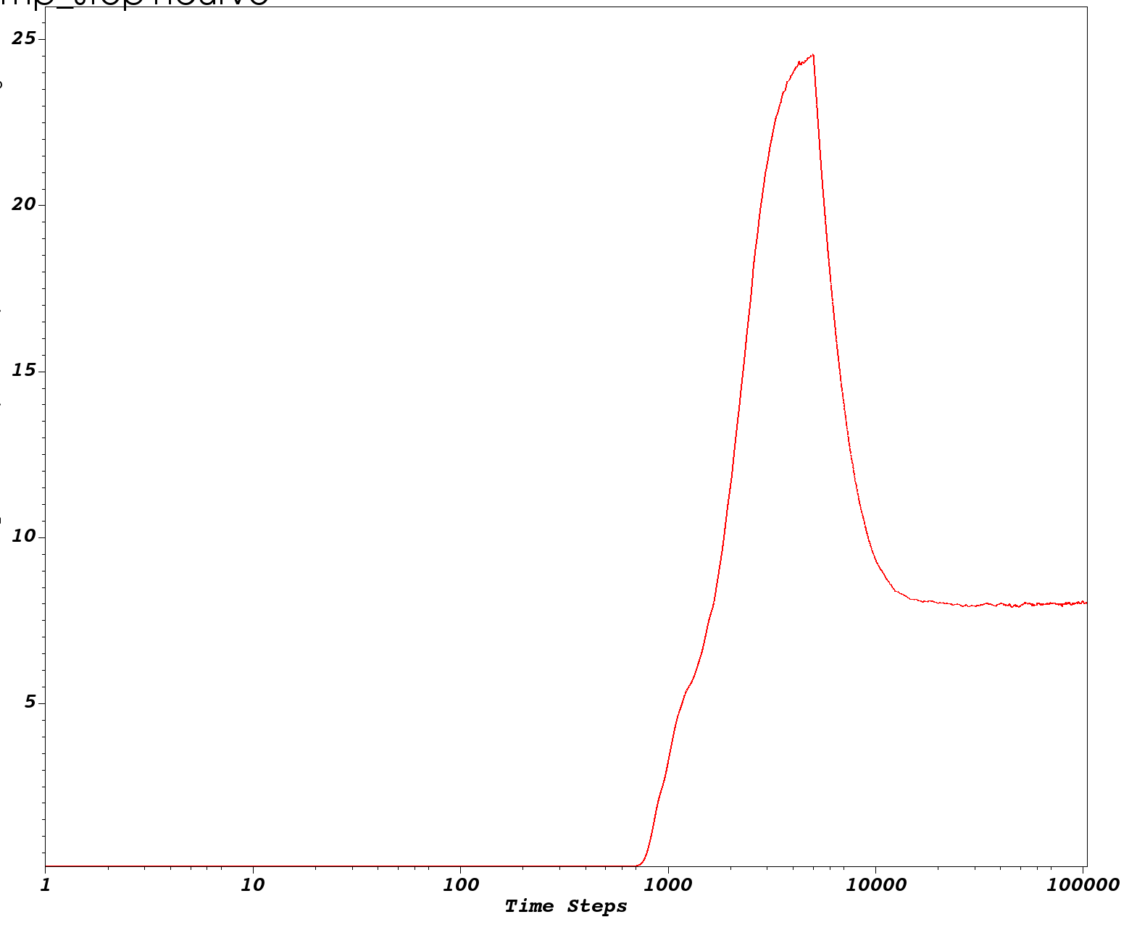
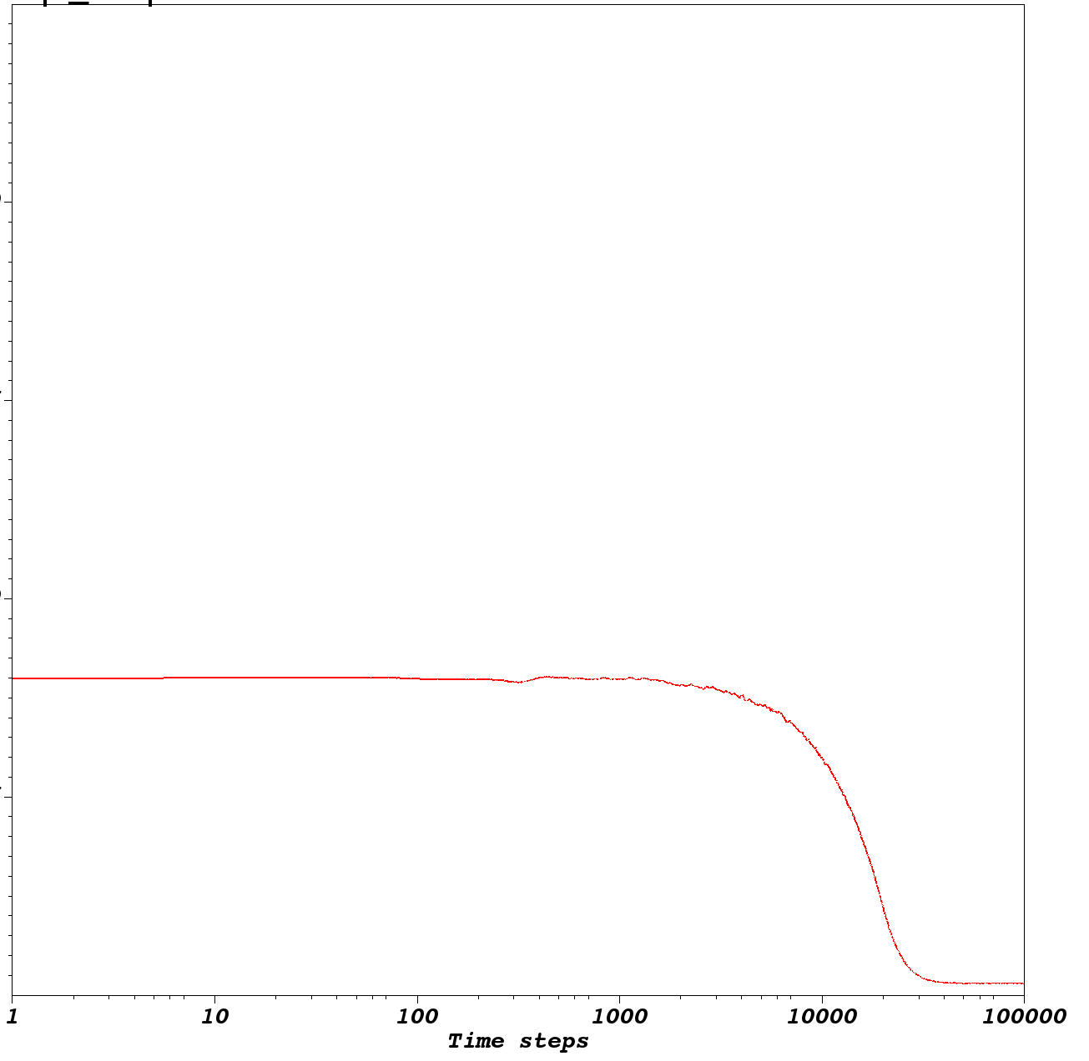
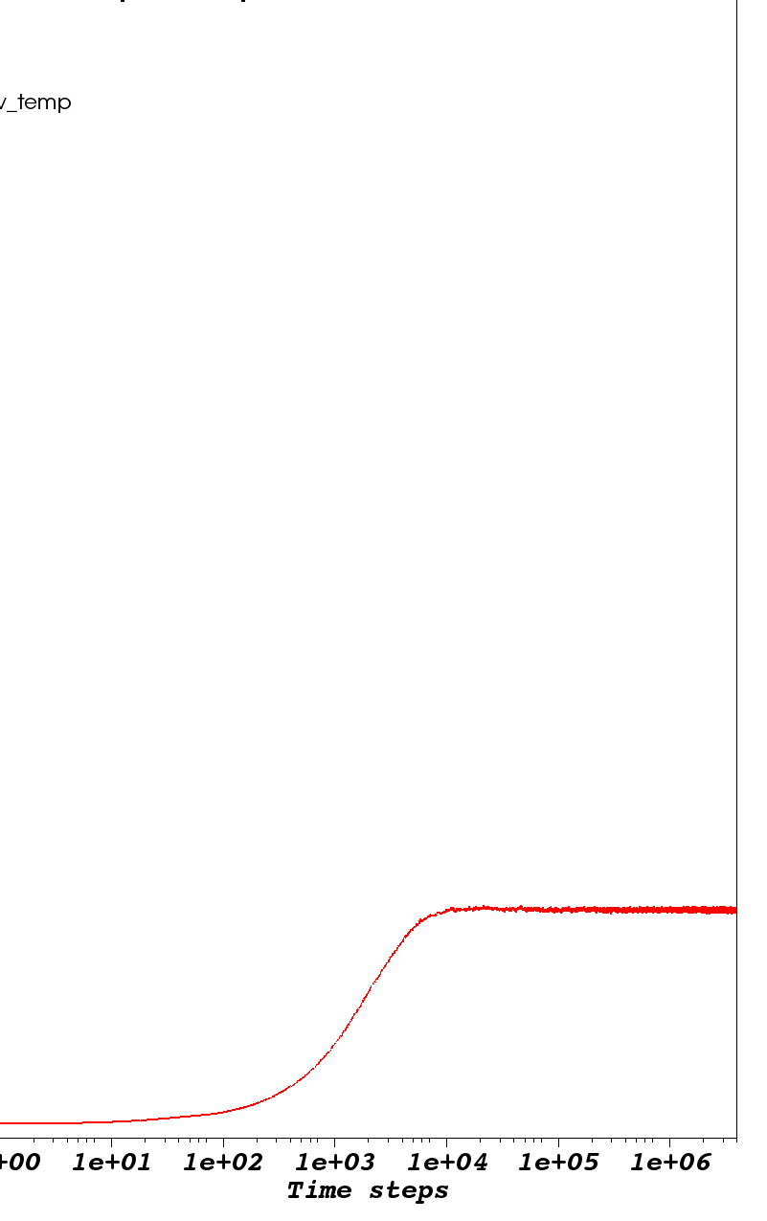
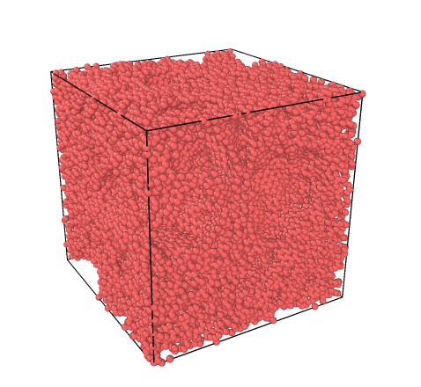
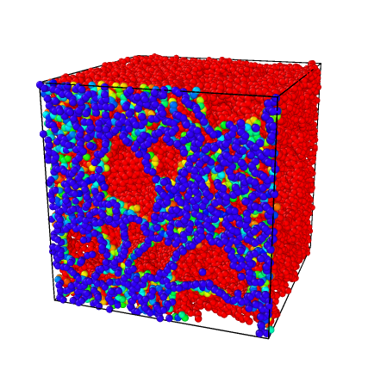
Tersoff Temperature Profile for Amorphous Carbon Creation
Temperature (10^3 K)
Time steps
Final structure:
De Tomas, Carla, et al., Carbon, vol. 109, 2016, pp. 681–693.
Surface topography
Notes:
Step 1: 0.25 ps NVE melting, 5 ps NVT equilibration
Step 2: 1 ps NVT cooling, 4 ps NVT equilibration
Step 3: 400 ps NVT annealing
Step 1: Liquid carbon creation (melting, equilibration)
Step 2: Liquid quench (cooling, equilibration)
Step 3: Annealing a-C

Slide 8
Verification of Structure

Slide 9
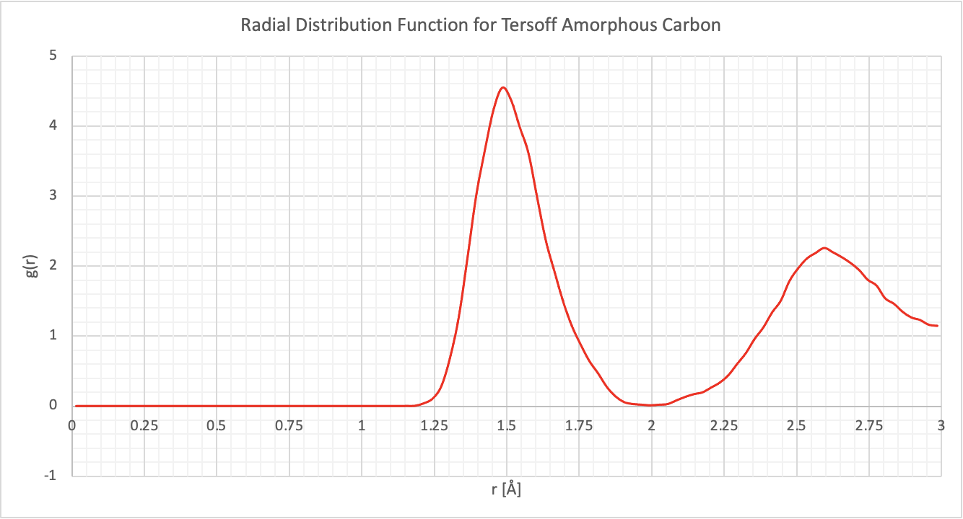
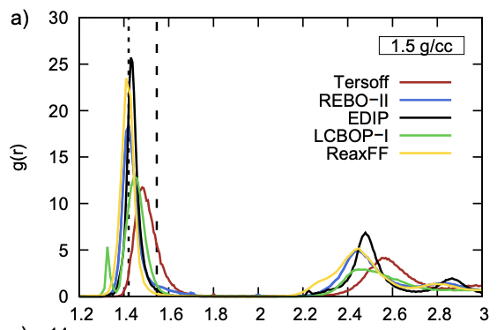
Tersoff Structural Analysis -- Radial Distribution Function
Average distribution of atoms around any reference atom in the system
Peaks at 1.5 and 2.6 Å
De Tomas, Carla, et al., vol. 109, 2016, pp. 681–693.

Slide 10
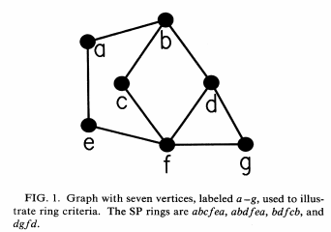
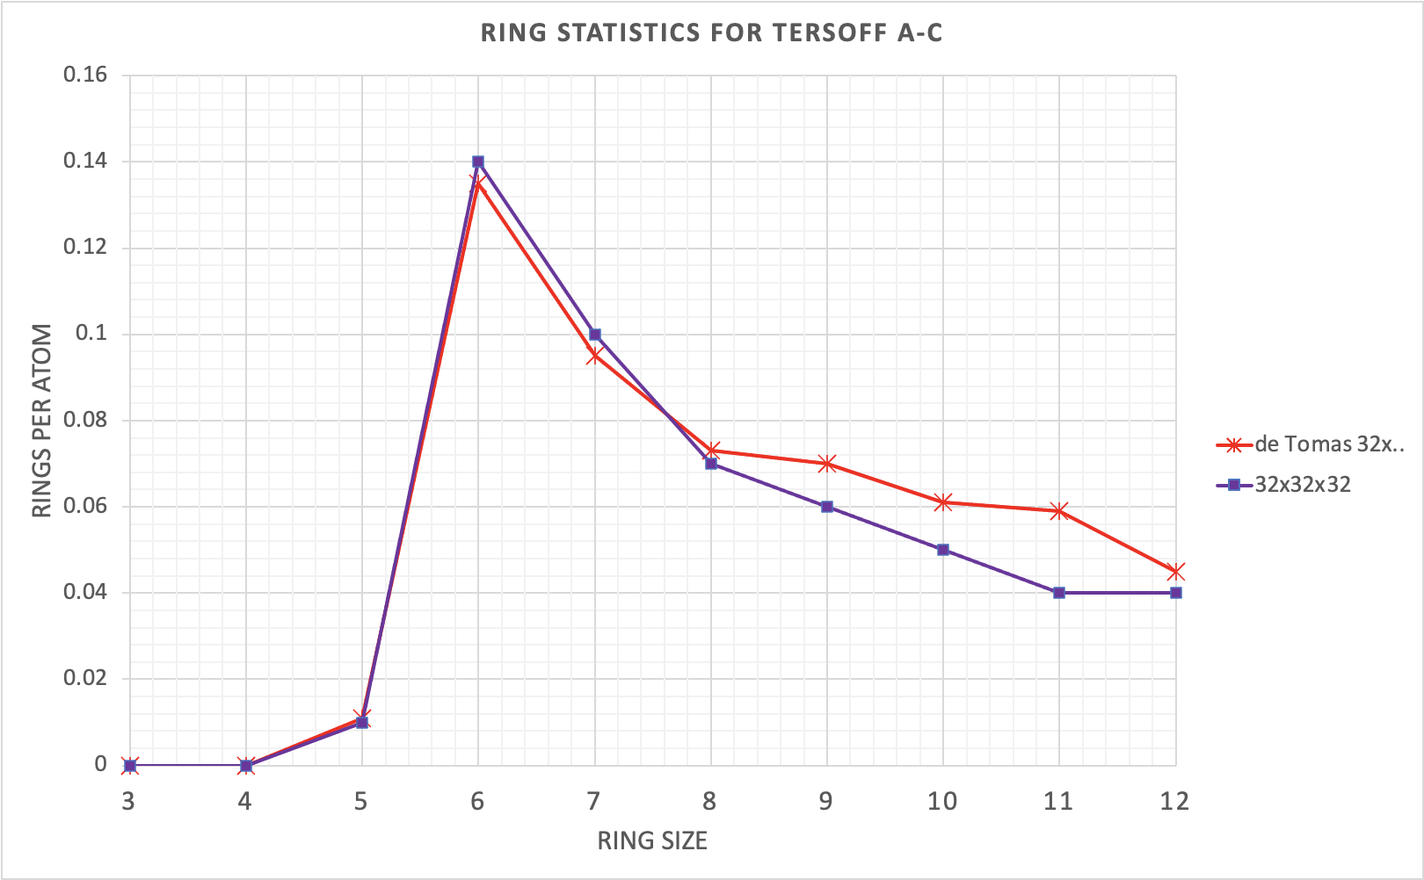
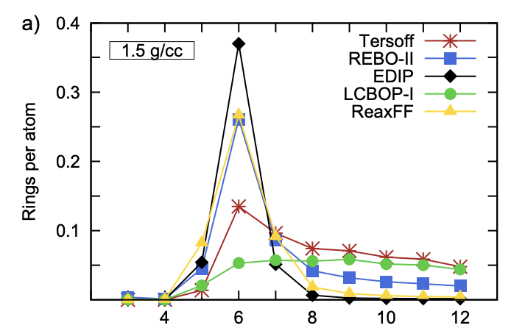
Tersoff Structural Analysis -- Ring Statistics
Shortest-path (SP) criterion: includes only rings that cannot be decomposed into smaller rings
D.S. Franzblau, Phys. Rev. B 44, 4925-4930 (1991)
De Tomas, Carla, et al., Carbon, vol. 109, 2016, pp. 681–693.
Notes:
Shortest-path (SP) criterion: "Computation of ring statistics for network models of solids", D.S. Franzblau, Phys. Rev. B 44, 4925-4930 (1991)

Slide 11
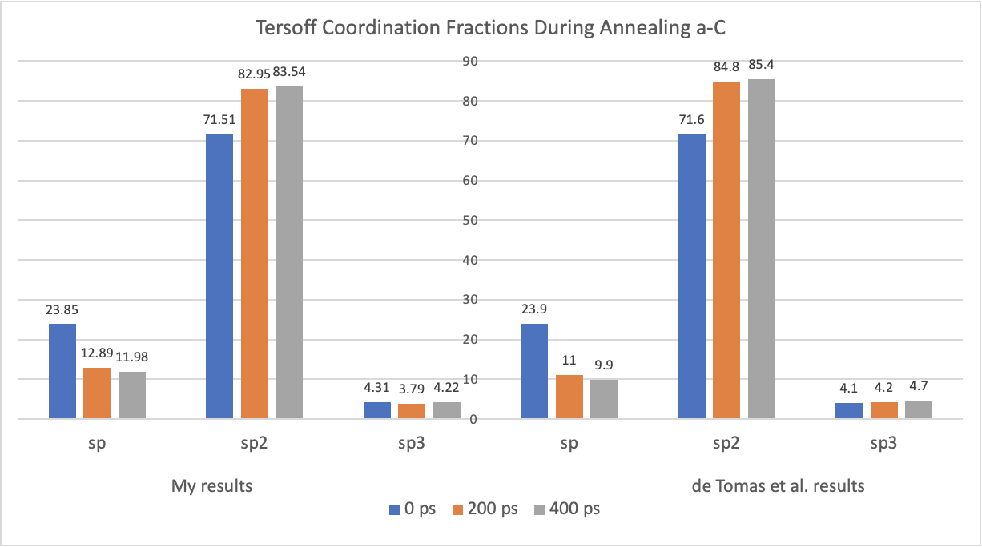
Tersoff Structural Analysis -- Coordination Fractions
Fractions of sp, sp2, sp3 bonding throughout 400 ps of annealing
De Tomas, Carla, et al., vol. 109, 2016, pp. 681–693.
Notes:
Coordination number 2 = sp, 3 = sp2, 4 = sp3

Slide 12
Quasicontinuum (QC) Simulation of Amorphous Carbon Fracture

Slide 13
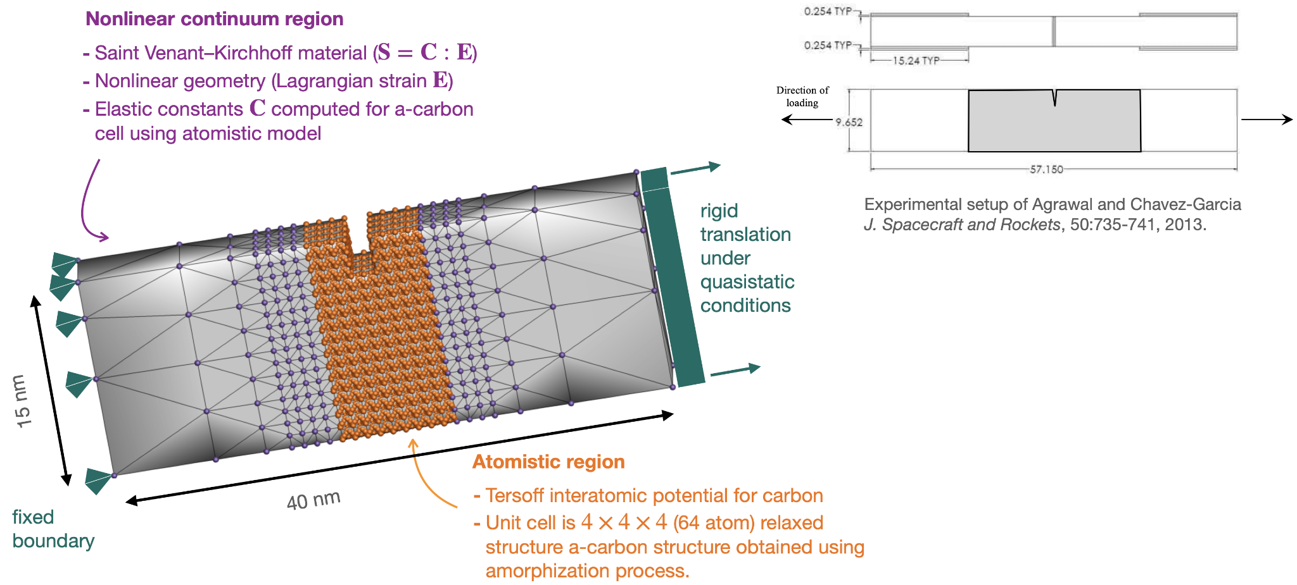
Setup of QC Amorphous Carbon Fracture Simulation
mm

Slide 14
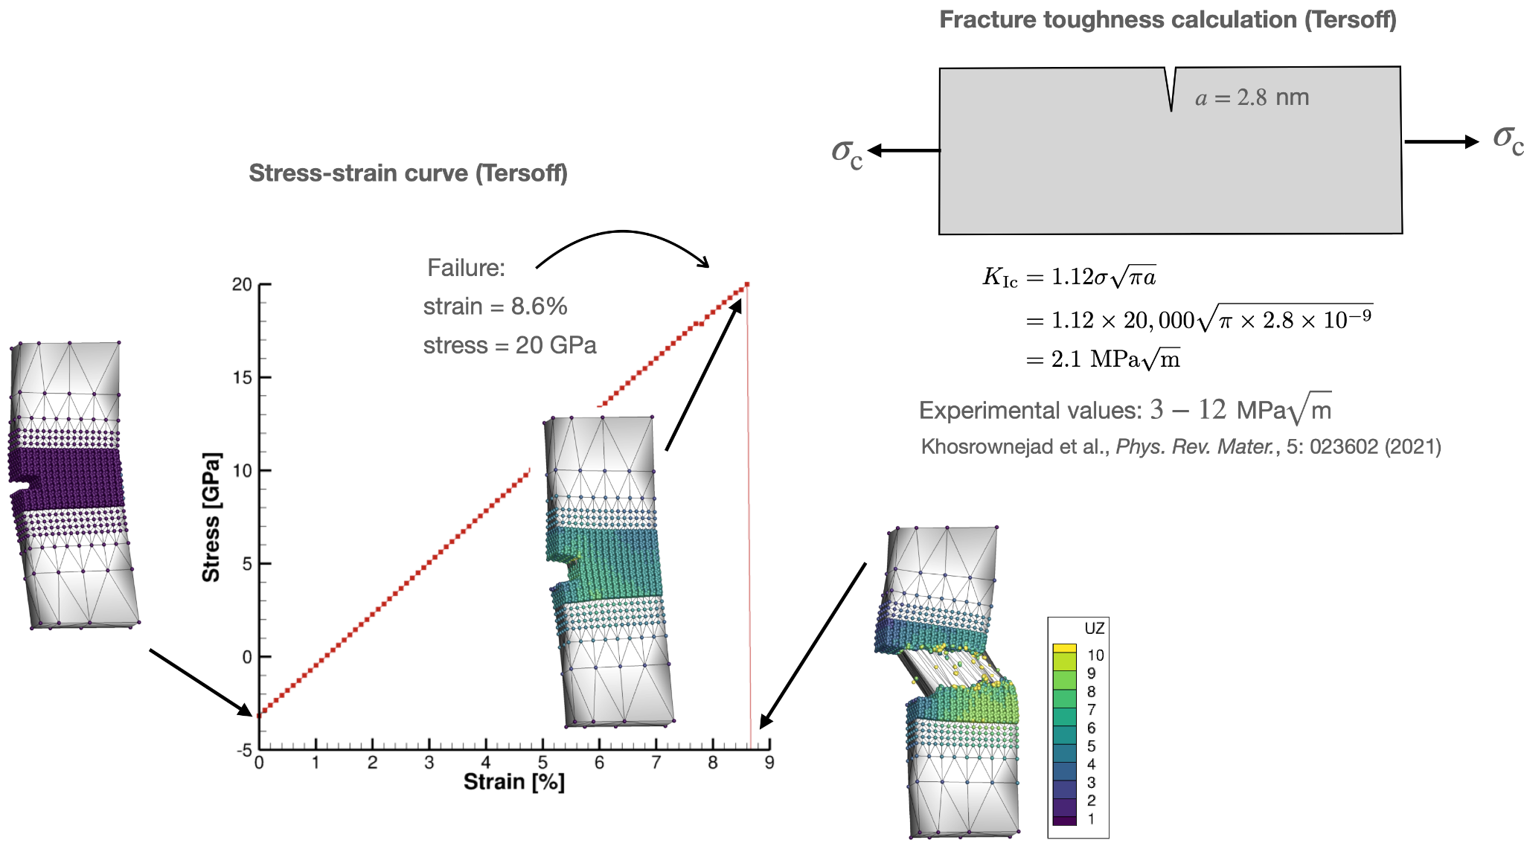
Results from QC Amorphous Carbon Fracture Simulation
Possible reasons for discrepancy in fracture toughness:
Tersoff not the best model for a-C
Small unit cell (64 atoms)
Nano-scale structure
[Å]

Slide 15
Future Work
Convergence study
  Fracture test using larger atomistic region
  Fracture simulation with different RVE size (> 4x4x4)
Compare fracture between different interatomic potentials (Tersoff, EDIP, AIREBO)
  What is the relationship between fracture toughness and the a-C structural characteristics?
Scale up simulations closer to experimental sizes
Explore toughening mechanisms, eg. adding impurities
Study realistic geometries such as corners, holes, and notches

Slide 16

Thank you!

