Slide 1
Development of a Statistical Model for Arc Jet Data Santa Clara University, UC Santa Cruz Internship with AMA, Inc. at NASA Ames Research Center Thursday, August 12, 2021
Julian Ornelas

Slide 2
Project Goals
Compile a model that can predict the value of a certain diagnostic variable with other diagnostics acting as independent/predictor variables
E.g.: predict expected arc voltage from operational settings
Build a model that can predict with as high an accuracy as possible with as little error as possible
Potentially detect any problematic data

Slide 3
Importance/Why Machine Learning?
Automates tasks such as searching for the last similar condition or finding similar settings
Predict and interpolate in varying number of dimensions
Utilize all the available data
Machine learning is highly efficient for modeling n-dimensional, non-linear data
Notes:
Only so much when it comes to doing statistics manually (limited to typically zero- or 1-dimensional data), as you will see in upcoming slides

Slide 4
Approach
Using arc jet datasets from eu files, load into Pandas dataframes in Python
Independent variables:
Main Air Mass Flow, Add Air Mass Flow, Argon Mass Flow, Arc Current
Dependent variables:
Arc Heater Pressure, Arc Voltage
6 total models tested (each of 2 depend. variables * 3 algorithms)

Slide 5
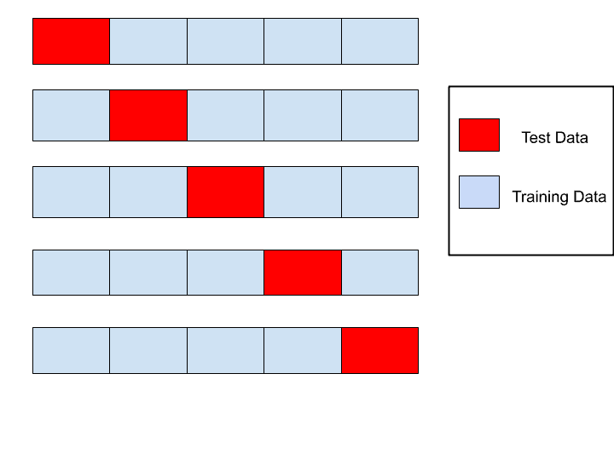
Approach cont’d
Algorithms considered
Multiple linear regression
Tree-based methods – decision trees, random forests, XGBoost
Try each model on a single dataset, see which performed the best, and evaluate that model against all other datasets
Linear regression determined not to be a good technique for the data
Metrics used
Accuracy: 5-fold cross-validation
Error: Root Mean Squared Error (RMSE)
Notes:
Explain CV and RMSE, include graphics? Regression problem, not classification, because trying to predict numerical outputs.

Slide 6
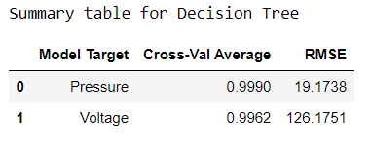
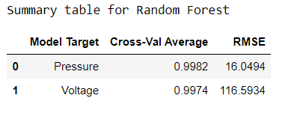
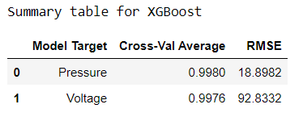
Model results for a single dataset
Notes:
How good/bad are the RMSE values? Can it be normalized? CV is normalized value, between 0 and 1.
Ultimately chose XGBoost because it had the best performance of the three algorithms

Slide 7
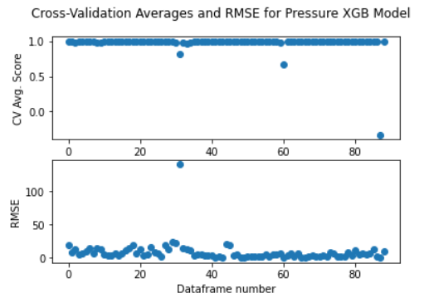
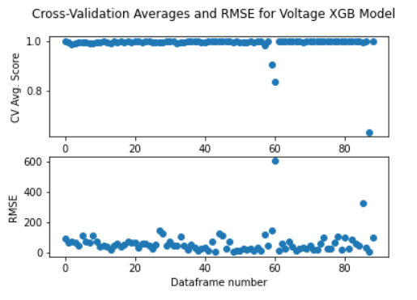
XGB Model Results

Slide 8
Anomalous Data
“Weird” behaviors in the diagnostic variables
Large gaps in the time spans of certain runs
Notes:
Outliers indicative of arc failures that the model was able to identify; outliers can be identified because the model fit really well

Slide 9
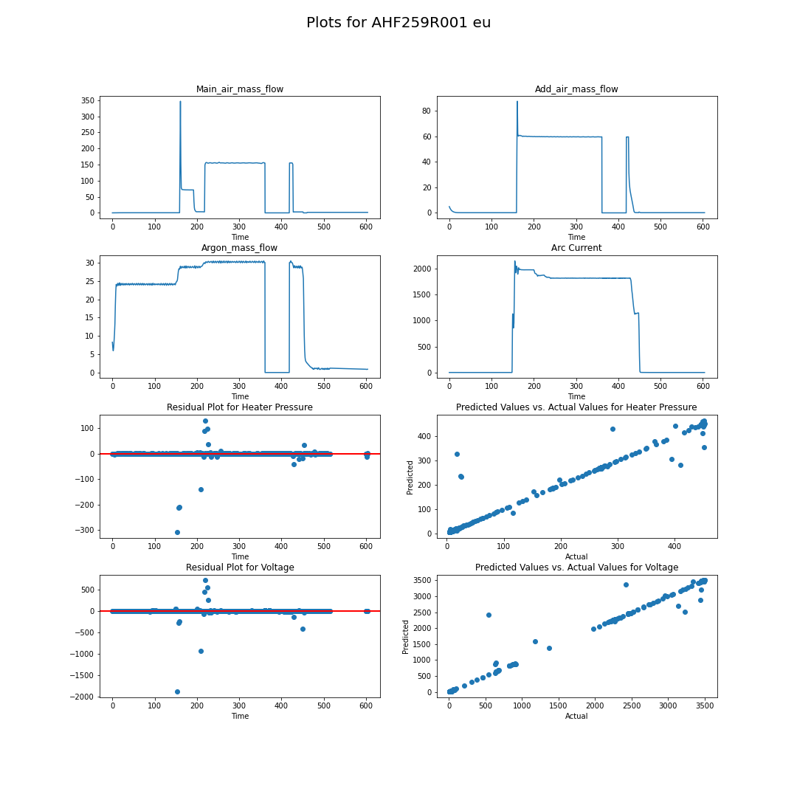
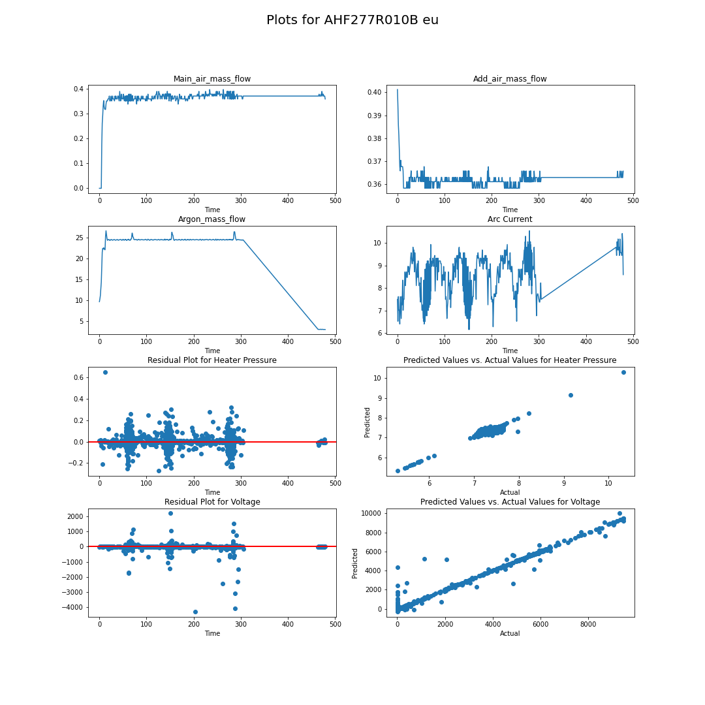
“Normal”
“Anomalous”
Notes:
Comparison – “Normal” (left) vs “Anomalous” (right); arc did not start; large gaps affect predictions

Slide 10
Materials Export Project
Goal: Export data from Materials Database into Excel workbook
Approach:
Gather the Variable Properties, Constant Properties, and Matrix Properties by accessing Django tables and objects
Compile a Pandas dataframe for each property category
Place each dataframe into its own sheet within the same workbook
Use of Python, Django, and OpenPyXL
Export/download procedure created and functioning
Workbooks for Cork and TACOT
In progress: procedure for importing data
Use case: Modify existing properties, add back into Django database
Notes:
Show the workbooks briefly?

Slide 11
Summary:
Suitable model built to fit the arc jet data
Demonstrated ability to detect outliers and anomalous data more clearly
Observe some abnormal behaviors among the data
Future work:
Apply the XGB model against unseen data
Used only historic data in building the model
If another material comes along, workbook can be created and exported
Notes:
XGB model exported and pushed to GitLab for future use within the database

Slide 12
Thank You!
Acknowledgments
Questions?

