Slide 1
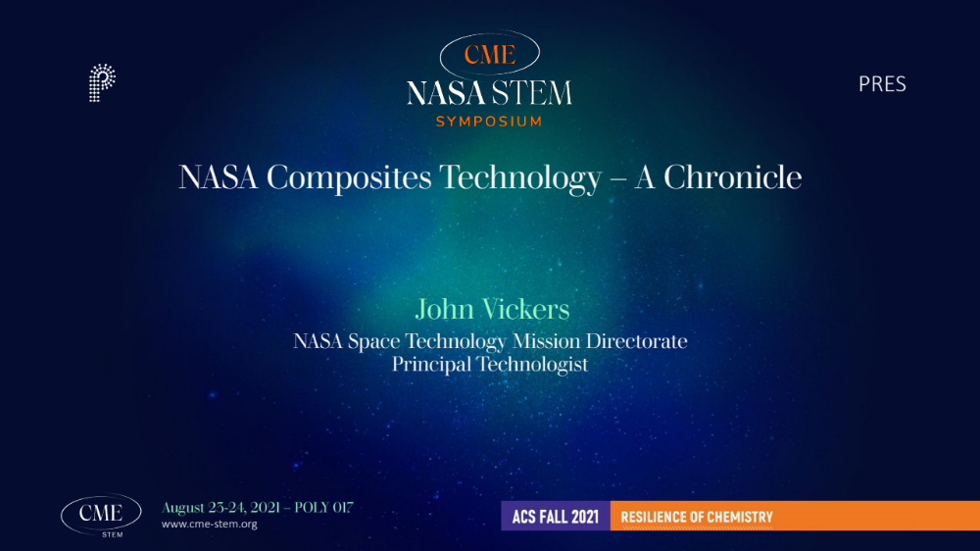
SAMPE WEBINAR
Today’s Strategic Impact and the Future of Composites for NASA's 21st Century Missions
John Vickers, Principal Technologist Advanced Manufacturing 02.25.2021

Slide 2

Mars 2020 Perseverance Rover & Helicopter Ingenuity

Slide 3
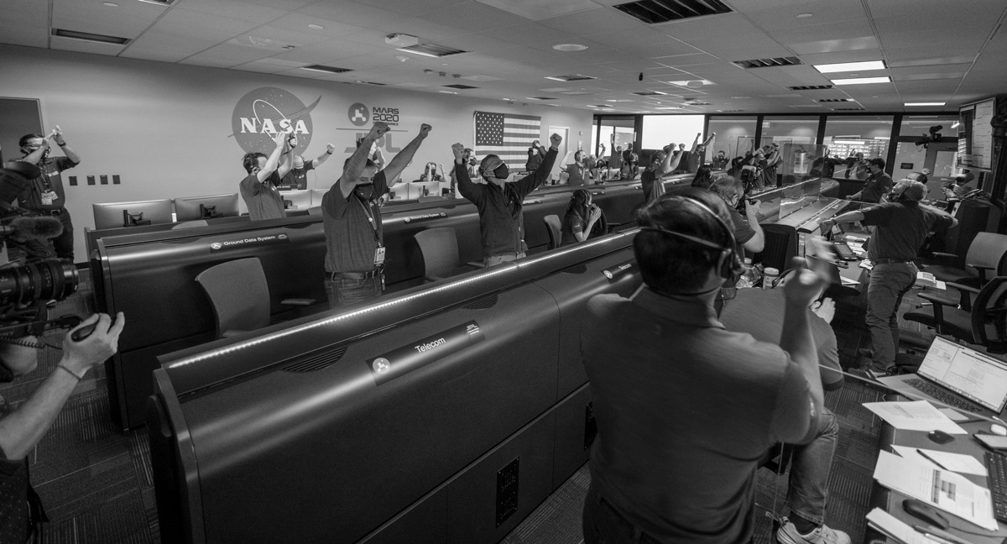
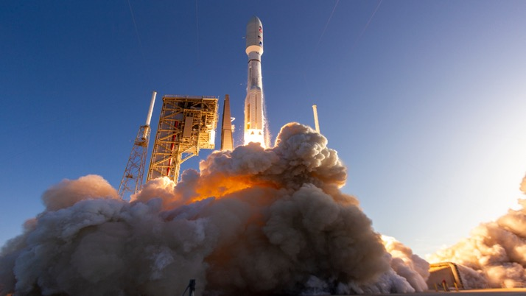
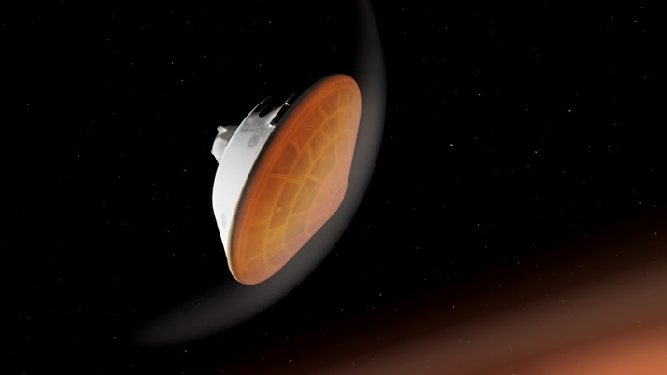
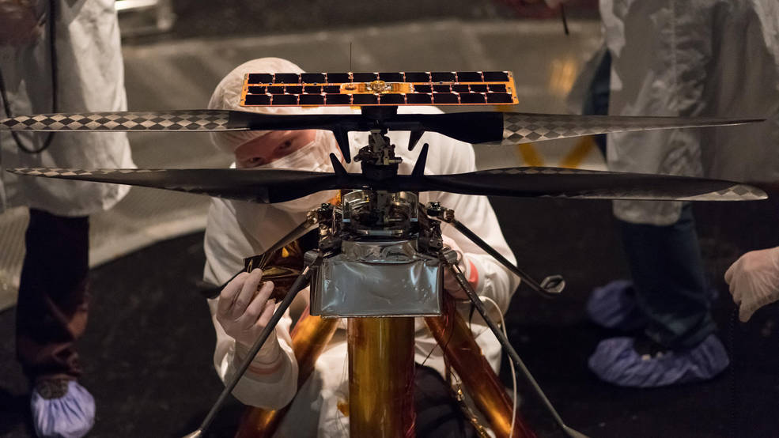
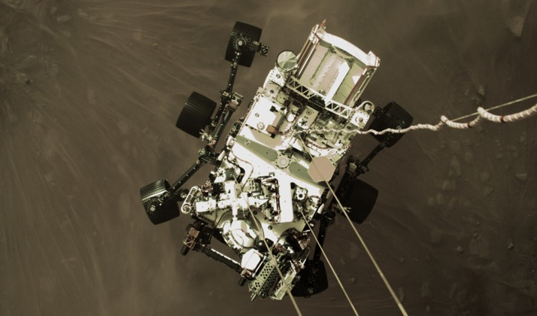
Mars 2020 Perseverance Rover & Helicopter Ingenuity

Slide 4
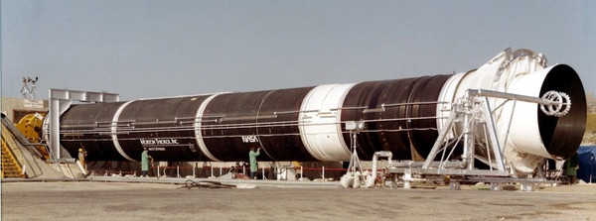
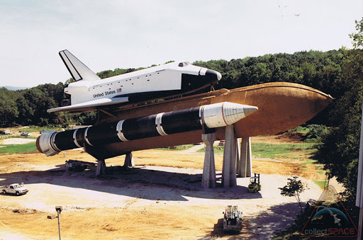
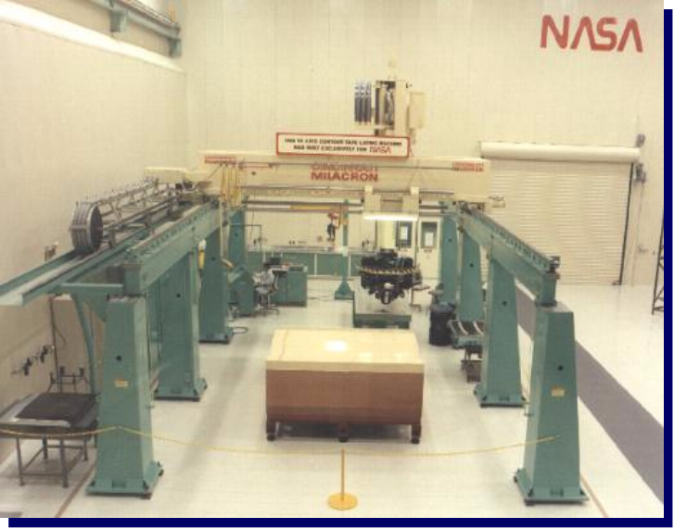
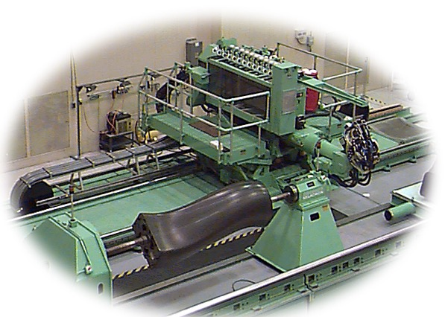
Back in Time Machine

Slide 5
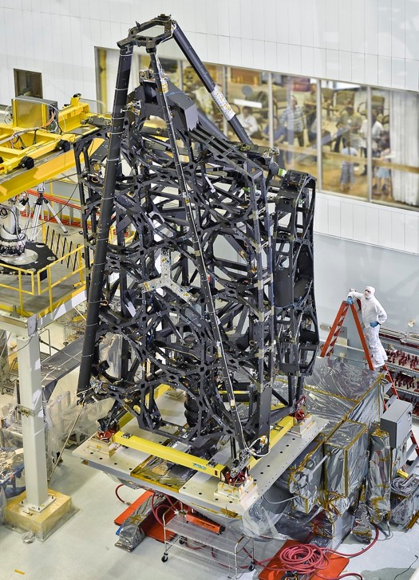
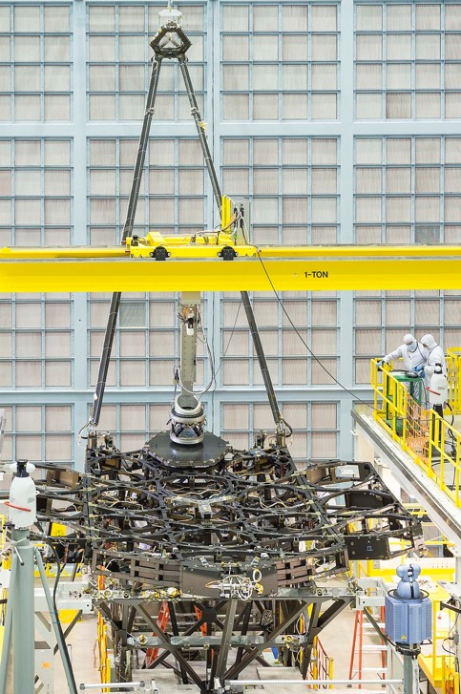
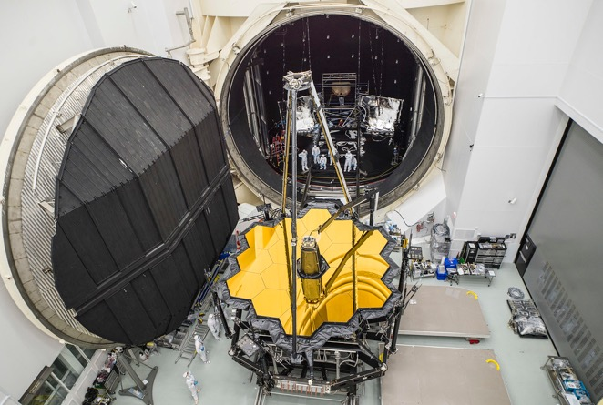
The James Webb Space Telescope’s Backplane
The backplane carries more than 2400kg (2 1/2 tons) of hardware, it performs at temperatures colder than -400°F (-240°C) with unprecedented thermal stability within 32 nanometers, which is 1/10,000 the diameter of a human hair!

Slide 6

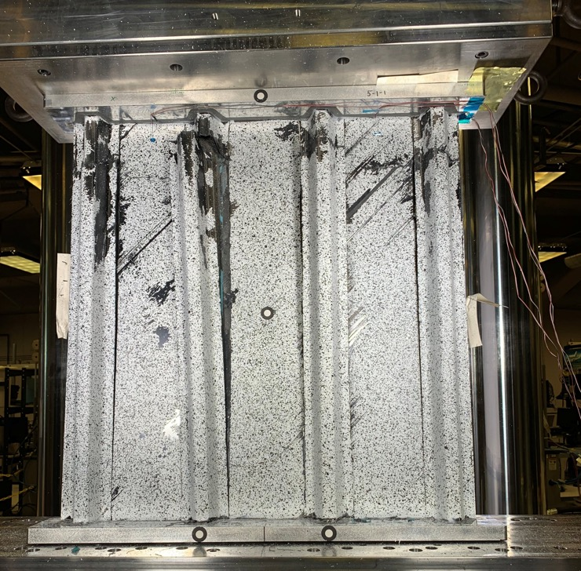
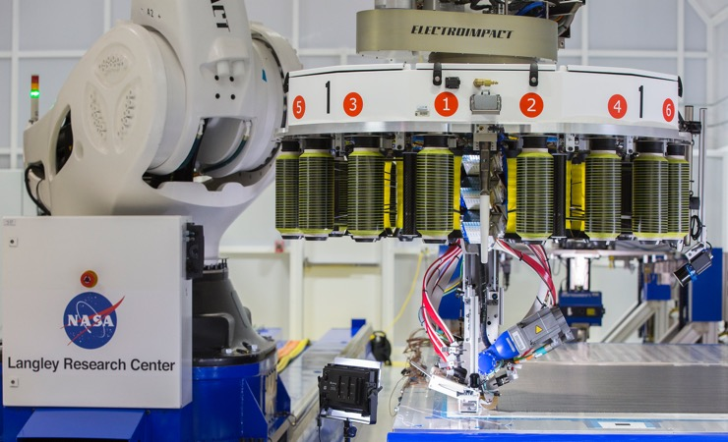

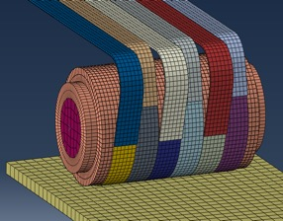
Remaining Competitive in Aircraft Manufacturing
Overlap
Gap
Roller
  Advanced Composites Project completed after a 5 year research effort and $170M investment
  Hi-Rate Composite Aircraft Manufacturing (HiCAM) (in formulation in FY21)
  Reducing time to develop & certify composite structures
  Partnerships between government, industry and academia
Notes:
Advanced Composites Project completes after 5 years research effort and $170M investment
Consortium Approach with 50/50 cost-share
Community Involvement and Buy-In
Research Transitioning into Standards and Practice
Left Pic: Structural test to validate life and strength prediction tools (Objective: reduce physical testing required to develop new aircraft)
Right Top Pic: Using ISAAC, automated fiber placement robot to conduct research (Objective: reduce manufacturing development time)
Right, bottom left pic: In ISAAC, developed thermal-based real-time inspection to detect and record manufacturing defects
Right, bottom right: Developed models to simulate ISAAC manufacturing process, to predict and prevent defects
Analysis methods, inspection technology, and manufacturing process improvements have transitioned to industry partners for next-generation transport, urban air mobility vehicles, and spacecraft.
Analysis and simulation capability will be incorporated in model-based system engineering solutions and applied in the context of the digital revolution.
Strategic partnerships between government, industry, and academic entities established under ACP will contribute to future programs as a result of the technical capability achieved through collaborative development, and due to the personal relationships and trust that have been established.
Hi-Rate Composite Aircraft Manufacturing (HiCAM)
(in formulation in FY21)
Enable a 4-6x production rate increase without cost or
weight penalty for large composite primary airframe structures
Affordable, high-rate composite manufacturing and assembly technologies
Model-based engineering tools to rapidly mature and optimize manufacturing processes
TRL/MRL 6 with capstone test in FY27

Slide 7
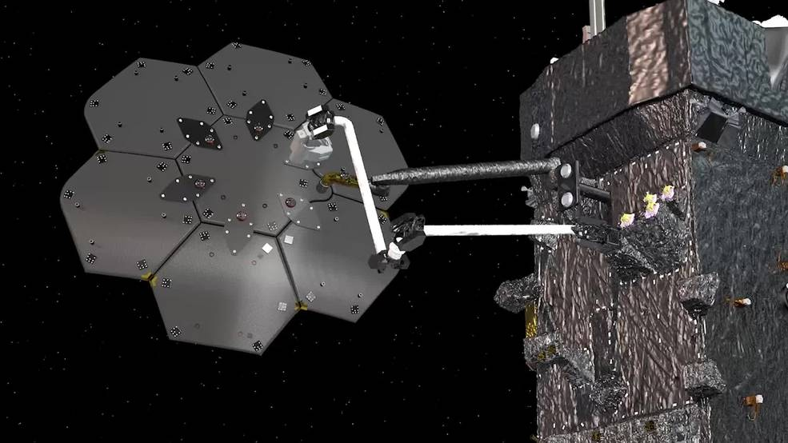
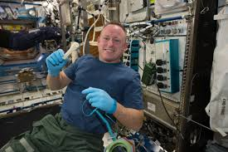
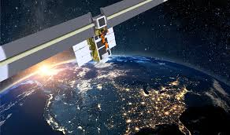
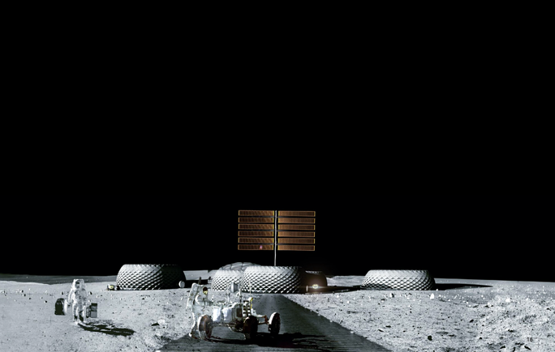
In-Space Manufacturing

Slide 8
Human Exploration and Operations
Notes:
how can Advanced Manufacturing help
RS25 has The Space Launch System – launching in 2019 – will use four RS-25 engines – leveraging the proven rocket engine technology from the Space Shuttle era.
How to make it more affordable? AM is one tool.
Weight removal to increase mission capability
Enables complex designs and unitized structures
Enables rapid manufacturing
Ability to use alternative materials
Ability to create highly customized, low-volume parts
There are currently 35 AM opportunities on the RS-25, which will result in a 33% reduction in cost
>700 welds eliminated
>700 parts eliminated
This was one of Marshall’s first challenges on how to maintain or evolve flight certification while incorporating AM parts.
Certification of system
Controlled process at part and vendor level
HARDEST application – apply AM to existing, traditional design
Want to start with AM from beginning
The European Service Module is ESA's contribution to NASA's Orion ... Belgium, Denmark, France, Germany, Italy, Spain, Sweden, Switzerland.
The structural test article already delivered was built by Thales Alenia Space in Turin, Italy.

Slide 9
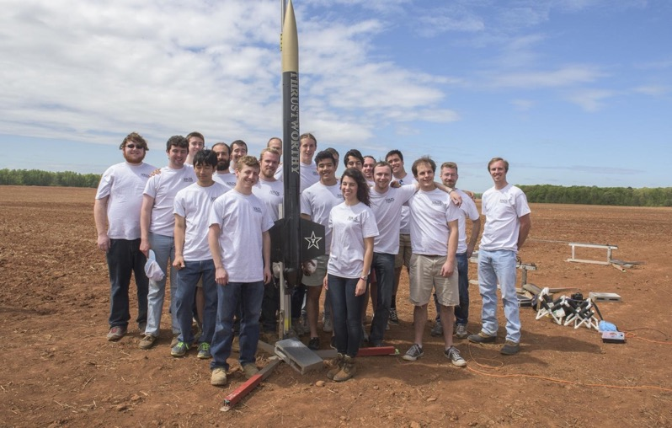
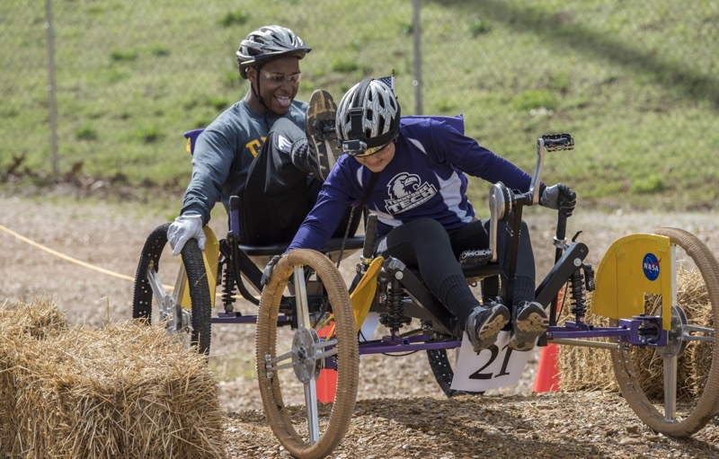
Space Technology Research Grants and STEM
Notes:
We know how important our business and educational community is
Working to inspire future workforce
Marshall provides industry and academia with opportunities to develop new technology, license technology for other applications, and collaborate with NASA through a variety of channels.
Preparing the next generation of innovators and leaders with programs like:
NASA Space Technology Graduate Opportunities
Graduate student research in space technology; research conducted on campuses and at NASA Centers and not-for-profit R&D labs
Space Technology Research Grants at many of your schools including but not limited to: UAH, University of Alabama, Vanderbilt University, Virginia Polytechnic Institute & State University, University of VA, University of Kentucky, Duke University
Student Launch:
TN: Vanderbilt University won the Student Launch contest in 2019, making it the sixth time in 7 years the team won.
KY: University of Louisville competed in the 2017–2018 competition
NC: Univ. North Carolina Charlotte, West Iredell High School to compete this year
AL: Univ. of Alabama in Huntsville to compete this year
VA: Virginia Tech to compete this year
FIRST Robotics Competition:
Teams from around the region compete
Rover Challenge:
AL: Students from five Alabama universities and four Alabama high schools participated in the Human Rover Exploration Challenge in 2018. The University of Alabama in Huntsville claimed the top spot in the college division, and Buckhorn High School (New Market, AL) placed first among high school participants.
KY: Two teams from Owensboro Community and Technical College in Kentucky competed in the 2019 Rover Challenge.
TN: 6 teams from 3 universities and 4 teams from 3 high schools in Tennessee participated in the Human Rover Exploration Challenge in 2018
Other Education Activities:
NASA is working with Morehead State University in KY on two projects: 1) Marshall partnership gaining an understanding of Xray spectrums, and 2) Lunar Ice Cube: Morehead State leads $20M mission in partnership with NASA (Goddard Spaceflight Center, JPL) other industry partners (Busek Space Propulsion Company) to send probe around the Moon to investigate potential water ice on Lunar surface. Lunar Ice Cube will fly on maiden voyage of SLS
HUNCH program: Lincoln County, TN students are collaborating with Marshall to fabricate hardware designs use for astronaut and ground personnel training; 11 AL high schools participate in HUNCH
Interns:
78 Pathways Interns in FY19.
172 OSTEM interns in FY2019
Your states are represented.
Images:
Top Left: Robertsville Middle School students participating in the NASA Project-Based Learning course visit Marshall to present their CubeSat project to a panel of engineers. Marshall developed curriculum and trained teachers for the elective course while Marshall engineers served as mentors to the students.
Credits: NASA/Oak Ridge City Schools
Top Right: Illustration of Lunar IceCube in orbit. Credits: Morehead State University
Bottom Left: FOR THE FOURTH YEAR IN A ROW, VANDERBILT UNIVERSITY WON FIRST PLACE AT THE 2016 STUDENT LAUNCH CHALLENGE
Bottom Right: 2017 Exploration Rover Challenge events at the U.S. Space and Rocket Center in Huntsville, Alabama. High school and college students from around the U.S. and the world come together for this 2 day event which challenges them to compete for the fastest time as well as technical design of the actual rover itself.
{Transition: We count on you to help support our missions by sharing the great news about happenings at Marshall and helping us build up the next workforce: the Artemis generation.}

Slide 10
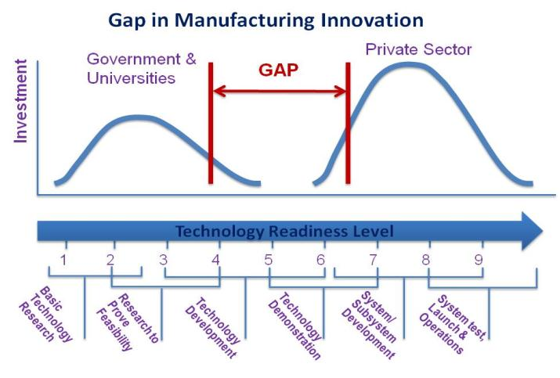
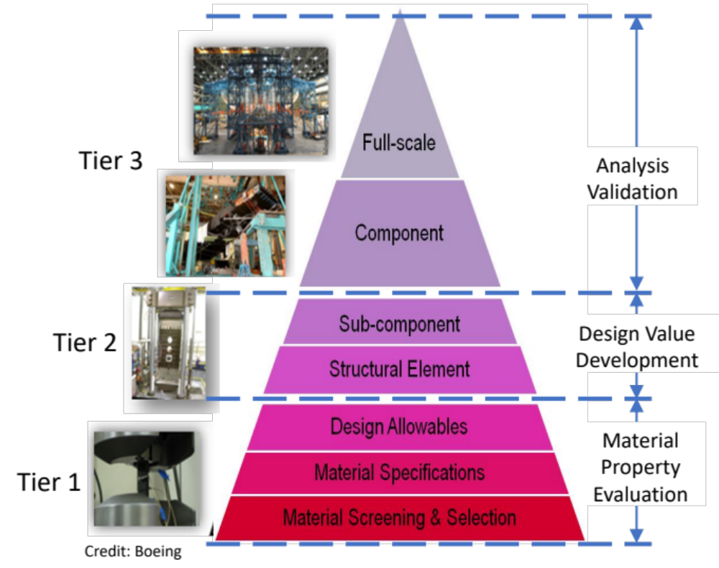
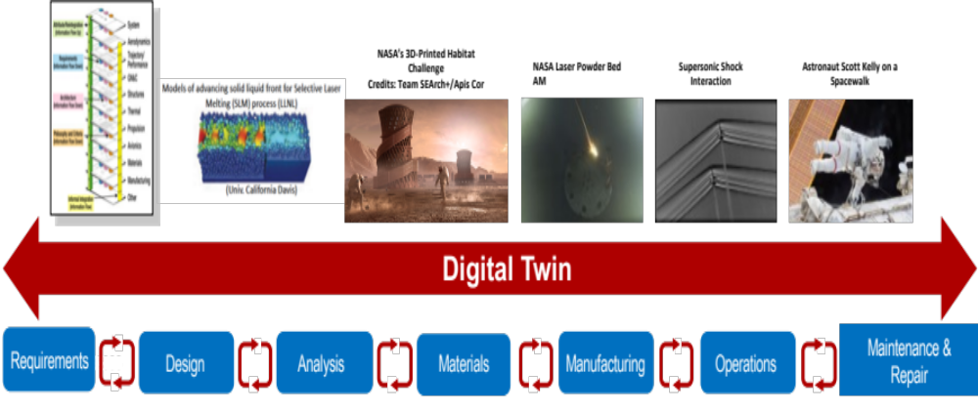
Digital Twin! “A Little Less Conversation
A Lot More Action Please”
Product Development, Testing and Certification Today
“It takes too long and costs too much to certify aerospace structures” - Exhaustive testing done to support analysis

Slide 11


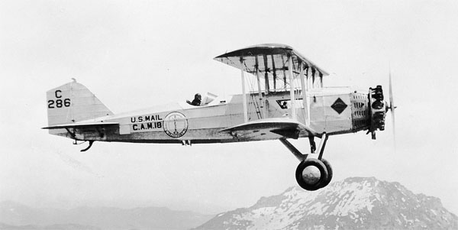
Sustainable Exploration
Links Discovery, Science and Commerce
The object of your mission is to explore the Missouri river…and its communication with the waters of the Pacific ocean…. for the purposes of commerce. Thomas Jefferson, 1803

Slide 12

Thank You
john.h.vickers@nasa.gov

