Slide 1
Geometric characterization, calibration and validation of
Satellite optical instruments for Earth Science
NASA Code 619 Terrestrial Information Systems Laboratory
Geometric characterization support team (GCST)
Guoqing (Gary) Lin, NASA/Code 619
Contributors:
Robert E. Wolfe, NASA/Code 619
Ping Zhang and Bin Tan, SSAI/NASA Code 619
John Dellomo, GST/NASA Code 619
Fred Patt, SAIC/NASA Code 616
Jaime Nickeson, SSAI/NASA Code 618
5 August 2021
SBG CVWG Webinar

Slide 2
Outline
Introduction
Sensor spatial response
Band-to-band registration (BBR)
Pointing & Geolocation
Concluding remarks
2

Slide 3
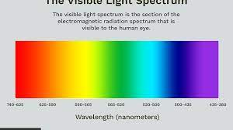
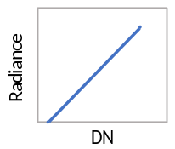

Context of Geometry in remote sensing
Spectral banding:: essence of remote sensing
  Central wavelength or frequency & band width, in-band response, out-of-band response (suppressed?), etc.
Radiometric calibration:: major part of CalVal
  Dynamic range, digitizing depth, calibration scaling (linear?), signal-to-noise ratio(SNR)/noise-equivalent-delta-temperature (NEdT), temporal stability, etc.
Geometry:: (is important!) location, location, location!
  System spatial response ➔ instrument resolution & image quality
    point spread function (PSF), line spread function (LSF), field of view (FOV) = full width at half maximum (FWHM) of PSF/LSF, modulation transfer function(MTF)
  Band-to-band registration (BBR) ➔affects data retrievals
  Alignment, pointing (orbit, star trackers, gyros, etc) ➔geolocation
3

Slide 4
Programs we support
MODIS sensors on Terra (L: 1999) and Aqua (L: 2002)
VIIRS sensors on SNPP (L: 2011), NOAA-20 (L: 2017), JPSS-2 (LPD: Sept 2022), JPSS-3 (LPD: 2027?), JPSS-4 (LPD: 2032?)
ABI and GLM sensors on GOES-16/East (L:2016), GOES-17/West (L:2018), GOES-T (LPD: Dec 2021), GOES-U (LPD: Apr 2024)
Commercial SmallSat Data Acquisition (CSDA) Program by NASA Earth Science Division
Focus more on VIIRS and touch on lessons learned.
Acronyms:
L: Launch time MODIS: Moderate Resolution Imaging Spectroradiometer
LPD: Launch planned date VIIRS: Visible Infrared Imaging Radiometer Suite
JPSS: Join Polar Satellite System ABI: Advanced Baseline Imager
SNPP: Suomi National Polar-orbiting Partnership GLM: Geostationary Lightning Mapper
GOES: Geostationary Operational Environmental Satellite
4

Slide 5
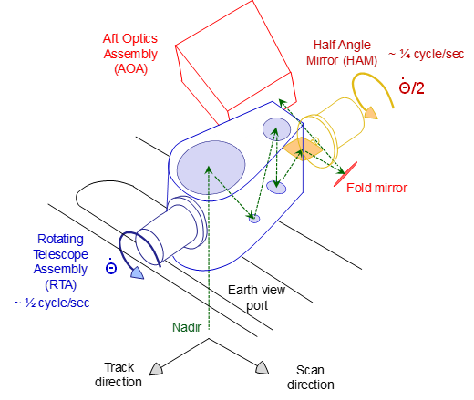
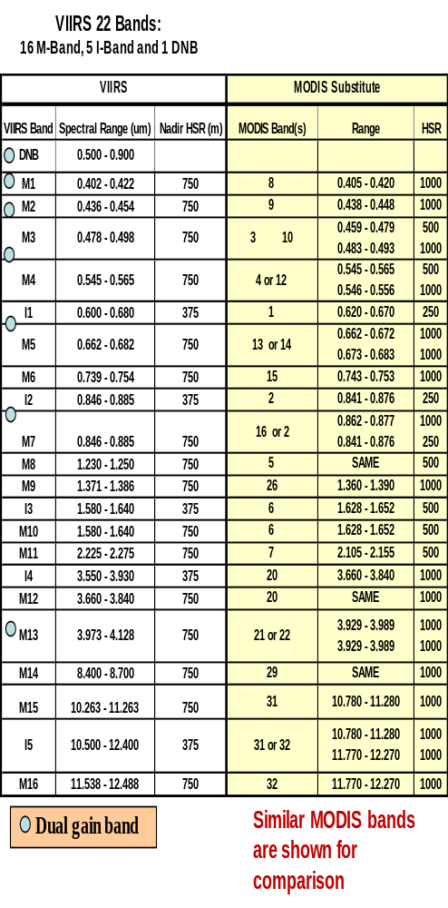
VIIRS instrument characteristics (1)
GSD
750
5

Slide 6
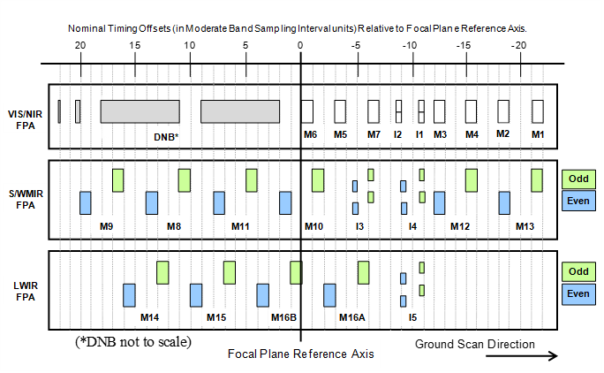
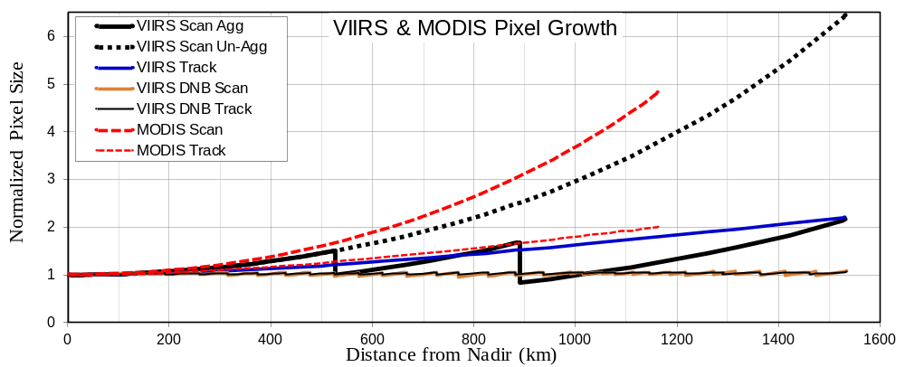
VIIRS instrument characteristics (2)
Agg3x1
Agg1x1
Agg2x1
MODIS has 32 bands, 3 resolutions: 250 m, 500 m, 1 km @nadir
VIIRS has 22 bands, 3 resolutions: Imagery 375 m, Moderate 750 m @ nadir, DNB 750 m throughout the scan. Single gain M-&I-bands have 3 on-orbit aggregation schemes in the scan direction.
6

Slide 7
Outline
Introduction
Sensor spatial response
Band-to-band co-registration (BBR)
Pointing & Geolocation
Concluding remarks
7

Slide 8
Spatial response, concept
System point spread function (PSF):: response to impulse functions at all possible (along-track, cross-track) locations
  Often can be decomposed into two orthogonal line spread functions (LSFs)
  Serves as a weighting function for a detector to collect energy from targets
LSF in “slow” motion direction:: ~ instantaneous LSF
  Determined by detector size, convolved/smeared by optical PSF
LSF in “fast” motion direction:: ~ dynamic LSF
  Determined primarily by detector size and convolved with motion (motion smear)
8

Slide 9
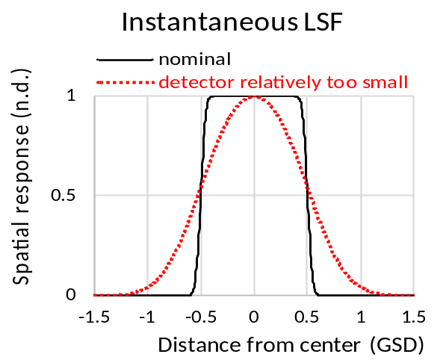
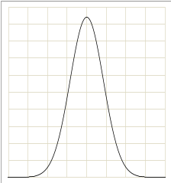

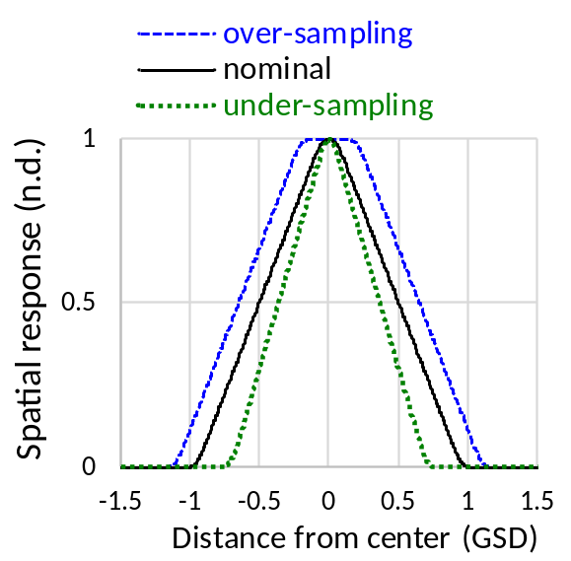
Spatial response, expressions
Instantaneous LSF
Dynamic LSF
➔
FWHM
Detector size
Optical blur
➔
Detector size
Optical blur
motion blur
FWHM
GSD: Ground Sample Distance FWHM: Full-width at Half-Maximum
convolution
9

Slide 10

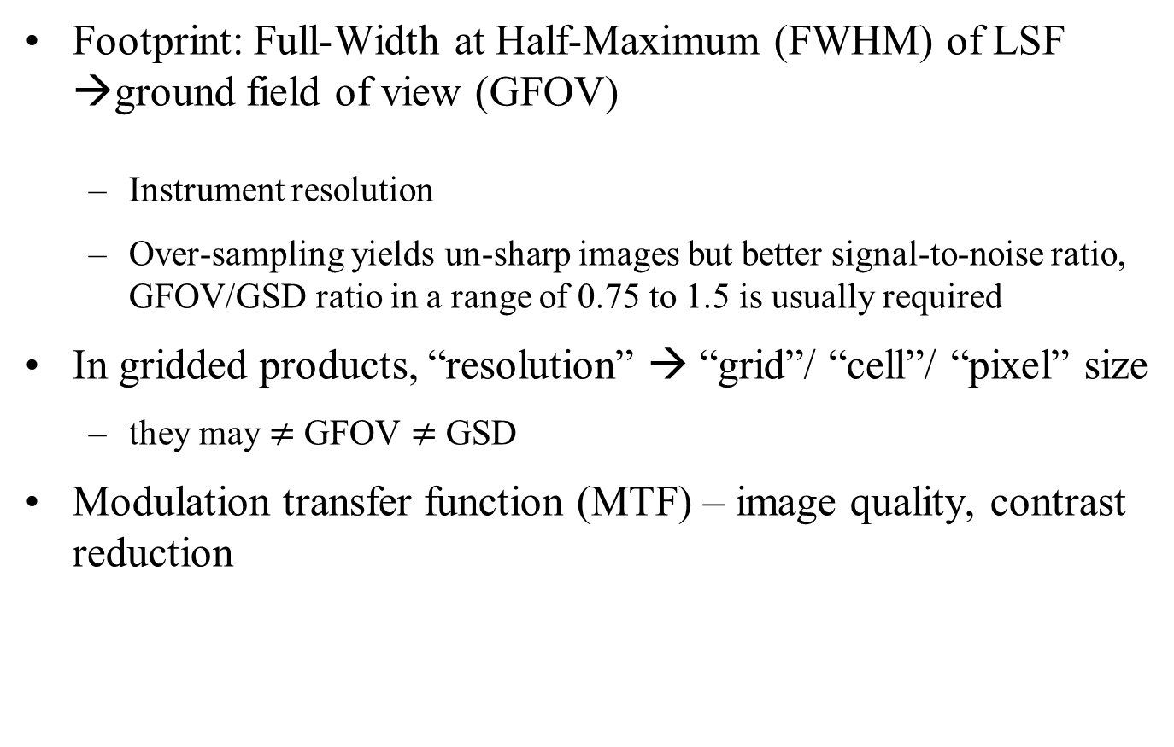
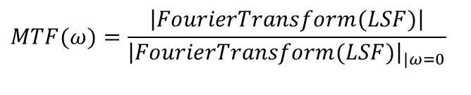
Spatial response, parameters
Footprint: Full-Width at Half-Maximum (FWHM) of LSF →ground field of view (GFOV)
  Instrument resolution
  Over-sampling yields un-sharp images but better signal-to-noise ratio, GFOV/GSD ratio in a range of 0.75 to 1.5 is usually required
In gridded products, “resolution” → “grid”/ “cell”/ “pixel” size
  they may $≠$ GFOV $≠$ GSD
Modulation transfer function (MTF) – image quality, contrast reduction
under-sampling, GFOV < GSD
Nyquist sampling, GFOV = GSD
over-sampling, GFOV > GSD
$$MTF(ω)=\frac{\left|FourierTransform(LSF)\right|}{{\left|FourierTransform(LSF)\right|}_{|ω=0}}$$
= 0.63 @NF for square LSF
= 0.40 @NF for triangular LSF
> 0.2 – 0.3 @NF is usually required
fraction of Nyquist frequency (NF)
10

Slide 11
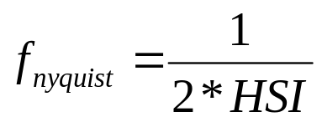
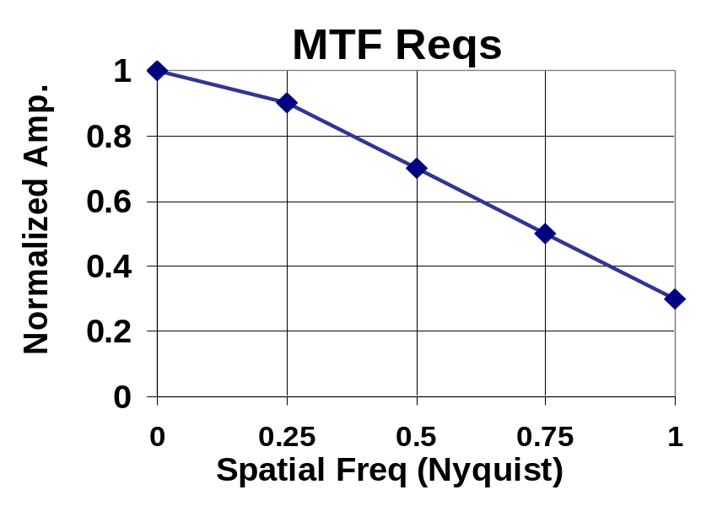
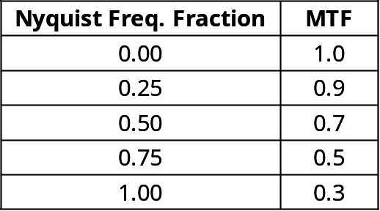
Spatial response, Spec, VIIRS example
GFOV specification is tailored to detector designed value + margin
  GFOV_design = detector_size/effective_focal_length * altitude
  GFOV_spec < GFOV_design + 10% for imagery bands (375 m @nadir)
  GFOV_spec < GFOV_design + 5% for moderate resolution bands (750m @ nadir)
The MTF requirements are to exceed values specified at fractional Nyquist frequency, which is the spatial frequency at two horizontal sampling intervals (HSI) apart
Desirable
Region
Undesirable
Region
11

Slide 12
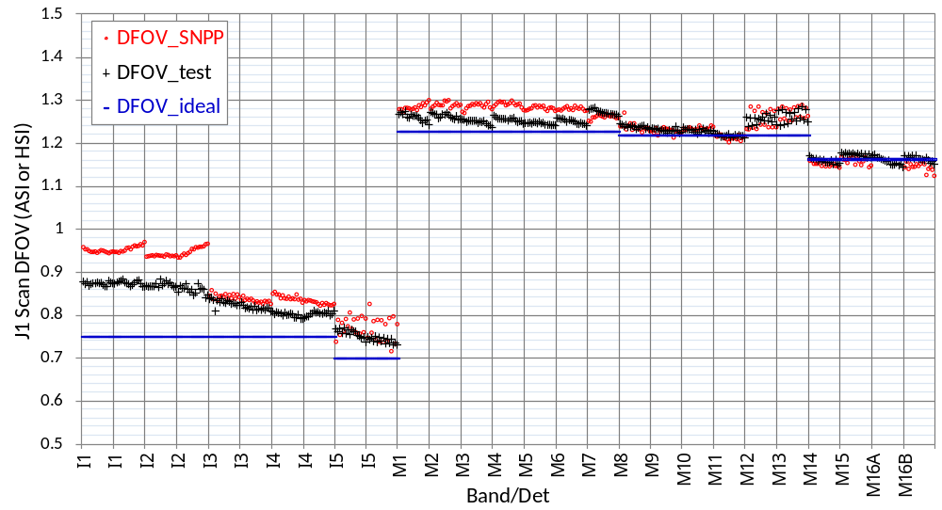
SNPP & J1 VIIRS scan LSF - FWHM
(GSD)
J1 F2 optical performance is good (better than SNPP F1)
M-Bands over-sample the earth, in the un-aggregated zones
I-bands under-sample the earth (TOA), mostly in the un-aggregated zones
Track direction LSFs are mostly square, IFOV ~ 1.0 GSD
12

Slide 13
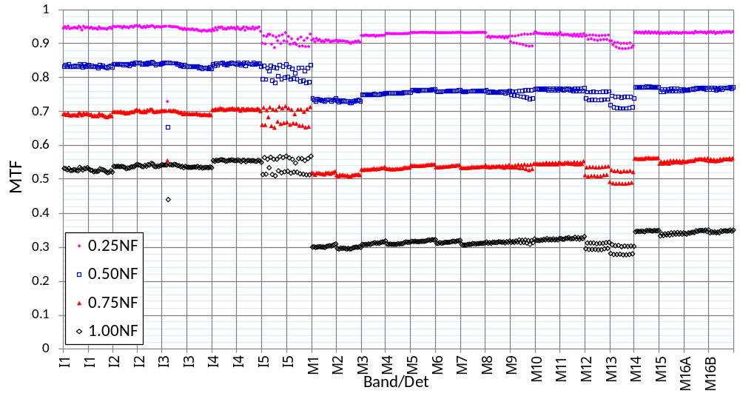
J1 VIIRS scan LSF - MTF
Spec
Spec
Spec
I3D4
Spec
MTF for M-bands mostly meets specification
I-bands images are very sharp, at least at TOA (I3D4 under-performs but is still good in MTF)
Track direction LSFs are mostly square, MTF ~= 0.63 at 1.00NF (Nyquist Frequency)
13

Slide 14
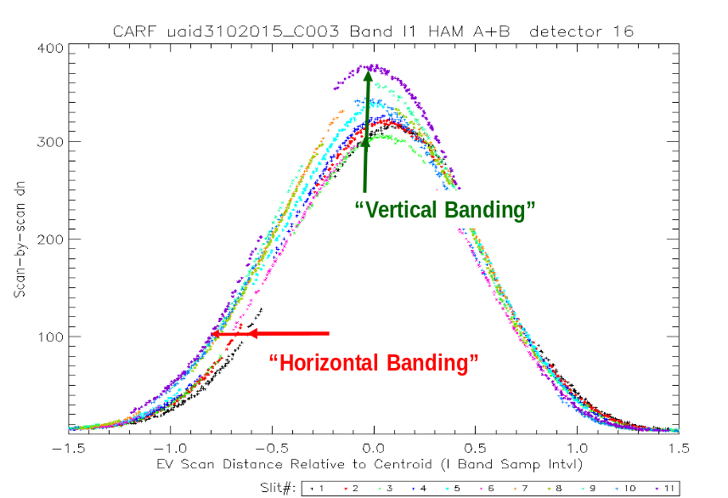
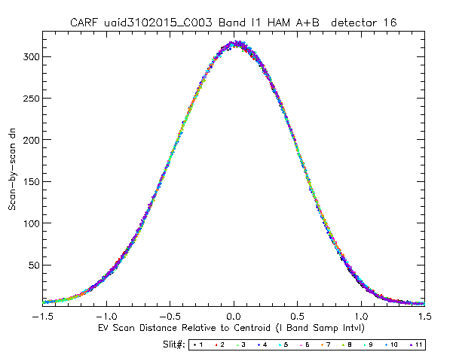
LSF “banding” issue in VIIRS ground testing
before
after
➔
“Horizontal banding” was caused by test reticle slits phase (spacing) non-uniformity
“Vertical banding” was caused by test reticle slits throughput (opening) non-uniformity
Resolved by using the calibratee (instrument) to calibrate the calibrator (test equipment)
For more details of the issue, c.f.: Fang, D.T and Puschell, J. (2010), “Imagery spatial performance throughput correction methodology,” Remote Sensing System Engineering III, SPIE 7813, doi: 10.1117/12.860740.
14

Slide 15
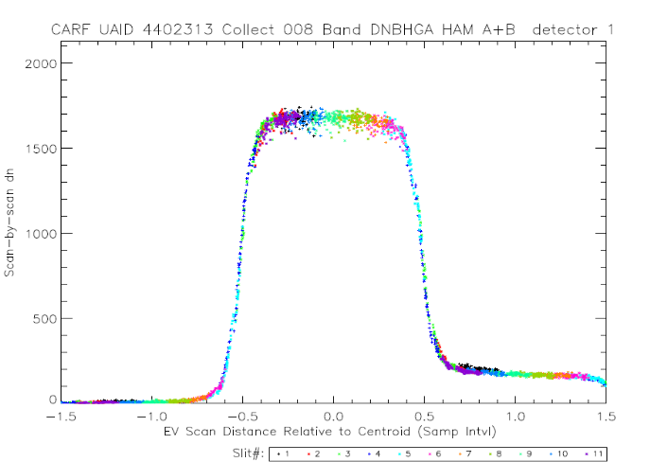
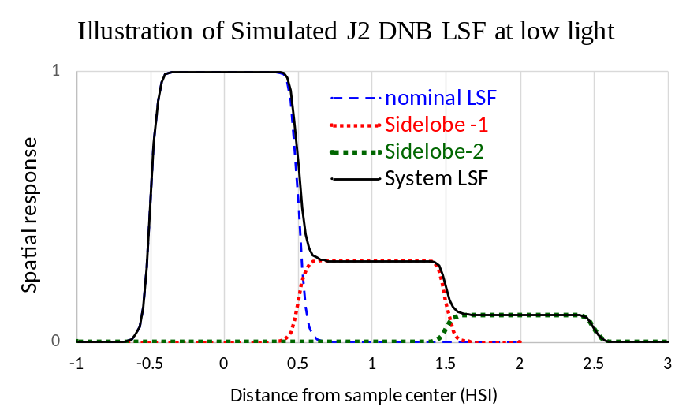
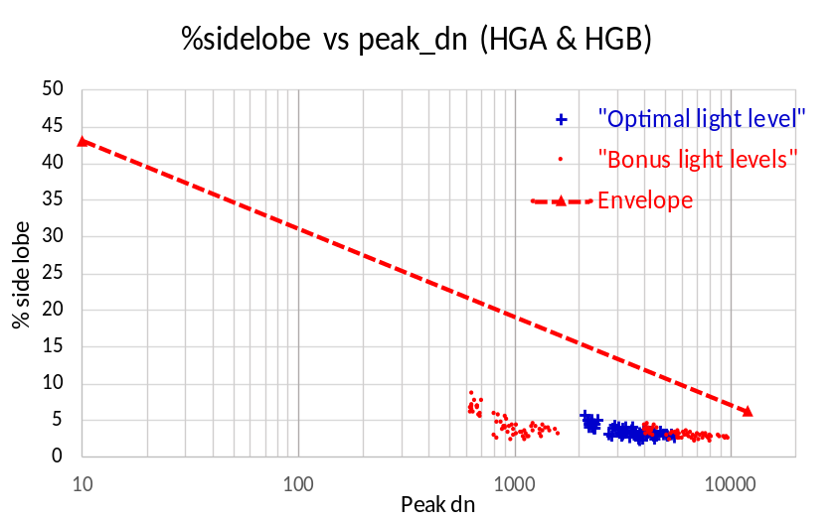
Right LSF construction helps, DNB low light
Test LSF from JPSS-2 VIIRS DNB
Scan direction
Incorrect voltage setting in the Focal Plane Integrated Electronic causes the charge in the current sample to remain behind in the transfer gate and be deferred into the next sample in the scan direction.
Envelope
dn at Lmin =
3 nW/cm^2/sr
Agg32, Agg1
We identified the issue. The lesson learned will ensure such anomaly will not happen again in later builds.
15

Slide 16
Questions for sensor spatial response?
16

Slide 17
Outline
Introduction
Sensor spatial response
Band-to-band registration (BBR)
Pointing & Geolocation
Concluding remarks
17

Slide 18
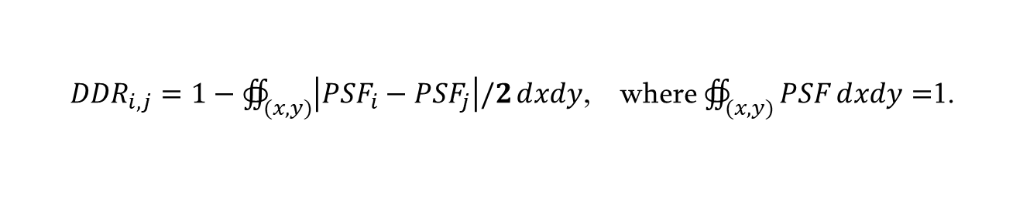
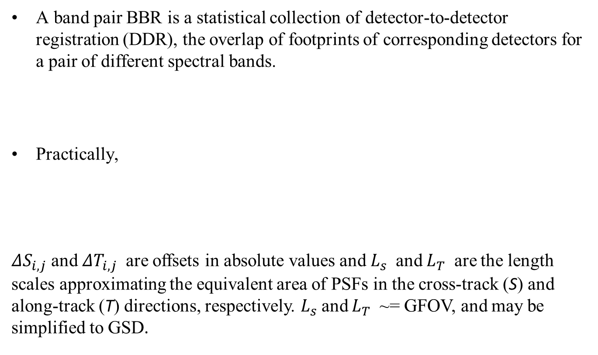
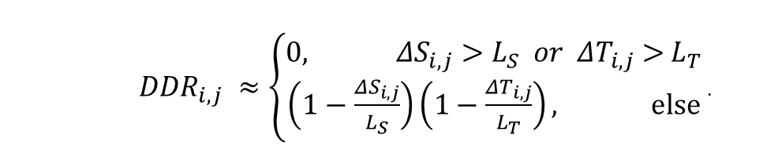
Band-to-band registration (BBR)
A band pair BBR is a statistical collection of detector-to-detector registration (DDR), the overlap of footprints of corresponding detectors for a pair of different spectral bands.
Practically,
$ΔS_{i,j}$ and $ΔT_{i,j}$ are offsets in absolute values and $L_{s}$ and $L_{T}$ are the length scales approximating the equivalent area of PSFs in the cross-track (S) and along-track (T) directions, respectively. $L_{s}$and $L_{T}$ ~= GFOV, and may be simplified to GSD.
${DDR}_{i,j}=1−∯_{(x,y)}{\left|{PSF}_{i}−{PSF}_{j}\right|/2ⅆxdy}$, where $∯_{(x,y)}{PSFⅆxdy}=$1.
${DDR}_{i,j} ≈\left\{\begin{aligned}0, ΔS_{i,j}>L_{S} or ΔT_{i,j}\text{ > }L_{T} \\ \left(1−\frac{ΔS_{i,j}}{L_{S}}\right)\left(1−\frac{ΔT_{i,j}}{L_{T}}\right), else\end{aligned}\right.$ .
18

Slide 19




BBR [cont.]
Good BBR is critical for biogeophysical parameter retrievals that use data from multiple spectral bands, especially in heterogeneous areas.
Good BBR is achieved mainly by shifting bands in time/space, mostly in pre-launch testing.
BBR is affected by many factors, such as focal plane clocking/tilting, adjustable time delay, scan rate for whiskbroom sensor, spacecraft speed for pushbroom or frame sensors, AND focal length.
BBR in pictures, 60% or 90%
$$ΔS$$
+
+
$L_{T}$
$$ΔT$$
+
+
$$L_{s}$$
BBR = 60%
BBR = 90%
19

Slide 20
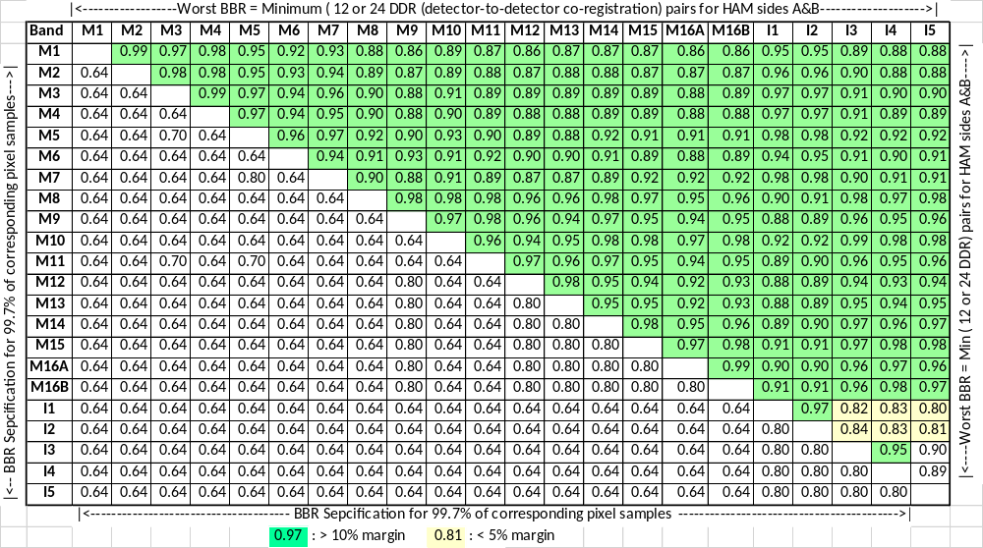
J1 BBR matrix– non-agg zones
Barely made it
None out of spec at the ground test level
On-orbit jitter should have little impact since I-bands are located close together with very short time delay for co-reg.
20

Slide 21
BBR, nesting issue and resolution
I Band Sample# 0, 1, 2
Sample# 0, 1, 2, 3
Detector 2
Detector 1
Detector 1
M Band Sample# 0, 1
Sample# 0, 1
Sample#0 was forgotten.
Sample#0 exists. Proper nesting required a change in electronics.
We discovered it in 2007. The issue was resolved in 2008. It was implemented by the vendor in 2009 by dropping 1 less sample in I-bands in the earth view in all VIIRS builds.
21

Slide 22
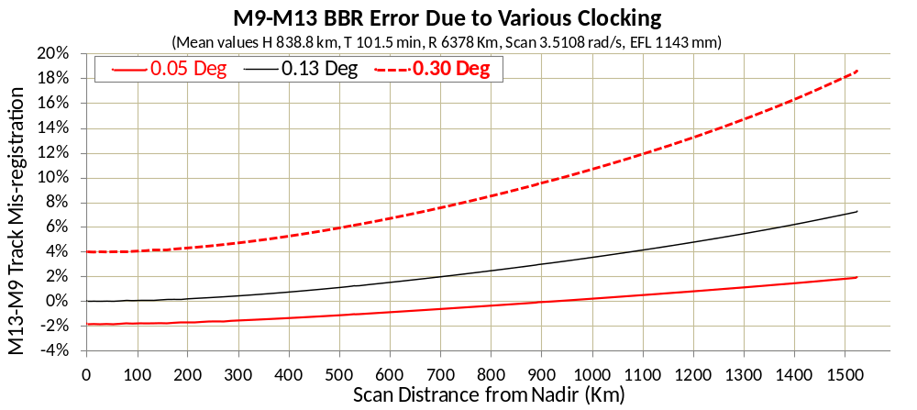
BBR, FPA clocking issue and resolution
Old specification, exact @nadir, but over-clocking off-nadir
New specification
Focal Plane Assembly (FPA) clocking is used to compensate spacecraft motion while a trailing band co-registers (by time delay) with a leading band
A 0.05º clocking is the right amount, with tolerance of +/- 0.05º (new spec).
JPSS-1 (now NOAA-20) VIIRS had a 0.3º clocking during sensor ambient testing. The aft optics assembly was re-aligned to within new spec.
22

Slide 23
Questions for BBR?
23

Slide 24
Outline
Introduction
Sensor spatial response
Band-to-band registration (BBR)
Pointing & Geolocation
Concluding remarks
24

Slide 25
Alignment, pointing & Geolocation
Alignment of various parts of the instrument, and various pointing sensors, such as star trackers, gyros, magnetometers and sun sensors on the spacecraft, need to be carefully designed, installed and tested (characterized and calibrated) at various stages of satellite build before launch.
After launch, an intensive calibration and validation (CalVal) campaign must be carried out that includes the pointing sensors on the spacecraft as well as the instrument. Earth-pointing instruments should perform pointing CalVal with ground truth (coastlines or ground control points).
Long-term monitoring and continuous CalVal must be performed to ensure temporal stability.
Geolocation accuracy is important for time series analysis of satellite data.
Geolocation accuracy is critical in synergizing different data sources for interoperability.

Slide 26
Geolocation requirements, examples for VIIRS
The known pointing of the VIIRS instrument boresight, referenced to the center of the effective field of view for any channel, prior to on-orbit calibration shall be within 1200 m (radial, 3-s) of the true location of that field of view, at nadir, on the WGS84 reference ellipsoid, at any time during nominal JPSS operations.
The known pointing of the VIIRS instrument boresight, referenced to the center of the effective field of view for any channel, following on-orbit calibration shall be within 375 m (radial, 3-s) of the true location of that field of view, at nadir, on the WGS84 reference ellipsoid, at any time during nominal JPSS operations.
The 1st requirement allows more tolerance in static errors while the 2nd requirement dictates the removal of such static errors by on-orbit CalVal.
Actual initial post-launch VIIRS geolocation offsets could be > 1200 m.
There are non-static but slow-varying errors that may be removed.
Actual on-orbit VIIRS geolocation accuracy after calibration is better than 125 m (radial, 1-s), or 88 m (along-track and cross-track directions, 1-s), even better than 75 m (20% 375 m band GSD).
26

Slide 27
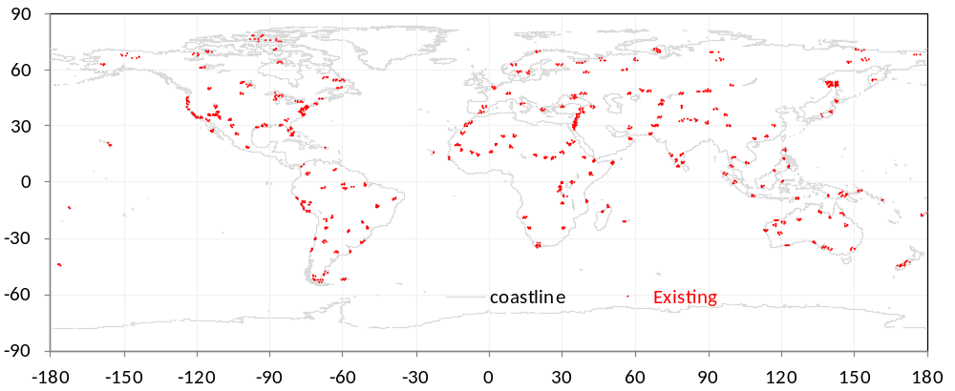
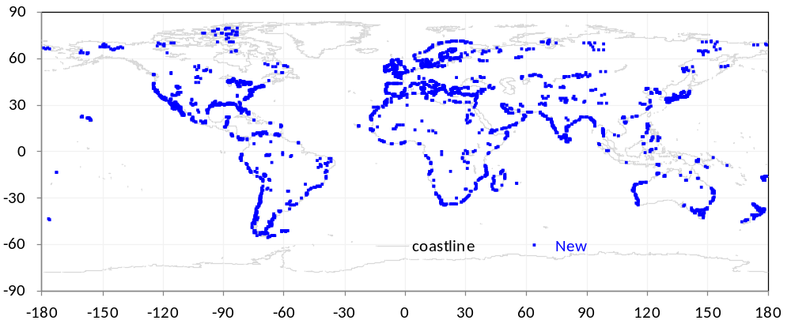
Landsat sub-images for MODIS/VIIRS ground control points (GCPs) that are used to measure geolocation errors
1214 existing chips mostly from Landsat-5/7 before 2003
The library has been used for MODIS and VIIRS since 2000.
2514 new chips from Landsat-8 around 2015
The new library is used in SNPP C2 and J1 C2.1
It will be used in MODIS C7
27

Slide 28
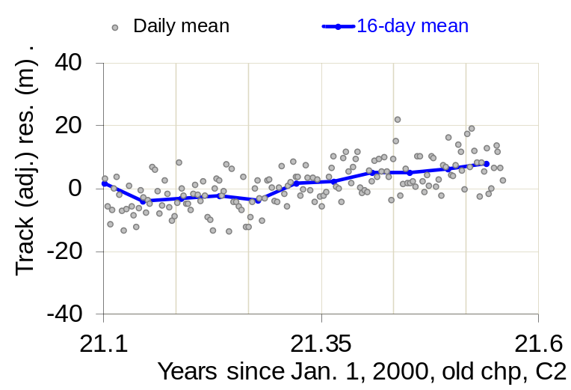
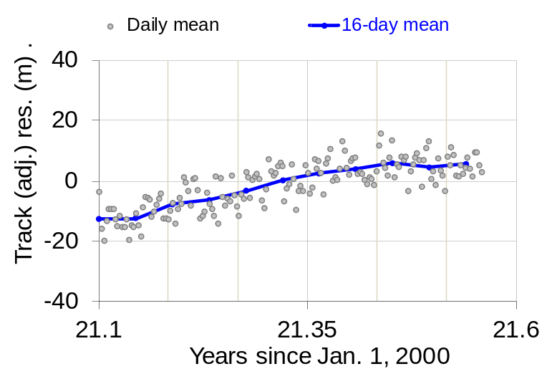
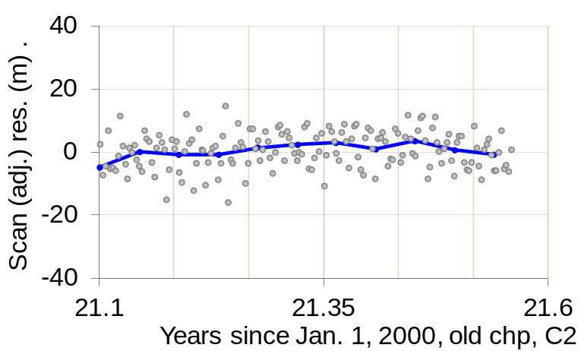
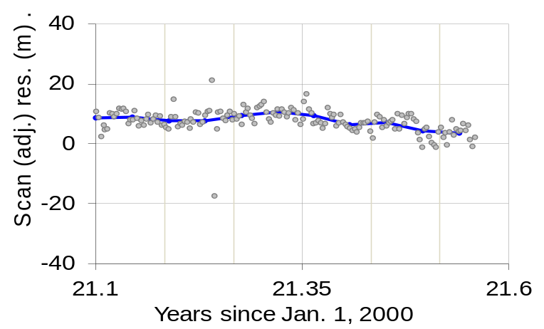
Errors measured by the 2 chip libraries
C2, existing chip library
C2.1, new chip library
Exactly the same algorithms and LUTs for N20 VIIRS after 2/2/2021
Slightly different measured errors, ~10 m in 16-day means.
The new chip library is postulated to be better in accuracy.
28

Slide 29
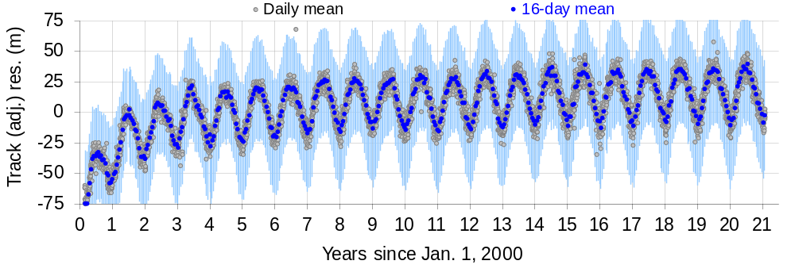
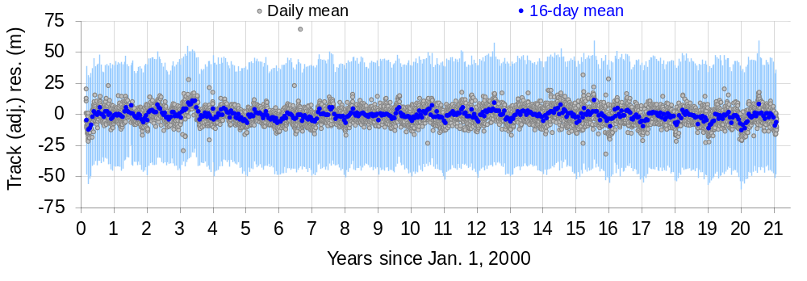
Terra MODIS geolocation accuracy
Before correction
After correction
C6.1, existing chip library
29

Slide 30
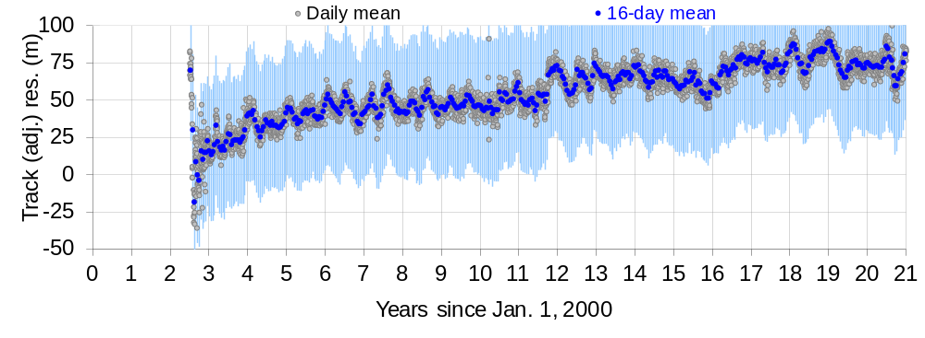
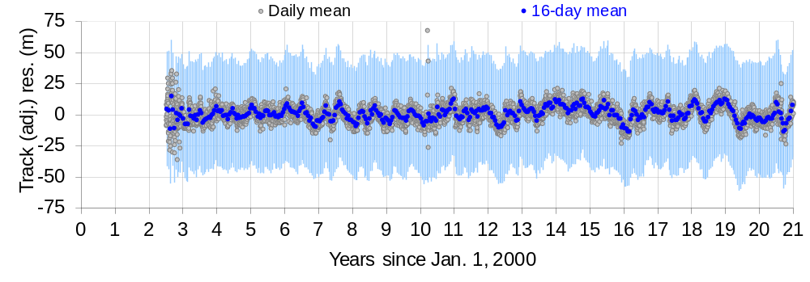
Aqua MODIS geolocation accuracy
Before correction
AMSR-E
0->2 rpm
2013-12-5
AMSR-E
40->0 rpm
2011-10-4
AMSR-E
2->0 rpm
2015-12-4
After correction
C6.1, existing chip library
30

Slide 31
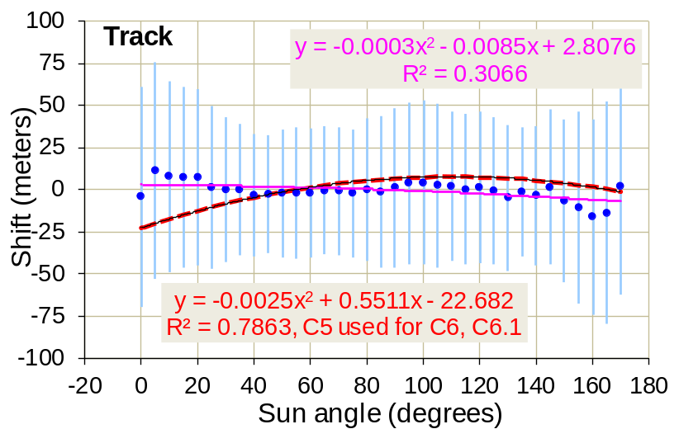
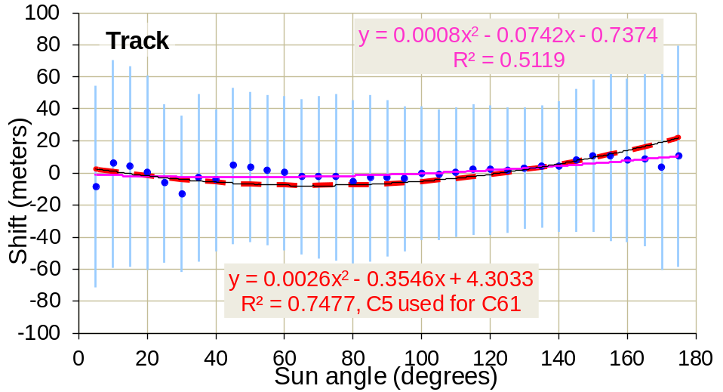
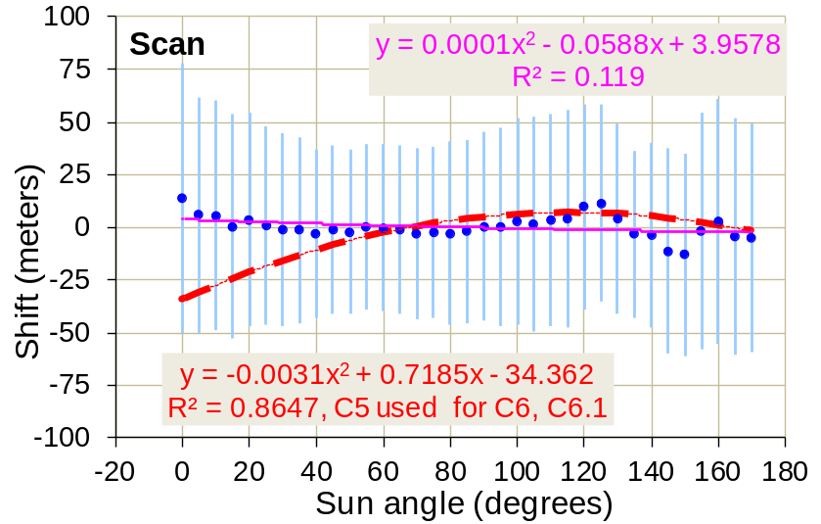
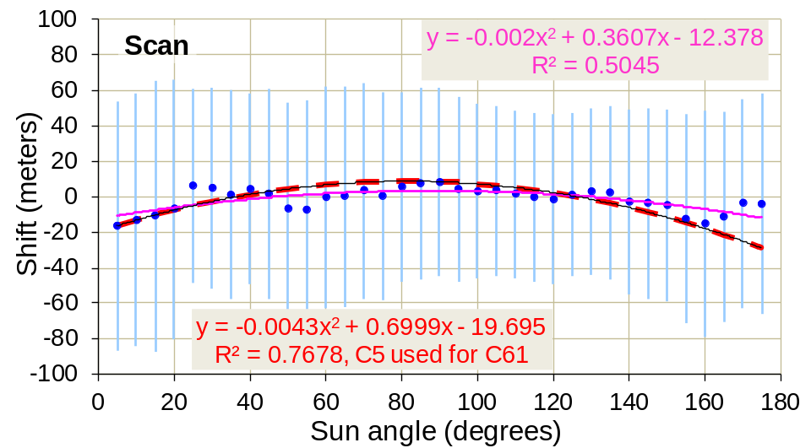
Sun angle correction
Terra C6.1 results
Aqua C6.1 results
Sun angle wrt the orbit trajectory serves as a proxy of thermal variation (sun rise → noon → sunset)
31

Slide 32
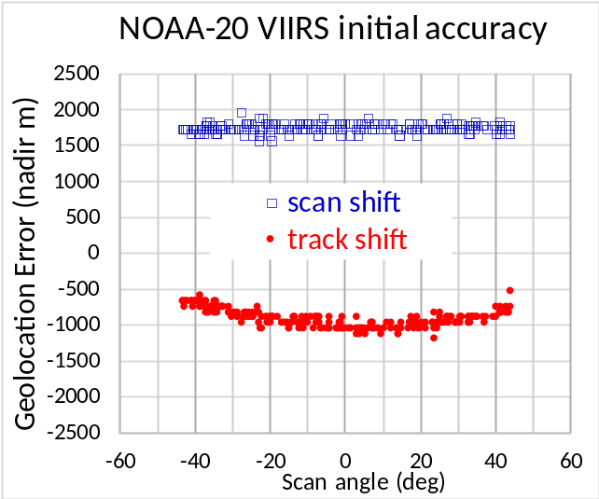
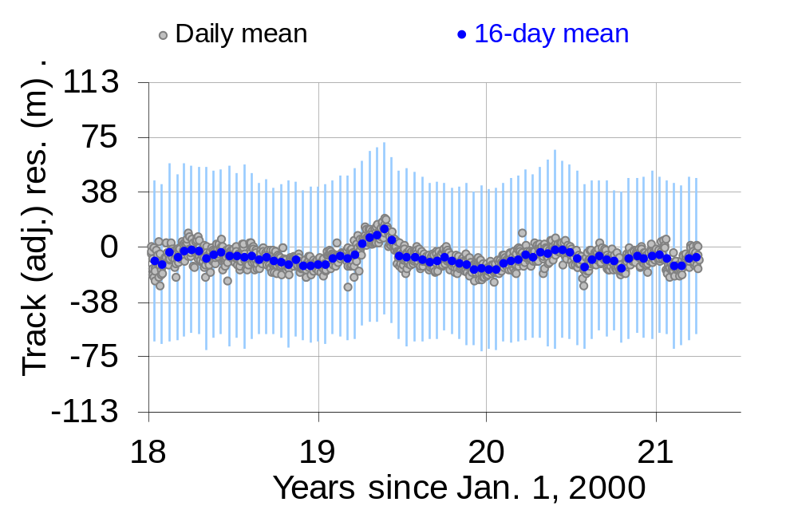
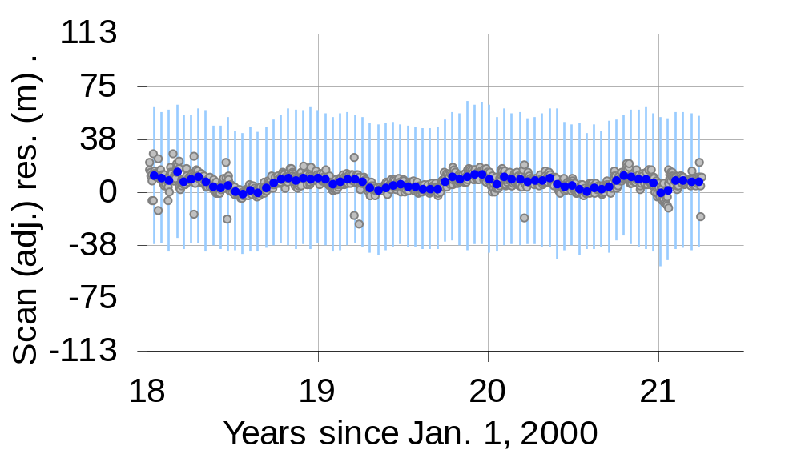
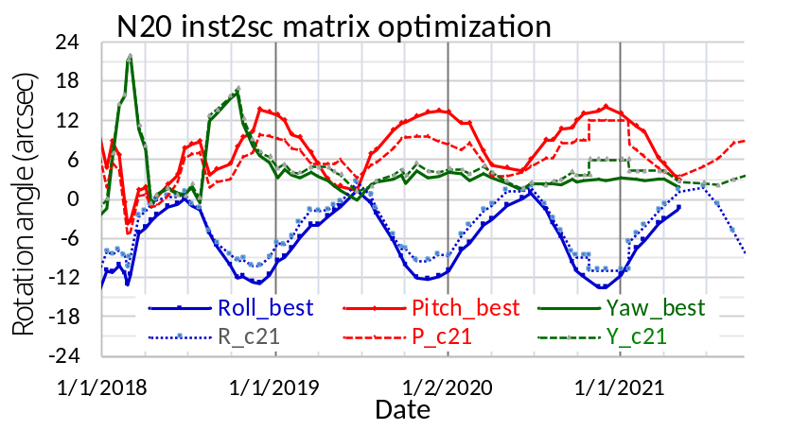

Geolocation accuracy for NOAA-20 VIIRS
$±$20% I-band pixel size
Initial geolocation error, up to ~2km
Temporal pointing variations, and geolocation accuracy after correction
32

Slide 33
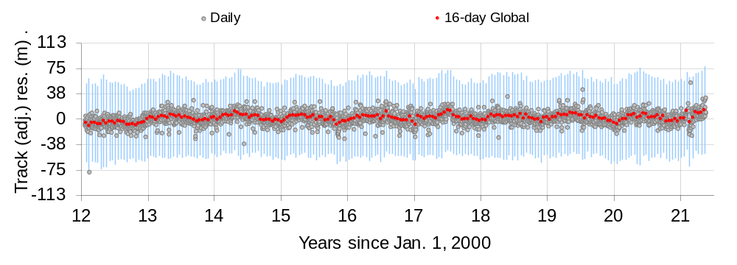
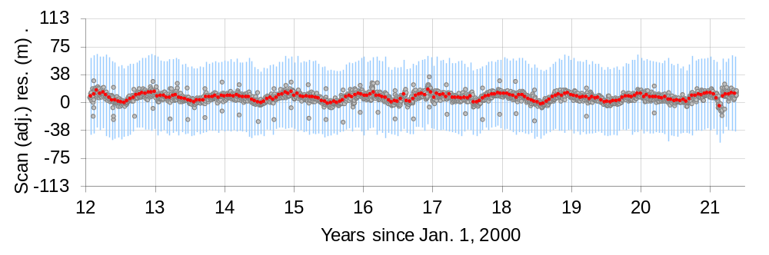

SNPP VIIRS geolocation accuracy
$±$20% I-band pixel size
C2 re-processing uses newly devised correction for temporal pointing variation, including 1-second time error from an onboard computer for 7 hours. New chip library is used for error measurements.
33

Slide 34
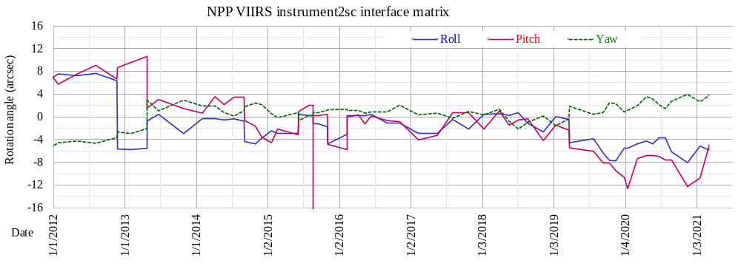
Impacts from SNPP/VIIRS operations
A B C D
Events:
Side switch of VIIRS scan control electronics
Erroneous star trackers realignment
1-second time error onboard of SNPP (213 arcsec pitch error) for 7 hours
Star Tracker-2 reset
The impacts are corrected for in C2.
34

Slide 35
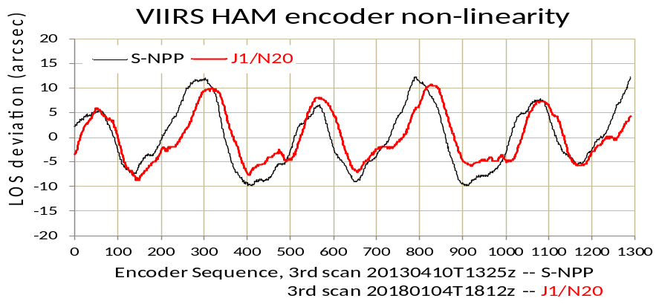
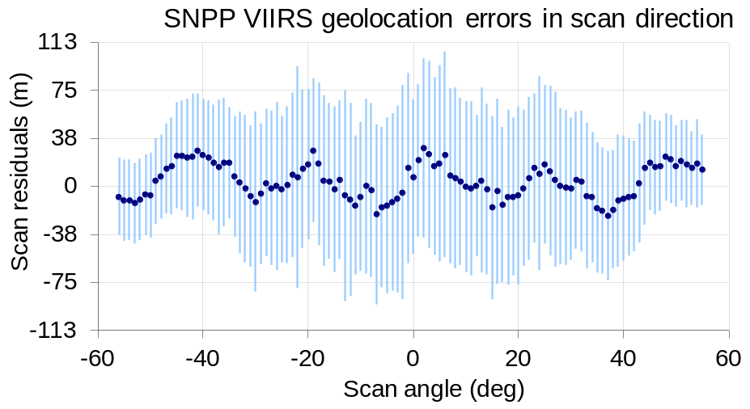
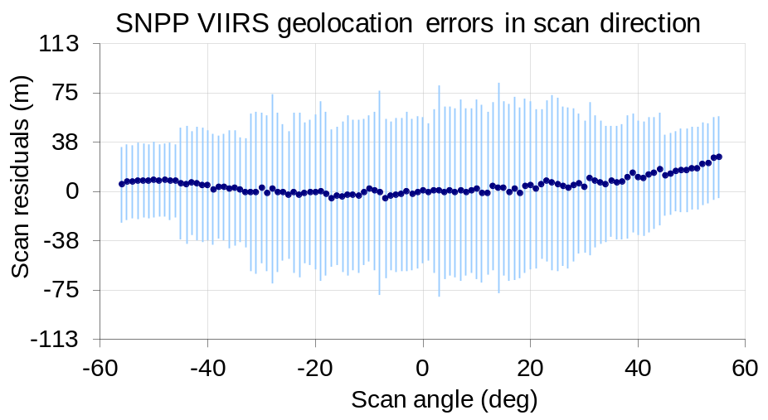
VIGMU:
VIIRS instrument geometric model update
The HAM encoder non-linearity was known before SNPP launch
Puzzled over the strange pattern in 2015
Found out the root cause in 2017
Implemented in the ground SW in NASA in 2019, & in IDPS in 2021
before
after
➔
35

Slide 36





SNPP attitude issue
sample
3981
sample
3621
RGB = (I4, I3, I2)
Scan#80
81
80
79
78
without geolocation
scan#
Roll
Rx -
YawRz -
x
Pitch Ry +
x
with geolocation
y
Scan Direction
z
Ground track
VIIRS images “see” the attitude errors
with geolocation, 16 days earlier
36

Slide 37

SNPP attitude disturbances & improvements
Launch
1st
2nd
3rd
4th year
5th
6th
7th
8th
9th year
Trackers TEC 0ºC→-10ºC
9/22/2016
Data up to
8/18/2020
Day 3218
using ~90% data
Large circles for control spec outage; Small dots hint knowledge spec outage
Star trackers’ head Thermal Electric Cooler (TEC) temperature lowering in September 2016 improved SNPP attitude performance
Kalman filter refining the attitude is implemented in NASA Land SIPS Collection-2
J1 is performing better but we are monitoring
37

Slide 38


SNPP & JPSS orbit propagator reset by GPS
70 m, 2.5 hours, ~ 1.5 orbits after burn
Cross-track burn, 178 sec 17:54:16 - 17:57:14z
Large geolocation errors detected
Return to mission pointing
18:10:14 UTC
ADICVGPS command
UTC hours
We worked with NOAA MOT to use ADICVGPS to re-initialize ephemeris with GPS onward after Fall 2017 in IAMs (Inclination Adjust Maneuvers) for SNPP and JPSS once a year.
The same command applies to leap-second insertion onward after 2015.
It also applies to DMUs (drag make-up maneuvers) to correction for along-track position errors ~150 m 3-4 times a year.
Along-track position error, 7 km at the insertion of leap-second, 2012-06-30T23:59:60Z
38

Slide 39


Scan-to-scan underlap
$Overlap=n\frac{p}{F}h−[V_{ECI}−V_{earth0}\cos{i}]T$, if < 0 → underlap
where F = effective focal length (EFL), p = detector “pitch” interval in the track direction, n = # detectors, h = range from satellite to earth terrain surface altitude, T = scan period, i=inclination angle in Earth Center Inertial (ECI) ~ 99 deg, V_{ECI} = spacecraft ground speed in the inertial frame, V_{earth0} = speed of earth rotation at equator, Overlap < 0 indicates underlap.
Inter-HAM-sides
Rocky Mnt.
Terrain effects
Underlap
Inter-scan
J1 Underlap
Within scan
We discovered the issue in JPSS-2 VIIRS testing while doing a sanity check of non-underlapping requirement after a HAM motor alignment re-work.
The earth rotation was missing in the calculations for the original instrument design.
This happens to MODIS sensors on Terra and Aqua as well.
Mitigation in JPSS-3+ VIIRS is implemented by shortening both focal length F and scan period T while keeping other parameters the same.
39

Slide 40



On-orbit Effective Focal Length( EFL) measurements
Adjusting EFL causes geolocation of columns of detectors in the track direction to expand/shrink in a scan. Best correlation with Landsat sub-image results in the measured EFL.
Ref: J.C. Tilton, R. E. Wolfe, G. Lin, and J. J. Dellomo, "On-Orbit Measurement of the Effective Focal Length and Band-to-Band Registration of Satellite-Borne Whiskbroom Imaging Sensors." Journal of Selected Topics in Applied Earth Observations and Remote Sensing, (accepted 10/19/2019), doi:10.1109/JSTARS.2019.2949677.
40

Slide 41

Assessing Planet Dove geolocation accuracy
Preliminary results from a pilot study for NASA Commercial SmallSat Data Acquisition (CSDA) Program.
Planet Dove images have reported pixel resolution at 3-4 m. Worldview (WV) and Quickbird (QB) images at finer resolutions are used as references.
We are trying to bring geolocation uncertainties of Planet images to within a pixel (4 m).
We are trying to build a global base of reference from selected “golden tiles” of finer resolution images (e.g., DigitalGlobe).
41

Slide 42

Geometric specifications
FWHM
Footprint of
band B1 or at time T1
+
+
Footprint of
band B2 or at time T2
42

Slide 43
Recaps (Concluding remarks)
Geometric performance includes:
  Sensor spatial response
  Band-to-band registration
  Absolute position accuracy
Interesting lessons learned
  Ground CalVal test equipment may not be as good as the instruments – feedback from the instruments and corrections may be needed
  Index starting number (0 or 1) could be tricky
    BBR
    Time for orbit propagator vs attitude control
  Anomalous situations may be interesting, intriguing, and frustrating at times
43

Slide 44







Questions?
$$S_{k}=\sqrt{\frac{1}{N_{k}−1}\sum_{i=1}^{N_{k}}{{\left(x_{ki}−A_{k}\right)}^{2}} }$$
Local arithmetic mean Local Stdev
Global arithmetic mean ,
Global Stdev
Root-mean-square-error (1-σ)
3-σ error bound
Some short-term anomalous A_{k} may be buried in a long-term A.
$A_{k}=\frac{1}{N_{k}}\sum_{i=1}^{N_{k}}{x_{ki}}$
$$A=\frac{1}{N}\sum_{k=1}^{M}{{(N}_{k}A_{k}})$$
$N=\sum_{k=1}^{M}{N_{k}}$
$$S=\sqrt{\frac{1}{N−1}\sum_{k=1}^{M}{[N_{k}{\left({A−A}_{k}\right)}^{2}+\left(N_{k}−1\right){S_{k}}^{2}]} }$$
$$RMSE=\sqrt{\frac{N−1}{N}S^{2}+A^{2} }$$
$$E=\left|A\right| +3S$$
Thank you !
44

