Slide 1
GFSSP Software Demo
André LeClair & Alok Majumdar
Propulsion Systems Department
NASA/Marshall Space Flight Center
andre.c.leclair@nasa.gov
alok.k.majumdar@nasa.gov
Virtual Thermal & Fluids Analysis Workshop
August 24-26, 2021

Slide 2
Outline
Introduction & Overview
Mathematical Formulation
Resistance Options
Fluid Options
Demonstration Models

Slide 3
Background
GFSSP stands for Generalized Fluid System Simulation Program
It is a general-purpose computer program to compute pressure, temperature and flow distribution in a flow network
It was primarily developed to analyze
  Internal Flow Analysis of a Turbopump
  Transient Flow Analysis of a Propulsion System
GFSSP development started in 1994 to provide a generalized and easy to use flow analysis tool
Selected for NASA Software of the Year award in 2001

Slide 4
Availability
GFSSP is free for NASA civil servants and on-site contractors. Contact:
  andre.c.leclair@nasa.gov
  alok.k.majumdar@nasa.gov
GFSSP is also free for other civil servants and for contractors with federal contracts
  Request at software.nasa.gov
An Educational Version, without user subroutine capability, is available for universities
More information is available at the website:
  www.nasa.gov/gfssp

Slide 5
NETWORK FLOW OR
NAVIER-STOKES ANALYSIS (1/2)
Computational Fluid Dynamics
(CFD)
Navier Stokes Analysis
(NSA)
Network Flow Analysis
(NFA)
Finite Volume
Finite Difference
Finite Element
Finite Volume
Finite Difference
GFSSP

Slide 6
NETWORK FLOW OR
NAVIER-STOKES ANALYSIS (2/2)
Navier Stokes Analysis
Suitable for detailed flow analysis within a component
Requires fine grid resolution to accurately model transport processes
Used after preliminary design
Network Flow Analysis
Suitable for flow analysis of a system consisting of several components
Uses empirical laws of transport process
Used during preliminary design

Slide 7
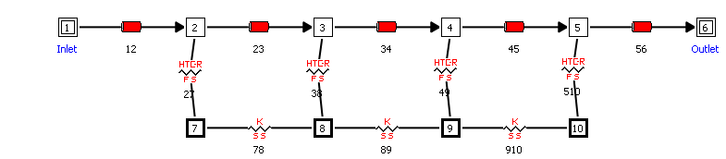
Network Definition
Fluid Nodes: mass and energy equations are solved for pressures and enthalpies
Fluid Boundary Nodes Set boundary P/T
Fluid Branches: momentum equation is solved for flowrates
Fluid-to-Solid Conductors: Convection
Solid Nodes: Solve solid energy equation for wall temperatures
Solid-to-Solid Conductors Conduction

Slide 8
UNITS AND SIGN CONVENTIONS
Units External (input/output) Internal (inside GFSSP)
  Length - in, ft, m, cm - feet
  Area - in², ft², m², cm² - feet²
  Pressure - psia, kPa - psf
  Temperature - °F, °R, °C, K - °R
  Mass injection - lbm/s, kg/s - lbm/s
  Heat Source - Btu/s, W - Btu/s
Sign Convention
  Mass input to node = positive
  Mass output from node = negative
  Heat input to node = positive
  Heat output from node = negative

Slide 9
MATHEMATICAL FORMULATION
Principal Variables
  Unknown Variables Available Equations to Solve
  1. Pressure 1. Mass Conservation Equation
  2. Flowrate 2. Momentum Conservation Equation
  3. Fluid Temperature 3. Energy Conservation Equation of Fluid
  4. Solid Temperature 4. Energy Conservation Equation of Solid
  5. Species Concentration 5. Conservation Equations for Mass Fraction of Species
  6. Mass 6. Thermodynamic Equation of State

Slide 10
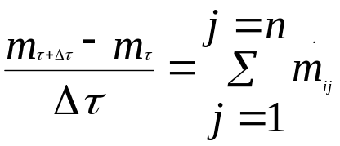
GOVERNING EQUATIONS
Node
Fluid
MASS CONSERVATION EQUATION
j = 2
Mixture
.
m
ij
Fluid
Mixture
Node
.
Node
.
Node
j = 1
m
ji
i
m
ij
j = 3
Single
Fluid
k = 1
.
.
.
Note : Pressure does not appear explicitly in Mass Conservation Equation although it is earmarked for calculating pressures
m
ji
m
ij
=
-
m
ji
Single
Node
Fluid
j = 4
k = 2

Slide 11
GOVERNING EQUATIONS
MOMENTUM CONSERVATION EQUATION
Node
j
Represents Newton’s Second Law of Motion
Branch
Mass X Acceleration = Forces
.
m
ij
Unsteady
Longitudinal Inertia
Transverse Inertia
Pressure
Gravity
Friction
Centrifugal
Shear Stress
Moving Boundary
Normal Stress
External Force
q
Node
i
g
w
r
r
i
Axis of Rotation
j

Slide 12

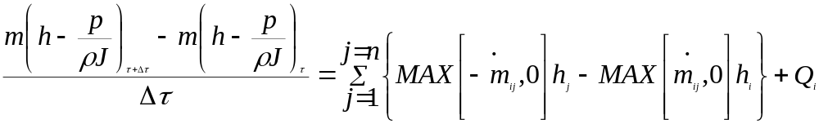
GOVERNING EQUATIONS
Node
Fluid
j = 2
Mixture
ENERGY CONSERVATION EQUATION
  Energy Conservation Equation can be written in Enthalpy or Entropy
.
m
ij
Fluid
Mixture
Based on Upwind Scheme
Node
.
Node
.
Node
j = 1
m
ji
i
m
ij
j = 3
Enthalpy Equation
Single
Fluid
Rate of Increase of Internal Energy =
Enthalpy Inflow - Enthalpy Outflow + Heat Source
k = 1
.
.
.
m
ji
m
ij
=
-
m
ji
Single
Node
Fluid
j = 4
k = 2

Slide 13
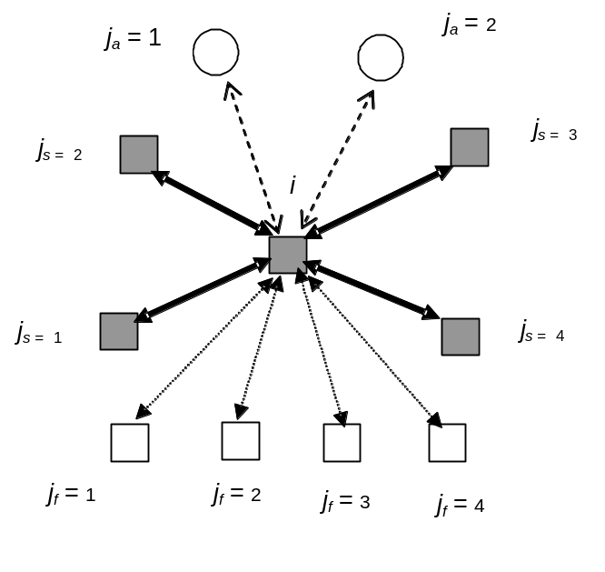
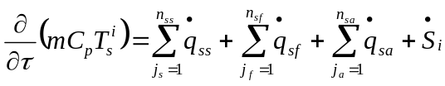
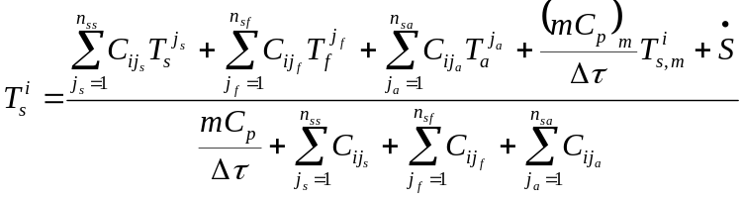



GOVERNING EQUATIONS
Ambient Node
Solid Node
Fluid Node
SOLID ENERGY CONSERVATION EQUATION
Successive Substitution Form

Slide 14
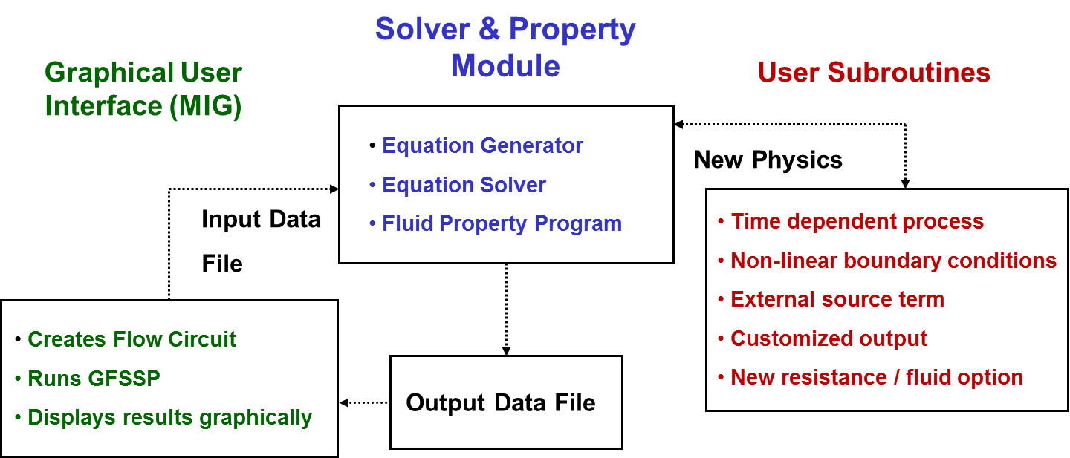
PROGRAM STRUCTURE

Slide 15

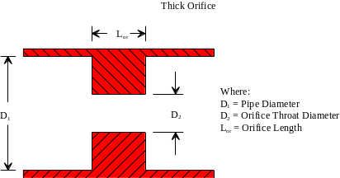
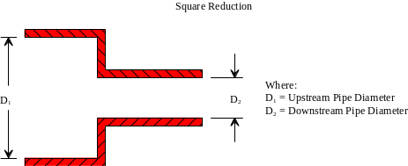
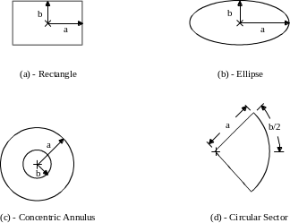
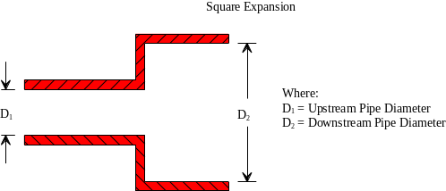
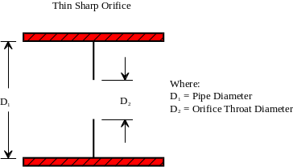
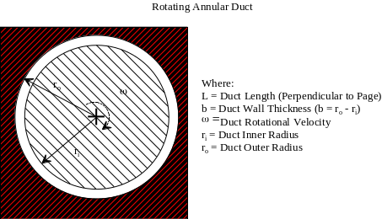
RESISTANCE OPTIONS
1. Pipe Flow
6. Thick Orifice
2. Flow Through a Restriction
7. Square Reduction
3. Non-Circular Duct
8. Square Expansion
4. Pipe Flow with Entrance
& Exit Losses
5. Thin, Sharp Orifice
9. Rotating Annular
Duct

Slide 16
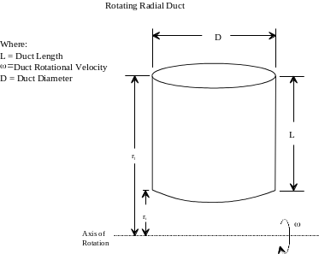
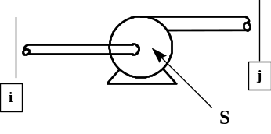
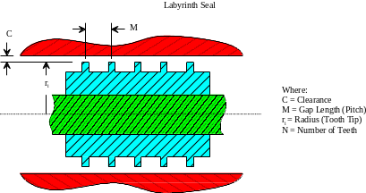
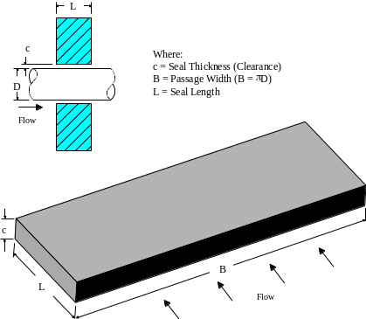
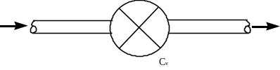
RESISTANCE OPTIONS
13. Common Fittings
& Valves
10. Rotating Radial Duct
14. Pump Characteristics
11. Labyrinth Seal
15. Pump Power
16. Valve with Given Cv
12. Face Seal
17. Viscojet
18. Control Valve
P

Slide 17


RESISTANCE OPTIONS
U
24. Fixed Flowrate
19. User Defined
25. Cartesian Grid
20. Heat Exchanger Core
21. Parallel Tube
22. Compressible Orifice
23. Labyrinth Seal (Egli Correlation

Slide 18
FLUID OPTIONS
ID Number | SOURCE / FLUID | ID Number | SOURCE / FLUID | ID Number | SOURCE / FLUID
1 | GASP He | 51 | GASPAK He | 69 | GASPAK Kr
2 | GASP CH₄ | 52 | GASPAK CH₄ | 70 | GASPAK Propane
3 | GASP Ne | 53 | GASPAK Ne | 71 | GASPAK Xe
4 | GASP N₂ | 54 | GASPAK N₂ | 72 | GASPAK R-11
5 | GASP CO | 55 | GASPAK CO | 73 | GASPAK R-12
6 | GASP O₂ | 56 | GASPAK O₂ | 74 | GASPAK R-22
7 | GASP Ar | 57 | GASPAK Ar | 75 | GASPAK R-32
8 | GASP CO₂ | 58 | GASPAK CO₂ | 76 | GASPAK R-123
9 | GASP F₂ | 59 | GASPAK H₂ (para) | 77 | GASPAK R-124
10 | GASP H₂ (para) | 60 | GASPAK H₂ (normal) | 78 | GASPAK R-125
11 | WASP H₂O | 61 | GASPAK H₂O | 79 | GASPAK R-134A
12 | RP-1 Tables | 62 | GASPAK RP-1 (liq) | 80 | GASPAK R-152A
 |  | 63 | GASPAK Isobutane | 81 | GASPAK N₂F₃
33 | Ideal Gas | 64 | GASPAK Butane | 82 | GASPAK NH₃
 |  | 65 | GASPAK Deuterium | 84 | GASPAK H₂O₂
37 | User Fluid 1 | 66 | GASPAK Ethane | 86 | GASPAK Air
38 | User Fluid 2 | 67 | GASPAK Ethylene
39 | User Fluid 3 | 68 | GASPAK H₂S

Slide 19
Demonstration
Models

Slide 20
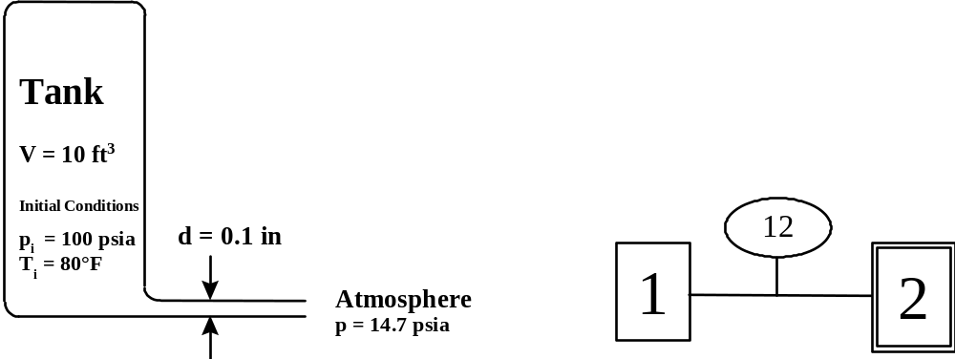
1. Blow Down of Pressurized Tank

Slide 21
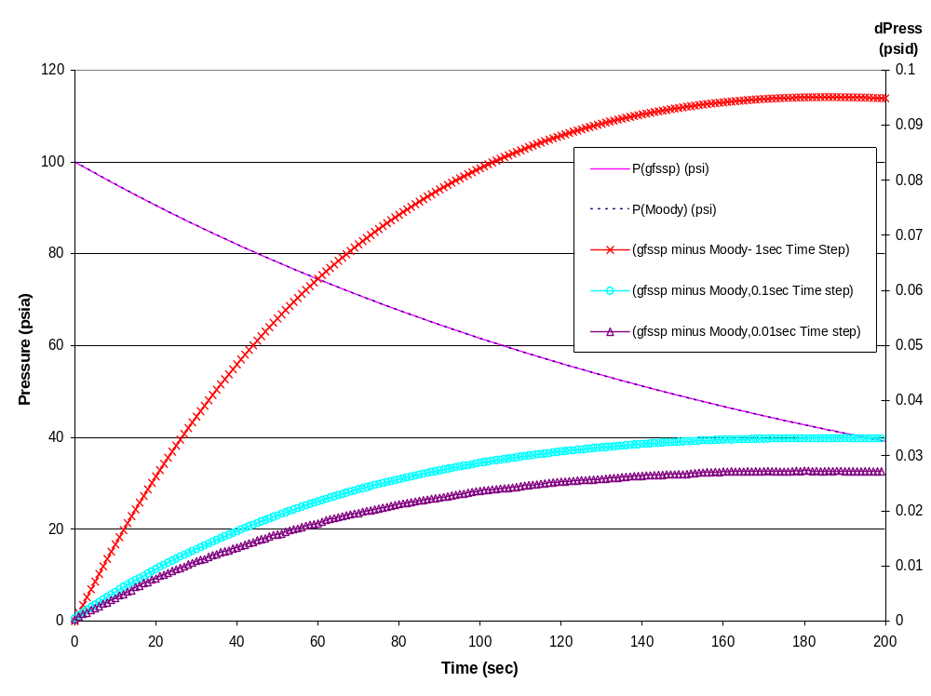
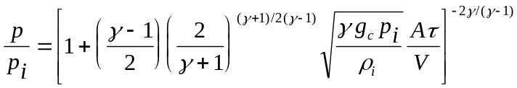
1. Blow Down of Pressurized Tank
Analytical Solution:

Slide 22
2. Waterhammer
Liquid Oxygen at 500 psia and 200 R
Valve closes in 100 milliseconds
Flowrate = 0.1 lb/s
D = 0.25 inch
450 psia
400 ft

Slide 23
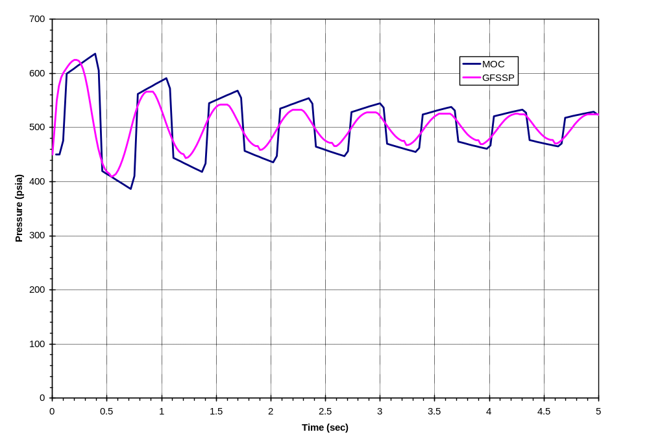
2. Waterhammer
GFSSP results compared to Method of Characteristics

Slide 24
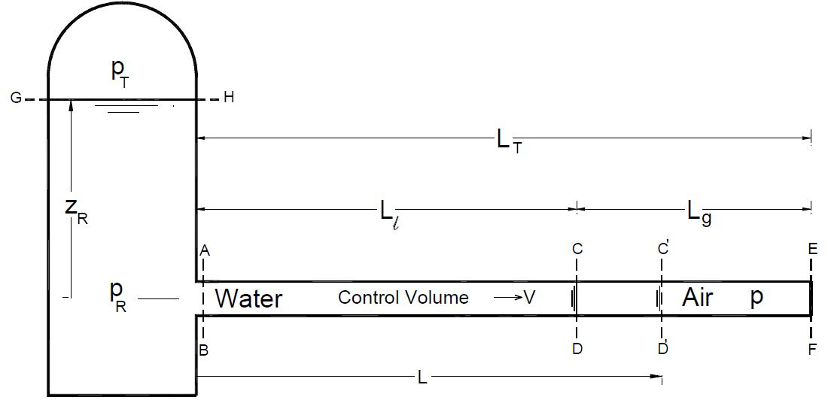
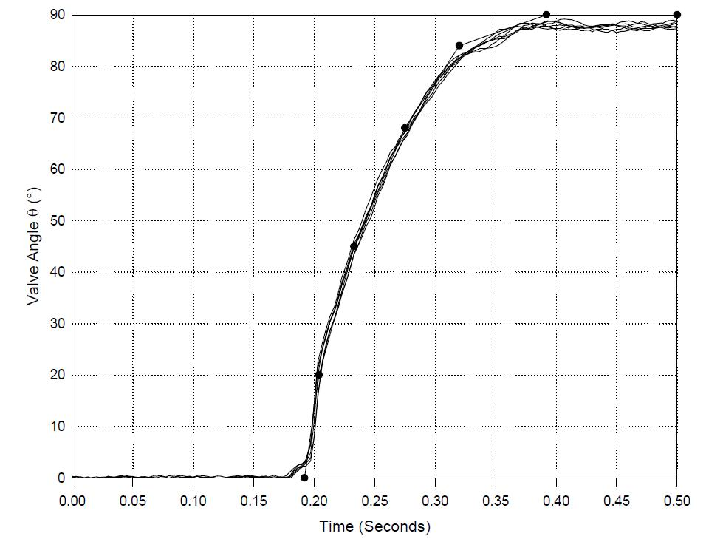

3. Sudden Valve Opening / Priming
Top: Schematic of the Pipeline System with ball-valve location.
Side: Ball-Valve Opening History
Parameters: α = L_{g}/L_{T}
P_{R} = p_{R}/p₀

Slide 25
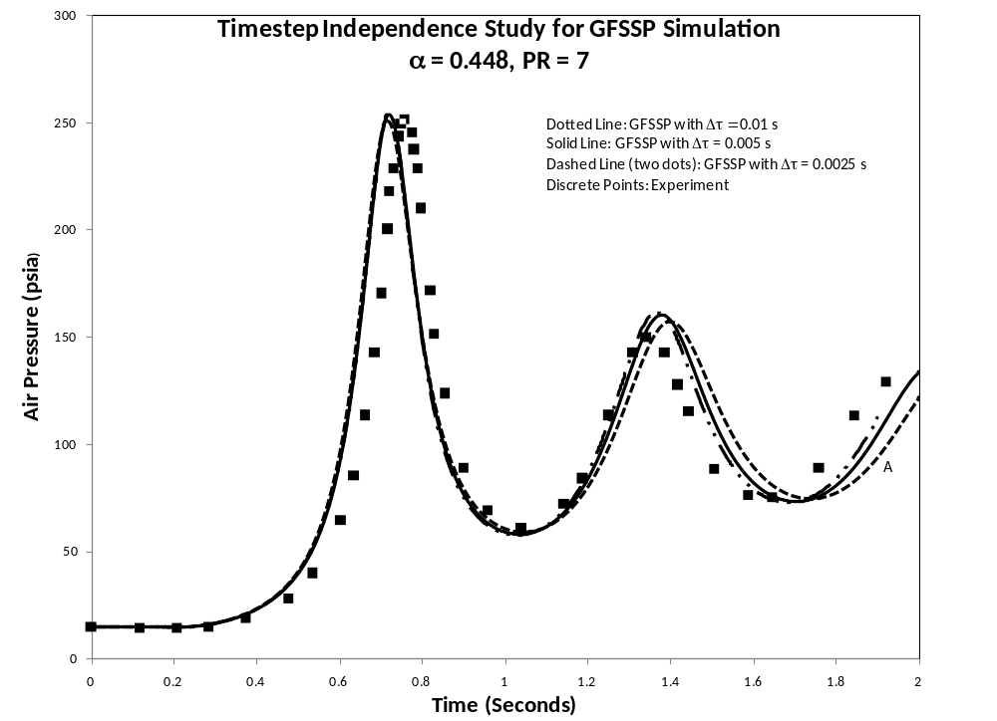
3. Sudden Valve Opening

Slide 26
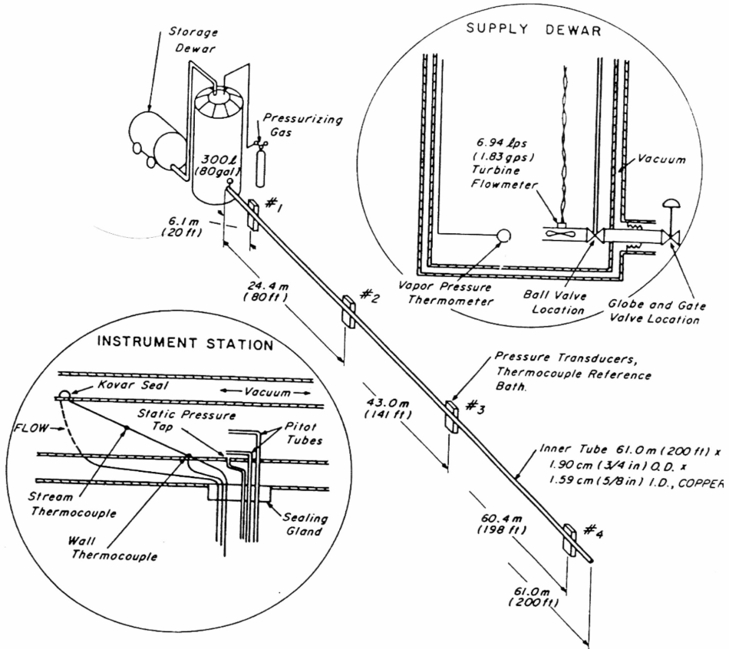
4. Transfer Line Chilldown
NBS Chilldown Experiment

Slide 27
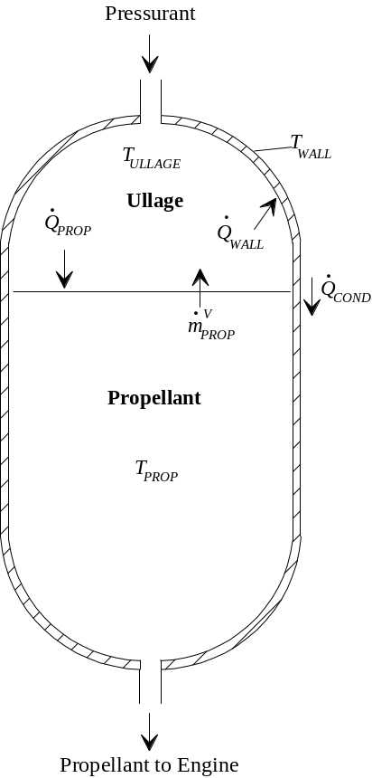
5. Tank Pressurization
Change in ullage and propellant volume.
Change in gravitational head in the tank.
Heat transfer from pressurant to propellant.
Heat transfer from pressurant to the tank wall.
Heat conduction between the pressurant exposed tank surface and the propellant exposed tank surface.
Mass transfer between the pressurant and propellant.

Slide 28
Questions?
For more information:
  www.nasa.gov/gfssp
Or contact:
  alok.k.majumdar@nasa.gov
  andre.c.leclair@nasa.gov

