Slide 1

API, Authentication, and Machine Learning for Arc Jet and Material Data
Koushik Chennakesavan
University of Texas at Austin
Internship with AMA, Inc. at NASA Ames Research Center

Slide 2
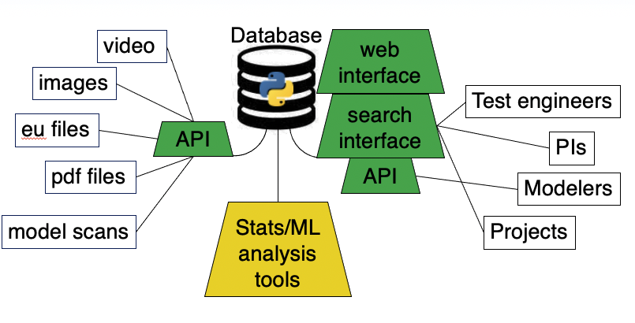
Presentation Outline
Build an API that provides a scriptable and user-friendly interface
  Ability to upload EU files
  Scriptable search functionality
User authentication between both Mat-DB and Beast-DB
  Group based authentication
Machine Learning using 1D Neural Net Convolutions for time segmentation

Slide 3
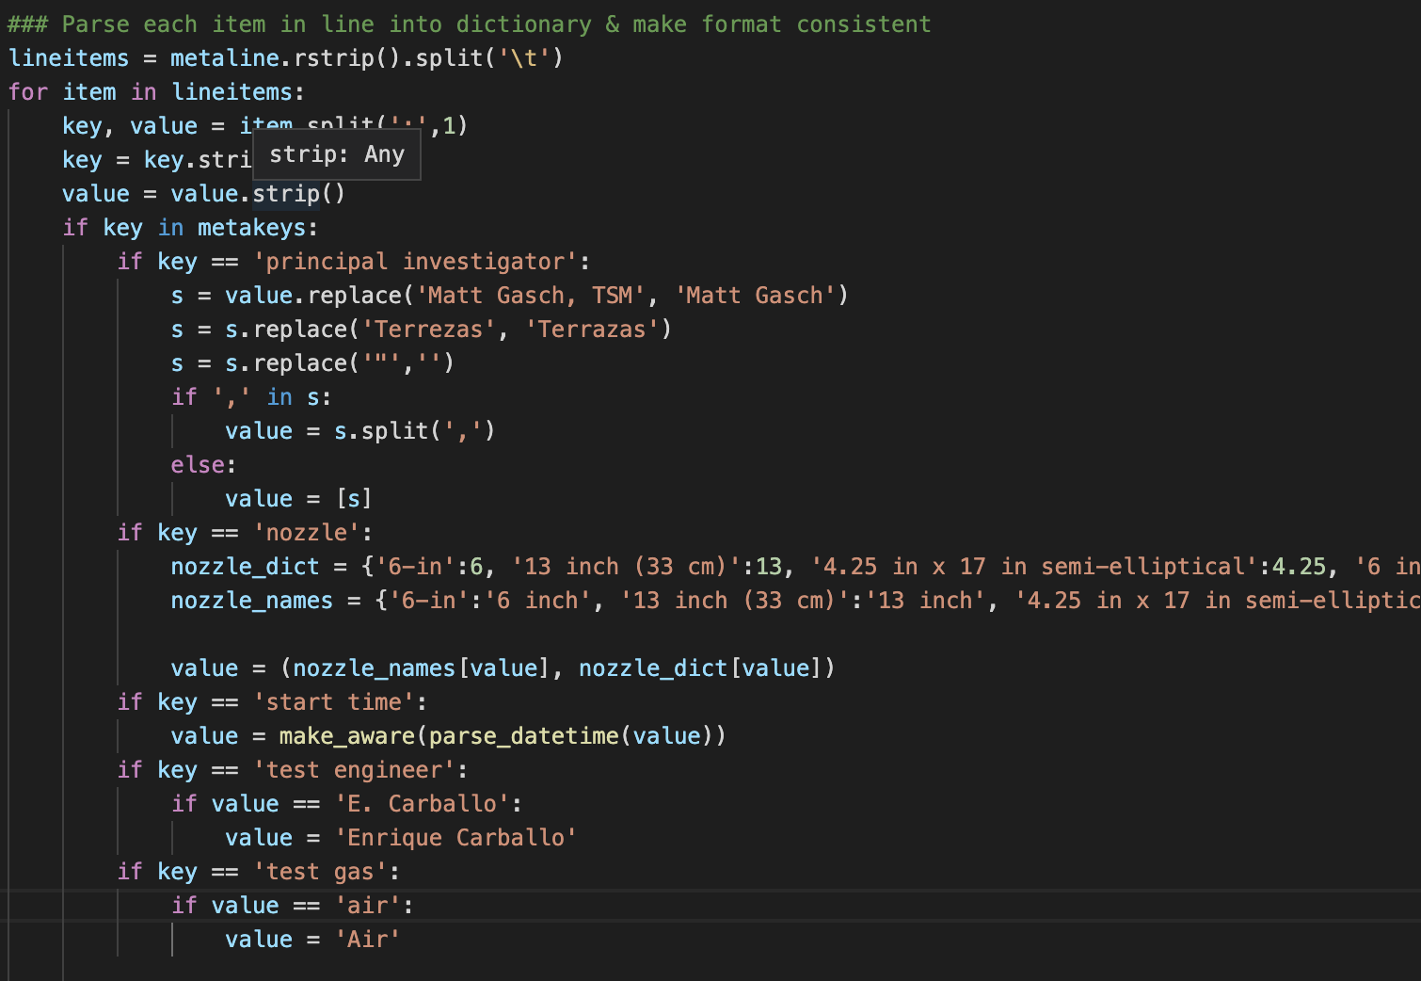
Parsing and Inserting Data into Database
Work was primarily based with engineering unit(EU) and only included run diagnostics
Used Pandas data frames, a data analysis tool, to identify data in files
Using Object Relational Mapping(ORM) helps to map objects and data into databases
Some potential issues encountered:
  File Duplicated(renamed A, B, C, etc…)
  Naming conventions(including TSS branch project, having multiple comments, and nicknames)
  Dictionaries help to filter and organize values despite these issues

Slide 4
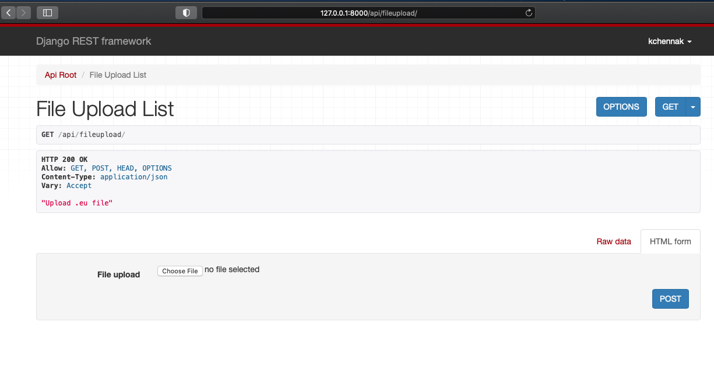
Django REST API Model
API – Application Programming Interface
Connection from our database to other programs via scripts or user interface
Each object is link based and can be also searched up based on Django API interface
Dynamically updates with new data added
Can add new data with eu file directly via the API
For example…

Slide 5
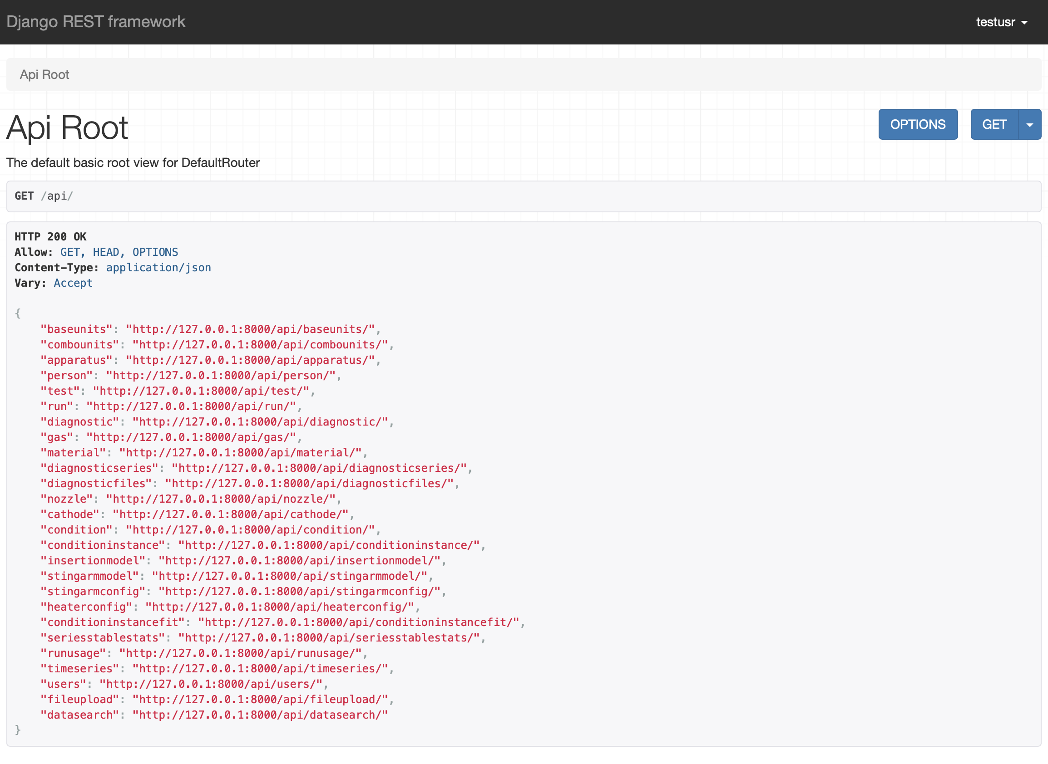

Slide 6
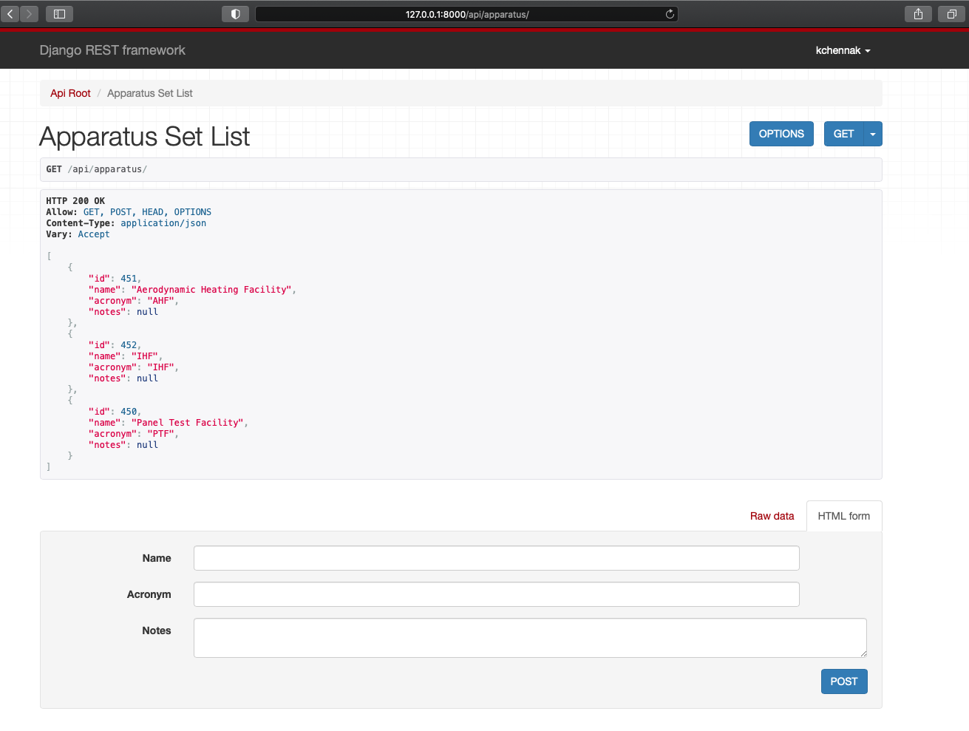

Slide 7
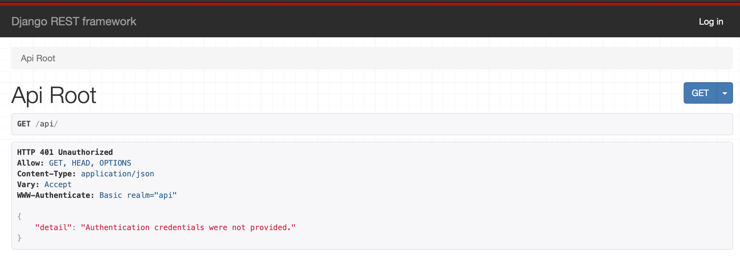
API Authentication

Slide 8
API Authentication View
Beast-DB
  Regular users can access all endpoints except users
  Admin can access users endpoint to allow/modify access for API
Mat-DB
  ITAR materials and Public Materials required different Access Policies
  ITAR view, ITAR edit, Material view, and Material edit access restrictions needed

Slide 9
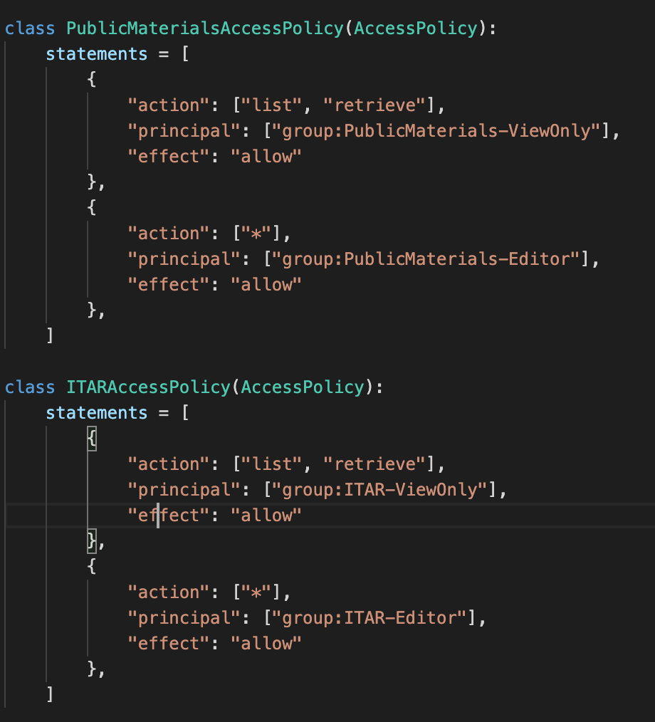
API Authentication View
Action – depicts what permissions are allowed; * indicates all permissions
Principal – what groups have this access
Effect – allow or deny
API access is incorporated into previous group
Straightforward implementation allows easy group modification access

Slide 10
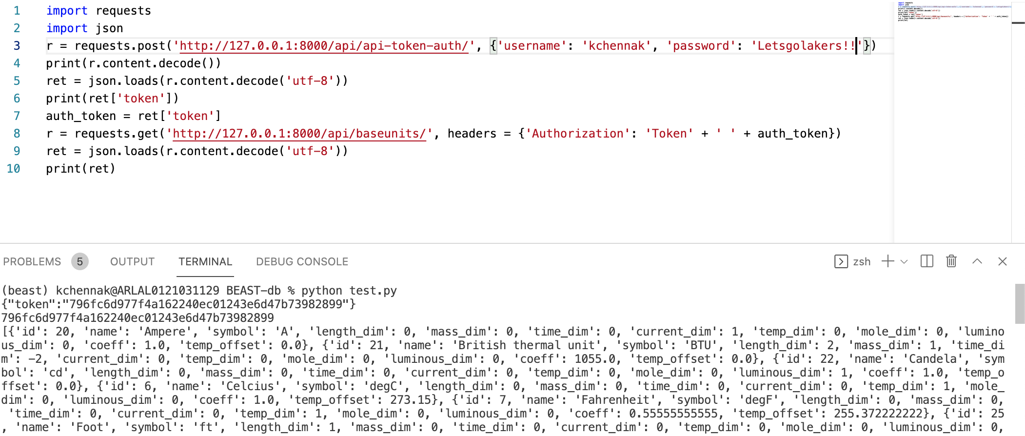
API Authentication View via 3rd Party Scripts

Slide 11
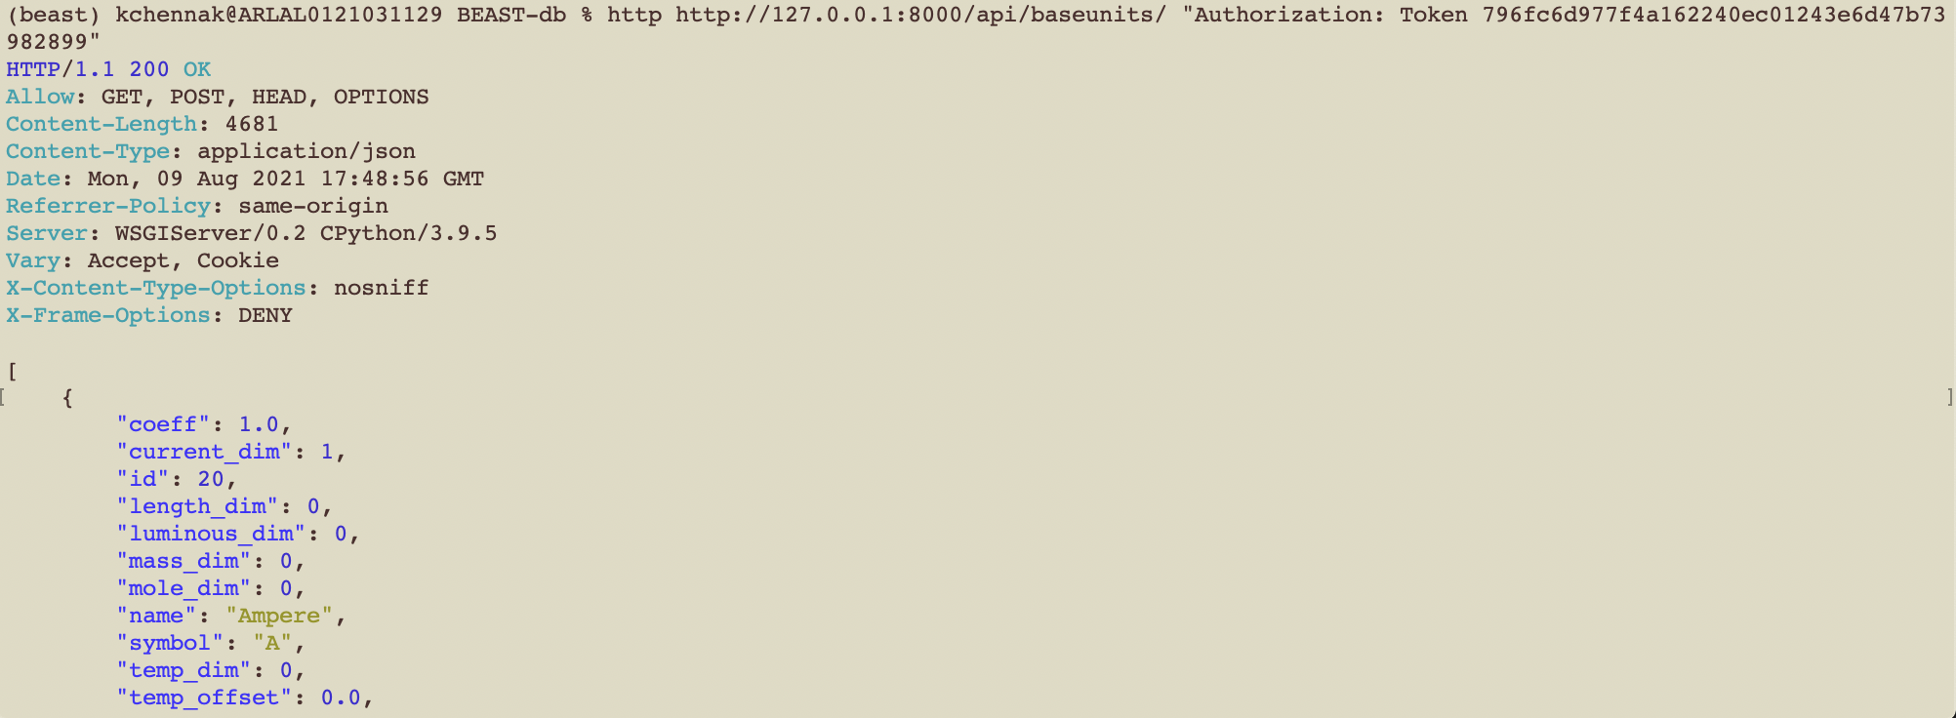
API Authentication View via Command Line Script

Slide 12
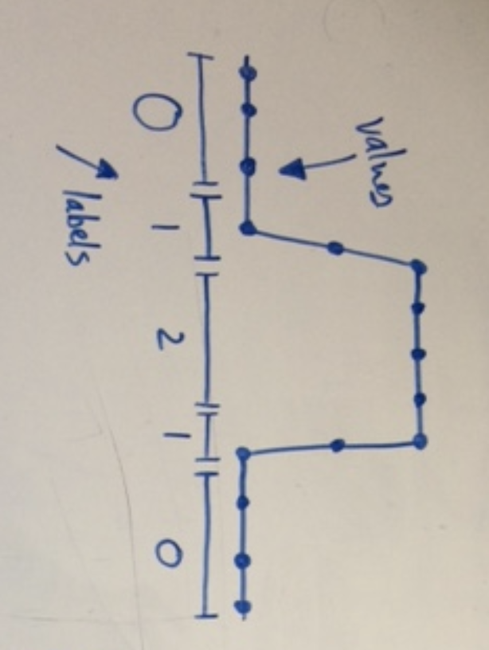
Machine Learning with Arc Jet Data
Wanted to design and model data from runs
  Most importantly Arc Voltage and Arc Pressure with respect to time
  Saves time from photo and video analysis
  Helps identify clear run start times if not specified in log
1D neural net convolution
Convolutions allow spatial features to be extracted, in this case labeling
0 indicates off, 1 being transition and 2 being on

Slide 13
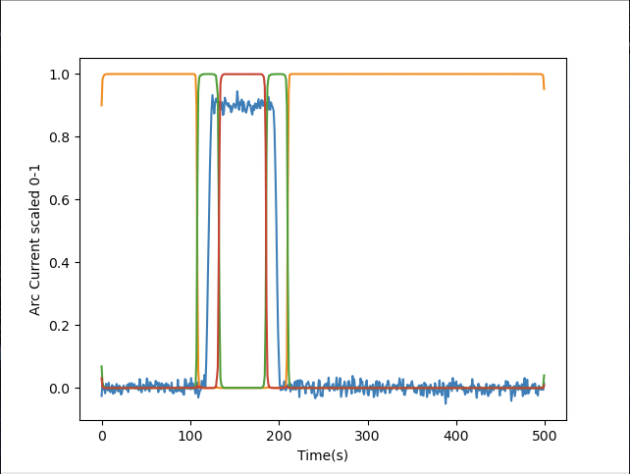
Machine Learning with Arc Jet Data
A training set of artificially generated “top hat” data was used to train the set
Once generated, each part of the data was labeled 0, 1, or 2 accordingly
This data was used to train the model

Slide 14
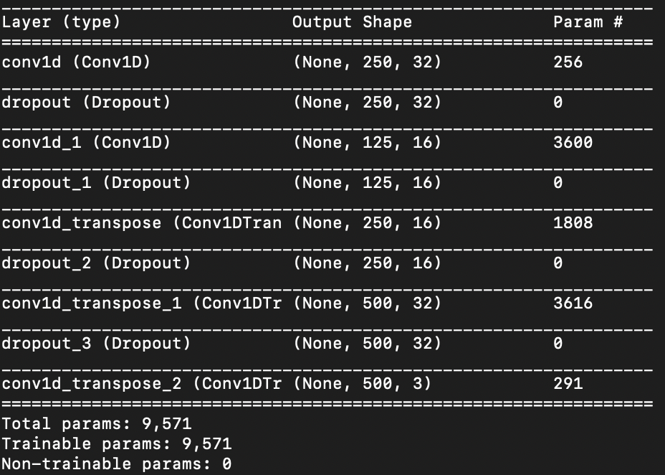
Machine Learning with Arc Jet Data
Neural net convolution consists of several layers
Data from values and labels is taken from inputted diagnostic and time, resized and labeled accordingly to input size
Each 1D convolution layer grabs a subset of the sequence and reshapes the data while learning
Dropout functions – act as a mask to prevent previous data batches from dominating the training

Slide 15
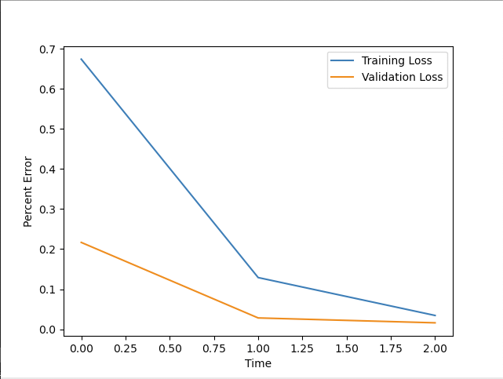
Machine Learning with Arc Jet Data
Training curve – ability of the model to comprehend the incoming data
Validation curve –Ability of the model to make predictions on data
Training error of the model itself is roughly around 1-1.5%
Model can also be exported and imported using Keras save/upload model tools

Slide 16
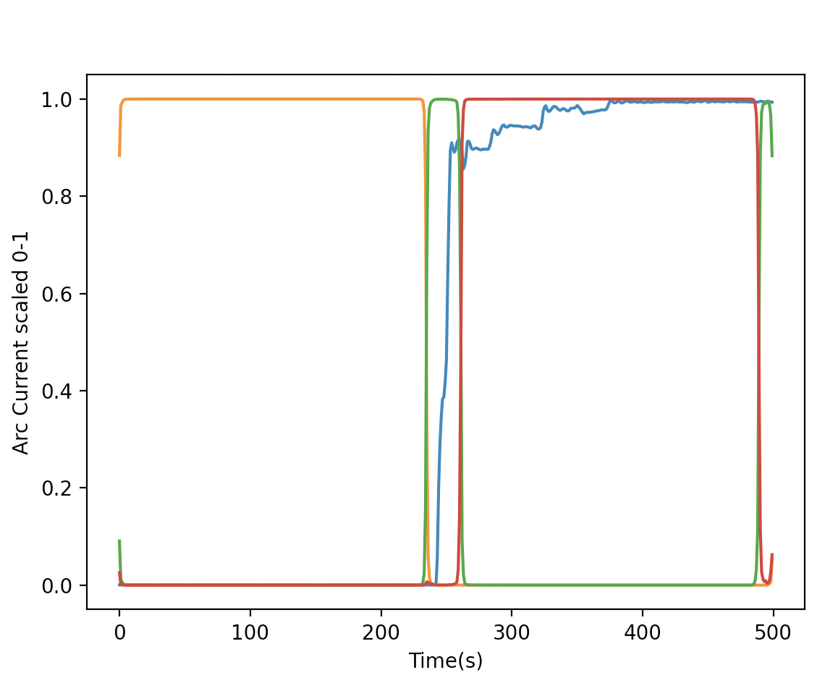
Machine Learning with Arc Jet Data
Results from AHF259R012 analyzing Arc Current from 0 -500 seconds
  Blue represents the original Arc Current data values called from 0 -1
  Orange represents 0-off
  Green represents 1-intermediate
  Red represents 2 – on

Slide 17
Summary
API for both Beast-db and Mat-db simplifies data access
  Scripts, third party application, command line
Authentication for databases are easy to control and are built into website
Separated databases in model minimizes chances of unauthenticated data access
Time series segmentation saves time to help determine critical segments of run data
  Saves manual oversight time for photo and video analysis of runs
  Helps identify run start times if not clear in runlog
Future scope
  Integrating with NASA NAMS security, improving UI, more data analysis

