Slide 1
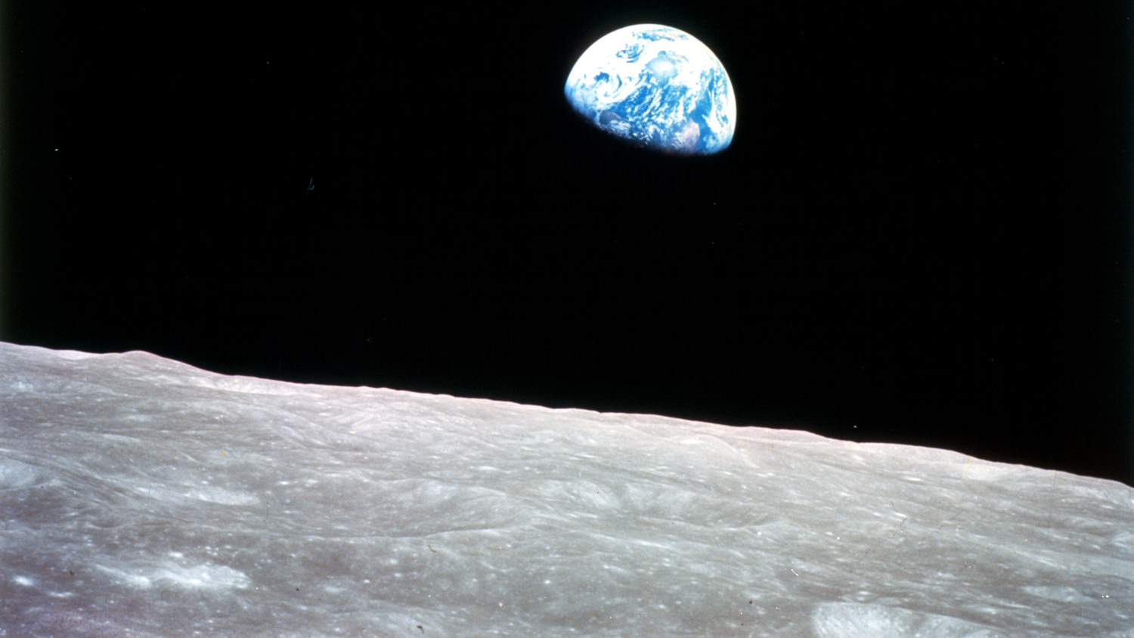
Construction Materials Development and Processing for ISRU
Dr. Jennifer Edmunson
18 August 2021
“Earthrise”
Image credit: Apollo 8 Crewmember Bill Anders/NASA

Slide 2
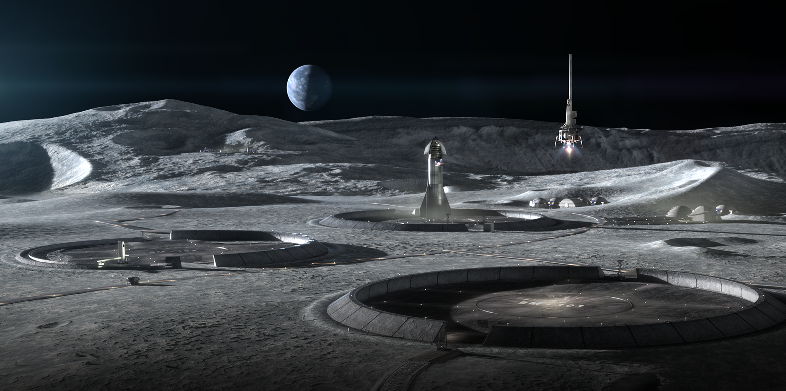
There are many applications for construction materials on the lunar surface
Image courtesy of ICON and Space Exploration Architecture (SEArch+)

Slide 3
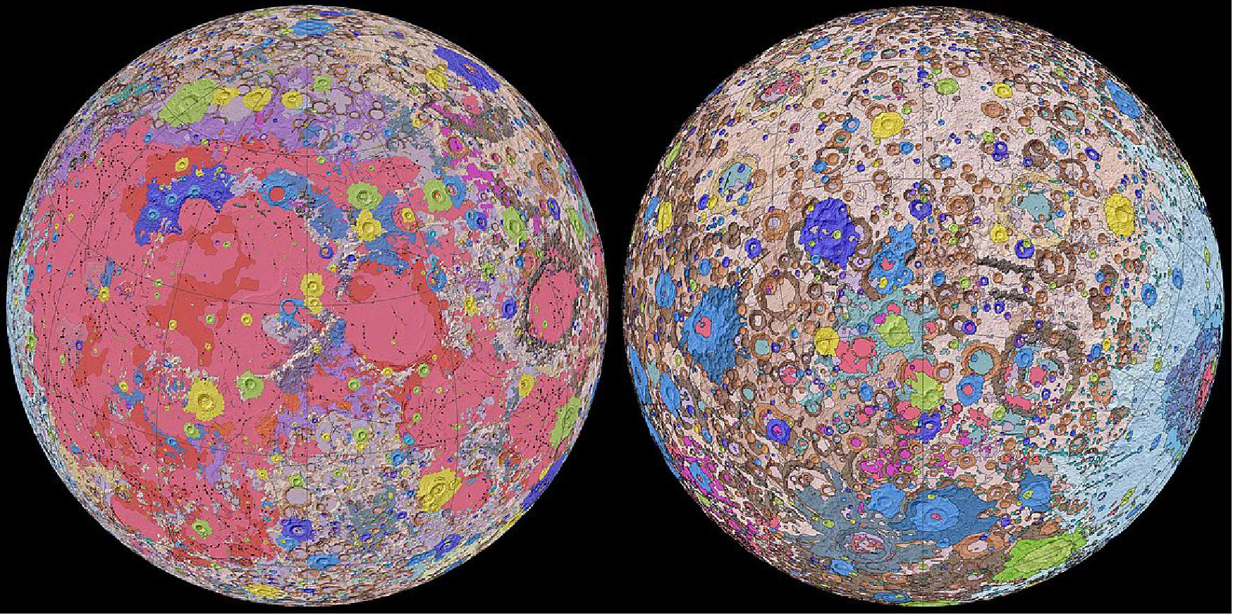
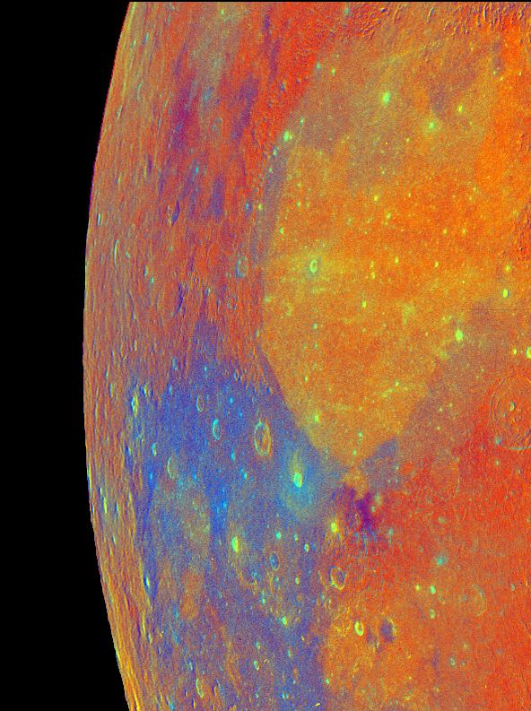
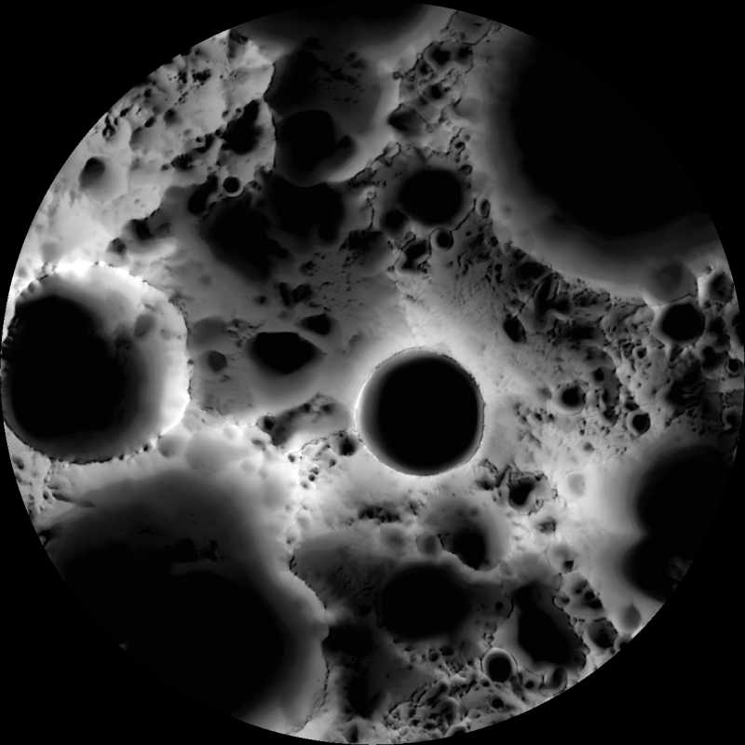
Resources exist on the lunar surface that can provide feedstock for construction materials
Unified Geologic Map of the Moon orthographic projections Image credit: NASA/GSFC/USGS
Lunar South Pole multi-temporal illumination map
Image credit: NASA/GSFC/Arizona State University/LRO
False color mosaic of the Moon
Galileo spacecraft 12-7-92 Image credit: JPL
Notes:
Moon false color mosaic: https://www.jpl.nasa.gov/images/moon-false-color-mosaic-3
Geologic map of the Moon: https://astrogeology.usgs.gov/search/map/Moon/Geology/Unified_Geologic_Map_of_the_Moon_GIS_v2
Shadows at the lunar south pole: https://apod.nasa.gov/apod/ap110423.html

Slide 4
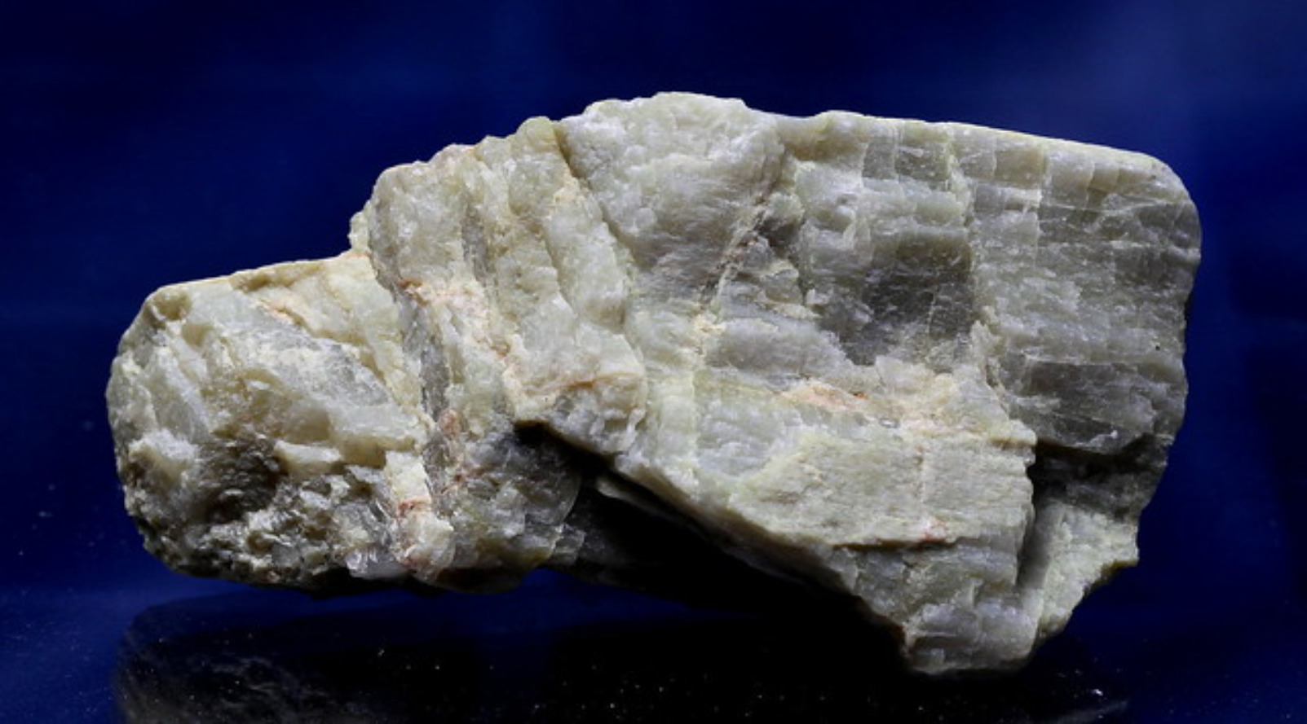
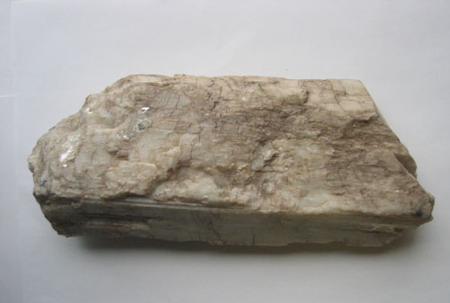
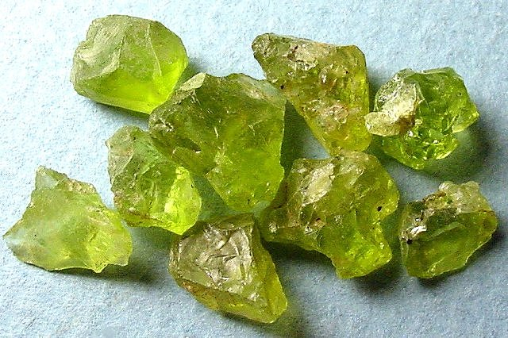
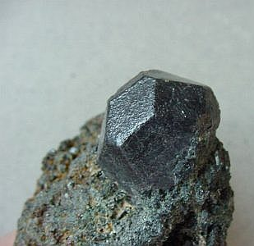
In-Situ Resource Utilization resource extraction technologies can isolate elements of interest
Al
Anorthite
CaAl₂Si₂O₈
Si
Pyroxene
(Ca,Mg,Fe)Si₂O₆
Ca
O
Olivine
(Mg,Fe)₂SiO₄
Mg
Fe
Ilmenite
FeTiO₃
Ti

Slide 5
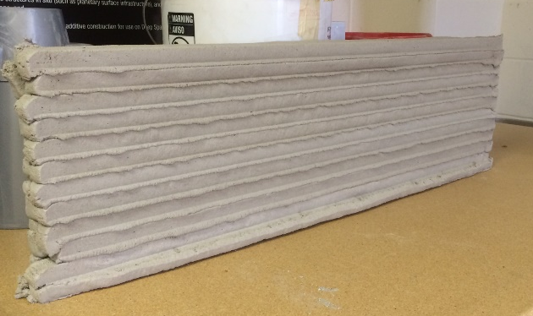
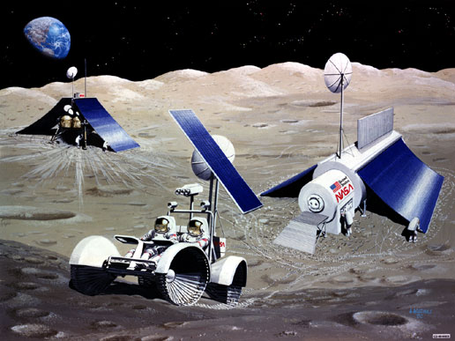
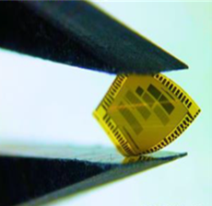
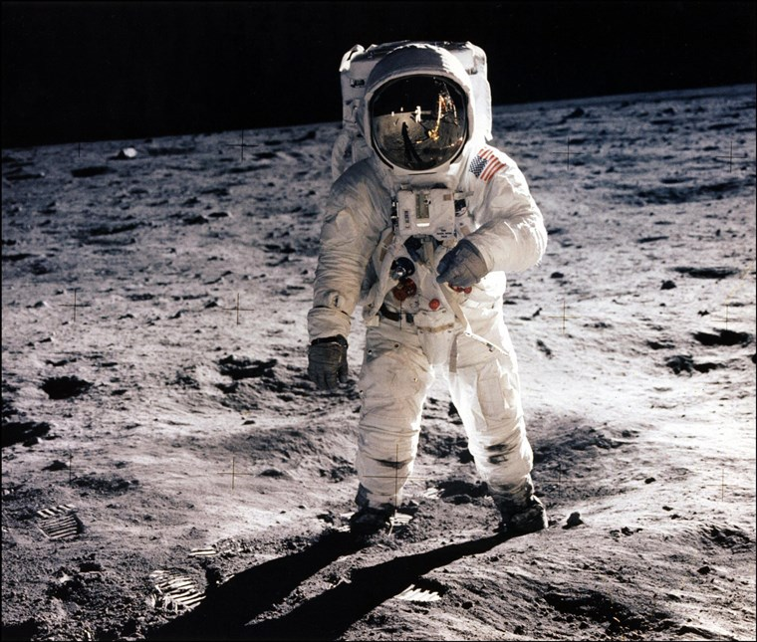
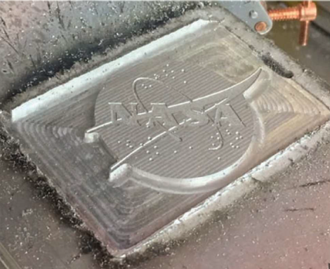
ISRU technology development must continue in order to provide feedstock for construction and manufacturing processes
Al
Anorthite
CaAl₂Si₂O₈
Si
Pyroxene
(Ca,Mg,Fe)Si₂O₆
Ca
O
Olivine
(Mg,Fe)₂SiO₄
American Semiconductor, Inc.
Mg
Fe
Ilmenite
FeTiO₃
Ti
Made In Space

Slide 6
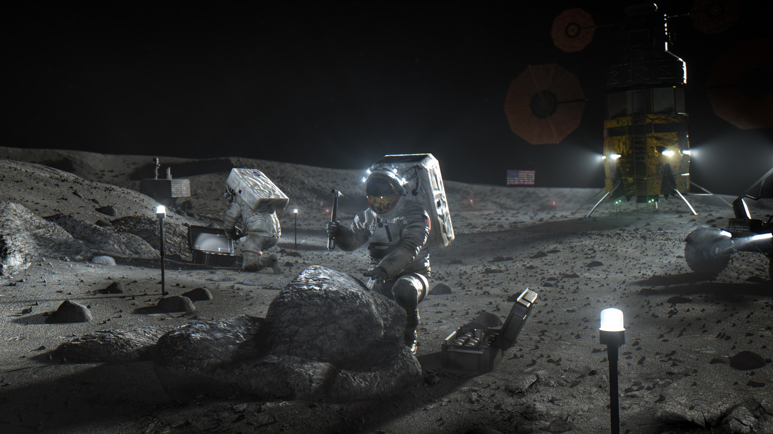

www.nasa.gov/spacetech

