Slide 1
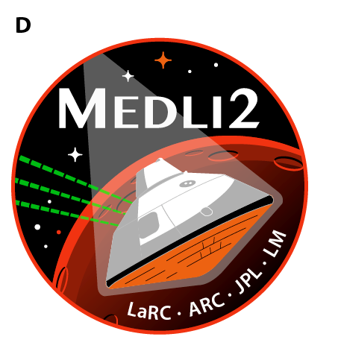
Data-Fusion of In-Flight Aerothermodynamic
Heating Measurements for MEDLI2 via
Ablation Product Deposition Testing
Kristen Price
University of Kentucky
Mentors: Ruth Miller and Tom West
August 13, 2021

Slide 2
Outline
MEDLI2 and Project Introduction
  Radiometers vs. Heat Flux Sensors
  Previous Arc-Jet Tests
PTF Testing
  Panel Modifications
  Test Plan
HyMETS Testing
  Test Articles

Slide 3
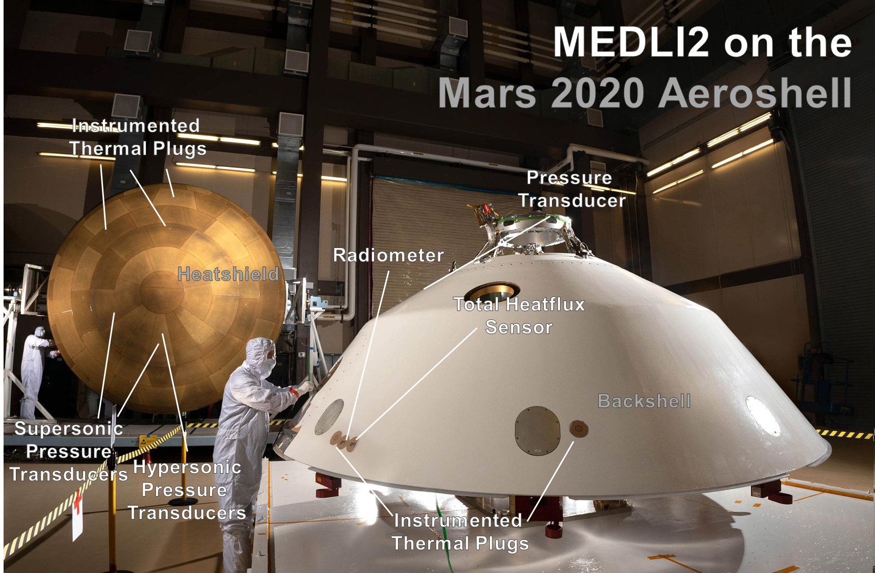
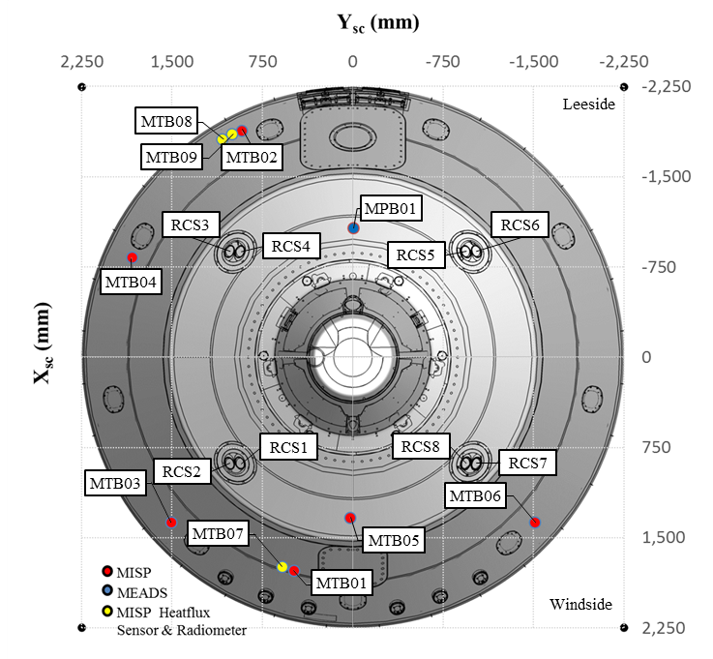
MEDLI2
MEDLI2 (Mars 2020 Entry, Descent and Landing Instrumentation 2) is an instrumentation suite for Mars 2020.
  Contains multiple sensors in order to make heatshield and backshell measurements during entry, descent, and landing
  The backshell includes:
    6 MISP thermal plugs
    1 pressure transducer
    2 heat flux sensors
    1 radiometer
Image Credit: White, T. R., et al, IPPW 2021

Slide 4
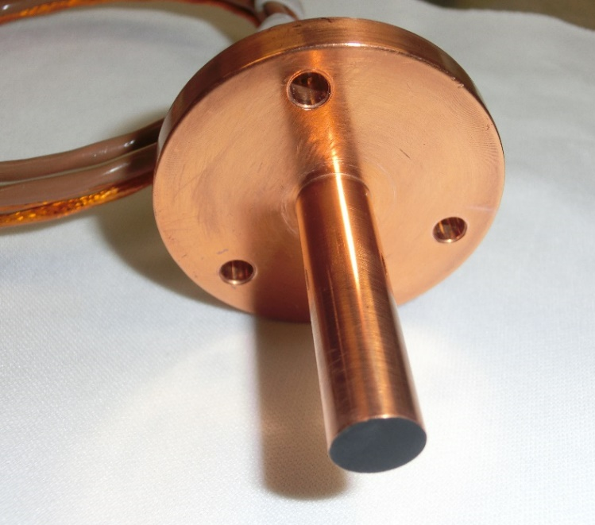
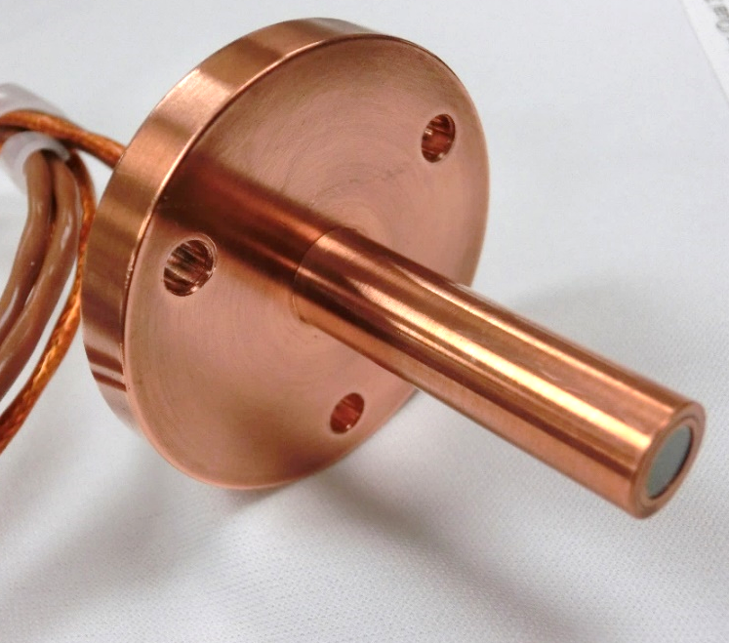








Heat Flux Sensors and Radiometers
The heat flux sensors and radiometers have very similar design.
The radiometers have an additional sapphire window.
$$T_{∞}$$
$$L\left(λ\right)$$
$$U_{∞}$$
Sapphire Window
$$L\left(λ\right)$$
$$T_{w}$$
$$T\left(λ\right)$$
$$A\left(λ\right)$$
Schmidt-Boelter Gauge
$$A\left(λ\right)$$
Schmidt-Boelter Gauge
Copper Housing
Copper Housing
Total Heat Flux Sensor Tip Cross-Section
Radiometer Tip Cross-Section
Image Credit: Miller, R.A., et al, submitted AIAA SciTech 2022

Slide 5
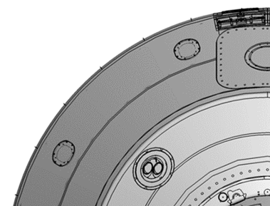
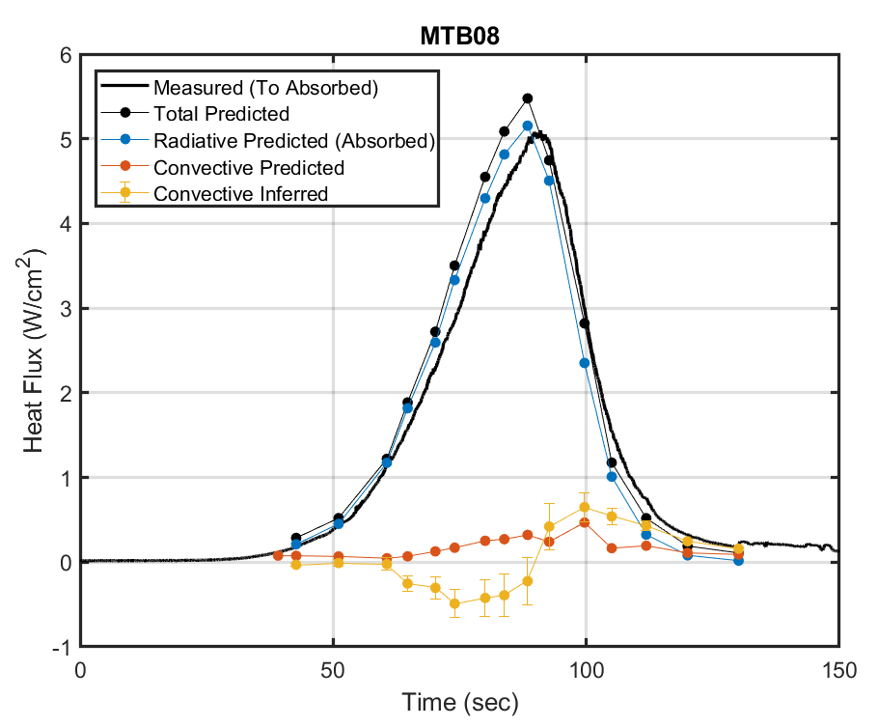
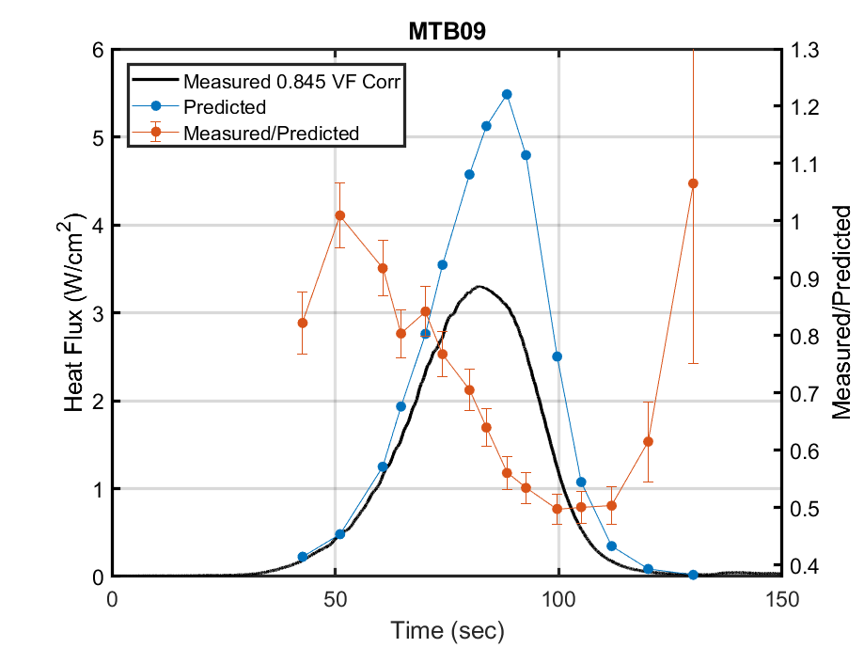
Measured Heating
Total heating (convective + radiative) measured by the heat flux sensor matched predicted heating well.
Radiative heating was significantly below what was predicted.
  Likely due to buildup of ablation products on radiometer windows
  Total uncertainty shown as error bars:
Heat Flux Sensor
Radiometer
PRELIMINARY
PRELIMINARY
Heat Flux Sensor
Radiometer
Image Credit: Miller, R.A., et al, submitted AIAA SciTech 2022

Slide 6
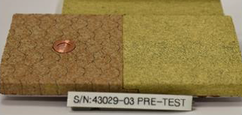
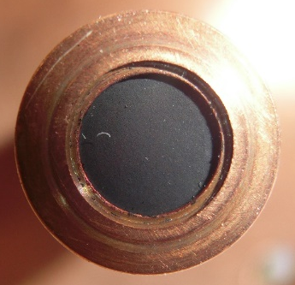
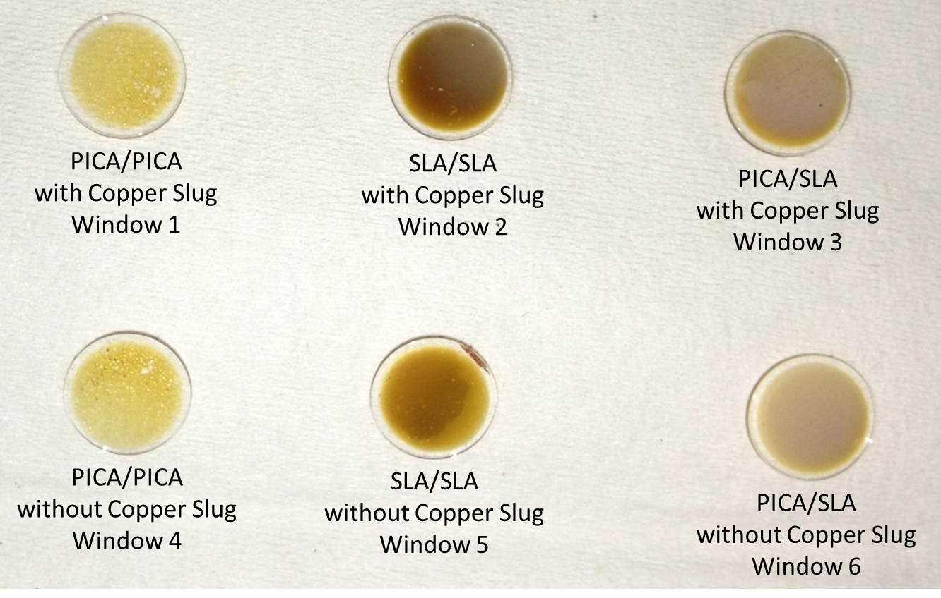
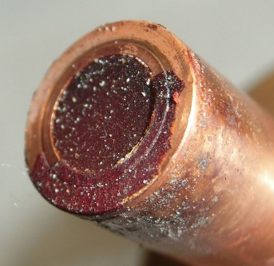
Previous Arc-Jet Tests
Previous arc-jet tests show the ablation product deposition.
  mARC tests: 12-30% signal loss
  PTF tests: 73-80% signal loss
Image Credit: Miller, R.A., et al, AIAA Aviation 2018
Image Credit: Miller, R.A., et al, submitted AIAA SciTech 2022

Slide 7
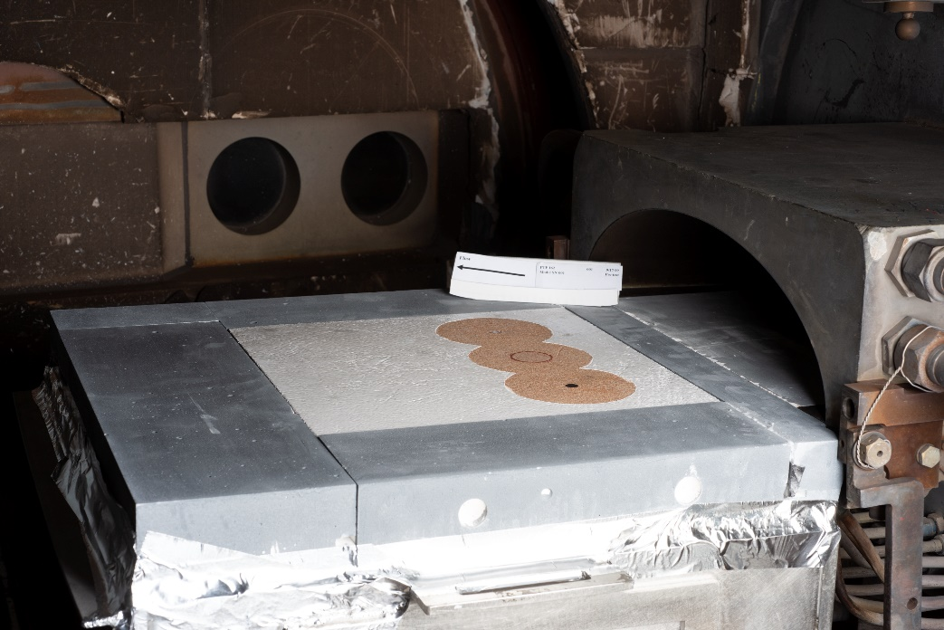
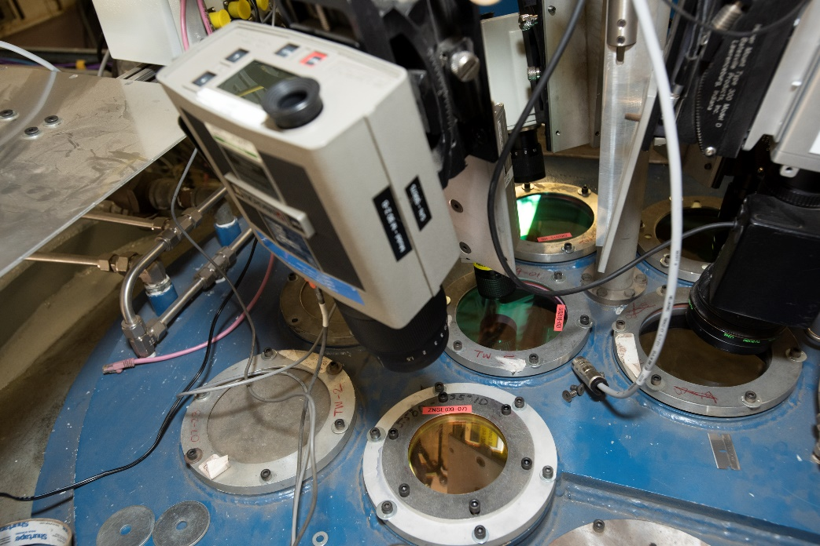
Upcoming PTF Tests
Additional PTF tests scheduled for September
Want time-varying transmission loss data
  4.3 µm laser through PTF window to excite radiometer
Both PICA and SLA ablation products
  Conditioning plate and leading edge closeout frame piece will be made of PICA in order to include PICA ablation products
Conditioning Plate
FLOW
Closeout Frame Leading Edge
Photo Credit: Jose Santos

Slide 8
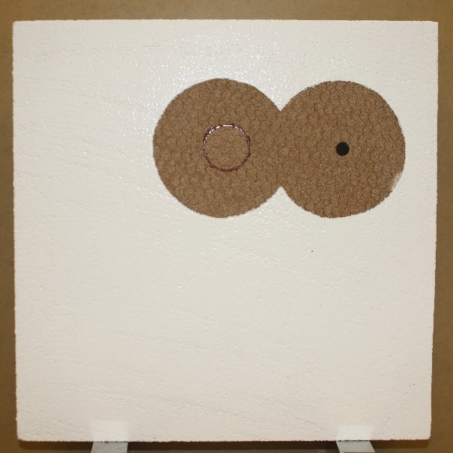
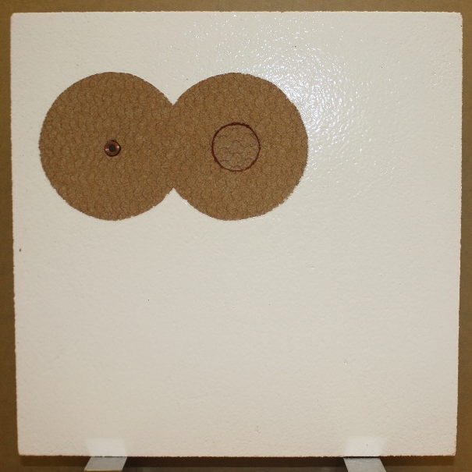
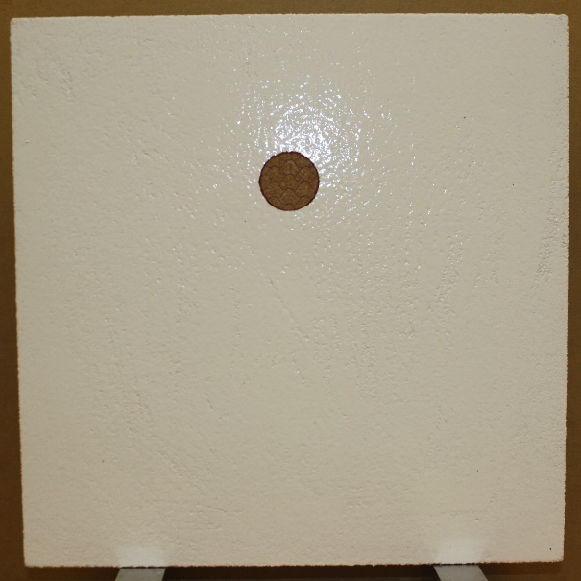
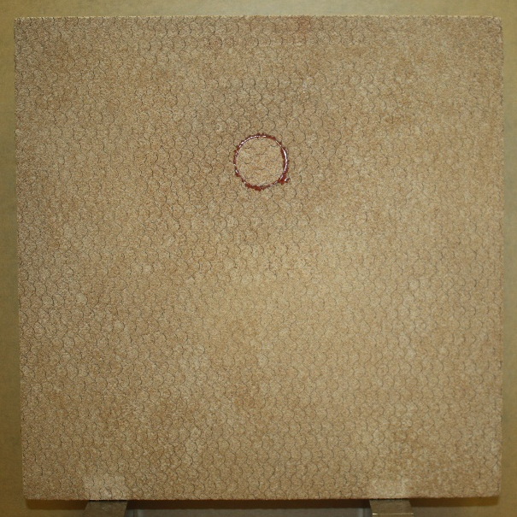
Upcoming PTF Tests
4 leftover panels from previous PTF tests
MISP Plug
Heat Flux Sensor
Radiometer
MISP Plug
SK0A0430216-502
SK0A0430216-503
MISP Plug
MISP Plug
SK0A0430216-506
SK0A0430216-505
Photo Credit: Ruth Miller

Slide 9
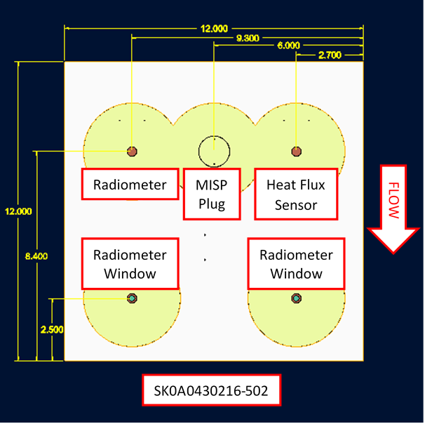
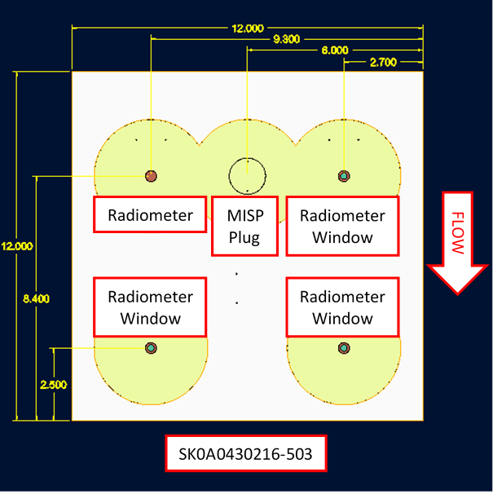
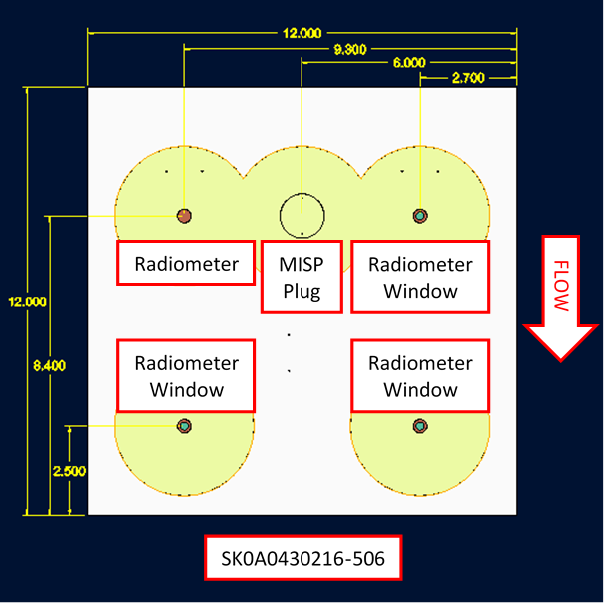
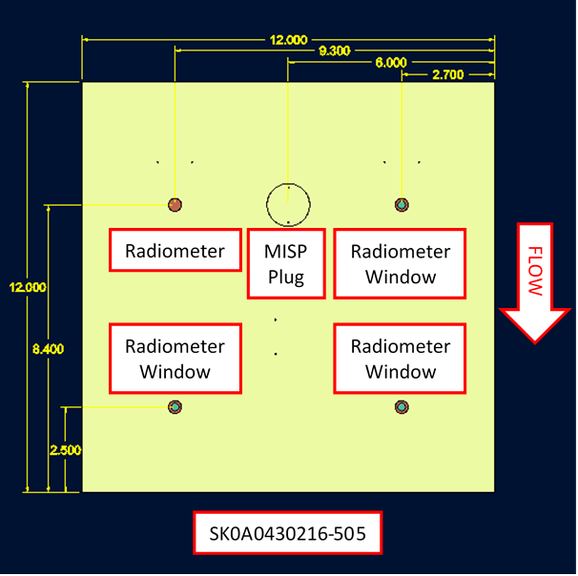
Upcoming PTF Tests
Adding additional radiometers and window assemblies

Slide 10
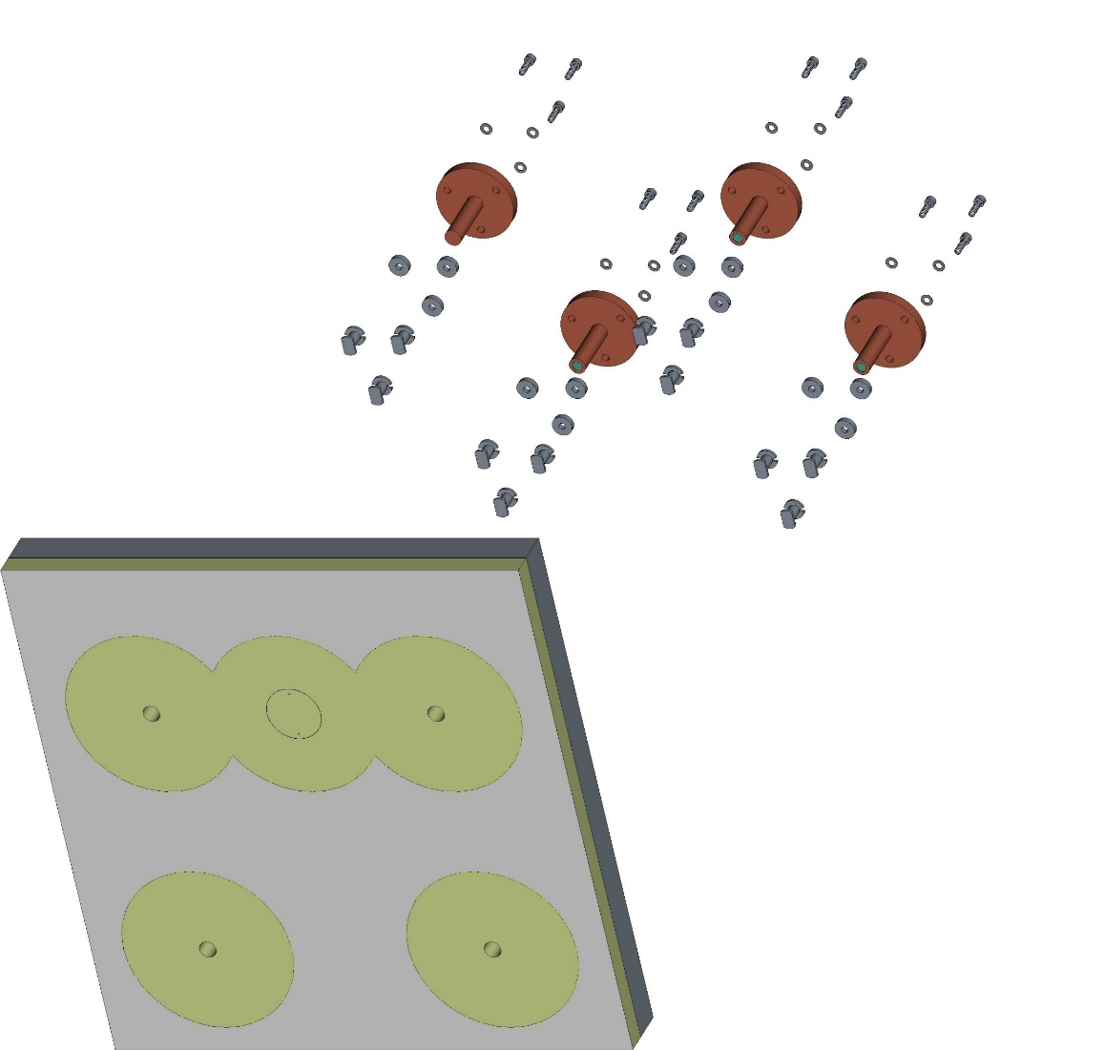
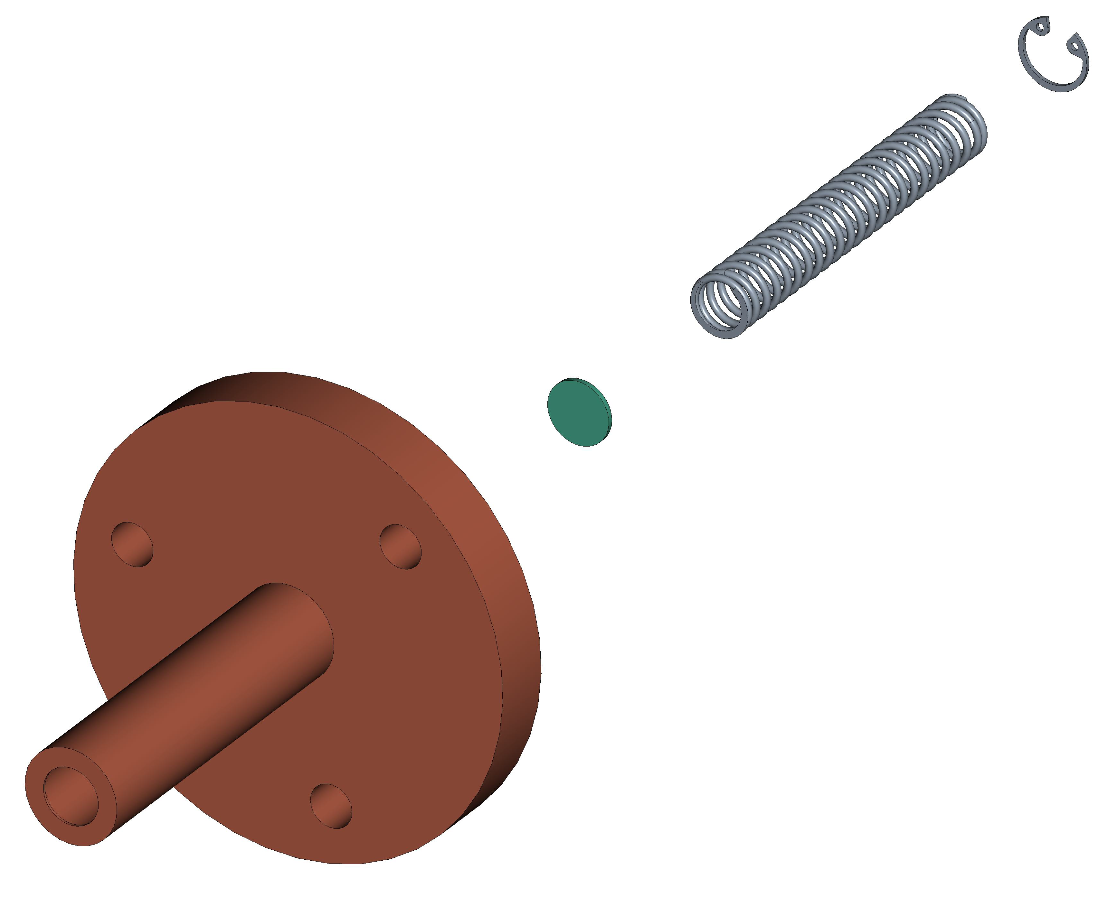
Modifications
Fabricate window holder assemblies
Add holes for sensors/inserts
Remove paint around sensor area
Assemble panels and secure with sealant

Slide 11
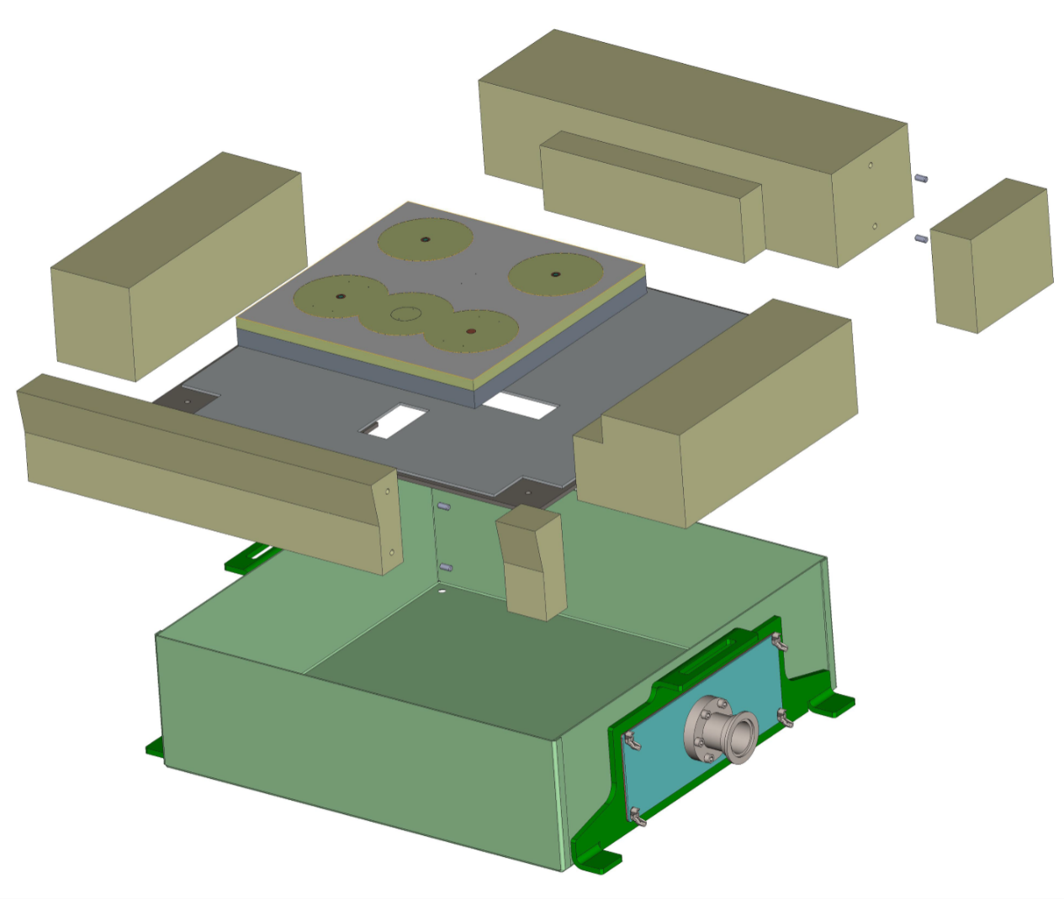
PTF Setup
Test article assembled in closeout frame
Conditioning plate and leading edge closeout frame piece will be made of PICA
4.3 µm laser shining through through PTF window above test article
Laser
Closeout Frame
Test Article
Interface Plate
Test Box

Slide 12
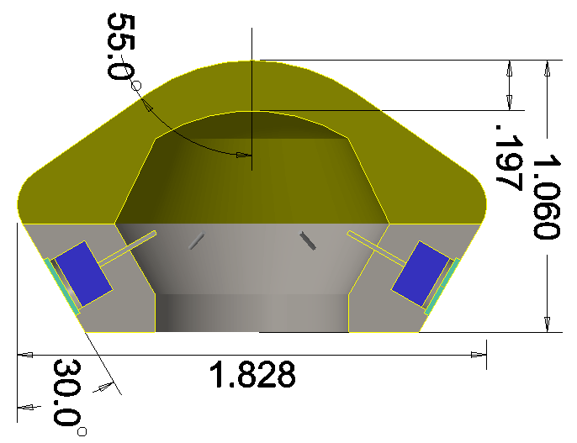
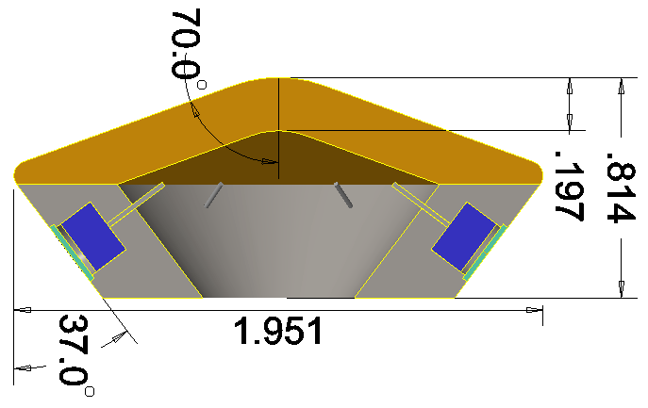
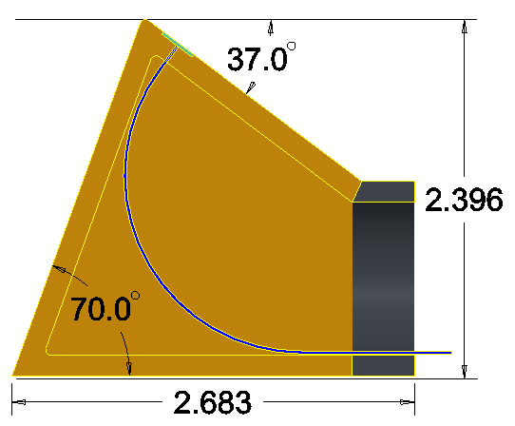
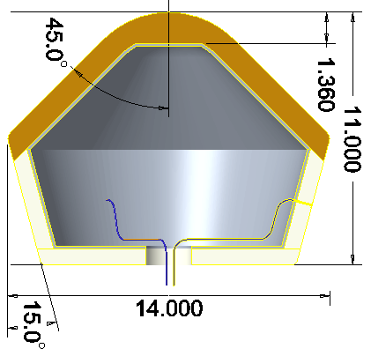
Additional Arc-Jet Testing Model Options
Sphere-Cone: Previous HyMETS sphere-cone geometry with added radiometer windows/sensors
Mars2020 Sphere-Cone: New HyMETS sphere-cone geometry with added radiometer windows/sensors with angles that match those of Mars2020
Wedge: New HyMETS wedge geometry with added radiometer window and spectrometer fiber optic cable and angles that match those of Mars2020
SPRITE: Previous AHF SPRITE geometry with added radiometer window and spectrometer fiber optic cable

Slide 13
Conclusions
  MEDLI2 efforts to better understand flight data have led to sensor characterization tests
  Ablation product deposition on radiometer windows is not well understood and a better estimate for transmission loss values and behavior is desired
  PTF tests planned for September are designed to investigate this process
    Model design and drawing creation
    Plans for panel modifications
    Coordination of necessary parts and materials
  Additional arc-jet tests intended to further measure this with different models and sensors
    Design of initial sample options for various facilities

Slide 14
Thank You!
  A huge thank you to the following for all of your help and guidance this summer:
    Ruth Miller
    Jose Santos
    Tom West
    Todd White
    Brody Bessire

