Slide 1
Performance of Doppler Lidar Velocity and Range Sensor Operating in Highly Dynamic Environments
Farzin Amzajerdian, Diego F. Pierrottet, Aram Gragossian, Glenn D. Hines, Nathan A. Dostart, Bruce W. Barnes, Lance L. Proctor
NASA Langley Research Center
SPIE Security + Defence 2021

Slide 2
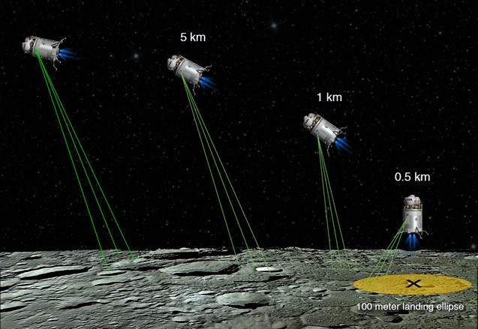
Navigation Doppler Lidar (NDL)
Utilizes FMCW technique to measure velocity and range along three laser beams
Simultaneous line-of-sight measurements are used to estimate:
  Velocity Vector (V)
  Altitude relative to local ground (No external data required)

Slide 3
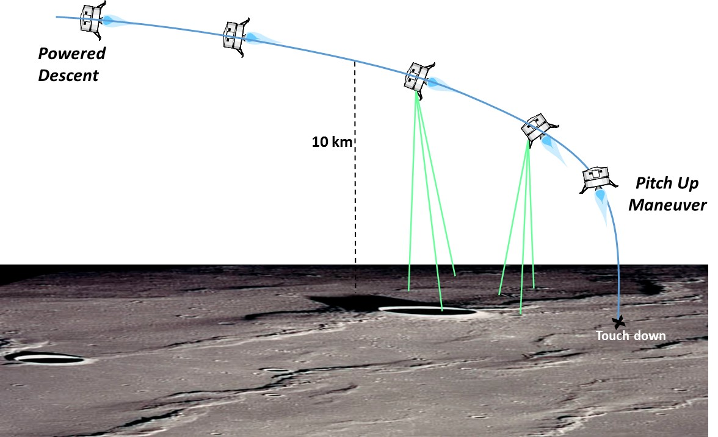
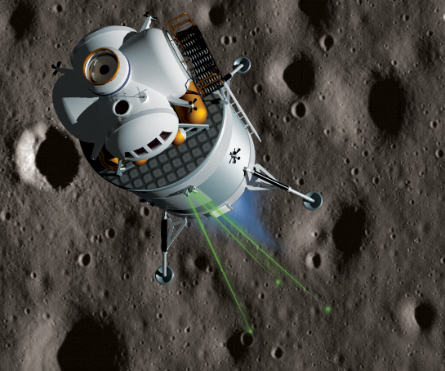
NDL Enables New Landing Capabilities
  Viable replacement for radars with an order of magnitude higher precision and much better data quality
  NDL enables “precision navigation” to the designated landing location
  NDL enables “well-controlled” descent, landing, and ascent maneuvers to within a few cm/sec

Slide 4
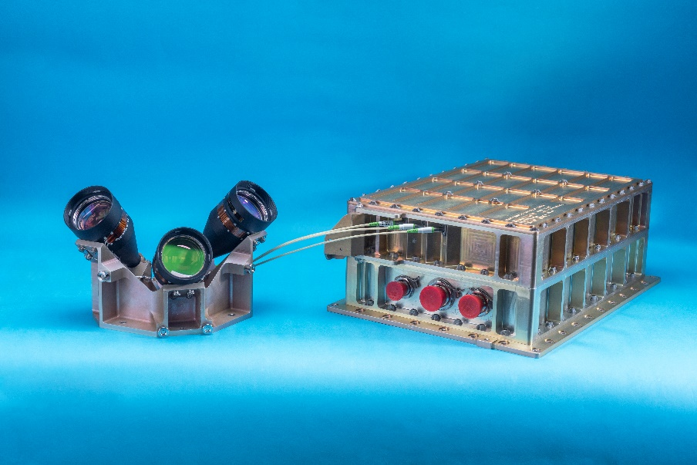
Spaceflight Engineering Test Units (ETUs)
  4 ETUs have been built and tested
  # 1 – Aircraft flight tests and integrated tests with other avionics
  # 2 – Suborbital flight test on Blue Origin New Shepard vehicle (Summer 2021)
  # 3 – Lunar Landing Demonstration onboard Intuitive Machines lander (Winter 2022)
  # 4 – Lunar Landing Demonstration onboard Astrobotic lander
  (Spring 2022)
Optical Head
Chassis

Slide 5
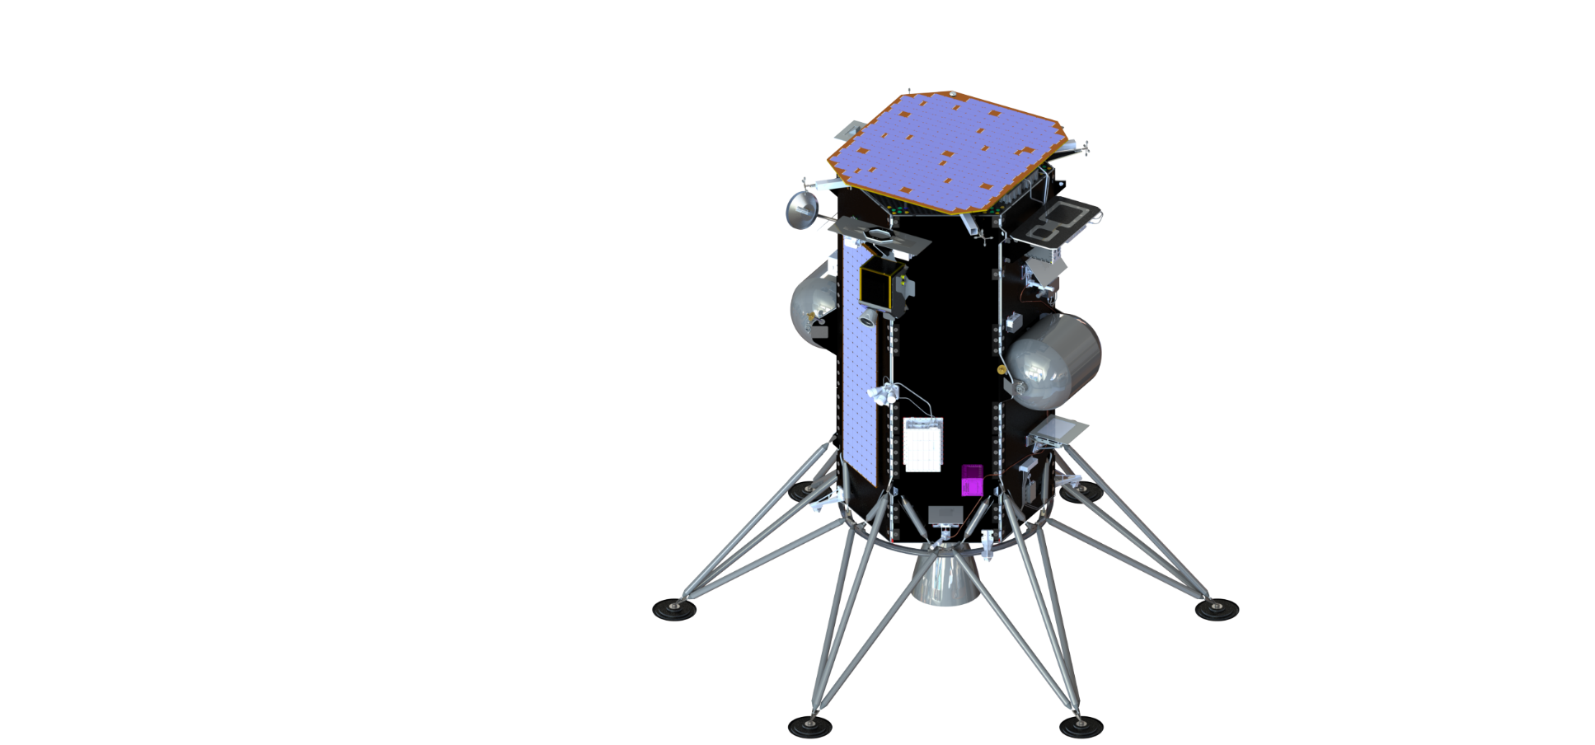
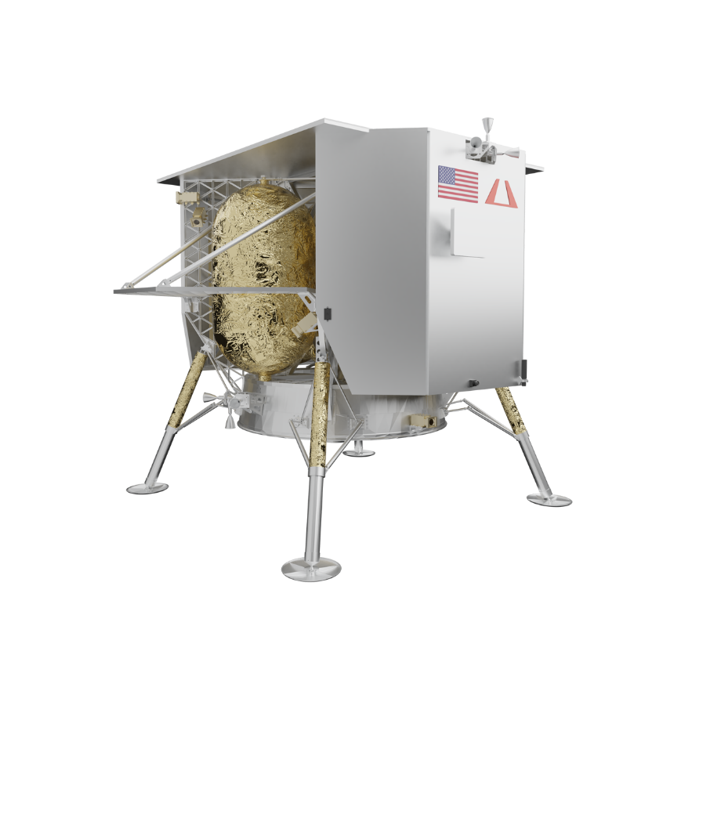
Demonstration Missions
Suborbital Flight
Lunar Landing Mission
NDL
Blue Origin
New Shepard Vehicle
Intuitive Machines
Nova-C Vehicle
Astrobotic
Peregrine Vehicle

Slide 6
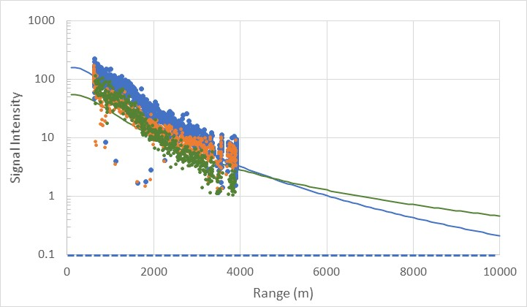
Maximum Operational Range
Signal intensity measured over a horizontal path at ~ 2 m above the ground
  Highly susceptible to atmospheric turbulence, absorption, and scattering
Maximum operational range in Moon environment is extrapolated from measured data
  No atmosphere
  0.2 surface albedo
Measured Data Points
Lidar Equation
  Target reflectivity = 0.5
  Visibility = 23 km
  Turbulence C_{n}² = 10⁻¹⁴
Moon Projection
Threshold

Slide 7
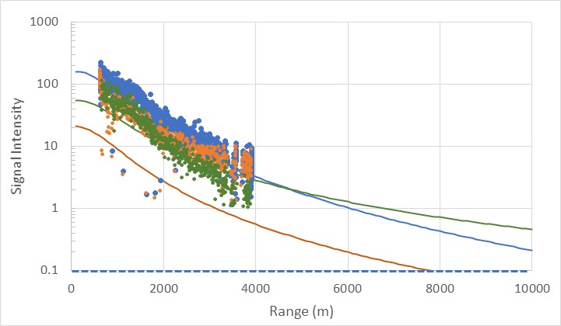
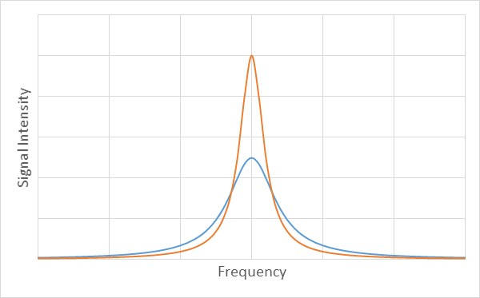
Vehicle Vibration Impacts
  Vibration broadens signal frequency spectra and lowers its peak intensity
    Reduces maximum operational range
    Increases measurement noise
  Measured signal frequency broadening at different vibration loads
Signal spectra broadening with vibration
No vibe
Moon with no vibe
Lidar Equation
Moon with vibe
With vibe

Slide 8
NDL Error Budget
LOS Velocity and Range Errors
Accuracy (Bias Error)
Precision (Noise)
Laser Frequency Knowledge
Laser Frequency Drift
Modulation Waveform Linearity
Beam Pointing Knowledge
SNR
Body Acceleration
Body Rotation Rate
Body Vibration
Laser Frequency Linewidth
Signal Processing Resolution
Dominant bias error source is beam pointing knowledge
Dominant noise source is vehicle vibration

Slide 9
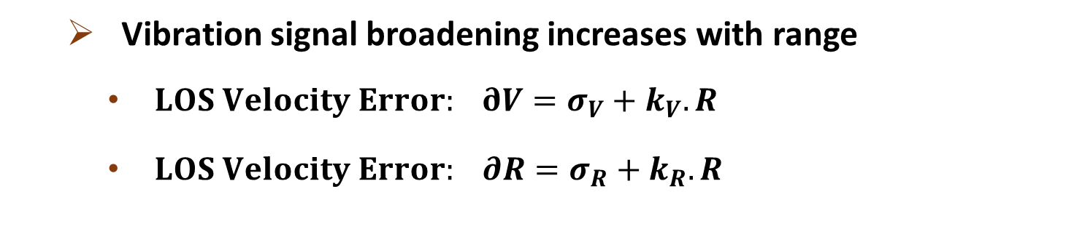
Vibration-Induced Measurement Error
  Vibration signal broadening increases with range
    $LOS Velocity Error: ∂V=σ_{V}+k_{V}.R$
    $LOS Velocity Error: ∂R=σ_{R}+k_{R}.R$
Signal spectra broadening with vibration
No vibe
With vibe

Slide 10
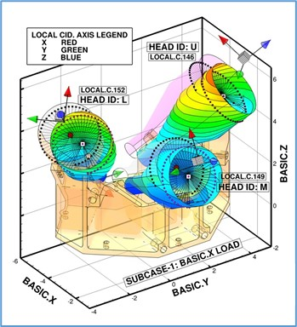
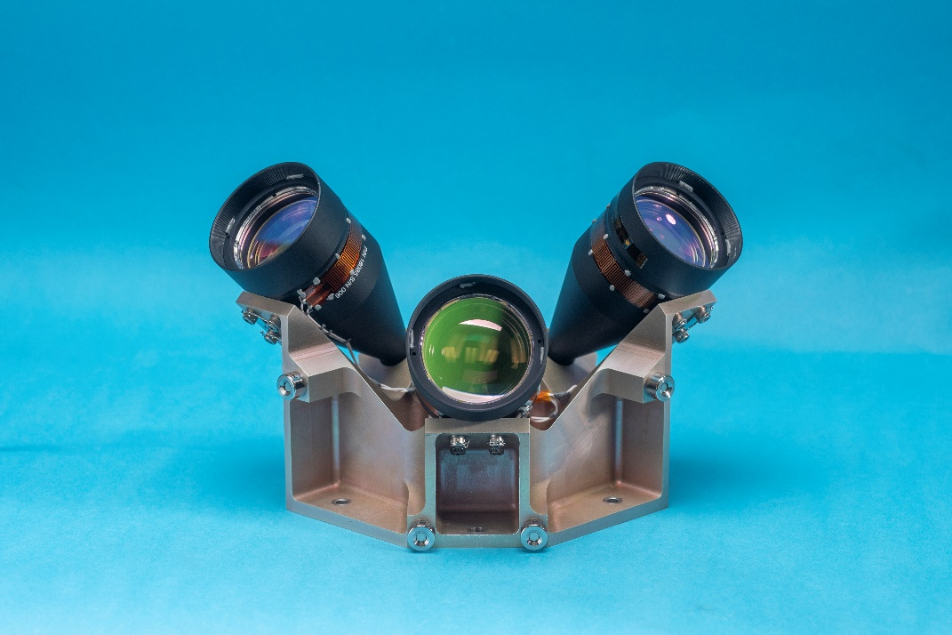
Beam Pointing Knowledge Error
Major sources of beam pointing knowledge error:
  Beam pointing registration error
  Thermal expansion of Optical Head
  Telescope displacement due to launch loads
  Vehicle flexing and thermal effects
Performed full Structural, Thermal, Optical, Performance (STOP) analysis

Slide 11
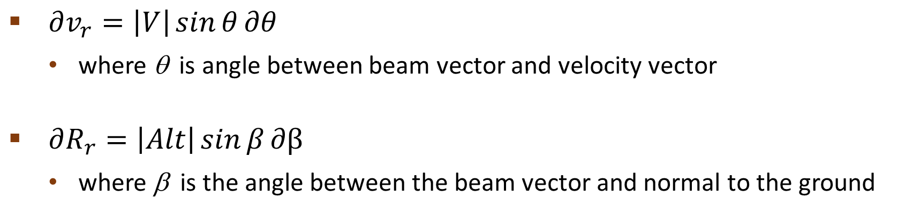
Measurement Errors Due to Beam Pointing Knowledge Error
$∂v_{r}=\left|V\right|\sin{θ}∂θ$
  where θ is angle between beam vector and velocity vector
$∂R_{r}=\left|Alt\right|\sin{β}∂β$
  where β is the angle between the beam vector and normal to the ground
θ
β
Velocity Vector
Laser Beam Pointing Vector

Slide 12
Concluding Remarks
  NDL can provide critical vehicle velocity and altitude data for precision soft landing on the Moon, Mars, and other solar system bodies
  Completed 4 ETUs of NDL for suborbital and lunar landing demonstration
  Performance of the NDL is dominated by the vehicle vibration and thermal environments
    Vehicle vibration impacts maximum operational range and measurement precision
    Thermal and vibration environments impacts measurement bias error
  Conducted a series of tests and analyses to estimate the NDL performance for lunar landing
  Landing vehicle dynamics increase NDL velocity and range errors from 2 mm/s and 17 cm by more than an order of magnitude

Slide 13
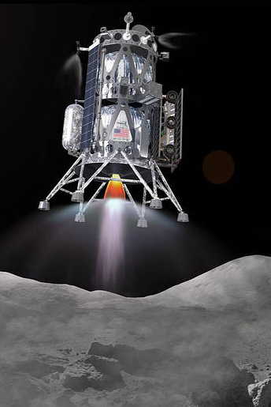
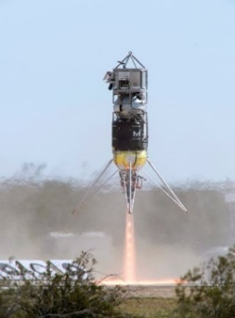
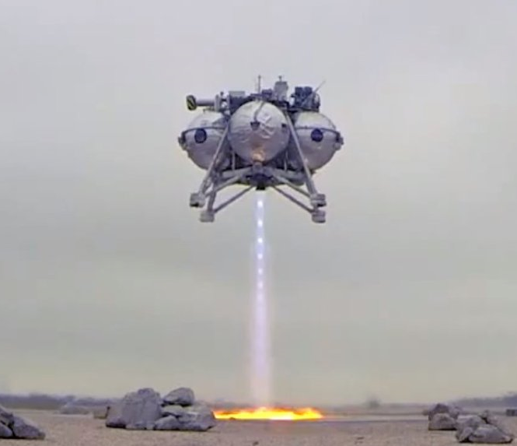
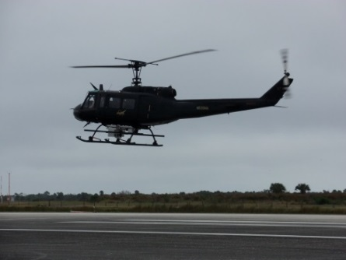
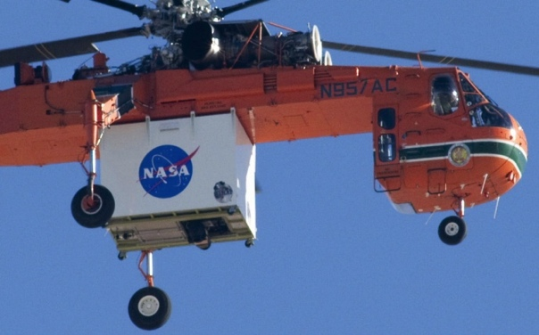
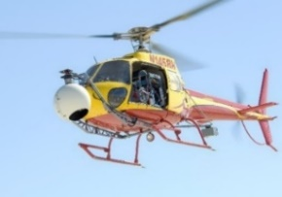
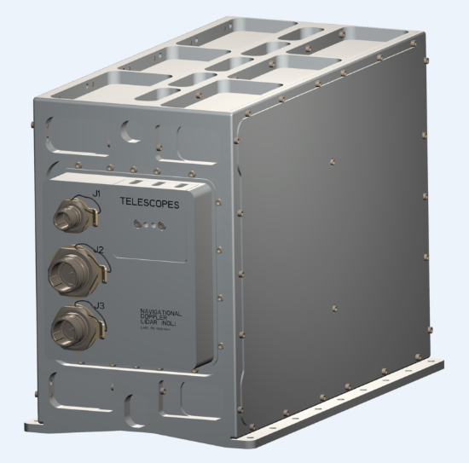
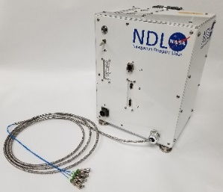
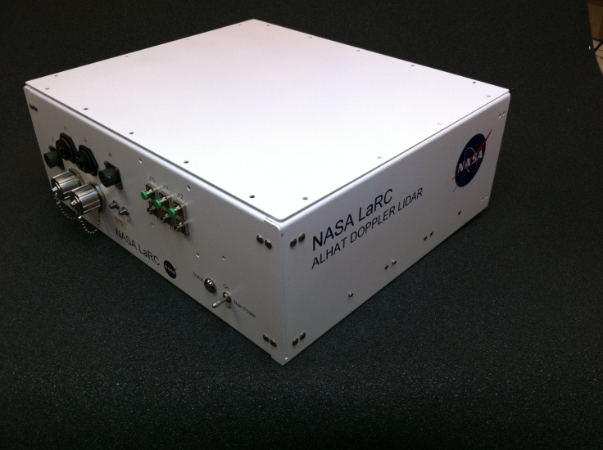
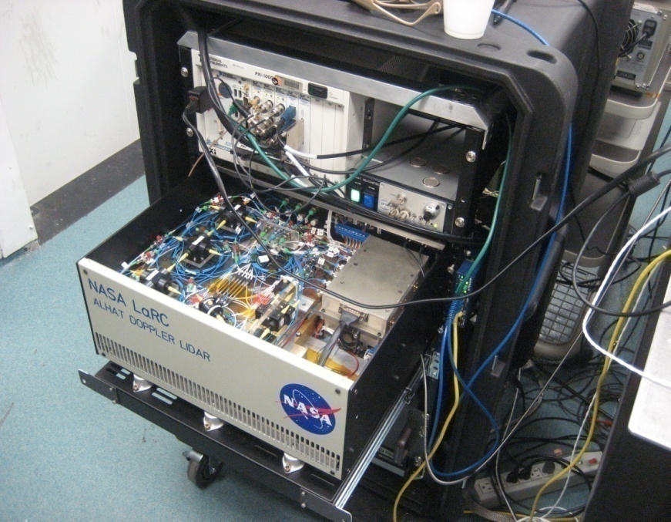
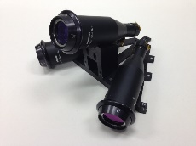
NDL development from breadboard to Spaceflight Unit
2022
2017
Spaceflight Engin. Unit
2014
2012
GEN 4: 11 kg
Fully-Autonomous Prototype
GEN 3: 10 kg
2010
GEN 2.1: 17 kg
2008
GEN 2: 28 kg
Breadboard w/o real-time processing
GEN 1: ~ 60 kg
~200 kg

Slide 14
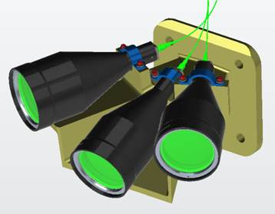
NDL ETU Specifications
Chassis
Maximum LOS Range on Moon |  | 7 km
Maximum LOS Velocity |  | 210 m/sec
LOS Velocity Error¹ |  | 0.2 cm/sec
LOS Range Error¹ |  | 25 cm
Data Rate |  | 20 Hz
Dimensions | Electronic Chassis | 15.8” X 11.4 “ X 5.9”
 | Optical Head² | 9.6” X 7.6” X 5.1”
Mass | Electronic Chassis | 13.0 kg
 | Optical Head | 2.2 kg
Power (28 VDC) |  | 85 W
5.9”
14.7”
11.4”
Optical Head
Vehicle induced errors not included.
Optical head design varies depending on vehicle and descent trajectory
9.6” x 7.6” x 5.1”

