Slide 1

Pragmatic Stress Prediction on Additively Manufactured Coupons
Kevin Wheeler (presenter), Jeremy Aires, Ken Gee, Vasyl Hafiychuk & Halyna Hafiychuk
Research Engineer
Intelligent Systems Division
The National Aeronautics and Space Administration
Ames Research Center
Moffett Field, CA

Slide 2

Presenter Biography
Kevin Wheeler
Kevin Wheeler earned his PhD in Electrical Engineering from the University of Cincinnati in 1996. He leads the Applied Physics Group at The National Aeronautics and Space Administration (NASA) Ames Research Center in Moffett Field, CA. The group specializes in computational multi-physics modeling of many different systems such as ultrasonic interrogation of composites, additive manufacturing, cryogenics and non-linear material responses. Computational models have been built for additive manufacturing processes such as polymer fused deposition, powder-bed fusion and direct energy deposition of super alloys. The group has expertise in utilizing a variety of simulation tools such as COMSOL Multiphysics, ABAQUS, ANSYS, ALE3D and LAMMPS.

Slide 3
Thanks
Special thanks to:
Thomas Gnaupel-Herold, NIST - Neutron diffraction measurements
David L. Ellis, NASA Glenn Research Center, Metallurgical analyses
John Fikes, NASA Marshall Space Flight Center, Co-I RAMPT Project
Paul Gradl, NASA Marshall Space Flight Center, Co-I RAMPT Project
Bhaskar Dutta DM3D Technology

Slide 4
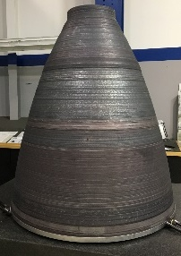
Goals & Approach
Goals:
Develop methods capable of scaling from cm scale to meters.
Validate predictions on printed coupons.
Lay the foundation for bi-metallic stress analyses.
Approach:
Print coupons in Inconel-625.
Develop pragmatic method within COMSOL, ABAQUS & ALE3D.
Develop similar model in ANSYS Additive (intrinsic stress).
Predict residual stresses across all codes and coupons.
Measure stresses using X-ray diffraction.
Measure stresses using neutron diffraction (NIST).
Comparisons presented.

Slide 5
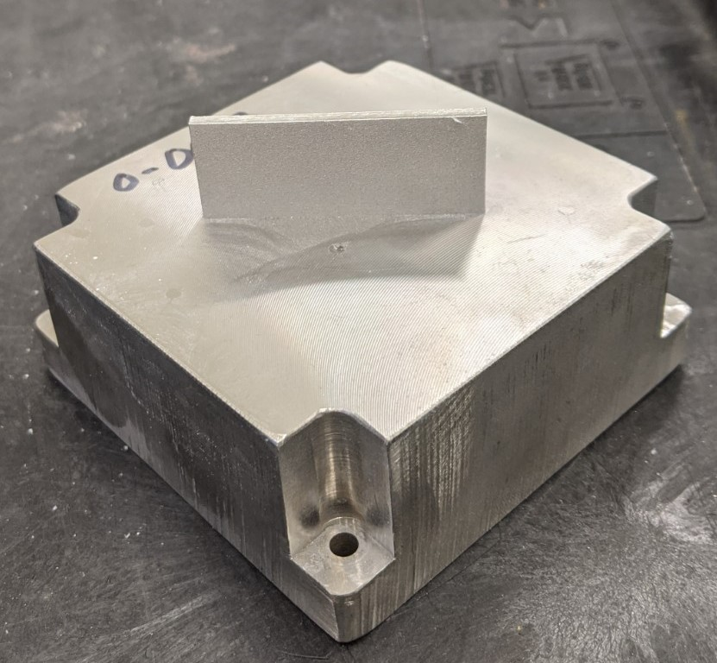
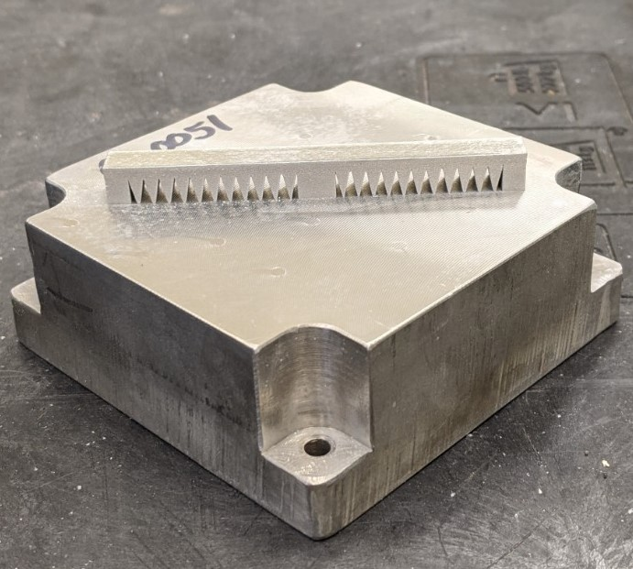
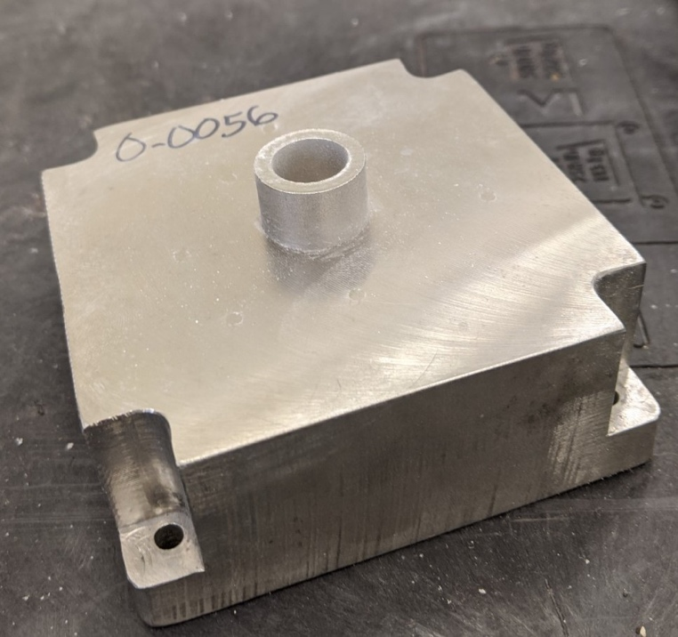
Metal Additive Coupons
Objectives:
Comparison of pragmatic stress prediction method with intrinsic stress method.
Implement and compare across commercial codes: COMSOL, ABAQUS, ALE3D, ANSYS Additive.
Three benchmark coupons manufactured in IN-625 via Powder-bed Fusion Concept Laser M2 Cusing.
Thin Wall
50 x 2.54 x 20 mm (LxWxH)
Twin Cantilever
Beam: 80 x 7.27 x 2.18 mm (LxWxH)
Main Pillar: 7.27 x 7.27 x 5.82 mm
Support pillars: 4.3 x 7.27 x 5.82 mm
  Hollow Cylinder
  ID: 13 mm
  OD: 19 mm
  Height: 12 mm

Slide 6
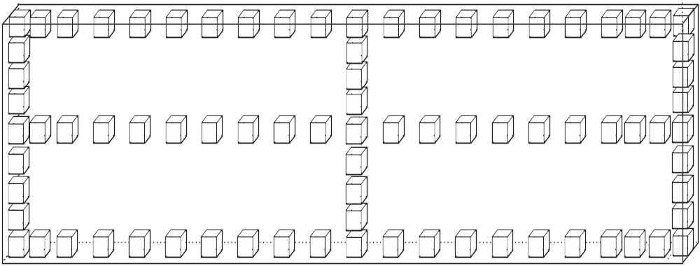
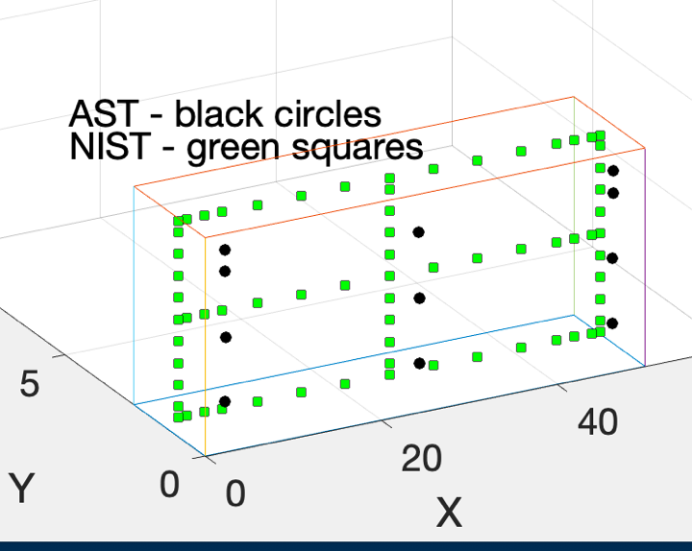
Measurements – Thin Wall
X-ray Diffraction
Neutron Diffraction
X-ray depth:
200μm
Neutron depth: 750μm
2mm
4mm
10mm
16mm

Slide 7
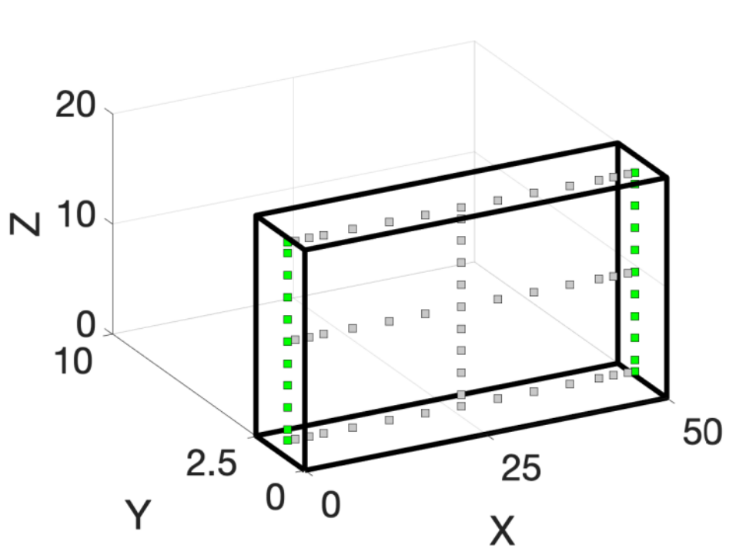
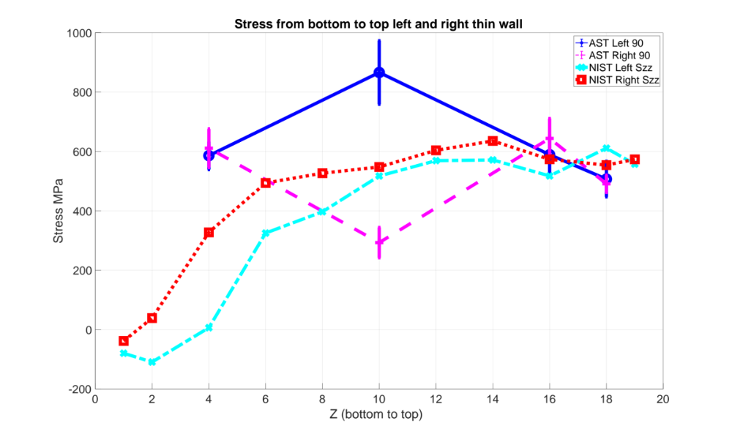
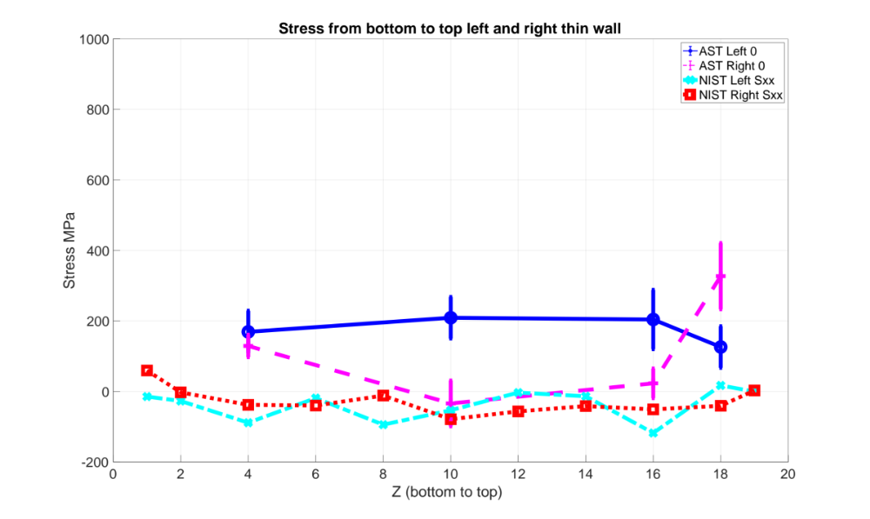
Thin Wall Stress Measurements
Szz
Sxx

Slide 8
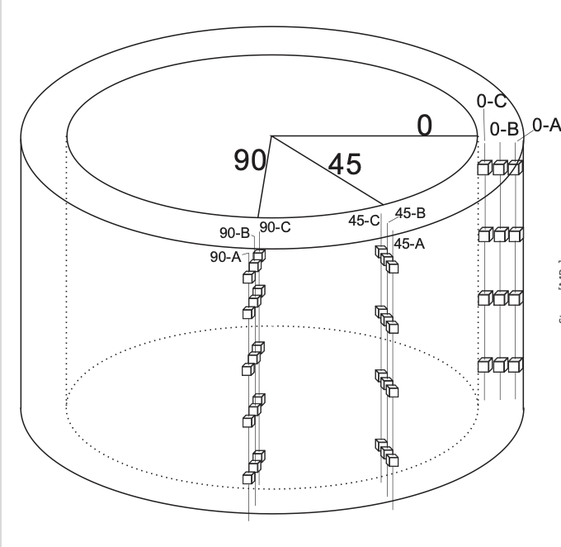
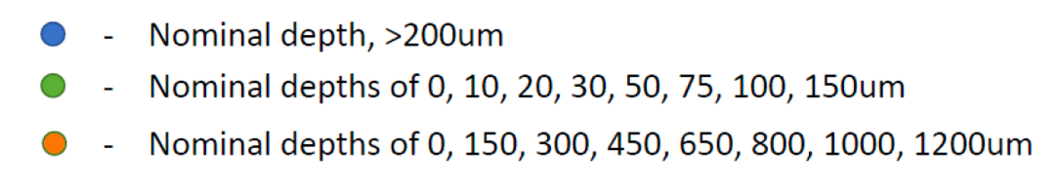
Measurements - Cylinder
X-ray measurements
Neutron measurements

Slide 9
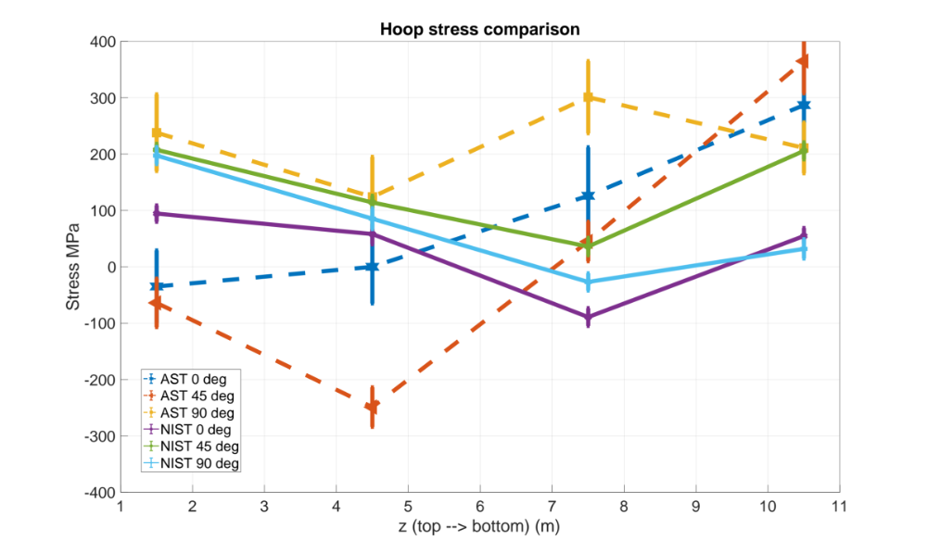
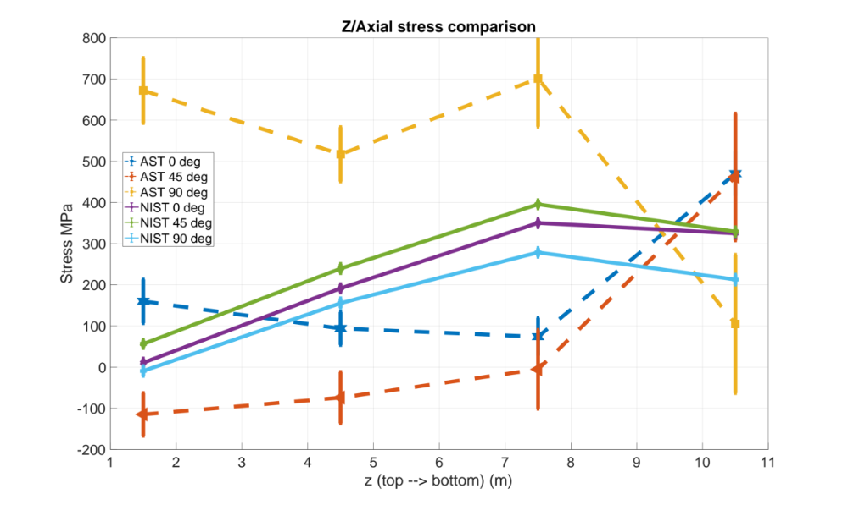
Cylinder Hoop & Axial Stresses
Hoop Stress
Axial Stress

Slide 10
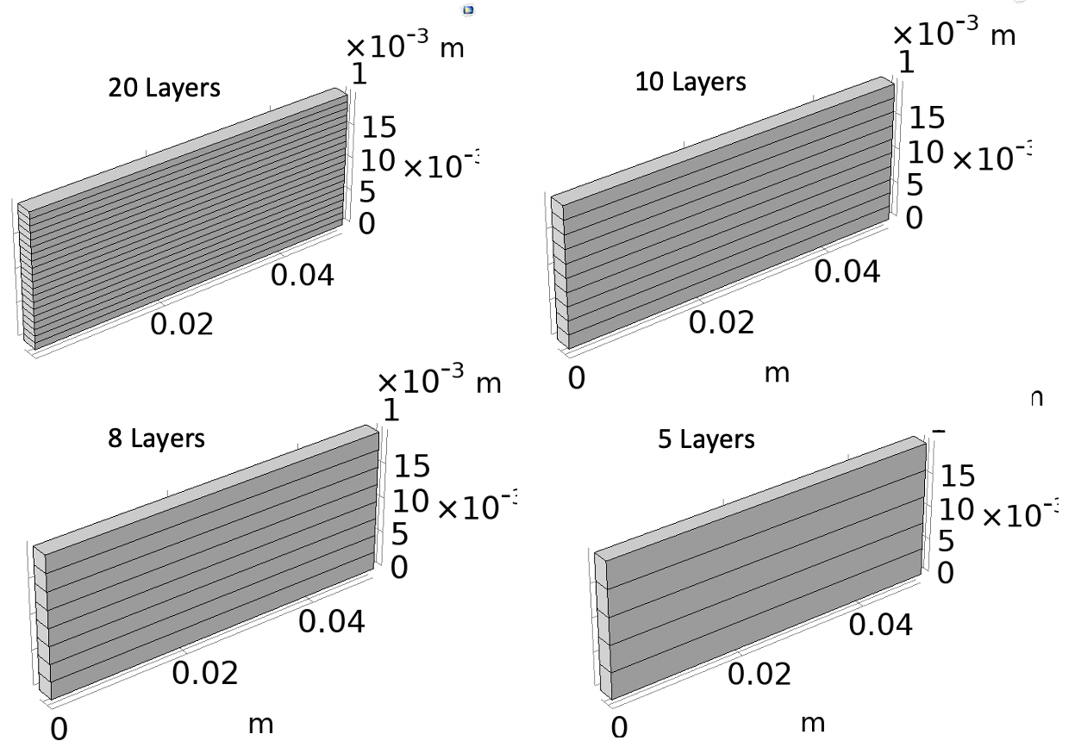
Simulations – Pragmatic Approximation
Steps:
Lumped temperature layers are heated and cooled representing several real layers simultaneously.
Thermal field history is fed into structural mechanics code to calculate stresses.
Fewer number of lumped layers is faster to compute, but suffers in accuracy of stress prediction.
Cooling rate of lumped layers must be determined for application.
A Pragmatic Part Scale Model for Residual Stress and Distortion Prediction in Powder Bed Fusion, Richard J. Williams, Catrin M. Davies, Paul A. Hooper, Additive Manufacturing, Vol. 22, August 2018, pp. 416-425.

Slide 11
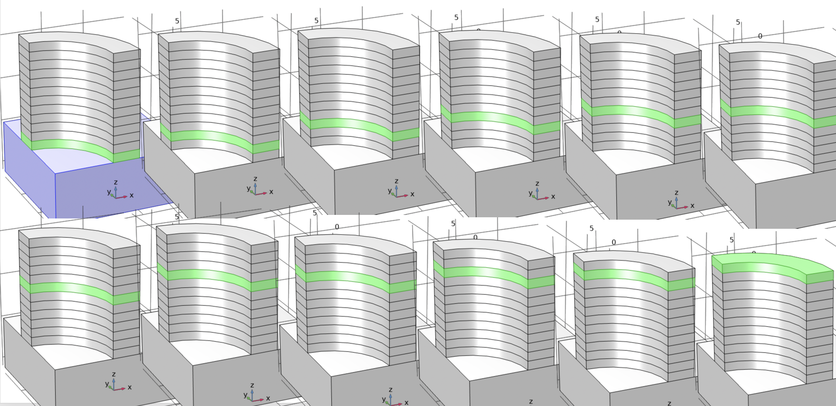
Cylinder lumped layers

Slide 12
Conditions at 5th layer in cylinder
Heating a layer Convection surface of active layer Symmetry conditions Heat loss

Slide 13
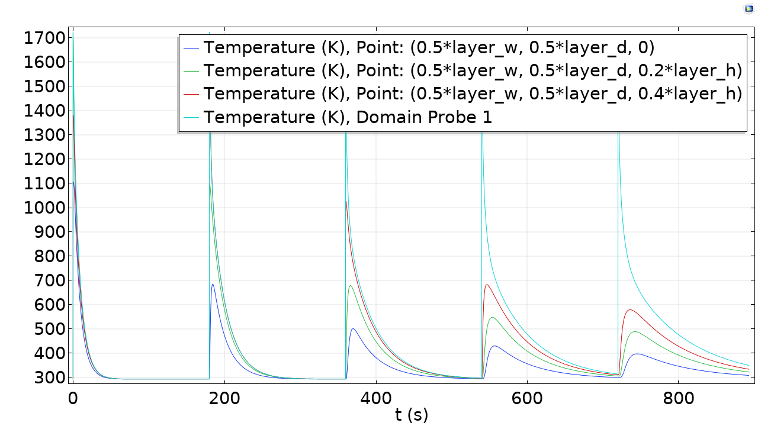
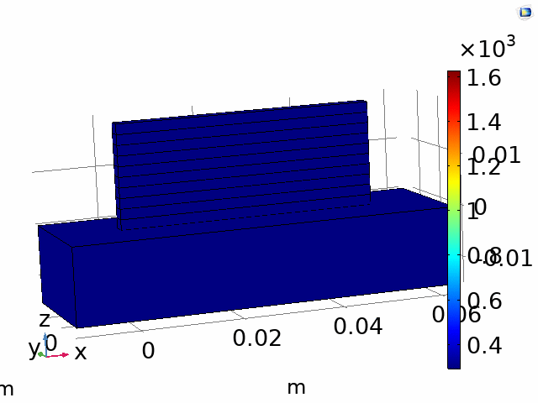
Thermal behavior in pragmatic approximation
Lumped layer heating

Slide 14
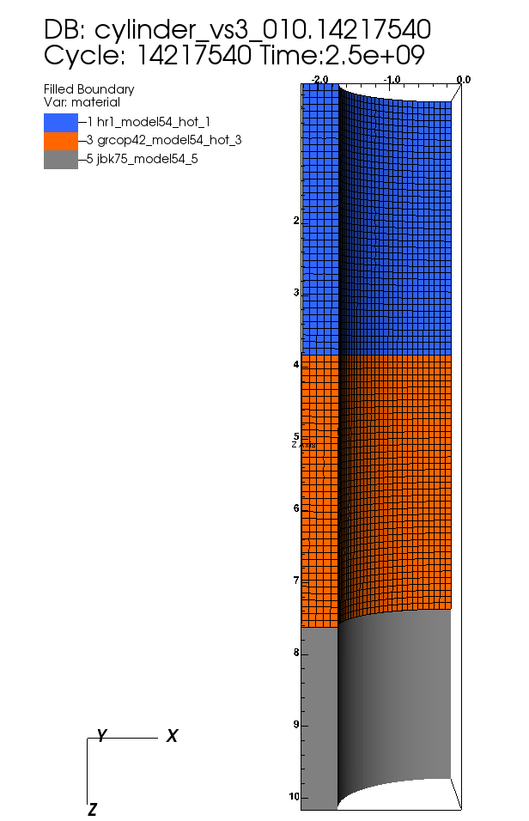
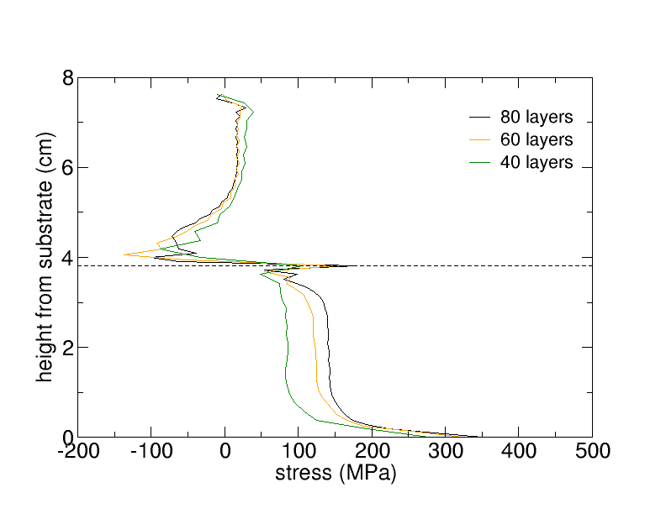
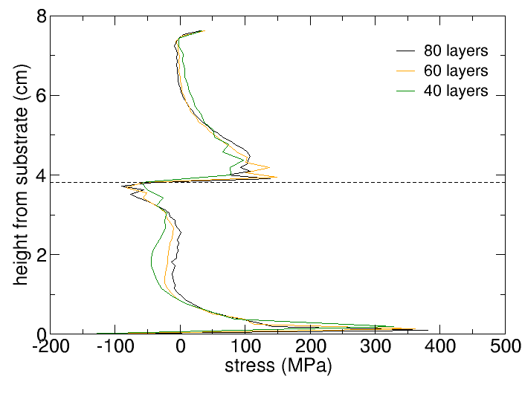
Effect of 80, 60, 40 lumped layers
Number of layers | Wall clock hours | Number of cores
80 | 84 | 10
60 | 60 | 10
40 | 20 | 10
Hoop Stress
Axial Stress
Bi-metallic cylinder with GrCop-42 lower half and HR-1 upper half.
Axial stress in copper changed almost 100 MPa and computation time from almost 1 day to 3.5 days.

Slide 15
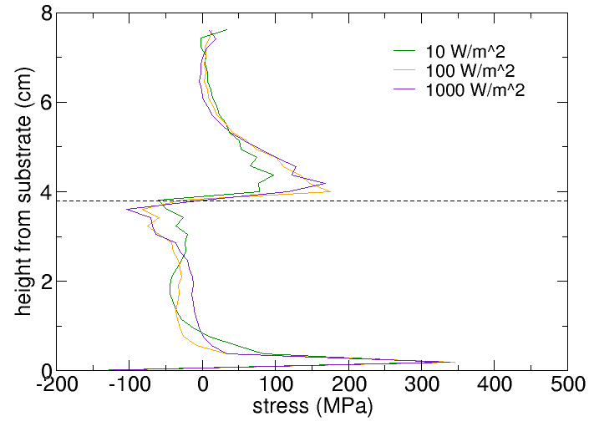
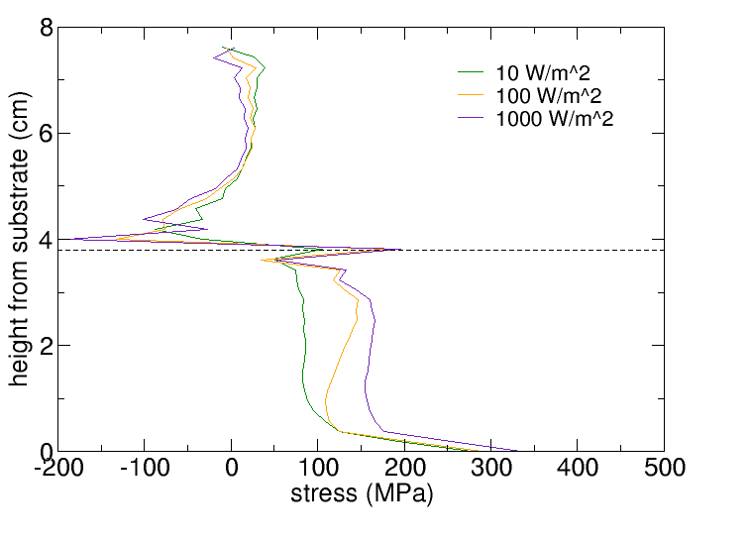
Convective heat transfer
Cooling rates for lumped layer from 10, 100, 1000 W/m^2 affected stress significantly.
Pragmatic method requires careful calibration of the convective transfer coefficient either with experiment or with finer scale simulations.
Hoop stress
Axial stress

Slide 16
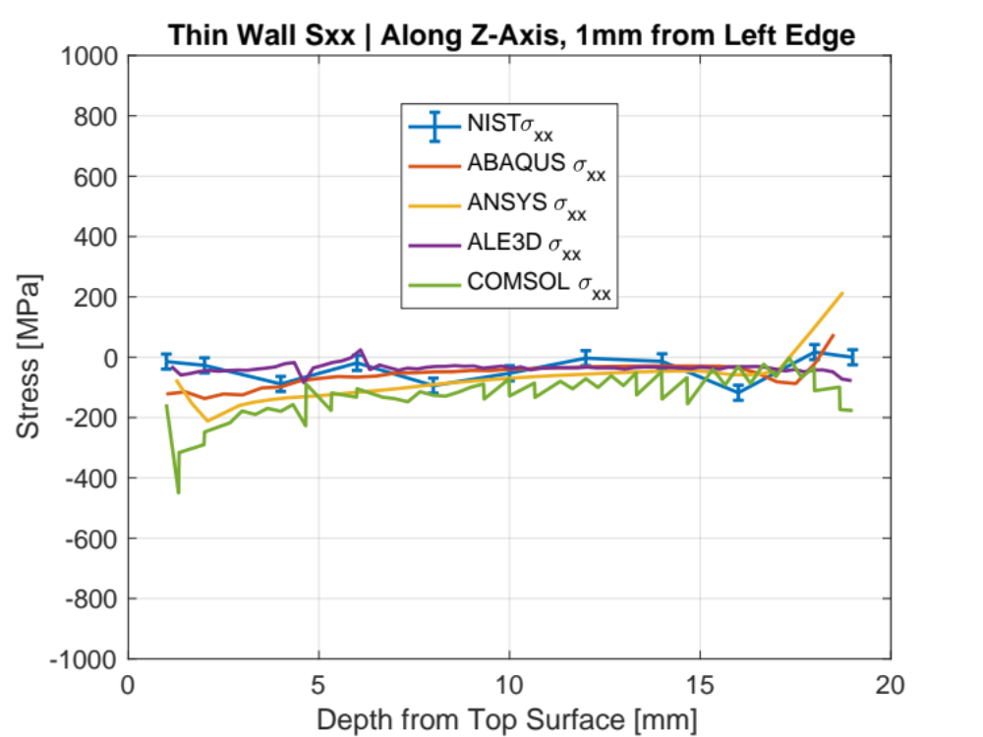
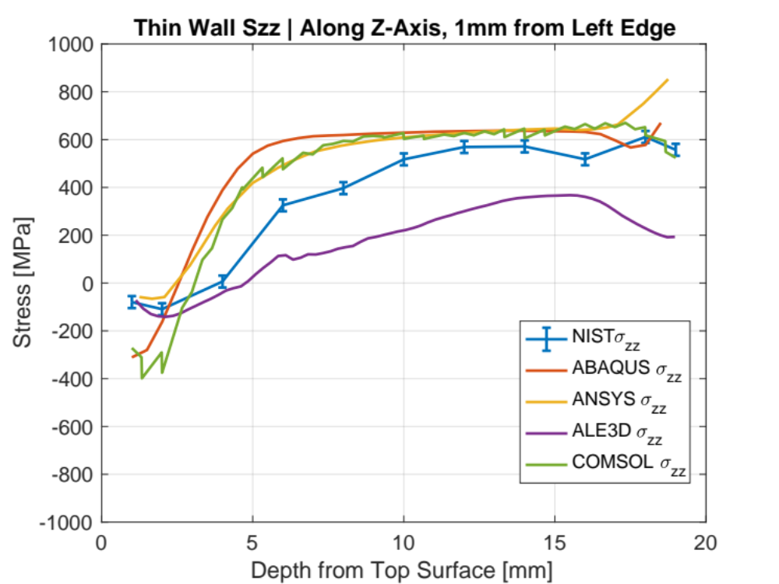
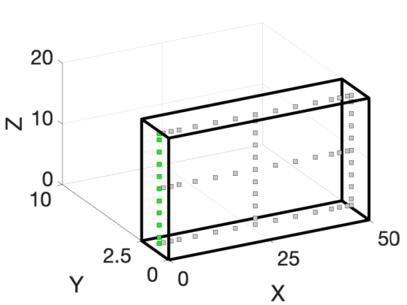
Thin wall simulation results
Left Edge

Slide 17
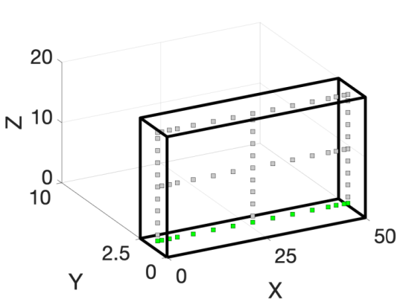
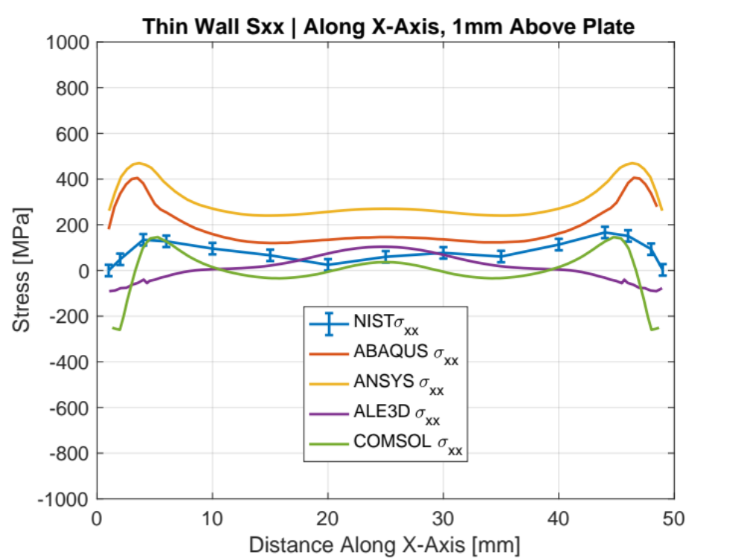
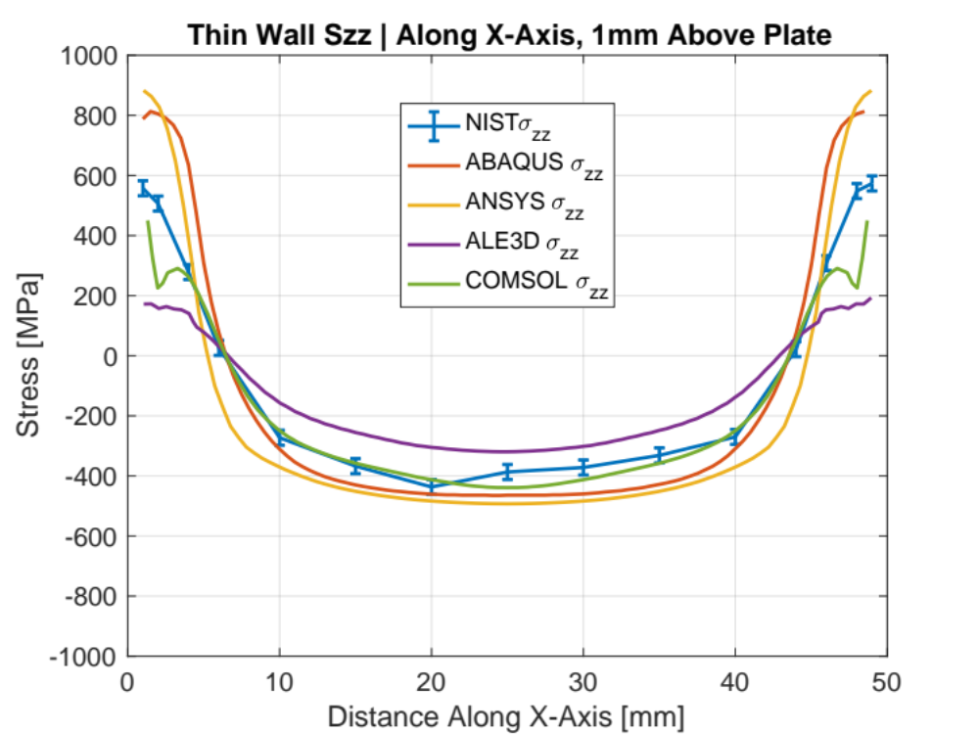
Thin wall simulation results
Bottom horizontal

Slide 18
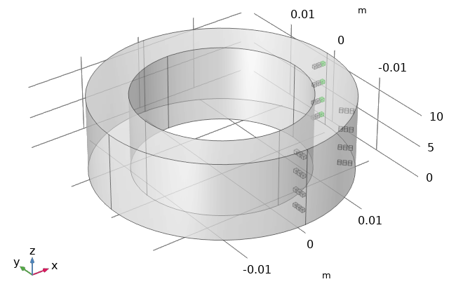
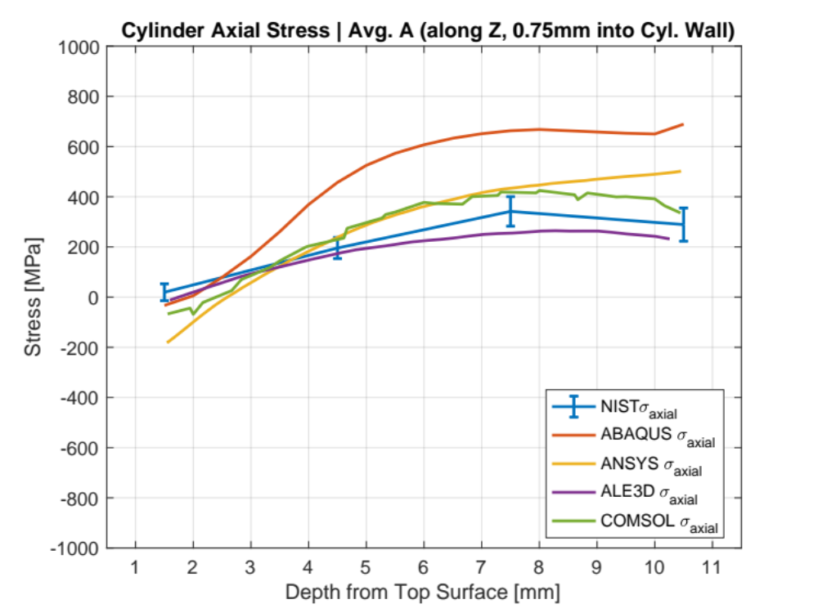
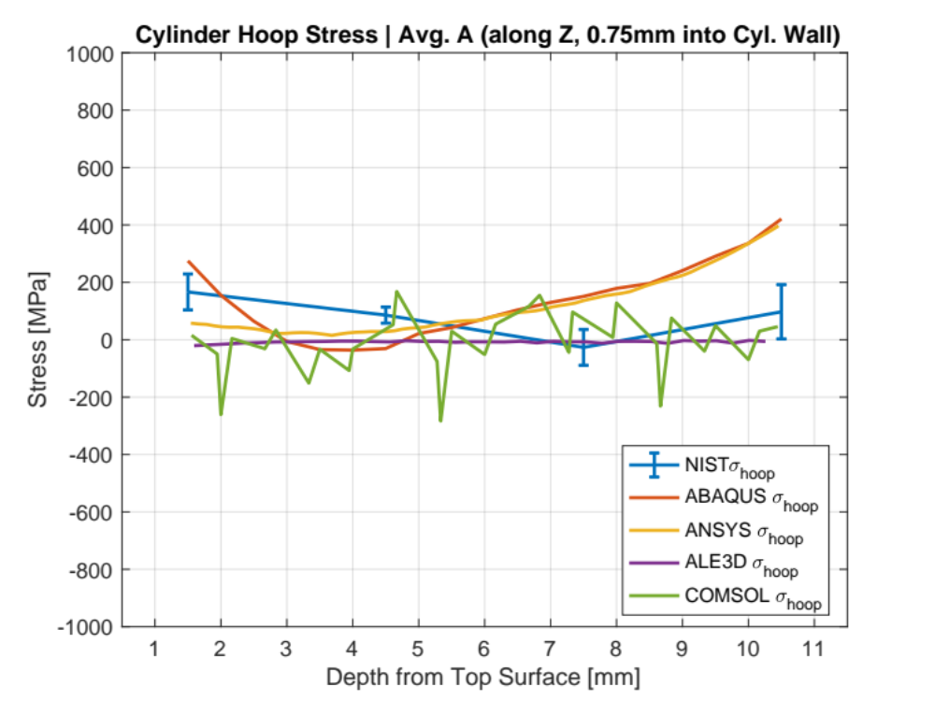
Cylinder simulation results
0 degrees, 0.75 mm deep

Slide 19
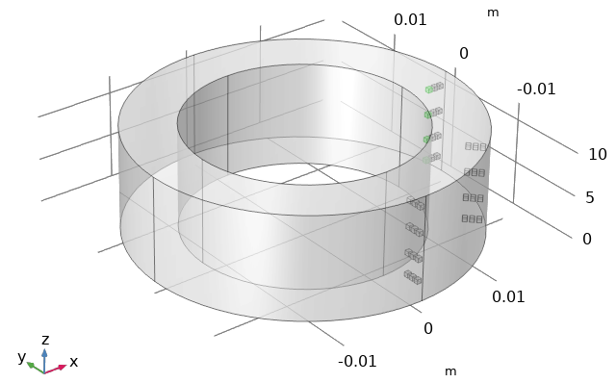
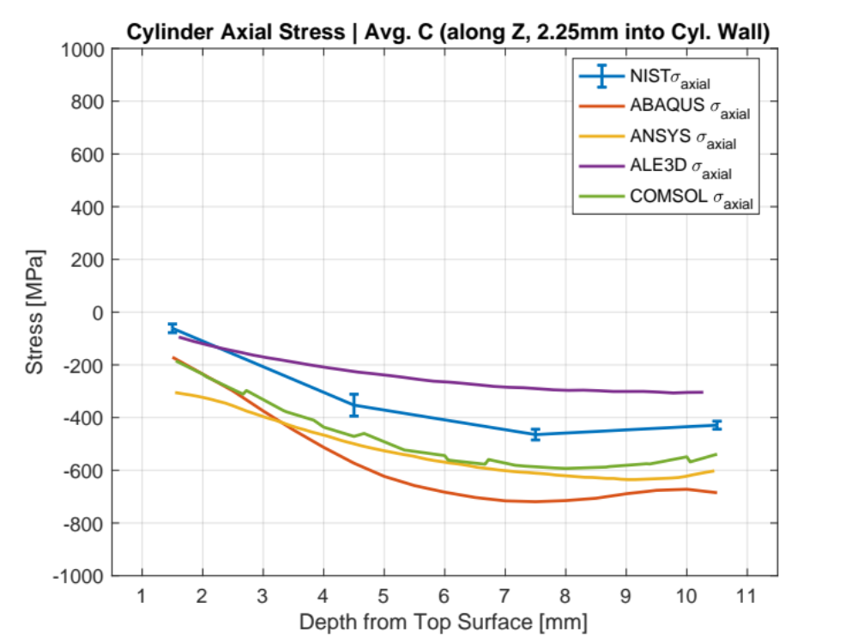
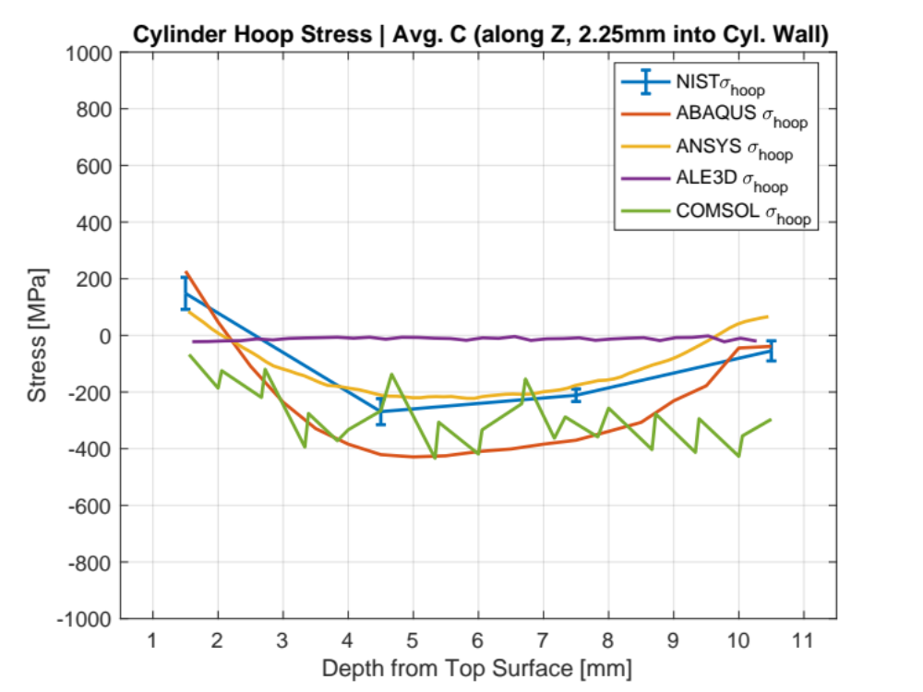
Cylinder simulation results
0 degrees, 2.225 mm deep

Slide 20
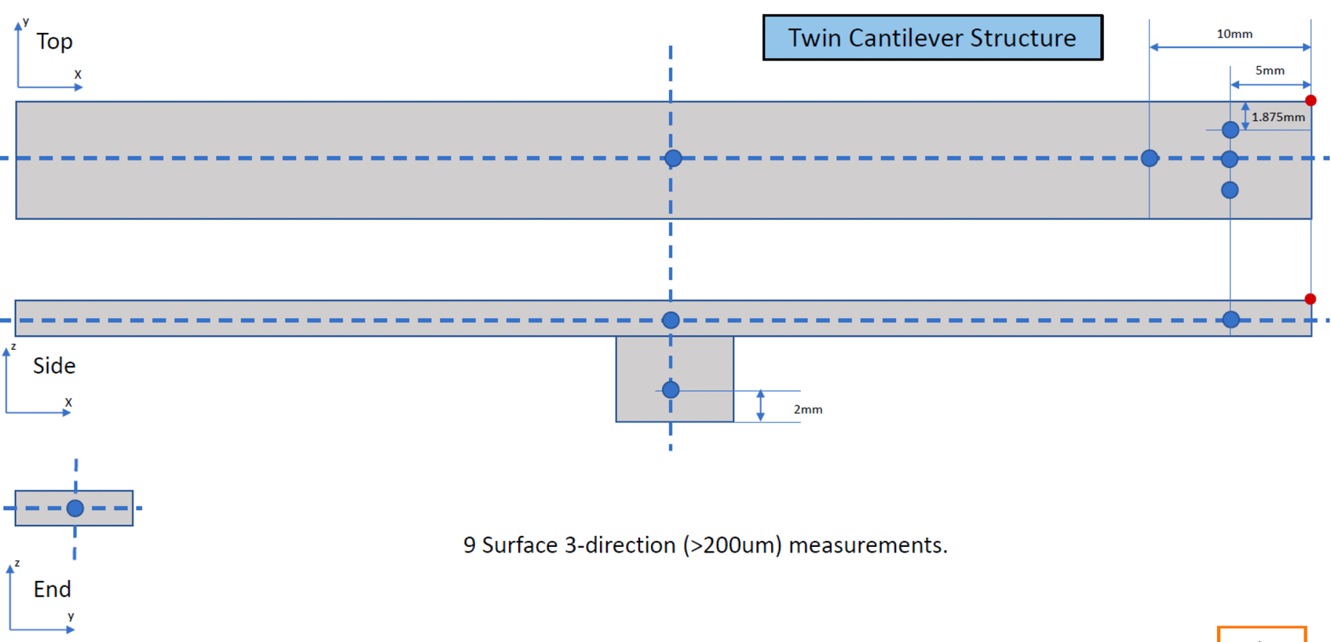
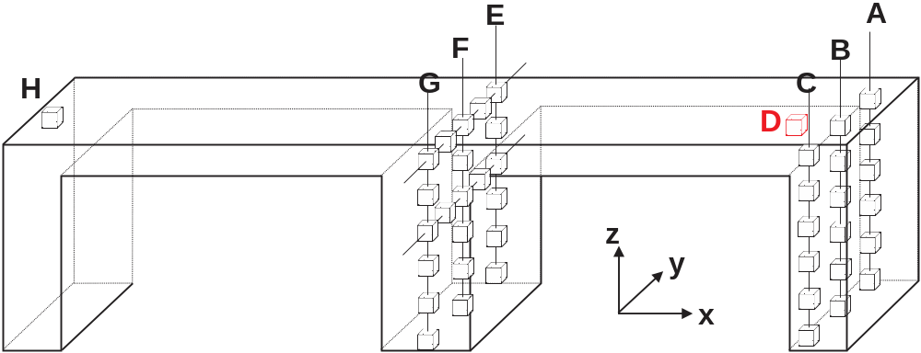
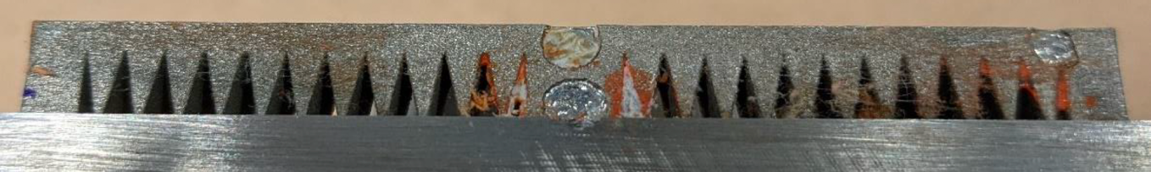
Measurements – Twin-cantilever
X-ray
Neutron

Slide 21
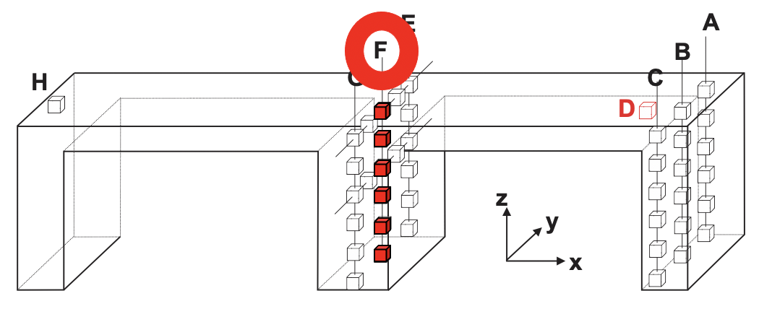
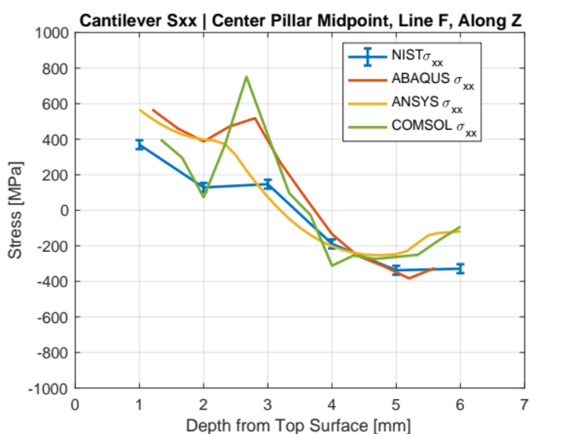
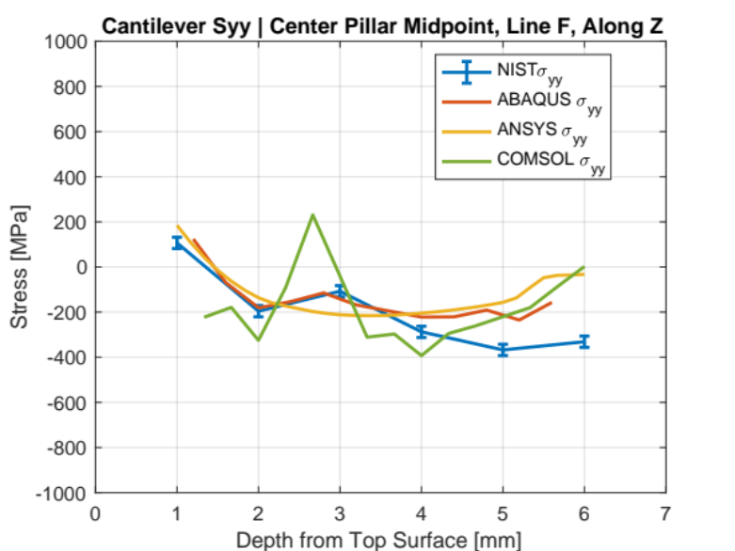
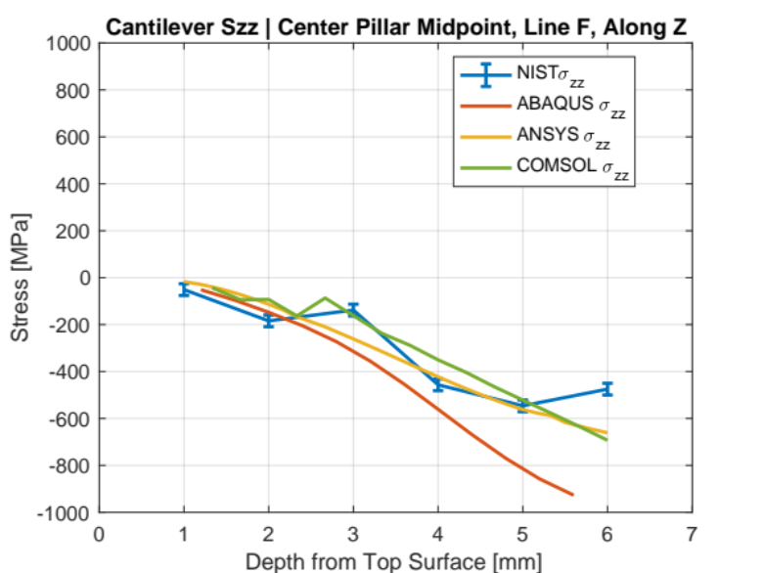
Cantilever simulation results
Column F, mid-cantilever

Slide 22
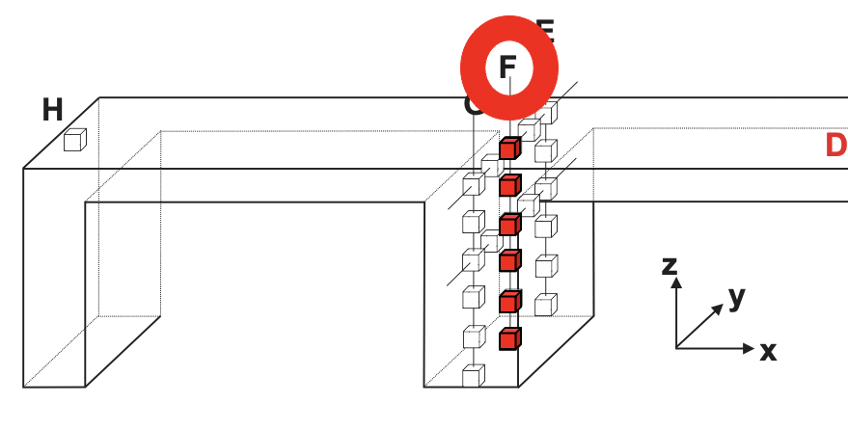
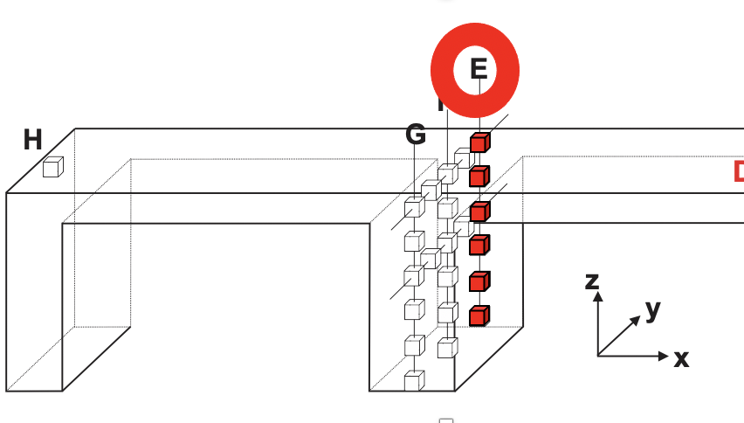
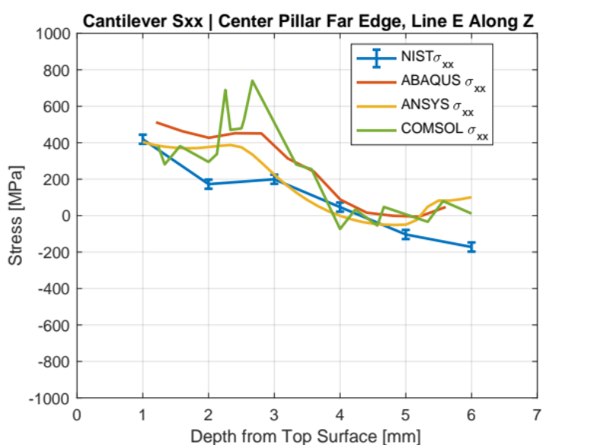
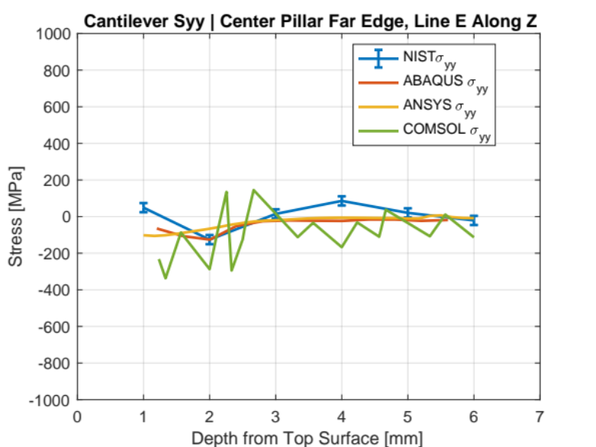
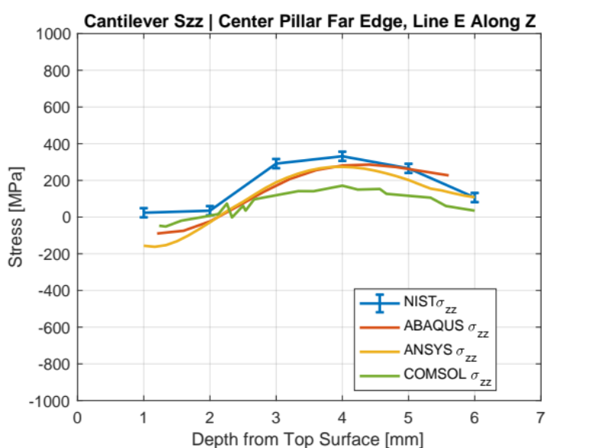
Cantilever simulation results

Slide 23
Large nozzle liner
Comparison results for a wide diameter down and up orientations for a single head deposition
Nozzle is 2.8 m tall (approximately 9 feet)
Manufactured by DM3D Technology with DED robot.
One month build time.
Questions simulations answered:
  Question: Which orientation (wide end down or up) will result in least distortion?
  Question: Can dual heads be used without changing stresses?
  Question: How should size of part be modified to mitigate distortion?

Slide 24
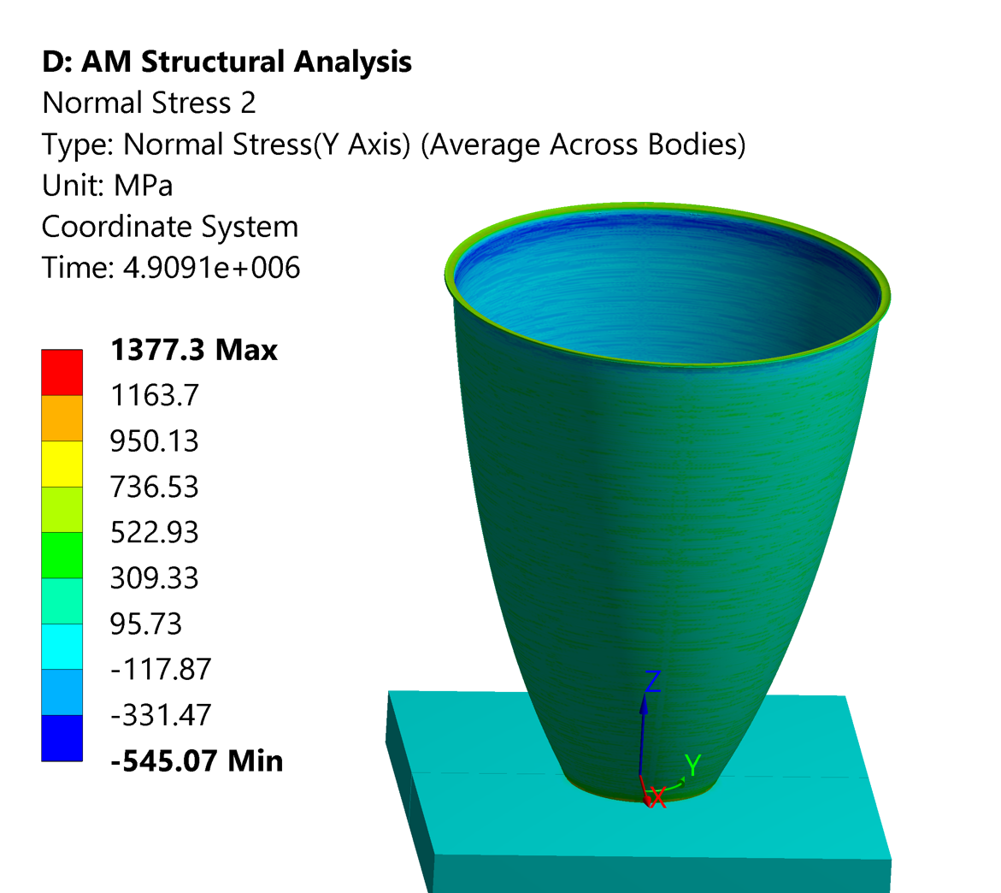
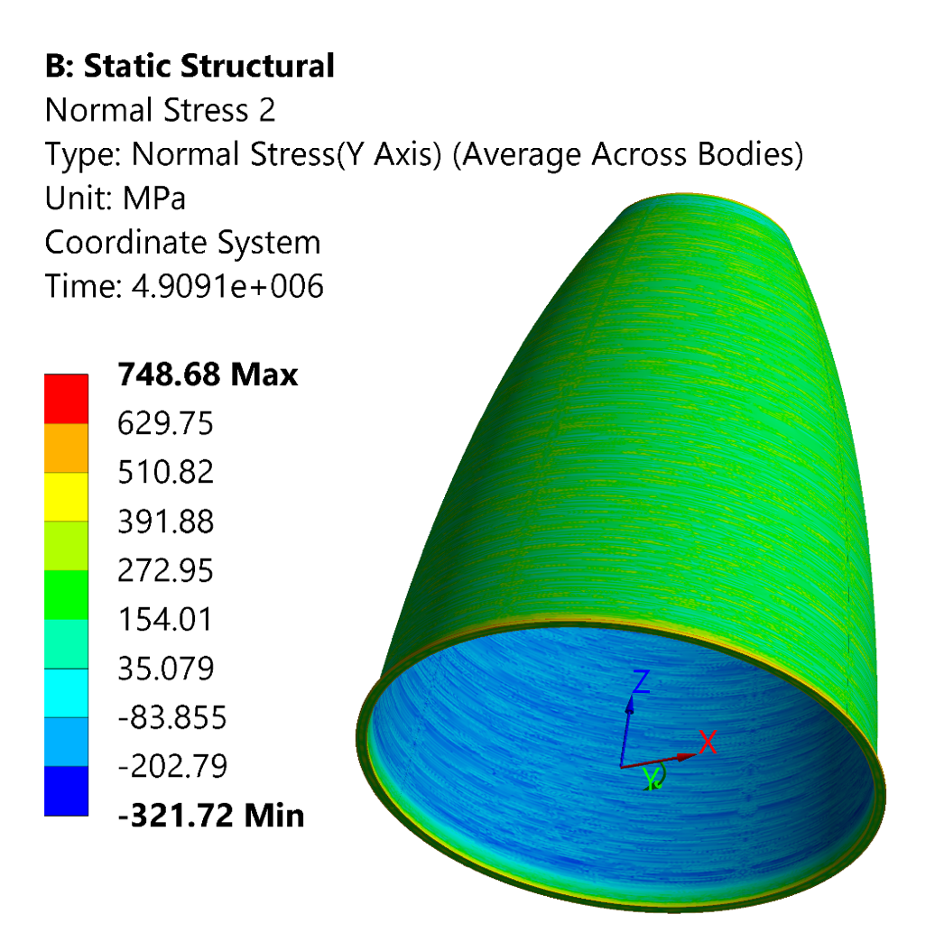
Large nozzle liner orientation result
Hoop Stresses
Conclusion: optimal build orientation should be built large end down on base plate.

Slide 25
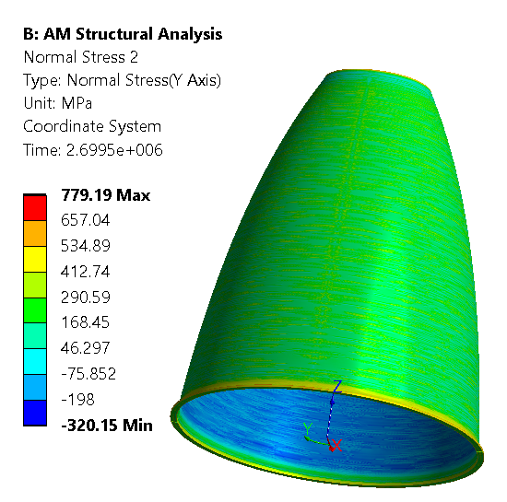
Large nozzle liner single vs dual head result
Single Deposition Head
Dual Deposition Head
Hoop Stresses
Dual deposition heads results in similar stress.

Slide 26
Code challenges implementing pragmatic method
ALE3D a method had to be developed to define the geometry and add each lumped layer into the solution at the correct temperature. To get the correct temperature, the pragmatic layer had to replace material in the grid that was also at that temperature by using a placeholder material with thermal conductivity set to a very small number which kept the temperature of the placeholder material at the desired value so that when the lumped layer was introduced, it had the desired initial temperature.
ALE3D had to use mass scaling to compute solutions in a reasonable amount of time. It was a tricky process to determine the max value of the scaling parameter (too high, and the solution starts to diverge, but only towards the end of the solution time). The scaling parameter was also a function of the material properties.
COMSOL does not have birth death capabilities for thermal physics which required that boundary conditions and material domains be changed upon the addition of each layer by setting state variables.
ABAQUS The greatest challenge in Abaqus analysis was undergoing excessive plastic yielding which led to convergence problems. Small increments of the structural mechanics simulation needed the default number of attempts increased from 5 to 50 to find a solution. Practically all solutions were obtained by iterative solver. The direct solver needed tuning of a damping factor and was not effective for this simulation.
ANSYS Additive is inherently setup for single materials. Excessive plastic yielding makes convergence difficult.

Slide 27
Differences between simulations
Boundary conditions change with each layer with different codes
Addition of layers utilizes birth death or discrete state variables
COMSOL struggled with stress field oscillations
ABAQUS …
Heat source ramping rate
Cooling convection rate and time can be varied
Mesh vs. number of lumped layers varied with codes
ANSYS Additive had a form of the intrinsic method
ALE3D was fully coupled simulation, others were segregated
ALE3D had to change material conductivity with layers to replicate air
Transfer of thermal field over time to solid mechanics varied with codes
Time steps could be different between different physics and different codes

Slide 28
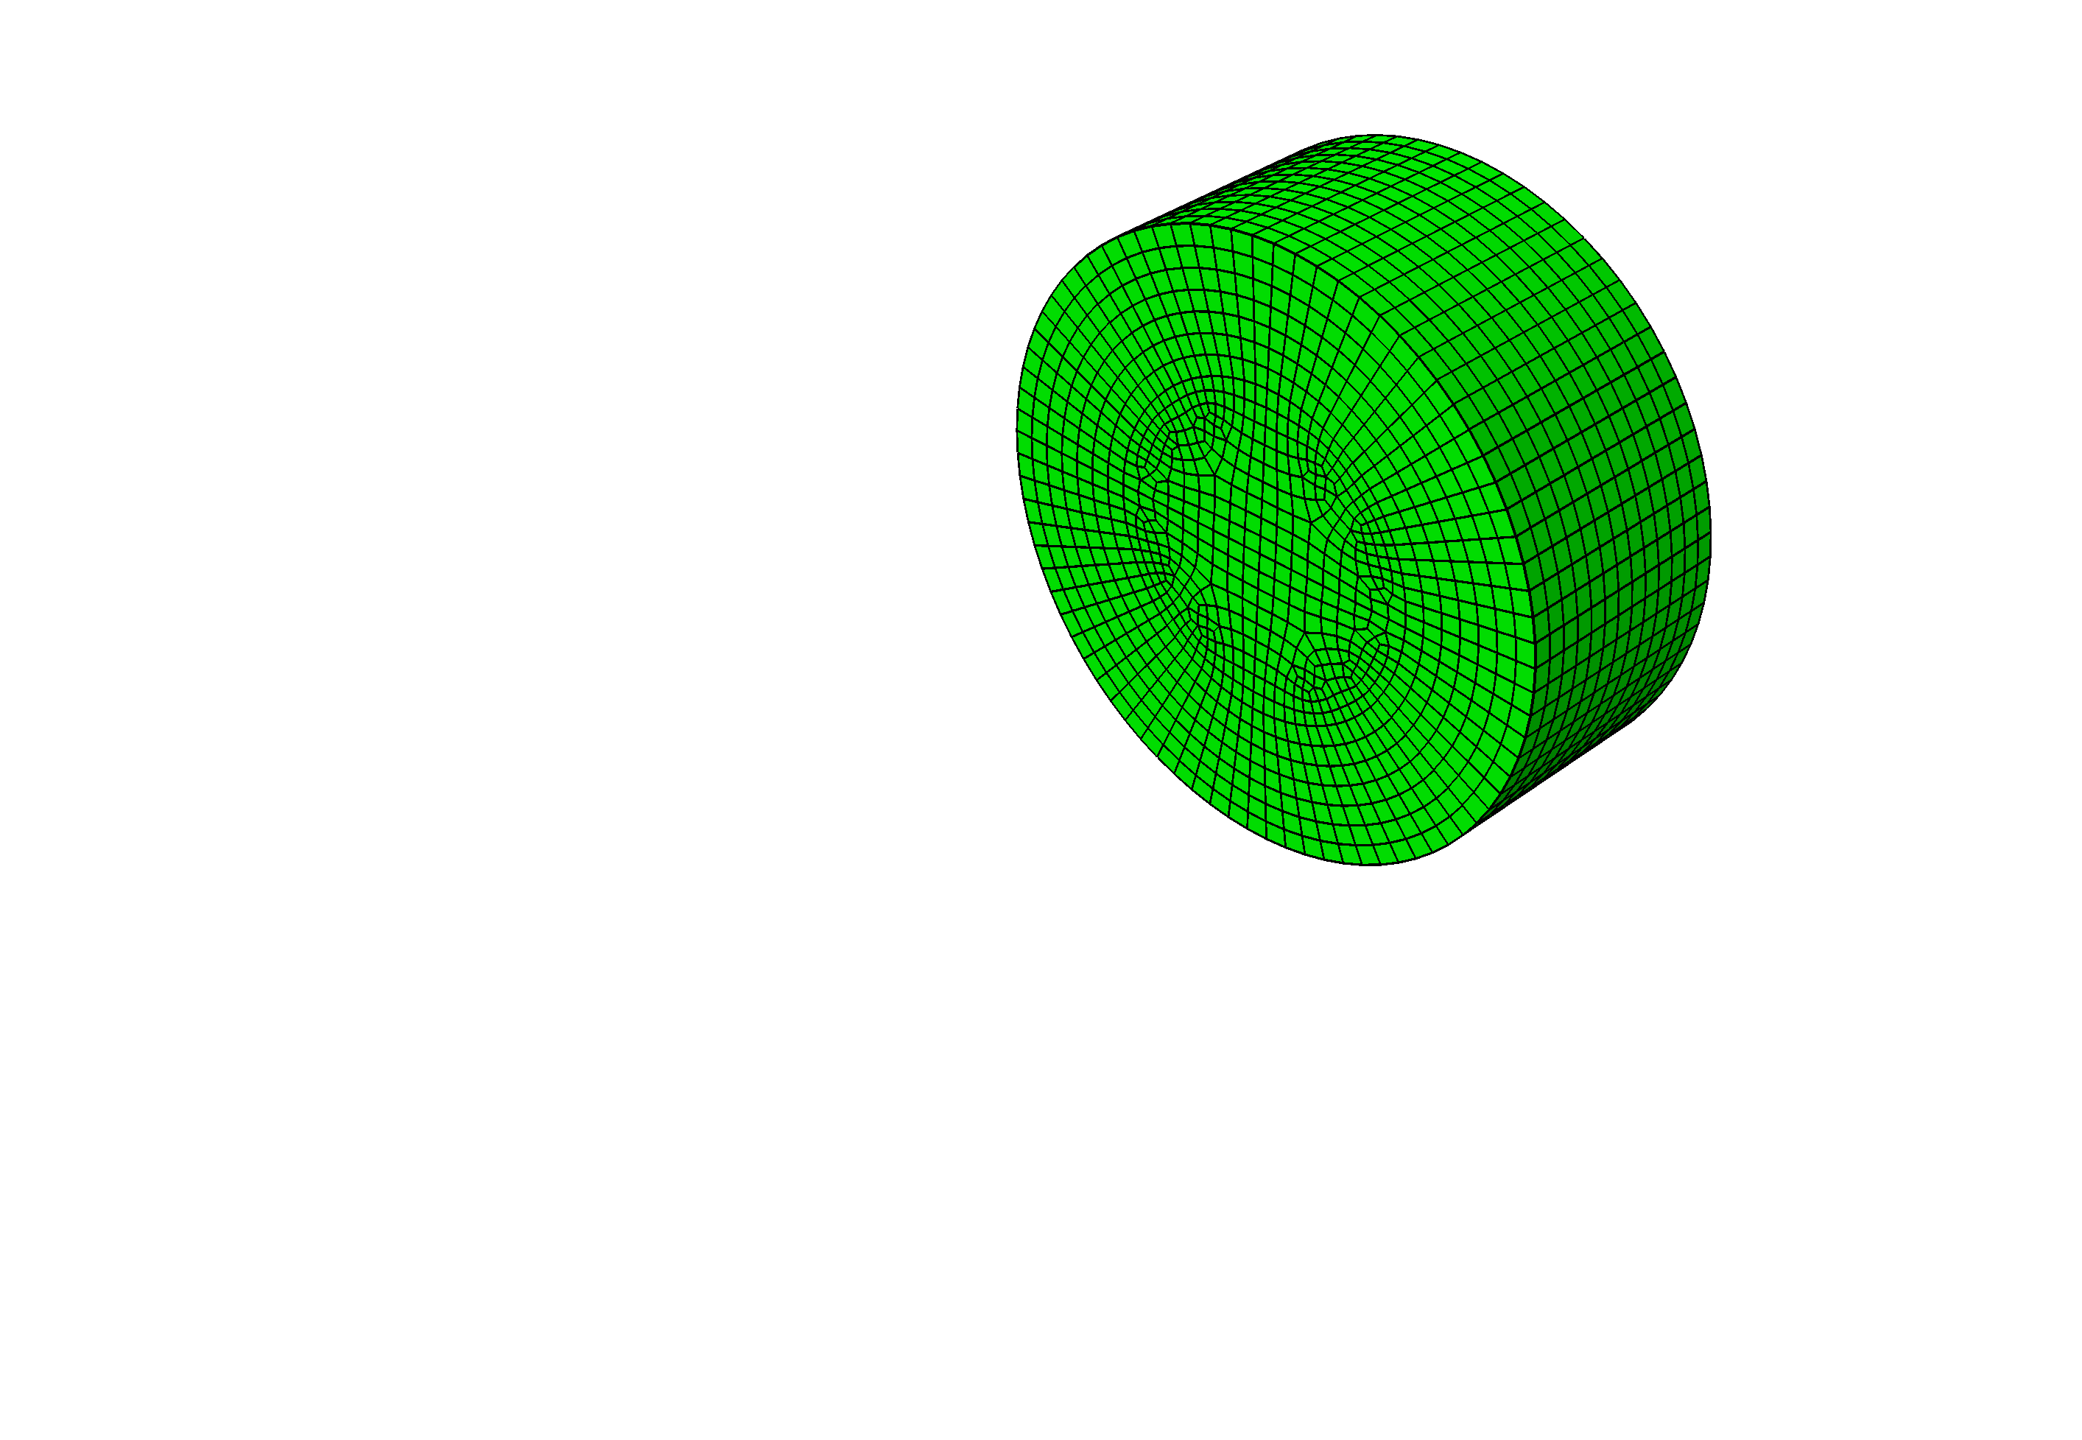



Future Application
Currently we are developing application of the pragmatic method to bi- and tri- metallic systems.
The diagram on the lower right depicts the geometry of a hollow cylinder consisting of the alloy JBK-75 on top, followed by a thin interface layer and then a bottom cylinder of a copper alloy. The part is built upon a stainless steel base-plate.
The picture at the top left is a copper cylinder that has been manufactured upon a solid stainless-steel cylinder. This hollow cylinder was manufactured with laser powder bed fusion. The interface layer will be applied upon that cylinder. Then direct energy deposition will be used to add JBK-75 to this bi-metallic part.
The goal of our work is to build these parts, measure the stresses and compare these measurements to our simulation-based stress predictions.
SS
Copper alloy
interlayer
JBK-75

Slide 29
Conclusion
The pragmatic stress method is a practical means to scale simulations up to the part scale.
No single code excels at stress predictions across the different coupon geometries when compared with experiment.
Using the predictions of multiple codes has allowed us to better represent the stress measurements made with neutron diffraction.
Feature limitations of the codes require work arounds to successfully implement the lumped thermal layers and the structural mechanics simulations.
The require material properties and the appropriate characteristic curves as a function of temperature are often difficult to determine and obtain.
In practice, the lumped cooling rate is a parameter that needs to be calibrated and may be difficult to determine and yet is critical.
The number of lumped layers impacts the computation time and the accuracy of the results. For a given problem, this can be treated much like a mesh size analysis. Large parts may require a compromise in accuracy so that only general trends are considered.

Slide 30
Thank you.
Kevin Wheeler, PhD
kevin.wheeler@nasa.gov

